Slide 1
Lezione 11

Slide 2
Selectivity and Query Optimization Example [1]
SELECT * FROM t WHERE Sex=‘F’
Distribution:
50% Male
50% Female
Index on Sex
Sex
ID
F
7
ID
Name
Sex
F
8
1
Alfred
M
F
5
2
Diana
F
F
2
3
Herman
M
M
4
4
Frank
M
M
6
5
Julia
F
M
3
6
Oscar
M
M
1
7
Sarah
F
8
Virginia
F

Slide 3
Selectivity and Query Optimization Example [2]
SELECT * FROM t WHERE Sex=‘F’
Distribution:
88% Male
12% Female
Index on Sex
Sex
ID
F
7
ID
Name
Sex
M
8
1
Alfred
M
M
5
2
Arnold
M
M
2
3
Herman
M
M
4
4
Frank
M
M
6
5
Gabriel
M
M
3
6
Oscar
M
M
1
7
Sarah
F
8
Serge
M

Slide 4
Indexing Guidelines
Columns to Index
  Primary and foreign keys
  Those frequently searched in ranges
  Those frequently accessed in sorted order
Columns Not to Index
  Those seldom referenced in queries
  Those that contain few unique values (low selectivity)
  Those defined with bit, text, or image data types

Slide 5
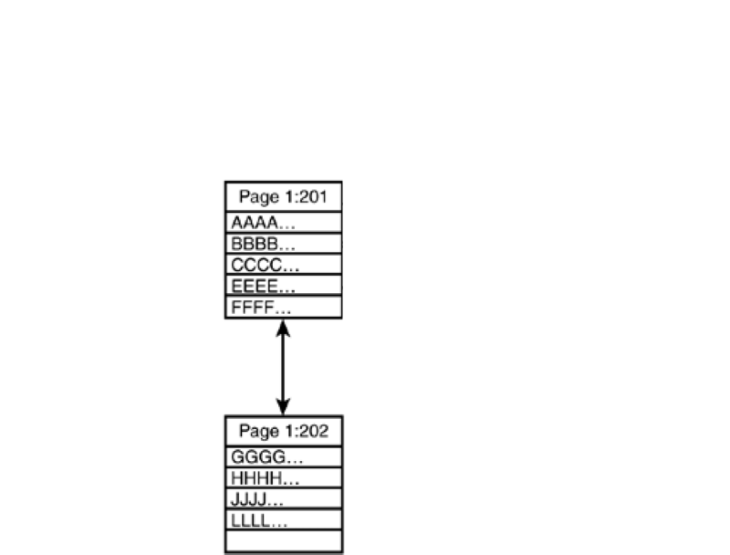
PAGE SPLIT: Initial state of records in pages

Slide 6
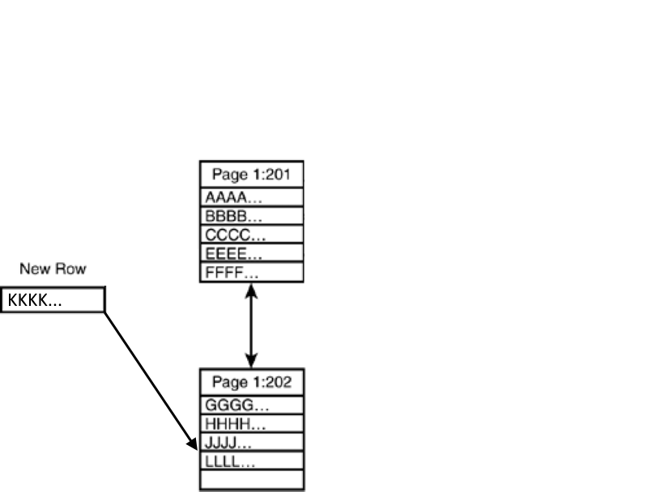
Case 1: Insert a record, with space available

Slide 7
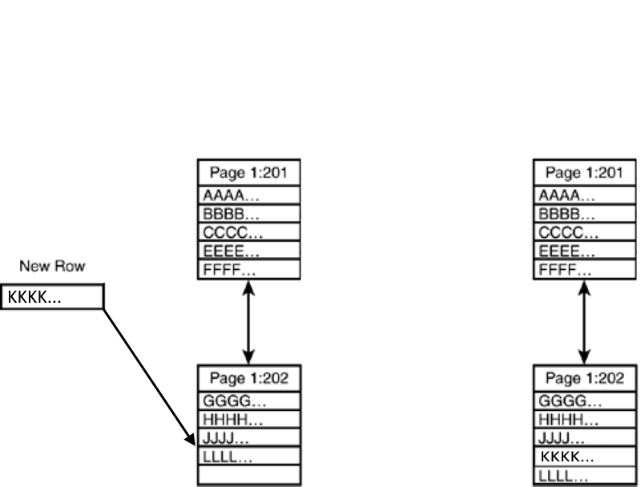
Record inserted, page reorganized

Slide 8
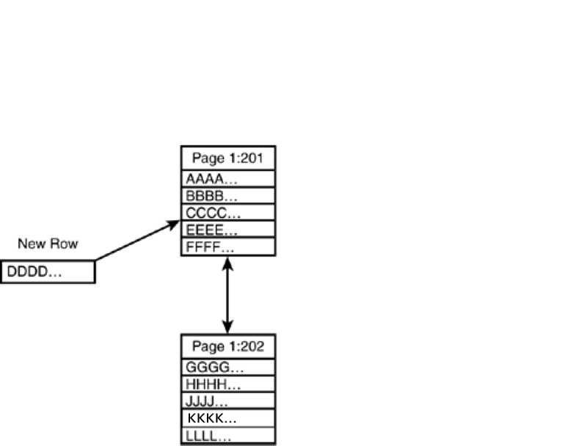
Case 2: Insert a record, no space available

Slide 9
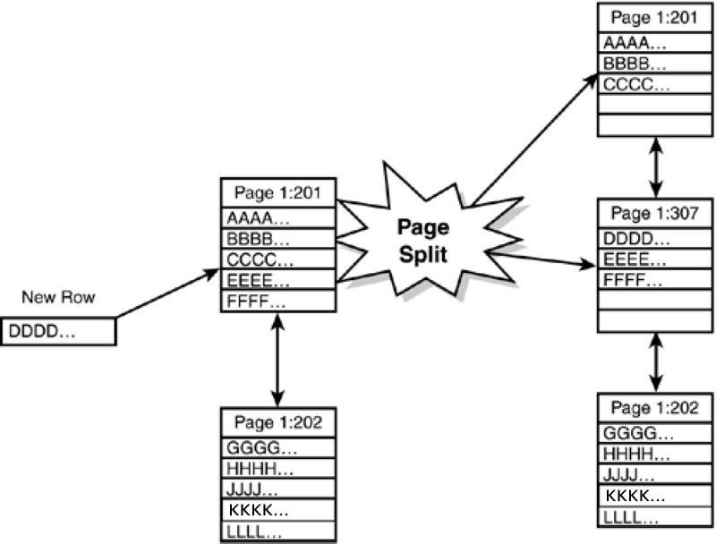
Page split occurs

Slide 10
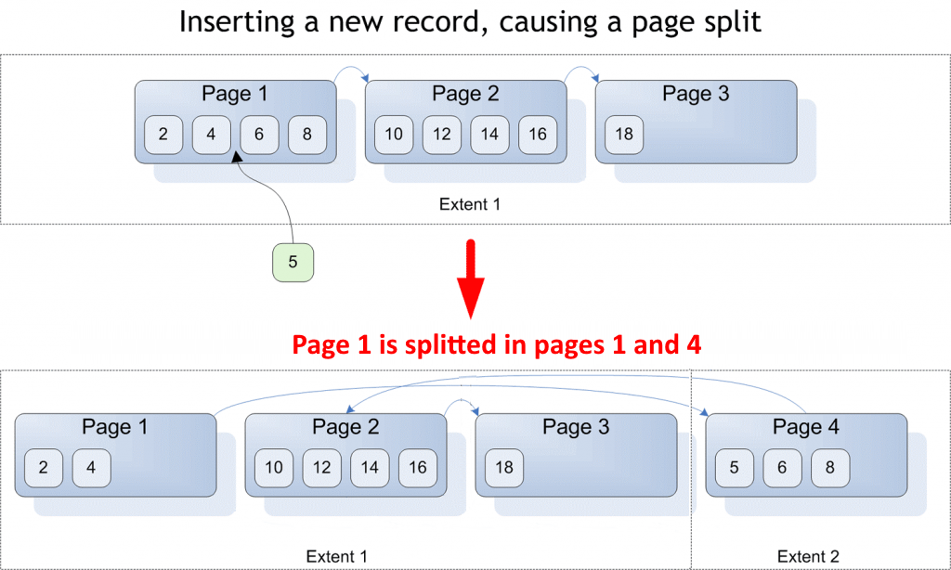
PAGE SPLIT produces fragmentation

Slide 11
Page Split and the FILLFACTOR Option
When Page Split happens (OLTP environments)
FILLFACTOR: Specifies How Much to Fill the Page
Data Pages Full
Con
...
470401
Akhtar
...
470601
Martin
...
470801
Funk
...
470402
Funk
...
470602
Phua
...
470802
White
...
470403
Smith
...
470603
Jones
...
470803
Rudd
...
470501
Martin
...
470604
Smith
...
470804
White
...
470502
Smith
...
470701
Ganio
...
470901
Barr
...
470503
Ota
...
470702
Jones
...
470902
Data Pages
50% Fillfactor
Con
...
470401
Rudd
...
470501
Akhtar
...
470601
Martin
...
470604
Martin
...
470801
Smith
...
470804
Funk
...
470402
White
...
470502
Funk
...
470402
Smith
...
470701
Phua
...
470802
Ganio
...
470901
White
...
470403
Barr
...
470503
Smith
...
470603
Ota
...
470702
Jones
...
470803
White
...
470902

Slide 12
OLTP vs OLAP
Online transactional processing (OLTP) enables the real-time execution of large numbers of database transactions by large numbers of people
Online analytical processing (OLAP) is a system for performing multi-dimensional analysis at high speeds on large volumes of data

Slide 13
OLTP vs OLAP
OLTP needs:
  Performance on data modifications
  High concurrency
  High availability, fault-tolerance
OLAP
  Performance on data query
  Precomputed aggregations (cubes)

Slide 14
Stored Procedures
A Stored Procedure is a named collection
of Transact-SQL statements
Encapsulate repetitive tasks
Implement business logic server-side
Can accept input parameters (parametric queries)
Can return:
  a status value (indicating success or failure)
  more values in output parameters
  a rowset
Five types of Stored Procedures:
System, Local, Temporary, Remote, Extended

Slide 15
Performance Considerations on Stored Procedures
Creation
Parsing
Definition stored
in system tables
Execution
(first time)
Optimization
Compilation
Compiled plan placed
in procedure cache
Next
Executions
Execution plan
retrieved

Slide 16
Stored Procedure Sample
USE library
GO
CREATE PROC dbo.overdue_books AS
SELECT *
FROM dbo.loan
WHERE due_date < GETDATE()
GO

Slide 17
UDF: User-Defined Functions
An UDF is similar to a Stored Procedure:
it is a multistatement T-SQL routine
An UDF is also similar to a System Function
An UDF can accept one or more input parameters
The result returned to the caller is NOT by output parameters
(as in stored procedures); so, UDFs can be used inside other expressions, in a nested way
UDF types:
  Scalar (return a scalar value: int, decimal, char,…)
  Table-Valued Functions, TVF (return a rowset in a table datatype)
    ITVF: inline table-valued functions
    MTVF: multistatement table-valued functions

