Slide 1
Slides Lezione 12

Slide 2
Concurrency, Locks, Transaction Isolation

Slide 3
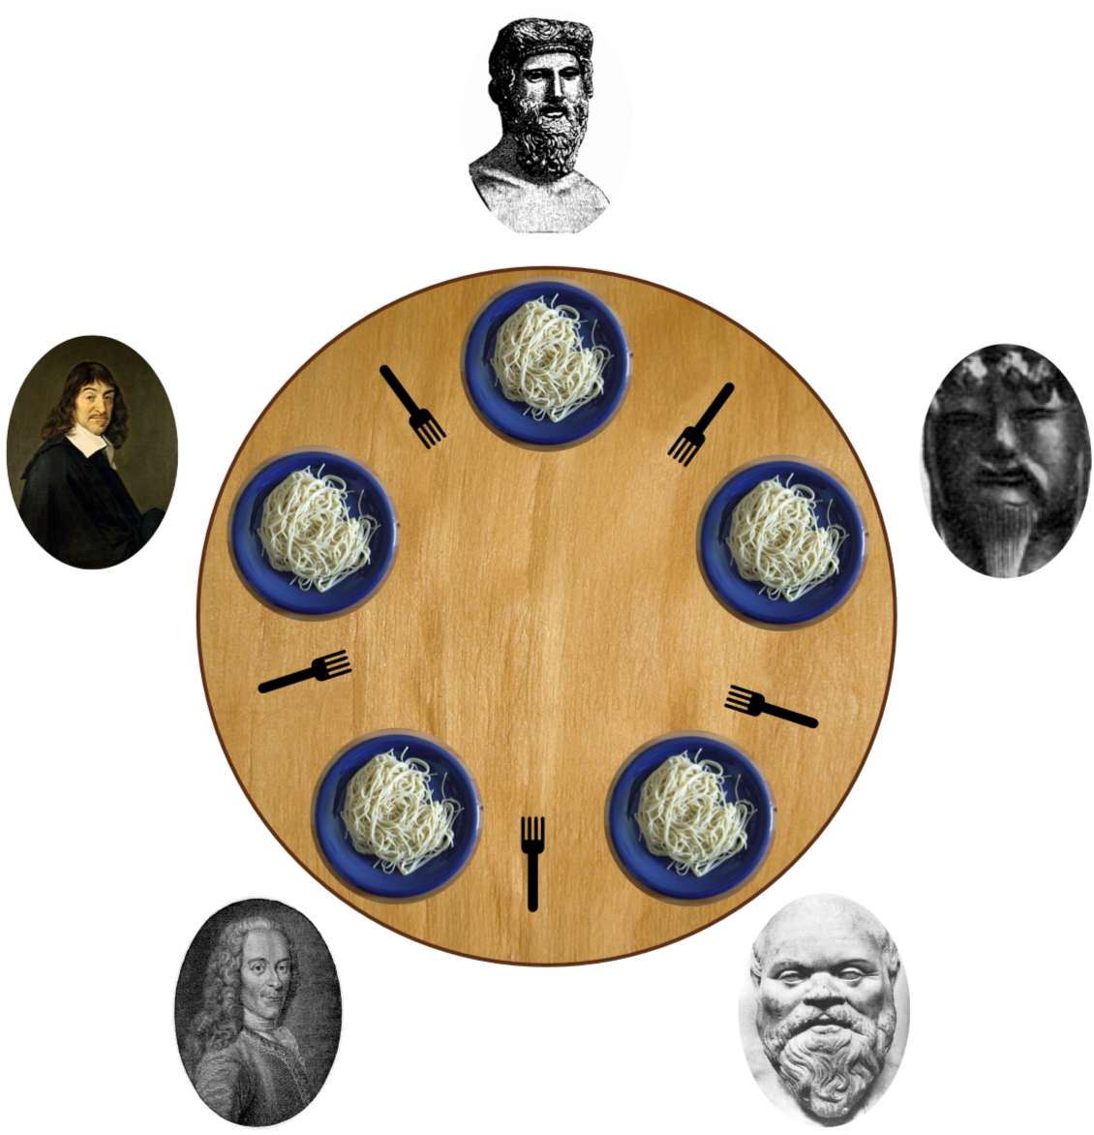
Introducing Concurrency
The "Dining Philosophers“
A classic problem
involving
concurrency
and
shared resources

Slide 4
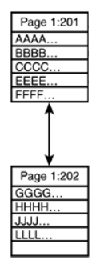
When Concurrency occurs?
DATA
(tables, indexes, statistics,…)
1st user accessing SOME data
AND
SQL Server
2nd user accessing THE SAME data

Slide 5
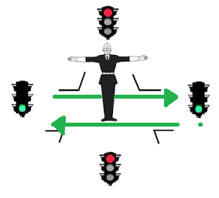
SQL Server concurrency
SQL Server manages concurrency with LOCKS,
that act as a traffic light in regulating the access to data.

Slide 6


When Concurrency occurs?
DATA
(tables, indexes, statistics,…)
1st user accessing SOME data
AND
SQL Server
2nd user accessing THE SAME data

Slide 7
Types of Lock
Shared Lock: makes the data available only for reading, which means that any other transaction will be prevented to modify the locked data as long as the lock is active
Exclusive Lock: ensures that data will be reserved exclusively for the transaction that imposed the exclusive lock, as long as the transaction holds the lock
Many other types of Lock https://www.sqlshack.com/locking-sql-server/

Slide 8
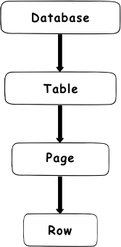
Granularity of Lock
Locks are managed in different levels of granularity.
Those granularity are organized in a hierarchy.
This ensures locking optimization.

Slide 9
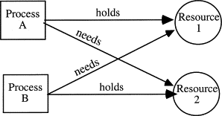
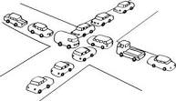
DeadLock
Situation where no-one can proceed because blocked by someone else, who can’t release the block because unable to proceed himself.
SQL Server detects the situation, choose a process as a “victim” and kills it in order to let the other proceed. Killed process must retry the operation applicatively.

