Slide 1
Slides Lezione 13

Slide 2
INSTEAD-OF Triggers
An INSTEAD OF trigger is a trigger that allows you to skip an INSERT, DELETE, or UPDATE statement to a table and execute other statements defined in the trigger instead.
The actual INSERT, DELETE, or UPDATE operation does not occur at all.

Slide 3
INSTEAD-OF Trigger sample
orders
Primary Key
When a DELETE occurs, we want to save deleted rows elsewhere
area
id
order_no
qty
1
1
2
2
3
3
1
1
1000
3100
1000
2380
1000
1070
1000
3100
~
~
~
~
~
~
~
~
15
22
32
8
7
19
15
22
orders
orders_backup
Primary Key
Primary Key
area
id
order_no
qty
area
id
order_no
qty
1
1
1
1
1000
3100
1000
3100
~
~
~
~
15
22
2
2
3
3
1000
2380
1000
1070
~
~
~
~
32
8
7
19
15
22

Slide 4
SQL Server Software
SQL Server Configuration Manager
SQL Server Management Studio
SQL Server Profiler
SQL Server Integration Services
SQL Server Business Intelligence Studio

Slide 5
SQL Server Profiler
Client
Application
SQL Server
Server

Slide 6
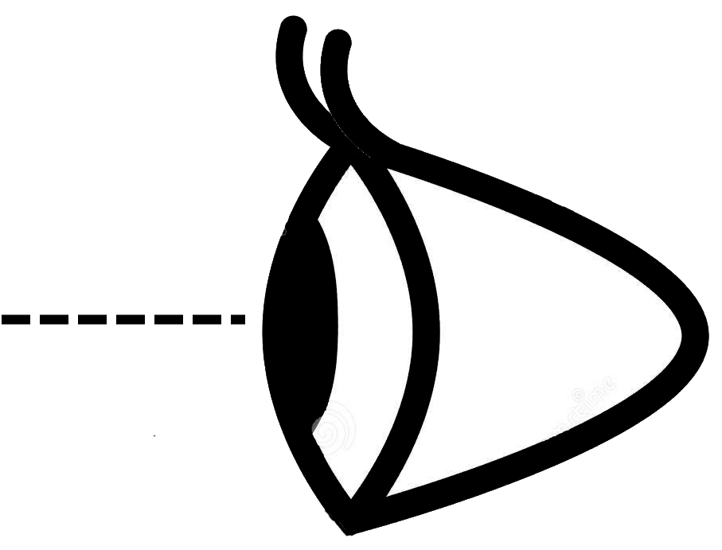
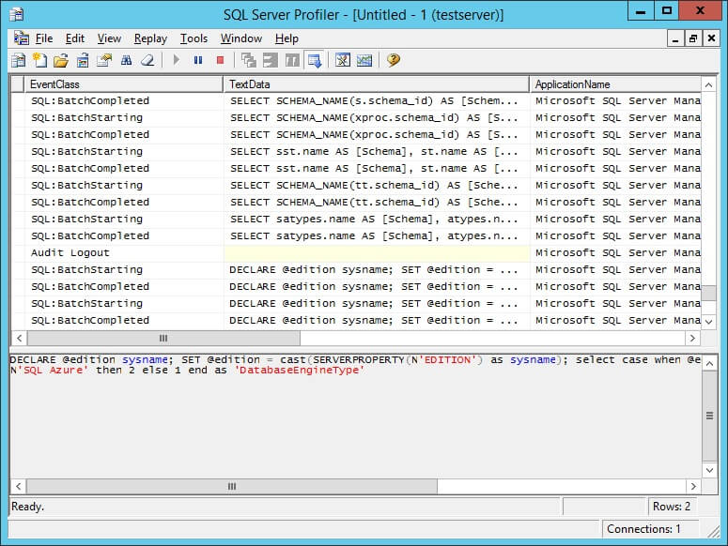
SQL Server Profiler
Client
Application
SQL Server Profiler
SQL Server
Server

Slide 7
SQL Server Security
AUTHENTICATION
SQL Server
“trusts” Windows
Windows
Windows
Group or User
Windows Verifies Password
OR
SQL Server
SQL Server
Verifies Password
SQL Server
Login Account

Slide 8
Database User Accounts and Roles
Windows Verifies Password
SQL Server Assigns Logins
to User Accounts and Roles
Windows
Group User
Windows NT
Database
User Account
OR
SQL Server
SQL Server
Login Account
SQL Server
Verifies Password
Database Role

Slide 9

Login and User Concepts
Login
User
pubs
SERVER

Slide 10
Users and Roles
User2
User3
User5
User6
User1
User4
User7
Login1
roleA
roleB
roleC
public
DATABASE

Slide 11
Granting, Denying, and Revoking Permissions
REVOKED
Neutral
Revoke
Revoke
Grant
Deny
GRANTED Can Perform Action
Deny
DENIED: Cannot Perform Action
Grant

Slide 12
Understanding Permissions
public 
roleA 
SELECT * FROM t
User1 
User
Role(s)
Public
Permission...



denied



granted



granted



granted



granted



granted



granted



granted

any
any
denied
any

any
denied
any
any

denied

Slide 13
Types of Permissions
Statement
Object
CREATE DATABASE
Tables, Views: SELECT
INSERT
UPDATE
DELETE REFERENCES
CREATE TABLE
CREATE VIEW
CREATE PROCEDURE
CREATE RULE
Stored Procedures: EXECUTE
CREATE DEFAULT
BACKUP DATABASE
BACKUP LOG

Slide 14
Permission Validation
1
2
3
Permissions OK;
performs command
Database User
executes command
Permissions not OK;
returns error
SQL Server
checks permissions
SELECT * FROM members

Slide 15
Fixed Server Roles
Role
Permission
sysadmin
Perform any activity
dbcreator
Create and alter databases
diskadmin
Manage disk files
processadmin
Manage SQL Server processes
serveradmin
Configure server-wide settings
setupadmin
Install replication
securityadmin
Manage and audit server logins

Slide 16
Fixed Database Roles
Role
Permission
public
Maintain all default permissions
db_owner
Perform any database role activity
db_accessadmin
Add or remove database users, groups & roles
db_ddladmin
Add, modify, or drop database objects
db_security admin
Assign statement and object permissions
db_backupoperator
Back up and restore database
db_datareader
Read data from any table
db_datawriter
Add, change, or delete data from all tables
db_denydatareader
Cannot read data from any table
db_denydatawriter
Cannot change data in any table

Slide 17
The “Power Hierarchy”
sa
dbo
dboo
users

