Slide 1


DREAMERV4
Training Agents Inside of
Scalable World Models
Paper Presentation and Practical Code Analysis
Marco Equisetto (VR535007)
Reinforcement Learning Course
Notes:
Good morning/afternoon everyone. Today we're presenting DreamerV4, a paper titled 'Training Agents Inside of Scalable World Models.' We'll split this into two halves: first, the theoretical methodology behind the paper, and second, a hands-on code analysis with a live demo of the PyTorch implementation. Let's get started.

Slide 2


METHODOLOGY
The World Model Paradigm
The Bottleneck
Standard RL requires millions of real-world interactions (slow, expensive, and unsafe for physical robots).
The Solution
Train a “World Model” to simulate the environment. The agent learns optimal policies entirely in its own “imagination.”
DreamerV4 Innovation
Replaces Recurrent State Space Models (RSSM) with massively scalable Block-Causal Transformers, the same architecture family behind modern LLMs.
2
Notes:
Let's start with the core problem DreamerV4 is solving. Standard reinforcement learning algorithms are incredibly data-hungry -- they often need millions of interactions with the real environment to learn anything useful. If you're training a physical robot, that's not just slow and expensive, it's actually dangerous -- you can't let a robot arm fail a few million times to learn not to crash into things. The solution that Dreamer-style algorithms propose is to train a 'World Model' -- essentially a learned simulator of the environment. Once you have this simulator, the agent can practice and learn its policy entirely inside its own imagination, without touching the real world at all. What's new in DreamerV4 specifically is the backbone architecture. Earlier Dreamer versions used Recurrent State Space Models, or RSSMs -- these are recurrent, sequential networks. DreamerV4 throws that out and replaces it with Block-Causal Transformers -- architecturally very similar to what powers large language models today. This means DreamerV4 can inherit all the scalability tricks the LLM community has developed over the past few years.

Slide 3
METHODOLOGY
Architecture: The Tokenizer
Objective
Compress high-dimensional pixels into a compact sequence of latent vectors.
Mechanism
Masked Autoencoders (MAE): randomly hide up to 90% of image patches during training.
Why it matters
Forces the encoder to learn robust semantic features (not just pixel compression) so the model understands the scene instead of memorizing it.
Visible patch tokens (teal) vs. masked patches (gray)
3
Notes:
Now let's dig into the architecture, starting with the tokenizer. Its job is to take a raw, high-dimensional image -- pixels -- and compress it down into a compact sequence of latent vectors that the rest of the model can work with efficiently. The key mechanism here is the Masked Autoencoder, or MAE. During training, the model randomly hides up to 90% of the image patches -- that's a huge fraction -- and then has to reconstruct or represent the scene from what's left. Here's why this matters, and this is worth emphasizing: without this masking strategy, the model could take the lazy route and just memorize pixel patterns -- essentially becoming a fancy compression algorithm. But because 90% of the information is hidden during training, the encoder is forced to learn robust, semantic features -- it has to actually understand what's in the scene, not just how to reproduce it. That semantic understanding is what makes the downstream world model actually useful for planning, rather than just being a lossy video codec.

Slide 4
METHODOLOGY
Architecture: The Dynamics Model
Objective: Predict future latent states given past states and the agent’s continuous actions.
Old approach: step by step
t
t+1
t+2
t+3
t+4
Sequential predictions: errors compound over long horizons
DreamerV4: Shortcut Forcing (τ)
t
t+k
Direct jump to future state: no compounding sequential error
Benefit: Drastically speeds up long-horizon imagination, allowing the agent to plan further ahead.
4
Notes:
The second core component is the dynamics model. Its job is to predict future latent states, given the past states and the agent's actions -- and note, these are continuous actions, which is more realistic for things like robotics than the discrete action spaces used in older Atari-style benchmarks. The really clever trick here is what the paper calls 'Shortcut Forcing.' Normally, a model like this would predict frame by frame -- t+1, then t+2, then t+3, and so on. The problem with that approach is error compounds: small mistakes at each step pile up over a long imagined rollout. DreamerV4 instead uses a denoising schedule, parameterized by tau, that lets the model jump directly to a future state t+k in fewer steps. The benefit is twofold: it's dramatically faster to imagine long horizons, and because you're not chaining together hundreds of small sequential predictions, you avoid that compounding error problem. This is what lets the agent 'plan' much further into the future than earlier Dreamer variants could. [This wraps up the theory half -- right at 15 minutes. Transition: 'That covers the theoretical core of DreamerV4. Now let's move into the second half: how this actually looks in a real PyTorch codebase, and where things get messy in practice.']

Slide 5

PRACTICAL CODE ANALYSIS
Analyzing the PyTorch Implementation
Open-source PyTorch port applied to DMControl (continuous action spaces)... diverging from the paper’s original JAX / Minecraft focus but retaining the idea of artificial world environment training.
350GB
8×
48 hrs
disk space to train
from scratch
high-end GPUs
required
continuous training
runtime
Adopted approach: Focus on the inference architecture and run a live, interactive web server using pre-trained weights.
5
Notes:
For the second half, we're switching gears from theory to practice. We worked with an open-source PyTorch implementation of DreamerV4. It's worth noting up front: this isn't the exact original setup -- the paper's original work used JAX and was demonstrated on Minecraft, while the repo we analyzed applies the same architecture to DMControl, a continuous-control benchmark. We also want to be upfront about the hardware reality here. Training this model from scratch is not something you do on a laptop -- we're talking roughly 350 gigabytes of disk space and eight high-end GPUs running for 48 hours straight. That's simply out of reach for a course project. So our approach was to focus on the inference side -- using pre-trained weights -- and build a live, interactive web server so we could actually see and control the world model in action, rather than trying to reproduce the full training run.

Slide 6
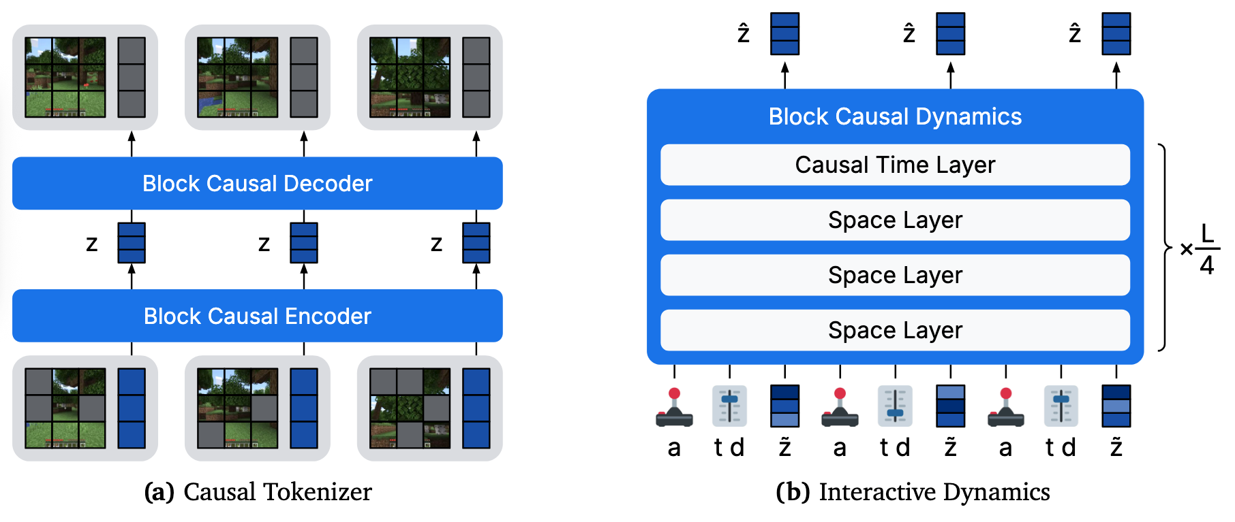
PRACTICAL CODE ANALYSIS
The Main Actors: Encoder & Tokenizer
6
Notes:
Let's look at real code now. This is the Encoder class, and it maps directly onto the tokenizer concept we discussed a few minutes ago. Step one: self.mae(patch_tokens) applies that random masking we talked about -- this line is literally where the 90%-patch-hiding happens during training. Step two: the masked tokens get passed through self.transformer -- this is the Block-Causal Transformer doing the heavy lifting, explicitly separating spatial mixing, meaning relationships within a single frame, from temporal mixing, meaning relationships across frames in the sequence. Step three, and this is a small detail but an important one: the output goes through a tanh bottleneck. This strictly bounds every latent value into the range [-1, 1]. That's a deliberate design choice -- it keeps the latent space numerically stable, which matters a lot when you're about to feed these latents into a dynamics model that's going to be predicting many steps into the future. So in about fifteen lines, you can see the entire tokenizer pipeline we described conceptually: mask, transform, bound.

Slide 7


PRACTICAL CODE ANALYSIS
Real-World Engineering Challenges
The Problem
Our Solution
preprocess_dataset.py expects .png files, but the HuggingFace dataset only hosts serialized .pt tensor dictionaries.
Patched the code to inject a “dummy” black frame at sequence initialization, avoiding a FileNotFoundError crash.
Result: The dynamics model “hallucinates” the environment from a blank state, driven purely by keyboard input.
Practice — Part 2 of 2
7
Notes:
This next slide is honestly one of the most important ones for us, because it's less about the paper and more about what it actually takes to get research code running. We want to highlight this as a demonstration of engineering problem-solving, not just running someone else's script. When we tried to run the preprocessing pipeline, we hit a wall: the script preprocess_dataset.py expects .png image files. But the dataset actually hosted on HuggingFace only ships serialized .pt tensor dictionaries -- a completely different format. Running it out of the box just threw a FileNotFoundError. Rather than getting stuck there, we patched the code ourselves. Our fix injects a 'dummy' black frame at the very start of the sequence, so the pipeline has something valid to initialize from instead of crashing. And the result is actually pretty striking: once that first frame is in place, the dynamics model takes over completely and starts hallucinating a full, coherent environment from what was essentially a blank canvas -- driven purely by our keyboard inputs. So we didn't just run the code -- we debugged it, understood why it broke, and got it working under real hardware and data constraints.

Slide 8


LIVE DEMONSTRATION
Let’s See It In Action
1. Interactive Jupyter Notebook
2. Real-Time Web Server Inference
Walking through the tensor shapes and architecture in dreamer4_tutorial.ipynb.
Launching interactive.py to control the agent and watch the World Model hallucinate live frames.
8
Notes:
To close things out, we're going to show you this live rather than just talk about it. First, we'll open dreamer4_tutorial.ipynb and walk through the actual tensor shapes moving through the architecture -- the encoder output, the latent bottleneck, the dynamics model rollout -- so you can see the numbers behind everything we just explained. Then, we'll launch interactive.py, which spins up a real-time web server. From there we can actually control the agent with the keyboard and watch the world model hallucinate the environment live, frame by frame, in response to our inputs. [Switch to live screen share / notebook now]

