Slide 1
Dynamical systems for decision-making

Slide 2
What we do
Pros and cosn of dynamical systes for decision making
Analzing a model of decision making for one agent
Bifurcattions in decision making (some conepcts will be generalible to multiple opnions)
Separation of timescale and its application for flexible decision making
Multiagent decision making and ring attractor, symmetries, selective ultra sensitivity

Slide 3
What are dynamical systems

Slide 4
Why dynamical systems for decision making
Consensus (good)
Accuracy (bad)
Extra good for collective decision-making

Slide 5

Why not dynamical systems
Dynamical systems assume infinite population size
Macroscopical description
Mechanistic models: can be derived from microscopical description
Phenomenological models: cannot be derived by microscopic description
*This is one possible interpretation, different people can mean different things

Slide 6
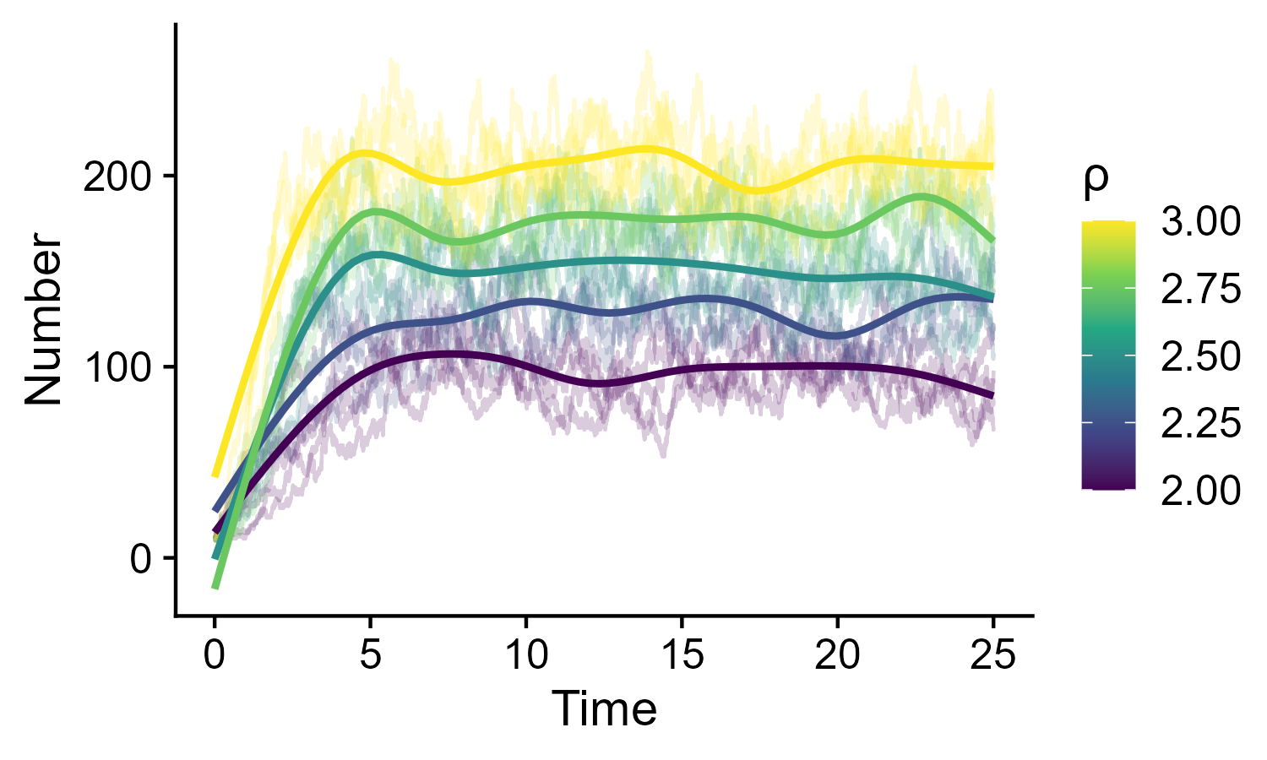

The problem with phenomenological models
Increasing ρ, will K:
Increase
Decrease
Stay the same
Macroscopic
Logistic growth equation
Clonal reproduction
Microscopic
Death
Density dependent death
Phenomenological models can lead to false conclusions

Slide 7
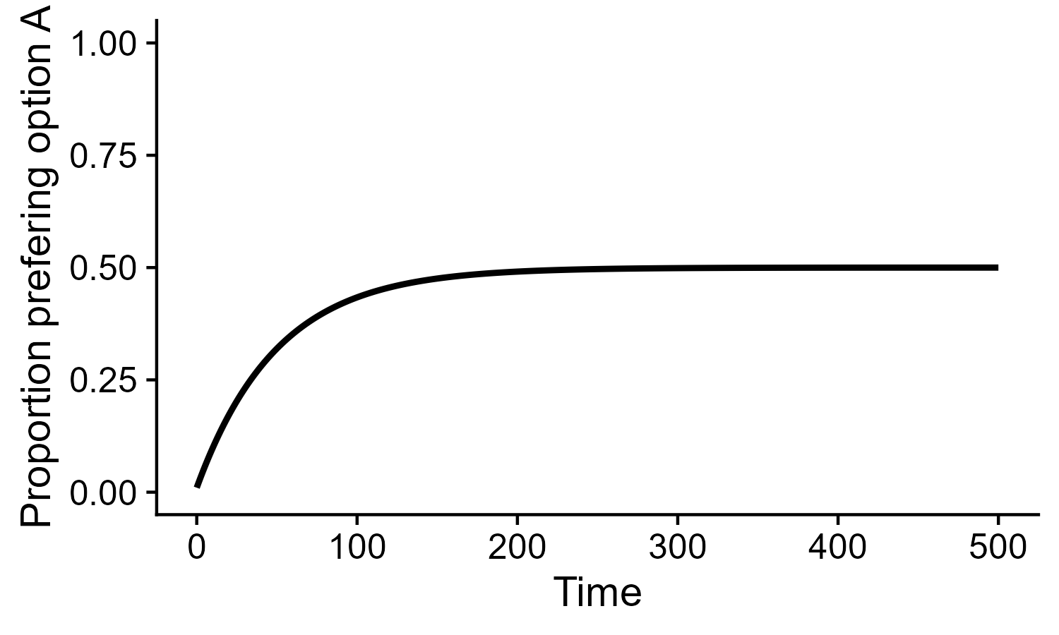
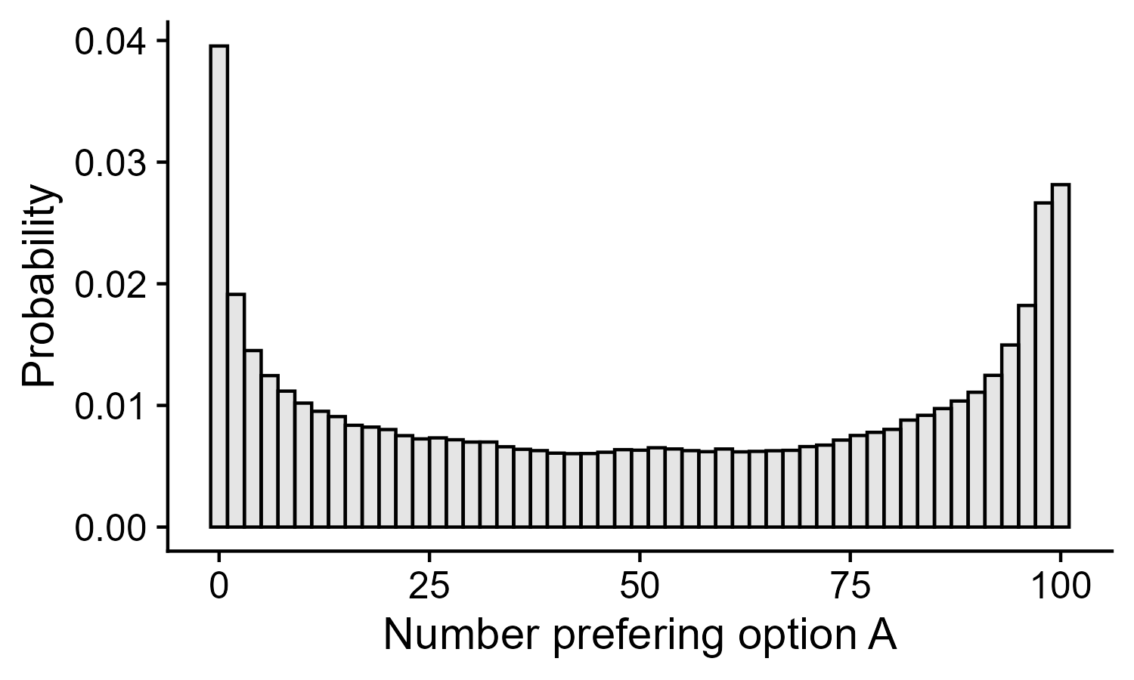
The problem with macroscopic models
Voter model
Voter model
What is the probability of population state:
Flat
Approximately gaussian (centered at 0.5)
Bimodal
Macroscopic models can miss dynamical outcomes

Slide 8
Qualitative vs Quantitative analysis
Linear non-linear (?)
Qualitative more interpretable and robust

Slide 9

Non-linear opinion dynamics model (NOD)
One agent, two options
Can x explode to infinity:
No
Depends on parameter values
Yes
$$\dot{x}=−δx+Tanh⁡(αx+υ)$$
This is node of neural network
Neurons are complex (REF) and perform computations

Slide 10
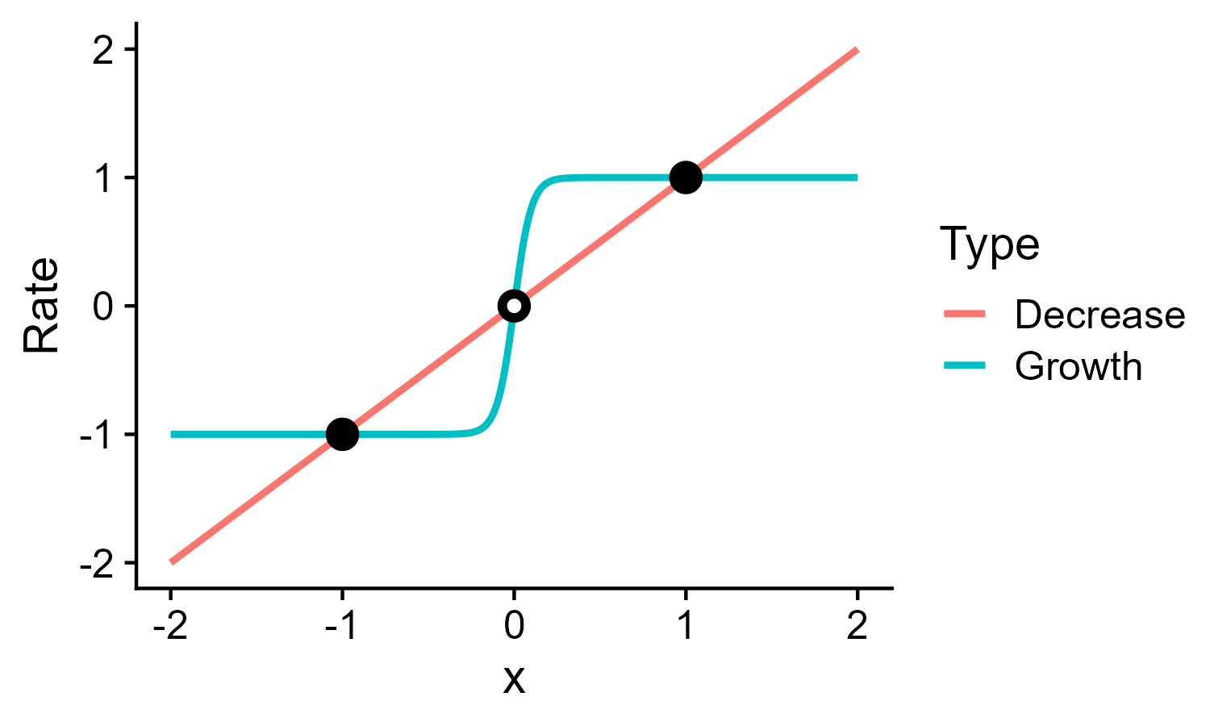
Non-linear opinion dynamics model (NOD)
One agent, two options
Can x explode to infinity:
No
Depends on parameter values
Yes
Linear
$$\dot{x}=−δx+Tanh⁡(αx+υ)$$
Constant for high x (tanh is monotonic and has bunded domain)
Linear term wins on constant term
This is node of neural network
Neurons are complex (REF) and perform computations

Slide 11
Non-linear opinion dynamics model (NOD)
Time series visualization (connect to bifurcation diagrams)

Slide 12
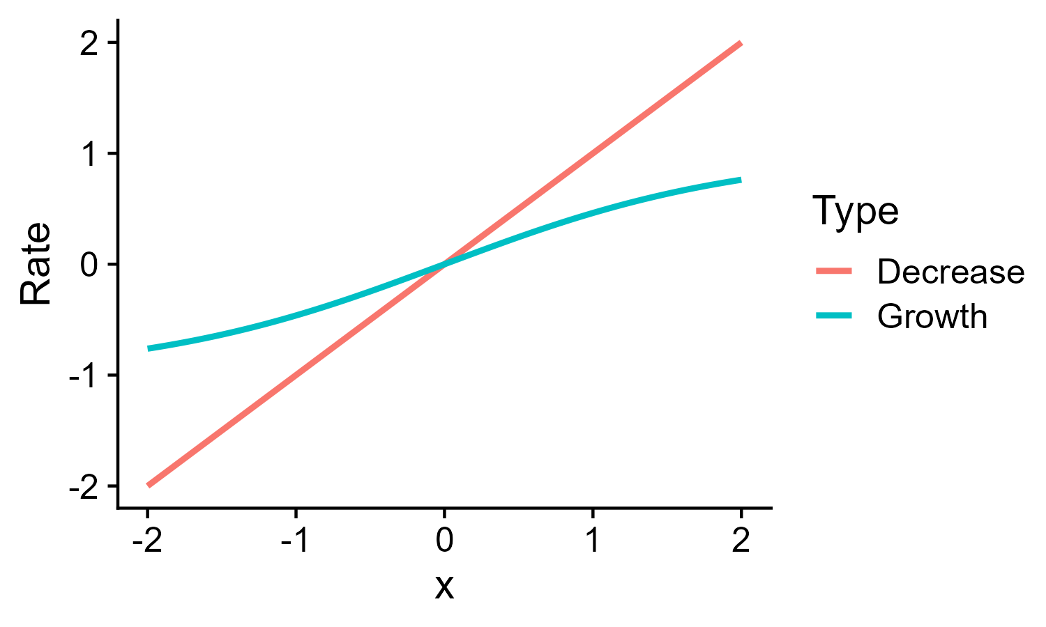
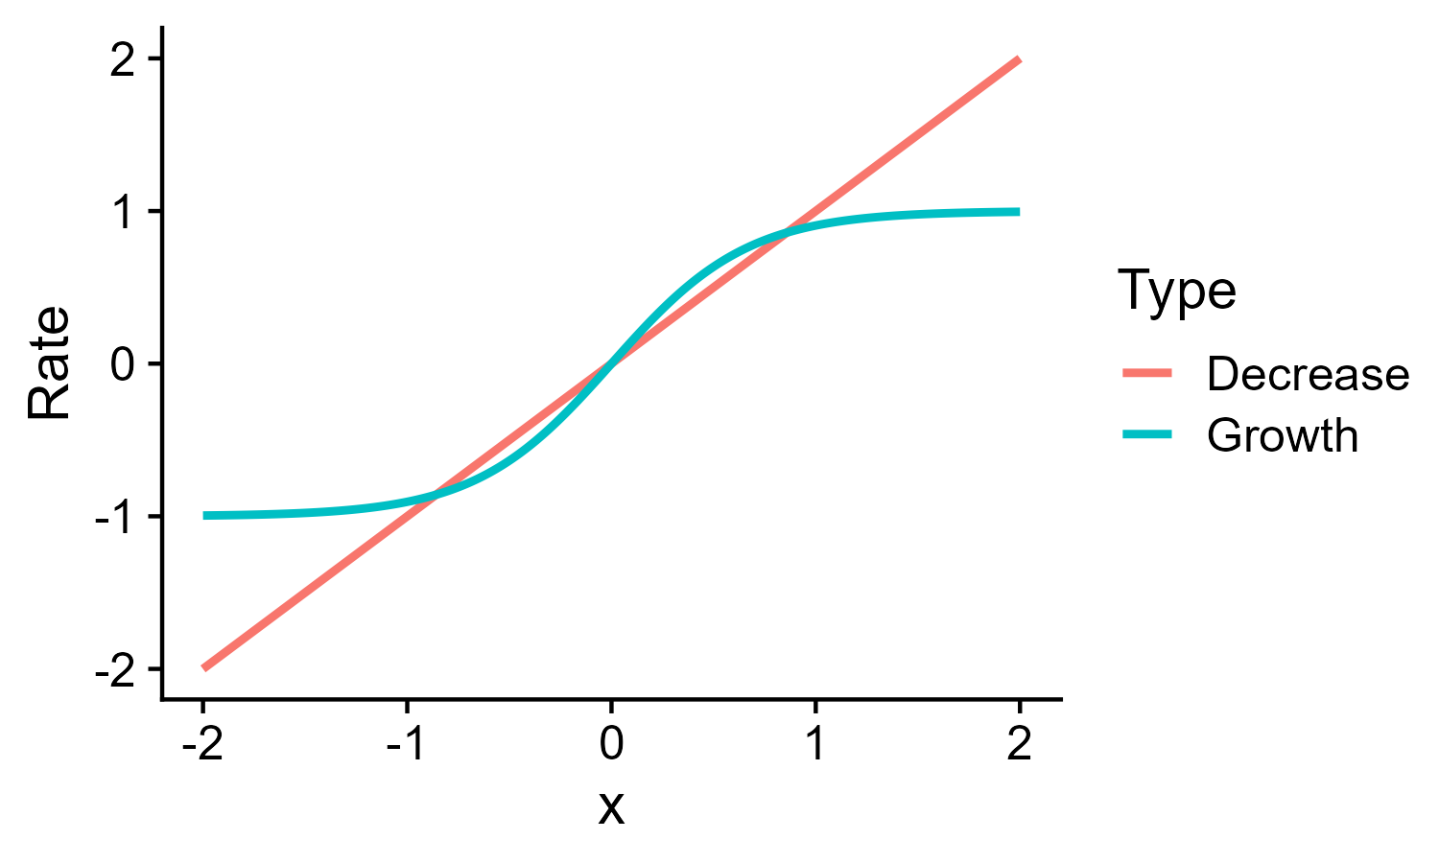
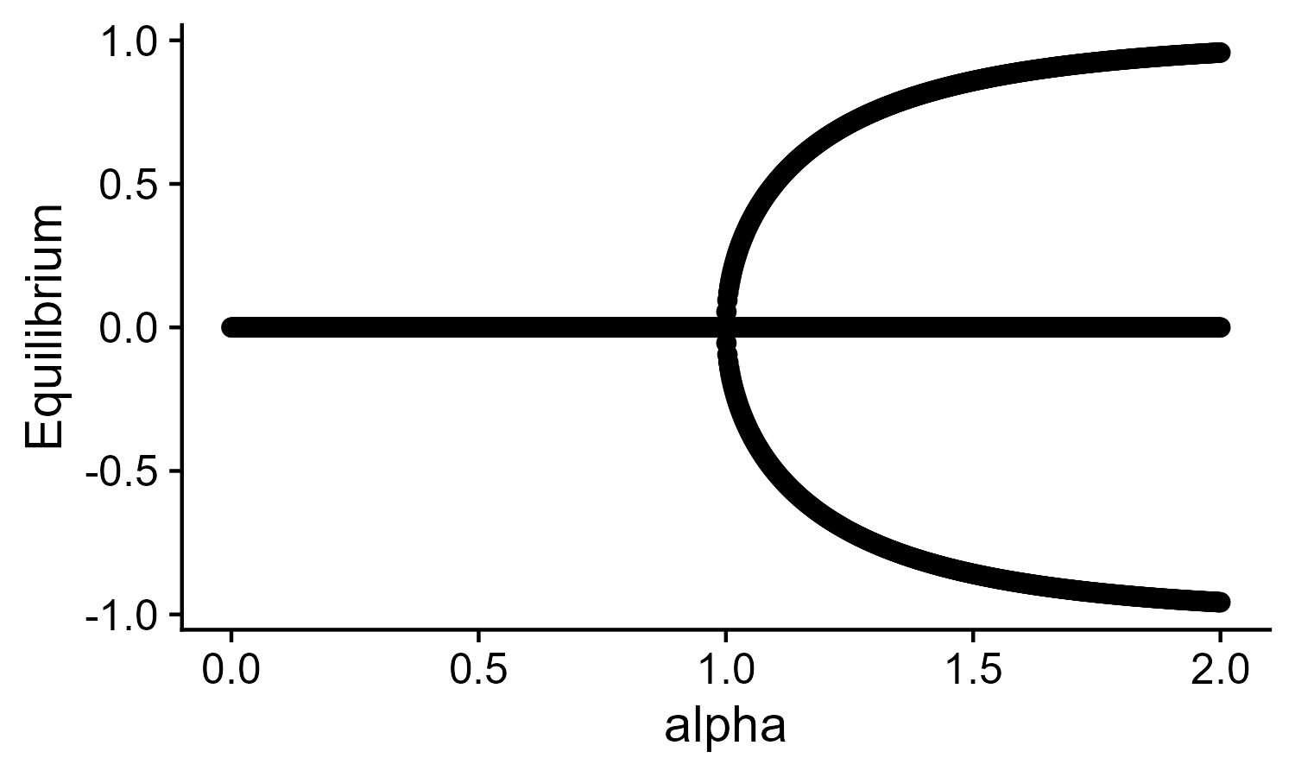
Bifurcation diagrams
Implicit function theorem
Numerical continuation techinques
Bifurcations
What is the shape of the Jacobian:
a)

Slide 13
Elementary bifurcations
Regular form
Saddle node
Transcritical
Pitchfork
Hopf(not show but cite)
Universal unfolding theorem (from pitchfork to other) (show diagram)
Applicable also for high dimensional dynamical systems (Lyapunov-Smhidt central manifold model reductions)

Slide 14

Histeresis
Catastrophe plot
Memory and path dependency
Impact for flexibility
Show three dimensional plot
Problem of duynamical systems: inputs are parameters
How will NOD unfold for $υ>1$:(show jacobian)

Slide 15
State dependent attention
How will it unfold? (Draw)

Slide 16
Ultra-sensitivity
Compare supercritical to subcritical
Role of thresholds for decision-making

Slide 17
Separation of time-scales
Two dimenisions, phase plane
Singular perturbation theory
With separation of timescales, phase plane is a bifurcation plot

Slide 18
Separation of time-scales
Designing nullclines for flexible decision making

Slide 19
Ring attractor (extension to multiple agents)

Slide 20
Equivariance and symmetries
Definition of equivariance
Ask what symmetry does two-dimensional decision-making have
My cool plot for cir?
Symmetry breaking for equilibria despite symmetric system

Slide 21
Linear stability analysis for multiple options
Jacobian
Leverage symmetry

Slide 22
Selective ultra-sensitivity
I have to figure out the Lypunov Schmidt model reduction!!

