Slide 1
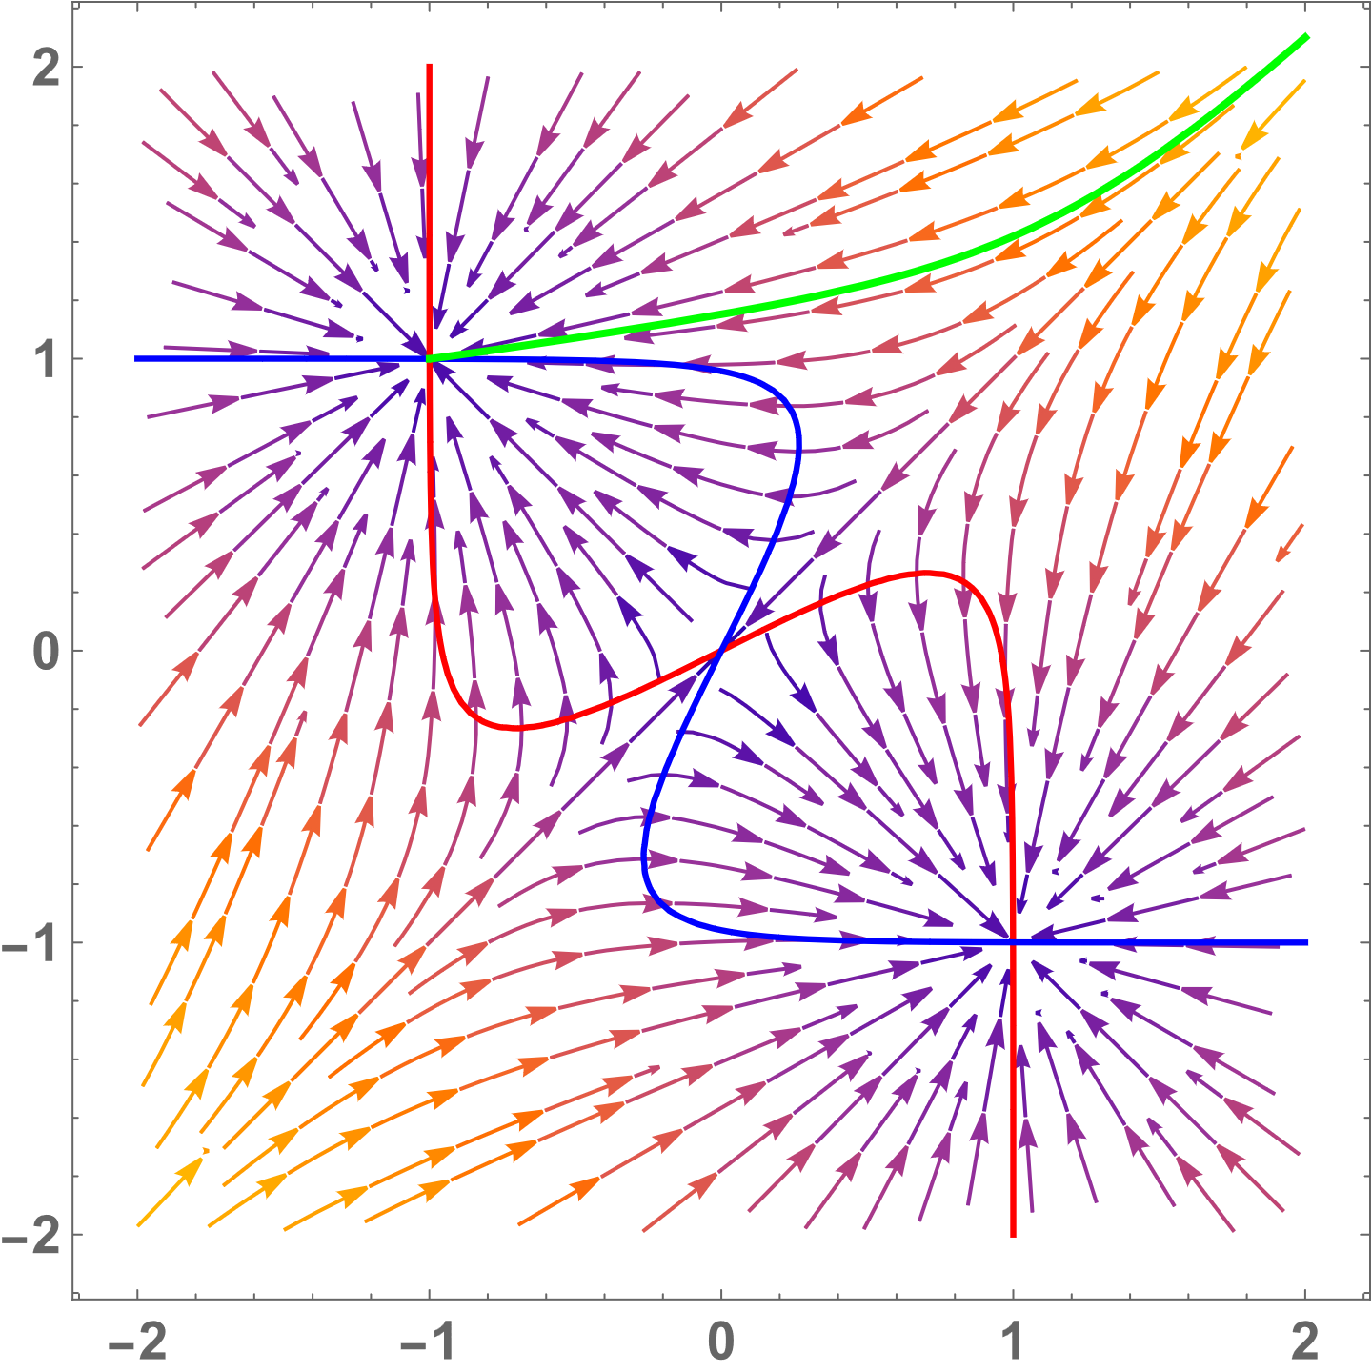
Modelling decision-making with dynamical systems
Konstanz summer school of collective behaviour – KSCB 2025
Marco Fele
Adapted from notes and work by Alessio Franci and Anastasia Bizyaeva – all mistakes mine

Slide 2
Topic summary
Why dynamical systems are bad for modelling decision-making

Slide 3
Topic summary
Why dynamical systems are bad for modelling decision-making
Introduce a baseline model of decision-making

Slide 4
Topic summary
Why dynamical systems are bad for modelling decision-making
Introduce a baseline model of decision-making
Using bifurcations to describe decision-making

Slide 5
Topic summary
Why dynamical systems are bad for modelling decision-making
Introduce a baseline model of decision-making
Using bifurcations to describe decision-making
Separation of timescales

Slide 6
Topic summary
Why dynamical systems are bad for modelling decision-making
Introduce a baseline model of decision-making
Using bifurcations to describe decision-making
Separation of timescales
Very brief introduction to symmetries in dynamical systems and their importance for decision-making

Slide 7
Topic summary
Why dynamical systems are bad for modelling decision-making
Introduce a baseline model of decision-making
Using bifurcations to describe decision-making
Separation of timescales
Very brief introduction to symmetries in dynamical systems and their importance for decision-making
Multi-agent decision-making and the ring attractor

Slide 8
Topic summary
Why dynamical systems are bad for modelling decision-making
Introduce a baseline model of decision-making
Using bifurcations to describe decision-making
Separation of timescales
Very brief introduction to symmetries in dynamical systems and their importance for decision-making
Multi-agent decision-making and the ring attractor
Focus on conceptual understanding rather than implementation
Answer questions
Code to replicate figures in GitHub repository

Slide 9

What are dynamical systems
We want to describe ant trails

Slide 10


What are dynamical systems
Microscopic level
We want to describe ant trails
We want to describe ant trails

Slide 11
What are dynamical systems
Microscopic level
Macroscopic level
We want to describe ant trails
We want to describe ant trails

Slide 12

What are dynamical systems
Microscopic level
Macroscopic level
Dynamical system describe the macroscopic level
$$\dot{x}=f\left(x, p\right)$$
Dynamical system are used to describe the macroscopic level

Slide 13


What are dynamical systems
Microscopic level
Macroscopic level
Dynamical system describe the macroscopic level
$$\dot{x}=f\left(x, p\right)$$
State variables $x∈ℝ^{n}$
Parameters $p∈ℝ^{k}$
Dynamical system are used to describe the macroscopic level

Slide 14
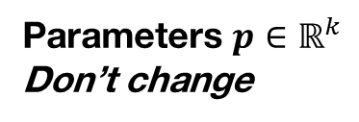
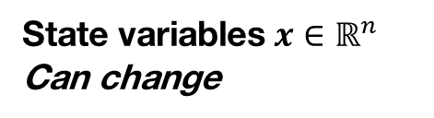
What are dynamical systems
Microscopic level
Macroscopic level
Dynamical system describe the macroscopic level
$$\dot{x}=f\left(x, p\right)$$
State variables $x∈ℝ^{n}$
Can change
Parameters $p∈ℝ^{k}$
Don’t change
Dynamical system are used to describe the macroscopic level

Slide 15
What are dynamical systems
Microscopic level
Macroscopic level
Dynamical system describe the macroscopic level
$$\dot{x}=f\left(x, p\right)$$
State variables $x∈ℝ^{n}$
Can change
Parameters $p∈ℝ^{k}$
Don’t change
Important assumptions:
Continuous state variables
Time evolution of state variables is deterministic

Slide 16
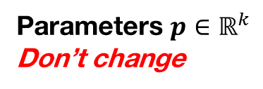
What are dynamical systems
2.
Problems
Microscopic level
Macroscopic level
$$\dot{x}=f\left(x, p\right)$$
State variables $x∈ℝ^{n}$
Can change
Parameters $p∈ℝ^{k}$
Don’t change
4.
Important assumptions:
Continuous state variables
Time evolution of state variables is deterministic
1.
3.

Slide 17
Part 1 The problems with dynamical systems
1
2
3
4
5
6

Slide 18
1. The problem with continuous state variables
A colony of Temnothorax ants must choose a new nest
A
B

Slide 19

1. The problem with continuous state variables
A colony of Temnothorax ants must choose a new nest
A
B
Tandem running
Basari et al. 2014

Slide 20




1. The problem with continuous state variables
A colony of Temnothorax ants must choose a new nest
A
B
Tandem running
$${\text{α}}_{+}$$
$${\text{α}}_{−}$$
Voter model
$${\text{σ}}_{+}$$
$${\text{σ}}_{−}$$
Marshall et al. 2009

Slide 21
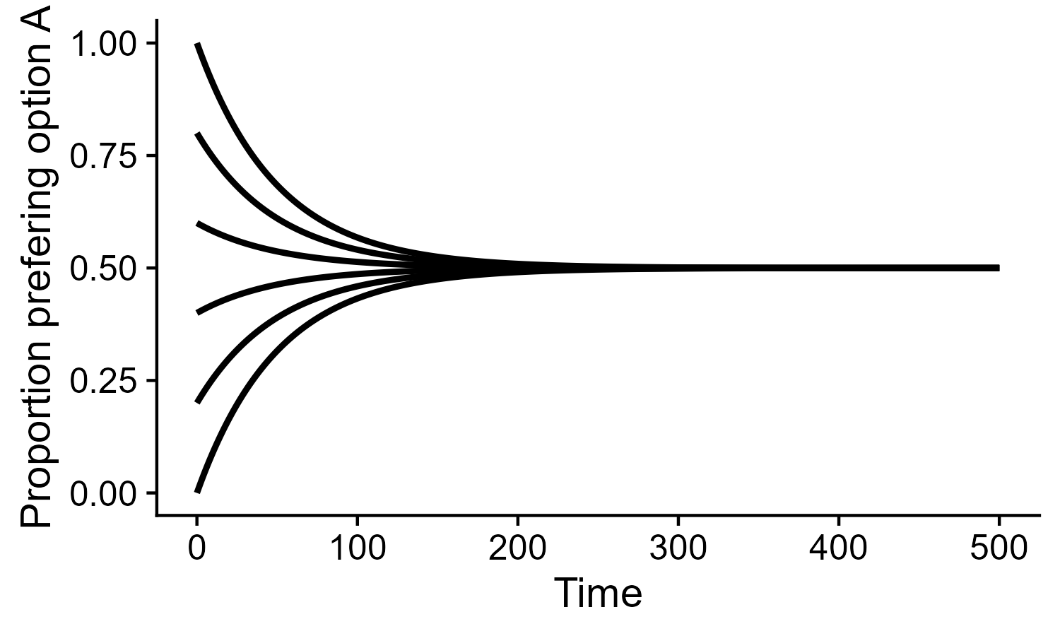
1. The problem with continuous state variables
$$\dot{{\text{x}}_{A}}=−{\text{σ}}_{−}{\text{x}}_{A}+{\text{σ}}_{+}\left(\text{1−}{\text{x}}_{A}\right)+({\text{α}}_{+}−{\text{α}}_{−}{\text{)}\text{x}}_{A}\left(\text{1−}{\text{x}}_{A}\right)$$
A colony of Temnothorax ants must choose a new nest
A
B
Assuming infinite population size
Tandem running
Tomorrow - how to derive dynamical systems from microscopic rules
$${\text{α}}_{+}$$
$${\text{α}}_{−}$$
Voter model
$${\text{σ}}_{+}$$
$${\text{σ}}_{−}$$

Slide 22
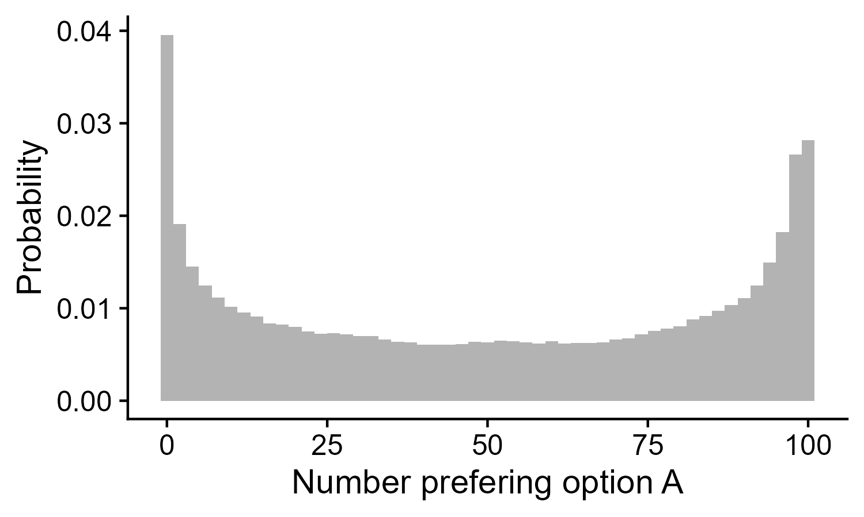
1. The problem with continuous state variables
$$\dot{{\text{x}}_{A}}=−{\text{σ}}_{+}{\text{x}}_{A}+{\text{σ}}_{−}\left(\text{1−}{\text{x}}_{A}\right)+({\text{α}}_{+}−{\text{α}}_{−}{\text{)}\text{x}}_{A}\left(\text{1−}{\text{x}}_{A}\right)$$
A colony of Temnothorax ants must choose a new nest
A
B
Tandem running
At the end of the task, with 100 ants, what is the shape of the probability mass for the number of ants preferring option A:
Flat
Approximately gaussian (centered at 50)
Bimodal
$${\text{α}}_{+}$$
$${\text{α}}_{−}$$
Voter model
$${\text{σ}}_{+}$$
$${\text{σ}}_{−}$$
Notes:
Potentilly change axis

Slide 23
1. The problem with continuous state variables
$$\dot{{\text{x}}_{A}}=−{\text{σ}}_{+}{\text{x}}_{A}+{\text{σ}}_{−}\left(\text{1−}{\text{x}}_{A}\right)+({\text{α}}_{+}−{\text{α}}_{−}{\text{)}\text{x}}_{A}\left(\text{1−}{\text{x}}_{A}\right)$$
A colony of Temnothorax ants must choose a new nest
A
B
Tandem running
At the end of the task, with 100 ants, what is the shape of the probability mass for the number of ants preferring option A:
Flat
Approximately gaussian (centered at 50)
Bimodal
$${\text{α}}_{+}$$
$${\text{α}}_{−}$$
Voter model
$${\text{σ}}_{+}$$
$${\text{σ}}_{−}$$

Slide 24
1. The problem with continuous state variables
$$\dot{{\text{x}}_{A}}=−{\text{σ}}_{+}{\text{x}}_{A}+{\text{σ}}_{−}\left(\text{1−}{\text{x}}_{A}\right)+({\text{α}}_{+}−{\text{α}}_{−}{\text{)}\text{x}}_{A}\left(\text{1−}{\text{x}}_{A}\right)$$
A colony of Temnothorax ants must choose a new nest
A
B
Tandem running
Very relevant for collective decision-making: the colony mostly agrees!
$${\text{α}}_{+}$$
$${\text{α}}_{−}$$
Voter model
$${\text{σ}}_{+}$$
$${\text{σ}}_{−}$$

Slide 25
1. The problem with continuous state variables
$$\dot{{\text{x}}_{A}}=−{\text{σ}}_{+}{\text{x}}_{A}+{\text{σ}}_{−}\left(\text{1−}{\text{x}}_{A}\right)+({\text{α}}_{+}−{\text{α}}_{−}{\text{)}\text{x}}_{A}\left(\text{1−}{\text{x}}_{A}\right)$$
A colony of Temnothorax ants must choose a new nest
A
B
Tandem running
Macroscopic models can miss dynamical outcomes
Noise induced effects
$${\text{α}}_{+}$$
$${\text{α}}_{−}$$
Voter model
$${\text{σ}}_{+}$$
$${\text{σ}}_{−}$$

Slide 26

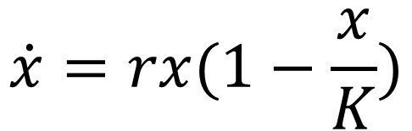
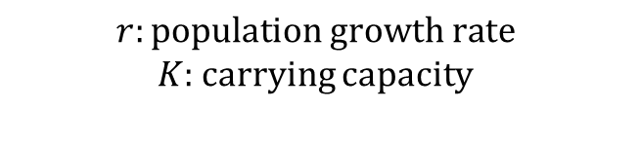
2. The problem with macroscopic descriptions
Logistic growth model
Clonal reproduction
ρ
$$r:population growth rate$$
$K$: carrying capacity
Death
δ
$$\dot{x}=rx(1−\frac{x}{K})$$
Density dependent death
γ

Slide 27
2. The problem with macroscopic descriptions
By increasing the rate of clonal reproduction, the population will change:
Faster
Same speed
Slower
Logistic growth model
Clonal reproduction
ρ
$$r:population growth rate$$
$K$: carrying capacity
Death
δ
$$\dot{x}=rx(1−\frac{x}{K})$$
Density dependent death
γ

Slide 28
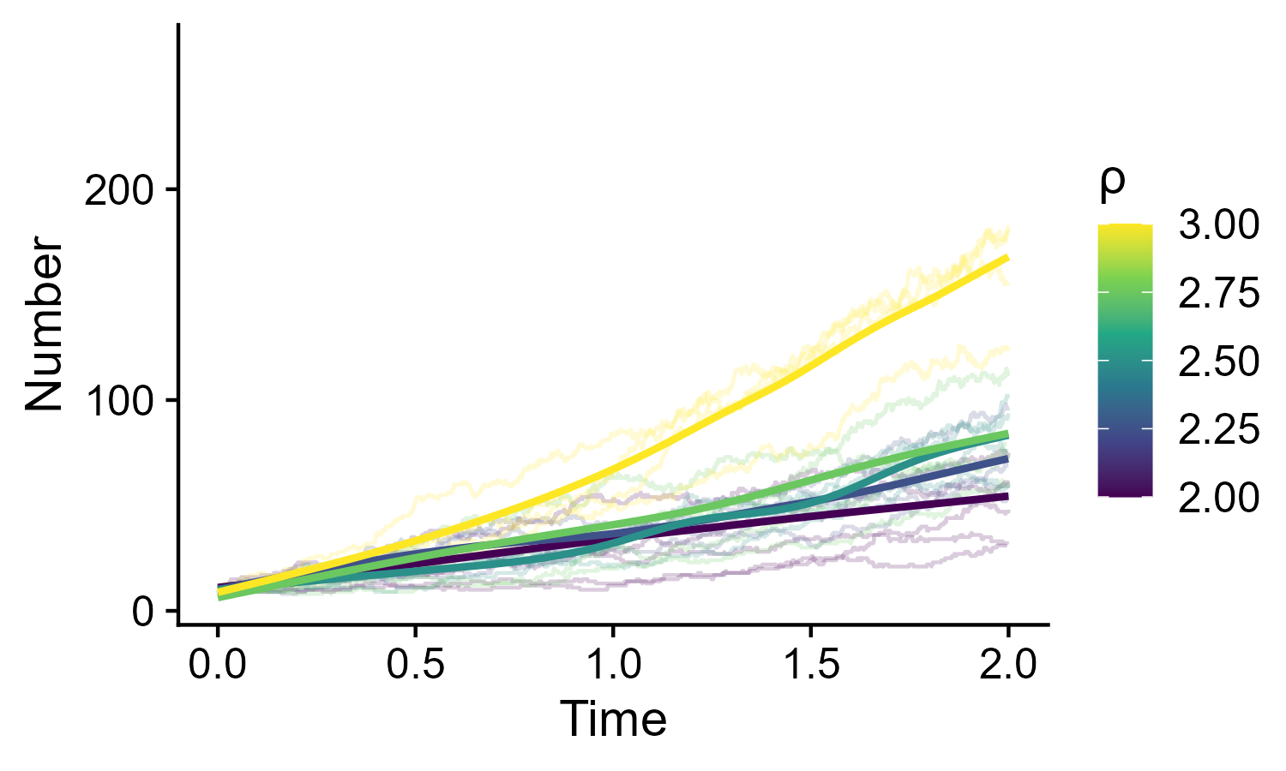
2. The problem with macroscopic descriptions
By increasing the rate of clonal reproduction, the population will change:
Faster
Same speed
Slower
Logistic growth model
Clonal reproduction
ρ
$$r:population growth rate$$
$K$: carrying capacity
Death
δ
$$\dot{x}=rx(1−\frac{x}{K})$$
Density dependent death
γ

Slide 29
2. The problem with macroscopic descriptions
By increasing the rate of clonal reproduction, the population will saturate:
At a lower number
At the same number
At a higher number
Logistic growth model
Clonal reproduction
ρ
$$r:population growth rate$$
$K$: carrying capacity
Death
δ
$$\dot{x}=rx(1−\frac{x}{K})$$
Density dependent death
γ

Slide 30
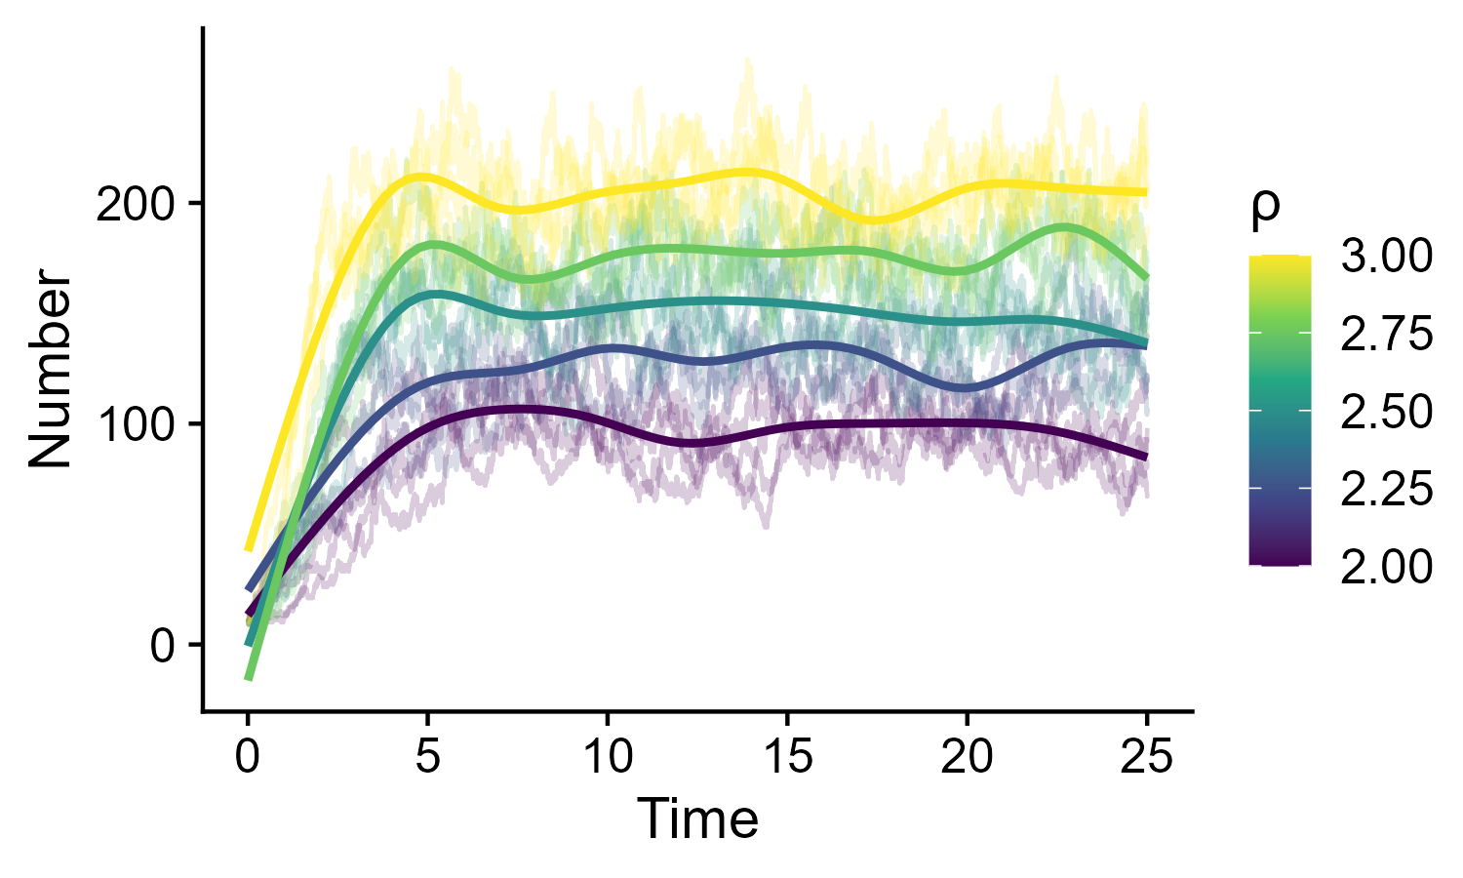
2. The problem with macroscopic descriptions
By increasing the rate of clonal reproduction, the population will saturate:
At a lower number
At the same number
At a higher number
Logistic growth model
Clonal reproduction
ρ
$$r:population growth rate$$
$K$: carrying capacity
Death
δ
$$\dot{x}=rx(1−\frac{x}{K})$$
Density dependent death
γ

Slide 31
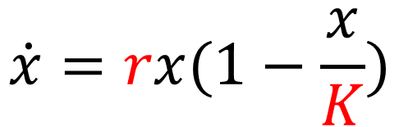

2. The problem with macroscopic descriptions
By increasing the rate of clonal reproduction, the population will saturate:
At a lower number
At the same number
At a higher number
Logistic growth model
Clonal reproduction
ρ
$$r:population growth rate$$
$K$: carrying capacity
Death
δ
$$\dot{x}=rx(1−\frac{x}{K})$$
Density dependent death
γ
$K=\frac{\text{ρ}−\text{δ}}{\text{γ}}$
$$r=\text{ρ}−\text{δ}$$
Population growth rate and carrying capacity are NOT independent

Slide 32
3. The problem with deterministic evolution of state variables
Everything that is stochastic will be missed
Accuracy (probability of choosing best option) is stochastic!

Slide 33
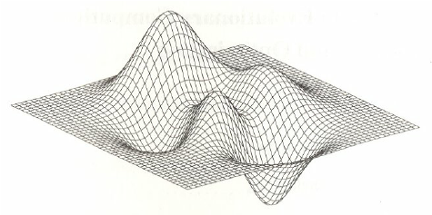
3. The problem with deterministic evolution of state variables
Everything that is stochastic will be missed
Accuracy (probability of choosing best option) is stochastic!
Dynamical systems “describe the landscape” over which decisions “move” …

Slide 34
Part 2 A baseline model of decision-making
1
2
3
4
5
6

Slide 35
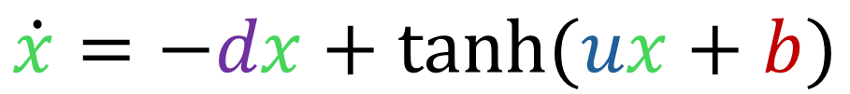
Non-linear opinion dynamics model (NOD)
Decision variable
Input or bias
$$\dot{x}=−dx+tanh⁡(ux+b)$$
Leak
Attention
One agent, two options

Slide 36
Non-linear opinion dynamics model (NOD)
Decision variable
Input or bias
$$\dot{x}=−dx+tanh⁡(ux+b)$$
Leak
Attention
With d>0, does x go to infinity:
Never
Depends on parameters
Always

Slide 37
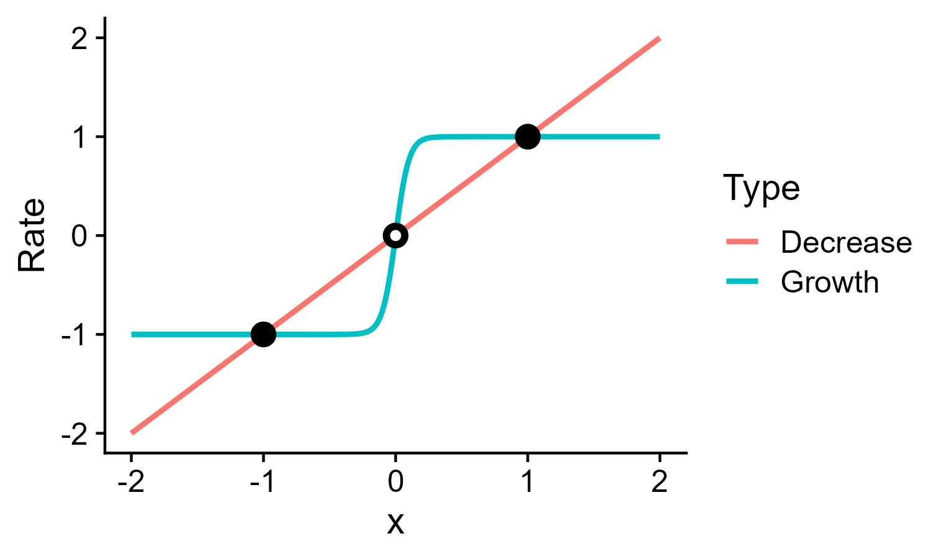
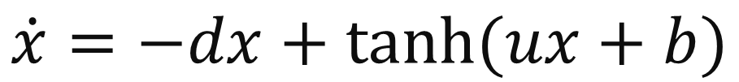
Non-linear opinion dynamics model (NOD)
Linear
Constant (for big |x|)
$$\dot{x}=−dx+tanh⁡(ux+b)$$
With d>0, does x go to infinity:
Never
Depends on parameters
Always

Slide 38
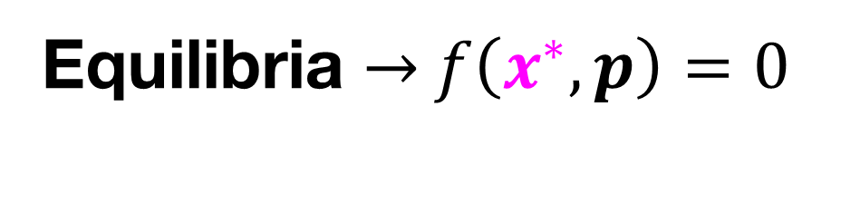
Non-linear opinion dynamics model (NOD)
$$\dot{x}=−dx+tanh⁡(ux+b)$$
Equilibria → $f\left(x^{∗}, p\right)=0$

Slide 39
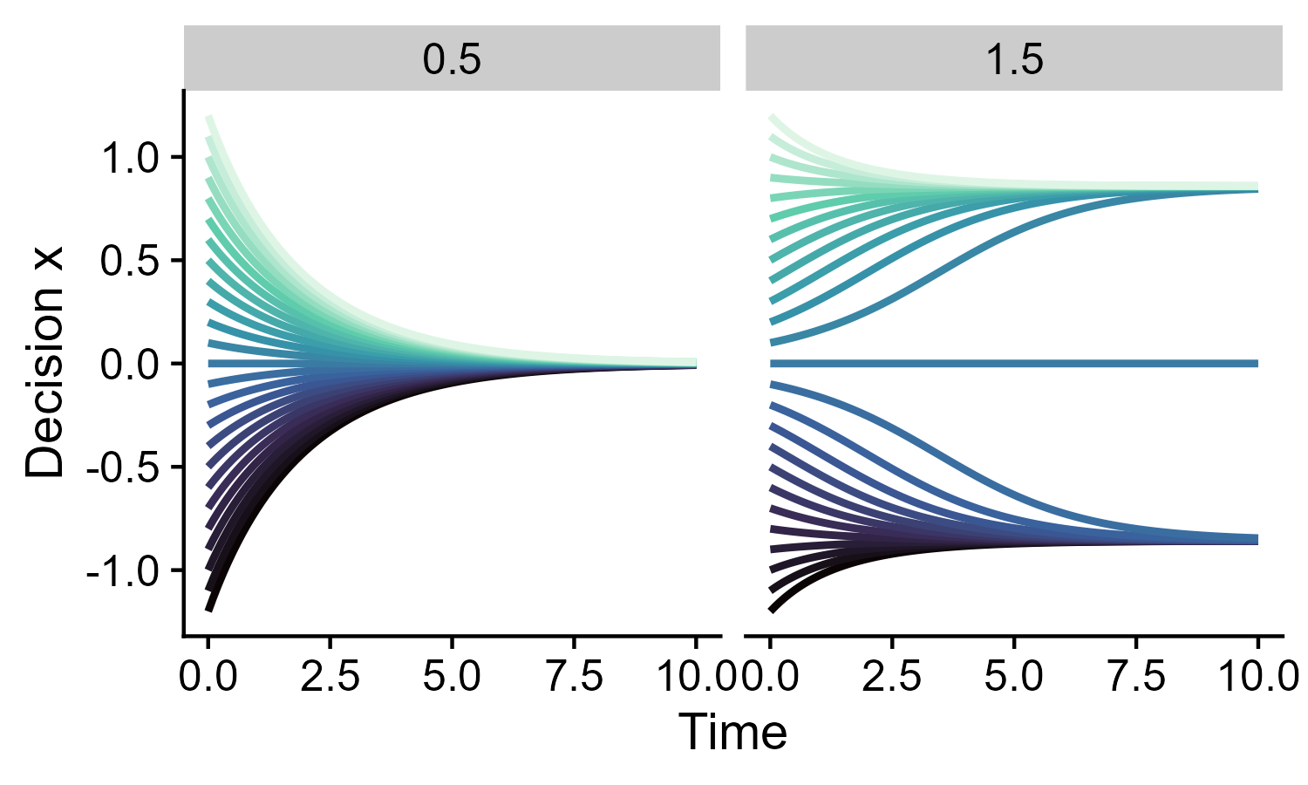
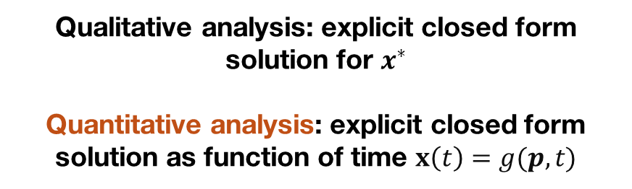


Non-linear opinion dynamics model (NOD)
$$\dot{x}=−dx+tanh⁡(ux+b)$$
Time series
Equilibria → $f\left(x^{∗}, p\right)=0$
$$u=$$
$$u=$$
Qualitative analysis: explicit closed form solution for $x^{∗}$
Quantitative analysis: explicit closed form solution as function of time $x\left(t\right)=g(p,t)$

Slide 40
Non-linear opinion dynamics model (NOD)
$$\dot{x}=−dx+tanh⁡(ux+b)$$
Time series
Equilibria → $f\left(x^{∗}, p\right)=0$
$$u=$$
$$u=$$
Qualitative analysis: explicit closed form solution for $x^{∗}$
Quantitative analysis: explicit closed form solution as function of time $x\left(t\right)=g(p,t)$
“Less information, more informative”

Slide 41
Part 3 Bifurcations
1
2
3
4
5
6

Slide 42
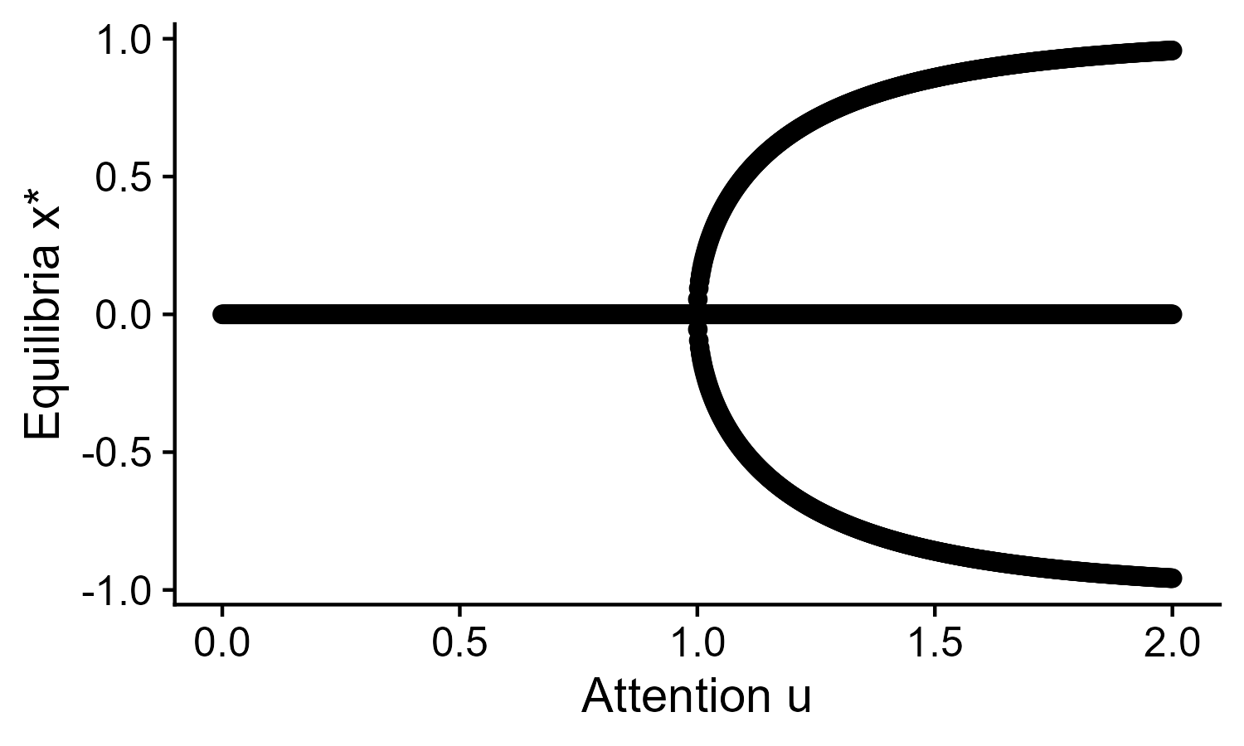

Bifurcation diagrams
Equilibria instead of state variable
$$\dot{x}=−x+Tanh⁡(ux)$$
Equilibrium branch
Parameter instead of time

Slide 43
Bifurcation diagrams
Equilibria instead of state variable
$$\dot{x}=−x+Tanh⁡(ux)$$
Stability of equilibria
Parameter instead of time

Slide 44
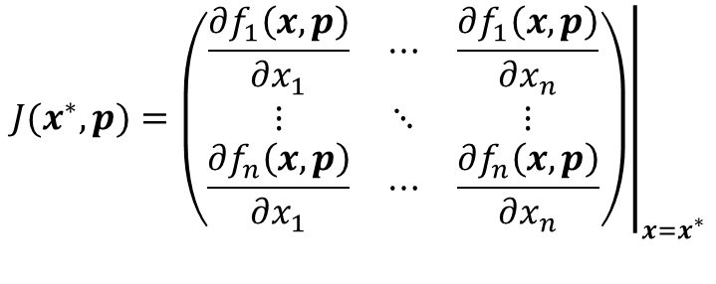
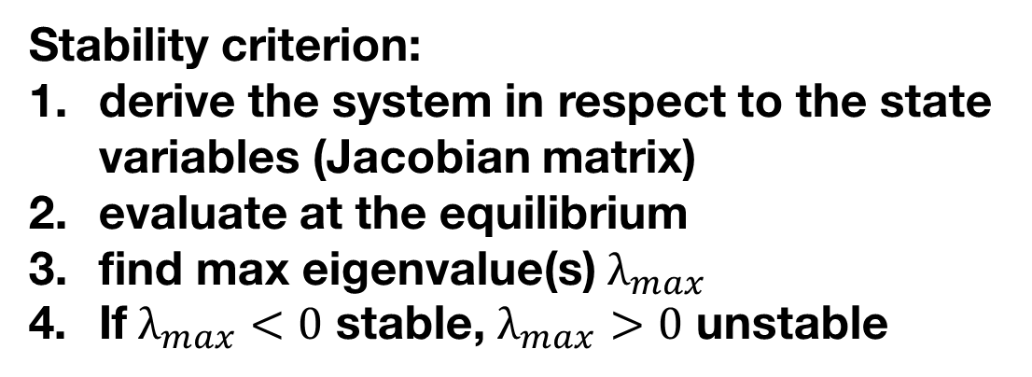
Bifurcation diagrams
Stability criterion:
derive the system in respect to the state variables (Jacobian matrix)
evaluate at the equilibrium
find max eigenvalue(s) $λ_{max}$
If $λ_{max}<0$ stable, $λ_{max}>0$ unstable
$$J(x^{∗},p)={\left.\left(\begin{matrix}\frac{\text{∂}f_{1}\left(x, p\right)}{\text{∂}x_{1}} & ⋯ & \frac{\text{∂}f_{1}\left(x, p\right)}{\text{∂}x_{n}} \\ ⋮ & ⋱ & ⋮ \\ \frac{\text{∂}f_{n}\left(x, p\right)}{\text{∂}x_{1}} & ⋯ & \frac{\text{∂}f_{n}\left(x, p\right)}{\text{∂}x_{n}}\end{matrix}\right)\right|}_{x=x^{∗}}$$

Slide 45
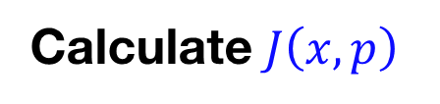




Bifurcation diagrams
Stability criterion:
derive the system in respect to the state variables (Jacobian matrix)
evaluate at the equilibrium
find max eigenvalue(s) $λ_{max}$
If $λ_{max}<0$ stable, $λ_{max}>0$ unstable
$$J(x^{∗},p)={\left.\left(\begin{matrix}\frac{\text{∂}f_{1}\left(x, p\right)}{\text{∂}x_{1}} & ⋯ & \frac{\text{∂}f_{1}\left(x, p\right)}{\text{∂}x_{n}} \\ ⋮ & ⋱ & ⋮ \\ \frac{\text{∂}f_{n}\left(x, p\right)}{\text{∂}x_{1}} & ⋯ & \frac{\text{∂}f_{n}\left(x, p\right)}{\text{∂}x_{n}}\end{matrix}\right)\right|}_{x=x^{∗}}$$
$$f\left(x, p\right)=−x+tanh⁡(10x)$$
$$f\left(x^{∗}, p\right)=0$$
Calculate $J\left(x, p\right)$
$$J\left(x, p\right)$$
$${J\left(x, p\right) }_{x=x^{∗}}$$

Slide 46
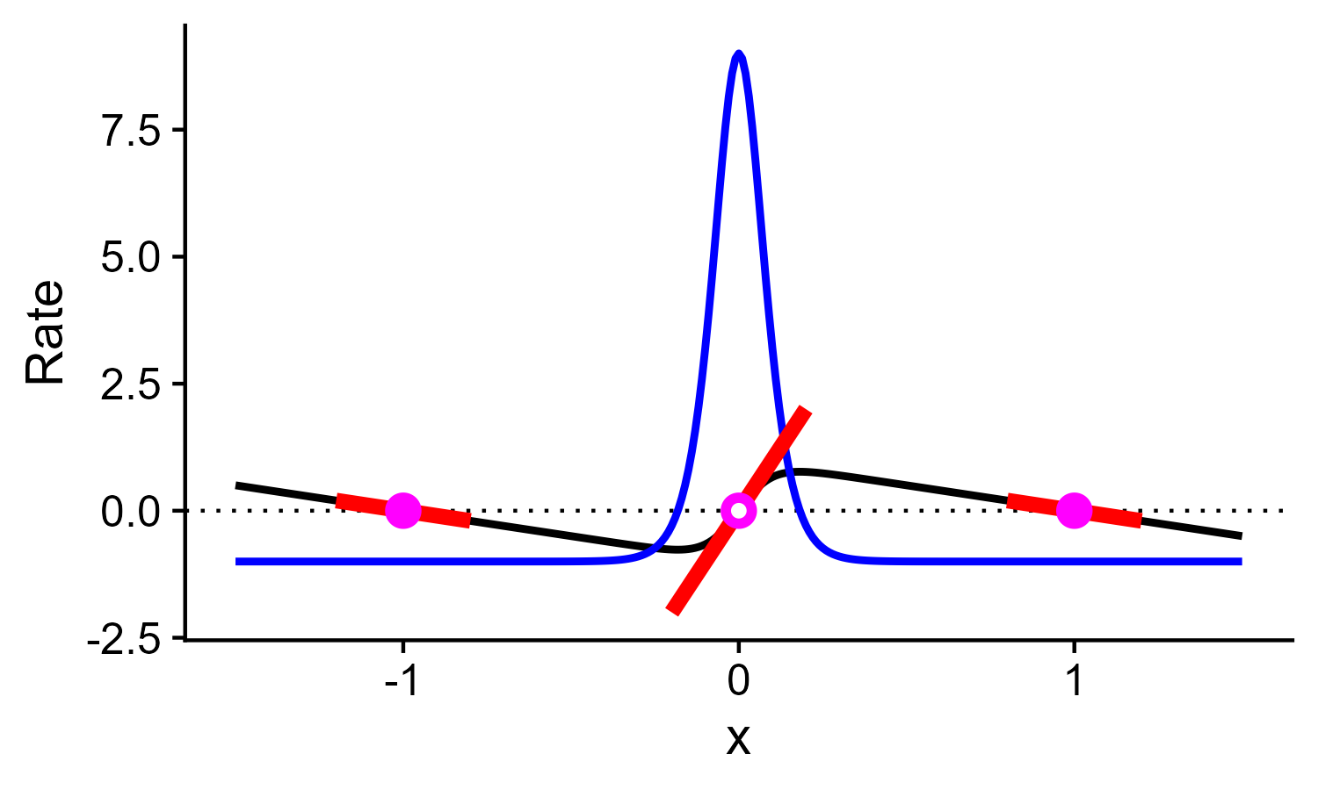

Bifurcation diagrams
Stability criterion:
derive the system in respect to the state variables (Jacobian matrix)
evaluate at the equilibrium
find max eigenvalue(s) $λ_{max}$
If $λ_{max}<0$ stable, $λ_{max}>0$ unstable
$$f\left(x, p\right)=−x+tanh⁡(10x)$$
$$f\left(x^{∗}, p\right)=0$$
$$J\left(x, p\right)=−1+10{sech⁡(10x)}^{2}$$
$${J\left(x, p\right) }_{x=x^{∗}}$$

Slide 47
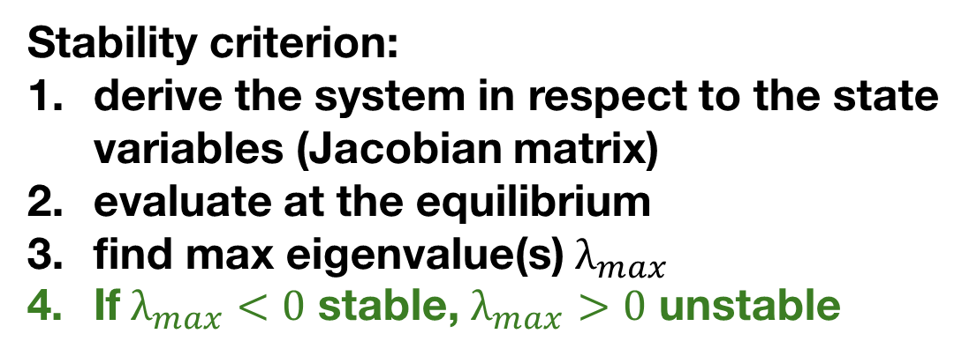
Bifurcation diagrams
Stability criterion:
derive the system in respect to the state variables (Jacobian matrix)
evaluate at the equilibrium
find max eigenvalue(s) $λ_{max}$
If $λ_{max}<0$ stable, $λ_{max}>0$ unstable
$$f\left(x, p\right)=−x+tanh⁡(10x)$$
Why?
$$f\left(x^{∗}, p\right)=0$$
$$J\left(x, p\right)=−1+10{sech⁡(10x)}^{2}$$
$${J\left(x, p\right) }_{x=x^{∗}}$$

Slide 48
Bifurcation diagrams
Stability criterion:
derive the system in respect to the state variables (Jacobian matrix)
evaluate at the equilibrium
find max eigenvalue(s) $λ_{max}$
If $λ_{max}<0$ stable, $λ_{max}>0$ unstable
Caution
This criteria fails when at least on eigenvalue is 0. Other tools can be used to define stability.
See end if curious
Hyperbolic equilibria: linearization succeeds
Singular/critical points: linearization fails

Slide 49
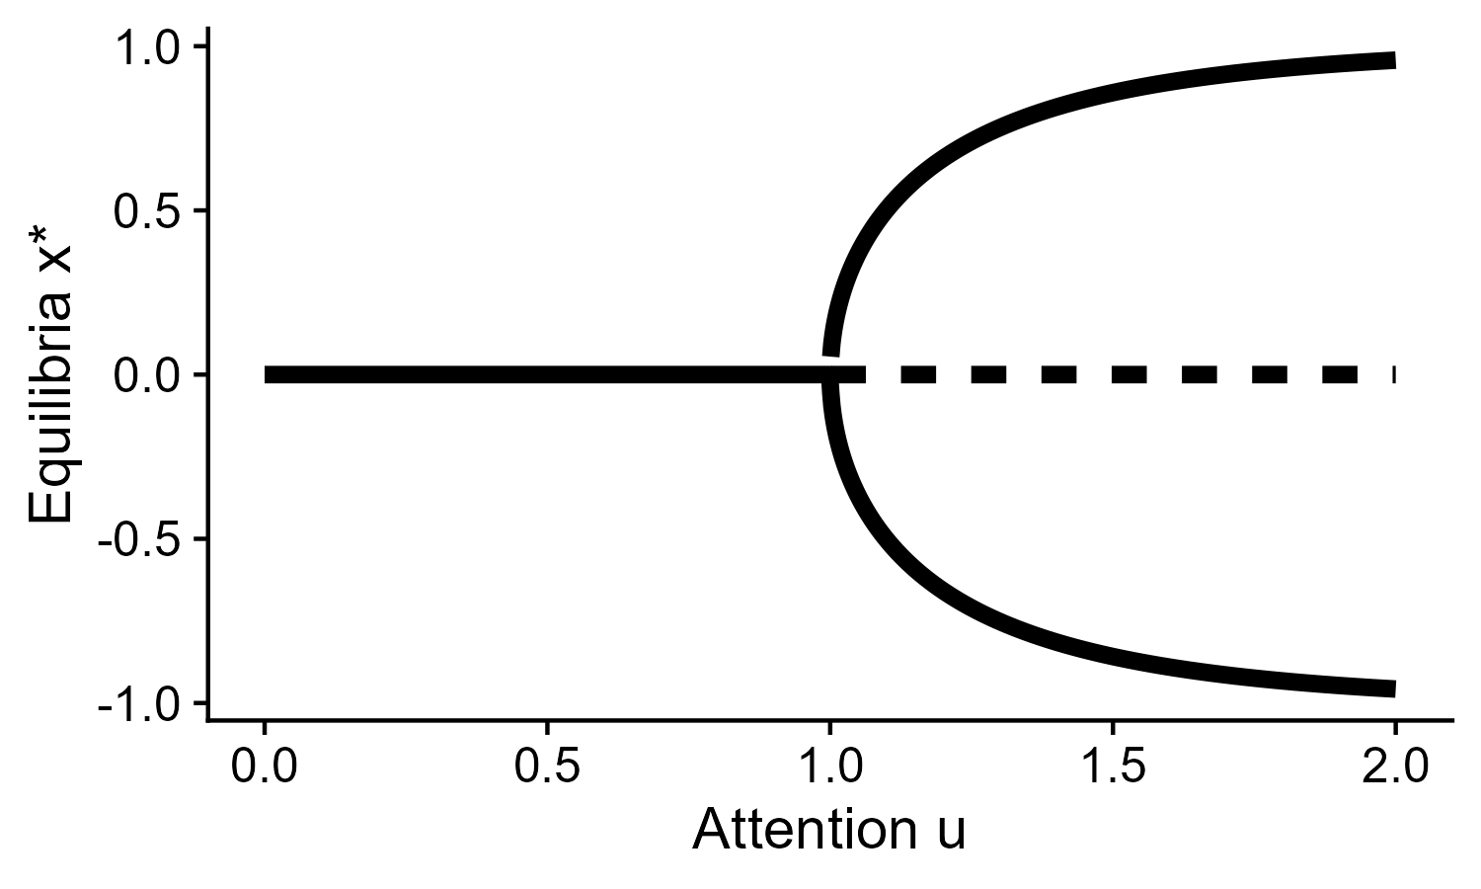
Bifurcation diagrams

Slide 50
Bifurcation diagrams
What does this tell us about decision-making?

Slide 51
Bifurcation diagrams
High attention u → decision
In this case, multi-stability is associated with making decisions

Slide 52
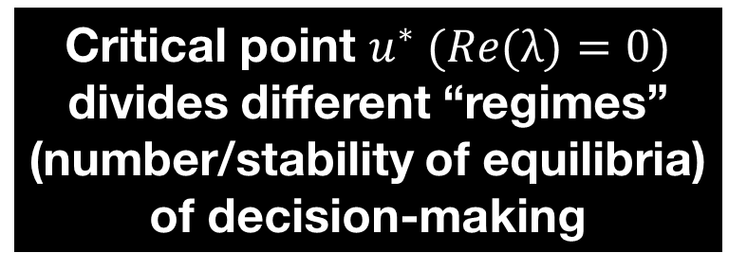
Bifurcation diagrams
High attention u → decision
Critical point $u^{∗} (Re(λ)=0)$ divides different “regimes” (number/stability of equilibria) of decision-making
Could it be otherwise?

Slide 53
Bifurcation diagrams
Critical point $u^{∗} (Re(λ)=0)$ divides different “regimes” (number/stability of equilibria) of decision-making
Could it be otherwise?
No*
Implicit function theorem: if $f\left(x^{∗},p\right)=0$and $x^{∗}$is not singular ($\text{λ}$≠0), then locally there is a differentiable function 𝜒($p$)= $x^{∗}$
*Only considering local bifurcations; in global bifurcations (ex: homo/heteroclinic) the vector field changes without singular points

Slide 54
Bifurcation diagrams
Smooth
Will not split
Does not disappear
Hyperbolic equilibria
Critical point $u^{∗} (Re(λ)=0)$ divides different “regimes” (number/stability of equilibria) of decision-making
Could it be otherwise?
No
Implicit function theorem: if $f\left(x^{∗},p\right)=0$and $x^{∗}$is not singular ($\text{λ}$≠0), then locally there is a differentiable function 𝜒($p$)= $x^{∗}$
(NB bifurcations can occur even for non singular Jacobians, ex Hopf, but $Re(λ)=0$ still holds)

Slide 55
Bifurcation diagrams
Smooth
Will not split
Does not disappear
Hyperbolic equilibria
Critical point $u^{∗} (Re(λ)=0)$ divides different “regimes” (number/stability of equilibria) of decision-making
Could it be otherwise?
No
Implicit function theorem: if $f\left(x^{∗},p\right)=0$and $x^{∗}$is not singular ($\text{λ}$≠0), then locally there is a differentiable function 𝜒($p$)= $x^{∗}$
Numerical continuation techniques use this fact to draw bifurcation diagrams. Bifurcation/qualitative “counter-part” of time integration
bifurcationKit Julia - matcont Matlab - dynamica Mathematica …

Slide 56
Bifurcation diagrams
Smooth
Will not split
Does not disappear
Hyperbolic equilibria
Critical point $u^{∗} (Re(λ)=0)$ divides different “regimes” (number/stability of equilibria) of decision-making
Could it be otherwise?
No
In what/how many ways can equilibria branches change?

Slide 57
Elementary bifurcations
At the critical point, the bifurcation diagram will have specific shapes resembling a normal form: these are the elementary bifurcations.

Slide 58
Elementary bifurcations
At the critical point, the bifurcation diagram will have specific shapes resembling a normal form: these are the elementary bifurcations. This holds for multidimensional systems as well: the bifurcation will always have the same possible shapes along the directions associated with λ $=0$ of Jacobian. To classify bifurcation, Taylor expand at the critical point and check defining conditions

Slide 59
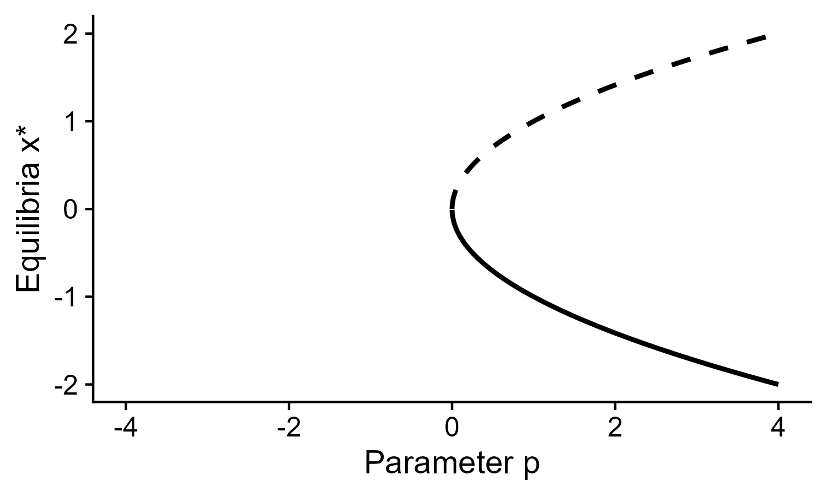
Elementary bifurcations
At the critical point, the bifurcation diagram will have specific shapes resembling a normal form: these are the elementary bifurcations. This holds for multidimensional systems as well: the bifurcation will always have the same possible shapes along the directions associated with λ $=0$ of Jacobian. To classify bifurcation, Taylor expand at the critical point and check defining conditions
Saddle node
$$\dot{x}=f\left(x, p\right)=ε_{1}p+{ε_{2}x}^{2},ε_{i}∈\{−1,+1\}$$

Slide 60
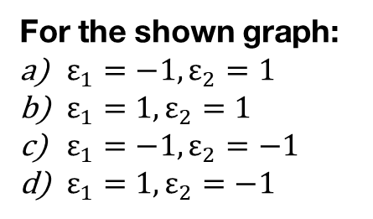
Elementary bifurcations
At the critical point, the bifurcation diagram will have specific shapes resembling a normal form: these are the elementary bifurcations. This holds for multidimensional systems as well: the bifurcation will always have the same possible shapes along the directions associated with λ $=0$ of Jacobian. To classify bifurcation, Taylor expand at the critical point and check defining conditions
Saddle node
For the shown graph:
$ε_{1}=−1,ε_{2}=1$
$ε_{1}=1,ε_{2}=1$
$ε_{1}=−1,ε_{2}=−1$
$ε_{1}=1,ε_{2}=−1$
$$\dot{x}=f\left(x, p\right)=ε_{1}p+{ε_{2}x}^{2},ε_{i}∈\{−1,+1\}$$

Slide 61
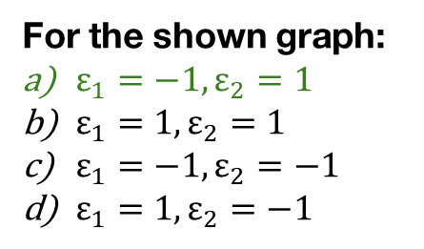
Elementary bifurcations
At the critical point, the bifurcation diagram will have specific shapes resembling a normal form: these are the elementary bifurcations. This holds for multidimensional systems as well: the bifurcation will always have the same possible shapes along the directions associated with λ $=0$ of Jacobian. To classify bifurcation, Taylor expand at the critical point and check defining conditions
Saddle node
For the shown graph:
$ε_{1}=−1,ε_{2}=1$
$ε_{1}=1,ε_{2}=1$
$ε_{1}=−1,ε_{2}=−1$
$ε_{1}=1,ε_{2}=−1$
$$\dot{x}=f\left(x, p\right)=ε_{1}p+{ε_{2}x}^{2},ε_{i}∈\{−1,+1\}$$

Slide 62



Elementary bifurcations
At the critical point, the bifurcation diagram will have specific shapes resembling a normal form: these are the elementary bifurcations. This holds for multidimensional systems as well: the bifurcation will always have the same possible shapes along the directions associated with λ $=0$ of Jacobian. To classify bifurcation, Taylor expand at the critical point and check defining conditions
Saddle node
Defining conditions
a)
$$\frac{{\text{∂}}^{2}f\left(x, p\right)}{\text{∂}x^{2}}≠0$$
b)
$$\frac{\text{∂}f\left(x, p\right)}{\text{∂}p}≠0$$
c)
$$\frac{\text{∂}f\left(x, p\right)}{\text{∂}x}=0$$
$$\dot{x}=f\left(x, p\right)=ε_{1}p+{ε_{2}x}^{2},ε_{i}∈\{−1,+1\}$$

Slide 63
Elementary bifurcations
At the critical point, the bifurcation diagram will have specific shapes resembling a normal form: these are the elementary bifurcations. This holds for multidimensional systems as well: the bifurcation will always have the same possible shapes along the directions associated with λ $=0$ of Jacobian. To classify bifurcation, Taylor expand at the critical point and check defining conditions
Saddle node
Which defining condition is shared among all one-dimensional elementary bifurcations?
Defining conditions
a)
$$\frac{{\text{∂}}^{2}f\left(x, p\right)}{\text{∂}x^{2}}≠0$$
b)
$$\frac{\text{∂}f\left(x, p\right)}{\text{∂}p}≠0$$
c)
$$\frac{\text{∂}f\left(x, p\right)}{\text{∂}x}=0$$
$$\dot{x}=f\left(x, p\right)=ε_{1}p+{ε_{2}x}^{2},ε_{i}∈\{−1,+1\}$$

Slide 64

Elementary bifurcations
At the critical point, the bifurcation diagram will have specific shapes resembling a normal form: these are the elementary bifurcations. This holds for multidimensional systems as well: the bifurcation will always have the same possible shapes along the directions associated with λ $=0$ of Jacobian. To classify bifurcation, Taylor expand at the critical point and check defining conditions
Saddle node
Which defining condition is shared among all one-dimensional elementary bifurcations?
Defining conditions
a)
$$\frac{{\text{∂}}^{2}f\left(x, p\right)}{\text{∂}x^{2}}≠0$$
b)
$$\frac{\text{∂}f\left(x, p\right)}{\text{∂}p}≠0$$
c)
$$\frac{\text{∂}f\left(x, p\right)}{\text{∂}x}=0$$
$$\dot{x}=f\left(x, p\right)=ε_{1}p+{ε_{2}x}^{2},ε_{i}∈\{−1,+1\}$$
Condition for being a critical point

Slide 65
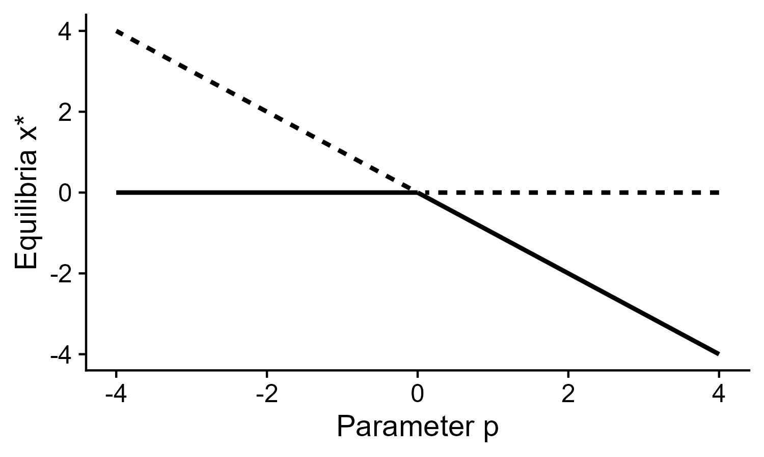

Elementary bifurcations
At the critical point, the bifurcation diagram will have specific shapes resembling a normal form: these are the elementary bifurcations. This holds for multidimensional systems as well: the bifurcation will always have the same possible shapes along the directions associated with λ $=0$ of Jacobian. To classify bifurcation, Taylor expand at the critical point and check defining conditions
Saddle node
$$\dot{x}=f\left(x, p\right)=ε_{1}p+{ε_{2}x}^{2},ε_{i}∈\{−1,+1\}$$
Transcritical
$$\dot{x}=f\left(x, p\right)=px+{εx}^{2},ε∈\{−1,+1\}$$

Slide 66
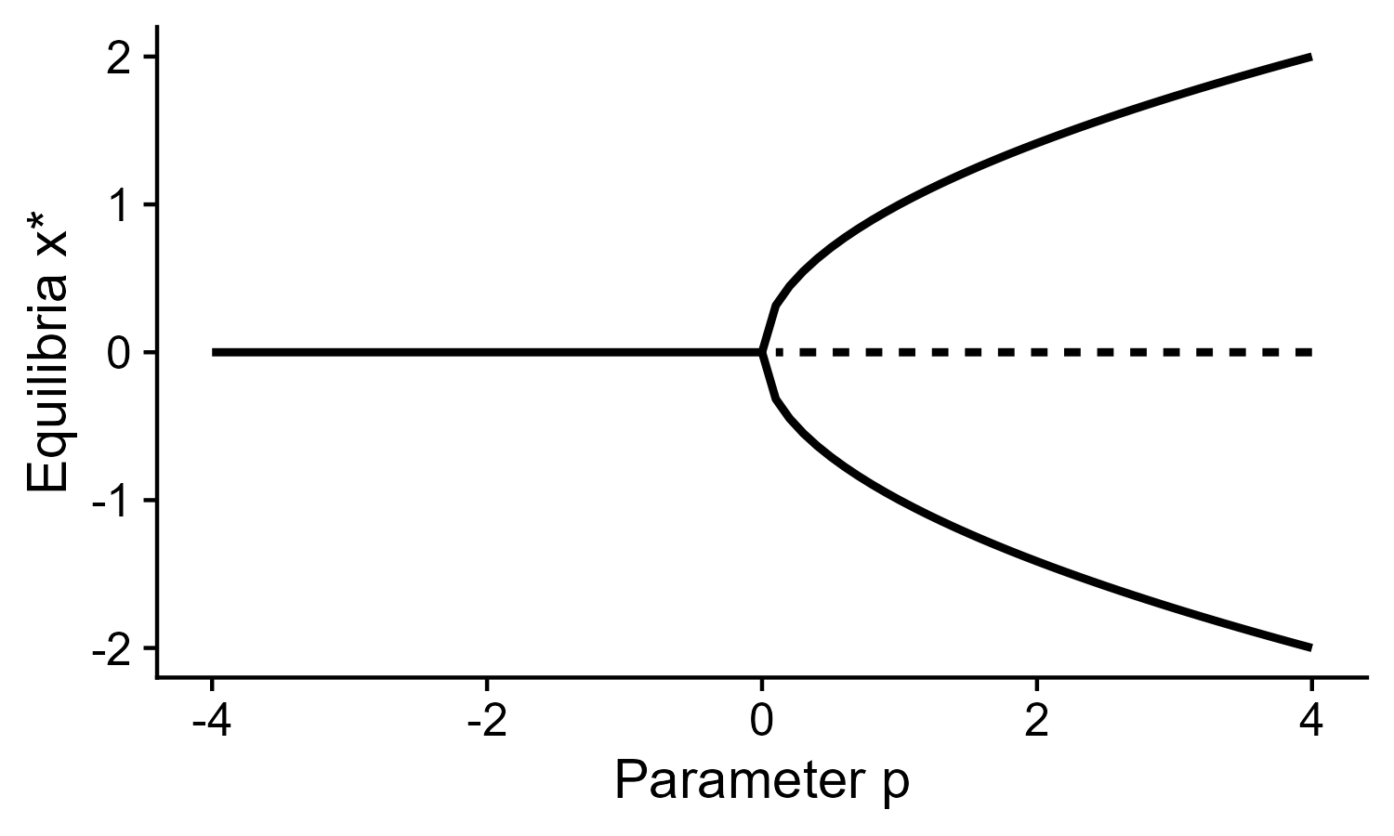

Elementary bifurcations
At the critical point, the bifurcation diagram will have specific shapes resembling a normal form: these are the elementary bifurcations. This holds for multidimensional systems as well: the bifurcation will always have the same possible shapes along the directions associated with λ $=0$ of Jacobian. To classify bifurcation, Taylor expand at the critical point and check defining conditions
Saddle node
Supercritical pitchfork
$$\dot{x}=f\left(x, p\right)=ε_{1}p+{ε_{2}x}^{2},ε_{i}∈\{−1,+1\}$$
$$\dot{x}=f\left(x, p\right)=εxp−x^{3},ε∈\{−1,+1\}$$
Transcritical
$$\dot{x}=f\left(x, p\right)=px+{εx}^{2},ε∈\{−1,+1\}$$

Slide 67
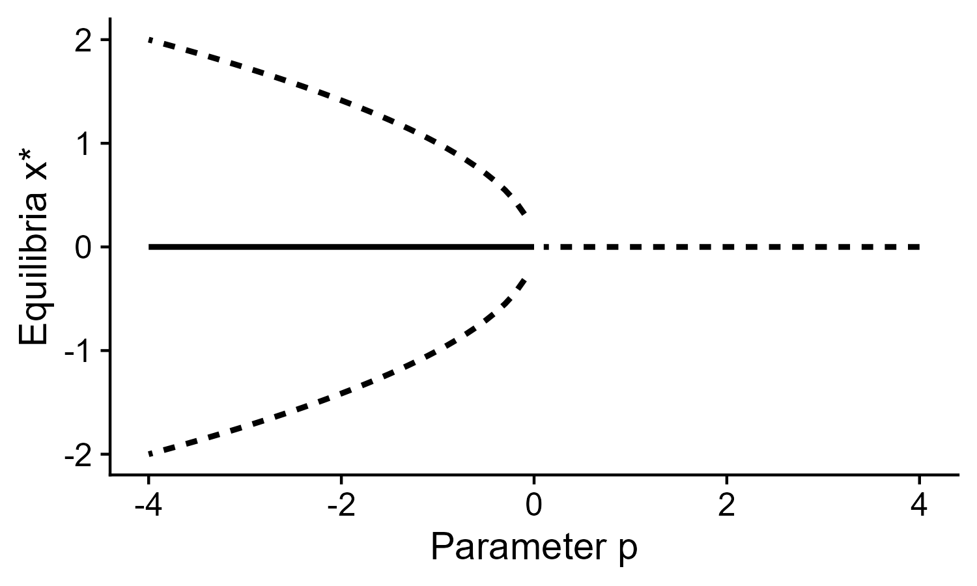

Elementary bifurcations
At the critical point, the bifurcation diagram will have specific shapes resembling a normal form: these are the elementary bifurcations. This holds for multidimensional systems as well: the bifurcation will always have the same possible shapes along the directions associated with λ $=0$ of Jacobian. To classify bifurcation, Taylor expand at the critical point and check defining conditions
Saddle node
Supercritical pitchfork
$$\dot{x}=f\left(x, p\right)=ε_{1}p+{ε_{2}x}^{2},ε_{i}∈\{−1,+1\}$$
$$\dot{x}=f\left(x, p\right)=εxp−x^{3},ε∈\{−1,+1\}$$
Transcritical
Subcritical pitchfork
$$\dot{x}=f\left(x, p\right)=px+{εx}^{2},ε∈\{−1,+1\}$$
$$\dot{x}=f\left(x, p\right)=εxp+x^{3},ε∈\{−1,+1\}$$

Slide 68
What we know
Usually, equilibria will not change in number or stability

Slide 69
What we know
Usually, equilibria will not change in number or stability
When they do, it is because of singular or bifurcation points

Slide 70
What we know
Usually, equilibria will not change in number or stability
When they do, it is because of singular or bifurcation points
At the bifurcation points, there are only specific ways in which equilibria will change (also for high dimensional systems)

Slide 71
What we know
Usually, equilibria will not change in number or stability
When they do, it is because of singular or bifurcation points
At the bifurcation points, there are only specific ways in which equilibria will change (also for high dimensional systems)
Elementary bifurcations can transform into each other
Only a finite way in which this can happen!

Slide 72
Universal unfolding theorem
There are a finite number of ways the bifurcation of $\dot{x}=f\left(x,p,r=0\right)$ transforms into the bifurcation of $\dot{x}=g\left(x,p,r≠0\right).$ r are the unfolding parameters $r≠0$ is called a parametric perturbation
Universal unfolding of pitchfork
$$\dot{x}=g\left(x, p,a,b\right)=−x^{3}+ax^{2}+px+b$$

Slide 73
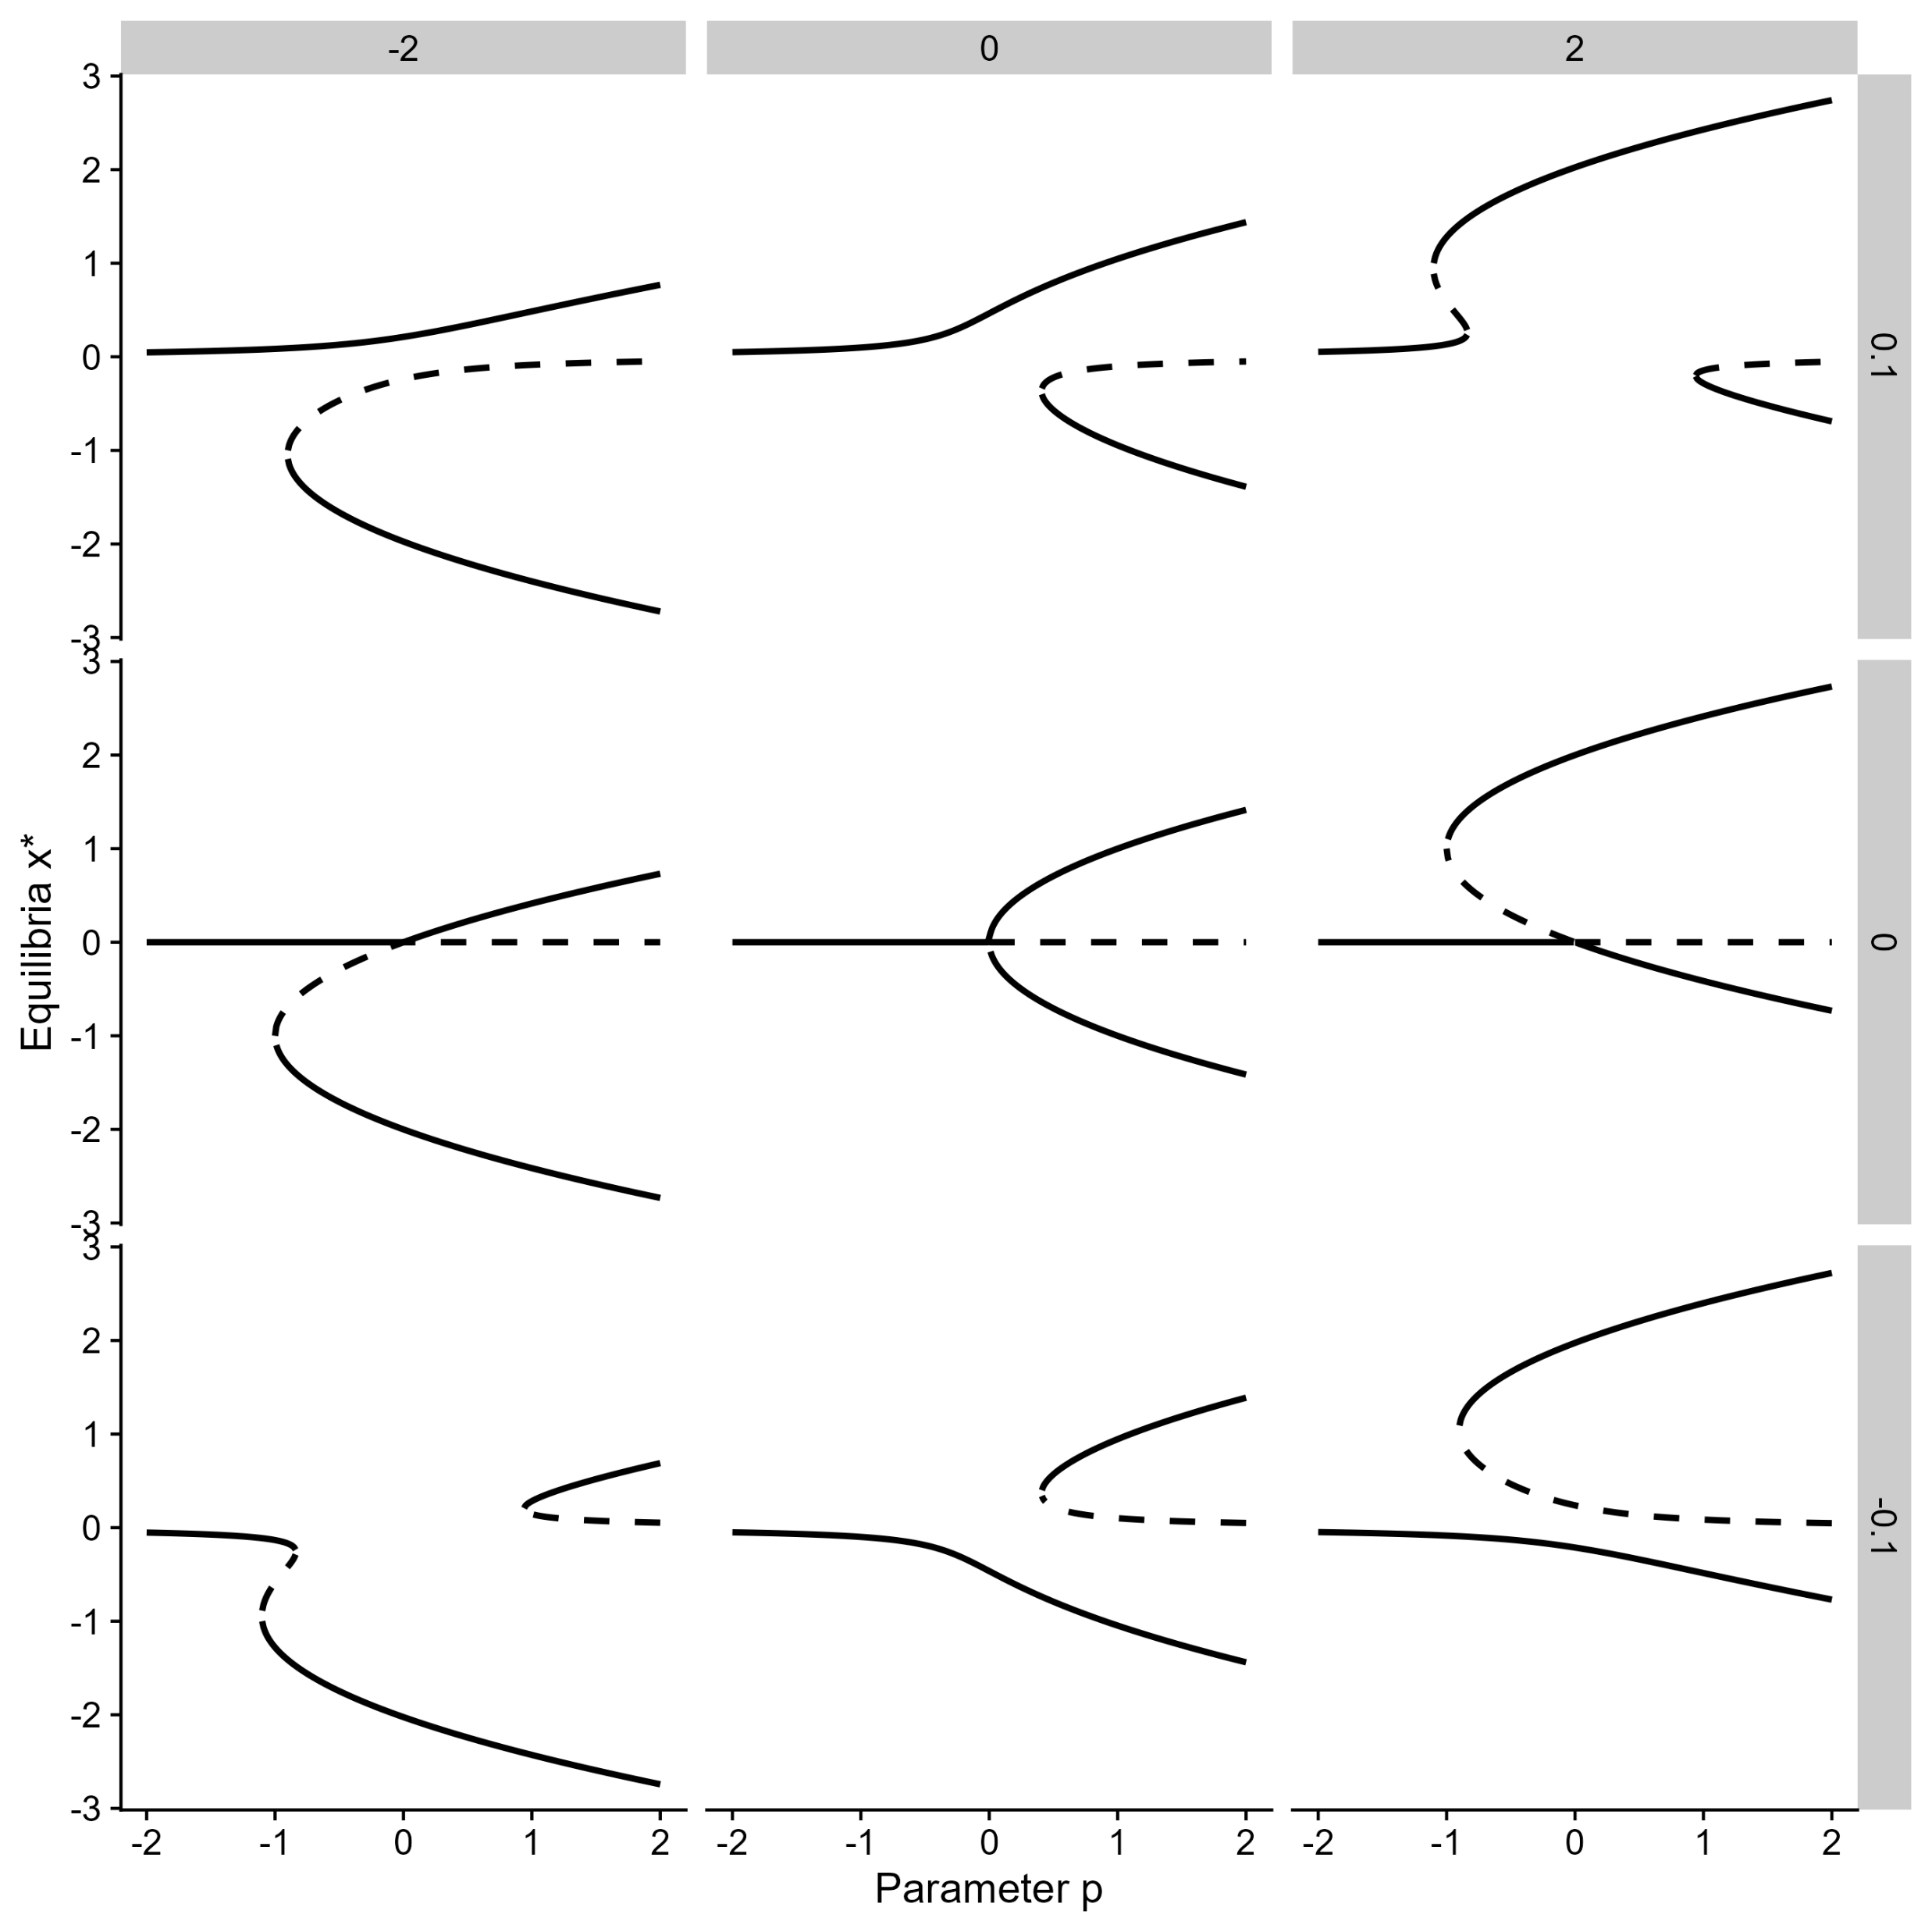
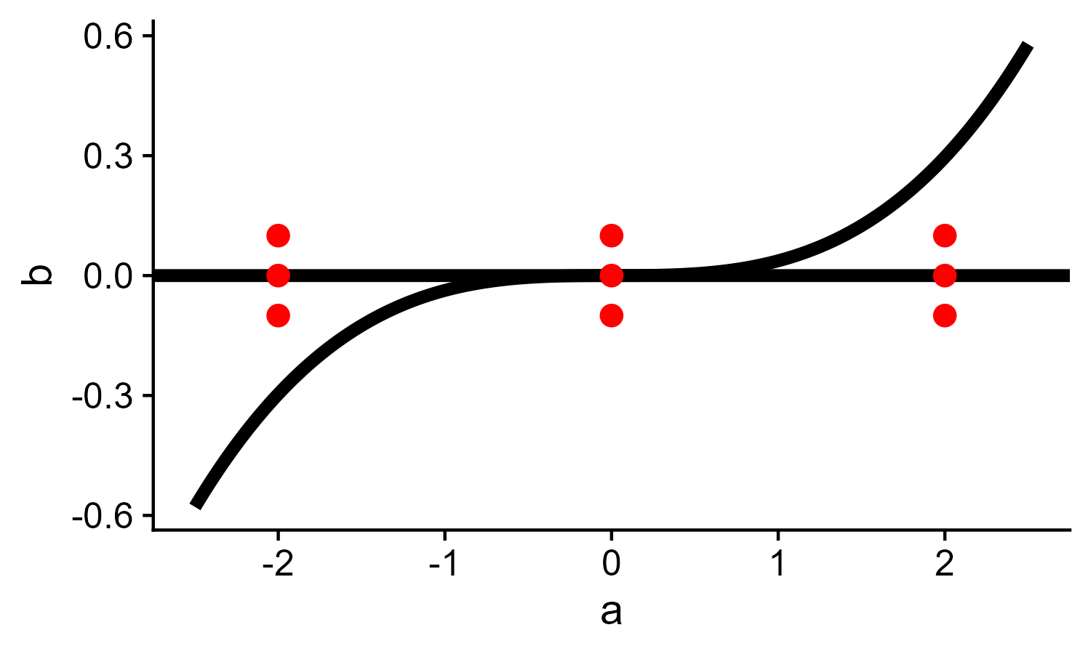


Universal unfolding theorem
There are a finite number of ways the bifurcation of $\dot{x}=f\left(x,p,r=0\right)$ transforms into the bifurcation of $\dot{x}=g\left(x,p,r≠0\right).$ r are the unfolding parameters $r≠0$ is called a parametric perturbation
Universal unfolding of pitchfork
$$\dot{x}=g\left(x, p,a,b\right)=−x^{3}+ax^{2}+px+b$$
$$a$$
$$b$$

Slide 74
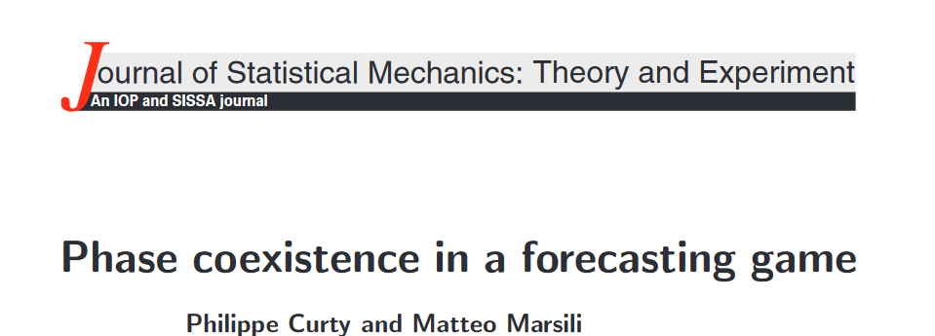
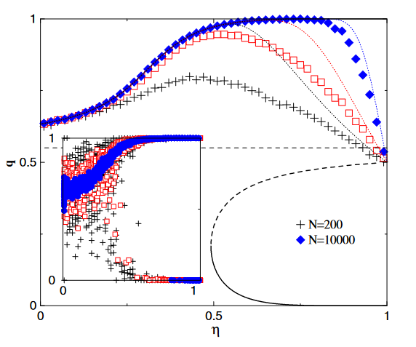

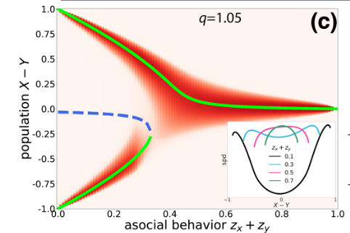

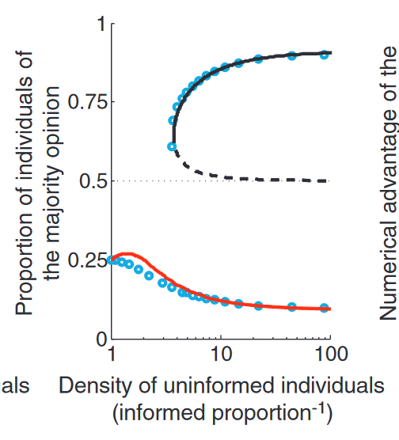
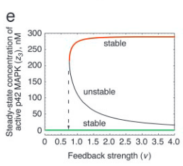


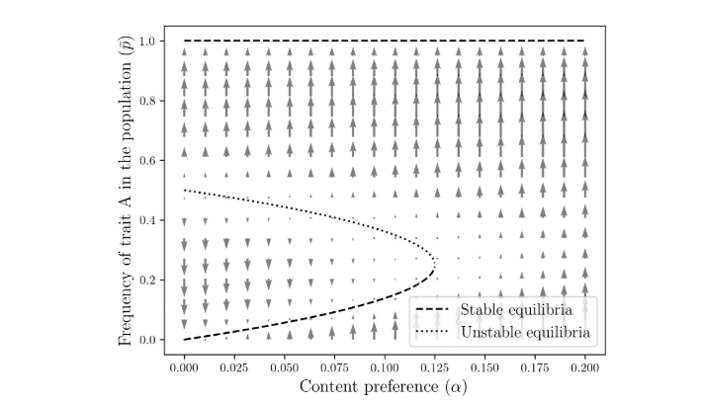

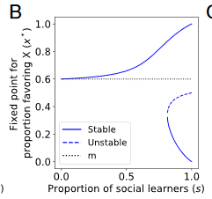
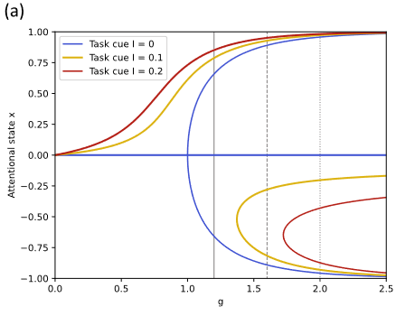

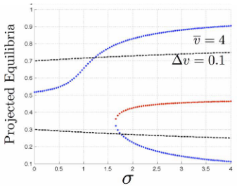


Slide 75
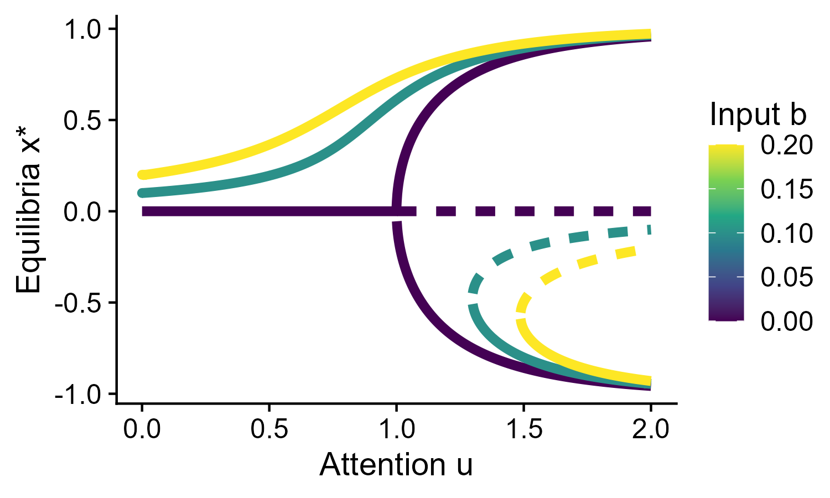
Unfolding in the nonlinear opinion dynamics model
$$\dot{x}=−dx+Tanh⁡(ux+b)$$

Slide 76
Unfolding in the nonlinear opinion dynamics model
$$\dot{x}=−dx+Tanh⁡(ux+b)$$
Input increases monostable regime for best option
Non-linear effects can still amplify wrong information and lead to errors
Attention u (strength of positive feedback) creates a trade-off between making decisions and cascades to wrong decisions

Slide 77
Unfolding in the nonlinear opinion dynamics model
$$\dot{x}=−dx+Tanh⁡(ux+b)$$
Draw the bifurcation diagram (u = 1.5) for input b as the bifurcating parameter

Slide 78
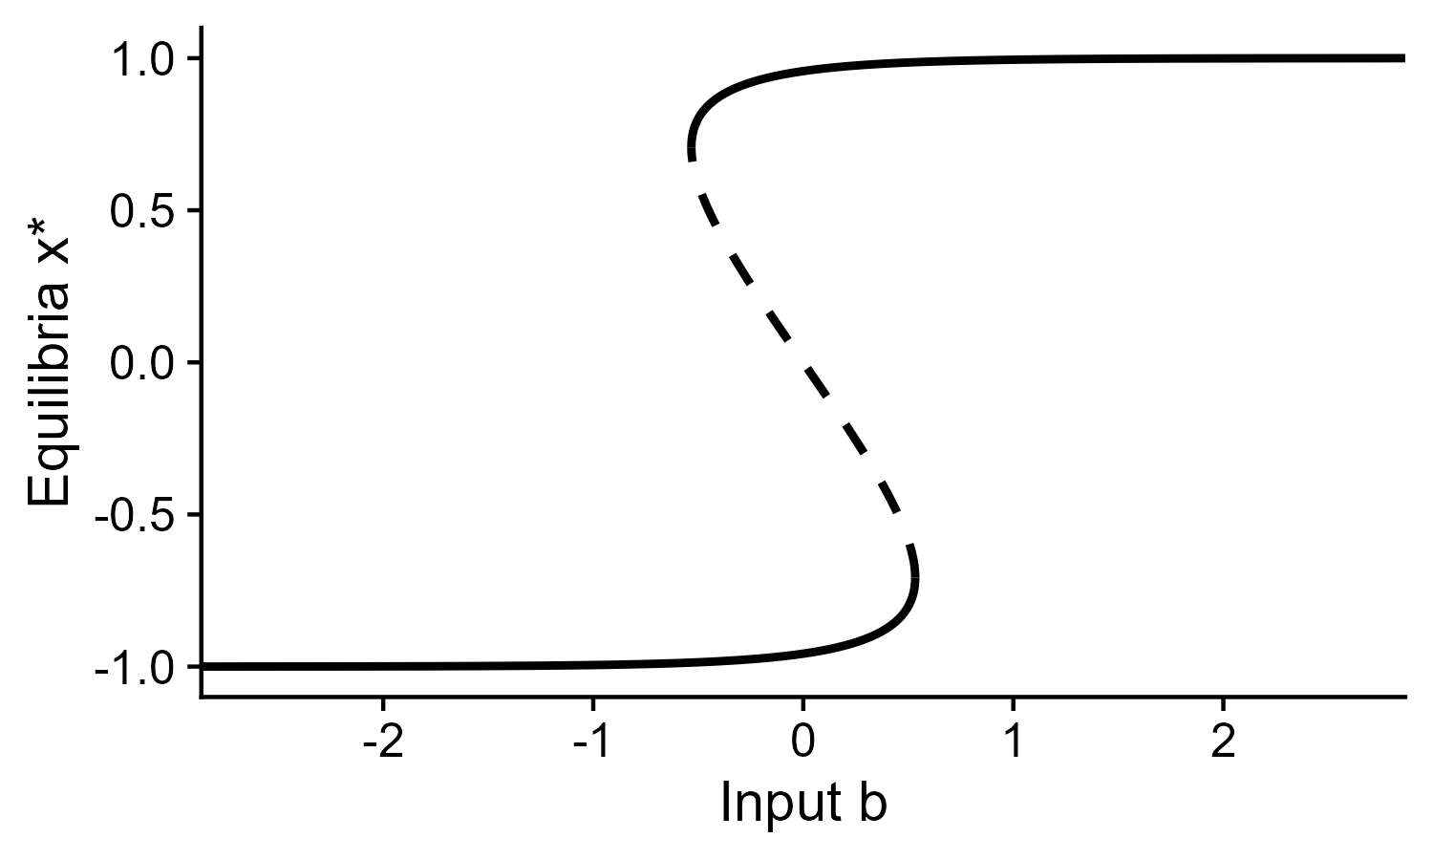
Unfolding in the nonlinear opinion dynamics model
Catastrophe plot
Multi stability can lead to hysteresis/memory/path dependence
Hysteresis is bad for flexible decision-making
Small changes in inputs can lead to big changes in decision

Slide 79
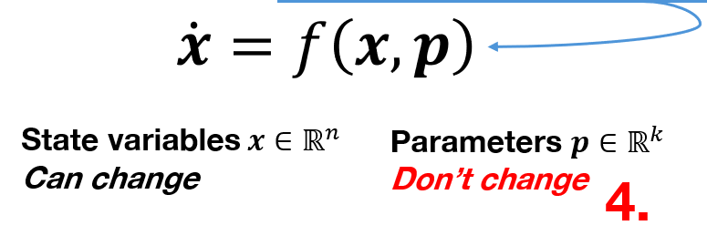
Unfolding in the nonlinear opinion dynamics model
Catastrophe plot
Problems
Multi stability can lead to hysteresis/memory/path dependence
Hysteresis is bad for flexible decision-making
Small changes in inputs can lead to big changes in decision
Dynamical systems treat inputs as parameters (they must change slowly compared to the decision’s dynamics)

Slide 80
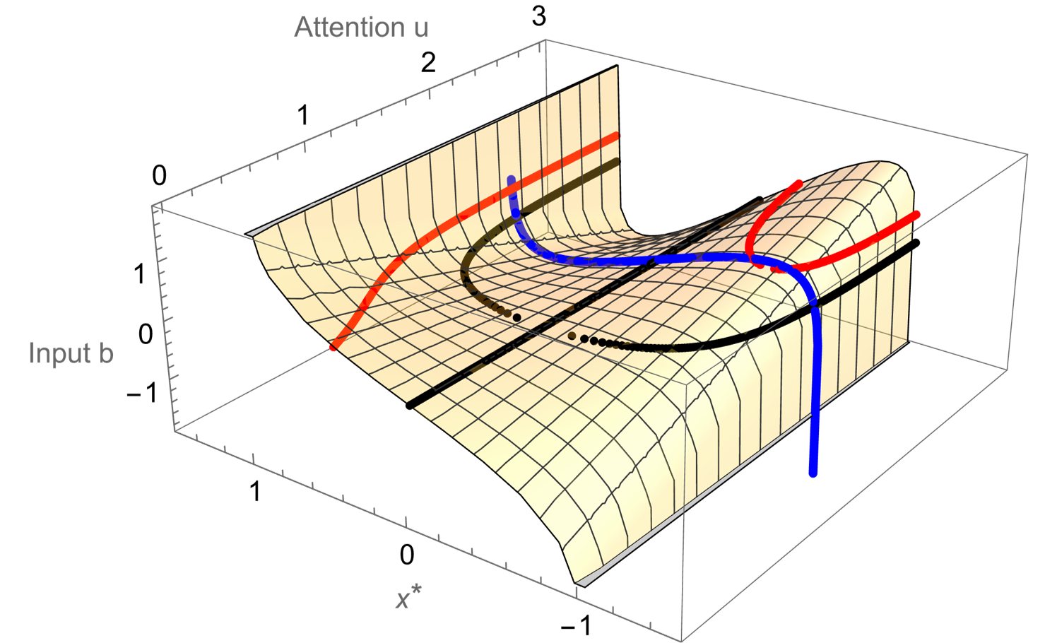
Unfolding in the nonlinear opinion dynamics model

Slide 81
Part 4 Separation of timescales
1
2
3
4
5
6

Slide 82

State dependent attention
Decision variable
Input or bias
$$\dot{x}=−dx+tanh⁡(ux+b)$$
Leak
Attention
Characteristic timescale
$$τ\dot{u}=−αu+u_{0}+kx^{2}$$
Gain
Baseline attention

Slide 83
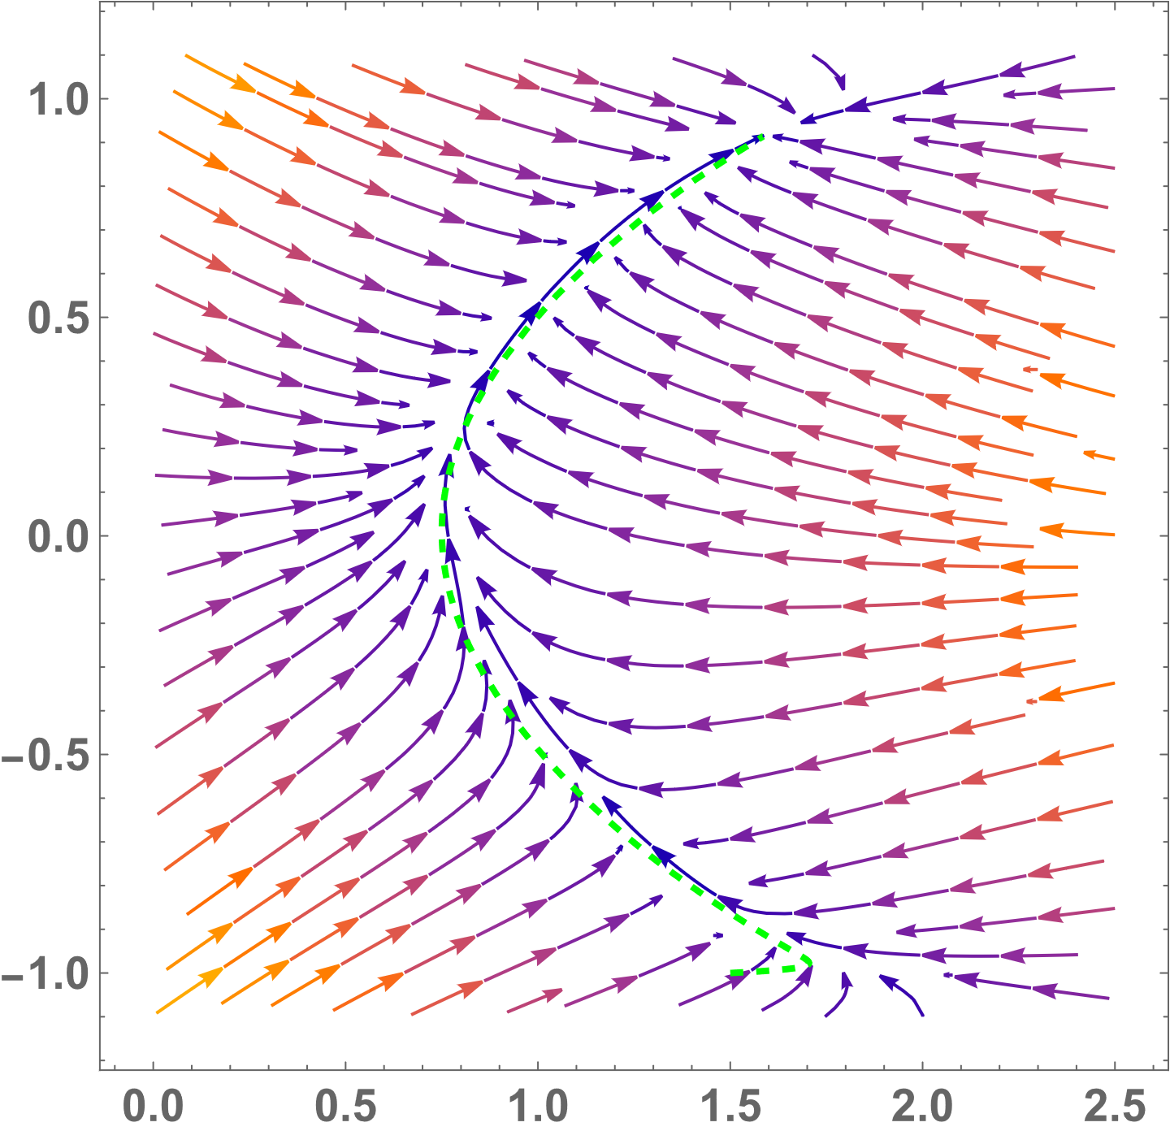
Phase plane
Trajectory
Decision variable
x
Attention
u

Slide 84
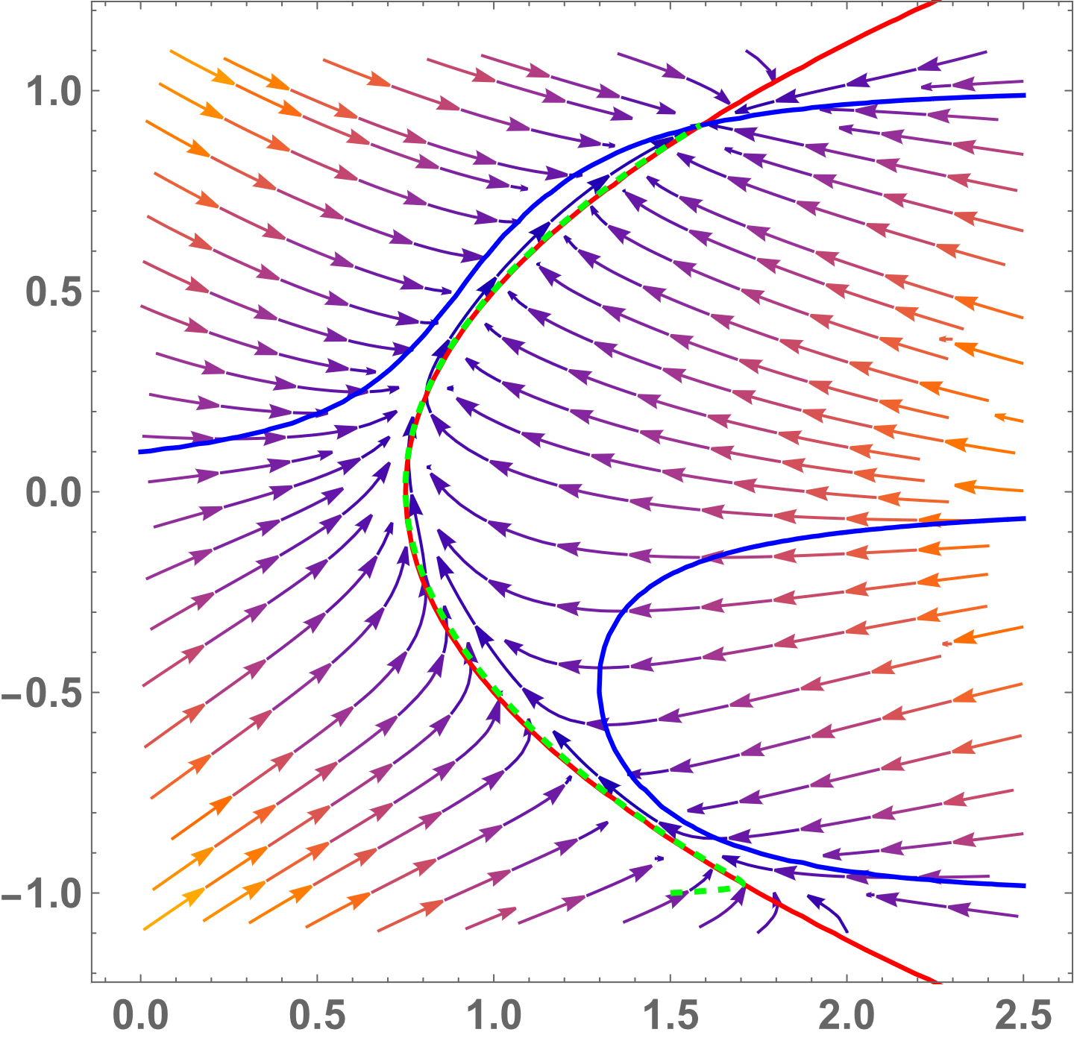


Nullclines
Decision variable
x
$$\dot{x}=f\left(x, u,p\right)=0$$
Attention
u
$$τ\dot{u}=g\left(x, u,p\right)=0$$

Slide 85
Nullclines
Global equilibria are where nullclines cross
Decision variable
x
$$\dot{x}=f\left(x, u,p\right)=0$$
Attention
u
$$τ\dot{u}=g\left(x, u,p\right)=0$$

Slide 86
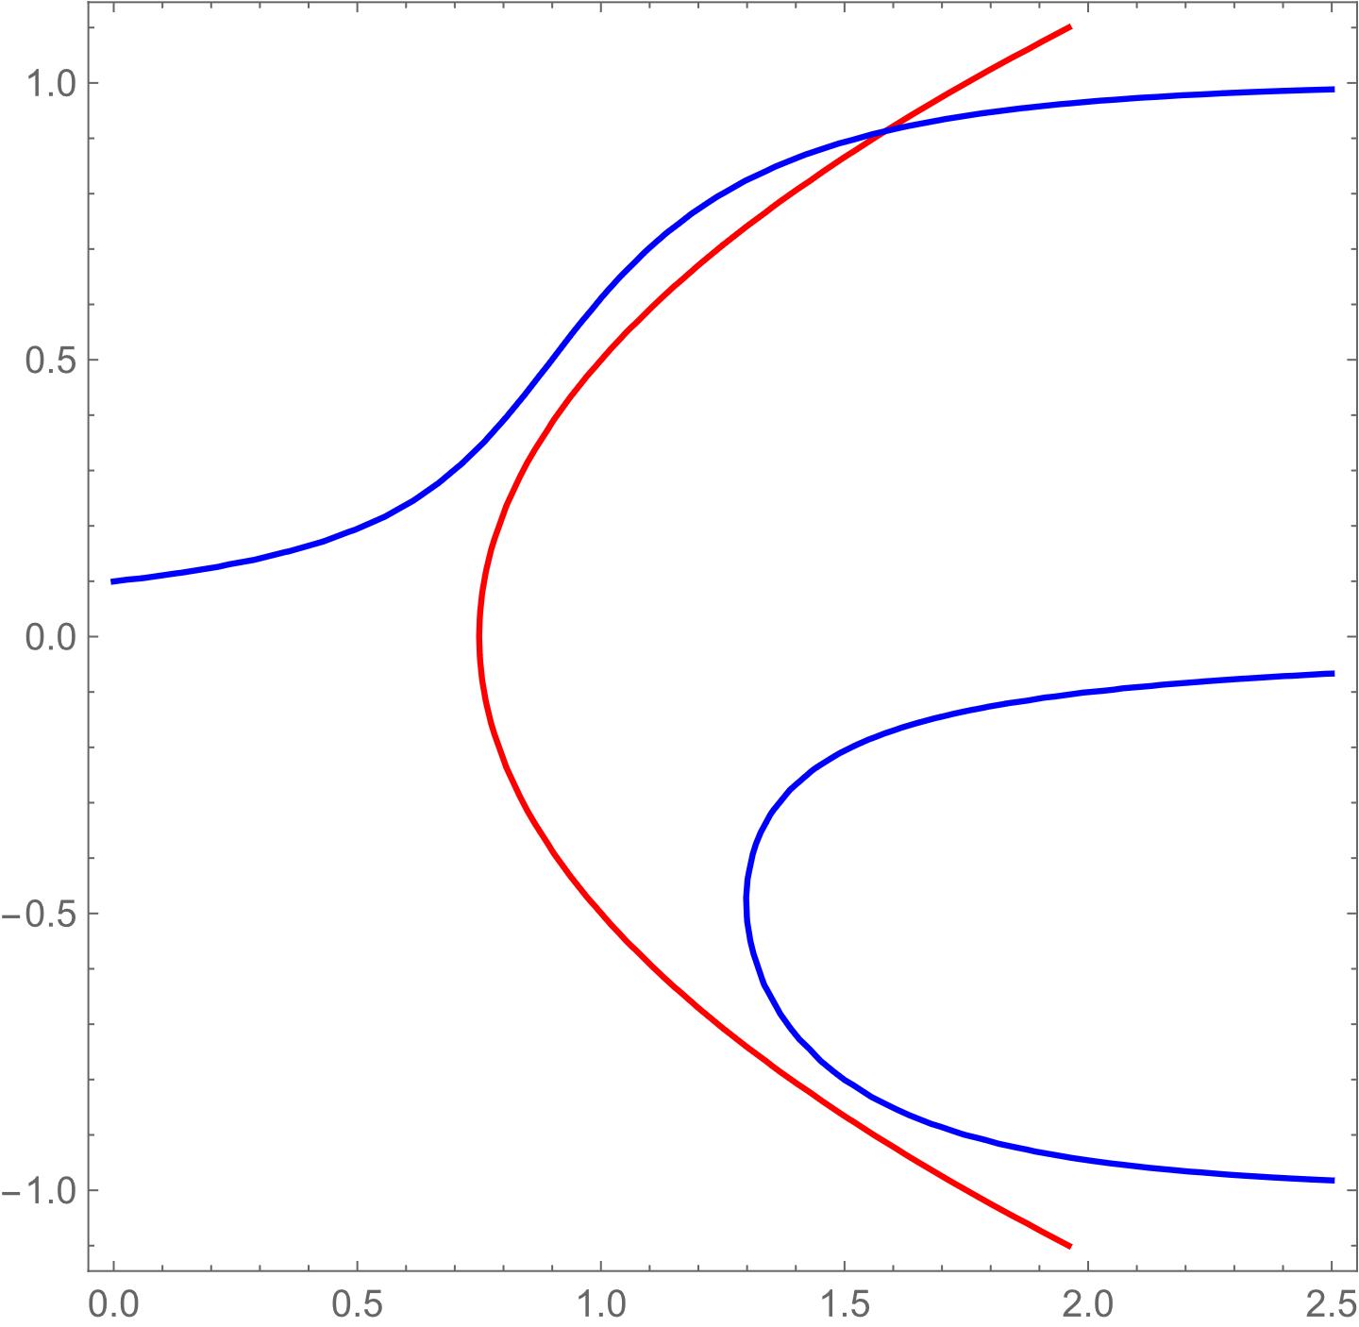


Separation of timescales
$\dot{x}=f\left(x, u,p\right)$
$τ\dot{u}=g\left(x, u,p\right)$
$τ$ is small
x
u

Slide 87
Separation of timescales
$\dot{x}=f\left(x, u,p\right)$
$τ\dot{u}=g\left(x, u,p\right)$
$τ$ is small
x
Which dynamic will be faster?
1)
2)
u

Slide 88
Separation of timescales
$\dot{x}=f\left(x, u,p\right)$
$τ\dot{u}=g\left(x, u,p\right)$
$τ$ is small
x
Which dynamic will be faster?
1)
2)
u

Slide 89
Separation of timescales
$\dot{x}=f\left(x, u,p\right)$
$τ\dot{u}=g\left(x, u,p\right)$
Decompose the dynamics along the systems’ dimensions
$τ$ is small
x
u

Slide 90


Separation of timescales
$\dot{x}=f\left(x, u,p\right)$
$τ\dot{u}=g\left(x, u,p\right)$
Decompose the dynamics along the systems’ dimensions
$τ$ is small
x
$$←g\left(x, u,p\right)<0$$
The fast dynamics occurs along attention u
$$g\left(x, u,p\right)>0→$$
u

Slide 91
Separation of timescales
$\dot{x}=f\left(x, u,p\right)$
$τ\dot{u}=g\left(x, u,p\right)$
Decompose the dynamics along the systems’ dimensions
$τ$ is small
x
$$←g\left(x, u,p\right)<0$$
The fast dynamics occurs along attention u
The slow dynamics occurs along the decision variable x
$$g\left(x, u,p\right)>0→$$
u

Slide 92
Separation of timescales
$\dot{x}=f\left(x, u,p\right)$
$τ\dot{u}=g\left(x, u,p\right)$
$τ$ is small
x
The fast dynamics occurs along attention u
The slow dynamics occurs along the decision variable x
Which arrows describe the slow dynamics?
1) left
2) right
u

Slide 93



Separation of timescales
$\dot{x}=f\left(x, u,p\right)$
$τ\dot{u}=g\left(x, u,p\right)$
$$f\left(x, u,p\right)<0$$
$τ$ is small
$$f\left(x, u,p\right)>0$$
x
The fast dynamics occurs along attention u
$$f\left(x, u,p\right)<0$$
The slow dynamics occurs along the decision variable x
Which arrows describe the slow dynamics?
1) left
2) right
u

Slide 94
Separation of timescales
$\dot{x}=f\left(x, u,p\right)$
$τ\dot{u}=g\left(x, u,p\right)$
u
You can consider the slow variable a parameter, along which there is an equilibrium branch for the fast variable
x (slow)

Slide 95
Separation of timescales
$\dot{x}=f\left(x, u,p\right)$
$τ\dot{u}=g\left(x, u,p\right)$
u
You can consider the slow variable a parameter, along which there is an equilibrium branch for the fast variable
If the state was not on the fast nullcline, the fast dynamics would take the state back to the fast nullcline
x (slow)

Slide 96
Separation of timescales
$\dot{x}=f\left(x, u,p\right)$
$τ\dot{u}=g\left(x, u,p\right)$
u
The dynamics mainly occur along the fast nullcline(s) in the direction indicated by the slow variable
If the state was not on the fast nullcline, the fast dynamics would take the state back to the fast nullcline
x (slow)

Slide 97

Ghost equilibria
When passing near previous global equilibria
the dynamics slow down

Slide 98
Ghost equilibria
When passing near previous global equilibria
the dynamics slow down
Dynamics always slow down near the critical point (critical slowing down)
Even if the equilibrium disappeared!
(the further away, the smaller the effect)

Slide 99
Part 5 Symmetries in dynamical systems
1
2
3
4
5
6

Slide 100
Why do we care about symmetries in dynamical systems?

Slide 101
Why do we care about symmetries in dynamical systems?
1) Model development
All decision-making systems should exhibit some symmetry. This models decision-making in absence of evidence.

Slide 102

Why do we care about symmetries in dynamical systems?
1) Model development
All decision-making systems should exhibit some symmetry. This models decision-making in absence of evidence.
Problem of symmetry-breaking: problem of deadlock (individual) and consensus formation (collective)
Buridan’s ass

Slide 103

Why do we care about symmetries in dynamical systems?
1) Model development
All decision-making systems should exhibit some symmetry. This models decision-making in absence of evidence.
Problem of symmetry-breaking: problem of deadlock (individual) and consensus formation (collective)
Buridan’s ass
Consensus formation

Slide 104
Why do we care about symmetries in dynamical systems?
1) Model development
2) Model analysis
All decision-making systems should exhibit some symmetry. This models decision-making in absence of evidence.
Problem of symmetry-breaking: problem of deadlock (individual) and consensus formation (collective)
A model with symmetry can be reduced and simplified.
Example: mapping between ring attractor (many dimensions) and drift-diffusion (one dimensional)
Buridan’s ass
Consensus formation

Slide 105








Symmetries in dynamical systems
$Equivariance:given a system \dot{x}=f\left(x,p\right)$, if for every solution x(t), γx(t) is also a solution, $the system$is symmetric with respect to γ (for our purposes γ is a matrix) (formal definition at the end).
$$\dot{x_{1}}=−δx_{1}+tanh⁡(u({α_{self}x}_{1}+{α_{other}x}_{2}))$$
$$\dot{x_{2}}=−δx_{2}+tanh⁡(u({α_{self}x}_{2}+{α_{other}x}_{1}))$$
$$α_{self}>0$$
$$α_{other}<0$$
$$α_{self}$$
$$α_{self}$$
$$α_{other}$$
$$x_{1}$$
$$x_{2}$$
$$α_{other}$$

Slide 106

Symmetries in dynamical systems
$Equivariance:given a system \dot{x}=f\left(x,p\right)$, if for every solution x(t), γx(t) is also a solution, $the system$is symmetric with respect to γ (for our purposes γ is a matrix) (formal definition at the end).
$$\dot{x_{1}}=−δx_{1}+tanh⁡(u({α_{self}x}_{1}+{α_{other}x}_{2}))$$
$$\dot{x_{2}}=−δx_{2}+tanh⁡(u({α_{self}x}_{2}+{α_{other}x}_{1}))$$
$$α_{self}>0$$
$$α_{other}<0$$
Two ways to establish symmetry:
Verify the criteria $\text{γ}f\left(x,p\right)=f\left(\text{γ}x,p\right)$ Proof:
$\dot{x}=f\left(x\right), y=\text{γ}x→\dot{y}=f\left(\text{y}\right)=f\left(\text{γ}x\right),\text{γ}\dot{x}=\text{γ}f\left(x\right)→\text{γ}f\left(x\right)=f\left(\text{γ}x\right)$

Slide 107
Symmetries in dynamical systems
$Equivariance:given a system \dot{x}=f\left(x,p\right)$, if for every solution x(t), γx(t) is also a solution, $the system$is symmetric with respect to γ (for our purposes γ is a matrix) (formal definition at the end).
$$\dot{x_{1}}=−δx_{1}+tanh⁡(u({α_{self}x}_{1}+{α_{other}x}_{2}))$$
$$\dot{x_{2}}=−δx_{2}+tanh⁡(u({α_{self}x}_{2}+{α_{other}x}_{1}))$$
$$α_{self}>0$$
$$α_{other}<0$$
Two ways to establish symmetry:
Verify the criteria $\text{γ}f\left(x,p\right)=f\left(\text{γ}x,p\right)$ Proof:
$\dot{x}=f\left(x\right), y=\text{γ}x→\dot{y}=f\left(\text{y}\right)=f\left(\text{γ}x\right),\text{γ}\dot{x}=\text{γ}f\left(x\right)→\text{γ}f\left(x\right)=f\left(\text{γ}x\right)$
Which equation does not hold for non equivariant systems?

Slide 108

Symmetries in dynamical systems
$Equivariance:given a system \dot{x}=f\left(x,p\right)$, if for every solution x(t), γx(t) is also a solution, $the system$is symmetric with respect to γ (for our purposes γ is a matrix) (formal definition at the end).
$$\dot{x_{1}}=−δx_{1}+tanh⁡(u({α_{self}x}_{1}+{α_{other}x}_{2}))$$
$$\dot{x_{2}}=−δx_{2}+tanh⁡(u({α_{self}x}_{2}+{α_{other}x}_{1}))$$
$$α_{self}>0$$
$$α_{other}<0$$
Two ways to establish symmetry:
Verify the criteria $\text{γ}f\left(x,p\right)=f\left(\text{γ}x,p\right)$ Proof:
$\dot{x}=f\left(x\right), y=\text{γ}x→\dot{y}=f\left(\text{y}\right)=f\left(\text{γ}x\right),\text{γ}\dot{x}=\text{γ}f\left(x\right)→\text{γ}f\left(x\right)=f\left(\text{γ}x\right)$
Which equation does not hold for non equivariant systems?
Correct change of variable: $\dot{{\text{γ}}^{−1}y}=f\left({\text{γ}}^{−1}y\right)$

Slide 109







Symmetries in dynamical systems
$Equivariance:given a system \dot{x}=f\left(x,p\right)$, if for every solution x(t), γx(t) is also a solution, $the system$is symmetric with respect to γ (for our purposes γ is a matrix) (formal definition at the end).
$$\dot{x_{1}}=−δx_{1}+tanh⁡(u({α_{self}x}_{1}+{α_{other}x}_{2}))$$
$$\dot{x_{2}}=−δx_{2}+tanh⁡(u({α_{self}x}_{2}+{α_{other}x}_{1}))$$
$$α_{self}>0$$
$$α_{other}<0$$
Two ways to establish symmetry:
Verify the criteria $\text{γ}f\left(x,p\right)=f\left(\text{γ}x,p\right)$ Proof:
$\dot{x}=f\left(x\right), y=\text{γ}x→\dot{y}=f\left(\text{y}\right)=f\left(\text{γ}x\right),\text{γ}\dot{x}=\text{γ}f\left(x\right)→\text{γ}f\left(x\right)=f\left(\text{γ}x\right)$
2) Just look at the vector field
a)
$$\left(\begin{matrix}1 & 0 \\ 0 & −1\end{matrix}\right)$$
b)
$$\left(\begin{matrix}−1 & 0 \\ 0 & −1\end{matrix}\right)$$
Under what transformation(s) is the system equivariant:
$$\left(\begin{matrix}0 & 1 \\ 1 & 0\end{matrix}\right)$$
$$\left(\begin{matrix}−1 & 0 \\ 0 & 1\end{matrix}\right)$$
c)
d)
e)
$$\left(\begin{matrix}0 & −1 \\ 1 & 0\end{matrix}\right)$$
f)
$$\left(\begin{matrix}0 & 1 \\ −1 & 0\end{matrix}\right)$$

Slide 110


Symmetries in dynamical systems
$Equivariance:given a system \dot{x}=f\left(x,p\right)$, if for every solution x(t), γx(t) is also a solution, $the system$is symmetric with respect to γ (for our purposes γ is a matrix) (formal definition at the end).
$$\dot{x_{1}}=−δx_{1}+tanh⁡(u({α_{self}x}_{1}+{α_{other}x}_{2}))$$
$$\dot{x_{2}}=−δx_{2}+tanh⁡(u({α_{self}x}_{2}+{α_{other}x}_{1}))$$
$$α_{self}>0$$
$$α_{other}<0$$
Two ways to establish symmetry:
Verify the criteria $\text{γ}f\left(x,p\right)=f\left(\text{γ}x,p\right)$ Proof:
$\dot{x}=f\left(x\right), y=\text{γ}x→\dot{y}=f\left(\text{y}\right)=f\left(\text{γ}x\right),\text{γ}\dot{x}=\text{γ}f\left(x\right)→\text{γ}f\left(x\right)=f\left(\text{γ}x\right)$
2) Just look at the vector field
a)
$$\left(\begin{matrix}1 & 0 \\ 0 & −1\end{matrix}\right)$$
b)
$$\left(\begin{matrix}−1 & 0 \\ 0 & −1\end{matrix}\right)$$
Under what transformation(s) is the system equivariant:
$$\left(\begin{matrix}0 & 1 \\ 1 & 0\end{matrix}\right)$$
$$\left(\begin{matrix}−1 & 0 \\ 0 & 1\end{matrix}\right)$$
c)
d)
e)
$$\left(\begin{matrix}0 & −1 \\ 1 & 0\end{matrix}\right)$$
f)
$$\left(\begin{matrix}0 & 1 \\ −1 & 0\end{matrix}\right)$$

Slide 111

Symmetries in dynamical systems
$Equivariance:given a system \dot{x}=f\left(x,p\right)$, if for every solution x(t), γx(t) is also a solution, $the system$is symmetric with respect to γ (for our purposes γ is a matrix) (formal definition at the end).
$$\dot{x_{1}}=−δx_{1}+tanh⁡(u({α_{self}x}_{1}+{α_{other}x}_{2}))$$
$$\dot{x_{2}}=−δx_{2}+tanh⁡(u({α_{self}x}_{2}+{α_{other}x}_{1}))$$
$$α_{self}>0$$
$$α_{other}<0$$
$S_{n}$ Symmetry group (permutations of n options) can be used to model multi-option decision-making
a)
$$\left(\begin{matrix}1 & 0 \\ 0 & −1\end{matrix}\right)$$
b)
$$\left(\begin{matrix}−1 & 0 \\ 0 & −1\end{matrix}\right)$$
Under what transformation(s) is the system equivariant:
$$\left(\begin{matrix}0 & 1 \\ 1 & 0\end{matrix}\right)$$
$$\left(\begin{matrix}−1 & 0 \\ 0 & 1\end{matrix}\right)$$
c)
d)
e)
$$\left(\begin{matrix}0 & −1 \\ 1 & 0\end{matrix}\right)$$
f)
$$\left(\begin{matrix}0 & 1 \\ −1 & 0\end{matrix}\right)$$

Slide 112

Symmetries in dynamical systems
$Equivariance:given a system \dot{x}=f\left(x,p\right)$, if for every solution x(t), γx(t) is also a solution, $the system$is symmetric with respect to γ (for our purposes γ is a matrix) (formal definition at the end).
$$\dot{x_{1}}=−δx_{1}+tanh⁡(u({α_{self}x}_{1}+{α_{other}x}_{2}))$$
$$\dot{x_{2}}=−δx_{2}+tanh⁡(u({α_{self}x}_{2}+{α_{other}x}_{1}))$$
$$α_{self}>0$$
$$α_{other}<0$$
$S_{n}$ Symmetry group (permutations of n options) can be used to model multi-option decision-making
Is the shape symmetric under $S_{4}$?
No
Yes
1
2
4
3

Slide 113

Symmetries in dynamical systems
$Equivariance:given a system \dot{x}=f\left(x,p\right)$, if for every solution x(t), γx(t) is also a solution, $the system$is symmetric with respect to γ (for our purposes γ is a matrix) (formal definition at the end).
$$\dot{x_{1}}=−δx_{1}+tanh⁡(u({α_{self}x}_{1}+{α_{other}x}_{2}))$$
$$\dot{x_{2}}=−δx_{2}+tanh⁡(u({α_{self}x}_{2}+{α_{other}x}_{1}))$$
$$α_{self}>0$$
$$α_{other}<0$$
$S_{n}$ Symmetry group (permutations of n options) can be used to model multi-option decision-making
Is the shape symmetric under $S_{4}$?
No
Yes
1
2
1
3
4
3
4
2

Slide 114
Symmetries in dynamical systems
$Equivariance:given a system \dot{x}=f\left(x,p\right)$, if for every solution x(t), γx(t) is also a solution, $the system$is symmetric with respect to γ (for our purposes γ is a matrix) (formal definition at the end).
$$\dot{x_{1}}=−δx_{1}+tanh⁡(u({α_{self}x}_{1}+{α_{other}x}_{2}))$$
$$\dot{x_{2}}=−δx_{2}+tanh⁡(u({α_{self}x}_{2}+{α_{other}x}_{1}))$$
$$α_{self}>0$$
$$α_{other}<0$$
Symmetric systems can have non−symmetric solutions: this is symmetry breaking

Slide 115
Part 6 The ring attractor
1
2
3
4
5
6

Slide 116


Network coupling u
Ring attractor
Direction
Interaction’s kernel
$$\dot{z}=−z+tanh. \left(u M z+b\right)$$
Targets’ inputs
Short-range excitation and long-range inhibition

Slide 117

Network coupling u
Ring attractor
Direction
Interaction’s kernel
$$\dot{z}=−z+tanh. \left(u M z+b\right)$$
Targets’ inputs
Multi-option decision-making
Circular symmetry $C_{n}$

Slide 118


Reduced model dynamic

Slide 119
Reduced model dynamic
What bifurcations are these?

Slide 120


Selective ultra-sensitivity
A ring attractor showing off his Fourier glasses
Mathematica notebook for designing input in frequency domain

Slide 121





Selective ultra-sensitivity
At the critical point, a decision-maker responds to inputs that have a non-zero component when projected along the center manifold (one of the dynamics’ dominant eigenvector)
Partially aligned input
Input $υ$
System dynamics
​${proj}_{v}υ$
Dominant
eigenvector v
Misaligned input
Input $υ$
System dynamics
Dominant
eigenvector v

Slide 122
Selective ultra-sensitivity
At the critical point, a decision-maker responds to inputs that have a non-zero component when projected along the center manifold (one of the dynamics’ dominant eigenvector)
This is linked to infinite susceptibility
For random inputs, dimensionality decreases probability of alignment
Partially aligned input
Input $υ$
System dynamics
​${proj}_{v}υ$
Dominant
eigenvector v
Misaligned input
Input $υ$
System dynamics
Dominant
eigenvector v

Slide 123
Selective ultra-sensitivity
At the critical point, a decision-maker responds to inputs that have a non-zero component when projected along the center manifold (one of the dynamics’ dominant eigenvector)
This is linked to infinite susceptibility
For random inputs, dimensionality decreases probability of alignment
For all circulant unimodal kernels, the center manifold is spanned by the Fourier basis of the first harmonic, which modes are the dominant eigenvalues. Every linear combination of the Fourier basis of a given harmonic is also one of its corresponding eigenvector (which preserves circulant symmetry of opinion formation by encoding phase). The center manifold for the ring attractor is a plane (2-d)
Partially aligned input
Input $υ$
System dynamics
​${proj}_{v}υ$
Dominant
eigenvector v
Misaligned input
Input $υ$
System dynamics
Dominant
eigenvector v

Slide 125



Caution
When linearization fails $nullity(J\left(x^{∗},p^{∗}\right))≠0$, different definitions of stability (Lyapunov) can be used and strange things can happen: a point can be stable but not attractive (e.g., Lotka-Volterra predator-prey, undampened pendulum) or attractive but unstable (e.g., in excitable systems). See end if curious
Lyapunov stable: if for every distance ε >0 from the equilibrium there exists a starting condition within δ>0 for which the trajectory remains within ε, the equilibrium is Lyapunov stable
Why is δ needed in the definition?
Which points are stable but not attractive and attractive but not stable?

Slide 126
Caution
When linearization fails $nullity(J\left(x^{∗},p^{∗}\right))≠0$, different definitions of stability (Lyapunov) can be used and strange things can happen: a point can be stable but not attractive (e.g., Lotka-Volterra predator-prey, undampened pendulum) or attractive but unstable (e.g., in excitable systems). See end if curious
Lyapunov stable: if for every distance ε >0 from the equilibrium there exists a starting condition within δ>0 for which the trajectory remains within ε, the equilibrium is Lyapunov stable
Why is δ needed in the definition?
Lyapunov unstable but attractive
Which points are stable but not attractive and attractive but not stable?
Lyapunov stable but not attractive

Slide 127

$Equivariance:given a system \dot{x}=f\left(x,p\right)$, if for every solution x(t), γx(t) is also a solution, $the system$is Γ-equivariant (symmetric under the action of a member of the group Γ). A group is always defined in respect to 1) an operation and 2) its members. A group is a collection of elements that are closed in respect to an operation that has associative property, and identity element, and an inverse. For our purposes, γ is a matrix and the operation is the dot product.

