Slide 1
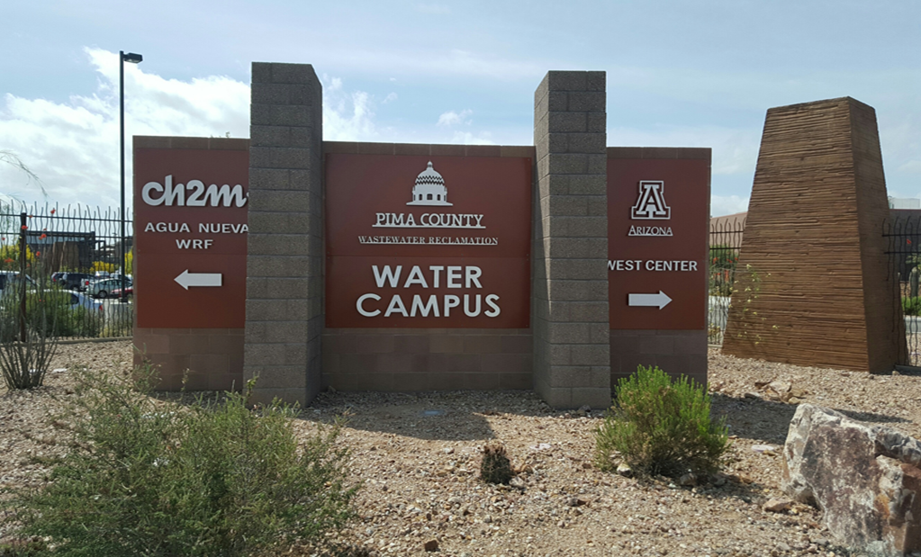

Minimizing Environmental Infectious Agent Transmission in the Built Environment: A Holistic Approach
Presenter:
Charles P. Gerba
Professor
Department of Environmental Science
University of Arizona

Slide 2
Studies on Transmission and control of infectious Microbes in the Built Environment
Identifying most contaminated sites
Microbiome of toilets
Targeting sites for maximum benefit of cleaning/disinfectants
Frequency of cleaning/disinfecting
Assessing impact of cleaning/disinfecting interventions in exposure reduction to pathogens
Quantifying reduction in risk of infection from interventions- QMRA
Transport/dissemination of viruses in the indoor environment
Re-suspension of viruses
Human activities

Slide 3
What is a Healthy Home – Can we define to minimize the Risk of Environmentally Transmitted Diseases?
Can we use QMRA to quantify risk of infection?
Should we look at individual site risks or integrate all risks from all sites and routes of exposure? (fomite + aerosol?)
Exposure is complex
Human behavior
Building design
Nature of materials (fabrics, vinyl, porcelain, etc.)
Activities (cleaning, walking, food preparation, etc.)
What is our goal (acceptable risk)
Should we only focus on the greatest risk or the or the ones we can have the most benefit with the least cost/environmental impact

Slide 4
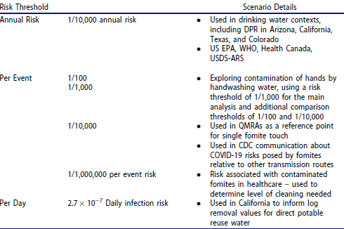
Examples of QMRA Targets (Wilson et al 2024 J. Occup. Environ. Hygiene)

Slide 5
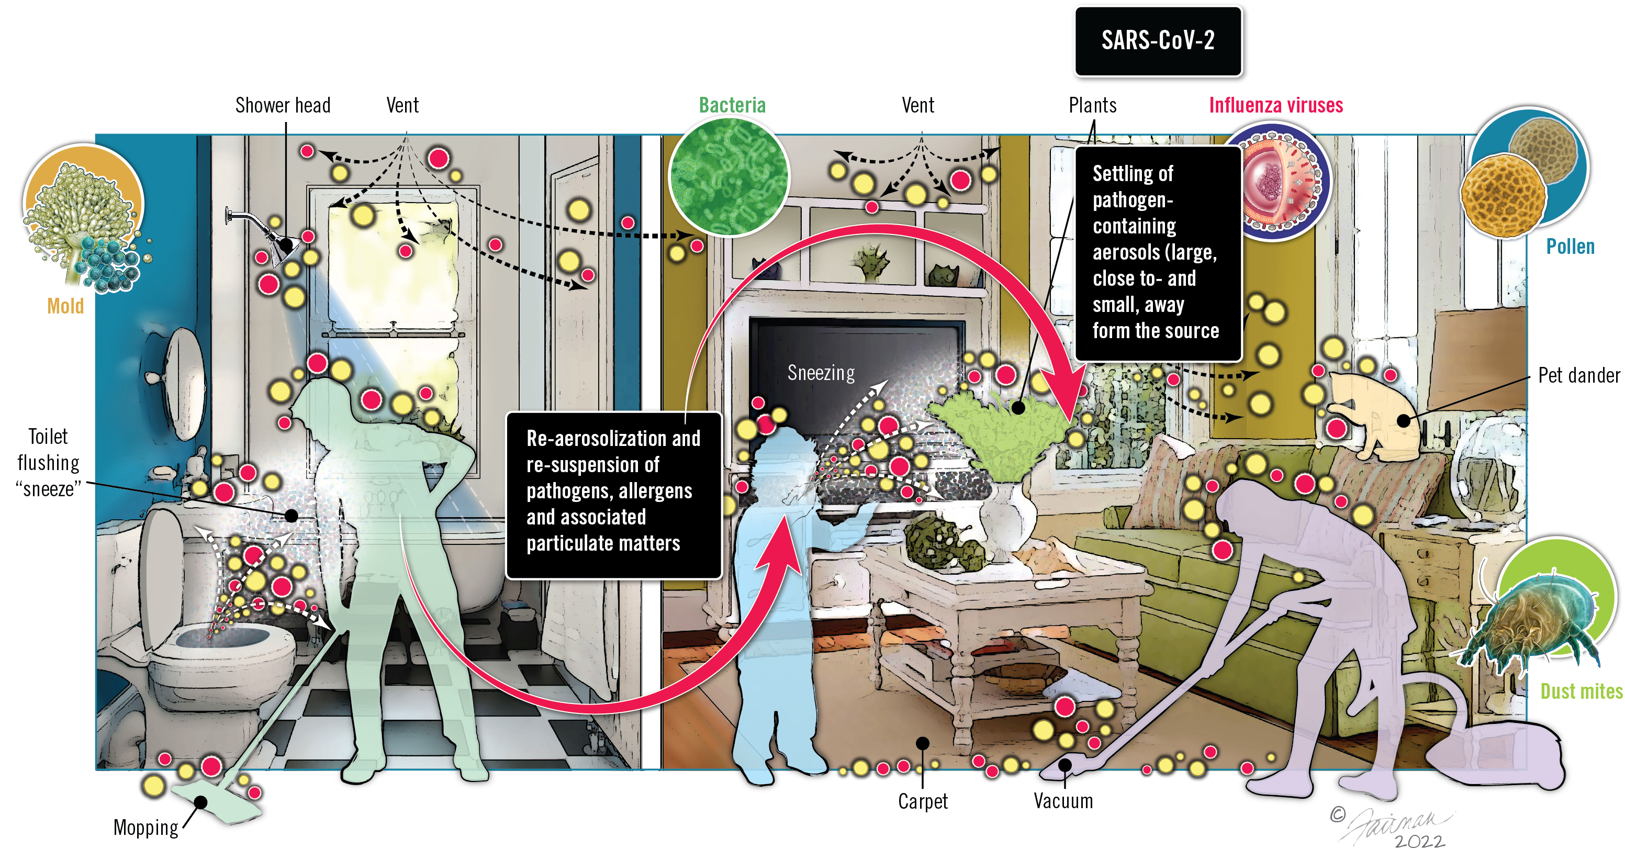
Pathogen movement in the built environment is complex

Slide 6
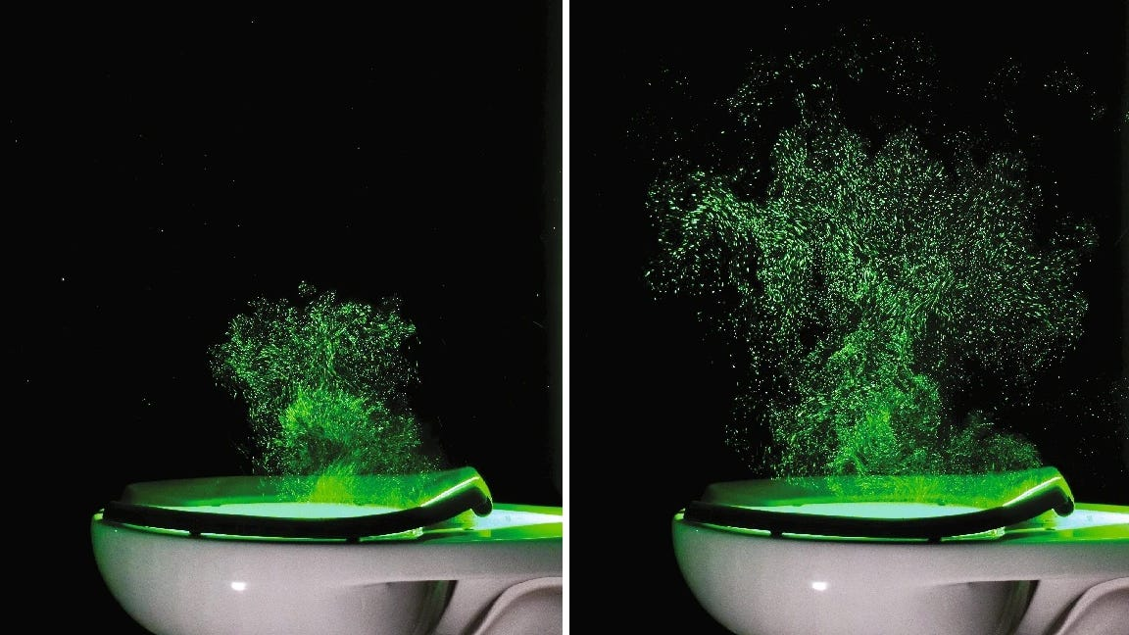
Why are we Focused on toilets?

Slide 7
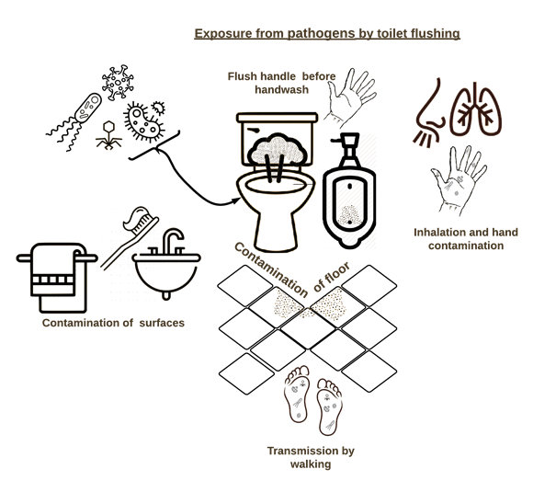

Slide 8
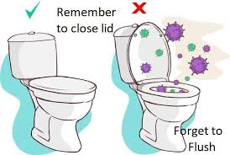
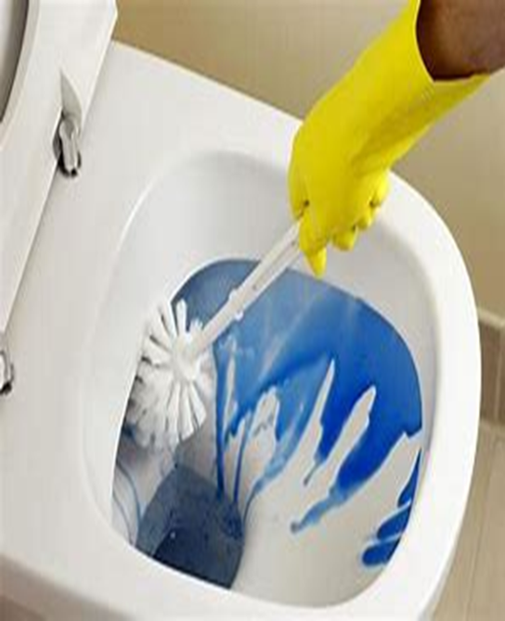
Objectives:
Determine impact of lid closure on fomite contamination in the restroom
Determine impact of cleaning toilet with and with out a disinfectant cleaner

Slide 9
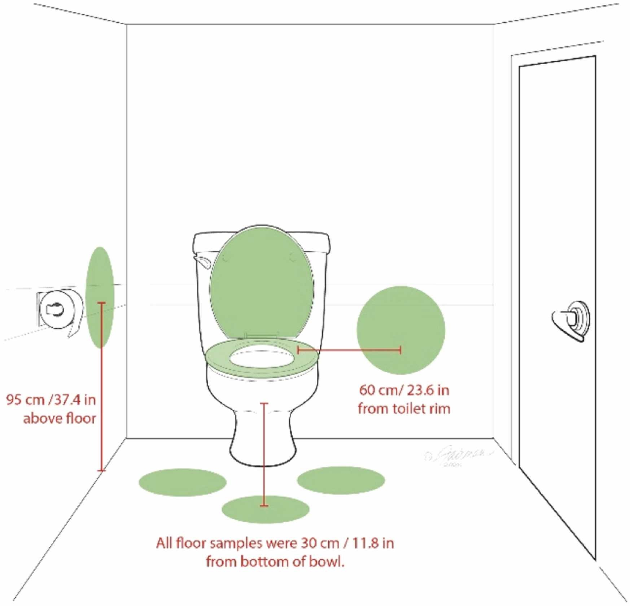
Fomite Sample Locations in Restroom

Slide 10
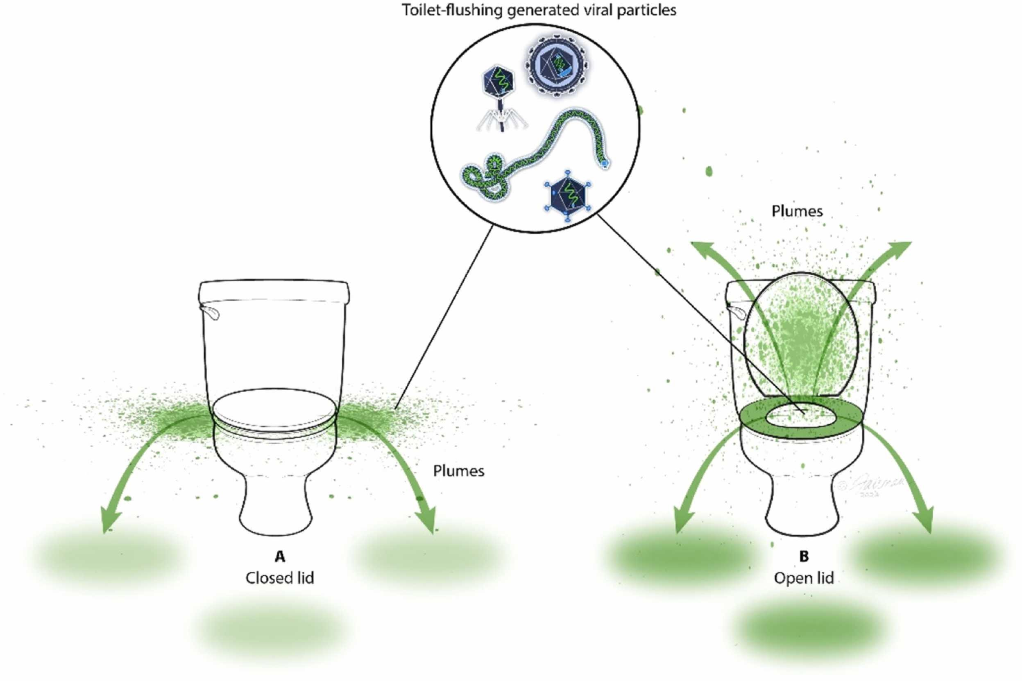

Slide 11
Impact of home toilet lid position prior to flushing on MS2 virus contamination of toilet surfaces
Lid Position | Toilet Lid PFU/ 100 cm² |  | Toilet Seat PFU/100 cm²
 | Top | Bottom | Top | Bottom
Up | 1.70 | 1.70 | 6.80 | 7.85
Down | 1.72 | 1.65 | 5.62 | 7.62
10¹⁴ PFU added to bowl before flush
Note: no statistical difference on contamination with lip up or down

Slide 12
Impact of home toilet lid position prior to flushing on MS2 virus contamination of floor and restroom walls
Lid Position | Floor PFU/ 100 cm² |  | Wall PFU/100 cm²
 | Left of toilet | Right of toilet | Left of toilet | Right of toilet
Up | 3.64 | 6.23 | 2.31 | 1.77
Down | 5.11 | 4.81 | 1.61 | 1.86
10¹⁴ PFU added to bowl before flush
Note: no statistical difference on contamination with lid up or down

Slide 13
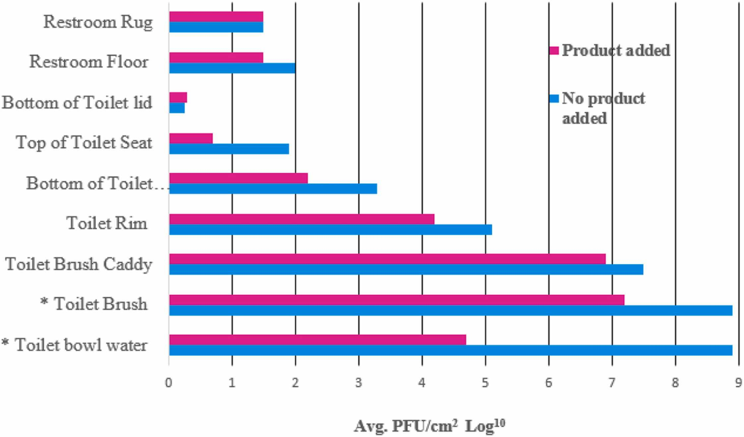
Impact of toilet bowl cleaning with and without a disinfectant product on virus contamination of restroom

Slide 14
Conclusions
Closure of toilet lid had no significant impact of viral contamination of the toilet seat, lid or surrounding areas (floor, walls)
Cleaning the toilet bowel with a brush resulted in contamination of the toilet seat, lid or surrounding areas (floor, walls)
Contamination was reduced if a disinfectant was used during toilet bowl cleaning

Slide 15
What is the Optimal Cleaning Frequency for a home Restroom?
Compared using one product vs. multiple products.
Cleaning frequency
Every 1, 2, 3 and 7 days.
Measured total bacteria, E. coli/coliform levels as reference for fecal contamination.

Slide 16
Cleaning Phase and Products Used*: Toilet Surfaces
*Applied as per use-directions provided

Slide 17
Cleaning Phase and Products Used: Restroom Surfaces

Slide 18

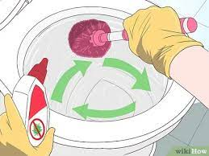

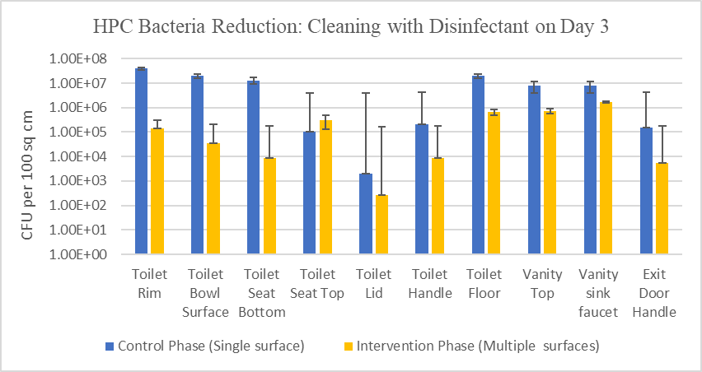
94.5% risk reduction
99.7% reduction risk reduction – 2X per week
For optimal microbe reduction, use multiple disinfectants to clean multiple bathroom surfaces twice a week.

Slide 19
Risk of norovirus infection after cleaning twice a week with Bundle approach of cleaning products
Site | One touch event |  | Percent reduction in risk
 | Before* | After** | After bundle use
Vanity countertop | 1.14×10⁻¹ | ≤3.30×10⁻⁴ | ≥99.7
Toilet seat | 5.8×10⁻³ | <3.30×10⁻⁴ | ≥94.3

Slide 20
Summary
Toilet flushing results in both air and fomite microbial contamination in the restroom
Closing the toilet lid does not result in significant reduction in restroom contamination
Best control of microbial contamination resulted from cleaning/disinfecting the restroom twice a week with a selected bundle of products
Probability of infection by norovirus was reduced by greater than 90% by touching the toilet seat and vanity top following intervention.

Slide 21
Future Work/Questions
Is cleaning/disinfecting frequency influenced by
Toilet design
Flushing mechanisms (water pressure)
Products used for cleaning/disinfection
Design of Restroom (materials – vinyl vs. porcelain)
Number and age of household inhabitants
Environmental factors (relative humidity & temperature)

