Slide 1
Air-surface-air nexus in viruses spread indoor: breaking the chain of infection
M. Khalid Ijaz, DVM, MSc(Honors), PhD, FRSPH
Director of Scientific Affairs
Global Research & Development for Lysol and Dettol
Reckitt Benckiser LLC
One Philips Parkway, Montvale, NJ 07645, USA
Leeds / Healthy buildings – January 23, 2025

Slide 2
outline
1
Source text is set in 6pt and goes here
Viruses Spread indoor in the backdrop of SARS-CoV-2/COVID-19 Pandemic & Noroviruses in restrooms
2
Role of air and fomites in virus transmission
3
Lysol Air Sanitizer: protocol development and use in assessment against airborne pathogens
4
Toilet flush generated aerosolized pathogens and cross-contamination reduction by Lysol Air Sanitizer
5
Summary
Leeds / Healthy buildings – January 23, 2025

Slide 3
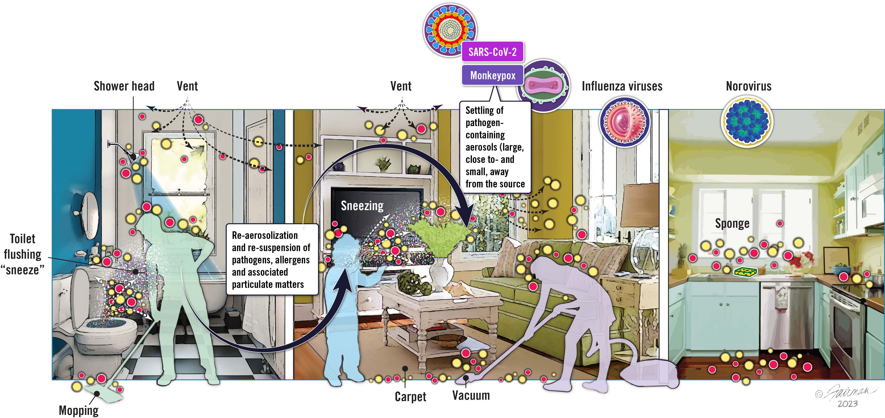
Pathogens spread indoors: Air-surfaces nexus – dynamic interdependencies & opportunities for re-aerosolization of such pathogens
Toilets sneeze as well!
Droplets directly or indirectly [contaminated surfaces touch]
Aerosols carrying pathogens
Re-aerosolized pathogens
*Predisposing to Air-surface-air nexus!
These sources may include humans, pets, plants, plumbing systems including operational toilets, shower head, heating, ventilation, vacuuming, mopping, air-conditioning systems; resuspension of settled dust indoor. The red and yellow dots represent human pathogens or harmless microorganisms. Ijaz et .al., 2023. Environmental dissemination of respiratory viruses: dynamic interdependencies of respiratory droplets, aerosols, aerial fomites, high-touch environmental surfaces, and contribution of viral re-aerosolization / https://peerj.com/articles/16420/
Leeds / Healthy buildings – January 23, 2025
Notes:
Activities such as Sneezing, coughing, and even talking, vacuuming, and flushing toilet as I mentioned earlier, can produce pathogens-containing aerosol.
Settled droplet can potentially become airborne and become exposure risk to bystanders (don’t have time to go in details, but we’re working on this aspect as well).
PM2.5 can be double edge sword – ACE2 receptor expression, could potentially act as carrier

Slide 4
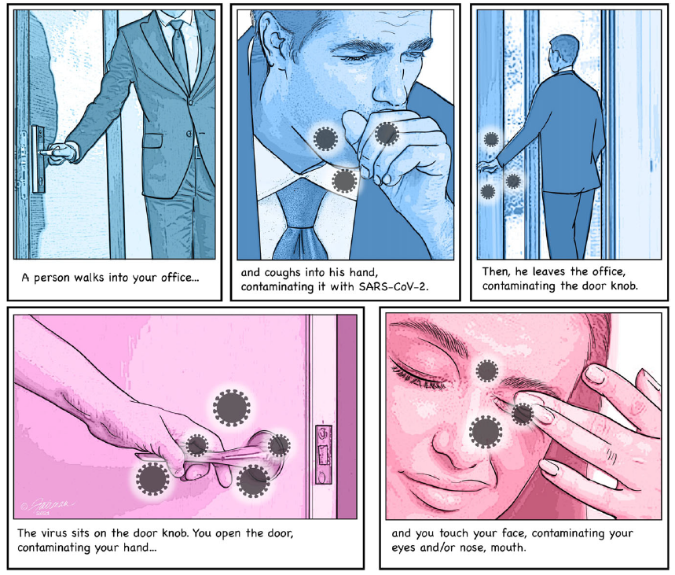
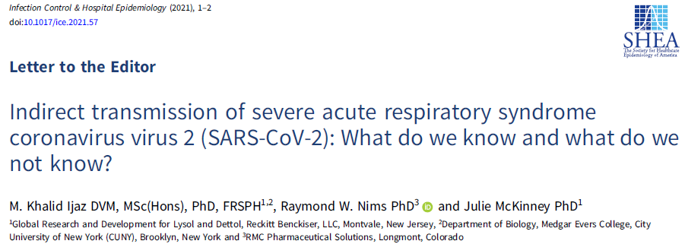
SARS-CoV-2 Transmission from one person to another through virus-contaminated HITES
Ijaz et al 2021
Leeds / Healthy buildings – January 23, 2025
Notes:
US and other from University of Birmingham (Prof Zhang group) and University of Calgary (Prof Conley’s group) questioned eliminating role of droplets/fomites in transmission.
-> Given virus can survive on fomites, the scenario its suggested a possible route – we questioned what’s the fate gravitationally settled droplet? The question is, can we separate airborne vs fomites mode of transmission? Aren’t these interrelated?

Slide 5
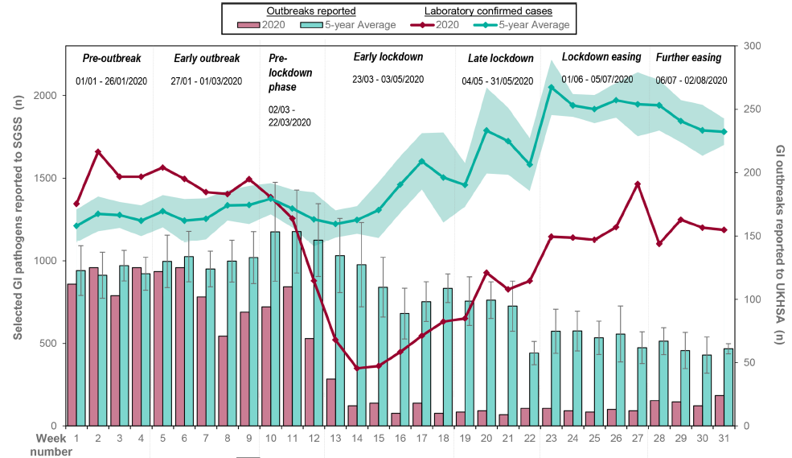
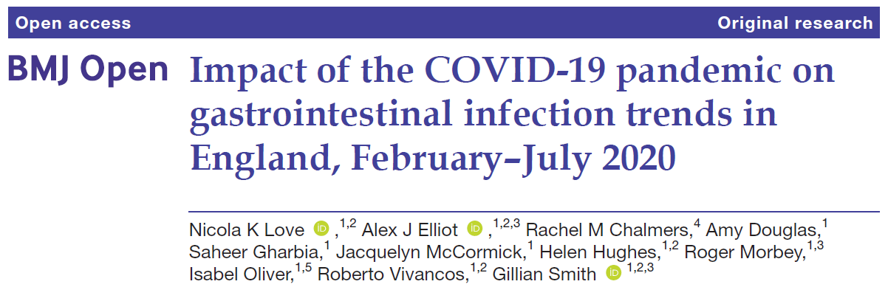
Public Health Measures during COVID-19 & GI outbreaks/pathogens in 2020 compared to 5 years wkly
Love et al 2022
Drivers in changes of behavior/applications of NPIs including
Mask
Improved hand hygiene
Social distancing
*Enteric pathogens: Campylobacter spp, STEC O157, STEC non-O157, Listeria spp, non-typhoidal Salmonella spp, typhoidal Salmonella, Shigella spp, norovirus, Cryptosporidium spp and Giardia sp.
Leeds / Healthy buildings – January 23, 2025

Slide 6
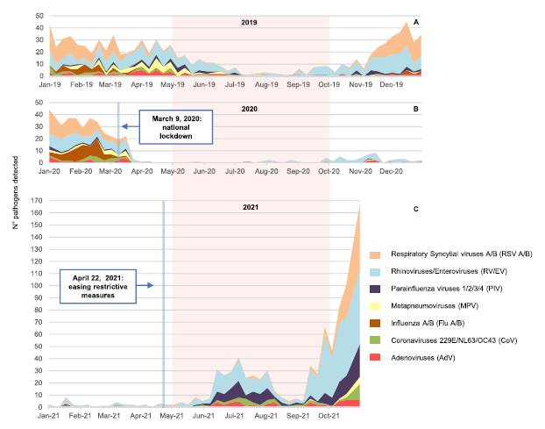
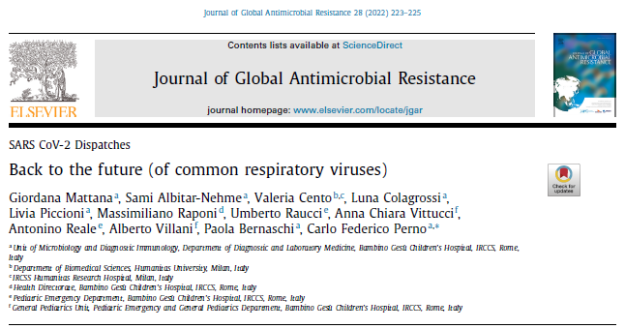
Number of different viral pathogens detected in (a) January–December 2019, (b) January–December 2020 and (c) January–October 2021 - Italy
Mattana et al 2023
The pink area highlights the three periods of five months (May–September) with the highest temperature, and the white area highlights the months with the lowest temperature (January–April and October–December).
Leeds / Healthy buildings – January 23, 2025
Notes:
Notice the respiratory before the Pandemic 2019, during Pandemic 2020, and relaxing time during 2021 w/resurgence of viruses

Slide 7
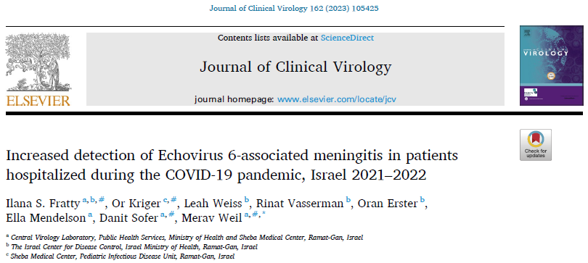
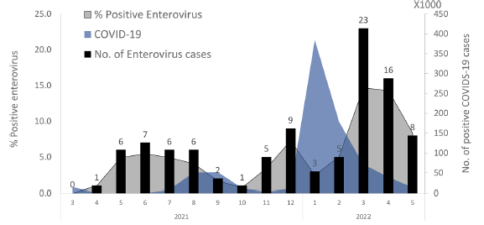
Enterovirus incidence in 2021–2022 during the delta and omicron SARS-CoV-2 waves.
Fratty et al 2023
The number of positive enterovirus cases is presented by black columns, the percentage of enterovirus-positive cases is shown in blue and the number of new COVID-19 cases per week is shown in gray.
Leeds / Healthy buildings – January 23, 2025

Slide 8
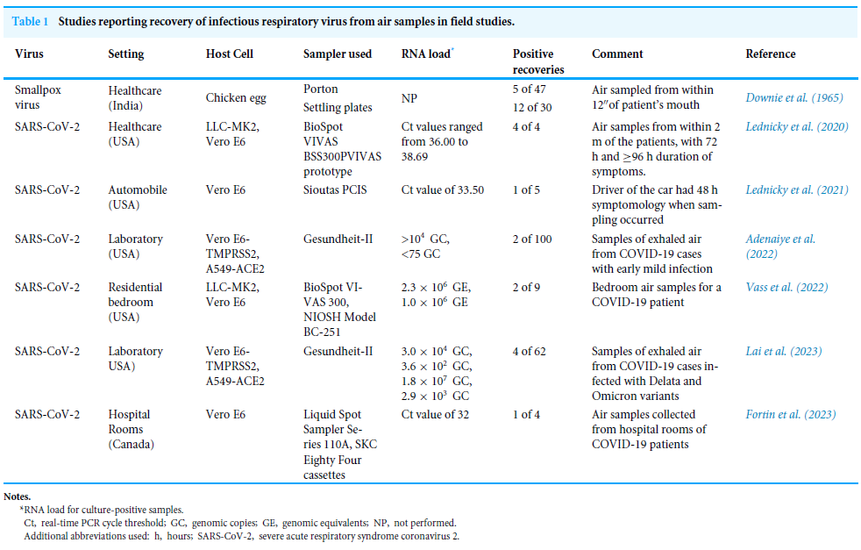
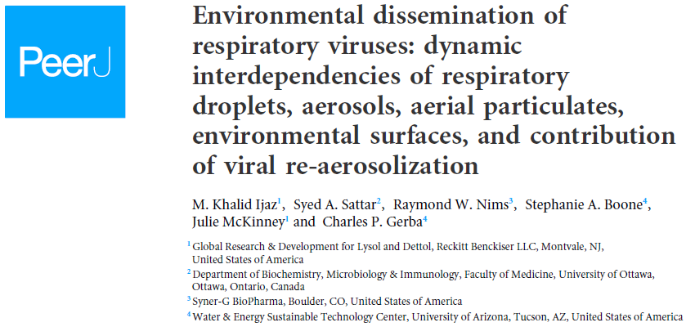
Infectious viruses recovered from the field air samples
Leeds / Healthy buildings – January 23, 2025
Notes:
1. This table show that you can recover infectious virus from air around patients but the stage of clinical symptom/sampling and detection method, were may each contribute to recovery of live virus, however when some group tried they able show the infectious.

Slide 9
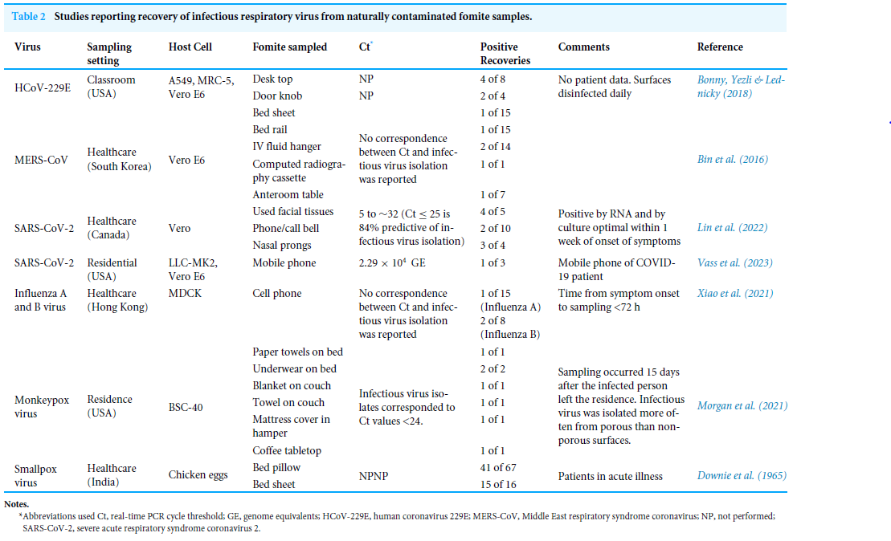
Infectious viruses recovered from the field fomites samples
Leeds / Healthy buildings – January 23, 2025
Notes:
Same is true for fomites – we were showing the relationship between Ct/PCR <25, you could infectious virus

Slide 10
Lysol Air Sanitizer
Testing formulations against bacteria and viruses
Leeds / Healthy buildings – January 23, 2025

Slide 11
Test Chamber with Essential Components
Produce them in respirable size
Keep them airborne
Collect them from the air to test viability
TOTAL AREA OF THE CHAMBER = 25 m³
Leeds / Healthy buildings – January 23, 2025

Slide 12
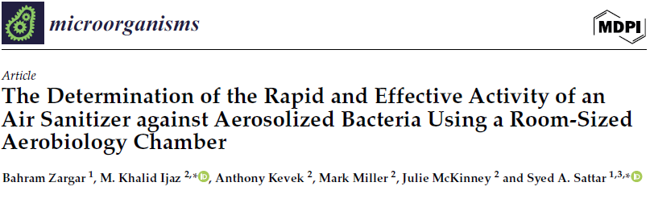
Lysol Air Sanitizer: Efficacy against aerosolized Staphylococcus aureus
3 log₁₀ Reduction
Tc
Three lots (e0199-069, e0032-170, e0199-070) tested (each lot tested in triplicate) and demonstrated a 99.9% (3.0-log₁₀) reduction in the viability of airborne S. aureus (suspended in ASTM tripartite soil load to simulate body secretions/excretions) in 3.21 minutes (3.46, 3.30, 2.86 minutes respectively) and met the acceptance criterion as required by the U.S. EPA
Leeds / Healthy buildings – January 23, 2025
Notes:
Tripartite soil load (~5% pathophysiological body fluid)= 0.5 g of yeast extract in 10 mL PBS.
0.5 g of bovine serum albumin (BSA) in 10 mL of PBS.
0.04 g of bovine mucin in 10 mL of PBS.

Slide 13
Efficacy against aerosolized Klebsiella pneumoniae
3 log₁₀ Reduction
Tc
Three lots (e0199-069, e0032-170, e0199-070) tested (each lot tested in triplicate) and demonstrated a 99.9% (3.0-log₁₀) reduction in the viability of airborne K. pneumoniae (suspended in ASTM tripartite soil load to simulate body secretions/excretions) in 1.15 minutes (1.17, 1.12, 1.16 minutes respectively) and met the acceptance criterion as required by the U.S. EPA
Leeds / Healthy buildings – January 23, 2025

Slide 14
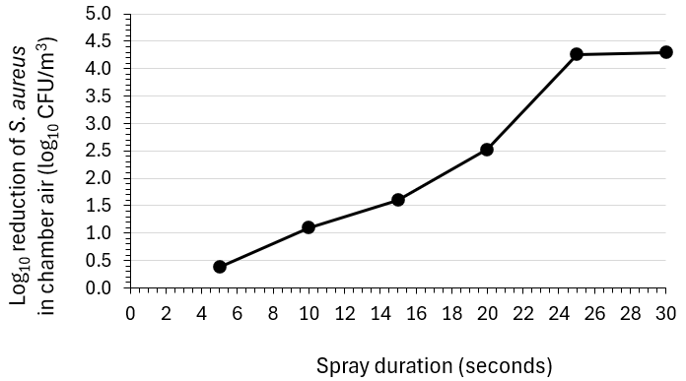
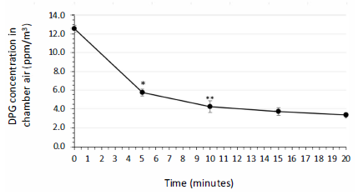
Dose response for the bactericidal efficacy of varying durations of spraying the air sanitizer against S. aureus – duration of spray vs. bactericidal activity.
Decay curve of dipropylene glycol (DPG) in the chamber air following a 30-s spray of the air sanitizer.
In six separate experiments, aerosolized S. aureus were challenged after which the air sanitizer was sprayed into the aerobiology chamber in increments of five seconds (i.e., 5 s, 10 s, 15 s, 20 s, 25 s, and 30 s).
As shown in Figure 2, there was a direct correspondence between the duration of the spray and the determined bactericidal activity.
Leeds / Healthy buildings – January 23, 2025

Slide 15
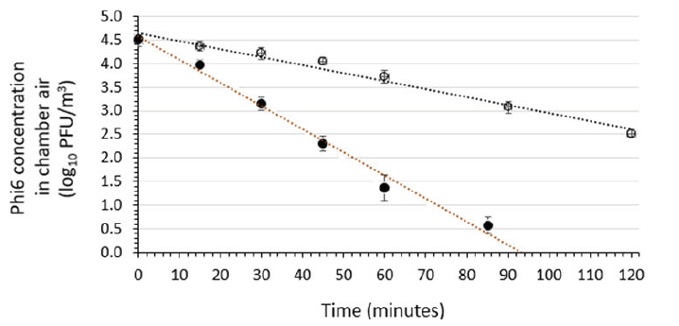
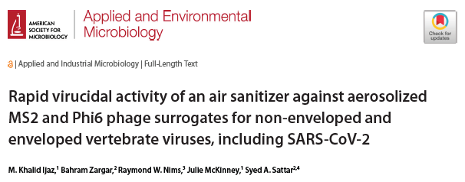
In-air Stability of phage Phi6 aerosolized from suspending medium without and with soil load.
Three independent runs were performed for Phi6 in the presence (open symbols) or absence (closed symbols) of a soil load.
Leeds / Healthy buildings – January 23, 2025
Notes:
-> Enveloped virus almost 3log10 difference

Slide 16
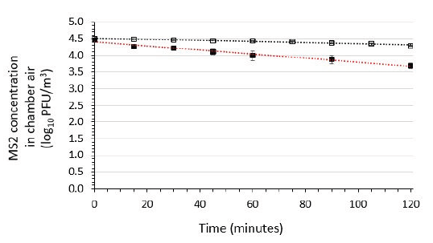
In-air Stability of phage MS2 aerosolized from suspending medium without and with the soil load
Three independent runs were performed for Phi6 in the presence (open symbols) or absence (closed symbols) of a soil load.
Leeds / Healthy buildings – January 23, 2025
Notes:
05 in case of non-enveloped

Slide 17
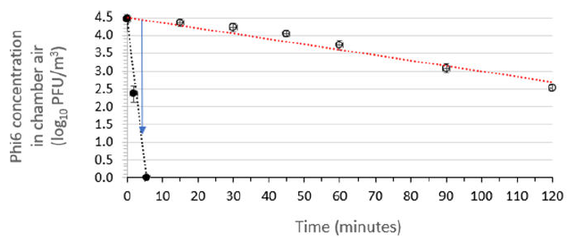
Assessment of the air sanitizer’s efficacy for inactivating aerosolized enveloped phage Phi6
The red dotted line displays the linear regression line fit to the Phi6 concentrations in the absence of air sanitizer (open symbols), while the black dotted line displays the Phi6 post-spraying air sanitizer.
A 3.0 log₁₀ reduction in viable Phi6 concentration was achieved within 3.6 min of air sanitizer release indicating efficacy against enveloped viruses (e.g., SARS-CoV-2; influenza; RSV).
Leeds / Healthy buildings – January 23, 2025

Slide 18
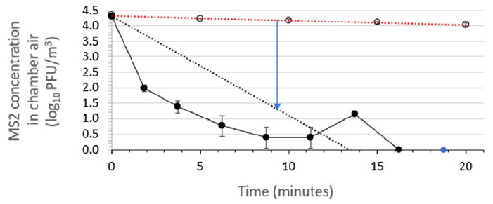
Assessment of the air sanitizer’s efficacy for inactivating aerosolized non-enveloped phage MS2
The red dotted line displays the linear regression line fit to the MS2 concentrations in the absence of air sanitizer (open symbols), while the black dotted line displays the linear regression line fit to the MS2 concentrations in the presence of air sanitizer (closed symbols). All data points indicate mean ± standard deviation (n = 3 independent runs). indicating A 3.0 log10 reduction in viable MS2 concentration was achieved within 9.8 min of air sanitizer release indicating efficacy against non-enveloped viruses (e.g., noroviruses and rhinoviruses).
Leeds / Healthy buildings – January 23, 2025

Slide 19
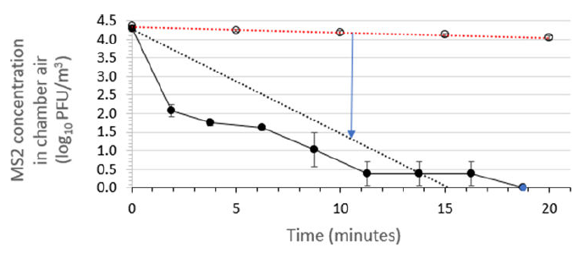
Assessment of the air sanitizer’s efficacy for inactivating aerosolized non-enveloped phage MS2
Time kinetics for efficacy of air sanitizer batch 3 for reducing the viability of aerosolized phage MS2 suspended in the soil load in a room-sized aerobiology chamber. The red dotted line displays the linear regression line fit to the MS2 concentrations in the absence of air sanitizer (open symbols), while the black dotted line displays the linear regression line fit to the MS2 concentrations in the presence of air sanitizer (closed symbols). All data points indicate mean ± standard deviation (n = 3 independent runs). A 3.0 log₁₀ reduction in viable MS2 concentration was achieved within 11.3 min of air sanitizer release indicating efficacy against non-enveloped viruses (e.g., noroviruses and rhinoviruses).
Leeds / Healthy buildings – January 23, 2025

Slide 20










Impacts of lid closure during toilet flushing and of toilet bowl cleaning on viral contamination of surfaces in United States restrooms
*Press Release
Lysol Pro Solutions reveals how germs survive and thrive on bathroom surfaces
DISINFECTION IS KEY
Disinfecting surfaces just twice a week can reduce germ transmission in bathrooms by up to 90%
Disinfection of the toilet seat, sink countertop and floor are just as important as disinfection of the toilet bowl in preventing the spread of germs
*Dr. Gerba’s team observed
With the household toilet, researchers found that there was no statistical difference in the amount of virus collected from surfaces on the toilet or the nearby floor whether the toilet was flushed with the lid up or down.
New Analysis Shows that Disinfection Is the Most Effective Way to Prevent Viral Contamination of Restroom Surfaces [Tania Bubb, PhD, RN, CIC, FAPIC, 2024 APIC president, press release, January 25, 2025 ]
Additional findings from the study include:
Cleaning with a disinfectant and brush reduced viral contamination on the toilet by more than 99.99% and on the brush by 97.64%.
Closing the toilet lid may alter the direction of the aerosol plume. In this study, floor surfaces in front of and to the left of the toilet were more contaminated after flushing with a closed lid than with an open lid, and floor surfaces to the right of the toilet were less contaminated.
These findings extend to households. When one member of a household is sick, particularly with an infection that causes gastroenteritis, the regular incorporation of a disinfectant during cleaning or prior to flushing may help reduce the spread of infection to others in the household.
“This study helps establish a clearer understanding of how pathogens spread and the measures we can take to break those chains of transmission,” said Tania Bubb, PhD, RN, CIC, FAPIC, 2024 APIC president. “It also underscores the importance of regular disinfection of surfaces in healthcare settings for reducing the spread of viral infections.”
Leeds / Healthy buildings – January 23, 2025
Notes:
Do closing the lid stop aerosol spread psot-flushing?

Slide 21
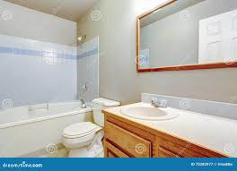
Reduction in restroom fomites’ cross contamination with and without spraying Lysol Air Sanitizer (8s spray) post toilet flushing*
* The Air Sanitizing Spray reduced surface cross-contamination on all the surfaces by 90 to >99.9% except the toilet flush handle and vanity countertop.
At 8 sec there was a significant difference found between product use and no use on the toilet seat (p = 0.0028).
Leeds / Healthy buildings – January 23, 2025

Slide 22
Reduction in restroom fomites’ cross-contamination with and without spraying Lysol Air Sanitizer (30s spray) post toilet flushing*
*Increasing the spray time to 30 seconds resulted in a 97% to >99.9999% reduction of virus on all the surfaces.
A significant difference was found between no use of product and spraying the air for 30 seconds with the Air Sanitizing Spray (p = 0.054): corner shelf (p = 0.0464) and vanity top left (p = 0.0483) and vanity top right (p = 0.0279), on the toilet seat (p = 0.000129) but not on the toilet floor, and handle (p = 0.167).
Leeds / Healthy buildings – January 23, 2025

Slide 23
Reduction of MS2 virus in air by spraying in restroom Lysol Air Sanitizer post-toilet flushing (8 seconds spray)*
*Air Sanitizing Spray , sampling restroom air post-toilet flushing using the Anderson Air Sampler demonstrated that infectious virus was reduced by almost 99% in the air.
Leeds / Healthy buildings – January 23, 2025

Slide 24
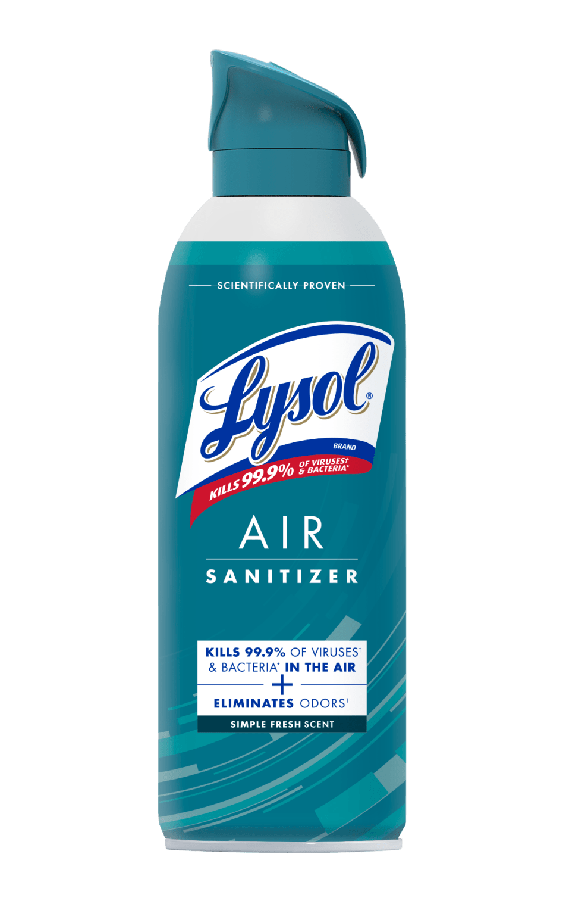
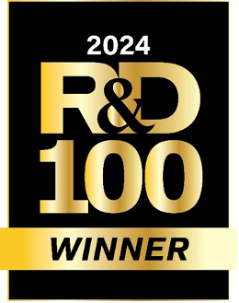
Summary/Conclusions
Indoor air is a significant vehicle for pathogen dissemination, plays role in establishing air-surfaces-air nexus highlighting the role of holistic approach for risk mitigation.
Standardized aerobiology protocols (bacteria & viruses) have been developed to study survival & inactivation of airborne pathogens.
Lysol Air Sanitizer (LAS) reduced airborne bacteria and viruses > 99.9% when tested against experimentally aerosolized bacteria and viruses.
Application post-toilet flushing in American restroom, indicated that use of LAS causes a reduction in cross-contamination of toilet seat and vanity top including air space when LAS was applied post-flushing toilet in the restroom.
Leeds / Healthy buildings – January 23, 2025
Notes:
Based on:
The results indicate that use of the Lysol Air Sanitizer causes a significant reduction in the risk of surface and aerosol pathogen exposure in the restroom.
What data is needed in order to use as a claim?
Khalid: QMRA to show the benefit for both on surfaces and in air

Slide 25







Acknowledgements
Professor C.P. Gerba
Dr. Stephanie Boone
Professor S.A. Sattar
Dr. Bahram Zargar
Leeds / Healthy buildings – January 23, 2025
Notes:
Based on:
The results indicate that use of the Lysol Air Sanitizer causes a significant reduction in the risk of surface and aerosol pathogen exposure in the restroom.
What data is needed in order to use as a claim?
Khalid: QMRA to show the benefit for both on surfaces and in air

