Slide 1
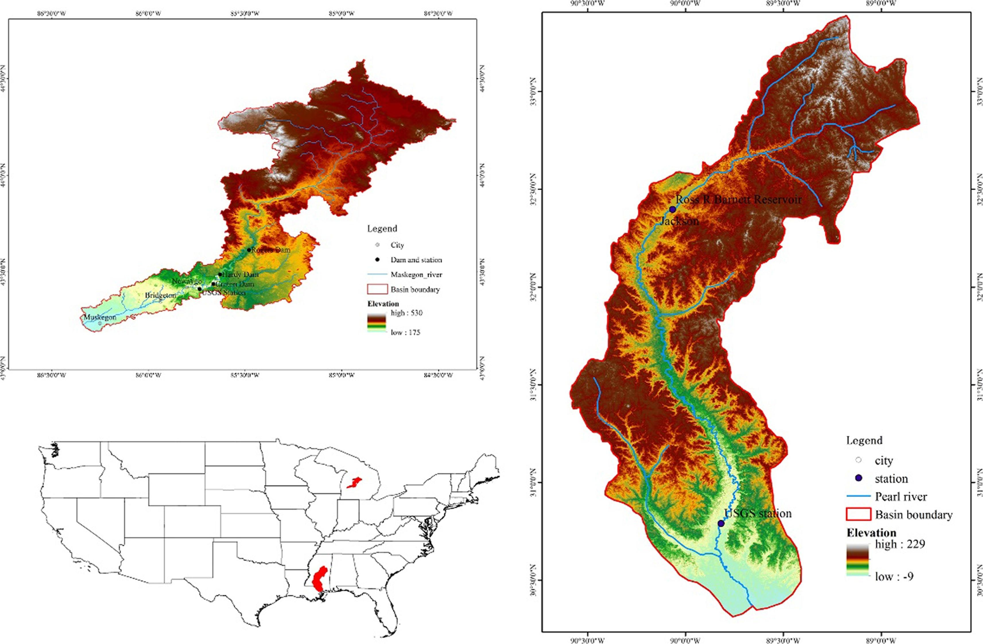
Fig Selected Real Catchment in US (left) and Machine Learning Prediction Against Observation Data (Zhang, J., Chen. X. et al 2021)

