Slide 1
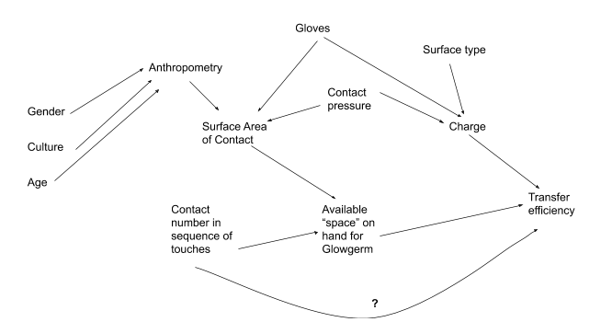
What do we believe are the relationships of the variables related to our question?
Causal Diagram
More good info at: Shahar & Shahar, http://www.u.arizona.edu/~shahar/Causal%20diagrams%20and%20bias%20for%20posting.pdf

Slide 2
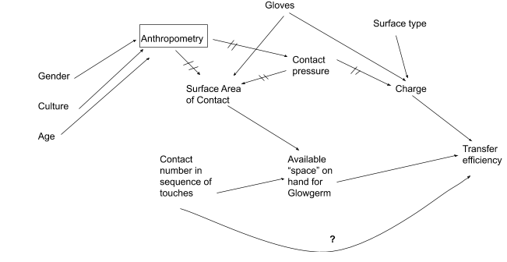
We want to remove the effect of anthropometry on downstream variables. Right now, it is acting as a confounder, effecting a mediator that we’re interested in.

Slide 3
When we isolate the effect of anthropometry, we remove its downstream effects on surface area of contact and contact pressure.

Slide 4
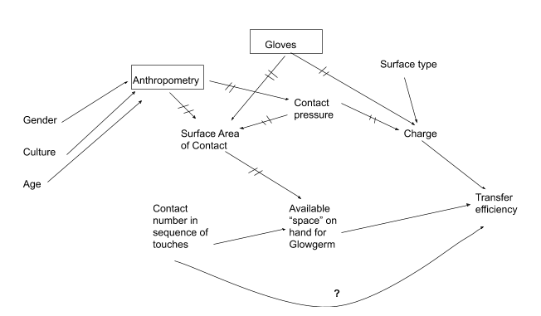
We isolate the effect of gloves to remove its downstream effects on surface area of contact and charge

Slide 5
All of the effects on surface area of contact have now been controlled, so we have removed its effect on available “space” on hand for Glowgerm

Slide 6
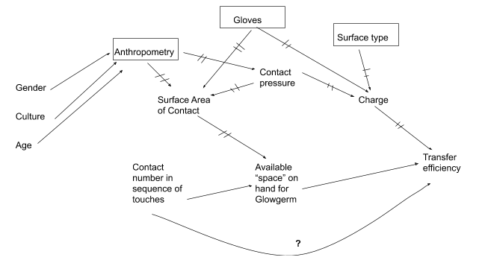
Lastly, we remove the effect of surface type on our outcome

Slide 7
So what does this mean?
We’ve identified….
2 confounders
Anthropometry and gloves
1 effect modifier
1 mediator (this is ok and does not have to be controlled)
How to handle these potential biases statistically to remove their effects
Confounders
Include as variables in the regression
Effect modifier (equivalent to “interaction term”)
Surface type*contact number in sequence

