Slide 1
Presentation
Group 04 OMAMZ

Slide 2
Introduction
One process with two threads:
Father: count the execution time and kills children
Child 1: implements a metaheuristic based on the tabu search with multi-start
Child 2: implements a metaheuristic based on the genetic algorithm hybridized with tabu search
Notes:
Good evening i would like to present you our project

Slide 3
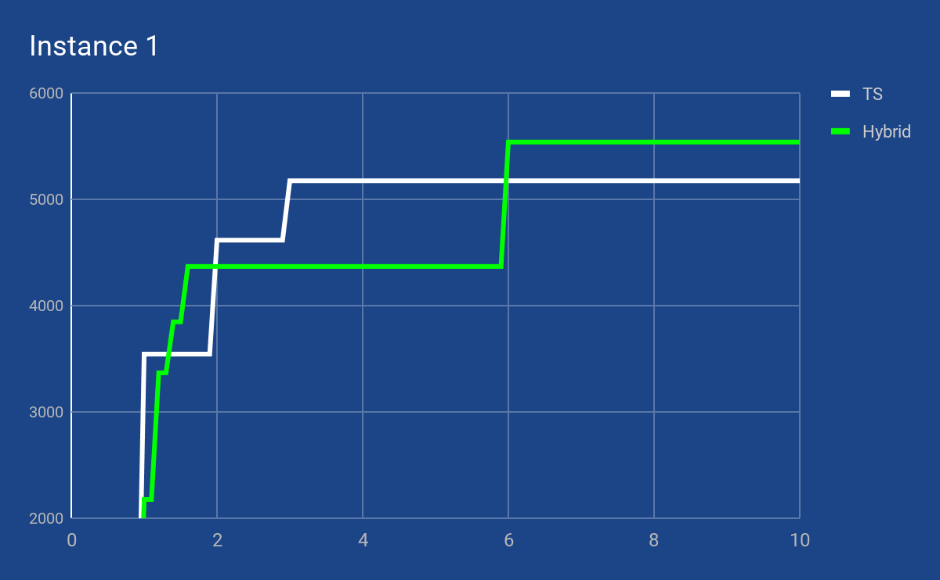
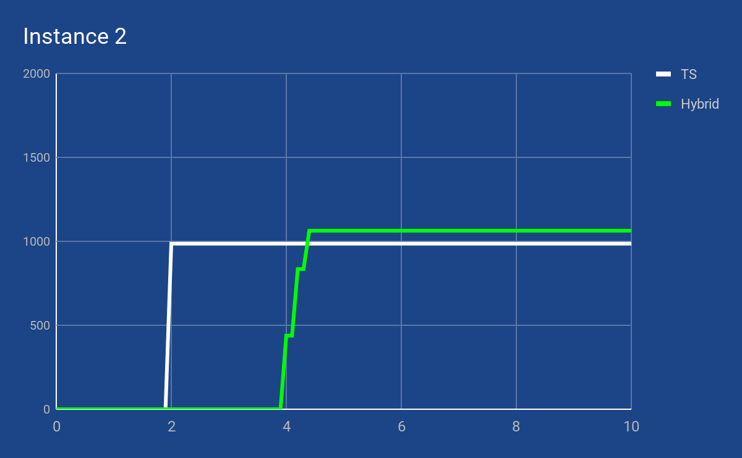
Charts: first ten seconds
Notes:
the reason why we use multiple threads is because Analyzing the execution of the single metaheuristics, we have noticed that they behave differently according to the requests. In some cases, the Tabu Search was the first to converge to better solutions, while the hybrid started to produce improved results only later. In other cases the opposite happened. Therefore, we decided to combine both metaheuristics in a single program.

Slide 4
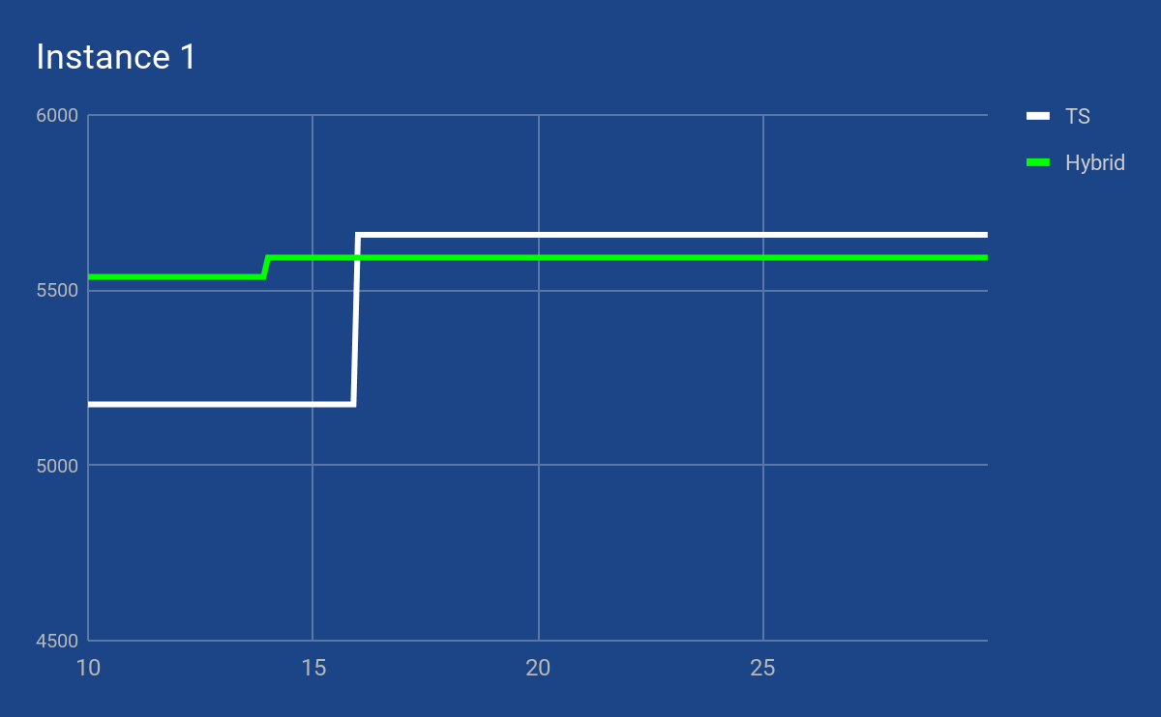
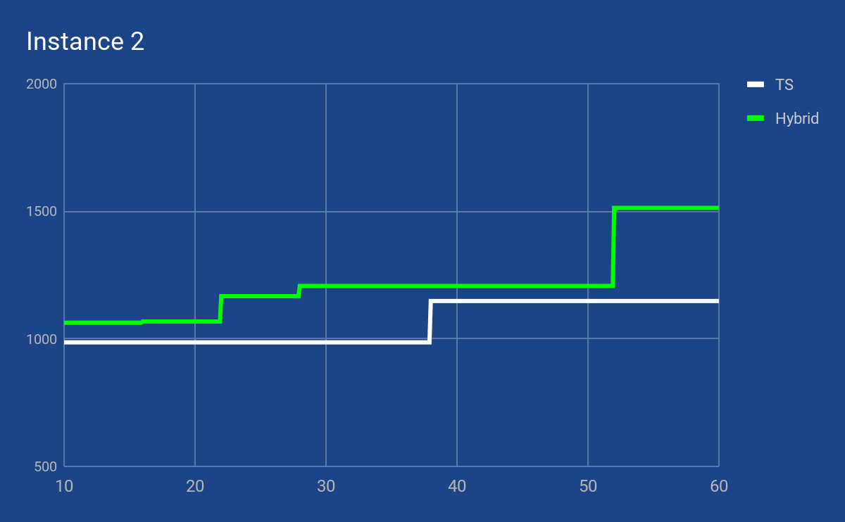
Charts: last seconds
Notes:
The result of the best solution depends of the time limit. In fact in some cases the better solution was found by tabu sarch and other times by hybrid, how we can see in this graphs
But we want to introduce both to maximize the gain.

Slide 5
Data Structures
vettX: array of queries with its configuration.
vettC: it is the vector that for every configuration assigned to a query (vettX), returns how much is compatible with the active indexes.
vettR: it is the vector that for every configuration assigned to a query (vettX), returns the ratio: gain/(mem+fixedcost).
Notes:
vettC&vettR related to the ibrid
vettX is used for both tabu search and hybrid approach

Slide 6
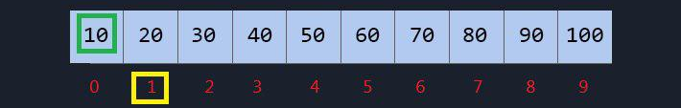
VettX
The value “-1” represents a query that is not served by any configuration.
Notes:
it is the vector of queries with its configuration. This data structure makes impossible the infeasibility
caused by multiple configuration used for the same query

Slide 7
Initialization
Greedy strategy to create a feasible solution with non-negative (*) objective function, that activate as many configurations as possible under the memory constraint.
* relaxed in the hybrid, iteration after iteration.
Notes:
both initialization functions are pretty similar, leggiucchia slide,
the initialization function related to the hybrid approach is different from the other because there is the possibility of accepting negative gains after a certain number of failed attempts
Questa è la differenza dell’init per l’ibrido
while ((pop[j].feasible == 0 || pop[j].gain <= -exp(iteration)) && iteration < 6) {
iteration+=0.5;
…….}
Ci prova al massimo dodici volte o finchè non abbiamo qualcosa di feasible con un gain superiore a una soglia che si abbassa esponenzialmente

Slide 8
Tabu Search
Local search operator
Neighborhood exploration
Tuning
Notes:
Here we are with the metaheuristic based on the tabu, is not exactly the canonical one, but it’s our sors of inspiration

Slide 9
Local Search operator
͠x feasible → increase the obj function
exchange the five best inactive configuration with the five worst active (gain wise)
͠x infeasible → reduce infeasibility & increase the obj function
exchange five best inactive configuration with five worst active (memory wise)
Notes:
To create the neighborhood we have decided to split our generation tecnique
exchange five inactive best configuration, in terms of gain, with the five active worst.
it does not respect the constraint on memory, we adopt a similar procedure: we exchange the five inactive best, in terms of memory, with the five active worst

Slide 10
Neighborhood Exploration
Chosen neighbor will be the one with the worst-best config exchange, allowed by the tabu list, that returns a greater obj function.
Notes:
So, once calculated the 25 neighbor generated in this way, we will chose as new current solution the one with the worst-best config exchange, allowed by the tabu list, that returns a greater obj function.
In case the current solution was infeasible we have also tried with the neighbor with the greater decrease in memory, but it did not give the same results

Slide 11
Tuning
New ͠x infeasible for 20 consecutive iterations → configurations randomly deactivated until it returns feasible.
New ͠x feasible for 5 iterations → add a configuration that serves a query without one.
No new best solutions for 50 consecutive iterations → Initialization
Before saving a best solution → activate extra configurations to increase obj function while respecting the memory constraint.
Notes:
the metaheuristic like that needed some guiding
If our current solution is infeasible for 20 consecutive iterations, the configurations are randomly deactivated until it returns feasible
Instead if it is feasible for 5 iterations, we add a configuration that work for a query without configuration.
If we do not find new best solutions for 50 consecutive iterations, we start from another solution.
adopting a multi-star approach
This is more or less the tabu, leonardo will introduce you the hibrid

Slide 12
Genetic Algorithm hybridized with Tabu Search
Fitness
Parent Selection
Population Replacement
Crossover (with two crossing point)
Mutation
Tabu Search
Notes:
Alongside the developing of the metaheuristic inspired to TS, we were developing another one based on GA. So, we decided to hybridize the two metaheuristics and we implemented an algorithm with the following features:

Slide 13
Genetic Algorithm Hybridized with Tabu Search: Features
Fitness:
Fitness computation is performed according to this formula: chromosome gain - (available memory - chromosome memory)
Parent Selection:
Is performed by scanning the population and selecting chromosomes with a probability based on fitness.
Population Replacement:
Generated children are inserted in the population with a probability based on fitness.
Notes:
Parent selection: the highest the fitness, the highest the probability to select the chromosome
Population replacement: the highest the fitness of the child, the highest the probability to replace a member of the population with that

Slide 14
Crossover (with two crossing points)
The crossover is applied to each pair of consecutive parents, among those chosen by the parent selection.
To decide the two crossing points we proceeded as follows:

Slide 15

Example
Notes:
2 chromosomes

Slide 16
Example
random
Notes:
random starting point

Slide 17
Example
random
i
j
i
j
Notes:
indexes i and j distributed as shown

Slide 18
Example
random
i
j
Is it greater than?
i
j
Notes:
If j+1 R ratio of the first chromosome is greater than the j+1 R ratio of the second one

Slide 19
Example
random
i
j
Is it greater than? YES => j++
i
j
Notes:
I increment the j index

Slide 20
Example
random
i
j
i
j

Slide 21
Example
random
i
j
Is it greater than?
i
j
Notes:
Otherwise, if the condition is not satisfied

Slide 22
Example
random
i
j
Is it greater than? NO => i--
i
j
Notes:
I decrement the i index

Slide 23
Example
random
i
j
i
j

Slide 24
Example
random
i
j
if sumR1 > 2*sumR2 OR sumR2 > 2^sumR1=> STOP
i
j
Notes:
We do this process until the summation of all R indexes in between the two indexes of one chromosome is bigger than twice the summation of the other chromosome. Than crossover happens.

Slide 25
Mutation
Every gene of the chromosome is mutated:
ascending order of compatibility
first those already served by a config and then those without.
We look for the configuration with positive gain and with the maximum compatibility then we assign this new configuration to the query accordingly to a threshold.
Notes:
it is applied to the entire population each time. It is performed once immediately after initialization and, thereafter, whenever no crossover occurs between the selected parents, to differentiate the population.
We consider all the queries in ascending order of compatibility (vettC), first those already served by a config and then those without. For each query we look for the configuration with positive gain and with the maximum compatibility (vettC), if this compatibility exceeds a threshold we assign this new conf to the query (updating the vettX accordingly). At the end we scroll all the queries to assign to each one the active configuration that has a major or positive (in the case of those not served by any conf) obj function .

Slide 26
Tabu Search
Tabu Search: It is a translation of the TS from a stand-alone algorithm to function. It is executed on every child generated by the crossover, to improve it before the population replacement.

Slide 27
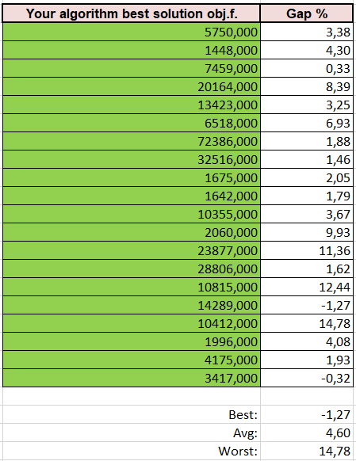
Conclusions
Average difference of 4.6%
Poor exploration of the solution space
Improving initialization of Tabu Search
Even the hybrid, based on the Genetic Algorithm
Notes:
In general we obtained an average difference of 4.6% from given optimal solution. The solutions that most deviate from the optimal value are probably due to a poor exploration of the solution space, so, in our opinion it would be necessary to improve the function that initializes the solution in the tabu search. Even the hybrid based on the Genetic Algorithm, which should move more randomly in the solution space, does not succeed.

