Slide 1
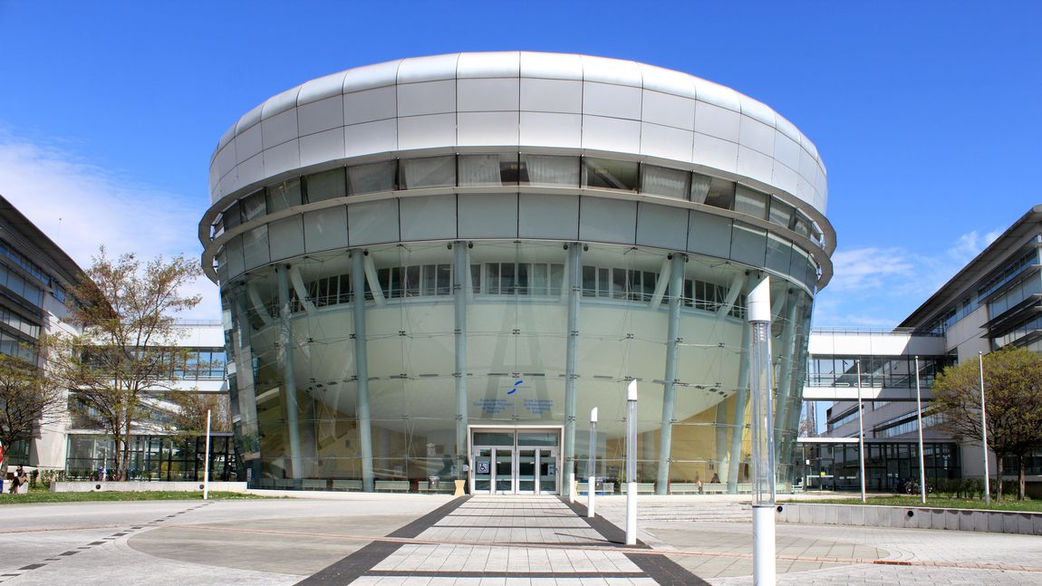

Exploring Deep Learning Domain Adaptation Performance: From Covariate Shift to Wasserstein and beyond
Encadrement: Étienne Baudrier, Sylvain Faisan, Alexandre Stenger

Slide 2
Introduction

Slide 3
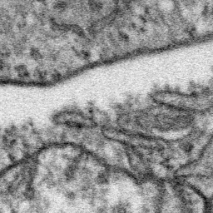
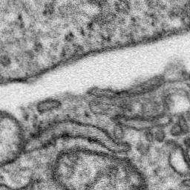
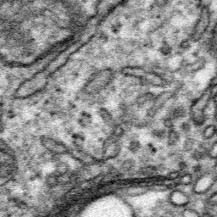
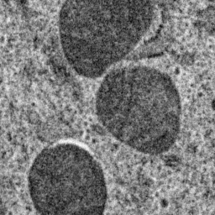
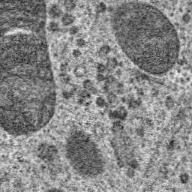
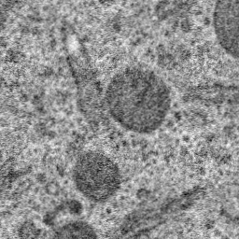



Introduction: Covariate Shift
Source data (chemical fixation)
Target data (cryo-fixation)
U-Net
U-Net
Covariate shift

Slide 4



Introduction: Covariate Shift
Source data
Target data
U-Net
U-Net
U-Net

Slide 5
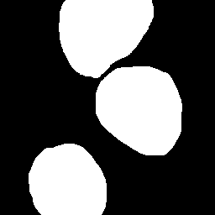
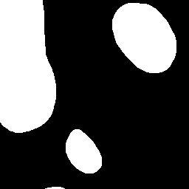
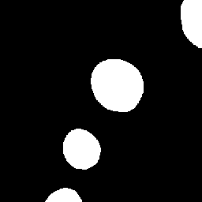
Introduction: Covariate Shift
Source data
We apply a domain adaptation technique
Target data
???
U-Net
U-Net
(adapted)

Slide 6
Introduction: Covariate Shift
Source data
Target data
Batch norm adaptation!
U-Net
U-Net
(adapted)

Slide 7
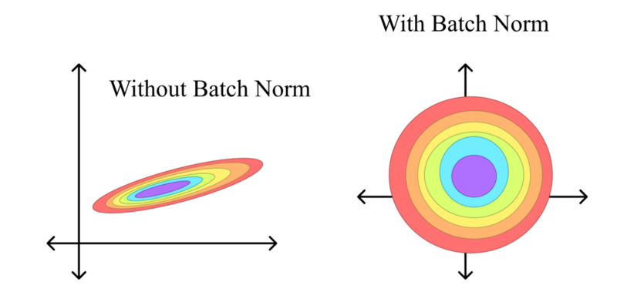
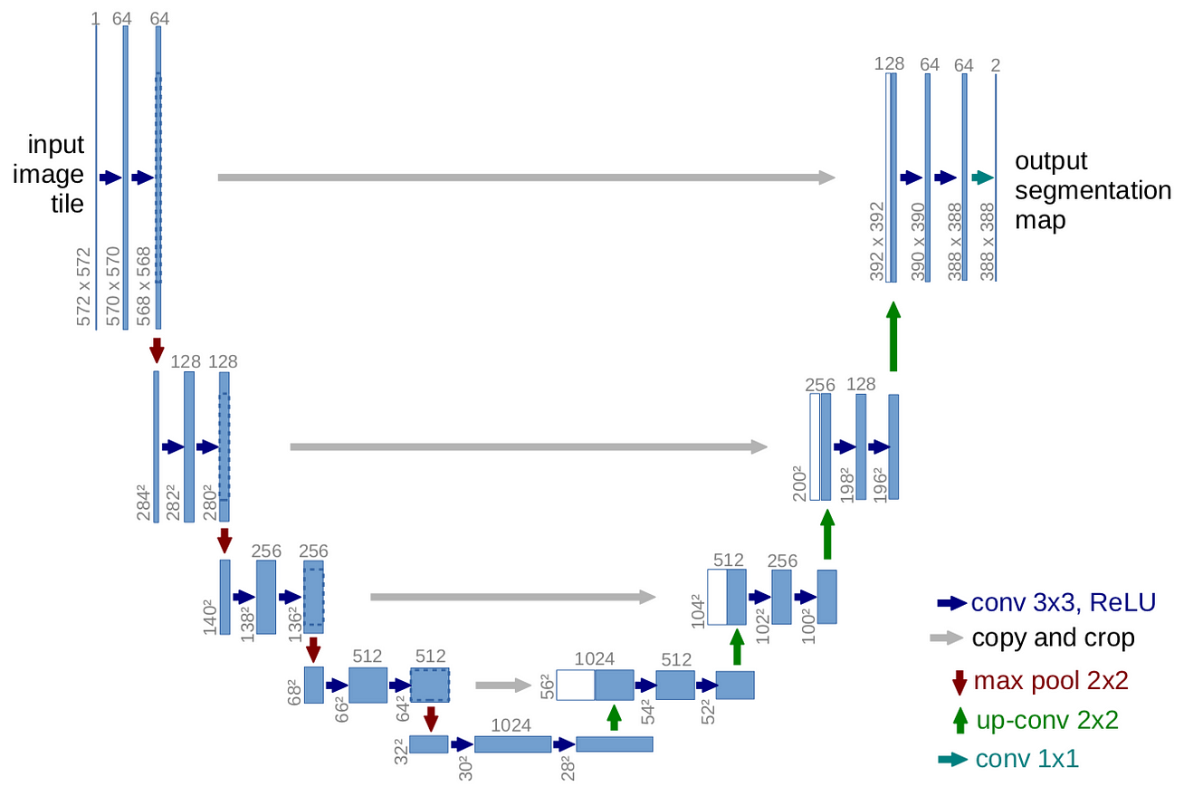
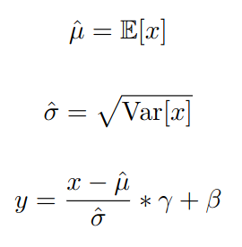

Introduction: Batch Norm adaptation
What is Batch Norm?
U-Net
Batch Norm
Layer
Batch Norm
learned during training

Slide 8
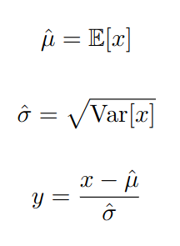
Introduction: Batch Norm adaptation
What is Batch Norm adaptation?
- we take the target dataset and pass it through the network, freezing all parameters but updating and

Slide 9

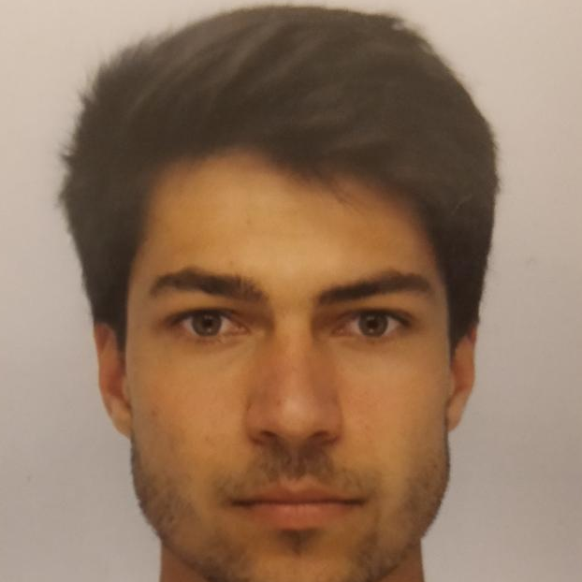

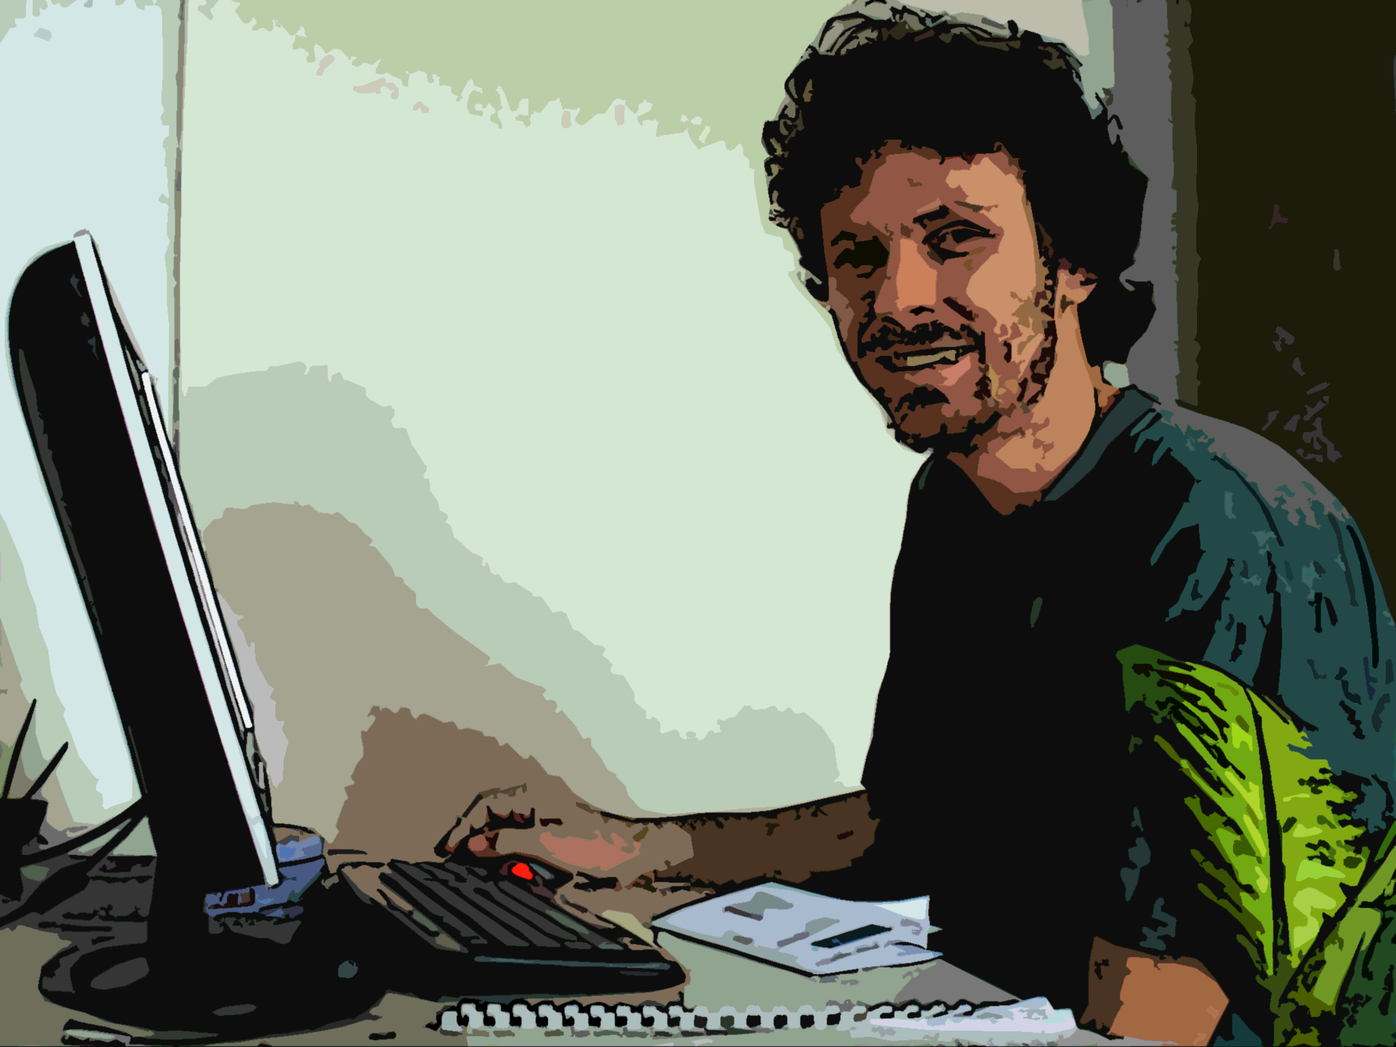
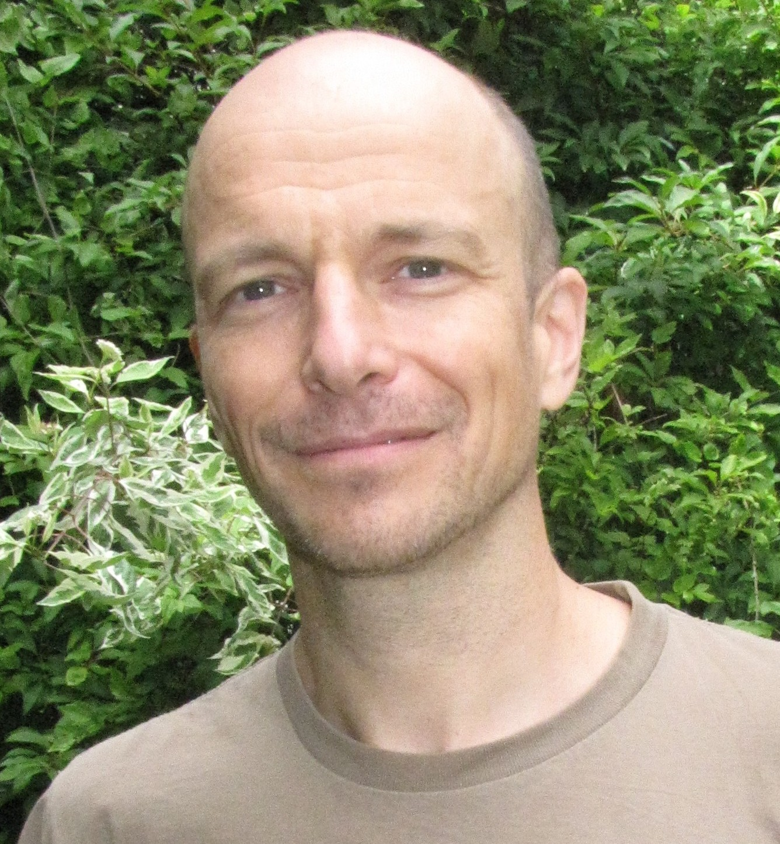
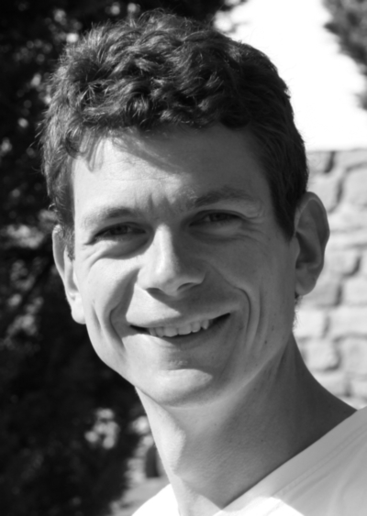
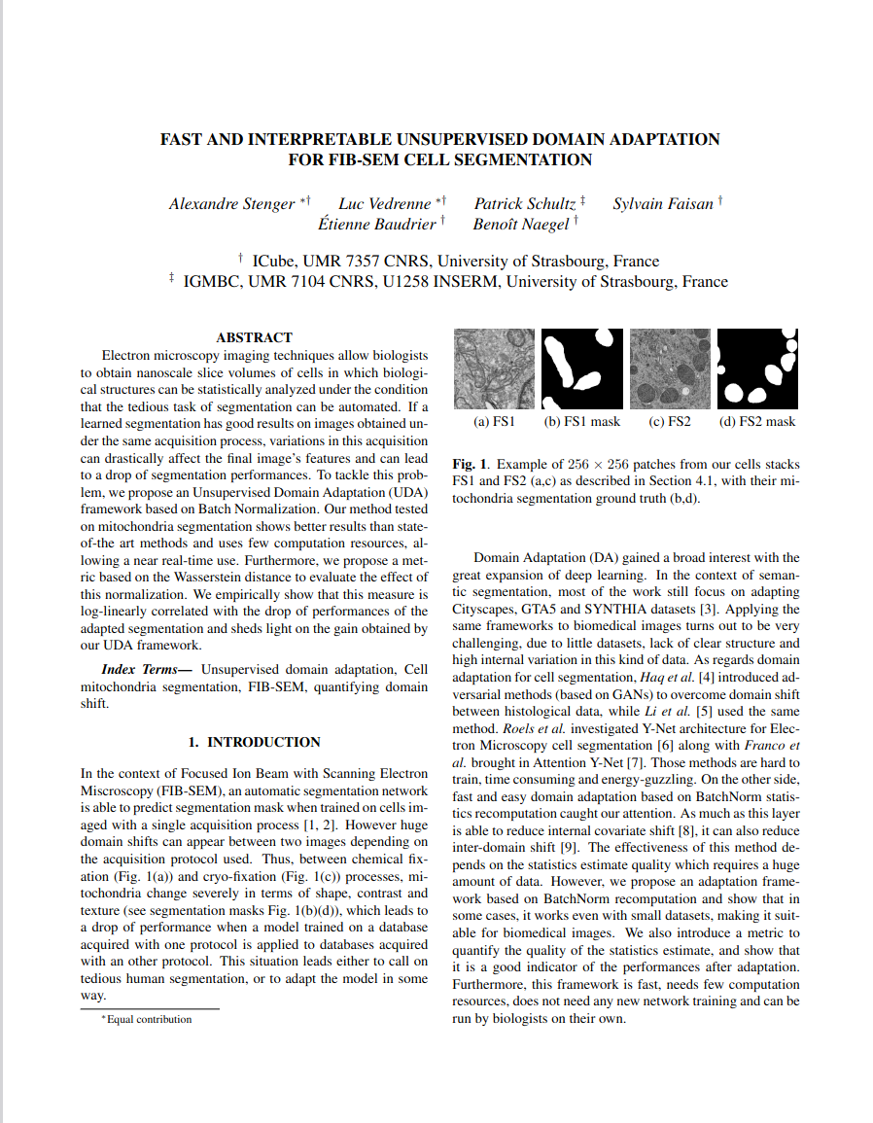
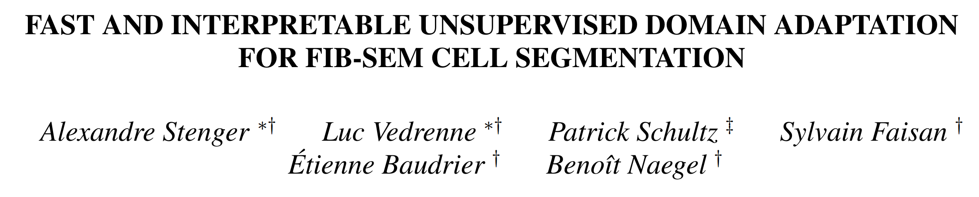
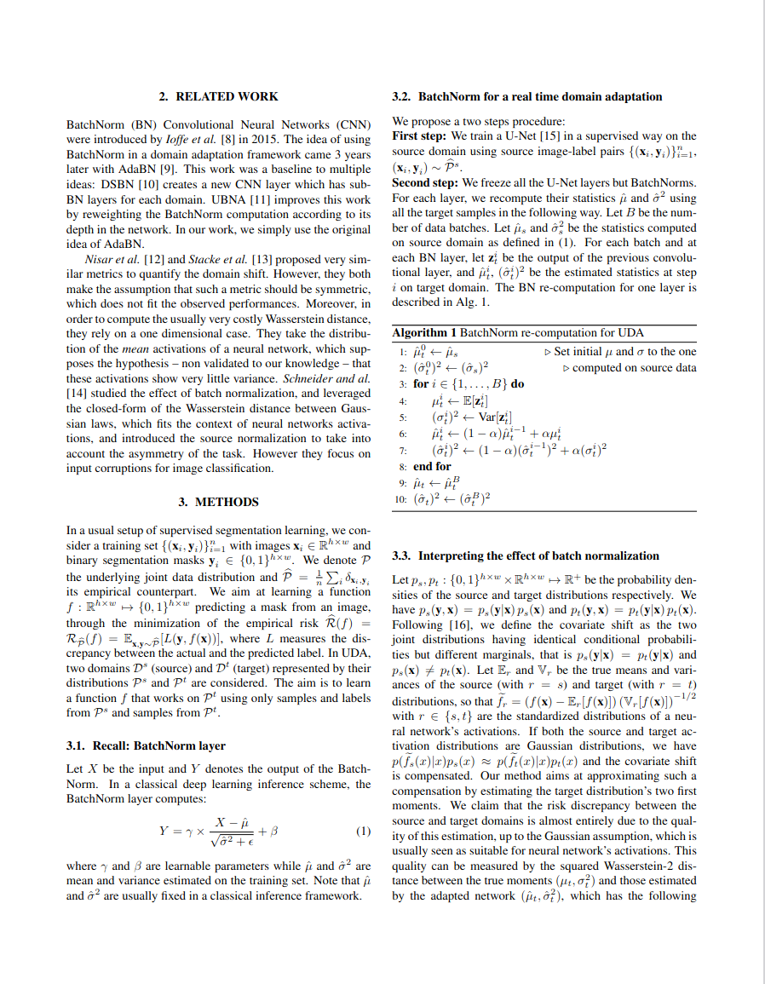
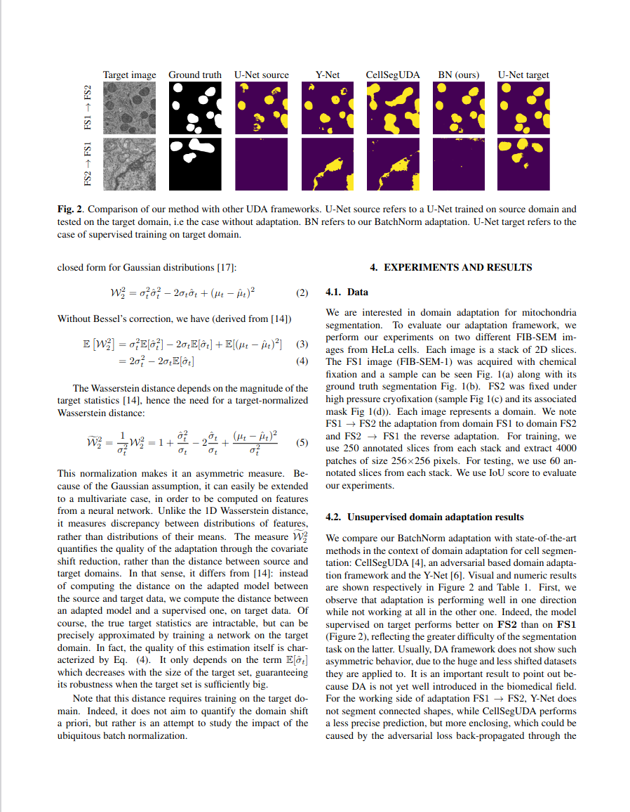

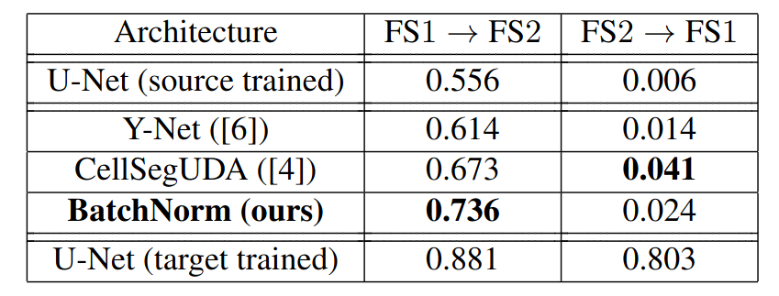
Introduction: The work of my équipe
https://publis.icube.unistra.fr/docs/17711/ISBI_paper_559.pdf

Slide 10
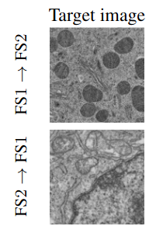
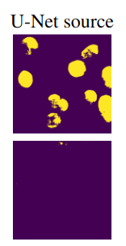
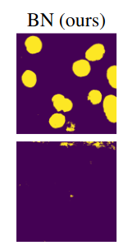
Introduction: The work of my équipe
Asymmetric behaviour of BN (Batch Norm adaptation)
Pros:
- Simple implementation
- Extremely fast
Cons:
- we don’t know when it works

Slide 11
My internship goal
When (and why) does Batch Norm adaptation work?

Slide 12
Dataset Generation

Slide 13







Dataset generation
Source data
Add noise
inspired

Slide 14
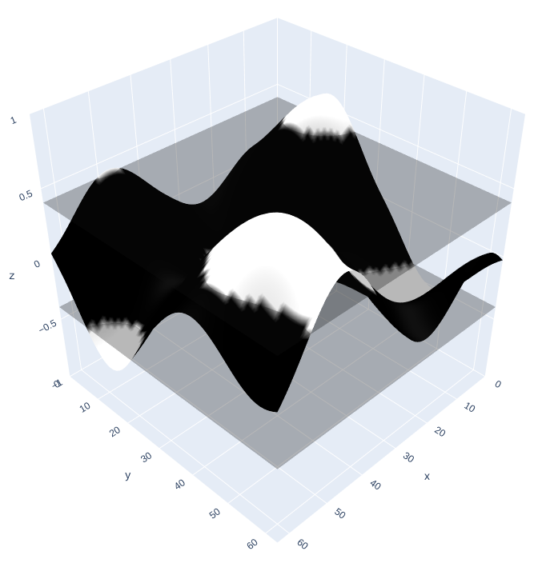
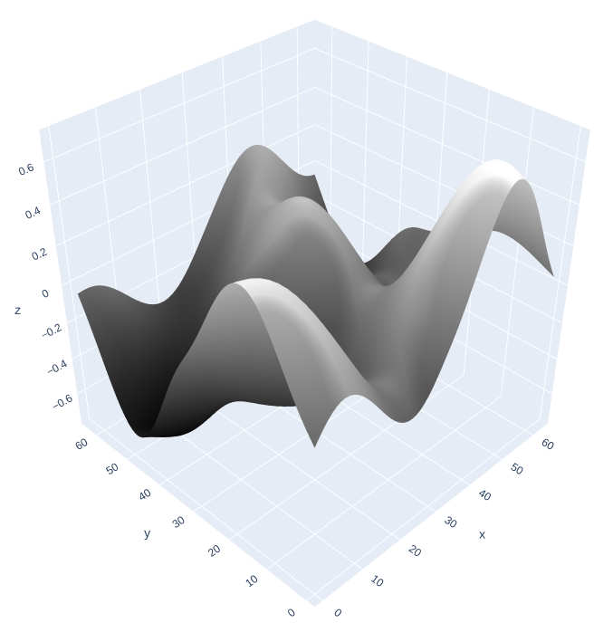
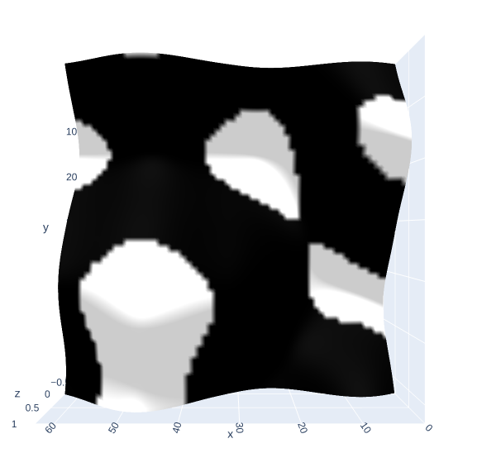
Dataset generation
1) generate a Perlin Noise
2) set a threshold
3) “look from above”
~40s for 10.000 images

Slide 15









Dataset generation

Slide 16
When does BN adaptation work?

Slide 17
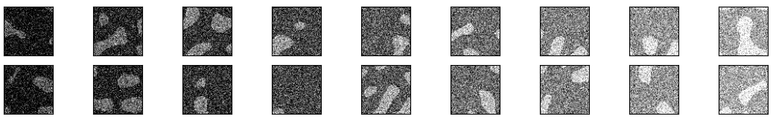
when does BN adaptation work?
When BN adaptation works
(means of mask and background white noises)
(μ1,μ2)
(10,90)
(30,110)
(50,130)
(70,150)
(90,170)
(110,190)
(130,210)
(150,230)
(170,250)

Slide 18
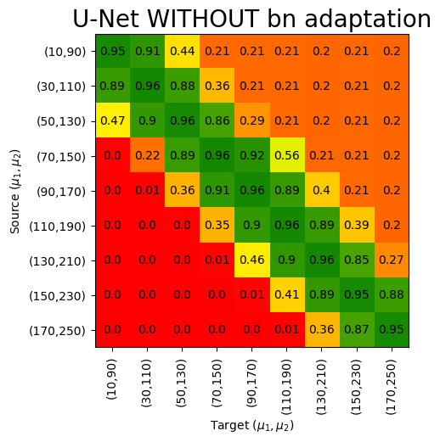
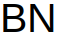

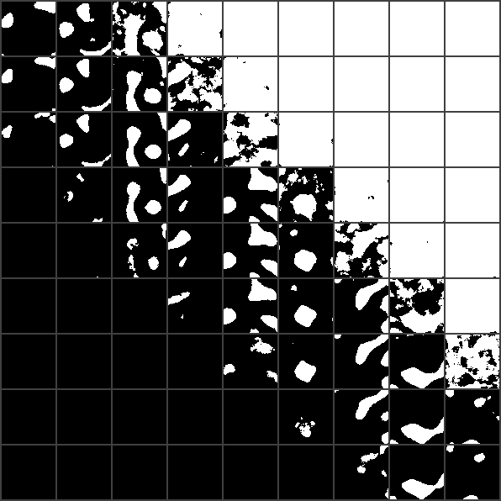








when does BN adaptation work?
Mask predictions
Source dataset
Source dark, target bright → all white
Source bright, target dark → all black
Target dataset

Slide 19
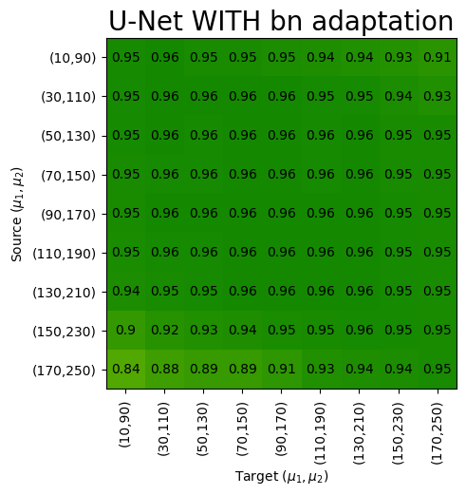
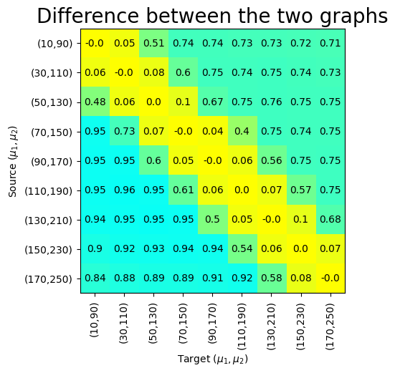
when does BN adaptation work?
Source dataset
Source dataset
Target dataset
Target dataset

Slide 20
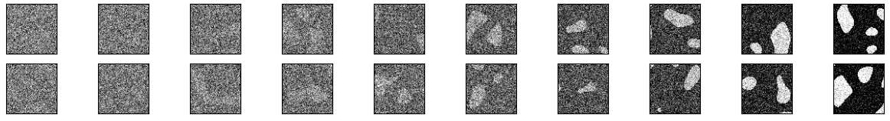
when does BN adaptation work?
When BN adaptation ..kinda works?
(means of mask and background white noises)
(μ1,μ2)
(123,133)
(121,135)
(117,139)
(113,143)
(106,150)
(97,159)
(83,173)
(65,191)
(38,218)
(1,255)

Slide 21
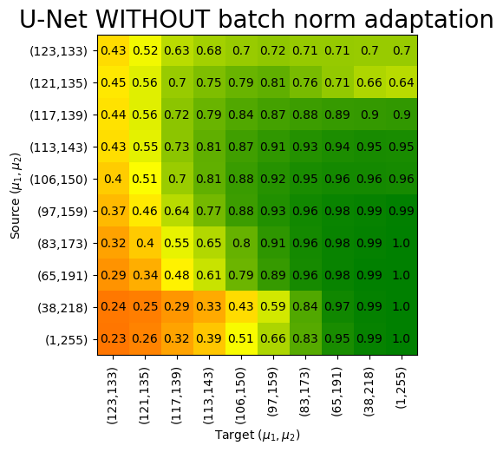










when does BN adaptation work?
Source dataset
Target dataset

Slide 22
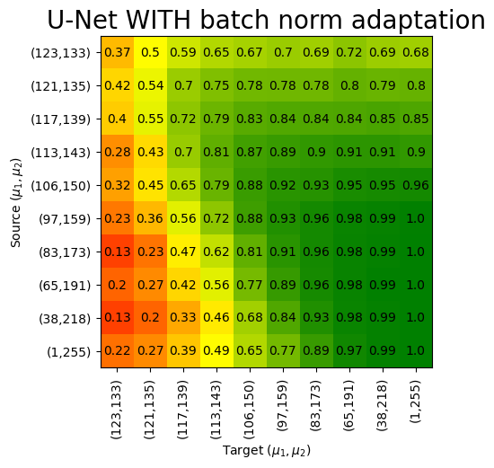
when does BN adaptation work?
Source dataset
Target dataset

Slide 23
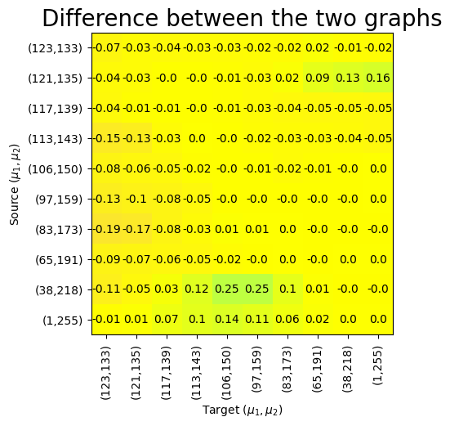
when does BN adaptation work?
Source dataset
Target dataset

Slide 24
When should we use BN adaptation?

Slide 25
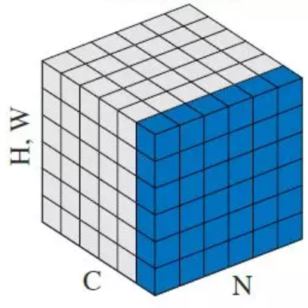
When should we use BN adaptation?
Latent space

Slide 26
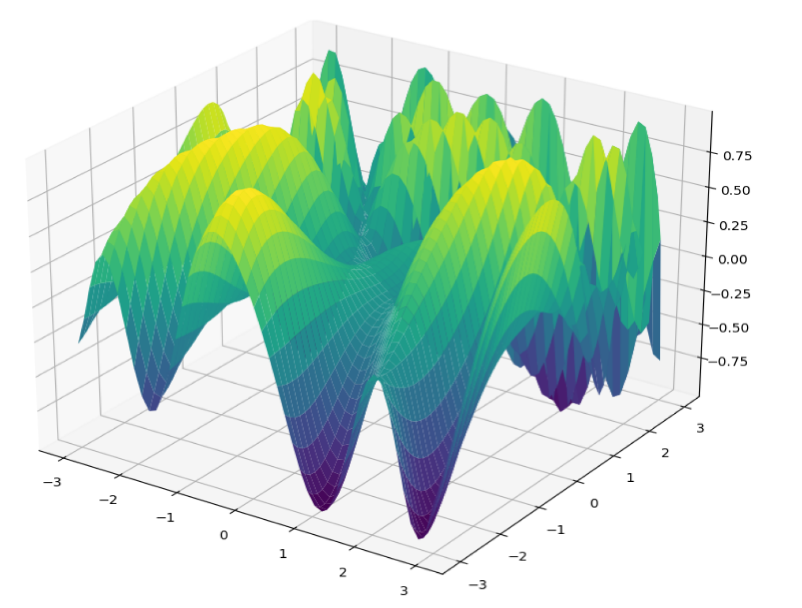
When should we use BN adaptation?
1024-dimensional distributions
Latent spaces
Source dataset → U-Net
distance
Target dataset → U-Net
(adapted)
Predict BN adaptation improvement

Slide 27
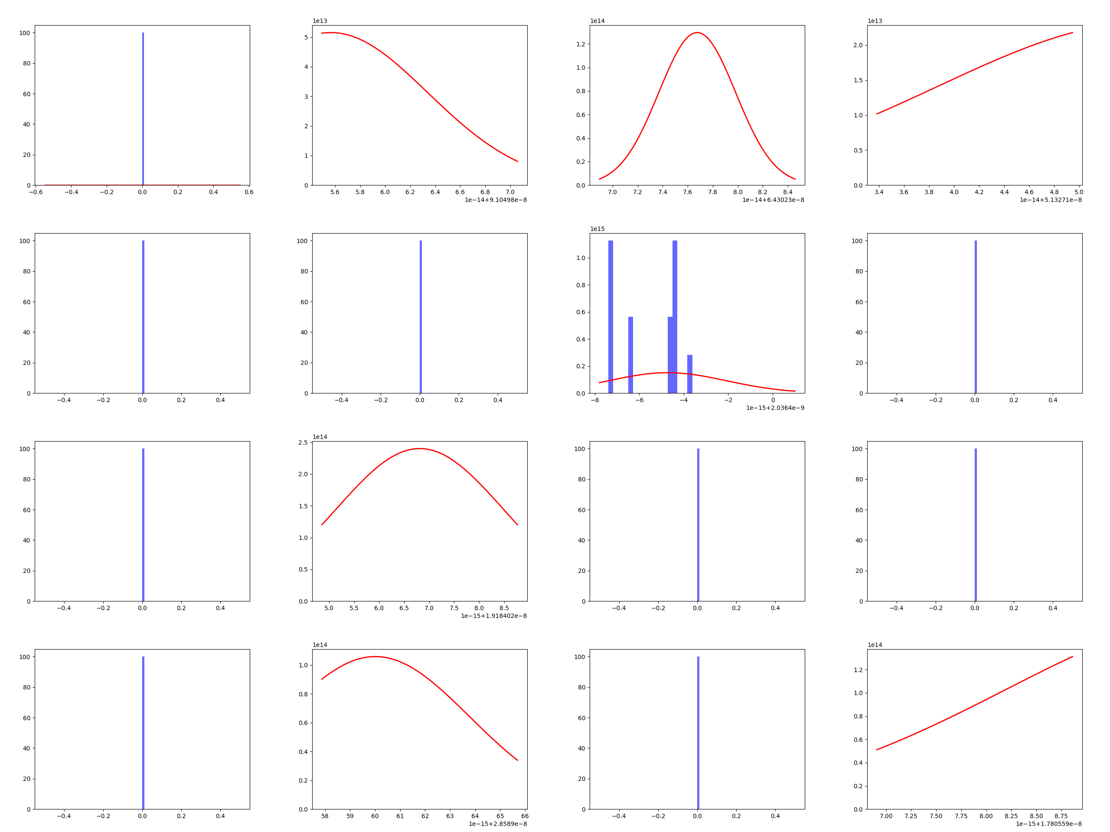
When should we use BN adaptation?
1024-dimensional distributions
Projection
per-dimension
What is going on???

Slide 28
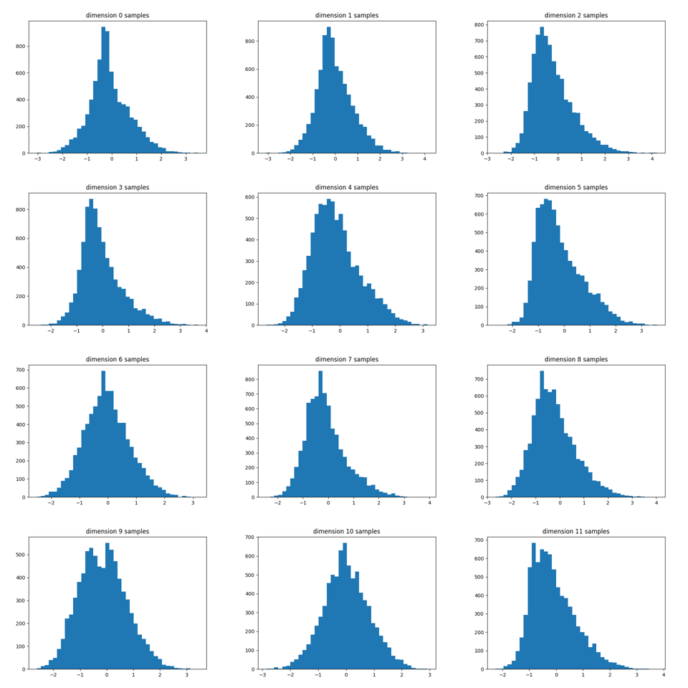
When should we use BN adaptation?
Removed weight decay +
Before ReLU
1024-dimensional distributions
Projection
per-dimension
We can work with this!

Slide 29
When should we use BN adaptation?
1024-dimensional distributions
 | WASSERSTEIN | SLICED WASSERSTEIN | BHATTACHARYYA
Accounts for | full distribution | projections | projections
Assumptions | Gaussianity | - | -
Sparsity of data | causes less issues | causes issues | causes issues
Computations | Rounding errors | [?] | manageable
distance

Slide 30
When should we use BN adaptation?
1024-dimensional distributions
Latent spaces
Source dataset → U-Net
Distance
(Bhattacharyya /
Wasserstein / …?)
Target dataset → U-Net
(adapted)
Predict BN adaptation improvement

Slide 31
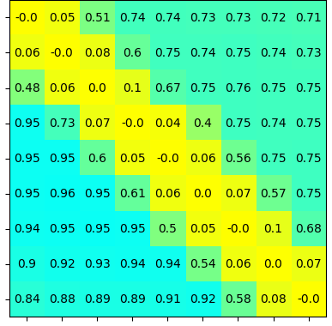
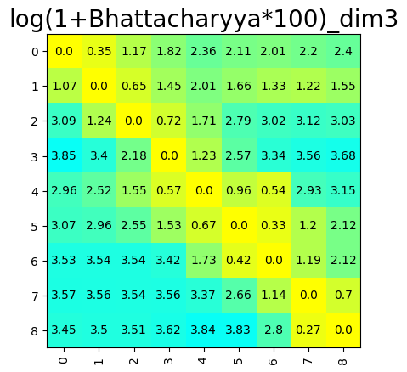
When should we use BN adaptation?
BN adaptation
improvement
Bhattacharyya
Close! But not there yet ...

Slide 32
Synthesis and future ideas

Slide 33

Synthesis
- BN adaptation works well with brightness shifts
- it can correct irregular training
- We need more experiments to find a good predictor for the improvement!
- in some cases it does not improve the performance

Slide 34
Future ideas
APRIL | MAY | JUNE | JULY | AUGUST | SEPTEMBER
What is the plan for my next 2 months?
What I’m working on
- keep experimenting with different datasets combinations
- test on all latent spaces of UNet
- test different distance measures (e.g. sliced Wasserstein)
- test for different image transformations (cropping, affine transformations, deformations, brighness, contrast, hue, ...)

Slide 35
Thanks for your attention!

Slide 36
- extra slides -

Slide 37
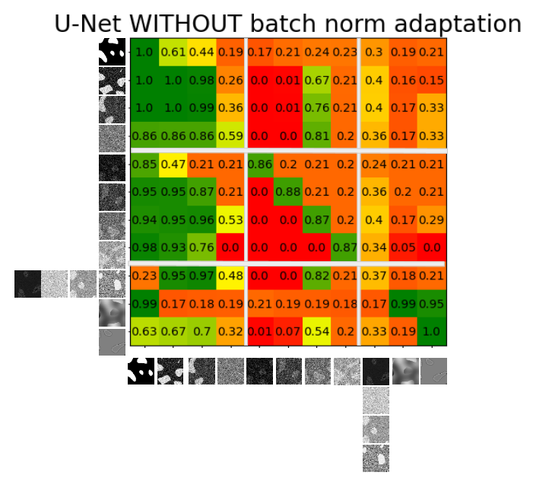
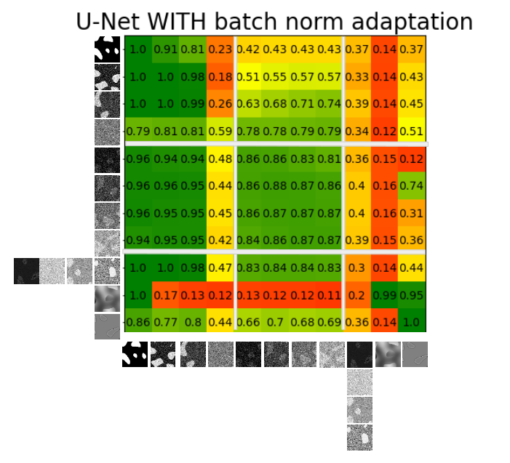
EXTRA

