Slide 1

Facial Recognition using Convolution Neural Network
Batch No: B-01 Project Guide:
M. Sai Rahul (164G1A0589) Dr. T. Hitendra Sarma Ph.D.
Syam Kakarla (164G1A05B0) ` Professor
G. Priyaranjan Reddy (164G1A0571)
C. Sai Charan Singh (164G1A0584)
Srinivasa Ramanujan Institute of Technology
Department of Computer Science & Engineering

Slide 2
Abstract
Facial recognition is one of the popular biometric process which is widely used in surveillance, security, criminal identification, etc.
Deep learning is a subset of machine learning which uses artificial neural networks inspired by the human brain to solve supervised and unsupervised learning problems

Slide 3
Contd..
Convolution Neural Networks is one of the neural network architectures, heavily used in face recognition problems.
This project proposes a convolutional neural networks (CNN) based facial recognition system

Slide 4
Contd..
This proposed facial recognition system includes :
Building the new face dataset
Data Preparation
Data Analysis
Building the CNN model
Training
Evaluation
Hyper Parameter Tuning
Prediction

Slide 5
Hardware and Software Requirements
Hardware :
CPU: 1xsingle core hyper threaded
RAM: .~12.6 GB Available
Disk: ~320 GB Available
GPU: 1xTesla K80
Software :
Python3
Jupyter Notebook
Scikit Learn
TensorFlow

Slide 6
Existing System
There are several existing systems for face recognition like:
Local Binary Pattern Histogram ( LBPH )
PCA
LDA
Eigen Face R+ecognition
Fischer Face Recognition

Slide 7
Proposed System
The proposed system is based on convolutional neural networks which performs feature extraction automatically
This project aims to develop an end-to-end process to build a custom facial recognition system using convolutional neural network.

Slide 8
Problem Definition
To develop a real time facial recognition system the existing architectures may or may not be handy with real time data.
In order to deal with such real time data we will build a CNN model with high accuracy

Slide 9
Planning
1 : Data Collection 2 : Data Cleaning and Exploratory Data Analysis
3 : Model building, training and hyperparameter tuning
4 : Developing web application
5 : Documentation, Verification

Slide 10
Literature Survey
[1] Face Recognition Based on Convolutional Neural Network
A modified CNN architecture by adding two normalization operations to two of the layers
The normalization operation used is Batch Normalization
The CNN architecture uses Softmax to classify the faces
In the experimental part Georgia Tech Database is used
An accuracy of about 98.8 is obtained.

Slide 11
Literature Survey
[2] Illumination Invariant Face Recognition using Convolutional Neural Networks
The problem of face recognition under non-uniform illumination using deep convolutional neural networks (CNN) is addressed
The symmetry of facial information is exploited to improve the performance of the system by considering the horizontal reflections of the facial images
Experiments conducted on Yale facial image dataset demonstrate the efficiency of the proposed approach
Fuzzy fischer approach was used in this problem
Near infrared (NIR) has the potential to overcome the problems associated with visible and thermal IR face recognition which is more robust against illumination variations and face detection

Slide 12
Literature Survey
[3] A Convolutional Neural Network based on TensorFlow for Face Recognition
A Convolutional Neural Network (CNN) based on TensorFlow, an open source deep learning framework, is proposed for face recognition
Experimental results show that the proposed method has better recognition accuracy and higher robustness in complex environment
They have used Adaboost algorithm

Slide 13
Literature Survey
[4] When Face Recognition Meets with Deep Learning: an Evaluation of Convolutional Neural Networks for Face Recognition
It uses LFW database (Labelled Faces in the Wild)
It also gives a major comparison of 3 published CNNs like DeepFace, DeepID, WebFace.
Quantitatively compares the architectures of CNNs and evaluates the effect of different implementation choices.

Slide 14
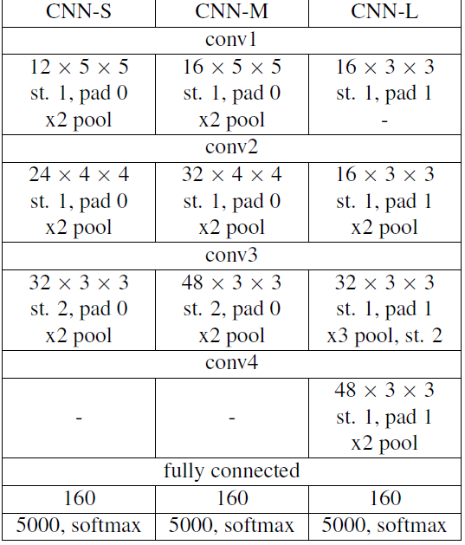
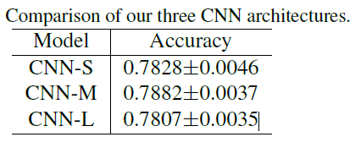
Literature Survey (Cont..)

Slide 15
References
[1] Coşkun, Musab, et al. "Face recognition based on convolutional neural network." 2017 International Conference on Modern Electrical and Energy Systems (MEES). IEEE, 2017.
[2] Ramaiah, N. Pattabhi, Earnest Paul Ijjina, and C. Krishna Mohan. "Illumination invariant face recognition using convolutional neural networks." 2015 IEEE International Conference on Signal Processing, Informatics, Communication and Energy Systems (SPICES). IEEE, 2015.

Slide 16
References
[3] Yuan, Liping, et al. "A convolutional neural network based on TensorFlow for face recognition." 2017 IEEE 2nd Advanced Information Technology, Electronic and Automation Control Conference (IAEAC). IEEE, 2017.
[4] Hu, Guosheng, et al. "When face recognition meets with deep learning: an evaluation of convolutional neural networks for face recognition." Proceedings of the IEEE international conference on computer vision workshops. 2015.

Slide 17
Thank you
Queries
?
Notes:
DOS VIDANYA

