Slide 1

DataCrafters
Ahmad Sadin, Alvise Bolzonella, Marco Gasparini, Seyedreza Safavi
Database II (Graph Databases)
PROF. GIANMARIA SILVELLO

Slide 2
Table of contents
01
02
03
Domain and Datasets
Domain Modelling and Ontology
04
Cleaning and Ingestion
SHACL Validation
05
06
Insightful Queries
Conclusions

Slide 3

01
Domain and Datasets

Slide 4
Domain and Datasets
We have decided to model a very big domain: football players and teams statistics.
They can be interesting for soccer fans and useful for people in the soccer business, and there have been efforts to make them powerful performance evaluation tools.
Our focus has been on their values and evolution through recent years. Our data describe top 5 European leagues: Bundesliga (Germany), LaLiga (Spain), Ligue 1 (France), Premier League (England) and Serie A (Italy).

Slide 5
Domain and Datasets
Kaggle datasets:
“In-depth soccer statistics”: detailed stats about players of main European leagues through recent years. Scraped from understat.com. One file per season, 2014 to 2020. “Main dataset”.
“Football data from Transfermarkt”: extensive collection of statistical, economic and overall information about players, clubs and competitions.
“Soccer player values and their statistics”: detailed, but less complete than the main dataset; scraped from Fbref. One file per season, 2017 to 2020. “Auxiliary dataset”.

Slide 6
02
Domain modelling and Ontology

Slide 7
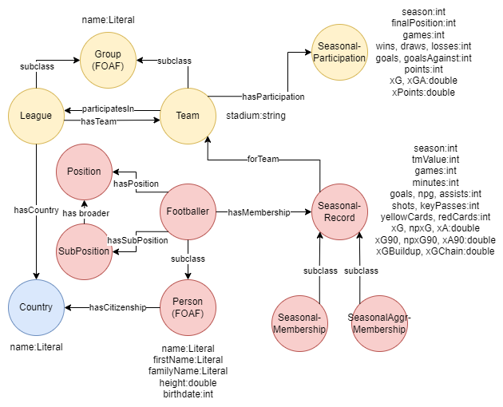
Domain Modelling

Slide 8
Domain Modelling Modelling statistics
Core entities to model seasonal statistics:
SeasonalRecord for players;
SeasonalParticipation for teams.
SeasonalRecord is a “wrapping” superclass for:
SeasonalMembership, collecting information about a player in a single team;
SeasonalAggrMembership, summarizing information about players going to a new team mid-season. Useful for query purposes (see later).

Slide 9
Domain Modelling External ontologies
Use of FOAF ontology:
Footballer subclasses FOAF’s Person;
League and Team subclass Group.
Use of SKOS: subpositions (e.g. left back) related to corresponding positions (e.g. defender) by means of has broader property.
In fact, Position and SubPosition are enumerated classes: their instances are added at ontological level, given that in TM they are few and well-defined.

Slide 10
03
Cleaning and Ingestion

Slide 11
Cleaning and Ingestion Matching issues
A challenging problem we had to face was to match items from other sources to Transfermarkt dataset, which we considered as a benchmark.
The issue is that names of the same players and teams can be different in different datasets.
Some reasons:
Nicknames (commonly used for Brazilian players)
Transliteration
Character encoding issues

Slide 12
Cleaning and Ingestion Matching strategies
Ideal situation: exact, unique match on “candidate name”.
In case of zero matches, different heuristic strategies:
Permuting candidate name: in TM multiple family names could be in a different order.
Looking for a very high similarity: could be successful in case of slightly different transliteration choices.
It may be needed to choose between multiple matches:
for each matched player, count his occurrences in the TM game logs for the considered season, and pick him if the result is equal to candidate player’s games in external dataset.

Slide 13
Cleaning and Ingestion Matching strategies (2)
Anyway, one strategy turned out to be the most effective (though not the most efficient) to cope with these issues: googling.
The googlesearch-python module provides an easy way to issue a query and explore the SERP.
In practice, searching “<team>/<player + pl. team> transfermarkt profile”, it’s very likely that the top ranked result is a TM page (hopefully the desired one). At this point, it’s enough to parse its URL to obtain the TM id allowing to access the correct rows in the benchmark datasets.

Slide 14
Cleaning and Ingestion Completing statistics
GOAL: for players traded during a season, we want both aggregate and per-team statistics.
Useful for queries with different point of views (teams or player career).
PROBLEMS: for trades inside a league, only aggregate stats (one row) available in the main dataset. For trades across leagues, two distinct rows present.

Slide 15
Cleaning and Ingestion Completing statistics (2)
SOLUTIONS:
FBref dataset contains separate rows in the first case: so, when an aggregate row is met in the main dataset and a match on the player’s name is found in the auxiliary one, two rows describing the two halves of the season are appended to the dataframe.
For trades across leagues, we just compute and append one row with total statistics.

Slide 16
04
SHACL Validation

Slide 17
SHACL Validation
After the ingestion of the data we have checked that all data are valid in order to avoid inconsistencies and discrepancies.
The majority of the check have the goal to avoid duplicate records.
Other validation scripts were made to check the consistence of all the datatypes in the database.

Slide 18
05
Insightful Queries

Slide 19
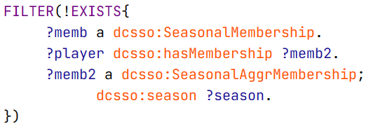
A useful SPARQL snippet
GOAL: get career details about a player, team by team and/or season by season, and maybe some aggregation on them
Some seasons are described by two SeasonalMemberships and one SeasonalAggrMembership. On aggregations, or for some visualization purposes, we must consider just one type.
SOLUTION:

Slide 20
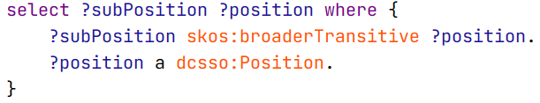
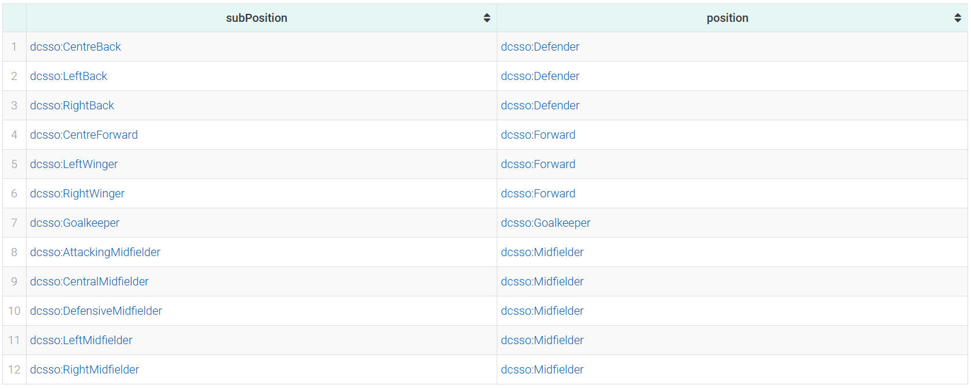
Subpositions
List of all subpositions, linked to positions by SKOS “has broader” property.

Slide 21
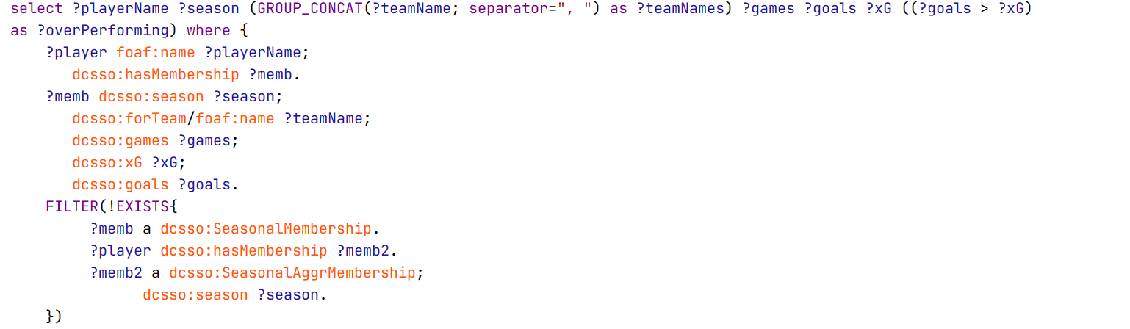
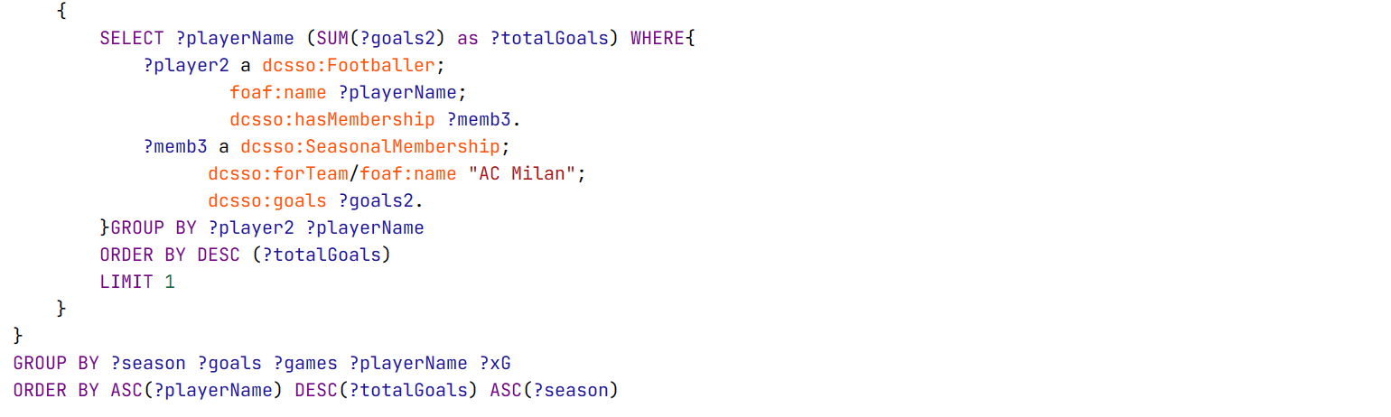
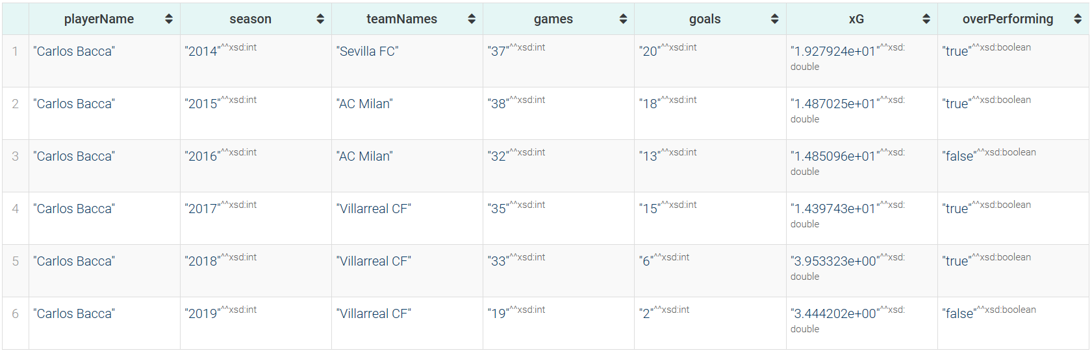
Career of best team scorer
Season-by-season career summary of best overall scorer of AC Milan.
“Overperforming” means that his actual goals were more than the xG.

Slide 22
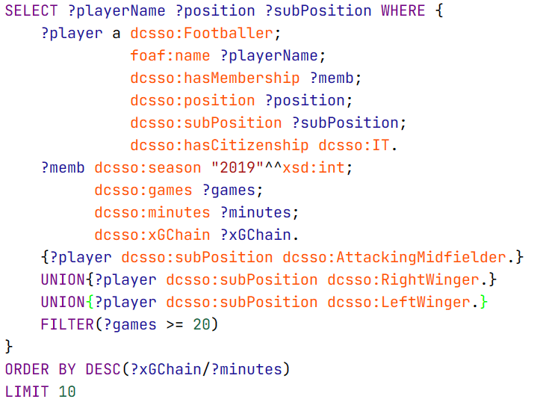
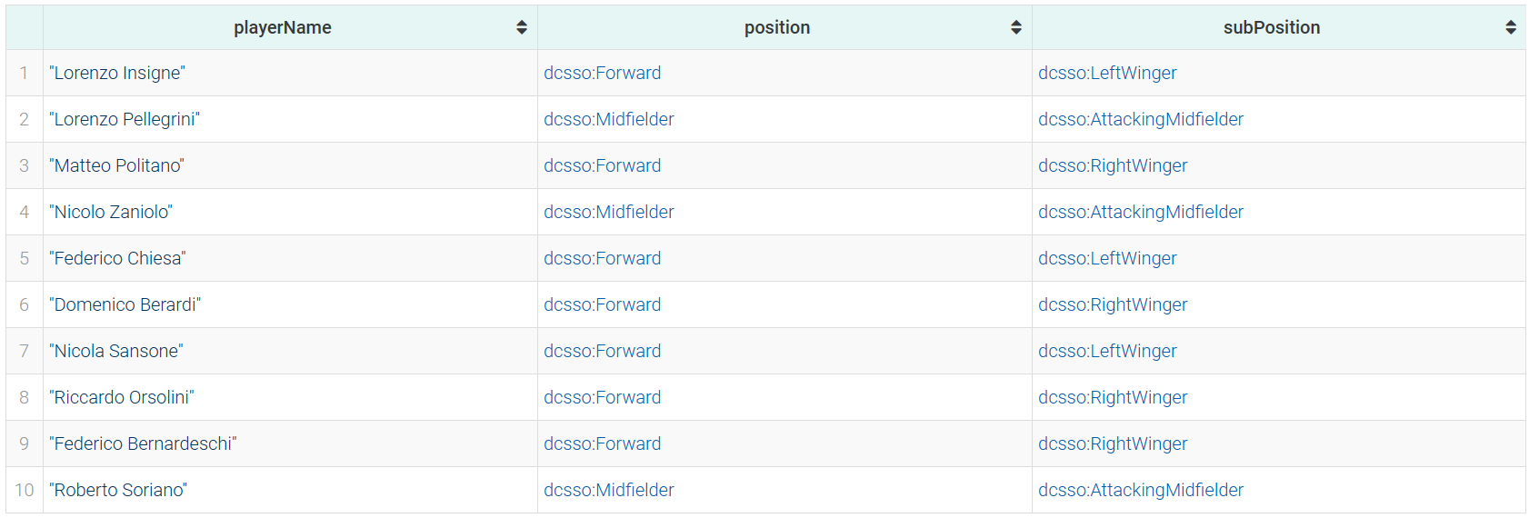
Italian best offensive players
After 19/20 season, the coach of the Italian national team wants to select the best offensive players in terms of overall contribution to the attacking phase.

Slide 23
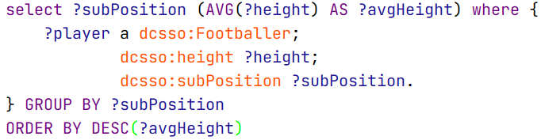
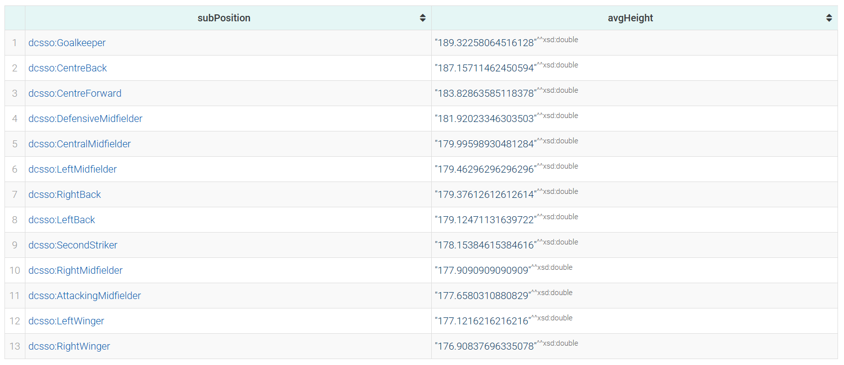
Average height by subposition

Slide 24
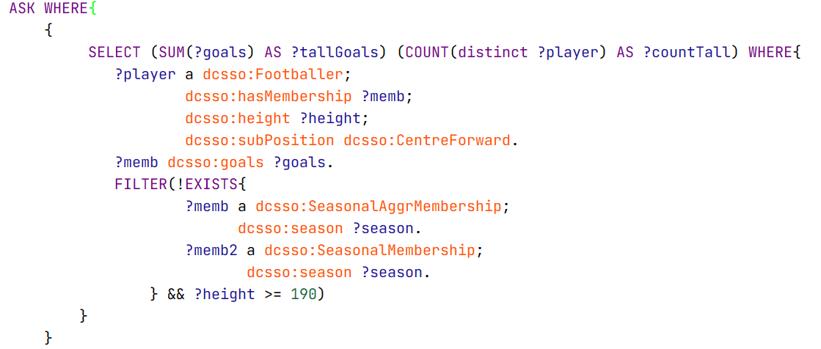
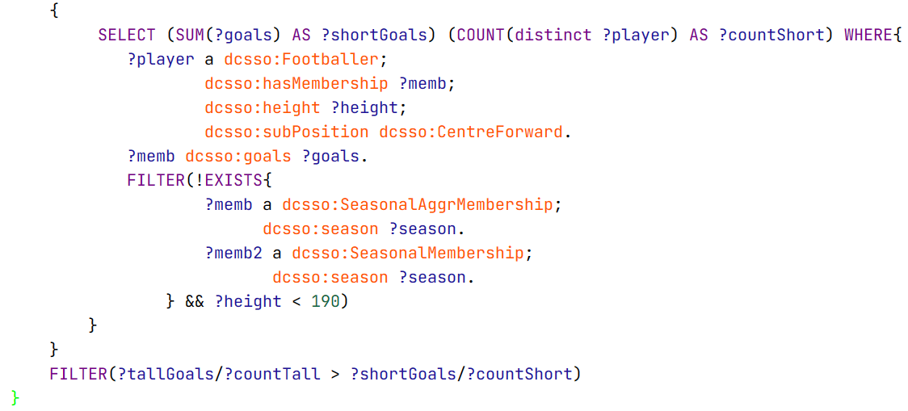

Tall vs short forwards
Is it true that centre forwards with an height >= 190 cm score on average more than the others?

Slide 25
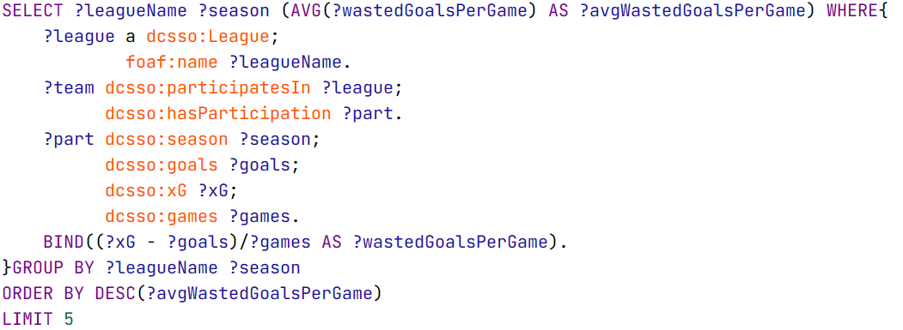
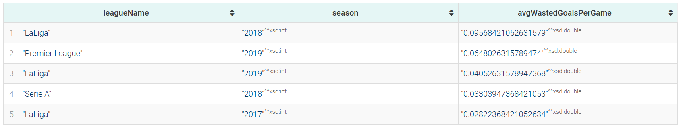
Wasted goals
«Wasted goals» is just a label for the difference xG - goals.
Which were the seasons when most goals were wasted?
We average on games for each team, and on teams for each league.

Slide 26
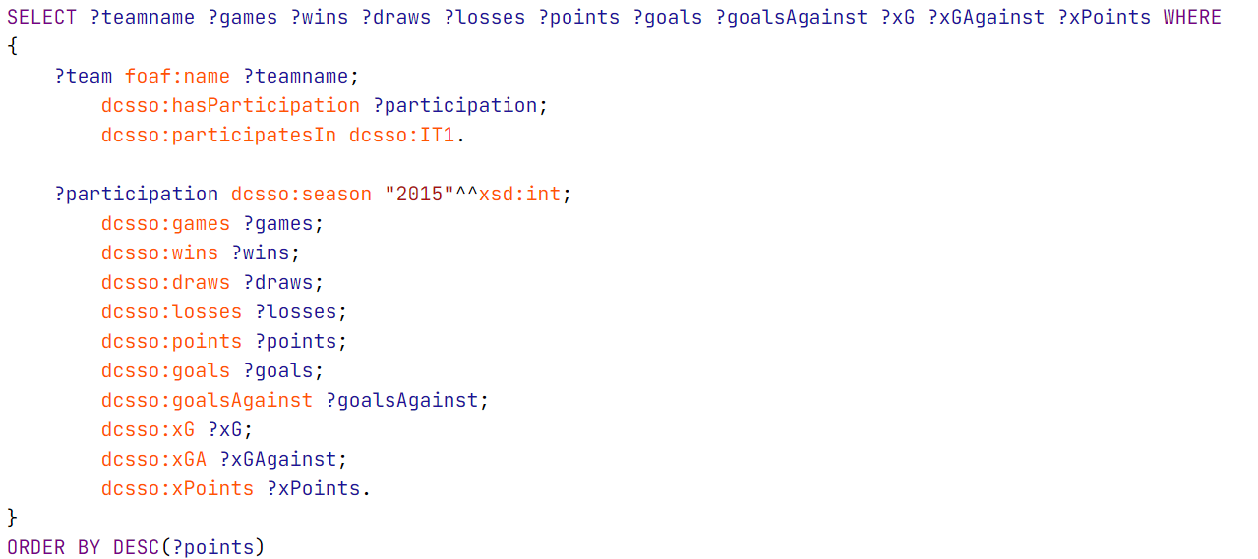
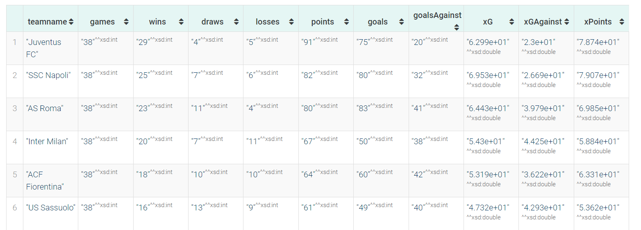
Standings
Query to visualize the standing of a league in a specific season.
Ordering the query by xPoints you can visualize the statistical standing.

Slide 27
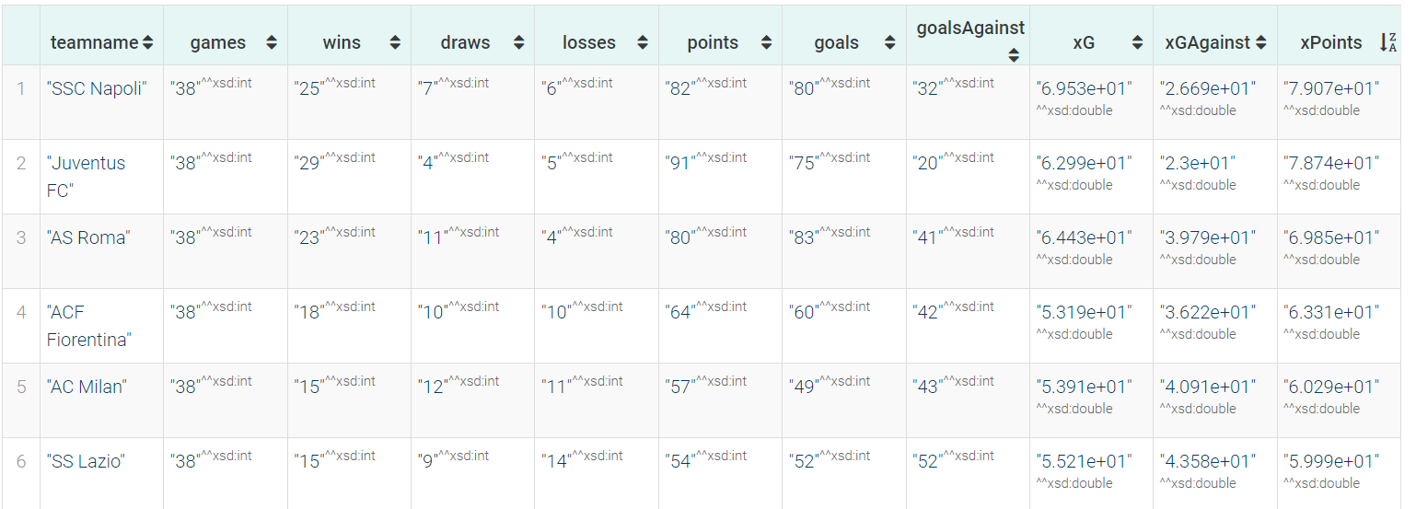
Standings
Query to visualize the standing of a league in a specific season.
Ordering the query by xPoints you can visualize the statistical standing.

Slide 28
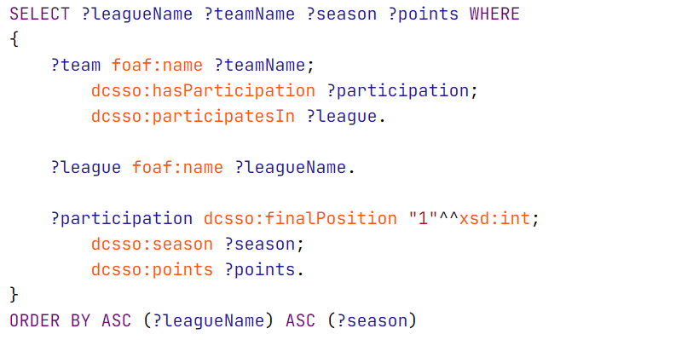
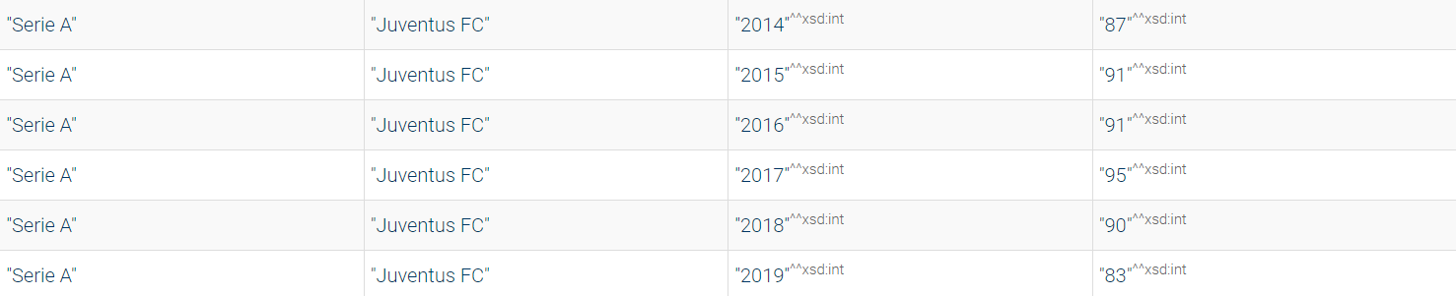
Hall of Fame
Query to visualize the Hall of Fame of the top 5 European leagues.
In the results we can see the league and the season considered with its winner and the points achieved.

Slide 29
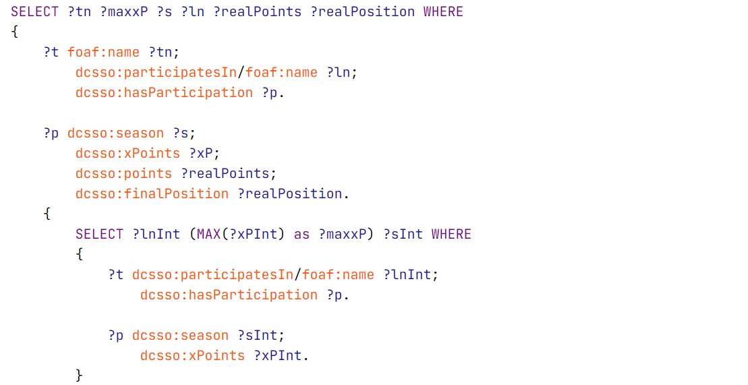
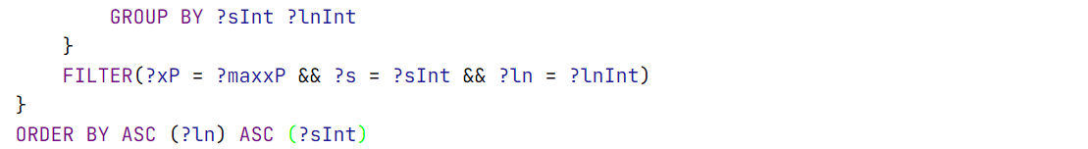
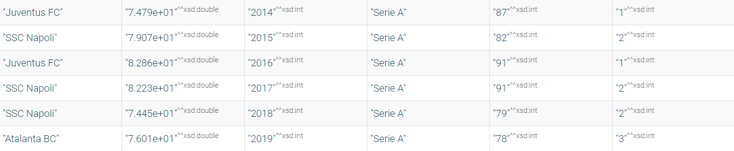
Statistical Hall of Fame
Query to visualize the statistical Hall of Fame of the top 5 European leagues.
The Hall of Fame is based on xPoints and shows also the team’s real points and real position.

Slide 30
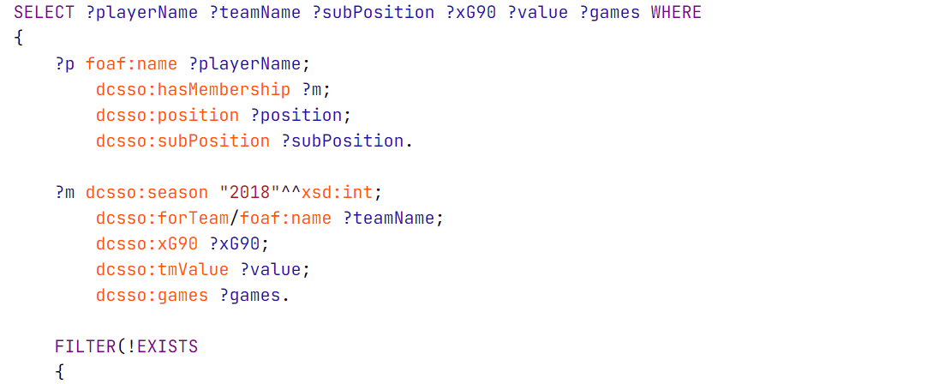
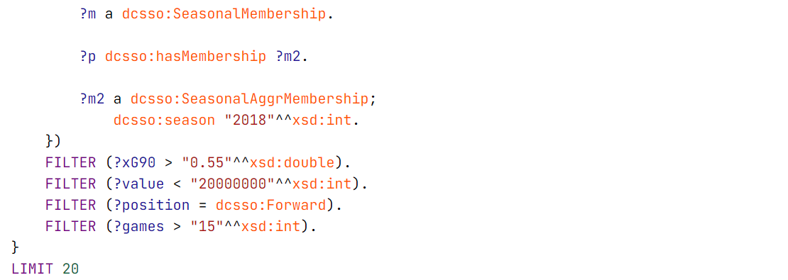
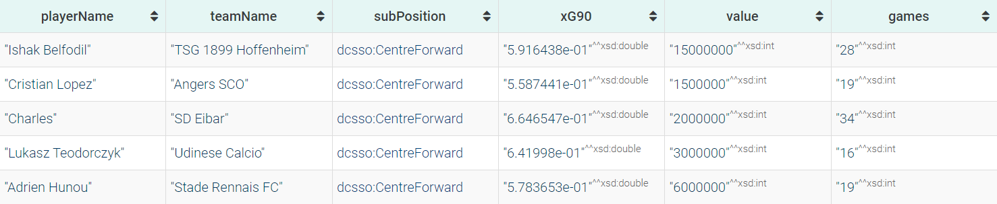
Market hidden gems
A football director wants to find some hidden gems to buy in the market window.
An attacking hidden gem is a player with a high xG90 value and a low market value.

Slide 31
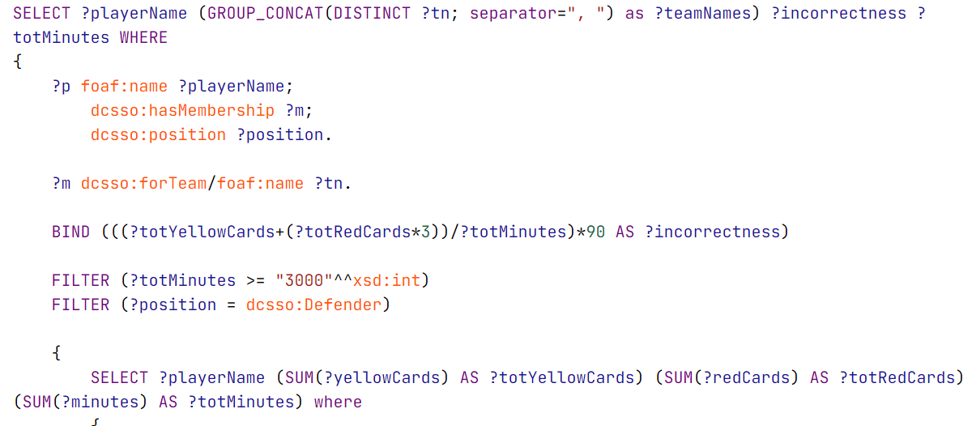
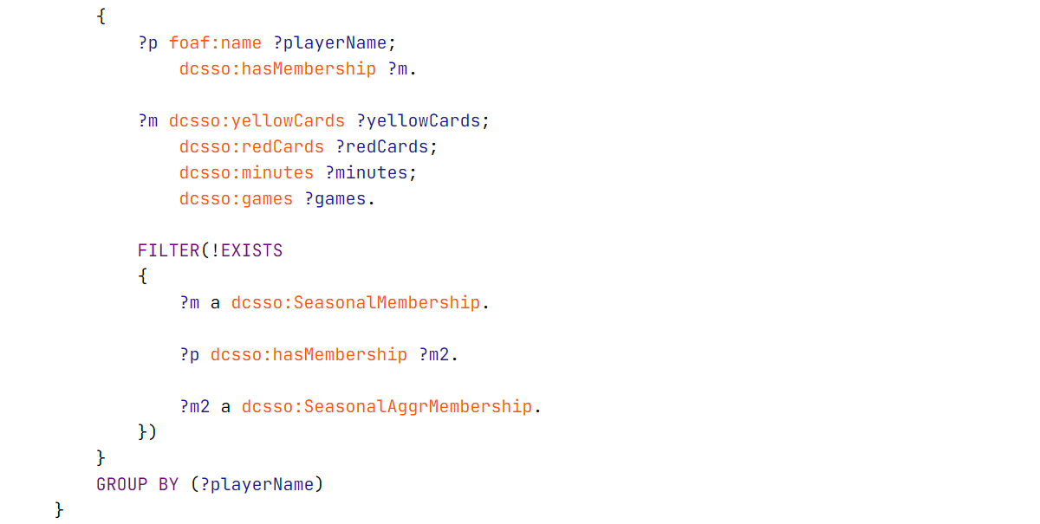
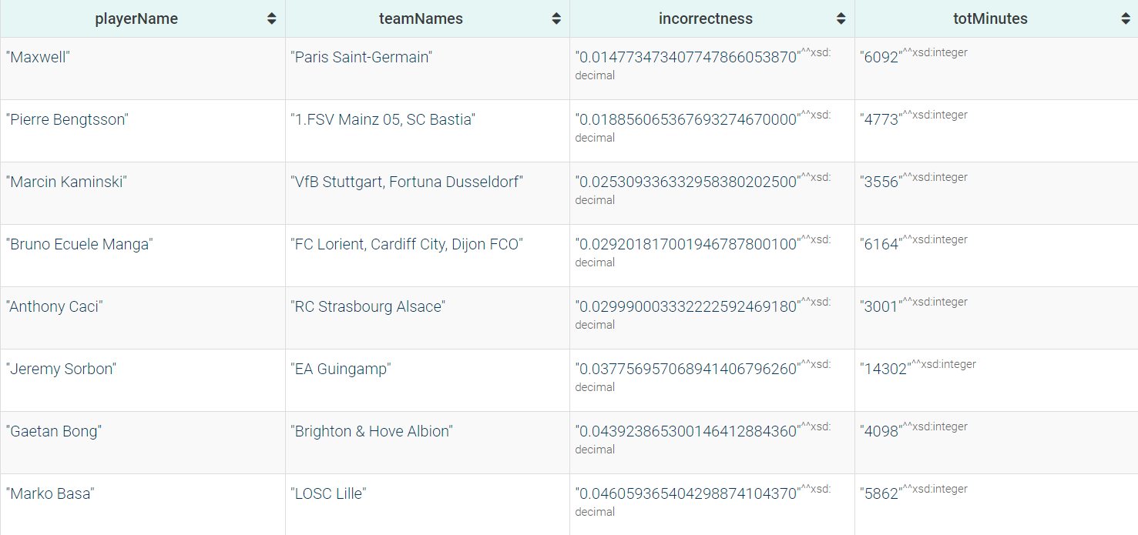
Correct defenders
List of the less incorrect defenders over all the considered seasons.
The incorrectness is computed as the number of yellow and red cards averaged in 90 minutes.

Slide 32
05
Conclusions

Slide 33
Conclusions
A database about all the statistics and records of football players and their teams can be beneficial for the work of the scouting teams.
One future improvement for the work can be the addition of all the players’ medical records.

Slide 34


Summarize key achievements

Slide 35
Thanks!
Do you have any questions?

