Slide 1

Blink Sketch con LL libraries
rev1.0 24/03/2020

Slide 2
GOAL
Toggle a GPIO Output using
LL Libraries

Slide 3
PREREQUISITES
Software needed:
STM32IDE
Hardware used in this example:
NUCLEO-F446ZE

Slide 4
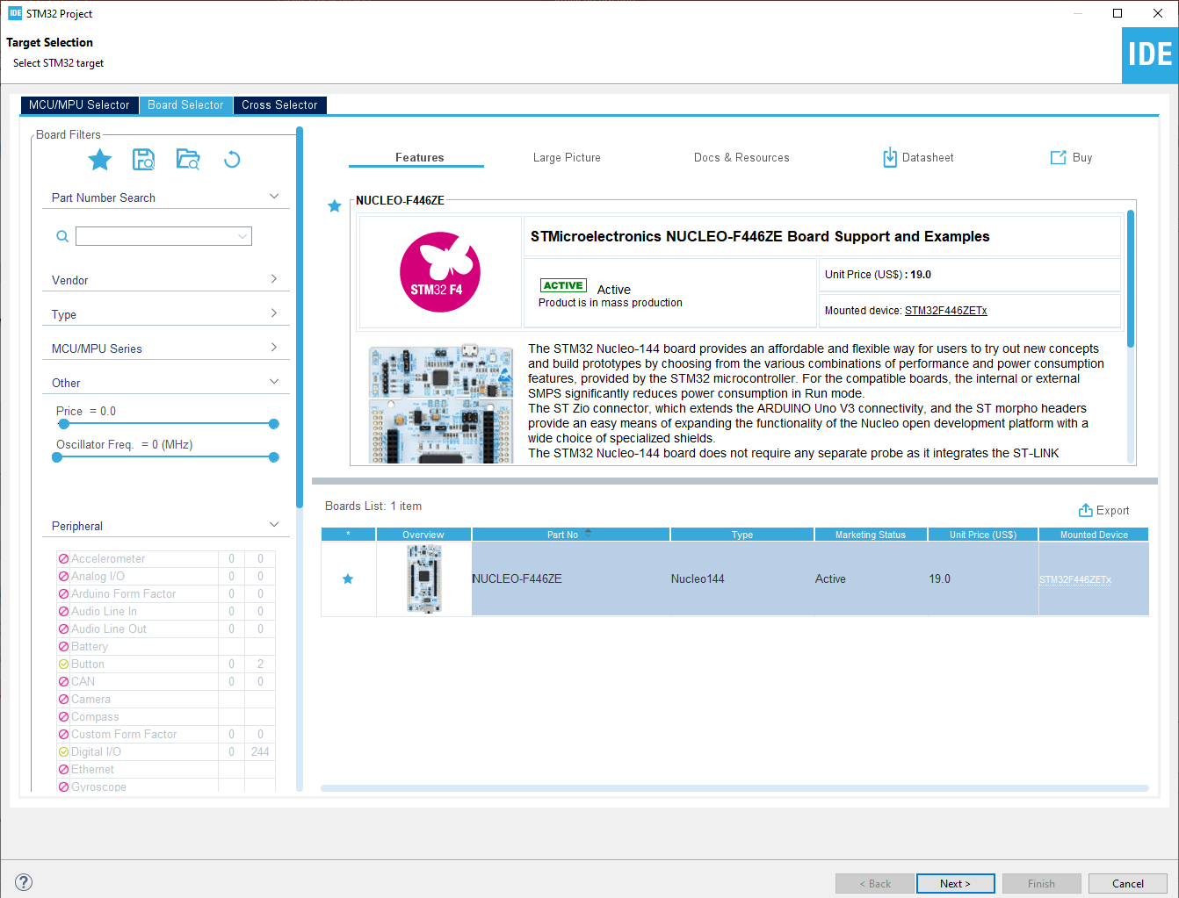
Start a new project
From the stm32IDE software click on File -> New -> STM32 Project.
Select your board or your uC and click next.

Slide 5
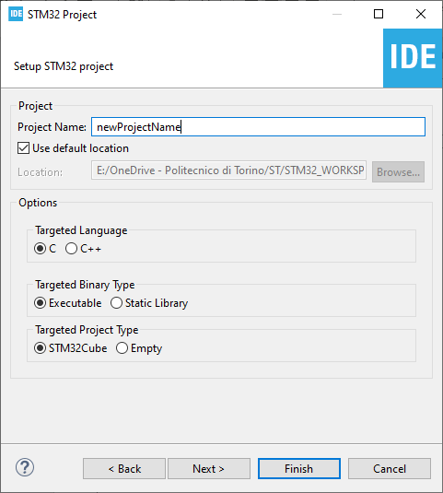
Start a new project
Type the name of your project and click next.
By default the project will be created in the workspace folder.

Slide 6
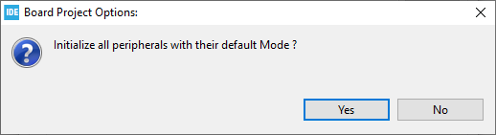
Start a new project
Type the name of your project and click next.
By default the project will be created in the workspace folder.
The STM32IDE has the option to initialize all the peripheral with their default mode:
Clicking Yes the USART3, all the LEDs and the blue UserButton will be configured as default.
Click Yes.

Slide 7
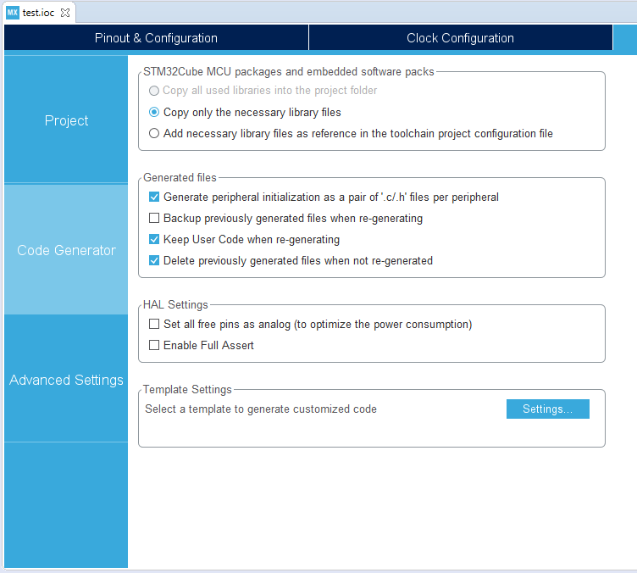
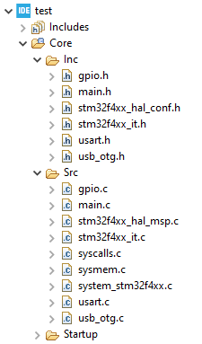
Project Manager
In the Code Generator Tab check the Generate peripheral initialization […] box: each periperhal will have a disting periph.c and periph.h files.

Slide 8
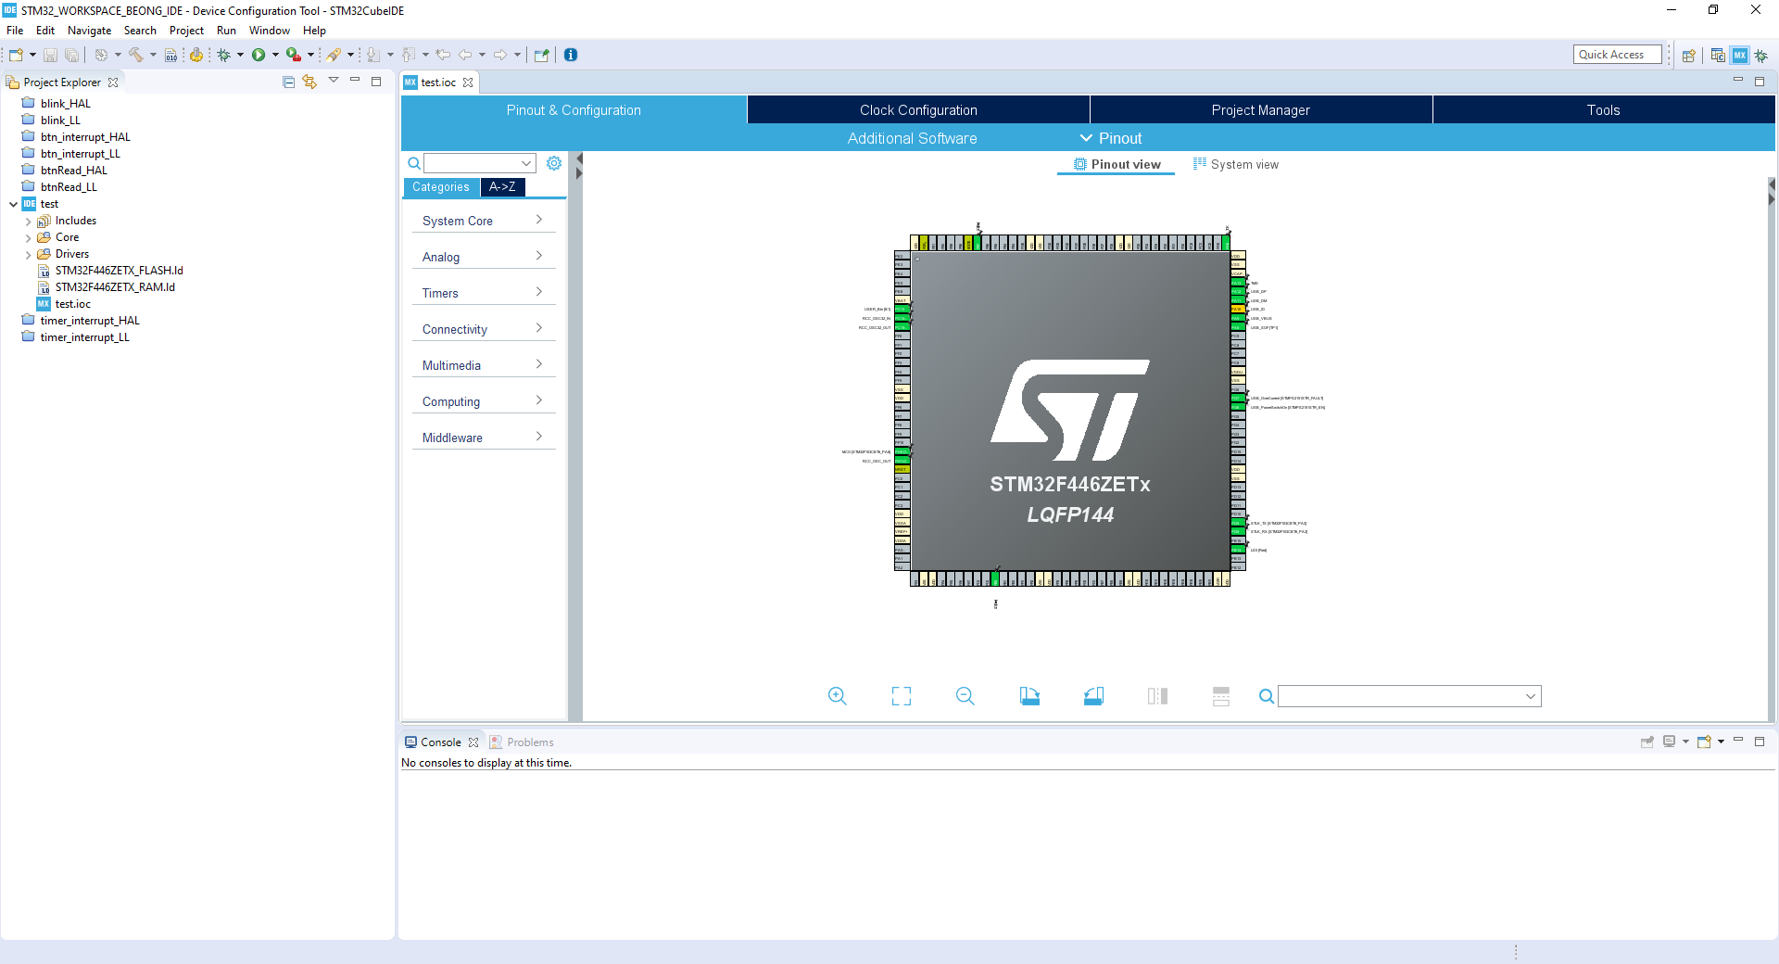
GPIO: General Pourpose Input/Output
Dopo aver creato il progetto e inizializzato le periferiche ai propri valori di default, è utile, prima di iniziare a programmare, scorrere velocemente le caratteristiche dei pin GPIO e come possono essere configurati.
Cliccando su un pin generico con il tasto sinistro del mouse apparirà una lista con tutte le possibili configurazione dei pin.

Slide 9
GPIO: General Pourpose Input/Output
After creating the project and initializing the functions to their default values, it is useful, before starting to scroll, to quickly scroll through the characteristics of the GPIO pins and how to be configured.
By clicking on a generic pin with the left mouse button a list will appear with all the pin configuration options.

Slide 10
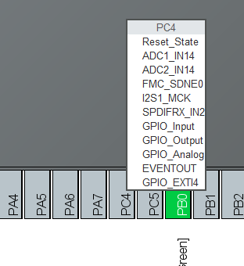
In this example we will analyze in particular the GPIO_xx:
GPIO_OUTPUT: Used to control an output device (e.g. LED, Motor, etc.)
GPIO_INPUT: It is used in case you want to read the state of an input device (eg Switch, Sensors, etc.)
GPIO_ANALOG: Similar to the input, it is used when the input device is analog (e.g. Photoresistor, Potentiometer, etc.)

Slide 11
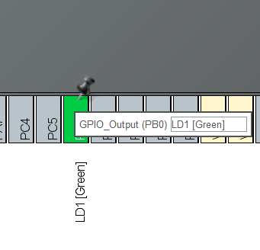
By right-clicking on an already set pin it is instead possible to insert a label, very useful when writing the code, when you have numerous peripherals to manage.
Under the heading system core → GPIO we find a more in-depth view of GPIOs

Slide 12
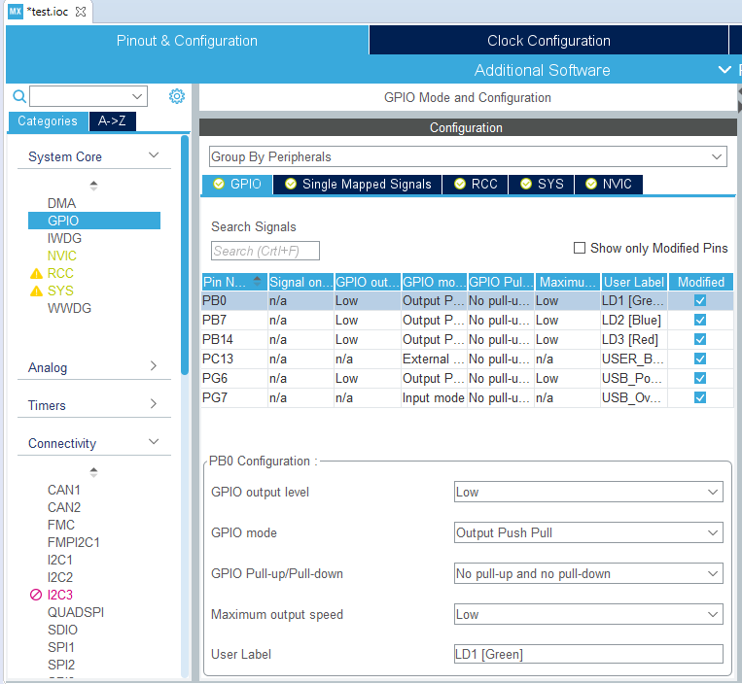
Below the GPIO tab we find the list of the set pins and their characteristics specifically.
Further down we find the Configuration section where you can set other parameters such as default output level, mode, etc.
Important, among the upper Tabs, we find the NVIC tab, useful for setting the interrupts which we will discuss later.

Slide 13
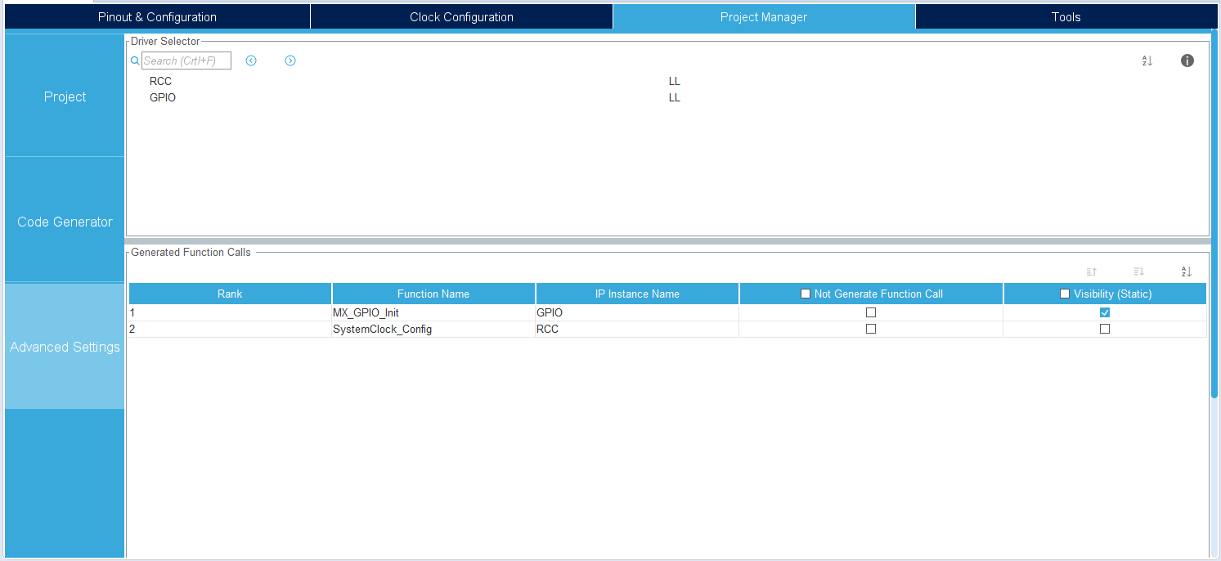

At this point, all that remains is to verify that you have chosen the HAL libraries for managing the GPIO and continue with the generation of the code using the appropriate icon.

Slide 14
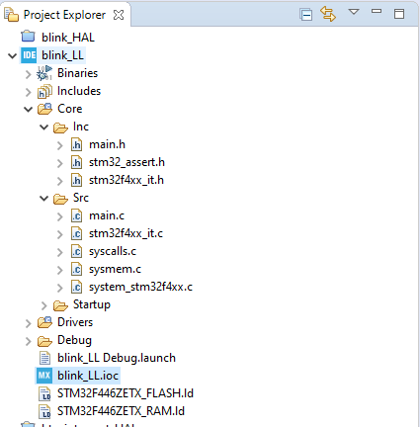
Iniziamo a Programmare
Una volta generato il codice, sulla sinistra troviamo il project explorer: da qui abbiamo una panoramica su tutti i file che compongono il nostro progetto.
Iniziamo con l’aprire il main.h e il main.c

Slide 15
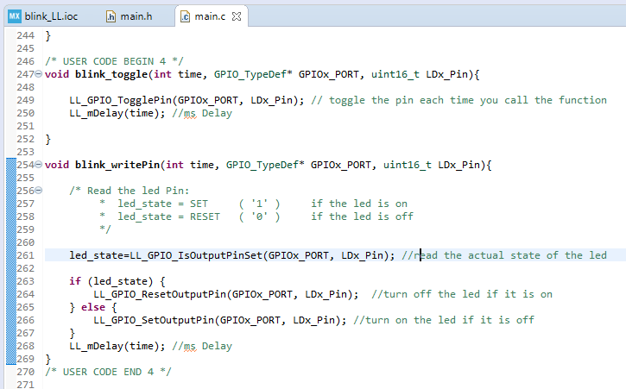
User code BEGIN and END
Inside files generated by CubeMX we will find spaces where the user can write some code: these spaces are marked with comments / * USER CODE BEGIN X * / and / * USER CODE END X * /
These will be the only fields that will not be touched after a possible regeneration of the code by CubeMX, therefore it is essential not to write outside these spaces.
In main.c, in section 4, you can add the functions written by the user, let's see them in more detail.

Slide 16
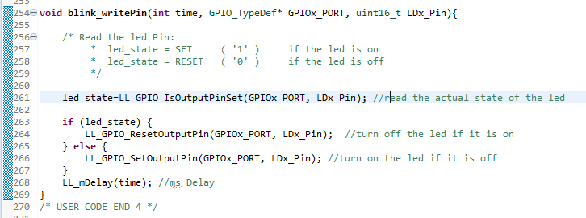
blink_writePin()
To make the led on the board flash, you can proceed in different ways:
A first strategy is to read the current state of the pin using the LL_GPIO_IsOutputPinSet function and consequently use the LL_GPIO_ResetOutputPin () function to reset the output, use the function LL_GPIO_SetOutputPin() to set output instead :
SET -> ‘1’
RESET -> ‘0’

Slide 17
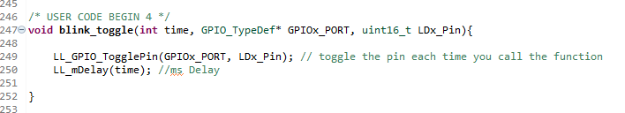
blink_toggle()
Another way to change the output of an output pin may be to use the LL_GPIO_TogglePin () function;
This does nothing but read the current state of the pin (LDx_pin) and invert its value:
If SET -> RESET
If RESET -> SET

Slide 18
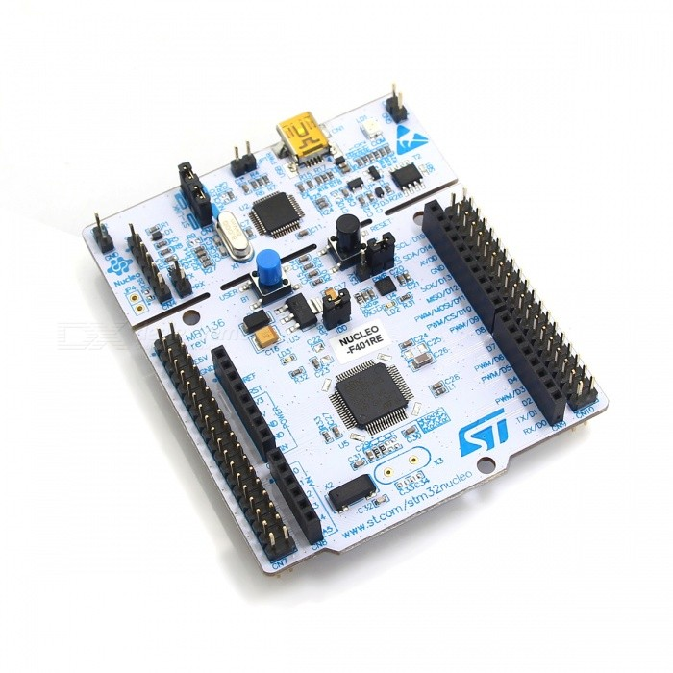
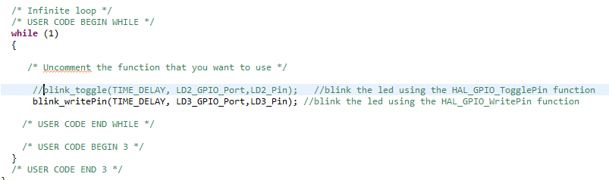
Main loop!
Within the main function, after the various initializations that CubeMX has done for us, we find the mainLoop: the program will do nothing but repeat what we will write within it indefinitely.
At this point, to make the LED flash, it is not enough to recall the functions we have just written!

Slide 19
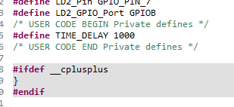
Tips & Tricks
It is good practice to write functions that are as versatile as possible, for this we use parameters.
It is also useful to use main.h to write the prototypes of the functions and also to define constants, such as the one we called TIME_DELAY so that we can use the same parameter several times in the code.
It is possible to use the CRTL + SPACE shortcut for the autocompletion of the code, indispensable!

