Slide 1

Button Read using LL libraries
rev1.0 24/03/2020

Slide 2
GOAL
Read the state of the button on the board and debounce it

Slide 3
PREREQUISITES
Software needed:
STM32IDE
Hardware used in this example:
NUCLEO-F446ZE

Slide 4
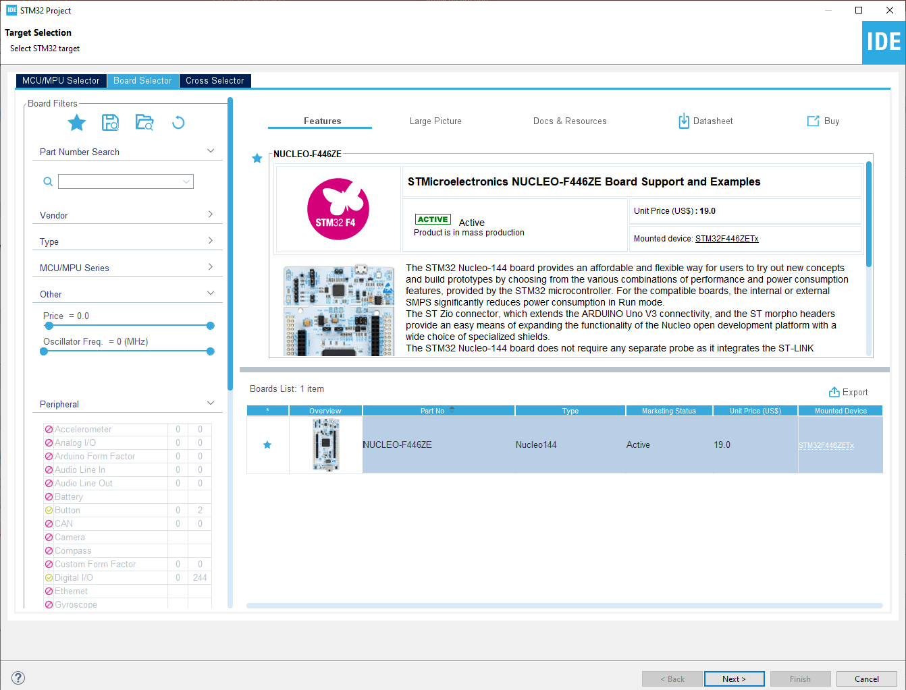
Start a new project
From the stm32IDE software click on File -> New -> STM32 Project.
Select your board or your uC and click next.

Slide 5
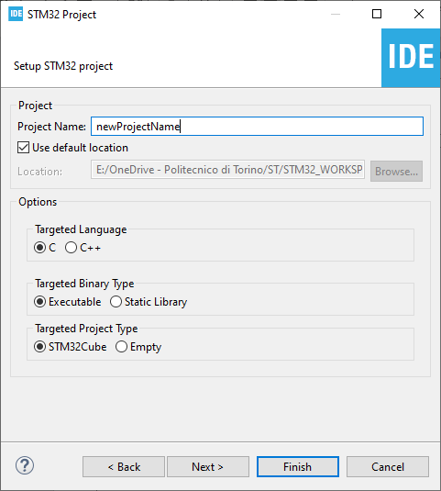
Start a new project
Type the name of your project and click next.
By default the project will be created in the workspace folder.

Slide 6
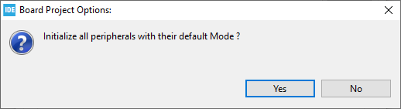
Start a new project
Type the name of your project and click next.
By default the project will be created in the workspace folder.
The STM32IDE has the option to initialize all the peripheral with their default mode:
Clicking Yes the USART3, all the LEDs and the blue UserButton will be configured as default.
Click Yes.

Slide 7
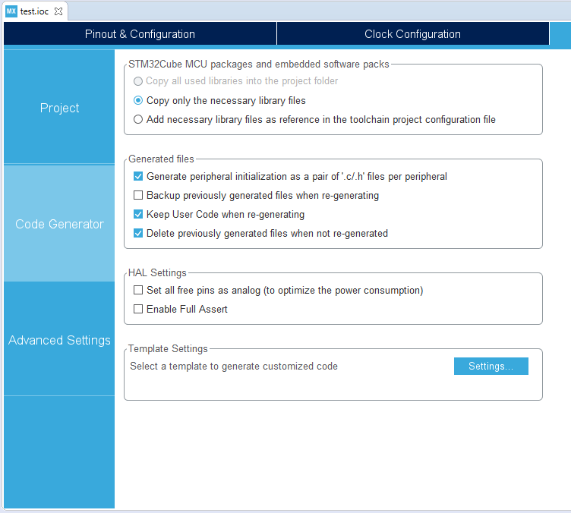
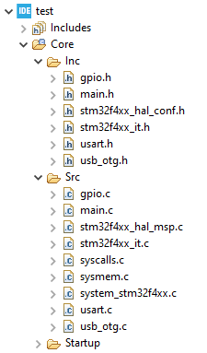
Project Manager
In the Code Generator Tab check the Generate peripheral initialization […] box: each periperhal will have a disting periph.c and periph.h files.

Slide 8
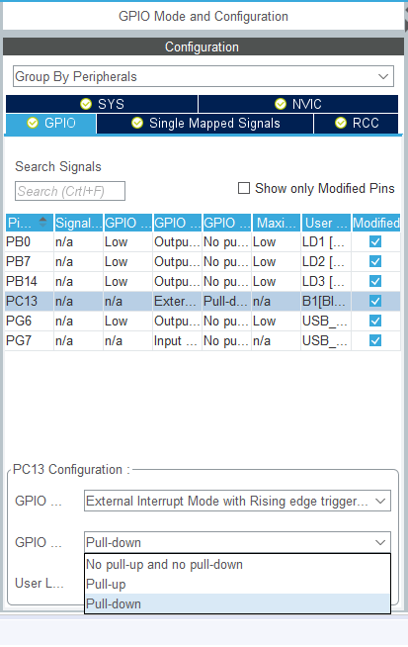
Pull-up o Pull-down ?
After the last overview of the GPIOs, it should be noted that sometimes, especially for the INPUT pins, it is convenient to decide whether these should be pull-up or pull-down, how to choose?

Slide 9
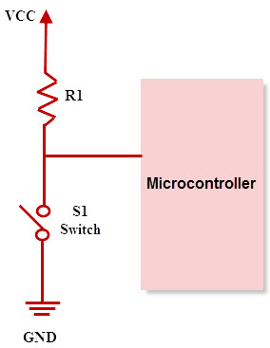
Pull-Up
In a digital circuit, the pull-up configuration is useful, when the switch that we are going to read is connected to GND:
OPEN → VCC
CLOSED → GND
In this way the input read will be:
‘1’ → Open Switch
‘0’ → Closed switch

Slide 10
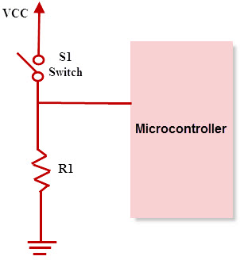
Pull-Down
n a digital circuit, the pull-down configuration is useful, when the switch we are going to read is connected to VCC:
CLOSED → VCC
OPEN → GND
In this way the input read will be:
‘1’ → Switch Closed
'0' → Open switch

Slide 11
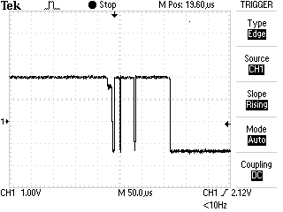
Debouncing, what is it?
When reading an input, in particular a button, it is often useful to debounce it, that is, to prevent the input noise from causing spurious switching. How to do ? There are various ways, both hardware and software, here we will focus on the second type.
Switch Bouncing prodotto dalla pressione di un pulsante

Slide 12
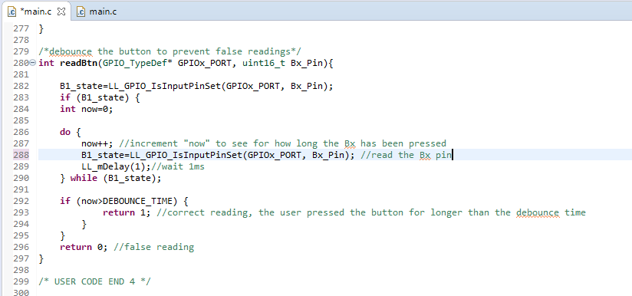
Software debouce
An example of software debounce can be the one shown here:
Through the function LL_GPIO_IsInputPinSet() the status of the input is checked: in the event that this assumes the 'SET' value then a counter is started which has the purpose of controlling how long the input is kept at a high level. The delay of 1ms causes the value assumed by the now variable to correspond to the time, in ms, during which our button was pressed.
Consideriamo una pressione volontaria del bottone se questo è stato attivo continuamente per un tempo maggiore al DEBOUNCE_TIME, altrimenti viene considerata come spuria e quindi rumore.

Slide 13
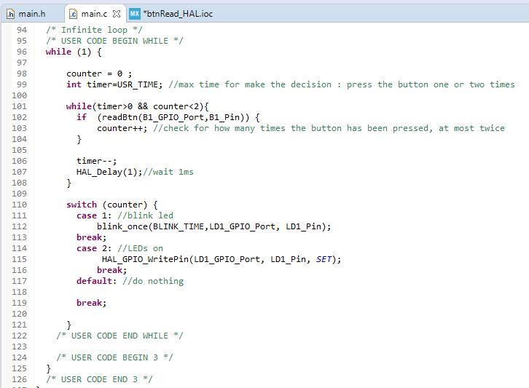
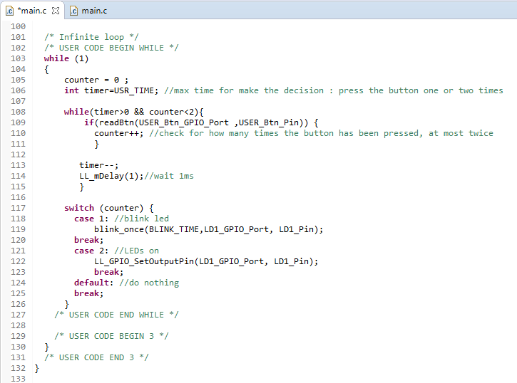
How many times has the button been pressed?
It may be useful to understand how many times the button has been pressed and then evaluate the different cases, for example:
1 press → Blink
2 presses → LED on
One strategy could be to define a USR_TIME time limit in which the user can press the button once or twice.
During this first phase, the counter variable takes into account how many times the switch is pressed.

Slide 14
How many times has the button been pressed?
As in the example above, the 1ms delay at the end of this pre-evaluation phase makes USR_TIME the ms that the user has available to make his choice.
At the end of this phase it is possible to evaluate how many times the button has been pressed using the value contained in the counter variable.

Slide 15
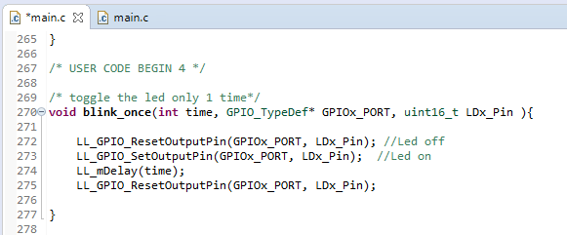
blink_once()
For completeness, the function that allows the LED to flash only once is also shown.
The code is very simple to interpret but it is important to understand the RESET→ SET passage on the first two lines which allows you to be sure of obtaining a flash ON / OFF and not vice versa.

