Slide 1

Interrupt with LL Libraries
rev1.0 24/03/2020

Slide 2
GOAL
Generate an interrupt when the blue push button has been pressed

Slide 3
PREREQUISITES
Software needed:
STM32IDE
Hardware used in this example:
NUCLEO-F446ZE

Slide 4
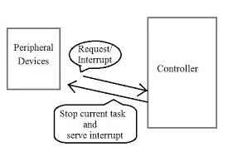
What is an Interrupt?
An interrupt is an asynchronous signal that allows you to manage situations in which particular attention is needed: there may be events such that it is necessary for the microcontroller to temporarily interrupt the normal execution of the program in order to execute a certain process.
Examples that generate an interrupt may be the pressing of a button, rather than an event at regular time intervals (timers) or a certain input being exceeded by a certain threshold.

Slide 5
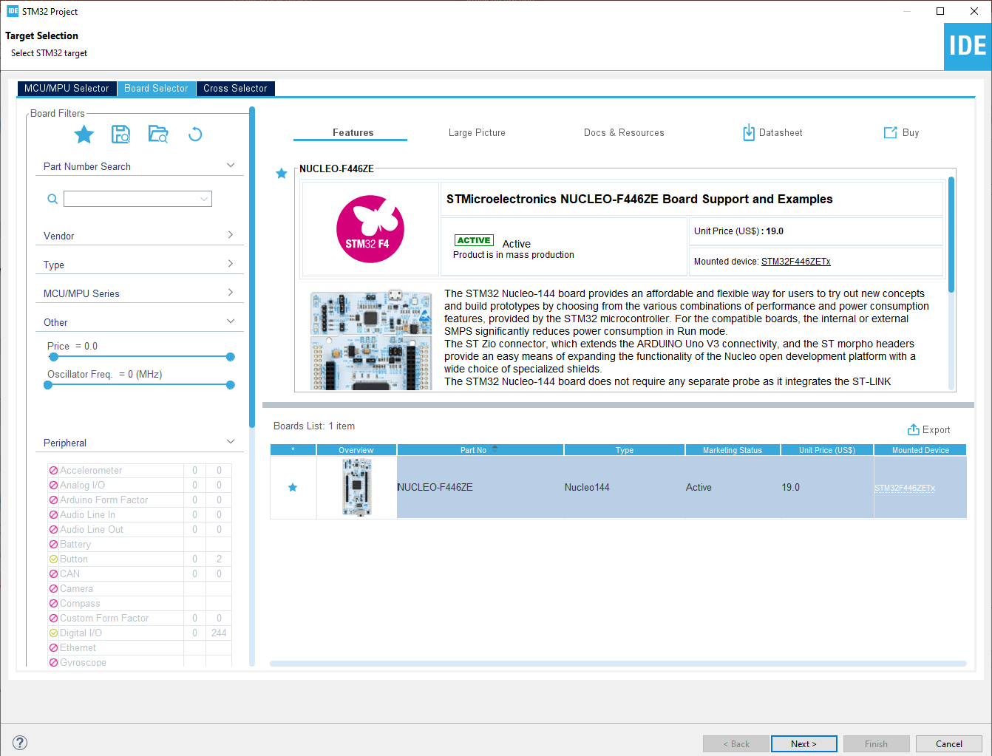
Start a new project
From the stm32IDE software click on File -> New -> STM32 Project.
Select your board or your uC and click next.

Slide 6
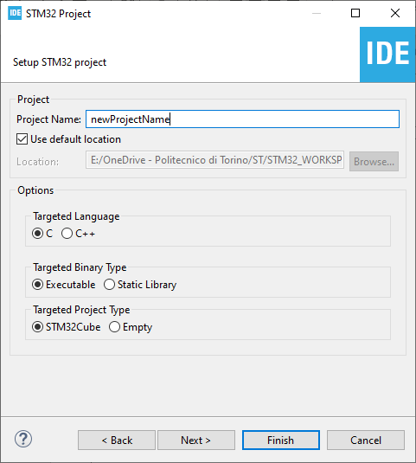
Start a new project
Type the name of your project and click next.
By default the project will be created in the workspace folder.

Slide 7
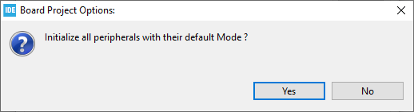
Start a new project
Type the name of your project and click next.
By default the project will be created in the workspace folder.
The STM32IDE has the option to initialize all the peripheral with their default mode:
Clicking Yes the USART3, all the LEDs and the blue UserButton will be configured as default.
Click Yes.

Slide 8
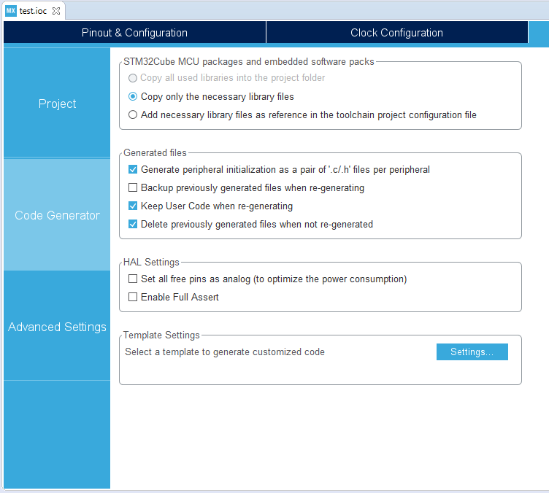
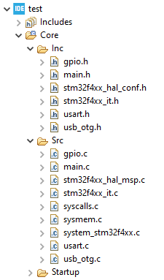
Project Manager
In the Code Generator Tab check the Generate peripheral initialization […] box: each periperhal will have a disting periph.c and periph.h files.

Slide 9
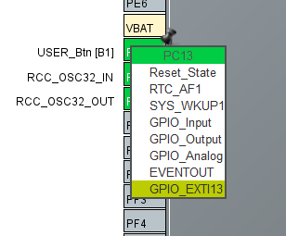
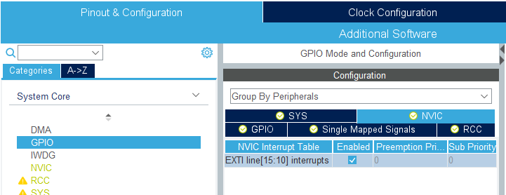
Set GPIO pin as interrupt
From CubeMX it is necessary to set the GPIO pin as GPIO_EXTIxx.
From the NVIC (Nested vector interrupt control) Tab we enable the interrupt: this causes CubeMX to worry about enabling the interrupt and setting its priority.

Slide 10
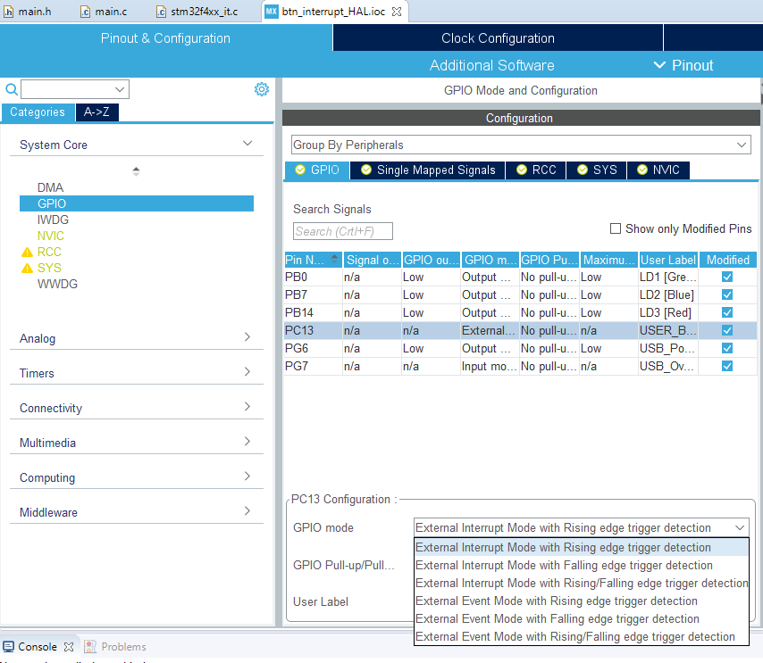
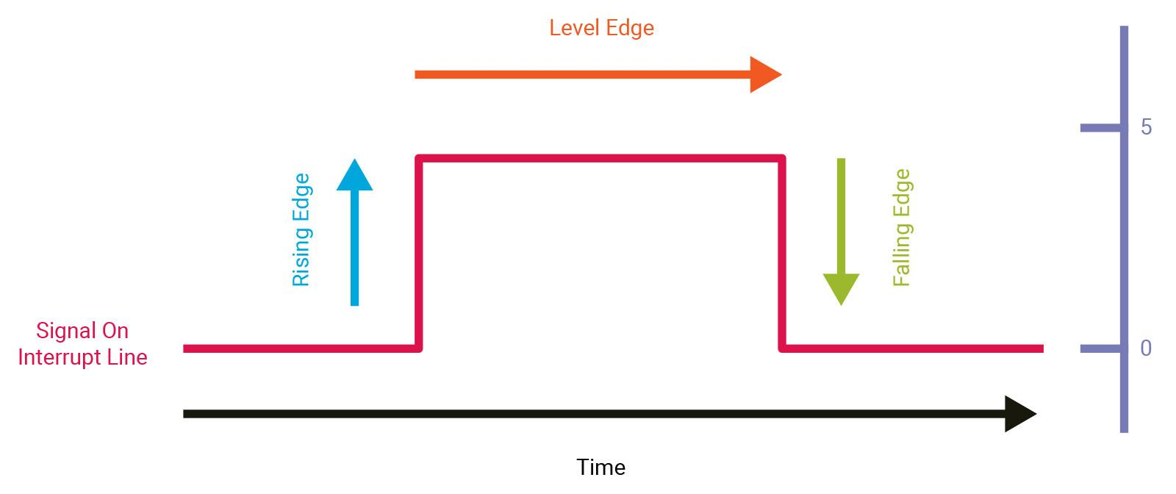
Falling & Rising edge detection
From the GPIO card, on the other hand, it is possible to manage the interrupt mode, in particular choosing whether the interrupt should be generated when detecting the rising edge rather than the falling edge, or both.

Slide 11
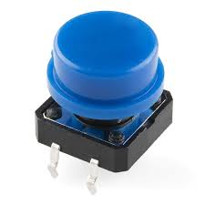
At this point we just have to generate the code and start writing our program. In this regard, we want to recreate the previous example but with the difference that this time when the button is pressed an interrupt will be generated.

Slide 12
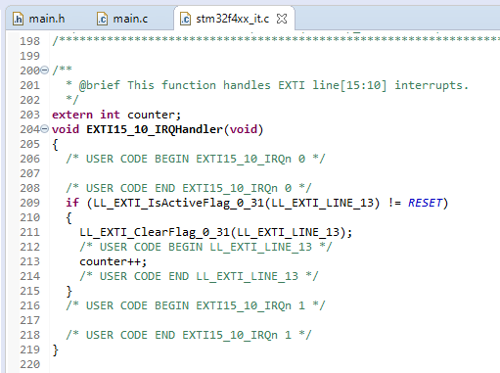
It is useful to note how CubeMX has already generated Handler for our interrupt. All Handlers are managed within the stm32f4xx_it.c file.
The LL_EXTI_IsActiveFlag() function will take care of verifying that the interrupt was generated by the correct line.
Each time the button is pressed, our counter variable will then be increased. It should be noted that we have called counter as an extern variable here, because it was defined within the main.c file.

Slide 13
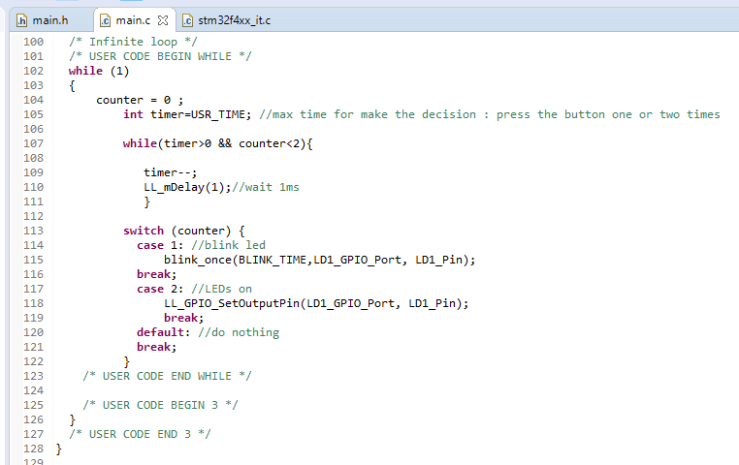
Now we just have to slightly modify the code that we wrote in the previous example: the function that took care of reading the button and increasing the counter has been eliminated, this is because now everything is managed through the interrupt.

Slide 14
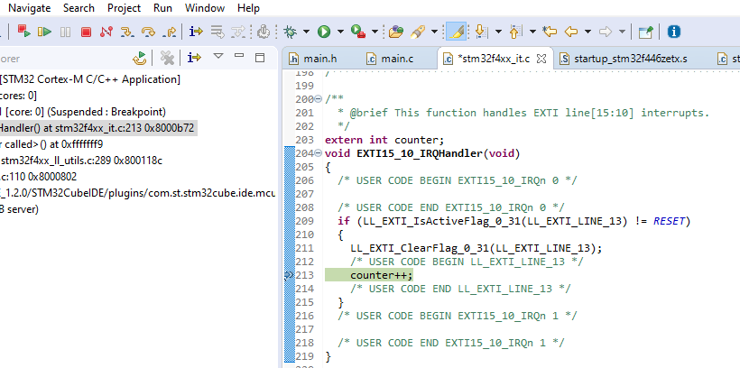

Debug
To view the correct management of the interrupt, it may be useful to start the program in debug mode , put a breakpoint inside the Callback function and start debugging.
When the button is pressed, it will take you to the function that manages the interrupt, as in the next figure.
At this point it is possible to press resume again or move within the program using the step arrows.
To view the correct management of the interrupt, it may be useful to start the program in debug mode , put a breakpoint inside the Callback function and start debugging.
When the button is pressed, it will take you to the function that manages the interrupt, as in the next figure.
At this point it is possible to press resume again or move within the program using the step arrows.

