Slide 1

Timers
rev1.0 24/03/2020

Slide 2
GOAL
Blink the on-board LEDs using timers interrupts

Slide 3
PREREQUISITES
Software needed:
STM32IDE
Hardware used in this example:
NUCLEO-F446ZE

Slide 4
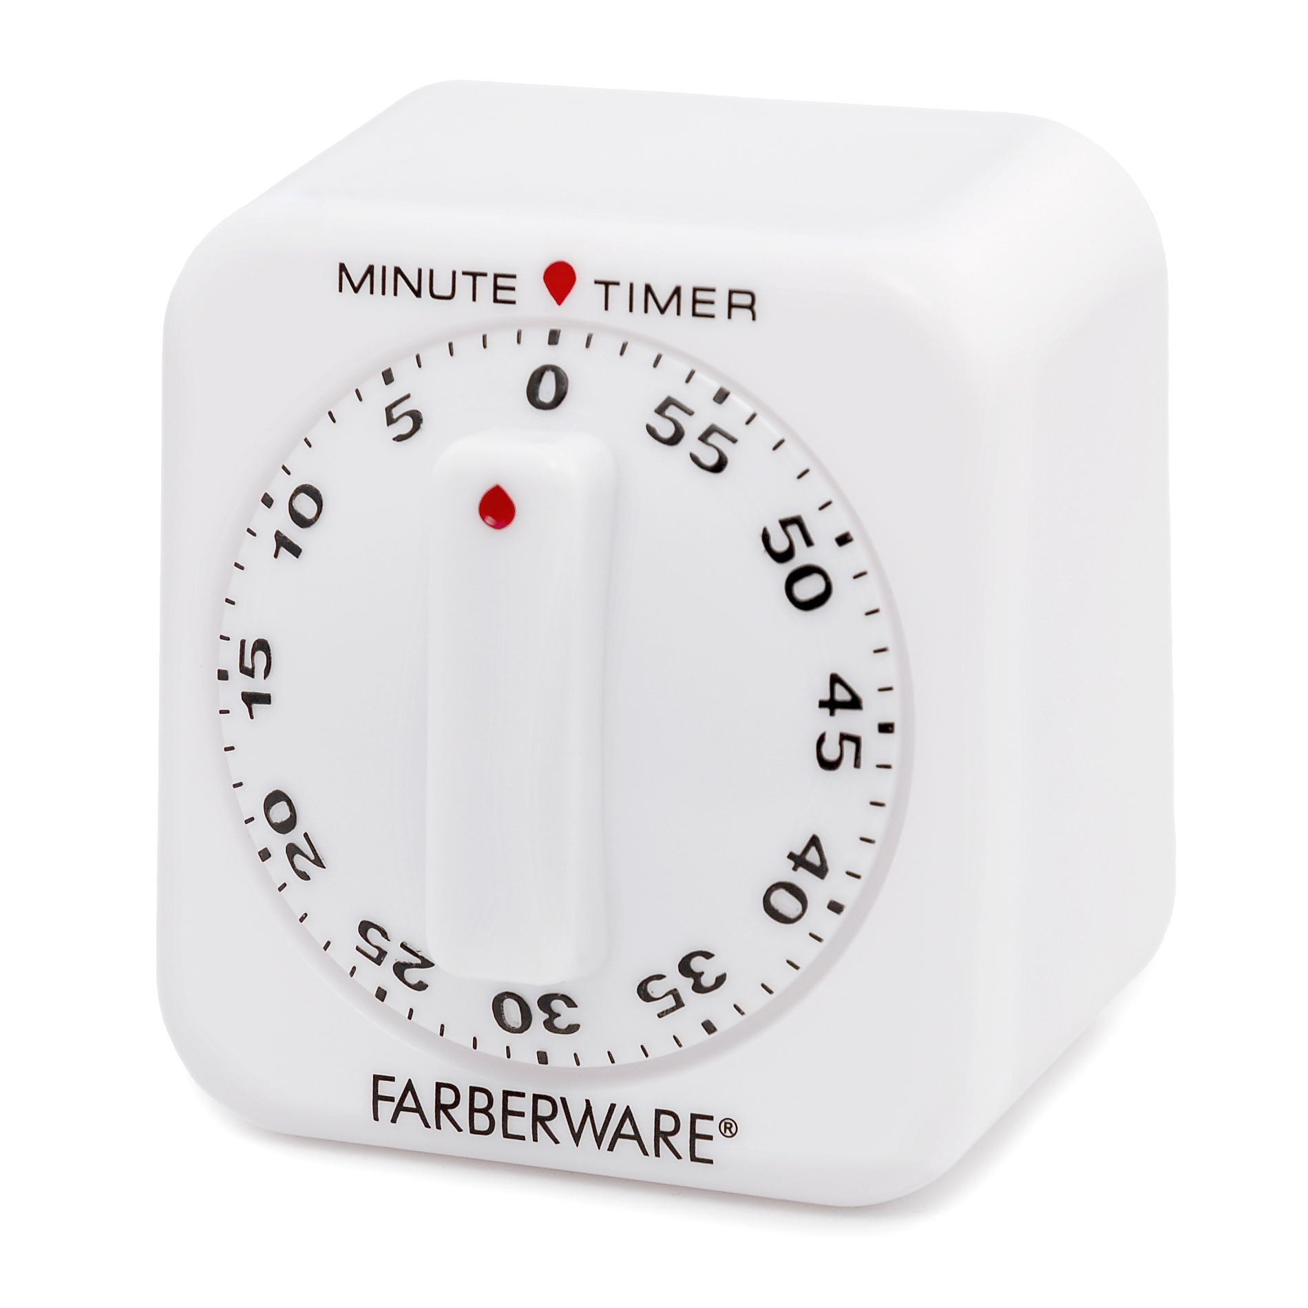
What is a Timer?
The timer is a tool that allows the timing of some actions.
They are very useful for having time references: it is important to note that they keep the date and time reference but only time intervals
They can generate interrupts at regular time intervals
Within the microcontroller there are several.

Slide 5
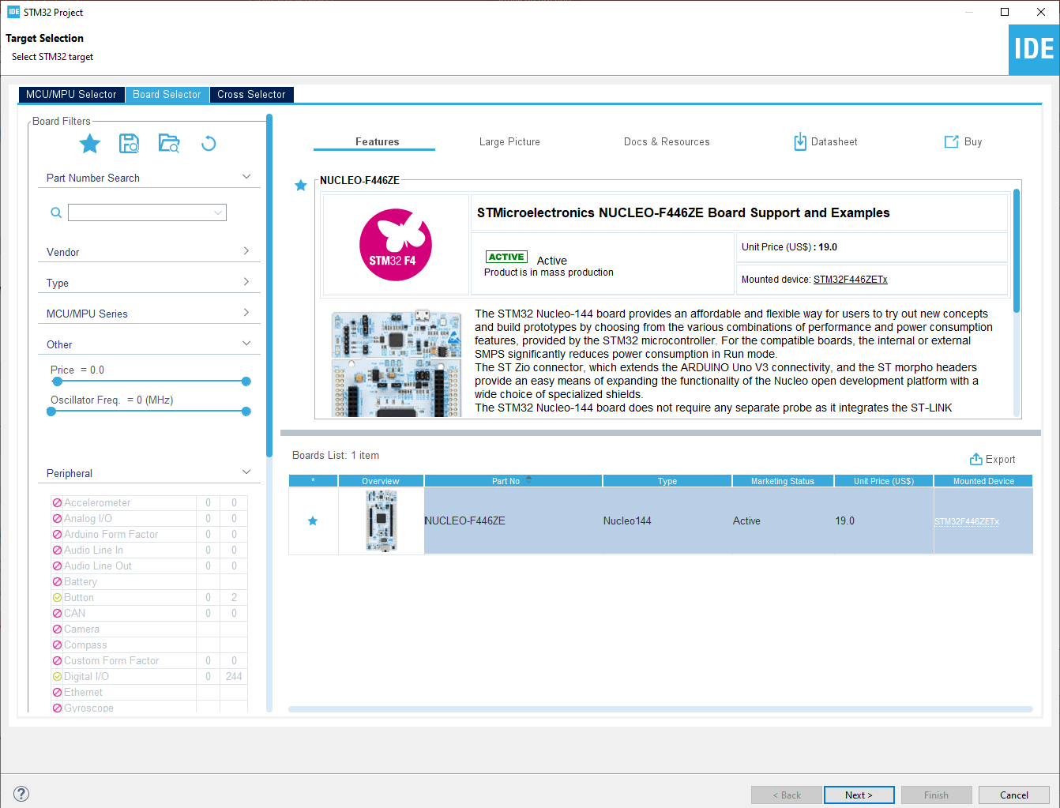
Start a new project
From the stm32IDE software click on File -> New -> STM32 Project.
Select your board or your uC and click next.

Slide 6
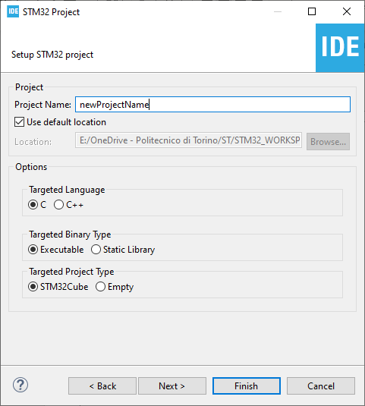
Start a new project
Type the name of your project and click next.
By default the project will be created in the workspace folder.

Slide 7
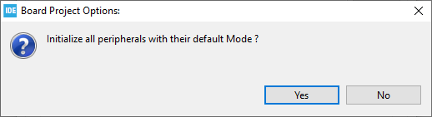
Start a new project
Type the name of your project and click next.
By default the project will be created in the workspace folder.
The STM32IDE has the option to initialize all the peripheral with their default mode:
Clicking Yes the USART3, all the LEDs and the blue UserButton will be configured as default.
Click Yes.

Slide 8
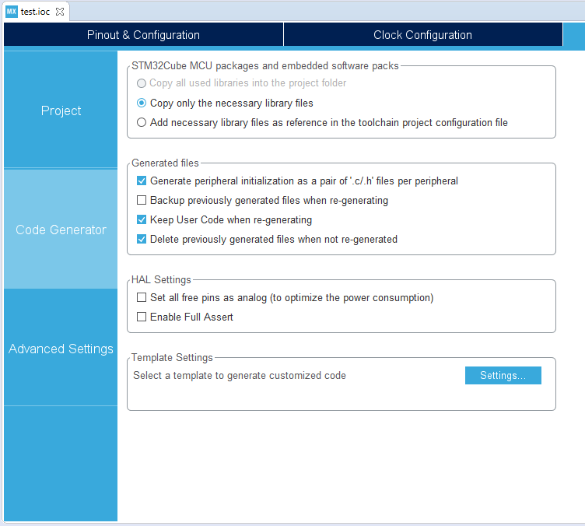
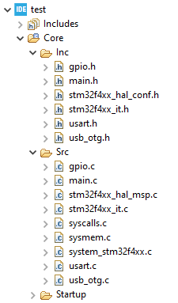
Project Manager
In the Code Generator Tab check the Generate peripheral initialization […] box: each periperhal will have a disting periph.c and periph.h files.

Slide 9
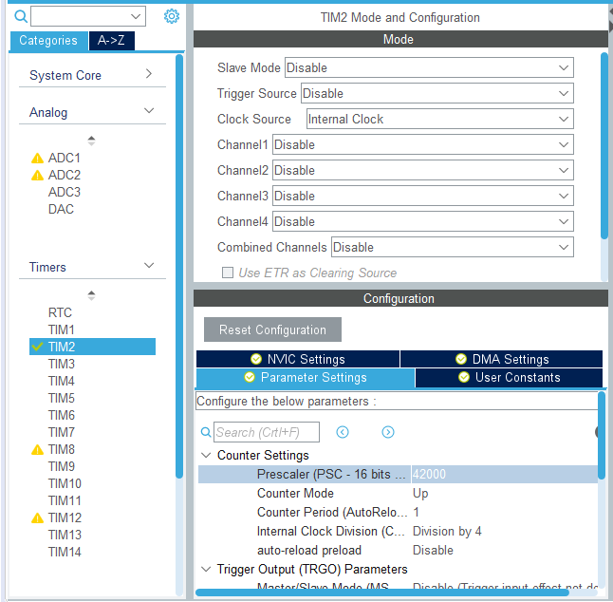
Timer Parameters
In this example we will use TIM2, the parameters to be set are as follows:
Clock Source: is the clock reference of the timer
Prescaler (PSC): is a divider of the timer activation frequency
Counter Period: timer activation period

Slide 10
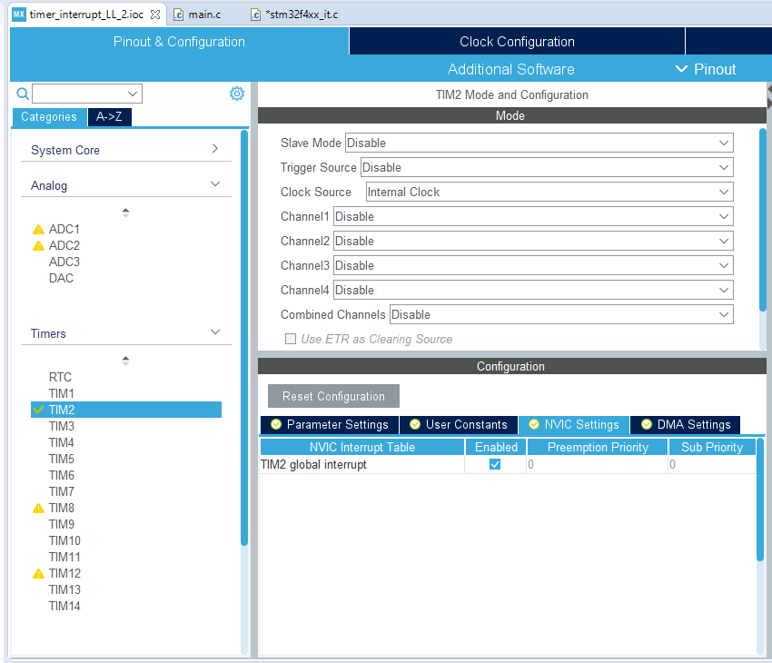
NVIC
NVIC is fundamental for the generation of the interrupt to enable it and set its priority.
Under the NVIC tab it is therefore necessary to tick the box for interrupt management

Slide 11
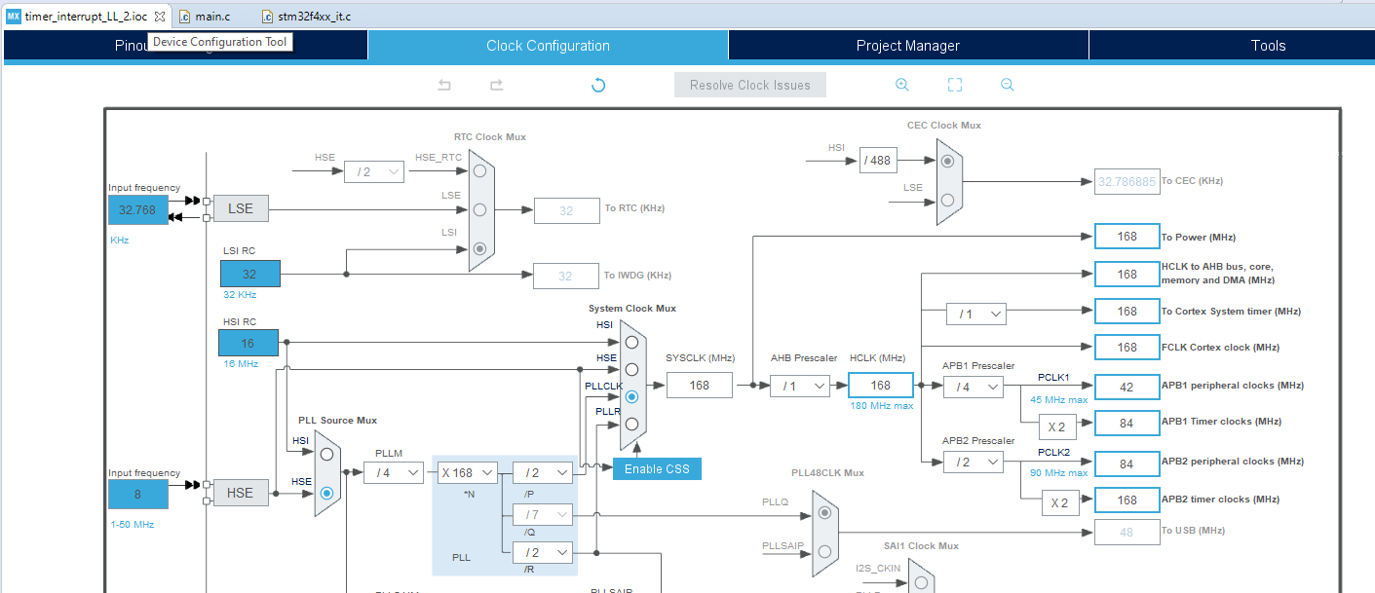
Prescaler
In our example the Prescaler has been set to 42000 as the APB1 peripheral clock, to which TIM2 also refers, is 42MHz: in this way, having the Counter Period set to 1, the timer will be called every millisecond (42MHz / 42000 = 1000). At this point we just have to generate the code

Slide 12
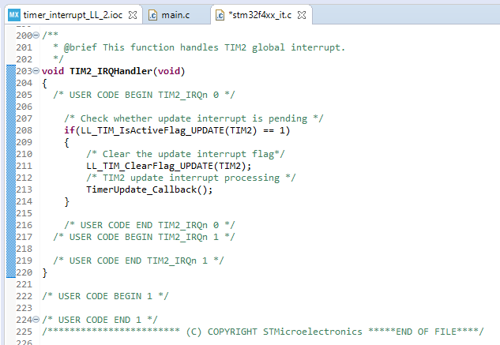
Handler
The first step is to check what happens as soon as the interrupt is generated: we then go to the Handler management within the stm32f4xx_it.c file.
Just as in the previous cases, you check whether the interrupt was actually generated correctly, then reset the Flag and call the Callback function present in the main.c.

Slide 13
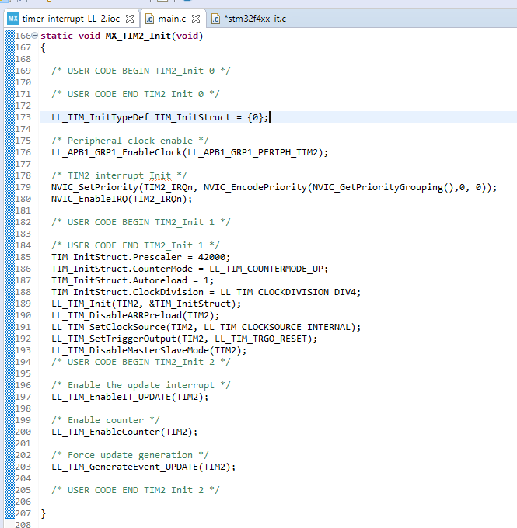
Timer initialization
Before managing the interrupt, it must be enabled: for this reason, when the timer is initialized, it is necessary to:
Enable the interrupt
Enable the counter
Otherwise no interrupt will be generated.

Slide 14
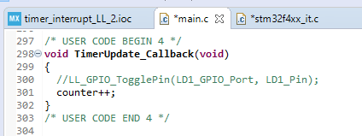
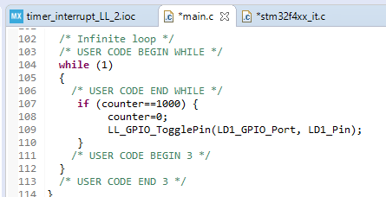
Callback
Further down, in section 4, we can define the timer callback function:
Using the counter variable, it is possible to "count" how many interrupts have been generated: remember that we have set the timer parameters in order to generate an interrupt every millisecond.
Therefore only 1 second will pass after 1000 interrupts.

Slide 15
Results
We load the program on the board and check that everything is working properly: Through the use of the oscilloscope we can note that exactly every second the LED changes its state, so we have a period of 2 seconds as we expected.

