Slide 1

UART communication using LL libraries
rev1.0 24/03/2020

Slide 2
GOAL
Receive data via UART protocol

Slide 3
PREREQUISITES
Software needed:
STM32IDE
CoolTerm
Hardware used in this example:
NUCLEO-F446ZE

Slide 4
UART communication using LL libraries
GOAL:
Receive data via UART protocol

Slide 5
UART communication using LL libraries
In this example:
What’s UART
Start a new project
Configure the peripherals
Generate code
USART Configuration code
Run the program and troubleshooting

Slide 6
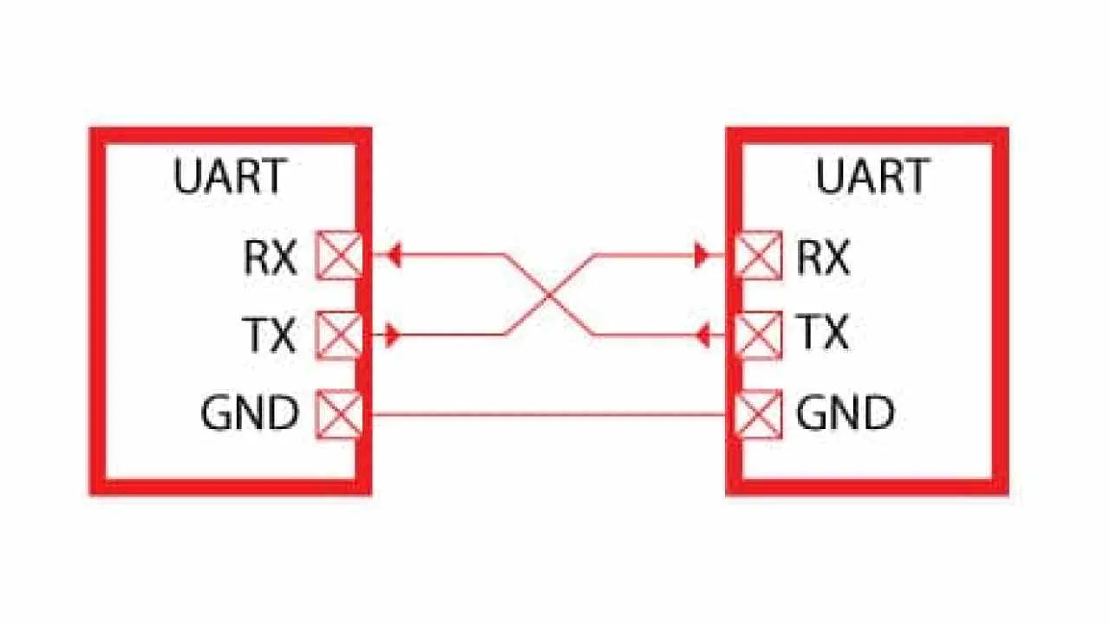
What’s UART
“UART” stands for Universal Asynchronous receiver-transmitter. It is a peripheral that is present inside a microcontroller. The function of UART is to convert the incoming and outgoing data into the serial binary stream.
Notice that in UART communication the TX pin of the transmitter is connected to the RX pin of the receiver and viceversa.

Slide 7
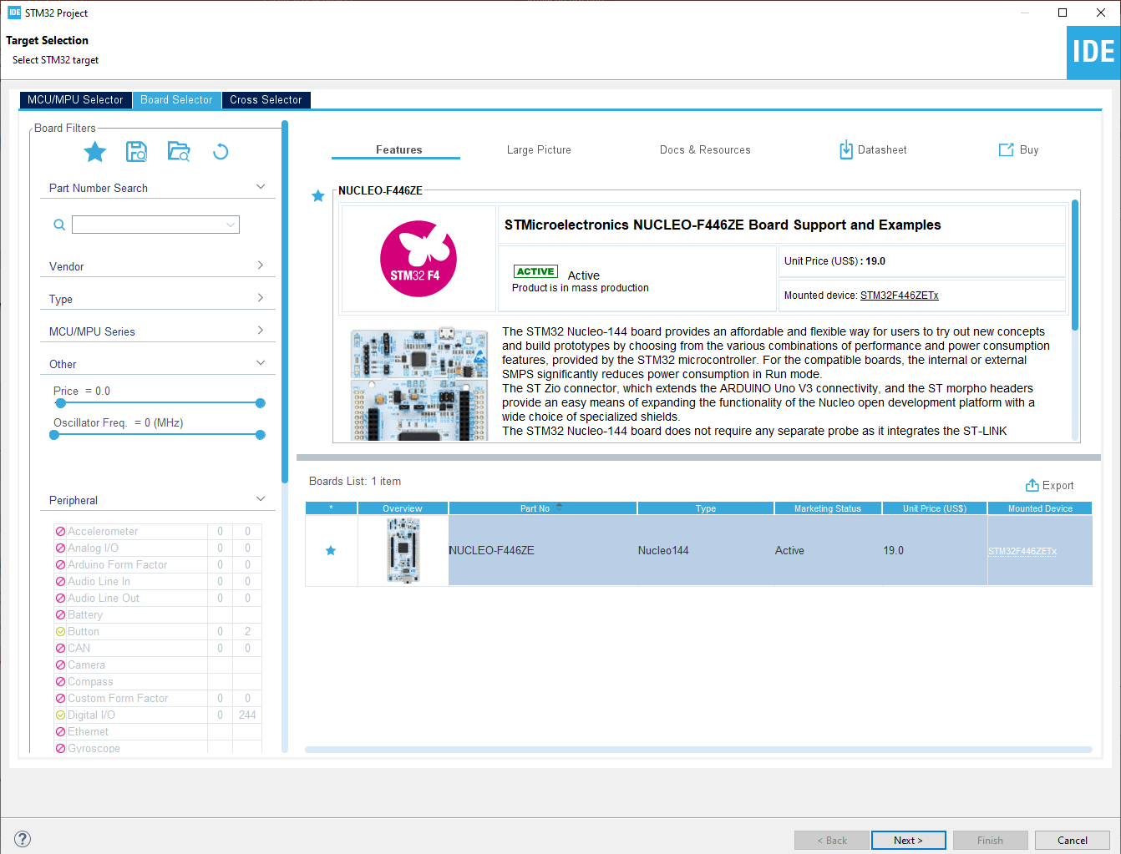
Start a new project
From the stm32IDE software click on File -> New -> STM32 Project.
Select your board or your uC and click next.

Slide 8
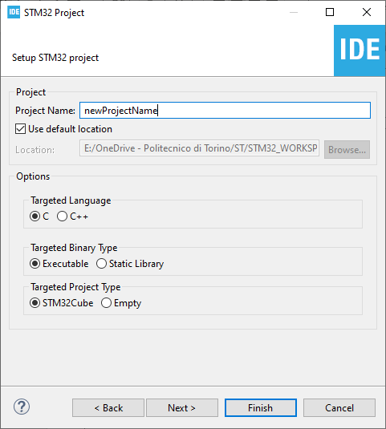
Start a new project
Type the name of your project and click next.
By default the project will be created in the workspace folder.

Slide 9
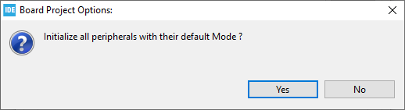
Start a new project
Type the name of your project and click next.
By default the project will be created in the workspace folder.
The STM32IDE has the option to initialize all the peripheral with their default mode:
Clicking Yes the USART3, all the LEDs and the blue UserButton will be configured as default.
Click Yes.

Slide 10
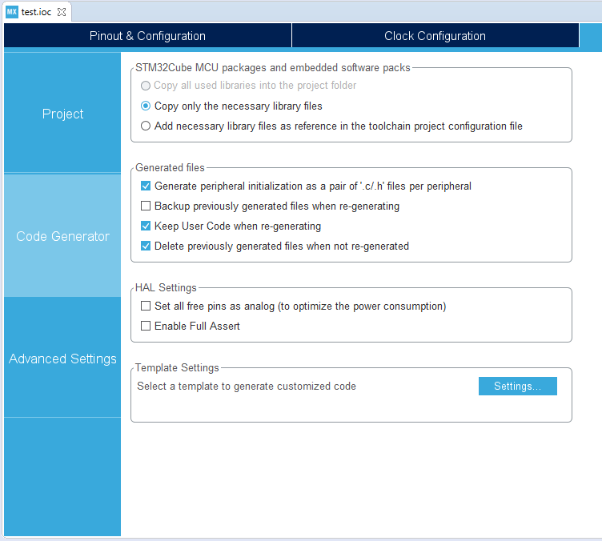
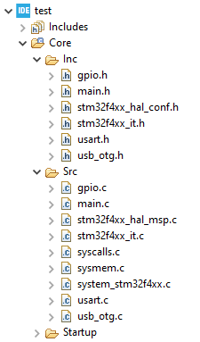
Project Manager
In the Code Generator Tab check the Generate peripheral initialization […] box: each periperhal will have a disting periph.c and periph.h files.

Slide 11
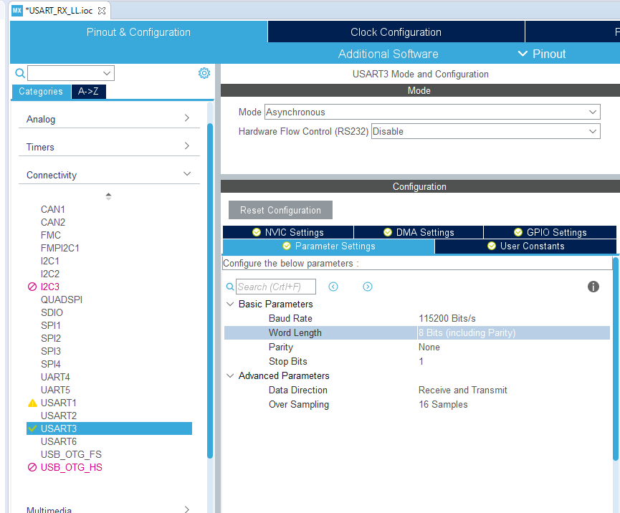
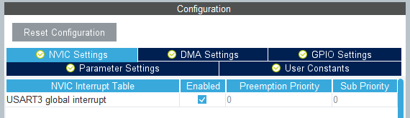
Configure the peripherals
The main core of this project is the USART peripheral, let’s have a look in the USART page configuration.
For this example we will use the USART3:
Mode: Asynchronous
Baud Rate: 115200 Bits/s
The Baud Rate is the speed of the serial communication, 115200 Bits/s is a reasonable speed.
Don’t forget to enable the interrupt under the NVIC tab.

Slide 12
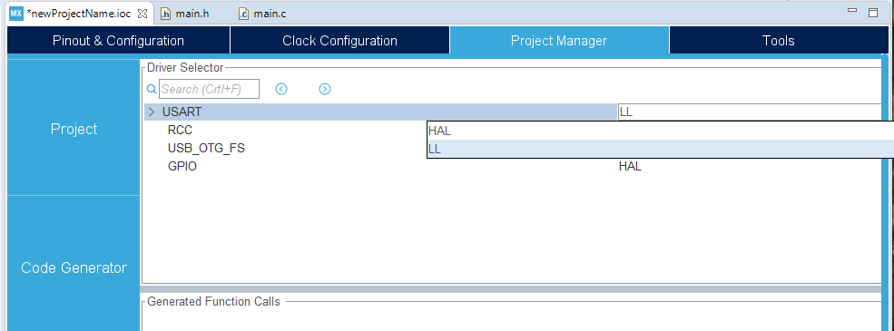

Generate code
The last step before generating the code is to select LL libraries for manage the USART peripheral.
Go in Project Manager -> Advanced Configuration and select LL (USART and GPIO).
Then generate the code (click on the generate icon )

Slide 13
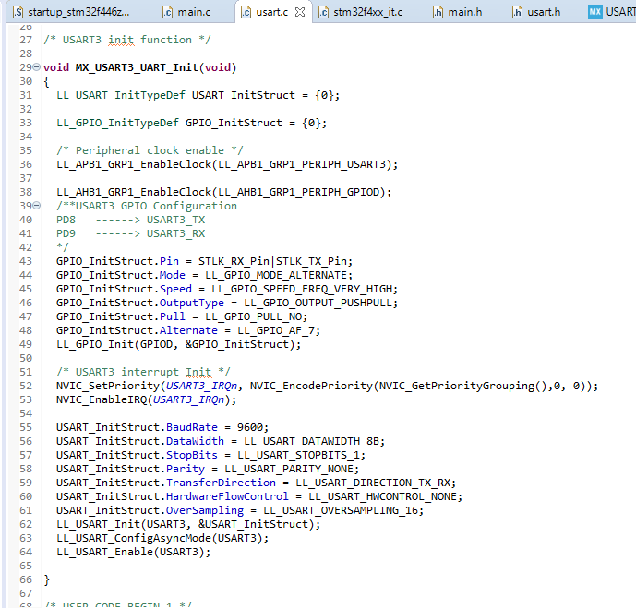
USART Configuration
Let’s have a look in the USART configuration function made by CubeMX.
As always we can find it in the usart.c file
We can subdivide this section in 5 parts:
Inizialization of the GPIO and USART structures, they contains all the configuration info for the peripherals.
Enable of the clock sources for the GPIO pins and for the USART bus.
1
2
3
4
5

Slide 14
USART Configuration
Configuration of the GPIO pins required for the communication. In this example we use USART3 since the RX and TX pins PD8 and PD9 are directly connected to the Nucleo ST-Link ( the upper part of the board that allows the communication between the uC and the PC ) by default. For other configurations have a look in the manual here.
Initialization of the interrupts and priorities.
1
2
3
4
5

Slide 15
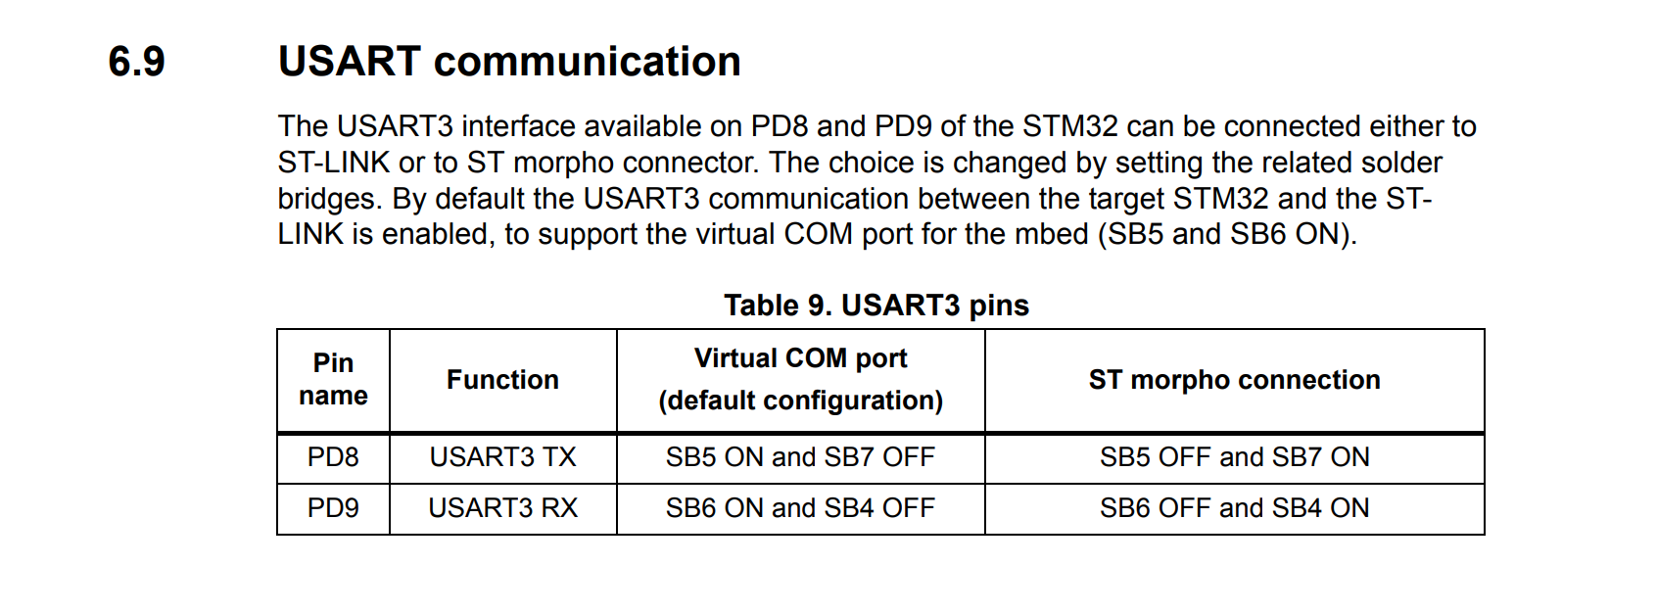
Usart configuration

Slide 16
USART Configuration
Configuration of the USART peripheral. Here it’s possible to see some values like the BaudRate, StopBits, Parity, ecc.
The last step is to enable the USART interrupt: with the function LL_USART_EnableIT_RXNE() we enable the RX Not Empty Interrupt, so the interrupt triggers only if the received message via UART is not empty.
1
2
3
4
5

Slide 17
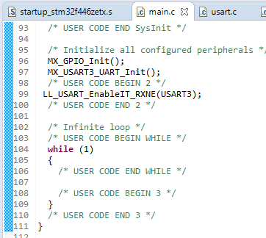
Enable interrupt
The last step is to enable the USART interrupt: with the function LL_USART_EnableIT_RXNE() we enable the RX Not Empty Interrupt, so the interrupt triggers only if the received message via UART is not empty.
Do it in the main.c file, after the peripherals initializations.

Slide 18
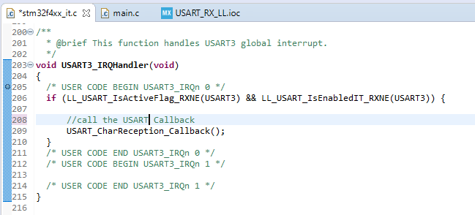
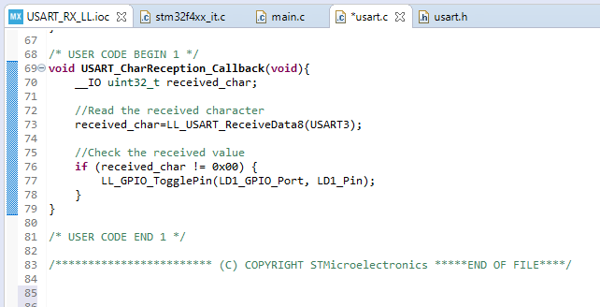
USART Handler
When the interrupt is triggered, the program calls the USART handler, defined in the stm32f4xx_it.c file.
At this point we check if the interrupt has been generated correctly and eventually calls the USART_CharReception_Callback() that we now define in the usart.c file.
Via the LL_USART_ReceiveData8() we read 1byte of data from the UART bus and put it the received_char variable.
For this example when we receive some data, the LED will toggle. In this case we are comparing the received value with an exadecimal value but take in mind that you can impose any condition you want.

Slide 19
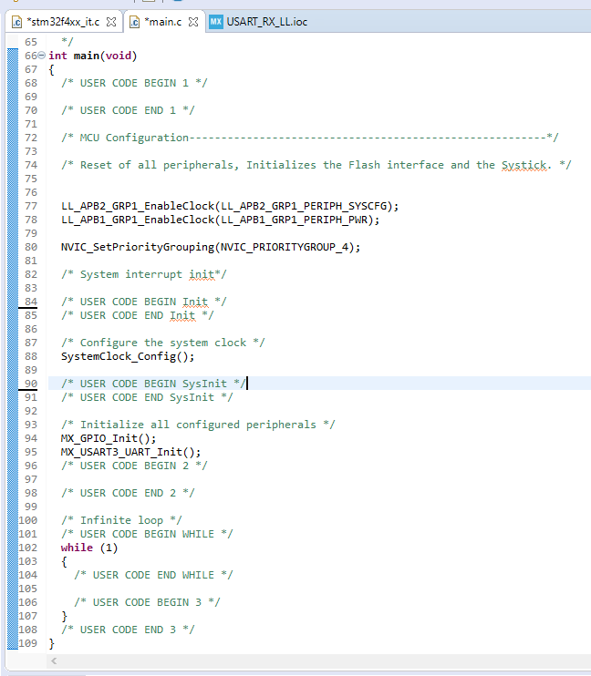
Empty Loop
Since our programs manage all the functions via the interrupts, the main loop is empty.
The coding part ends here, now simply download the program to your board.

Slide 20
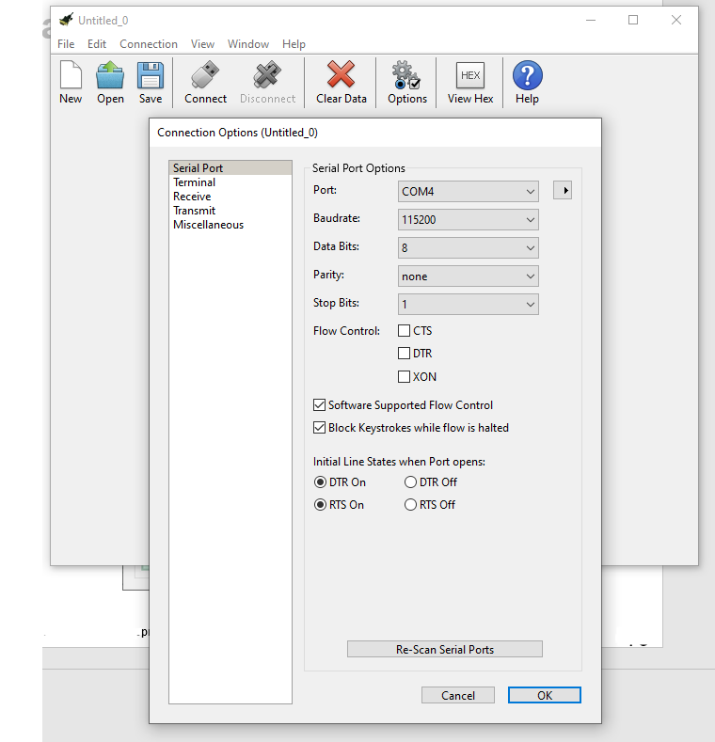
Send data via UART via PC
In this example we send the UART data via PC. You can use any Serial interface program you want, in this case we will use CoolTerm ( link ).
Run the program and select the correct settings in order to communicate with the board.
Remeber to select the correct COM Port and BaudRate.
Once done, click on Connect.
If you have troubles finding your board COM Port in the COM Port list try to click Re-Scan Serial Ports and check again.

Slide 21
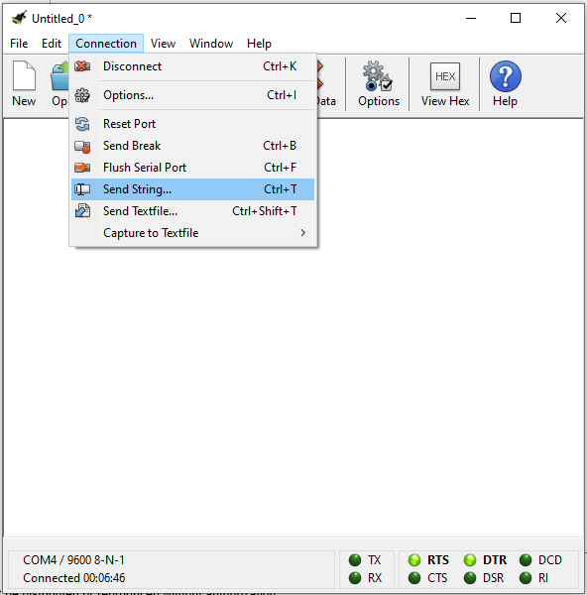
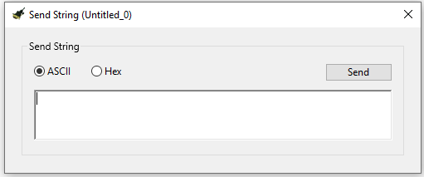
Send data via UART
To open the send window click on connection->Send String.
From here you can send any string you want: you can choose to send ascii o hexadecimal formatted message.
The result is that when you send any message the led will toggle.

Slide 22
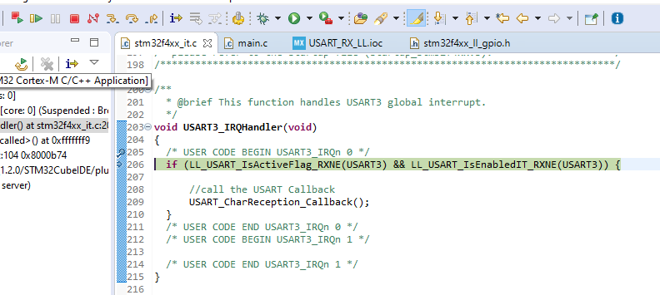
Troubleshooting
If you have any trouble getting the program to run correctly try to debug your application in the IDE:
Download the program to your board in debug mode, the debug view will open.
Place a breakpoint where the interrupt should be triggered ( to place a breakpoint double click on the number of line where you want to place it ).
Click on the resume icon.
Try to send a message via CoolTerm.

Slide 23
Troubleshooting
If all it’s correct your program will jump to the breakpoint and the line will be highlighted.
At this point you can resume again or move inside your program with the arrows
In this example we sent 0x87 via CoolTerm, as you can see in the next slide.
For more info in how the UART bus works see: https://www.youtube.com/watch?v=ZzRXKDkMBhA

Slide 24
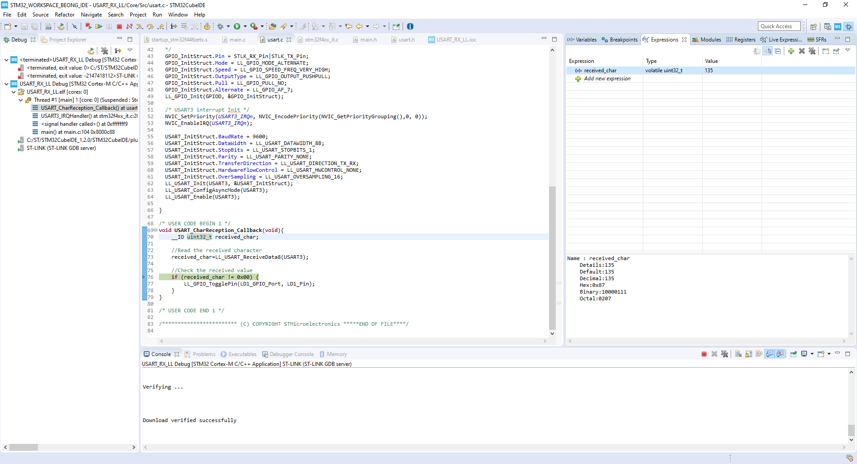
Troubleshooting
Select received_char and rightClick -> add to watch expression to monitor it.

