Slide 1

UART communication using LL libraries
rev1.0 24/03/2020

Slide 2
GOAL
Transmit data via UART protocol when the user button interrupt occours

Slide 3
PREREQUISITES
Software needed:
STM32IDE
CoolTerm
Hardware used in this example:
NUCLEO-F446ZE

Slide 4
UART communication using LL libraries
In this example:
What’s UART
Start a new project
Configure the peripherals
Generate code
USART Configuration code
GPIO Configuration code
Run the program and troubleshooting

Slide 5
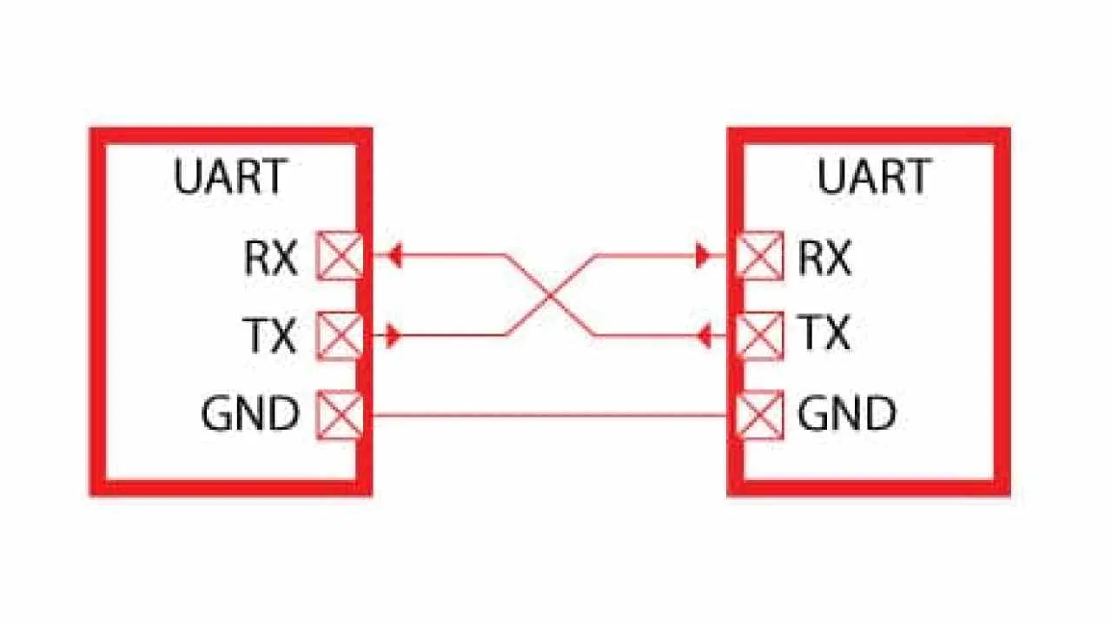
What’s UART
“UART” stands for Universal Asynchronous receiver-transmitter. It is a peripheral that is present inside a microcontroller. The function of UART is to convert the incoming and outgoing data into the serial binary stream.
Notice that in UART communication the TX pin of the transmitter is connected to the RX pin of the receiver and viceversa.

Slide 6
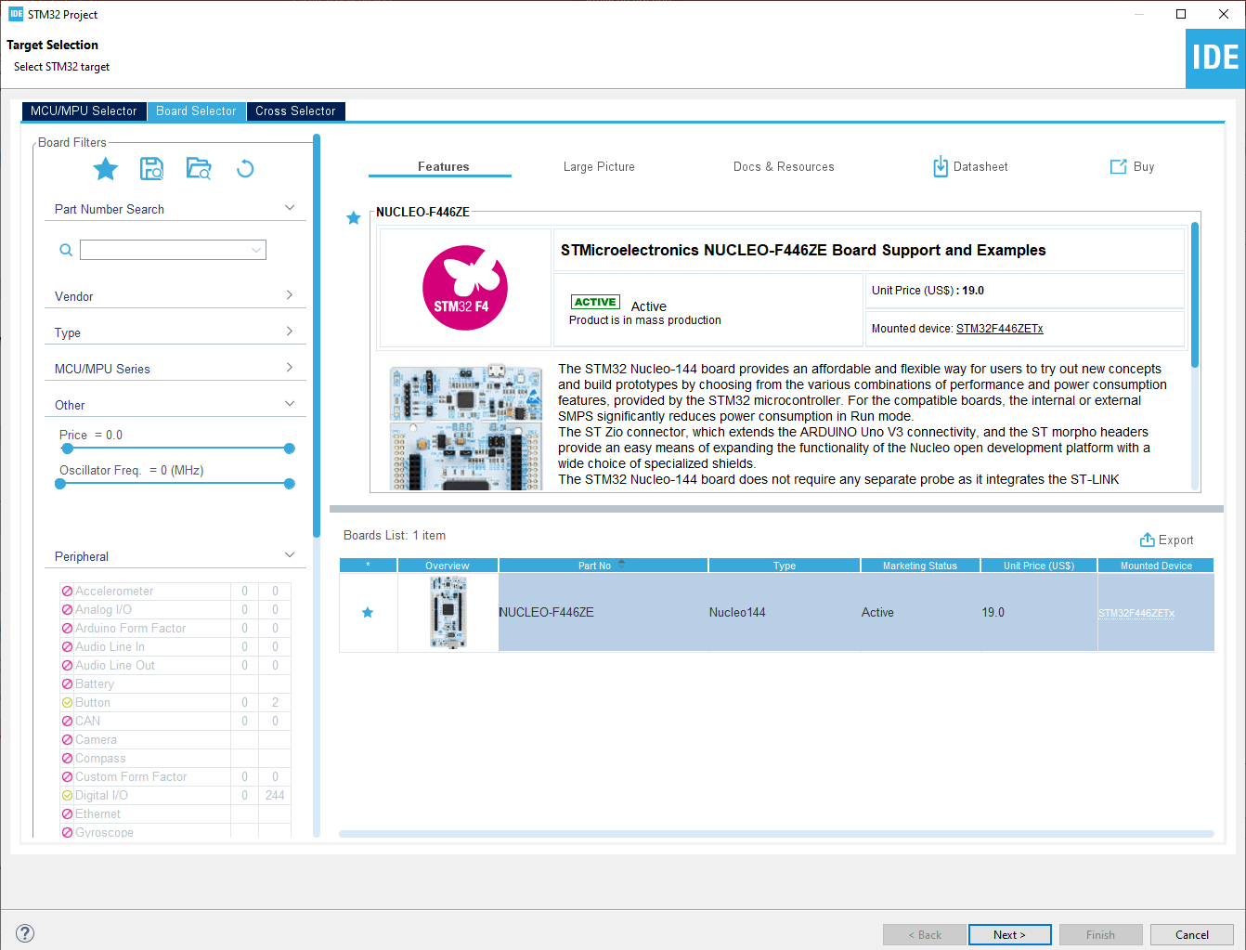
Start a new project
From the stm32IDE software click on File -> New -> STM32 Project.
Select your board or your uC and click next.

Slide 7
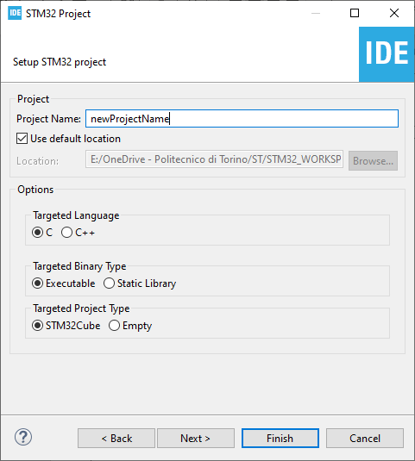
Start a new project
Type the name of your project and click next.
By default the project will be created in the workspace folder.

Slide 8
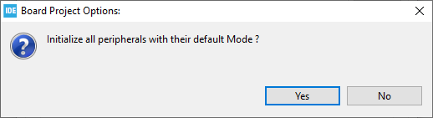
Start a new project
Type the name of your project and click next.
By default the project will be created in the workspace folder.
The STM32IDE has the option to initialize all the peripheral with their default mode:
Clicking Yes the USART3, all the LEDs and the blue UserButton will be configured as default.
Click Yes.

Slide 9
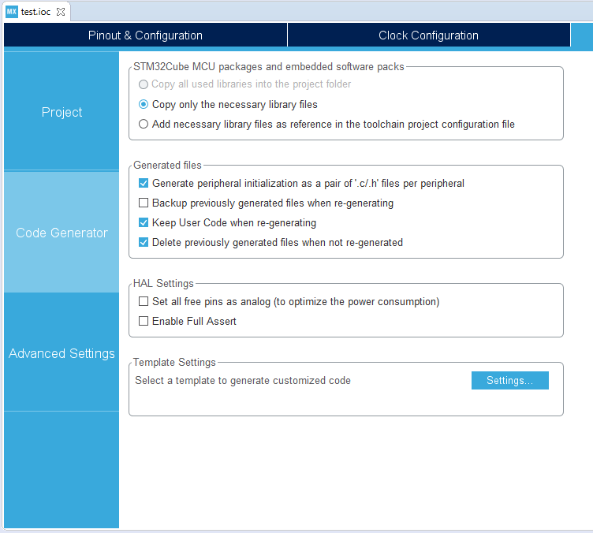
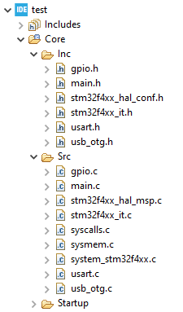
Project Manager
In the Code Generator Tab check the Generate peripheral initialization […] box: each periperhal will have a disting periph.c and periph.h files.

Slide 10
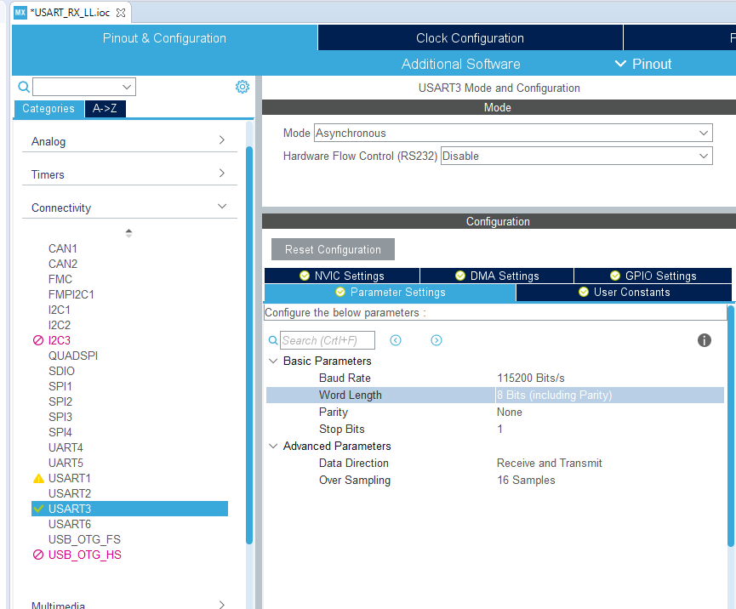
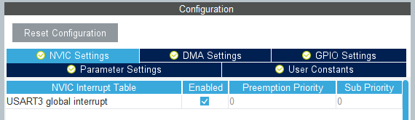
Configure the peripherals
The main core of this project is the USART peripheral, let’s have a look in the USART page configuration.
For this example we will use the USART3:
Mode: Asynchronous
Baud Rate: 115200 Bits/s
The Baud Rate is the speed of the serial communication, 115200 Bits/s is a reasonable speed.
Don’t forget to enable the interrupt under the NVIC tab.

Slide 11
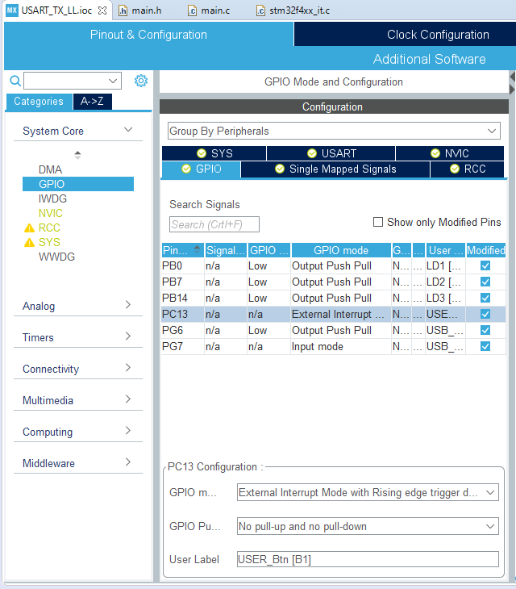
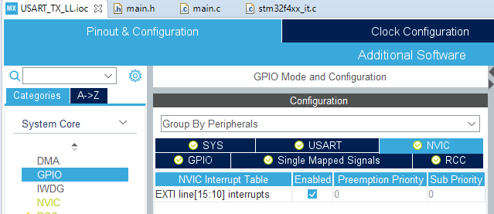
Configure the peripherals
For this example, we will send a character when an interrupt generated by a GPIO pins occours.
Let use the user button as our trigger source.
Under the GPIO Tab select the GPIO pin ( the blu user button is connected to GPIO PC13) and check that the GPIO mode is setted as External Interrupt Mode
Don’t forget to enable the interrupt under the NVIC tab.

Slide 12
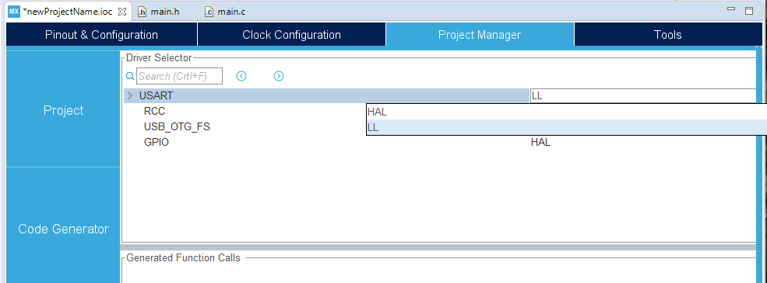

Generate code
The last step before generating the code is to select LL libraries for manage the USART peripheral.
Go in Project Manager -> Advanced Configuration and select LL (USART and GPIO).
Then generate the code (click on the generate icon )

Slide 13
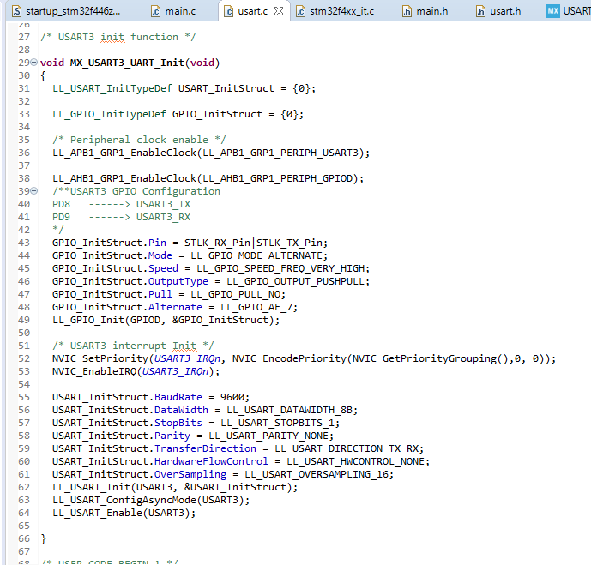
USART Configuration
Let’s have a look in the USART configuration function made by CubeMX.
As always we can find it in the usart.c file
We can subdivide this section in 5 parts:
Inizialization of the GPIO and USART structures, they contains all the configuration info for the peripherals.
Enable of the clock sources for the GPIO pins and for the USART bus.
1
2
3
4
5

Slide 14
USART Configuration
Configuration of the GPIO pins required for the communication. In this example we use USART3 since the RX and TX pins PD8 and PD9 are directly connected to the Nucleo ST-Link ( the upper part of the board that allows the communication between the uC and the PC ) by default. For other configurations have a look in the manual here.
Initialization of the interrupts and priorities.
1
2
3
4
5

Slide 15
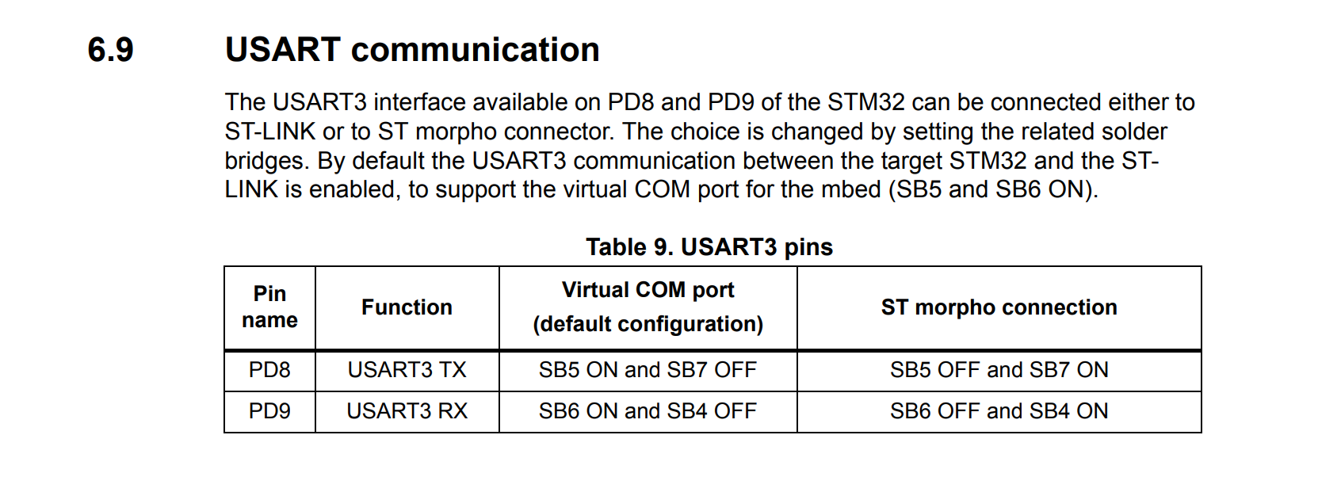
Usart configuration

Slide 16
USART Configuration
Configuration of the USART peripheral. Here it’s possible to see some values like the BaudRate, StopBits, Parity, ecc.
1
2
3
4
5

Slide 17
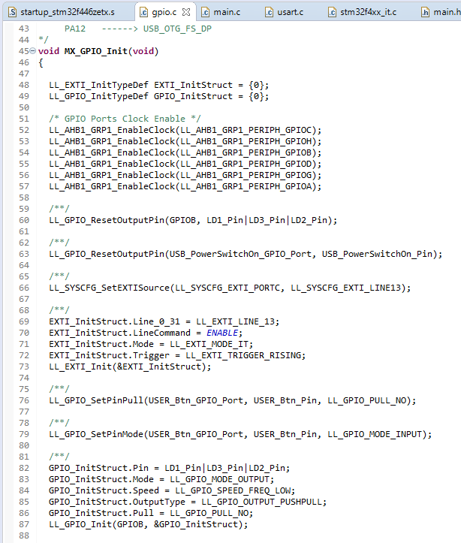
GPIO Configuration
Let’s have a look in the GPIO configuration function made by CubeMX.
As always we can find it in the gpio.c file.
The most important parts are the following:
Inizialization of the GPIO and INTERRUPT structures, they contains all the configuration info for the peripherals.
Enable of the clock sources for all the GPIO ports.
1
2
3
4

Slide 18
GPIO Configuration
Configuration of the interrupt structure:
Line: Line of the interrupt where the pin is connected (more info in the datasheet)
LineCommand: State of the line, ENABLE means that the interrupt is enabled
Trigger: Select the edge of triggering (see the button Interrupt report for more Info)
1
2
3
4

Slide 19
GPIO Configuration
Configuration of the GPIO structure for the LED’s:
Pin: GPIO Pins selected
Mode: set the pin as Output, Input, Analog Input, etc
Speed: Control the speed of GPIO pins.
Pull: Type of pull, choose between Pull-down, Pull-up or no-pull (see report on GPIO inputs for more info)
1
2
3
4

Slide 20
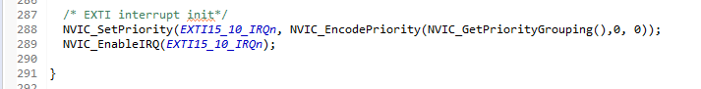
GPIO Configuration
4. Set the interrupt priorities.
4

Slide 21
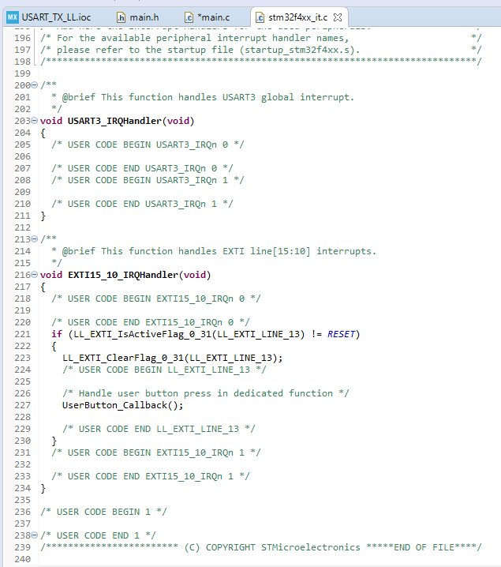
USART Handler
When the interrupt is triggered, the program calls the USART handler, defined in the stm32f4xx_it.c file.
At this point we check if interrupt has been generated correctly and eventually calls the UserButton_Callback() that we now define in the gpio.c file.
As you can see we check only the interrupt generated from the button, the usart handler should remain empty in this case.

Slide 22
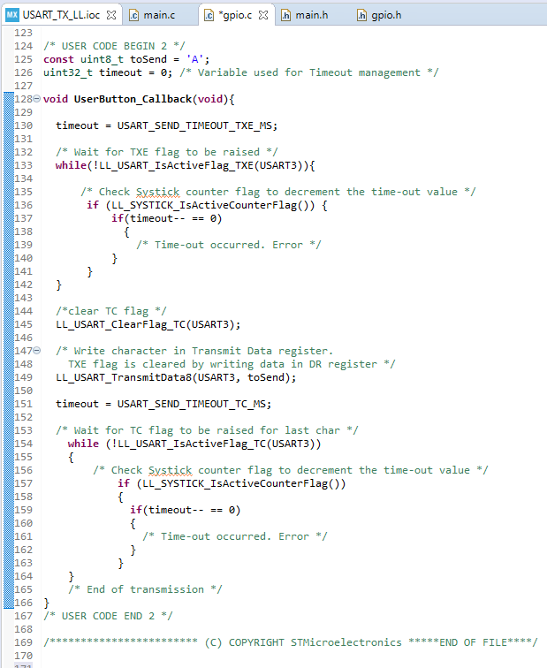
UserButton CallBack
Now go to the gpio.c file and check the UserButton_Callback() function.
At first we wait that the Transmit Data Register Empty (TXE) flag raises, so we know that there are no messages that have to be sent, then we clear the Transmission Complete Flag (TC).
Now we are ready to send data, so we send it using the LL_USART_TransmirData8() function and then we check the TC flag for the end of the trasmission.
Notice that we used some timeout to check for communication errors.

Slide 23
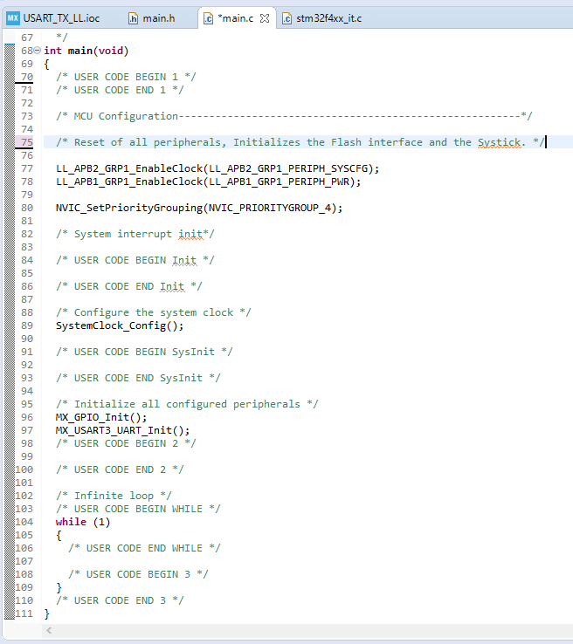
Empty Loop
Since our programs manage all the functions via the interrupts, the main loop is empty.
The coding part ends here, now simply download the program to your board.

Slide 24
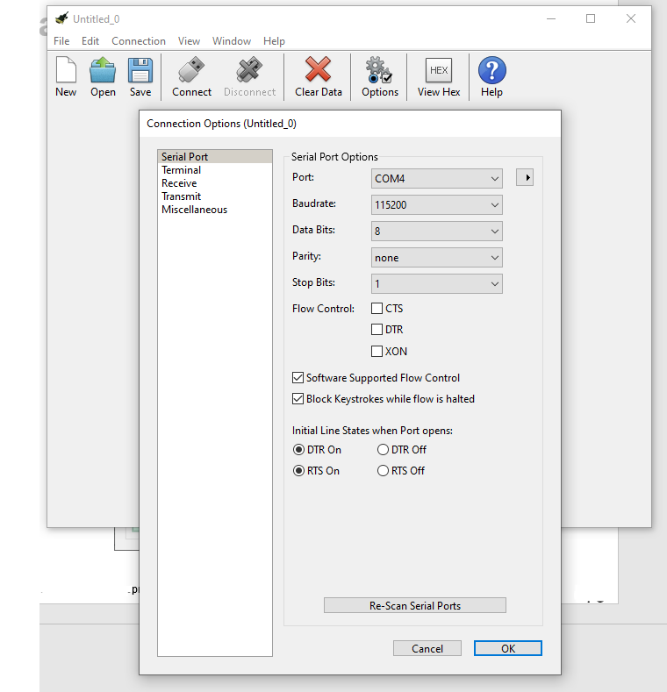
Receive data via UART
In this example we send the UART data via PC. You can use any Serial interface program you want, in this case we will use CoolTerm ( link ).
Run the program and select the correct settings in order to communicate with the board.
Remeber to select the correct COM Port and BaudRate.
Once done, click on Connect.
If you have troubles finding your board COM Port in the COM Port list try to click Re-Scan Serial Ports and check again.

Slide 25
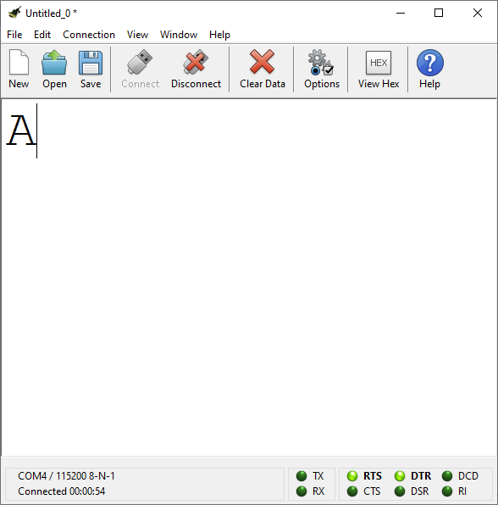
Receive data via UART
If it’s all correct the character ‘A’ will appear at each press of the blue button on the board.

Slide 26
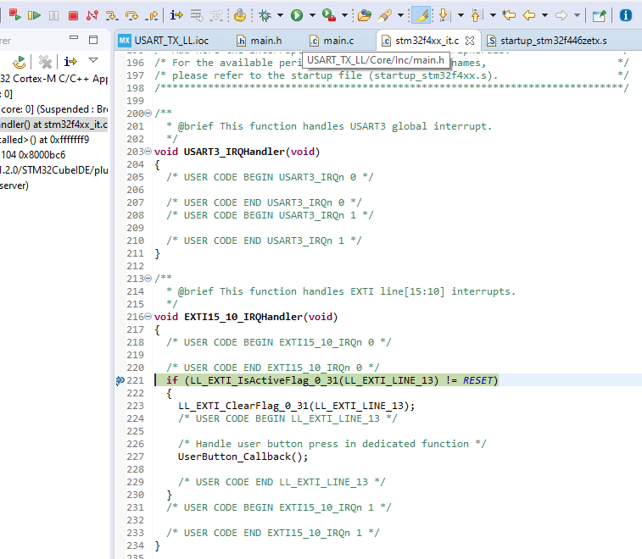
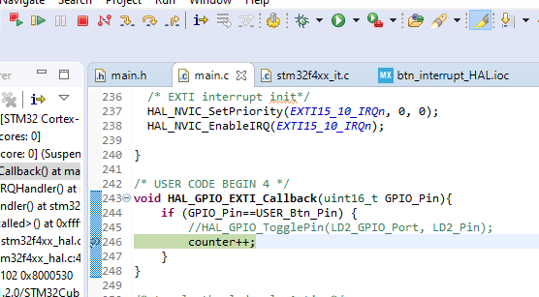
Troubleshooting
If you have any trouble getting the program to run correctly try to debug your application in the IDE:
Download the program to your board in debug mode , the debug view will open.
Place a breakpoint where the interrupt should be triggered ( to place a breakpoint double click on the number of line where you want to place it ).
Click on the resume icon.
Try to press the blue button on the board.

Slide 27
Troubleshooting
If it’s all correct your program will jump to the breakpoint and the line will be highlighted.
At this point you can resume again or move inside your program with the arrows .
For more info in how the UART bus works see: https://www.youtube.com/watch?v=ZzRXKDkMBhA

