Slide 1

Use of an I2C LCD Display
rev1.0 24/03/2020

Slide 2
GOAL
Write on a LCD Display connected via I2C protocol

Slide 3
PREREQUISITES
Software needed:
STM32IDE
Hardware used in this example:
NUCLEO-F446ZE
I2C Display

Slide 4
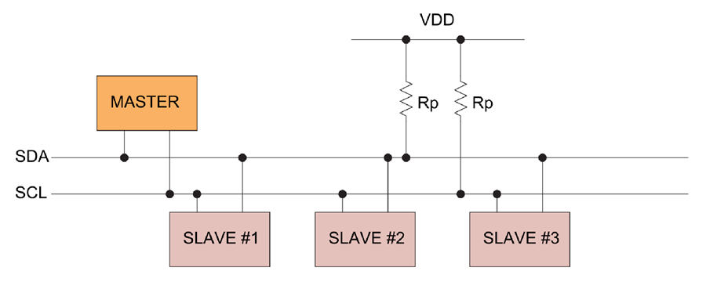
I²C (Inter-Integrated Circuit)
I²C is a synchronous, multi-master, multi-slave bus invented in 1982 by Philips Semiconductor. It is widely used for attaching lower-speed peripheral ICs to processors and uC in short-distance, intra-board communication. This protocol use only two data wires:
SDA (Serial Data)
SCL (Serial Clock)

Slide 5
I²C (Inter-Integrated Circuit)
Masters and Slaves shares the same data wires:
In order to communicate each slave has an address in order to differentiate from the others: so each Slave should have an UNIQUE address, different from the other ones.

Slide 6
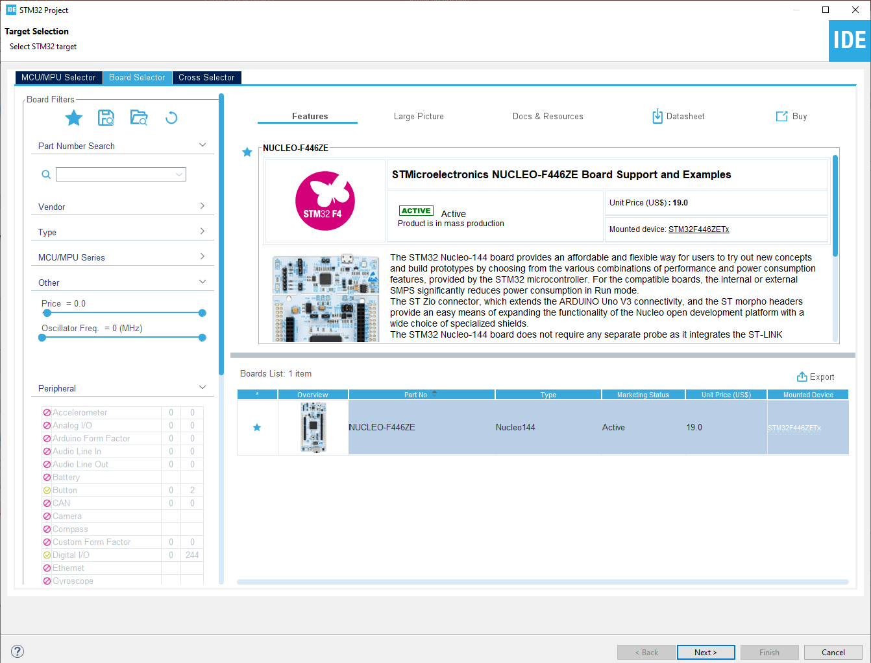
Start a new project
From the stm32IDE software click on File -> New -> STM32 Project.
Select your board or your uC and click next.

Slide 7
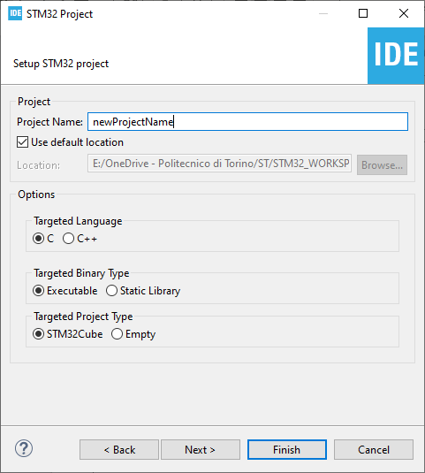
Start a new project
Type the name of your project and click next.
By default the project will be created in the workspace folder.

Slide 8
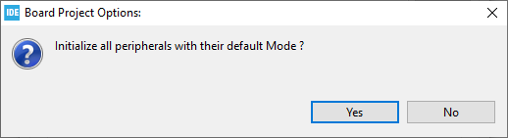
Start a new project
Type the name of your project and click next.
By default the project will be created in the workspace folder.
The STM32IDE has the option to initialize all the peripheral with their default mode:
Clicking Yes the USART3, all the LEDs and the blue UserButton will be configured as default.
Click Yes.

Slide 9
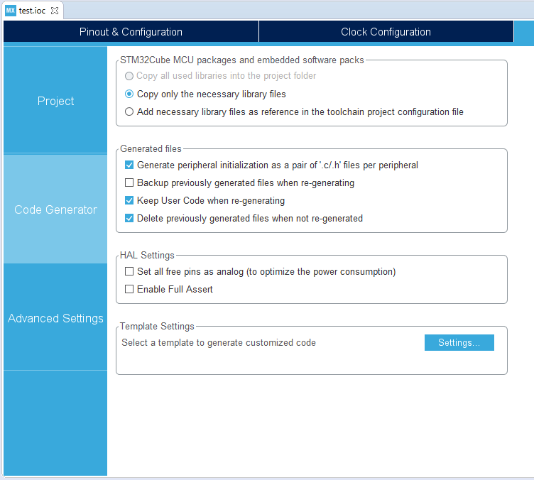
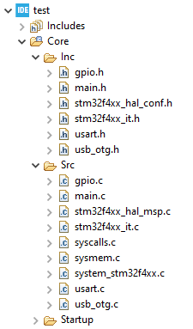
Project Manager
In the Code Generator Tab check the Generate peripheral initialization […] box: each periperhal will have a disting periph.c and periph.h files.

Slide 10
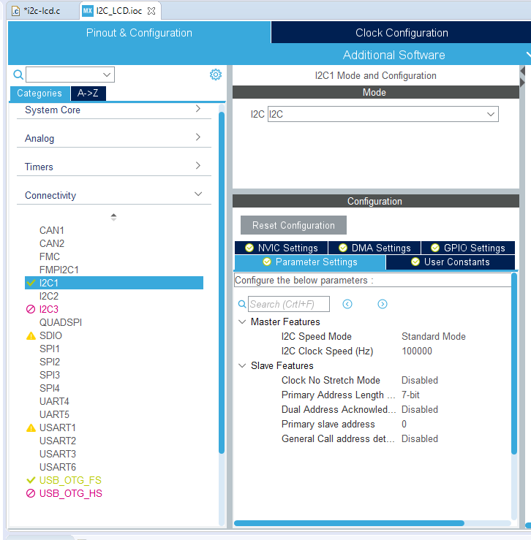

Configure the peripherals
For this project we’ll need to enable the I2C bus, so go under connectivity, select I2C1 and enable it.
All the configuration ends here, so now you can generate the code (click on the generate icon ).

Slide 11
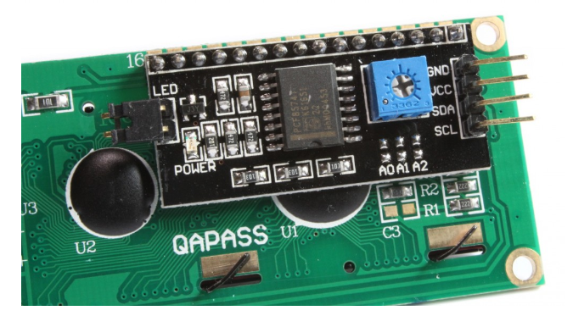
Connect the LCD
On the back of the LCD we can find a black board: it’s function is to let us communicate with the LCD via I2C. This board is based on the pcf8574 (or eventually pcf8574A, check your board).
The “blue Box” on the back is a trimmer, rotating it with a screwdriver we can adjust the contrast.
It’s possible to configure the address of the LCD using the 3 jumper A0, A1 and A2.
In the next page you will find all the configuration with all the respective addresses, take in mind that when the jumper is open the state us ‘H’ .

Slide 12
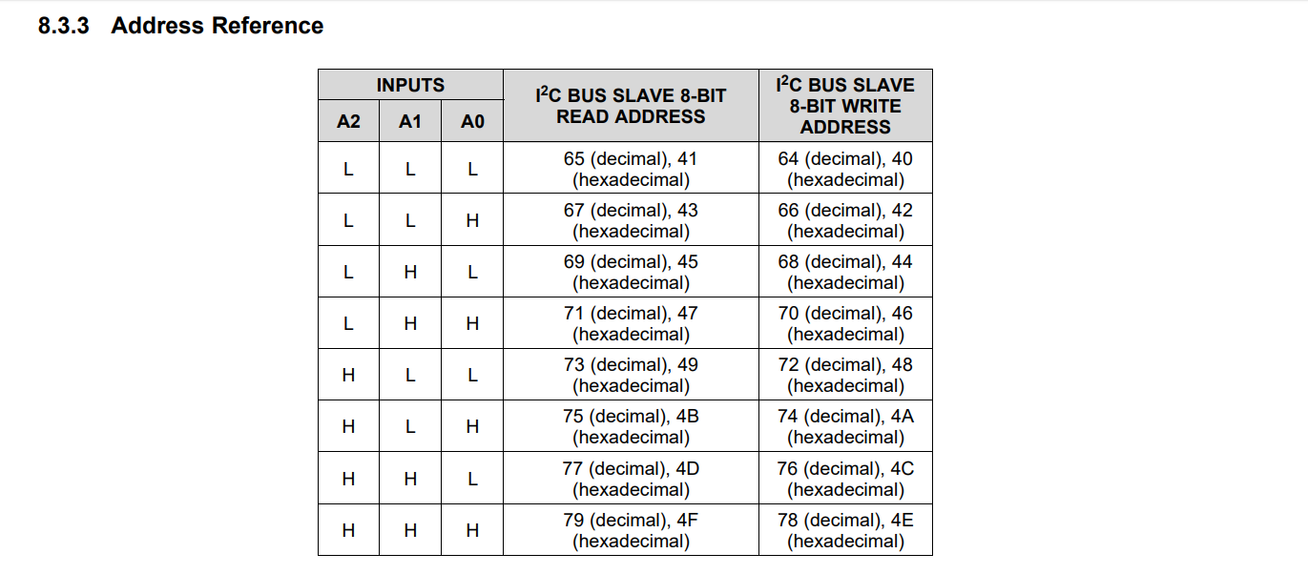

Slide 13
For our example we have a PCF8574 board based, so the address will be 0x4E

Slide 14
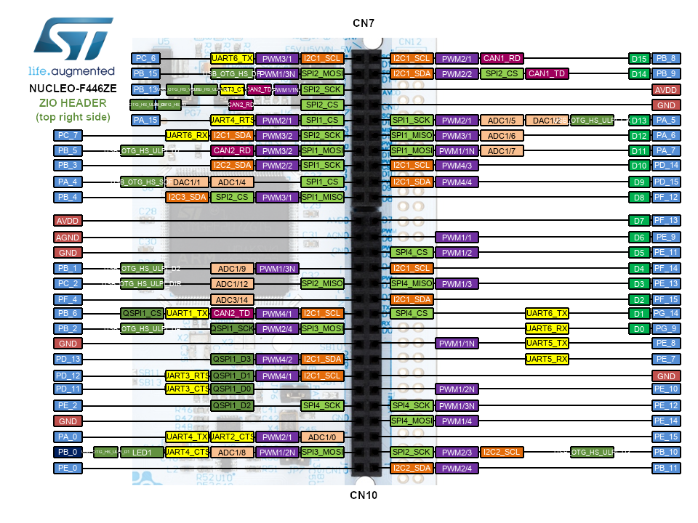
Connect the lcd
In order to communicate with the LCD you should wire it to the board.
For this example we are using a NUCLEO-F446ZE, you can find all the detailed pinout here.
Connect the SDA and the SCL pins of the LCD with the I2C1_SDA and the I2C1_SCL pins of the board (the 2 red dots).
Do not forget to connect 5V and GND pins too.

Slide 15
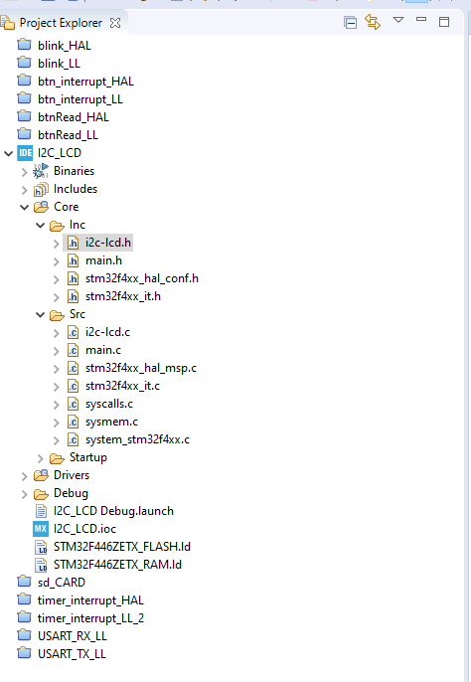
I2C pins
In the NUCLEO boards there are some pins that can do the same thing: so there could be more than one pin that can be configured as I2C1_SDA, I2C1_SCL and so.
To check which are the correct pins simply go to the I2C_LCD.ioc file under the project explorer and search for the i2c pins.

Slide 16
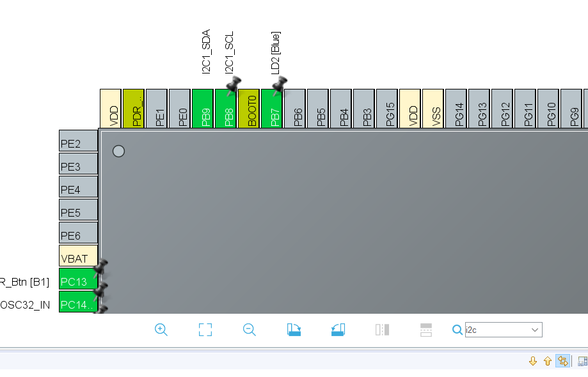
I2C pins
As you can see in our case SDA and SCL pins are PB8 and PB9.
If you can’t find your pins you can look for them typing in the search lens field: the found pins will blink black.

Slide 17
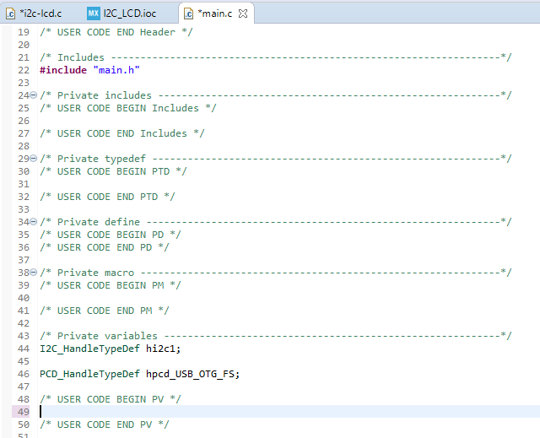
I2C Initialization
Let’s have a look in the I2C initialization function.
It’s automatically generated by CubeMX and we can find it in the main.c file.
Since we are using HAL Libraries for this example, CubeMX create first the I2C1 Handler under the private variables section.
Then we can scroll down and see the actual i2c initialization function.

Slide 18
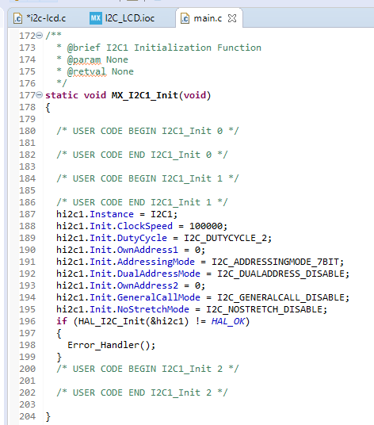
I2C Initialization
The code is very simple:
CubeMX takes the handler structure previously defined and fill with the parameters configured earlier.

Slide 19
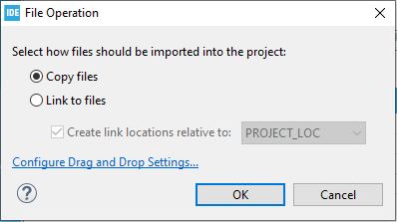
I2C lcd Library
The last step to be able to send data to our LCD screen is to include the library that will let us send strings and numbers very easily to the screen.
Simply drag and drop the i2c-lcd.h and i2c-lcd.c file in the inc and src folders as shown in the picture. If asked, copy the file in the workspace.

Slide 20
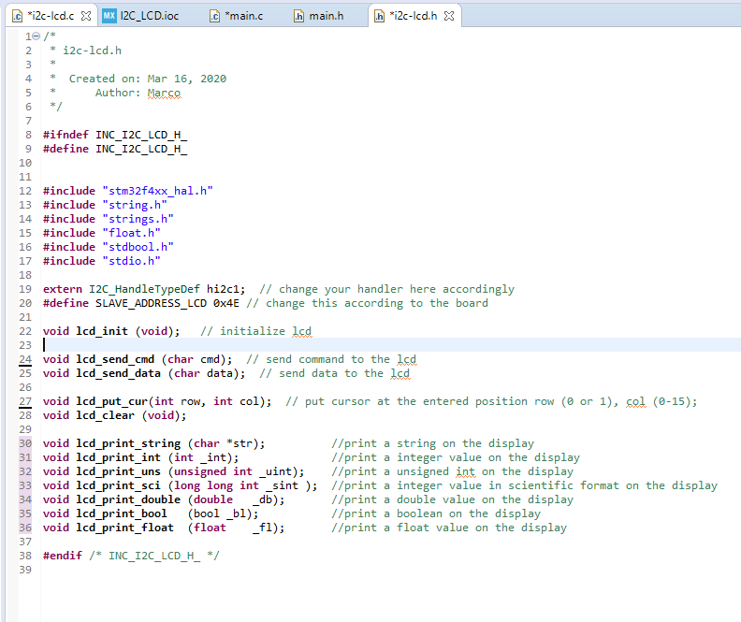
I2c-lcd library functions
In the file i2c-lcd.h we can find the prototypes of the library functions:
Lcd_init(): Initialize the LCD in order to work in 4 bit mode.
Lcd_put_cur(): put the cursor in a specific point of the LCD.
Lcd_clear(): clean the LCD, the screen will appear empty.
Lcd_print_xx(): these function allow to write any kind of data type on the screen.
Check Slave address, has to match your configuration.
1
2
3

Slide 21
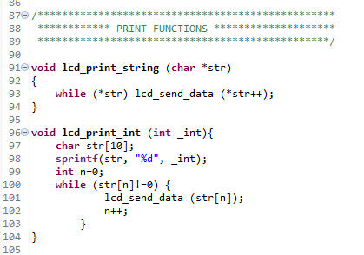
LCD print functions
In the i2c-lcd.c file you can find the definition of all the library functions.
About the print function, they work all in the same way:
Creation of a char array: it contains 10 elements since the max integer value in the architecture has 10 digits (32bit architecture)
Copy the value passed by parameters (the integer number for this case) in the array using the sprintf() function
Send each character of the array with the function lcd_send_data(). Notice that the value 0 ( not the number ‘0’) represents the termination of the array.

Slide 22
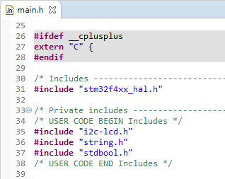
Include the libraries
Open the main.h file and include the i2c-lcd.h file as shown.

Slide 23
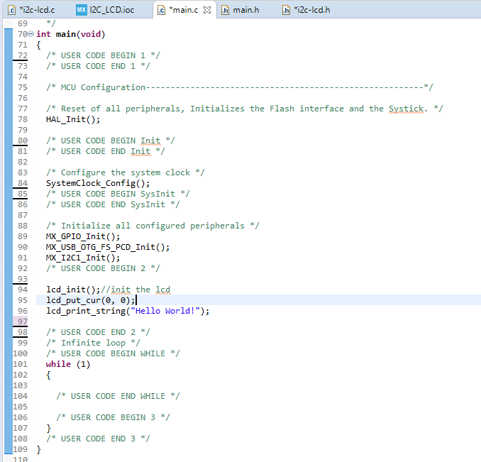
Print “HELLO WORLD”
With all of this knowledge we can try to print some texts on the display.
For this example we’ll display the string «Hello World!» after all the peripherals configurations.
Let’s write some code:
Initialize the lcd
Set the cursor at first row and first line. Remember to check the size of your display, in our case we have a 16 rows by 4 lines display (16x4 or 1604)
Print the desired text.

Slide 24
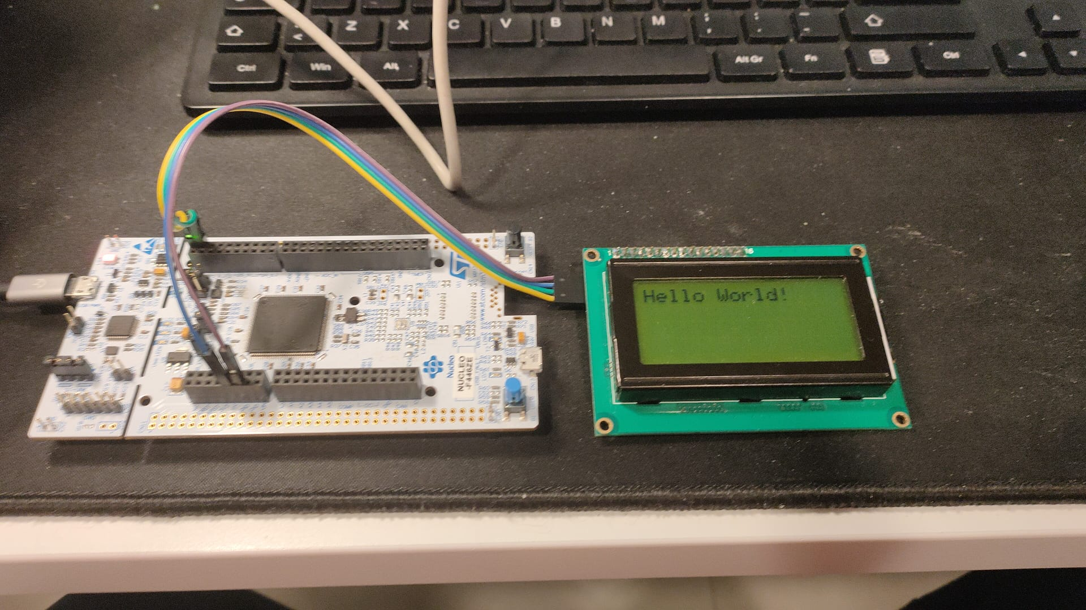
The result should be something like that:

Slide 25
Useful links
I2C introduction: https://www.youtube.com/watch?v=qeJN_80CiMU
I2C display: https://www.youtube.com/watch?v=rfRJGfK2t-A&t=473s
Oled display via i2c: https://controllerstech.com/oled-display-using-i2c-stm32/
Other links:
https://controllerstech.com/lcd-20x4-using-i2c-with-stm32/
https://controllerstech.com/i2c-lcd-in-stm32/

