Slide 1

INTERNET PROTOCOLS
rev1.0 20/04/2020

Slide 2
GOAL
Get a view of the different protocols to send data over internet.

Slide 3
PREREQUISITES
Software needed:
none
Hardware used in this example:
none

Slide 4
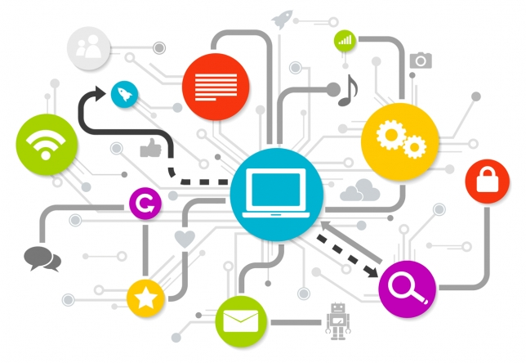
Internet protocol suite
The Internet protocol suite provides end-to-end data communication specifying how data should be packetized, addressed, transmitted, routed, and received.
The most common internet protocols are:
TCP/IP
MQTT
HTTP
FTTP

Slide 5
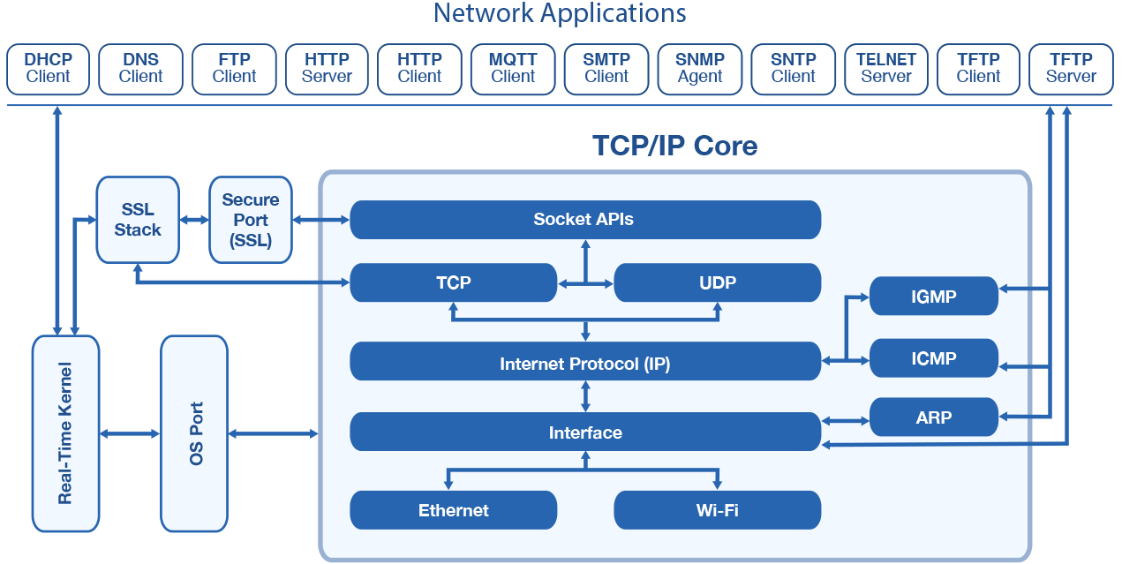
TCP/IP
TCP/IP is a stream protocol. This means that a connection is negotiated between a client and a server. Any data transmitted between these two endpoints is guaranteed to arrive, thus it is a so-called lossless protocol. Since the TCP protocol (as it is also referred to in short form) can only connect two endpoints, it is also called a peer-to-peer protocol.
Between the network applications of the TCP/IP core, we can find the MQTT protocol.

Slide 6
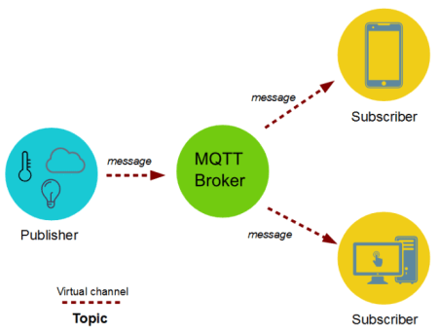
MQTT (Message Queuing Telemetry Transport)
MQTT is a lightweight, “publish-subscribe” network protocol: it usually runs over TCP/IP.
The MQTT protocol defines two types of network entities: the message broker and the client.
Information is organized in a hierarchy of topics. When a publisher has a new item of data to distribute, it sends a message with the data to the connected broker. The broker then distributes the information to any subscriber that have subscribed to that topic.

Slide 7
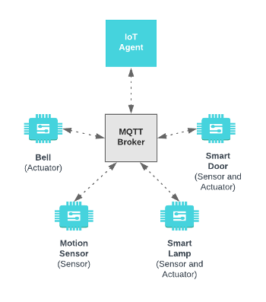
MQTT broker
The broker is a software usually running on a computer or on a cloud. Multiple clients can receive the message from a single broker (one to many capability). Similarly, multiple publishers can publish topics to a single subscriber (many to one).
With MQTT protocol, the devices can publish sensor data and still be able to receive the configuration information or control commands.

Slide 8
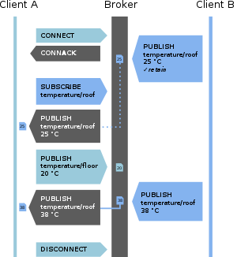
Message types
The MQTT protocol is very simple, there are only tree kind of messages:
Connect: Waits for a connection to be established with the server and creates a link between the nodes.
Disconnect: Waits for the MQTT client to finish any work it must do, and for the TCP/IP session to disconnect.
Publish: Returns immediately to the application thread after passing the request to the MQTT client.

Slide 9
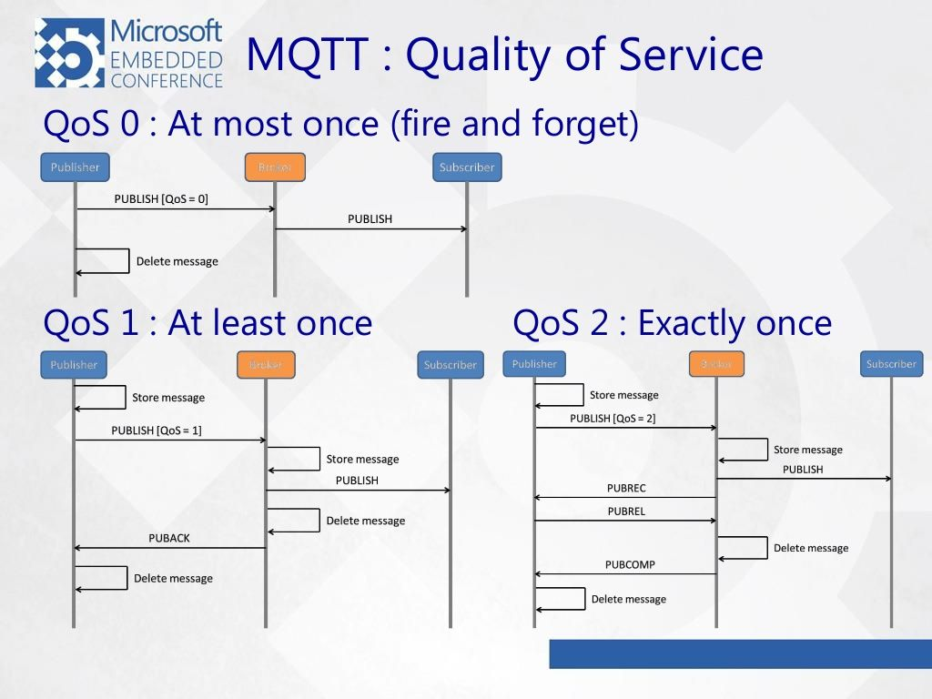
Quality of service (QoS)
Each connection to the broker can specify a quality of service measure. These are classified in increasing order of overhead:
At most once - the message is sent only once and the client and broker take no additional steps to acknowledge delivery (fire and forget).
At least once - the message is re-tried by the sender multiple times until acknowledgement is received (acknowledged delivery).
Exactly once - the sender and receiver engage in a two-level handshake to ensure only one copy of the message is received (assured delivery).

Slide 11

Advantages of MQTT
A few desirable features of such a protocol are:
Small code footprint (to make it easy to implement in small devices)
Low power consumption
Low bandwidth consumption
Low latency
Use of a publish/subscribe pattern
For these reasons is perfect for embedded applications and IoT Devices.

