Slide 1

AWS: Amazon Web Services
rev1.0 20/04/2020

Slide 2
GOAL
Introduction to AWS, create an account and generate certificates.

Slide 3
PREREQUISITES
Software needed:
Internet Browser
Hardware used in this example:
none

Slide 4

What is it ?
Amazon Web Services (AWS) is a secure cloud services platform, offering compute power, database storage, content delivery and other functionality to help businesses scale and grow.

Slide 5
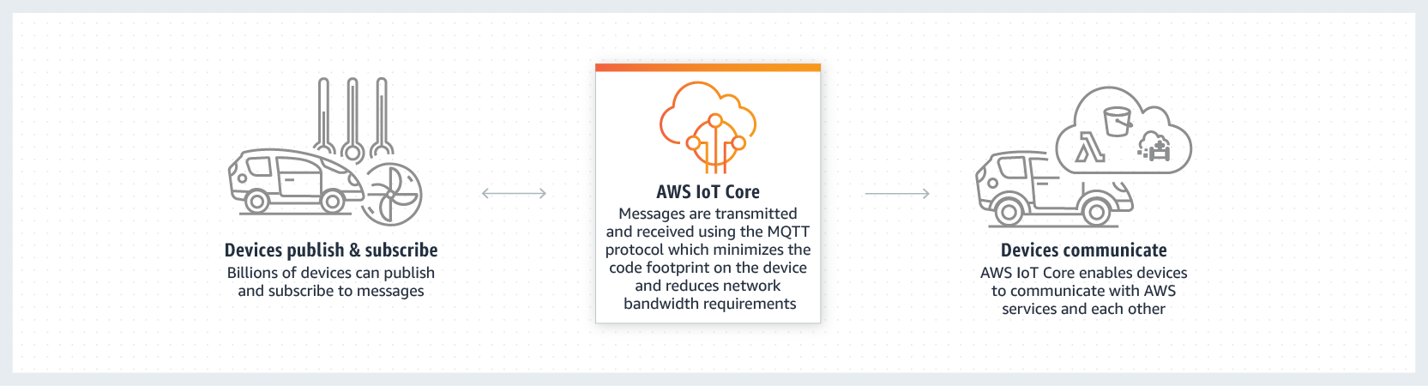
IoT functionality
Among all the AWS there is the AWS IoT Core service: allows to run a broker on the cloud with ease, create and manage any number of devices since it support HTTP, WebSockets and, more important, MQTT.
Aws IoT core provides end-to-end cryptography for secure connections, it’s very easy to create and manage certificates too.

Slide 6

Create an account
In order use the AWS you need to create and activate an account. Creating an account is very easy, go here and create a new one.
You will be asked for a credit card: the AWS are not all free and some services offer a free plan for only 12 months, anyway we will use only the AWS IoT Core, that with the free plan allows 250.000 messages sent and received per month for the first 12 months.

Slide 7

Register a new device
The registry allows you to keep a record of all of the devices that are registered to your AWS IoT Core account. The process of registering your device includes these steps:
Create and Activate a Device Certificate
Create an AWS IoT Core Policy
Attach an AWS IoT Core Policy to a Device Certificate
Attach a Certificate to a Thing

Slide 8
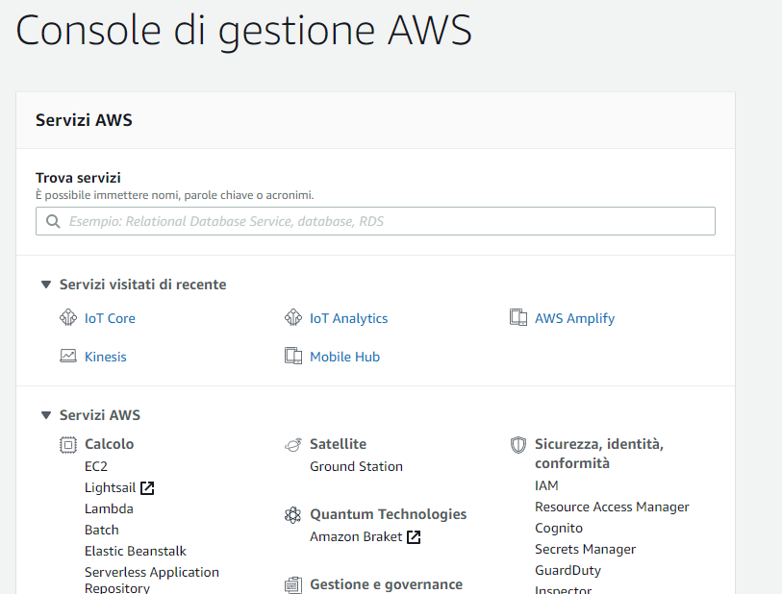
Create and Activate a Device Certificate
First of all sign in as Root user (use the AWS email and password to log in ) then go to IoT core.
If you can’t find it in the recent services, simply search it in the bar.

Slide 9
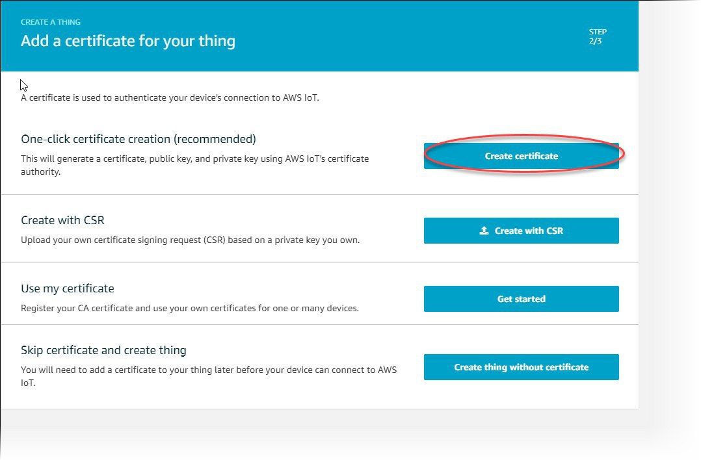
Create certificate
Then go to Security → Certificates and click on the create button.
Select One-Click certificate creation in order to create the certificates and the keys that we will need in the nexts steps.

Slide 10
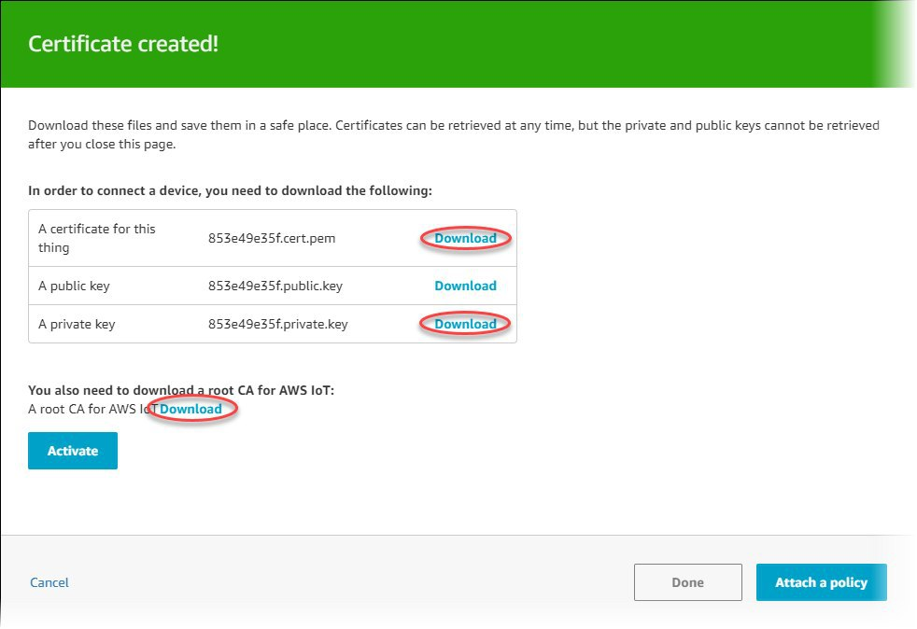
Download
On the Certificate created page, choose the Download links to download the certificate, private key, and root CA for AWS IoT Core. (You do not need to download the public key).
When click for generating the CA certificate, you will be redirected to another page: right click on Amazon Root CA 1 and “save as” the link as a .pem file.
Save each of them to your computer, and then choose Activate to continue.
Choose Done to return to the main page of the AWS IoT console.

Slide 11
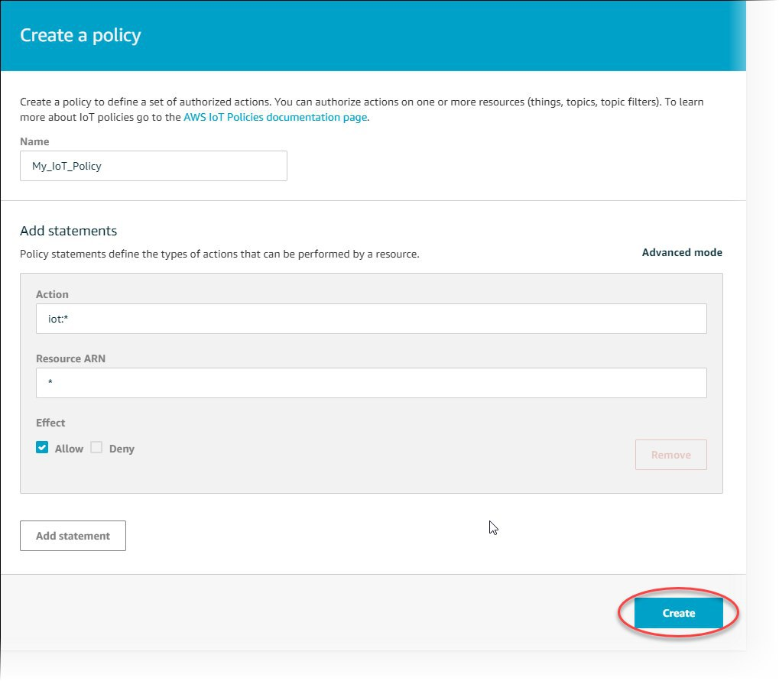
Create an AWS IoT Core Policy
To create an AWS IoT Core policy:
In the left navigation pane, choose Secure, and then choose Policies. On the You don't have a policy yet page, choose Create a policy.
On the Create a policy page, in the Name field, enter a name for the policy (for example, MyIotPolicy). Do not use personally identifiable information in your policy names.

Slide 12
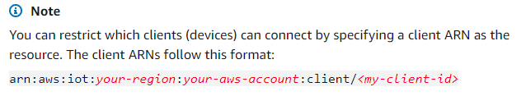
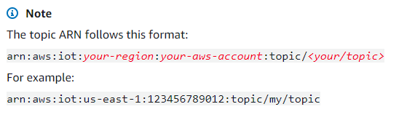
Create an AWS IoT Core Policy
In the Action field, enter iot:Connect. In the Resource ARN field, enter *. Select the Allow check box. This allows all clients to connect to AWS IoT Core.
Choose the Add Statement button to add another policy statement. In the Action field, enter iot:Publish. In the Resource ARN field, enter the ARN of the topic to which your device publishes.
Finally, select the Allow check box. This allows your device to publish messages to the specified topic.
After you have entered the information for your policy, choose Create.
For more information, see Managing AWS IoT Core Policies.

Slide 13
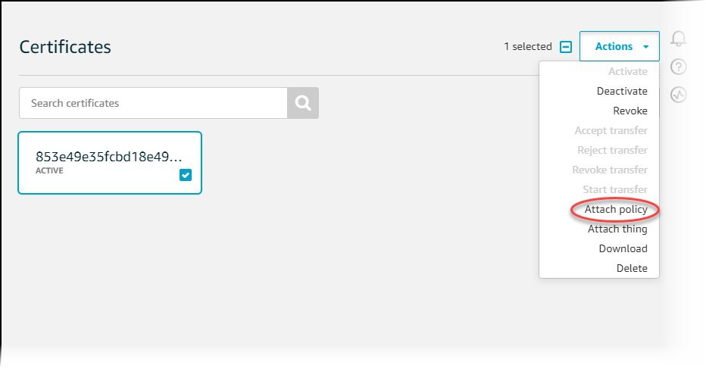
Attach an AWS IoT Core Policy to a Device Certificate
Now that you have created a policy, you must attach it to your device certificate. Attaching an AWS IoT Core policy to a certificate gives the device the permissions specified in the policy.
In the left navigation pane, choose Secure, and then choose Certificates.
In the box for the certificate you created, choose ... to open a drop-down menu, and then choose Attach policy.

Slide 14
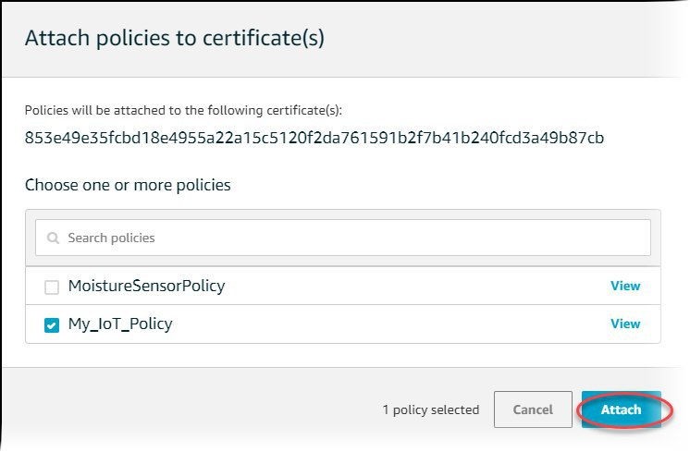
Attach an AWS IoT Core Policy to a Device Certificate
In Attach policies to certificate(s), select the check box next to the policy you created in the previous step, and then choose Attach.

Slide 15
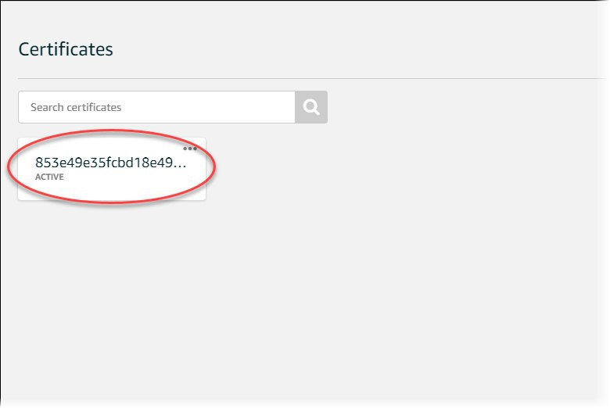
Attach a Certificate to a Thing
A device must have a certificate, private key, and root CA certificate to authenticate with AWS IoT Core. AWS recommend that you also attach the device certificate to the IoT thing that represents your device in AWS IoT Core.

Slide 16
Attach a Certificate to a Thing
To attach a certificate to the thing representing your device in the registry:
In the box for the certificate you created, choose ... to open a drop-down menu, and then choose Attach thing.
In Attach things to certificate(s), select the check box next to the thing you registered, and then choose Attach.
To verify the thing is attached, select the box for the certificate.
On the Details page for the certificate, in the left navigation pane, choose Things.
To verify the policy is attached, on the Details page for the certificate, in the left navigation pane, choose Policies.

Slide 17
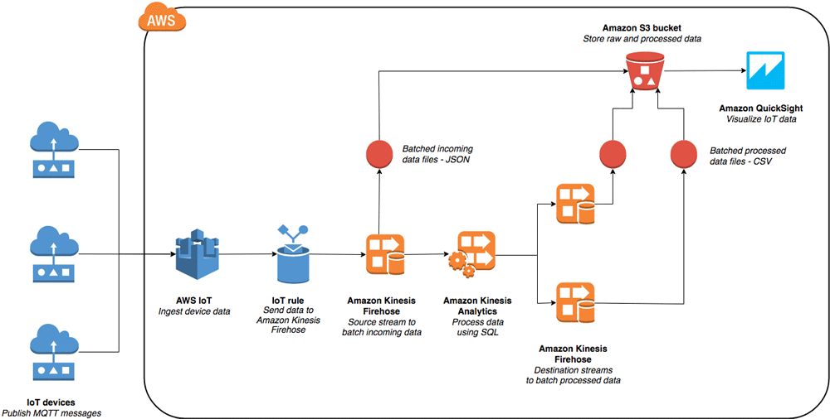
Connect with AWS
At this point is possible to connect your device to the AWS IoT Core Thing and manage your data inside the AWS world.
Consider that some services like AWS Kinesis, AWS QuickSight or other services are not all free, so a solution could be connect NodeRed to the broker hosted on AWS and manage all the data inside NodeRed as we will see.

Slide 18
For more informations
AWS IoT core : https://aws.amazon.com/it/iot-core/
Create an AWS Account : https://aws.amazon.com/it/premiumsupport/knowledge-center/create-and-activate-aws-account/
Register a Device AWS IoT core:
https://docs.aws.amazon.com/iot/latest/developerguide/register-device.html
Example of real-time data monitoring using AWS:
https://aws.amazon.com/it/blogs/big-data/build-a-visualization-and-monitoring-dashboard-for-iot-data-with-amazon-kinesis-analytics-and-amazon-quicksight/

