Slide 1

Node-RED : Introduction
rev1.0 20/04/2020

Slide 2
GOAL
Introduction to Node-RED

Slide 3
PREREQUISITES
Software needed:
Python
Node-RED
NodeJS
Hardware used in this example:
none

Slide 4
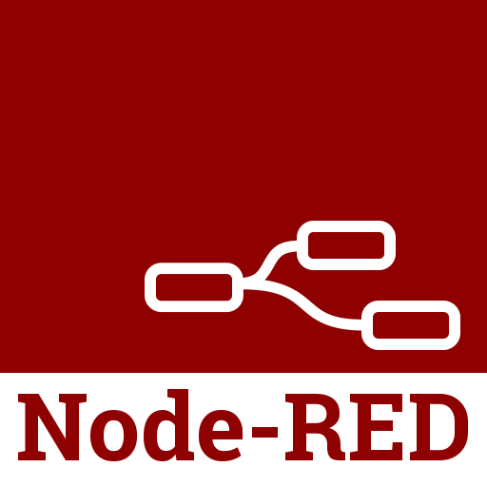
What is Node-RED
Node-RED is a programming tool for wiring together hardware devices, APIs and online services in new and interesting ways.
It provides a browser-based editor that makes it easy to wire together flows using the wide range of nodes in the palette that can be deployed to its runtime in a single-click.
The light-weight runtime is built on Node.js, taking full advantage of its event-driven, non-blocking model.

Slide 5

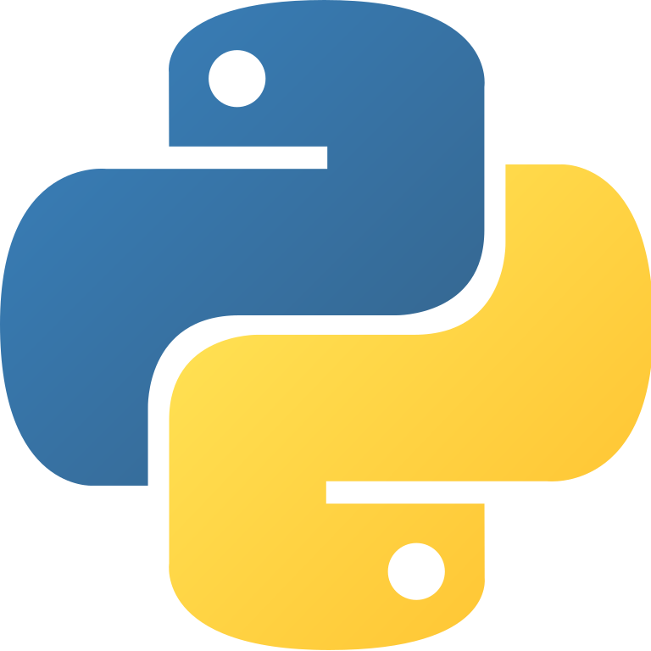

Install Node-RED
Node-RED should run on a machine in order to receive and send data via MQTT.
Node-RED can run locally on a machine such as Raspberry Pi or on a server with windows or a linux distro installed.
In our case we will install and run Node-RED in a windows machine.
Before proceding with the installation of Node-RED be shure to have node.js and python installed on your machine

Slide 6
Install Node.js
Installing Node.js is very simple, just go on the download section ( link ) and download the last stable release for your system.
Once downloaded, install it just as a normal application.

Slide 7
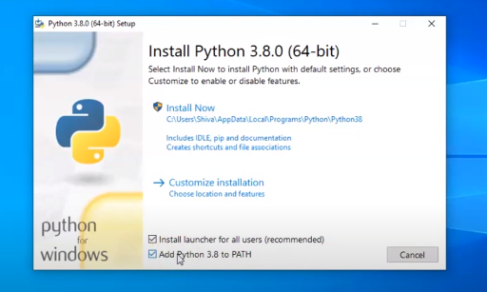
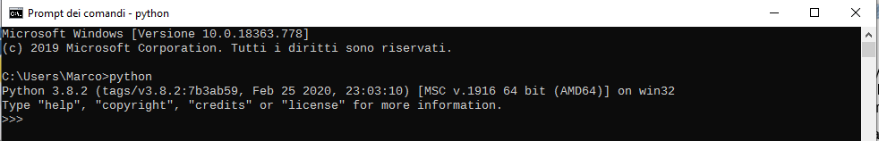
Install Python
Python is really simple to install as well: go to the download page ( link ) and get the last stable release for your system.
Install python as a normal application but be sure to add python to PATH.
Then check the python installation in the terminal as below.

Slide 8
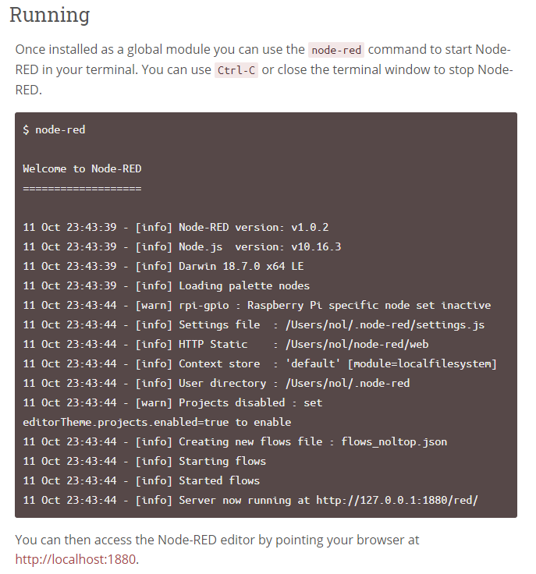
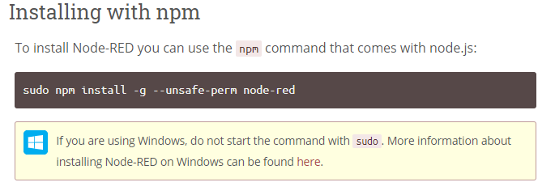
Install Node-RED
In order to install Node-RED open the terminal use the following command:
If you have any trouble here you find the Node-RED installation guide.
To run Node-RED use the command “node-red” on the terminal, then go to
http://localhost:1880 to open Node-Red Console.

Slide 9
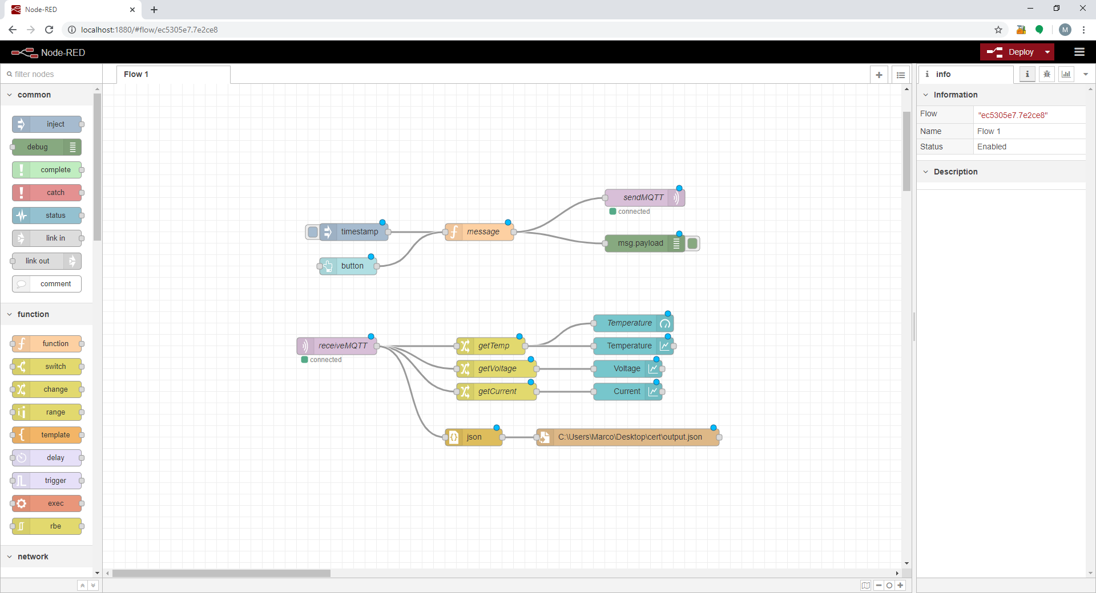

Slide 10
Node-RED Console
Deploy
Node-RED have a nice looking GUI interface, see the main components:
Palette: here you have the list of all nodes available to build your application
Canvas: put here the blocks and connect them together, this is your “flow”. You can have more than one flow as well.
Deploy: Save your flow and run it on your machine.
Nodes
Canvas

Slide 11
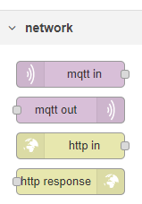
Connect to AWS
The main goal here is to communicate with AWS from Node-RED.
Under the Network tab in the palette pick the mqtt in and mqtt out blocks and put them in the canvas

Slide 12
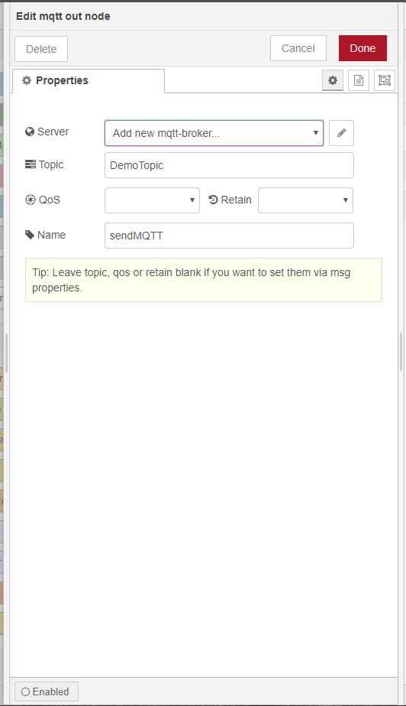
Add new mqtt broker
Double click on the mqtt out node, a windows will appear with some infos:
Server: address of the mqtt broker
Topic: subscribe or publish to a topic
QoS: quality of service
Name: name of the node, in this example we called it “sendMQTT”
Click on the pencil next to the server field.

Slide 13
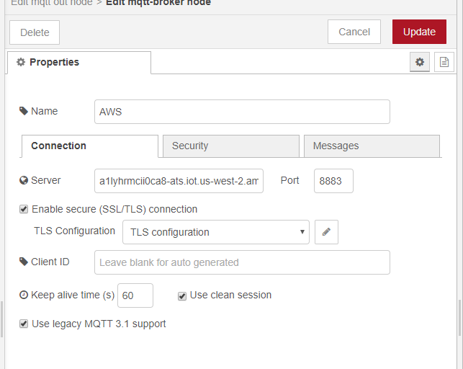
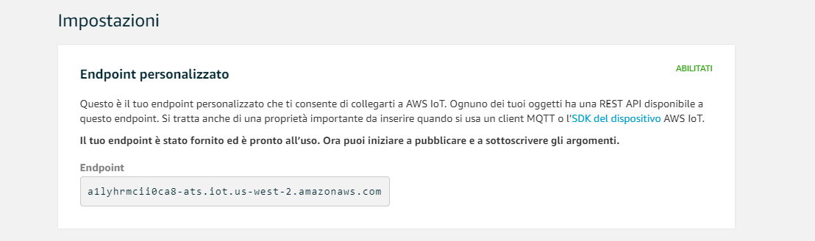
Connect to AWS
Follow the configuration on the picture.
The most important field here is the server field: here you have to put your personal endpoint of AWS.
To find the AWS personal endpoint, log in to AWS and go to AWS IoT Core → Settings

Slide 14
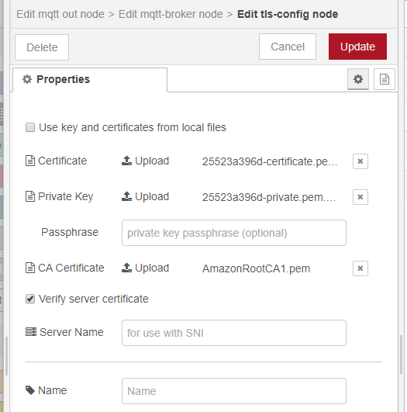
Connect to AWS
The next step is to enable the SSL/TLS connection and upload the certificates.
Click on the pencil and add a new TLS configuration.
Now upload the certificates and the private key, you can choose to upload the files or put a path to your directory.
Now update all setting and deploy your flow.

Slide 15
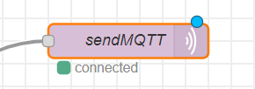
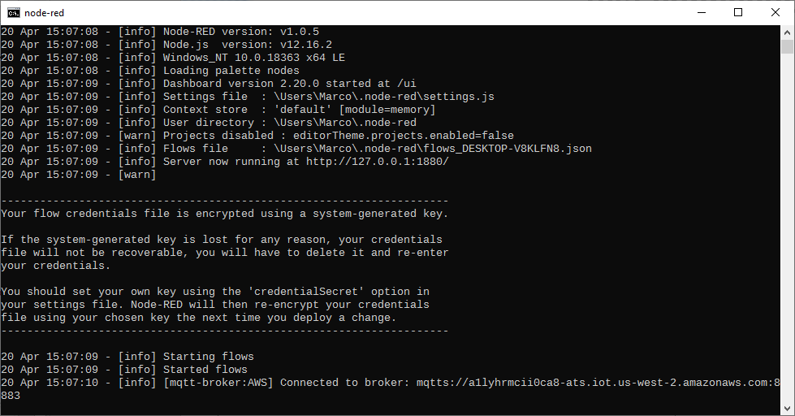
Test connection
If you done all correct, Node-RED should connect with no problems.
After Deploy, Node-RED will connect to AWS and a green square will appear under the node and a confirmation message will appear in the terminal.
Now we are connected to the AWS endpoint.

Slide 16
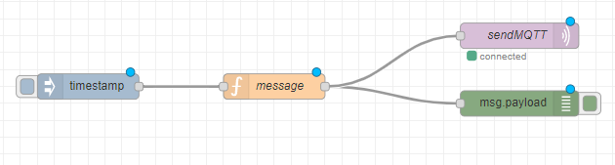
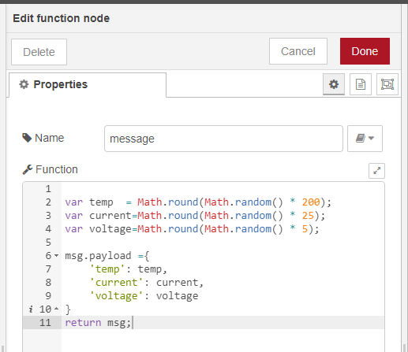
Send a message
Now try to send a message:
Create a simple flow like the one in figure. The blue node is a inject node: when blue box is pressed, the node activate and send a message to the mqtt out node.
The orange node is a function: in this example we generate random numbers in a json formatted way.
The green block is a debug block: in this configuration will show the message sent to the AWS broker.
One done deploy your flow.

Slide 17
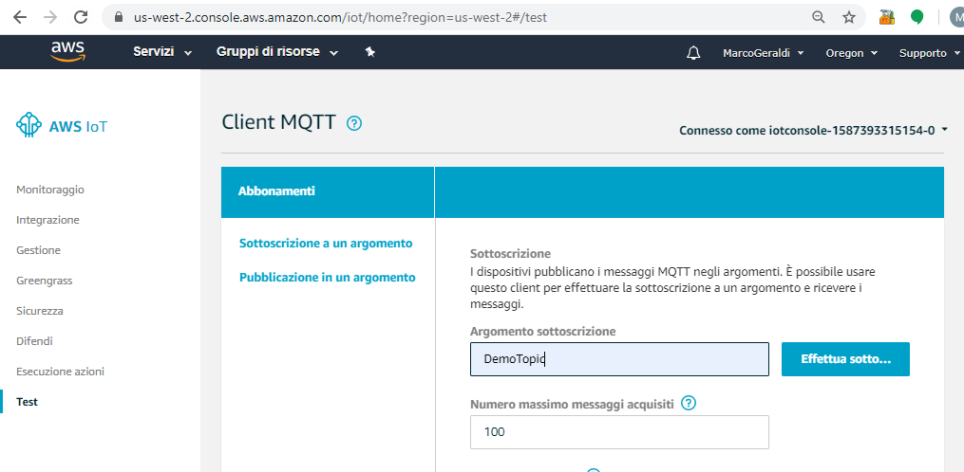
Subscribe to a topic from AWS
Open the AWS IoT Core and go to the Test tab end subscribe to the same topic as the Node-RED mqtt node, in our example DemoTopic.

Slide 18
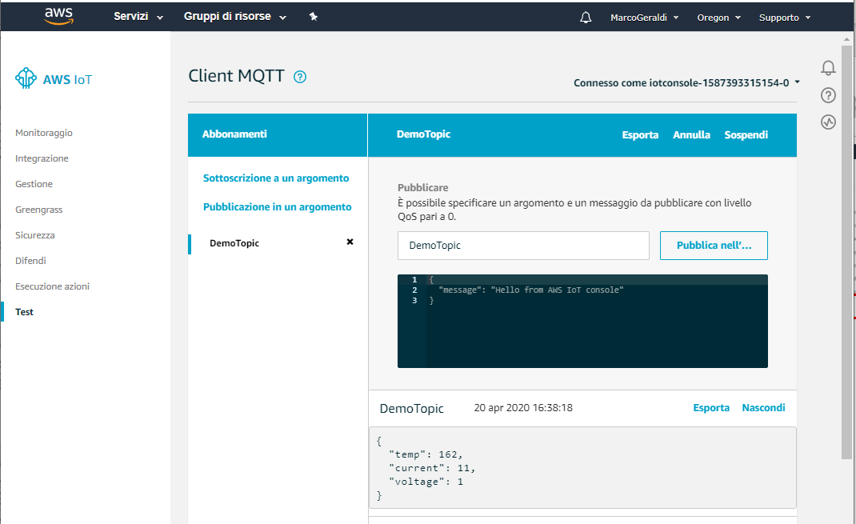
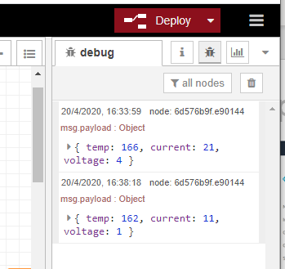
Publish to a topic from AWS
From here is possible to monitor all the messages sent and received in the topic. From the console you can publish on the topic by clicking on the Publish button.
From Node-RED when the inject node has been activated the message generated in the function will be sent to the DemoTopic.

Slide 19
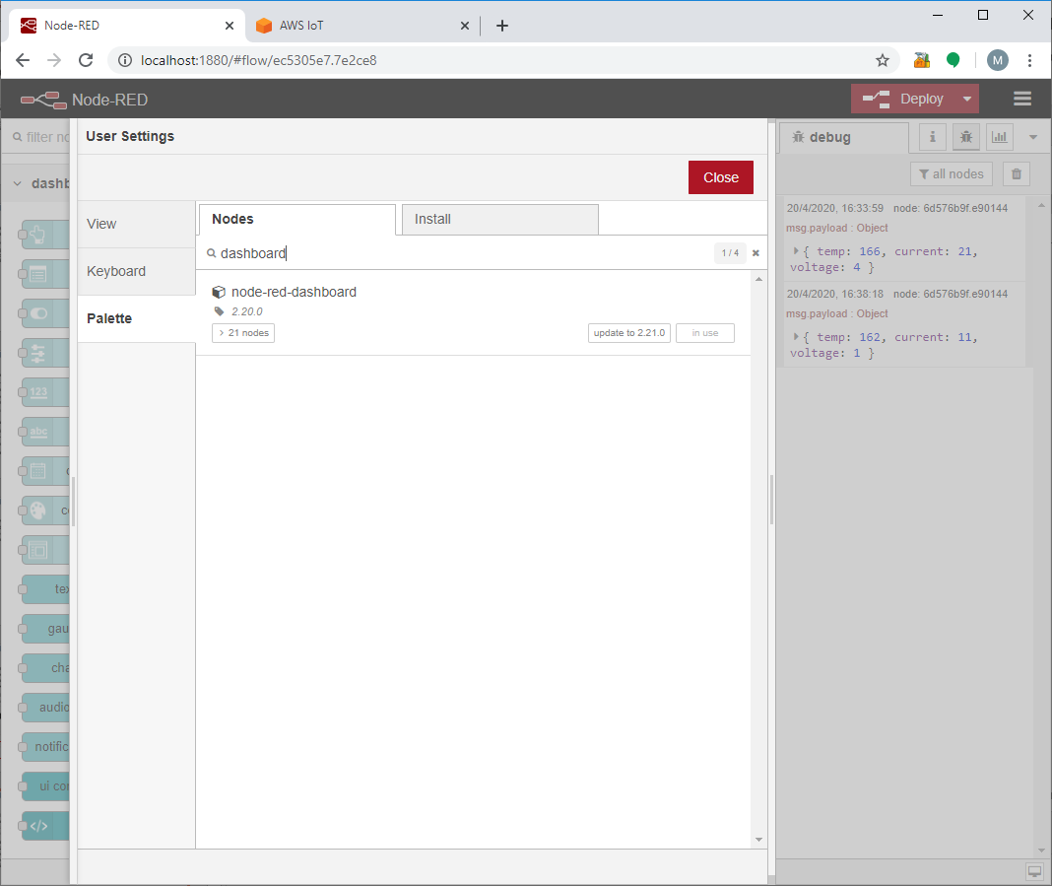
Receive a message
From Node-RED it’s possible to subscribe to a topic and receive all the message that other clients have sent to the AWS broker by using the mqtt in node.
To display data in a fancy way is possible to use the dashboard, a plug-in that includes other nodes such as charts, buttons, gauges, sliders and so, in order to create a great monitor GUI.
By the menu icon, go to manage palette and look for the dashboard palette, then install it.

Slide 20
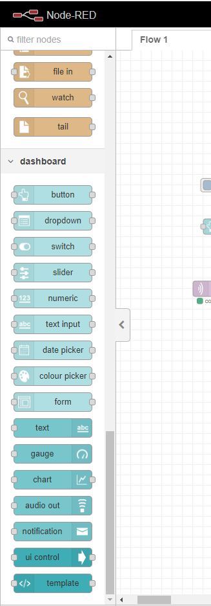
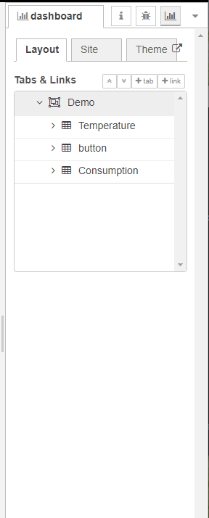
Dashboard plugin
The dashboard palette will be added to your palette of nodes.
From the dashboard menu it’s possible to change themes, layout and so on .
You can access your dashboard from :
http://localhost:1880/ui

Slide 21
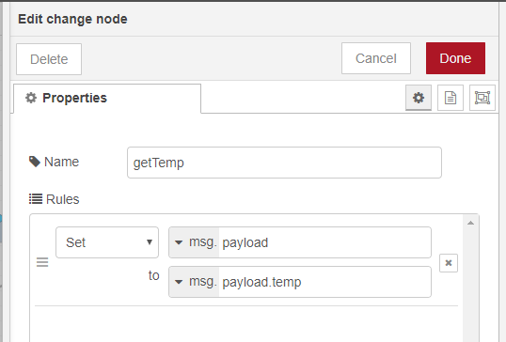
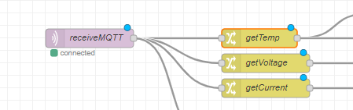
Create a monitoring dashboard
The first step to get the dashboard working is to configure the mqtt in node: the configuration is the same as the out node, you should be able to use the same AWS broker configuration.
For this example we publish a simulated message that contains 3 main data (temperature, voltage and current) to the topic and when we receive it from the mqtt in node, we save it to a json file for further analysis, and meanwhile, split the message and show it on the dashboard.
To split the message payload use the change node.

Slide 23
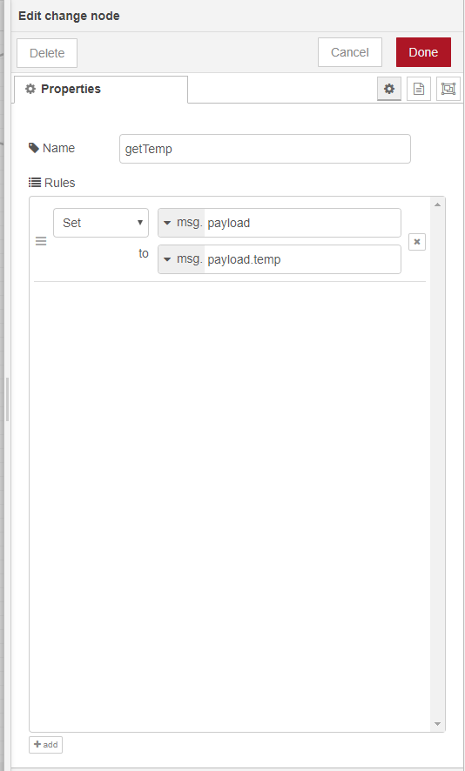
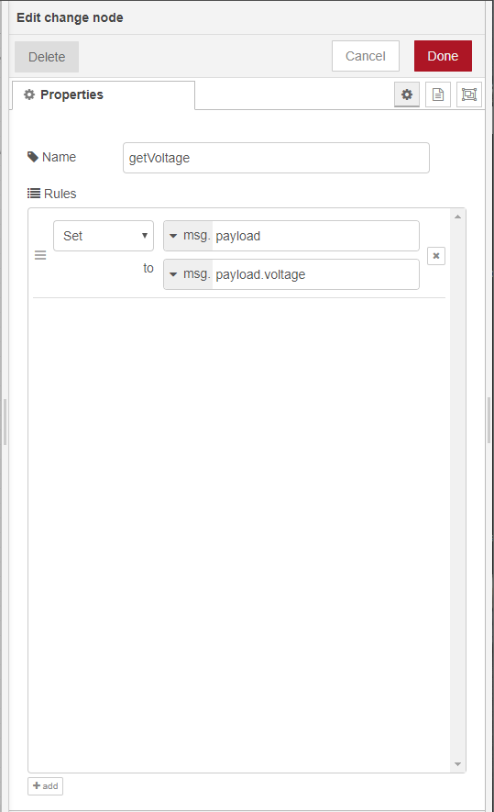
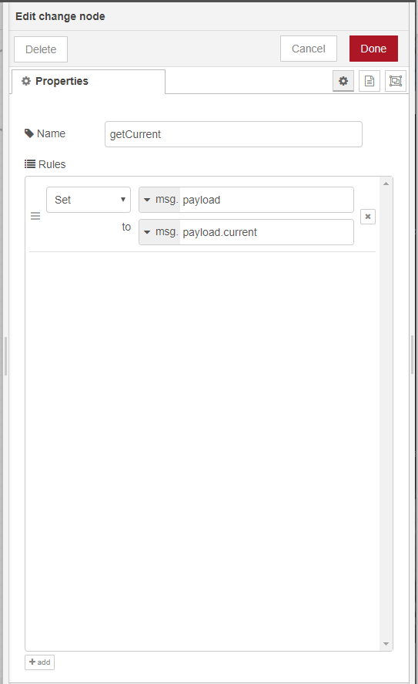

Slide 24
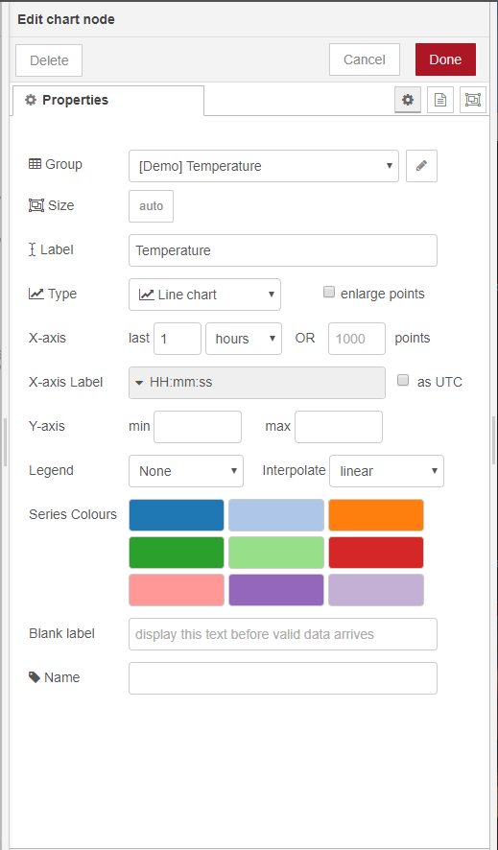
Show data with charts and gauges
To display data drag & drop the dashboard nodes as shown.
To organize data in the dashboard is possible to create groups and tabs: for this example we created one tab Demo and each message will be displayed in a different group.

Slide 25
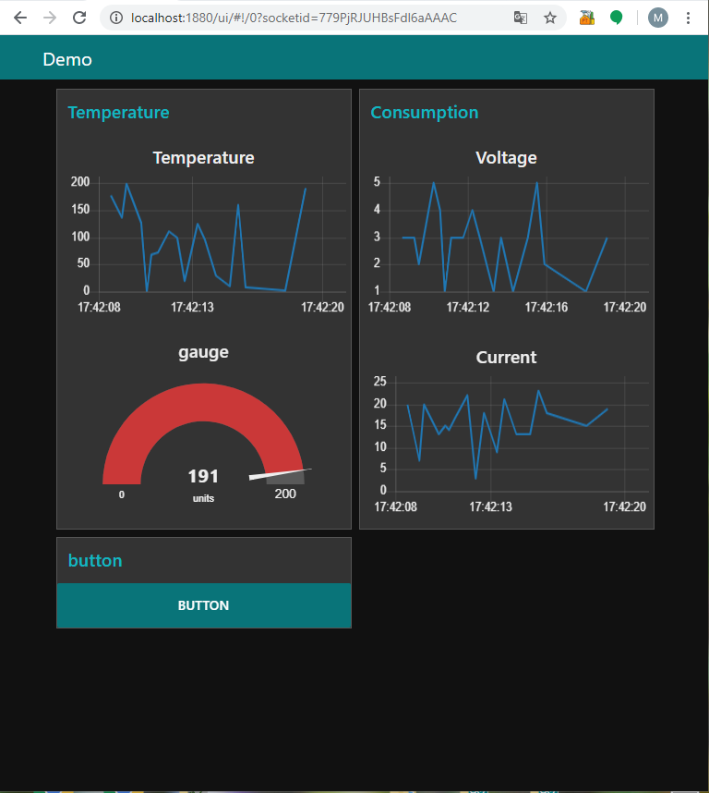
My Dashboard
Open the dashboard ( http://localhost:1880/ui ) When data will be published on the topic, the mqtt in node reads the message, split each field and send each data to the respective chart.
In the dashboard of the example we can used a gauge to show the actual «temperature» with a chart that rapresents the temperature over the time. The same for current and voltage.
For testing purposes the button is connected to the mqtt out node, so when the button is pressed, the «fake» message has been sent to the AWS broker.

Slide 26
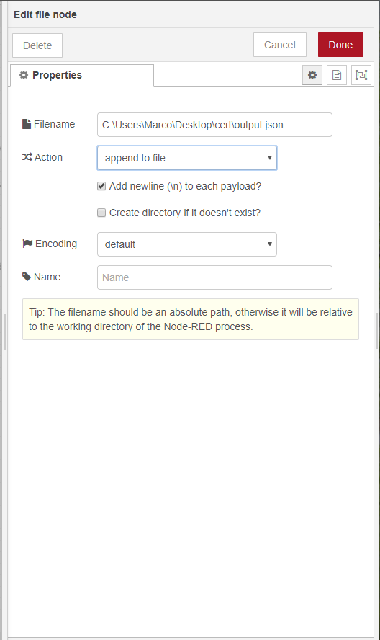
Save data to a file
Usually mqtt messages are sent in json format.
The easiest way to store data is to save each stream to a json formatted file and then convert this file to a .csv one.
To save data to a file is very simple, just connect a json parser to the mqtt in node, and a file node at the output of the parser.
Double click on the file node, and check the fields:
Filename: is the path where the file is store
Action: behavior of the file when opened

Slide 27
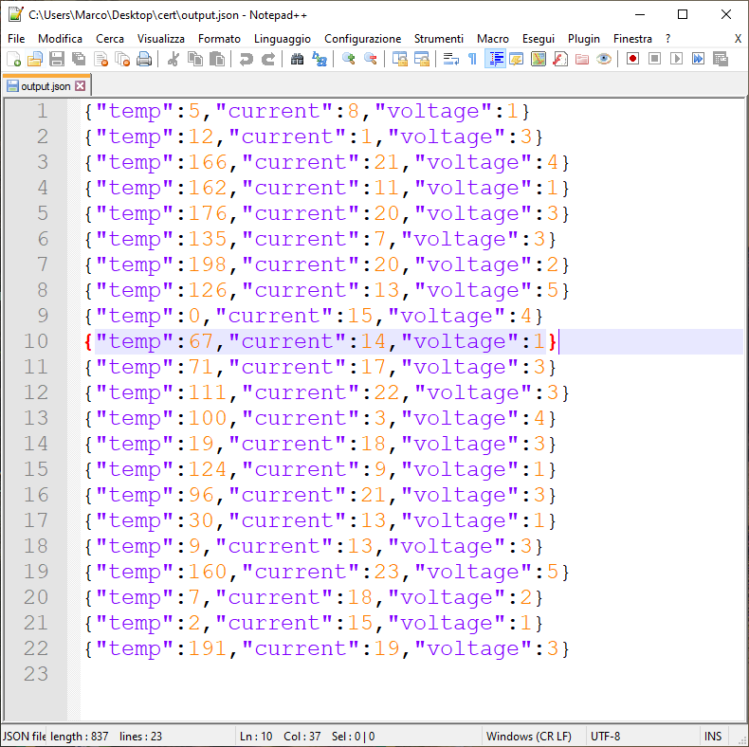
Json file
The output file will be something like the one in the picture: you can open with any software, in the example we used notepad++.
In order to convert it to a .csv file for more analysis is possible to use some free tools such as this .

