Slide 1

X-CUBE-AWS
rev1.0 09/06/2020

Slide 2
GOAL
Connect STM32 microcontrollers to AWS

Slide 3
PREREQUISITES
Software needed:
STM32IDE
X-CUBE-AWS
TeraTerm
Hardware used in this example:
32F769IDISCOVERY
P.S. Be sure to have fully understood the basics of AWS such as devices, certificates and JSON messages.

Slide 4
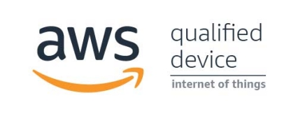
X-CUBE-AWS
The X-CUBE-AWS Expansion Package consists of a set of libraries and application examples for STM32L4 Series, STM32F4 Series, and STM32F7 Series microcontrollers acting as end devices.
For our example start with opening the example for the 32F769IDISCOVERY board, you can find it in:
..\STM32CubeExpansion_Cloud_AWS_Vx.y.z\Projects\STM32F769I -Discovery\Applications\Cloud\AWS

Slide 5

FreeRTOS
The X-CUBE-AWS libraries works on FreeRTOS, a Real-time operating system for microcontrollers. Using a OS allows the board to perform multiple tasks at almost the same time, indipendently so it’s important to have a basic understanding in how it works and the importance of threads.
You can find all the infos you may need here.

Slide 6
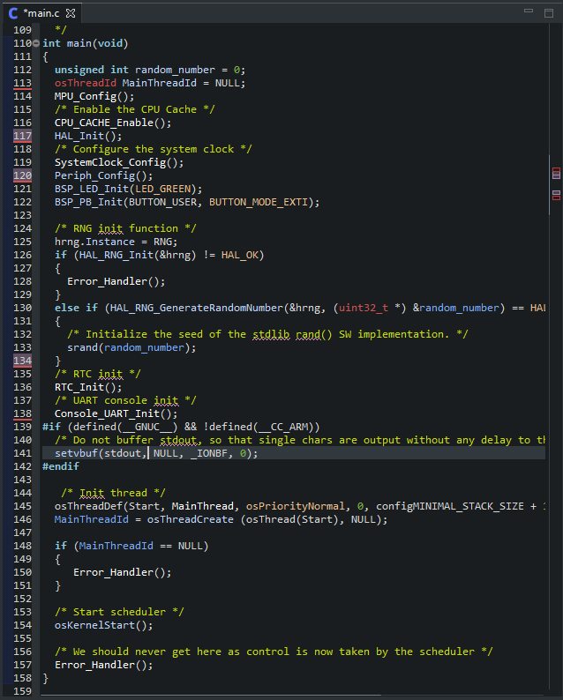
X-CUBE-AWS Example
Open the main.c file and go to the main function: after the initalization of the board, the MainThread will start: notice that the infinite loop is missing.
Scrolling down (or by searching it on the right tab) find the MainThread function: the aim of this thread is to create all the objects we need for the OS such as threads, tasks, timers and so.
After all of them have been created, the MainThread terminates, while all the other threads will continue to run indipendently.

Slide 7
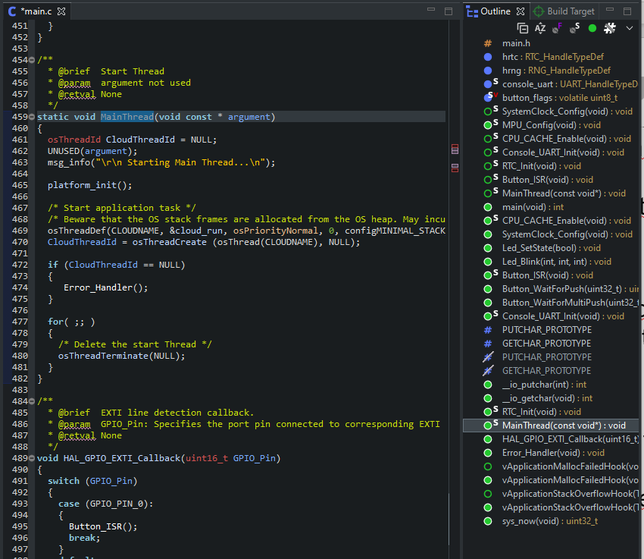
X-CUBE-AWS Example
Open the main.c file and go to the main function: after the initalization of the board, the MainThread will start: notice that the infinite loop is missing.
Scrolling down (or by searching it on the right tab) find the MainThread function: the aim of this thread is to create all the objects we need for the OS such as threads, tasks, timers and so.
After all of them have been created, the MainThread terminates, while all the other threads will continue to run indipendently.

Slide 8
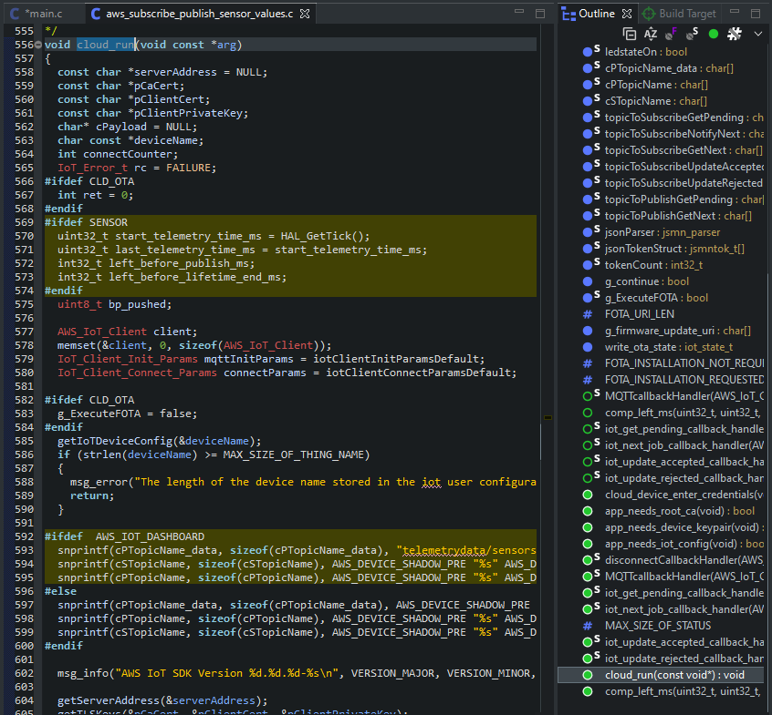
cloud_run()
The line:
osThreadDef(CLOUDNAME, &cloud_run,..)
Defines a thread called CLOUDNAME that will run the cloud_run function.
Select cloud_run, righ click and go to definition: the file aws_subscribe_publish_sensor_values.c will open.
Here are written the main functions that allows our system to communicate with AWS.

Slide 9

ATTENTION
There are 2 errors on the example given by ST.
Using the find tool in the IDE, substitute the following line (the error is repeated twice) :
paramsQOS1.payloadLen = strlen(cPayload) + 1;
With:
paramsQOS1.payloadLen = strlen(cPayload);

Slide 10
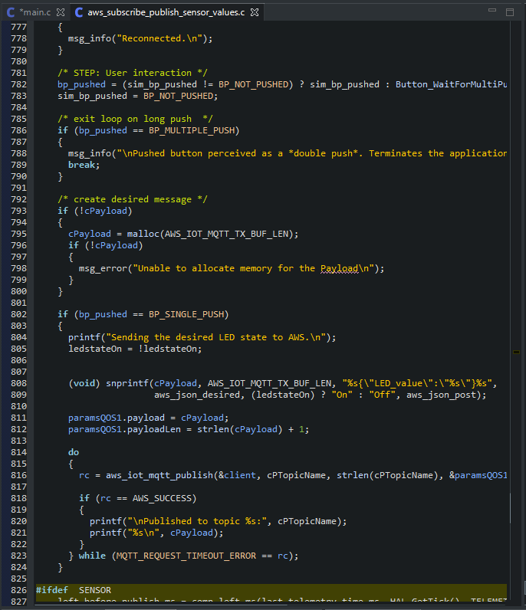
cloud_run
cloud_run() function provides us connection with AWS cloud, subscribing and publishing to topics, checking for errors all the time.
You should never touch this function for the most part.
As you can read on the ST’s papers (you can find the official guide here), the example provided will publish a message to the specific topic in order to change the built-in LED state when the blue button has been pushed.
This functionality is written between lines 802 and 824.

Slide 11
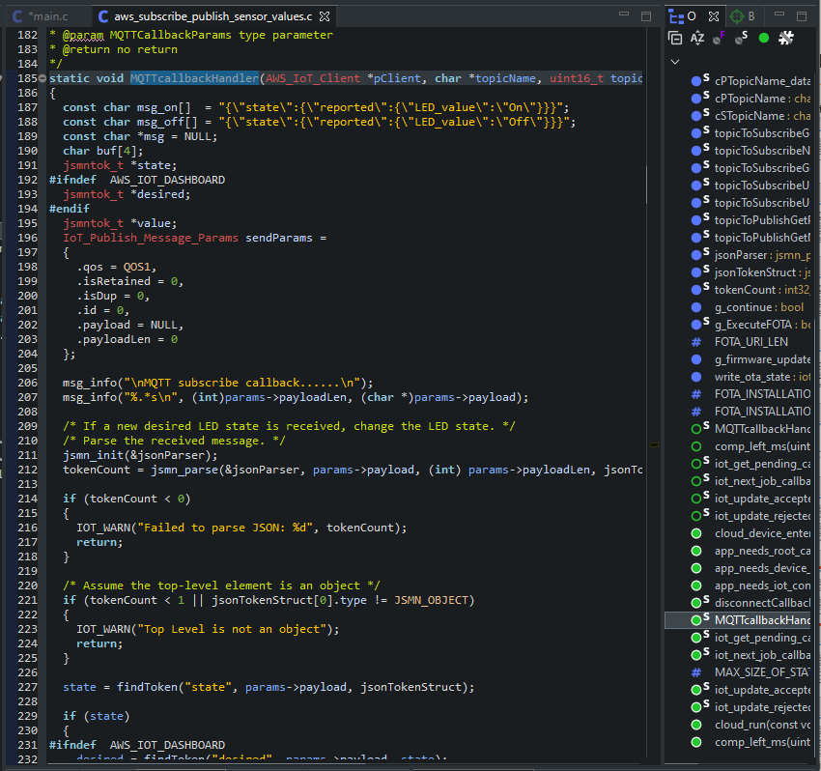
MQTTcallbackHandler
When any message has been published on the topic wich the board subscribed, the MQTTcallbackHandler triggers itself.
This function is written in the same file, at line 185 (try to find it with the browser tab at right) .
Any message that arrives in the topic is stored as payload: the jsmn parser interprets it and in this example, if the message is valid, the board will publish a message with the result of the led toggle, and set the led state.
But, where are defined the topics ?
.:

Slide 12
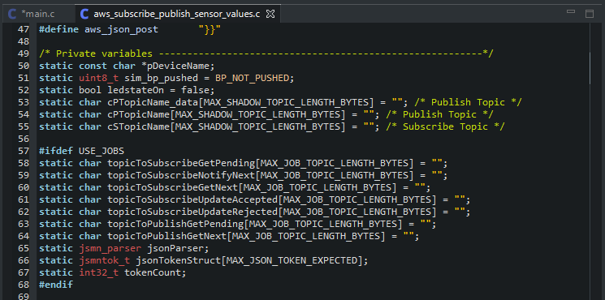
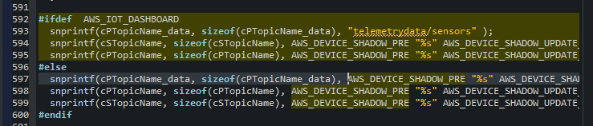
Topics
The topics for subscribing and publishing are defined at the beginning of this file at lines 54 and 55 but they are empty. Right click on the topic name and click on call hierarchy: you will find where the topics strings are filled (Lines 592-600).
They consists on a sum of different strings, containing the device name too.
An example is:
$aws/things/afr_test/shadow/update/accepted
As a cPTopicName for a device named afr_test .

Slide 13

Let’s Start !
This was an overview of how the X-CUBE-AWS example works, anyway I suggest you to explore better the functionality of FreeRTOS and of the entire X-CUBE-AWS libraries.
Start with creating a device in the AWS Console (for this example it is afr_test ), create and attach policies to the device and download the certificates (See the AWS basics slides as reference).
Once done, download the firmware on the board but keep in mind that debugging firmware based on FreeRTOS is not the same as previous examples: it will not work proprierly. See here to more infos.

Slide 14
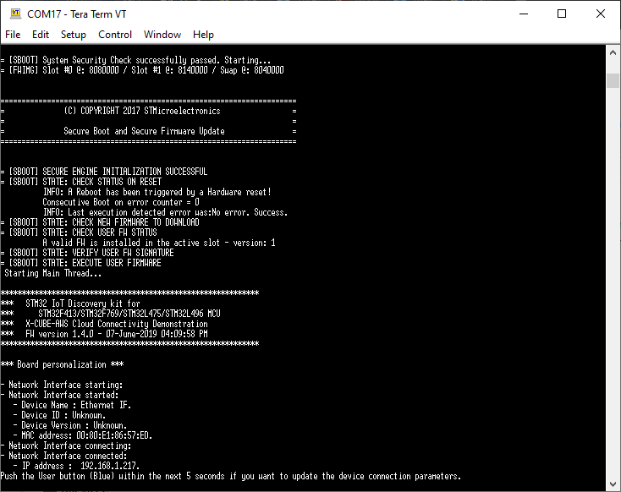
Console Logging
Open TeraTerm software select Setup→Restore setup and choose the file provided with the X-CUBE-AWS library in the utilities folder.
Select Setup→Serial Port and start the communication, then reset the board.
The board will begin to log on the console, asking for credential updates in the first 5 seconds after the network has been configured. Press the blue button within 5 seconds for updating credentials such as broker endpoint, certificates and so.

Slide 15
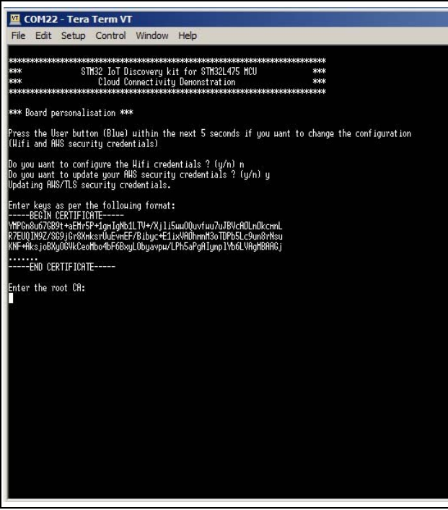
Enter Credential
You will be prompted to paste the certicates on the console: open the certificate file with MS Word (notepad will not work) select the text and paste it as in the picture.
If you have any troubles in pasting the text, go to edit→paste.
Press enter.
If the text has been inserted correctly, it will be echoed in the console, as in the picture.
Continue with the other certificates.

Slide 16
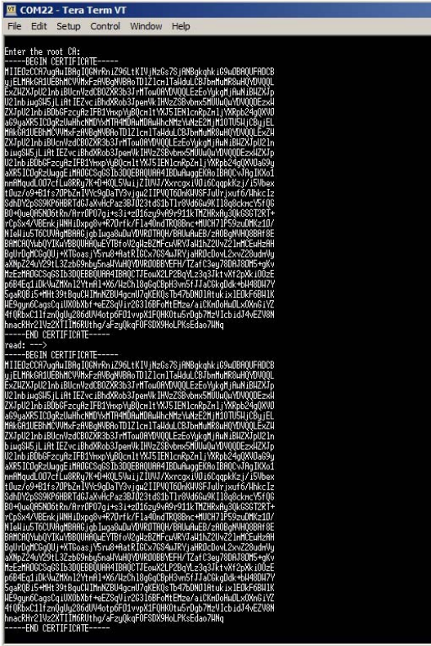
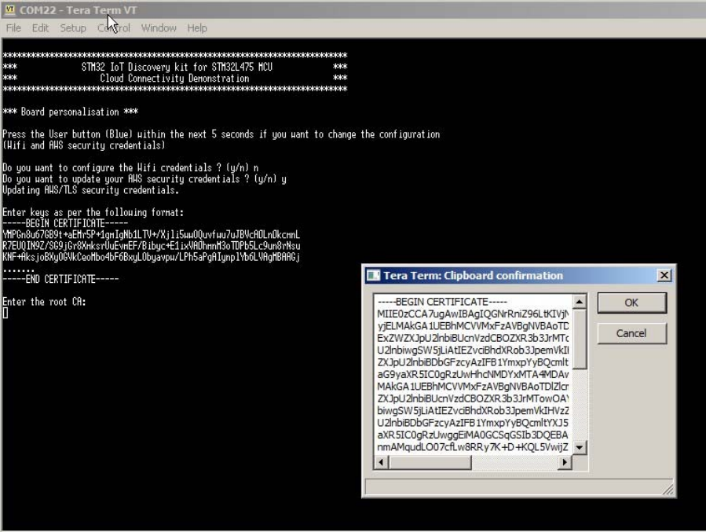

Slide 17
Start Sending Data
After all the credential have been written in the flash memory (you have to insert credential only once), after checking for fimware updates, it will connect to the broker endpoint.
Push the blue buttom to publish the message in the topic.
To check if all is working properly, log on AWS IoT core console, subscribe and publish to the same topics.

