Slide 1

X-CUBE-AWS
rev1.0 09/06/2020

Slide 2
GOAL
Modify X-CUBE-AWS example to develop a robotic arm

Slide 3
PREREQUISITES
Software needed:
STM32IDE
X-CUBE-AWS
TeraTerm
Hardware used in this example:
32F769IDISCOVERY
P.S. Some parts, like the communication with the robotic arm, can be unclear. Keep in mind that the main aim of these slides is to modify the given example from ST.

Slide 4

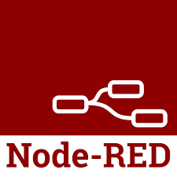
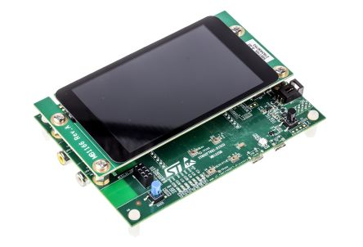
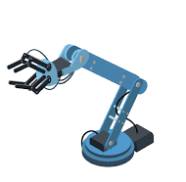
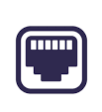
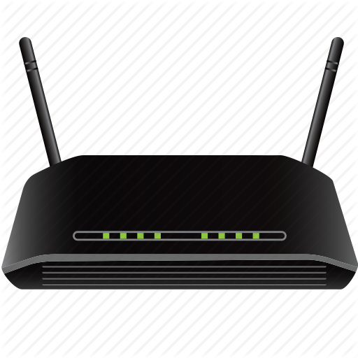

Project Setup

Slide 5
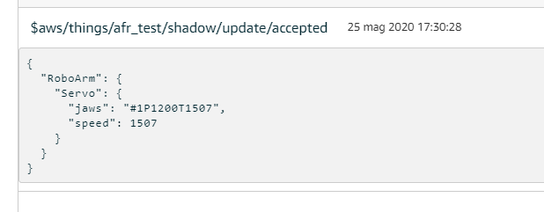
JSON Messages
Communication between devices takes place through the exchange of JSON messages to and from AWS.
TOPIC
TIMESTAMP
TOKENS
DATA

Slide 6
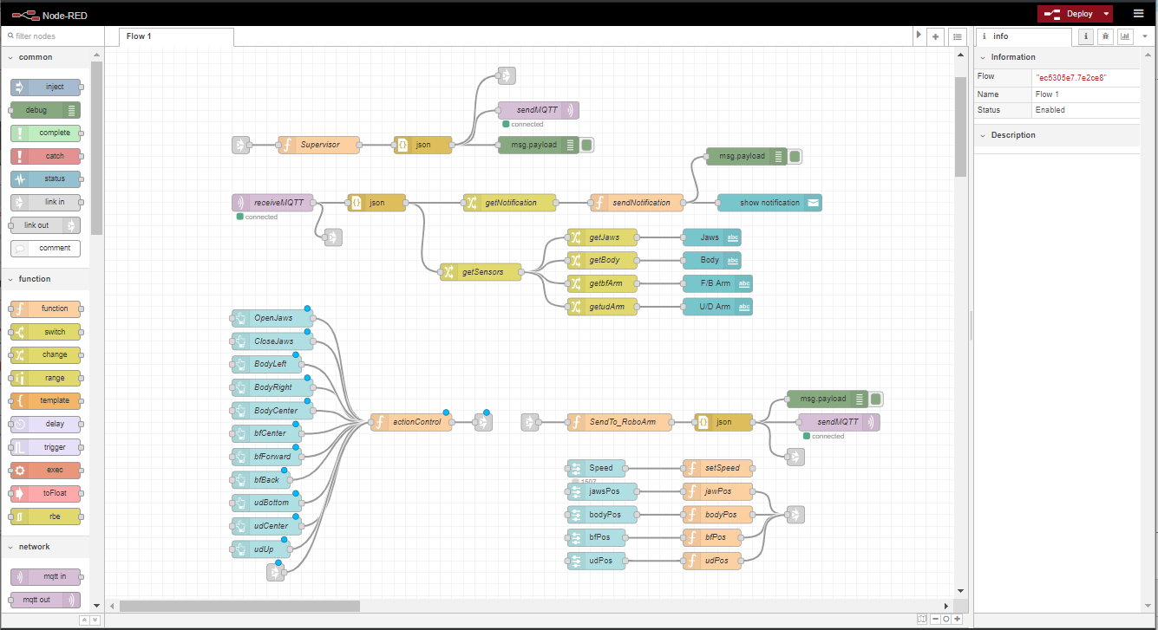
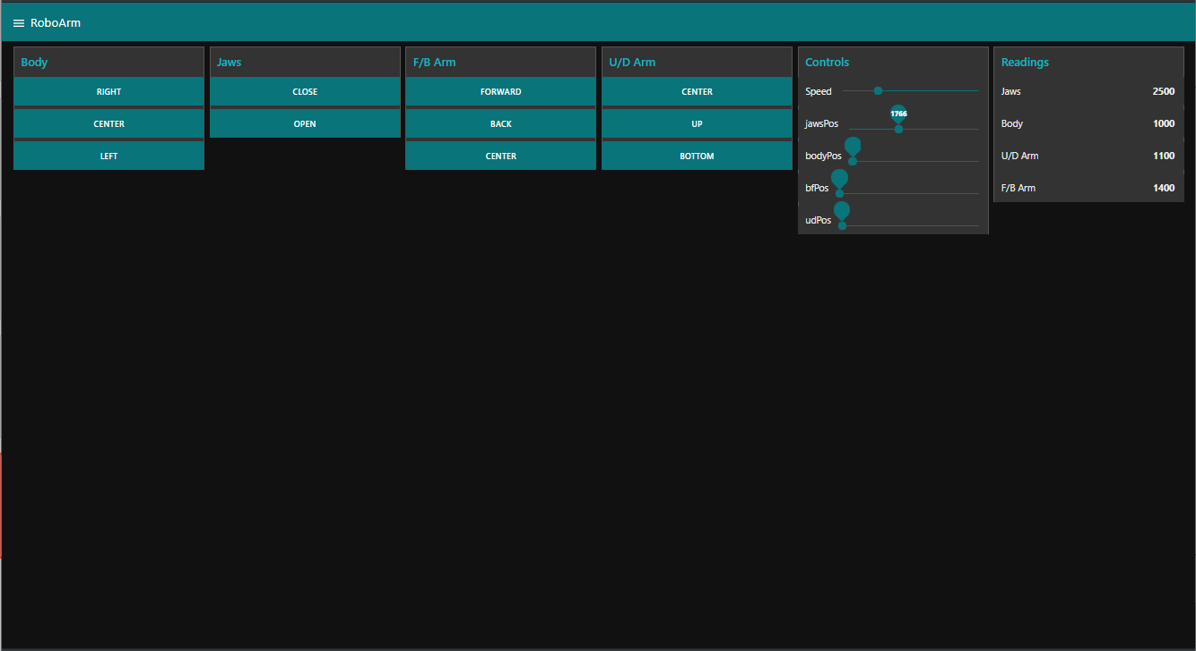
Node-RED
Node-RED server contains all the algorithms (flows) to manage the infrastructure and its function is to exchange messages with AWS.
A dashboard running on Node-RED has been implemented as well.

Slide 7
Dashboard Example
When any action is performed on the dashboard, a JSON message will be published on the topic.
TOPIC
TIMESTAMP
TOKENS
DATA

Slide 8
STM32F769 Board
Features:
Internet Connection over Ethernet
Controls a robotic Arm via UART
Toggle on board LED via AWS
Send notifications on Node-RED dashboard when an action has been performed.
Console logging, for an easy troubleshooting and AWS Credential update.

Slide 9
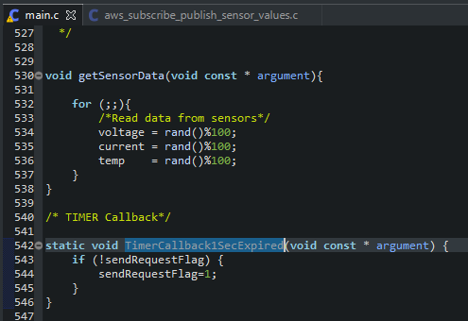
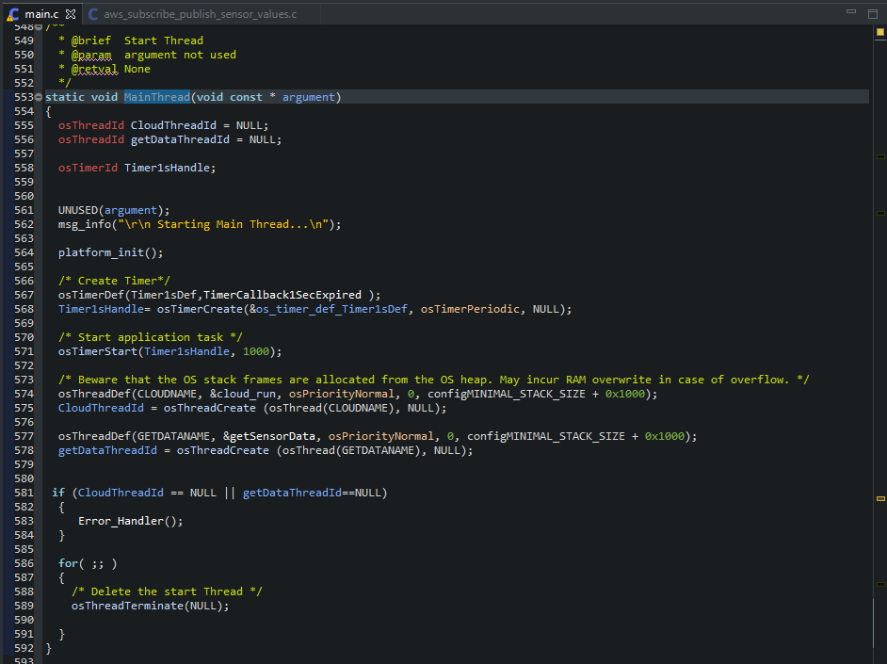
MainThread
For a real device, is usefull to send data at time intervals (like data acquired from sensors ): a timer is needed for this task.
For more infos about timers and FreeRTOS have a look here.
Sometimes creating other threads that can run indipendently is needed, for this pay attenction to red boxes.

Slide 10
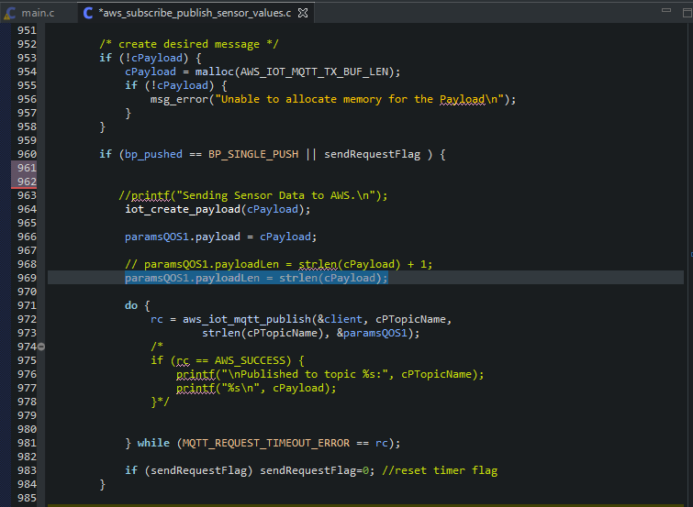
Cloud_run()
The main differences with the last example is in the aws_sub[..].c file.
One important feature of our project is to send feedback data to AWS. Using the flag setted by the timer, each timer interval, the payload containing all the data is published to the topic.
For cleanness, the payload is built inside the function :
iot_create_payload(cPayload);
All the definitions needed are inside the same file.

Slide 11
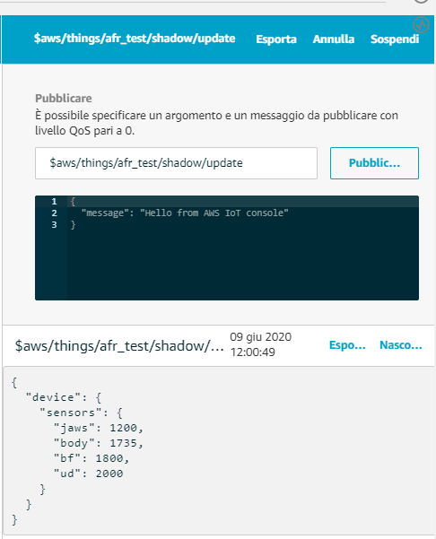
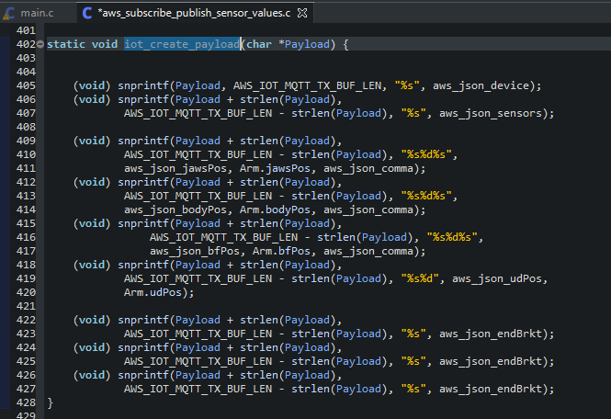
Creating the Payload
The message sent to AWS is this:

Slide 12
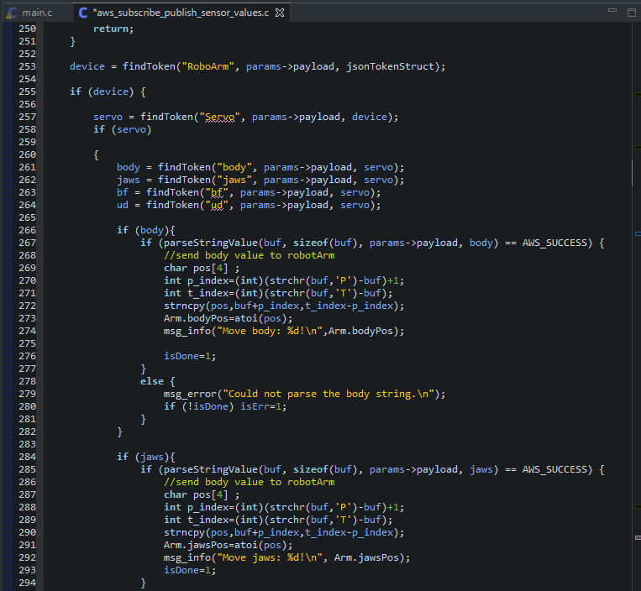
MQTTcallbackHandler
When any input is given by the dashboard, a message is published on the topic in wich the board is subscribed, so the handler will trigger.
At this point, the device parsed the message and split each token using the jsmn parser in order to get the string that have to been sent to the servo controller.

Slide 13
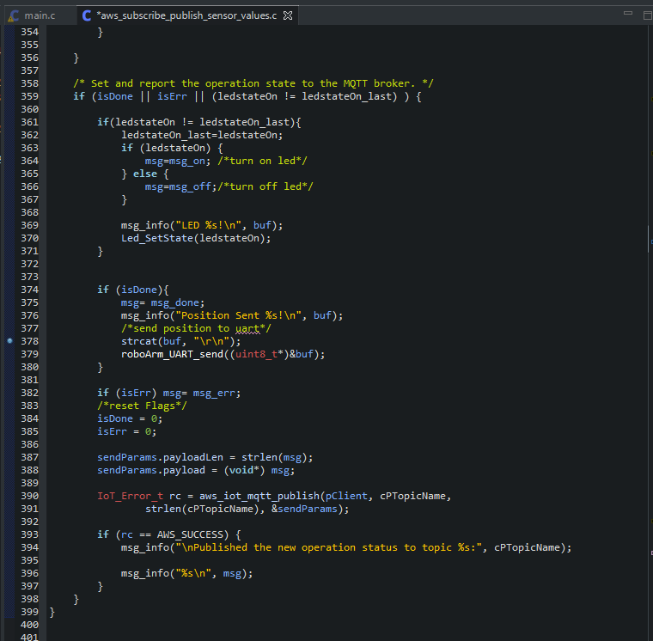
MQTTcallbackHandler
When the parsing is ended, the position or the led status is stored in buf .
If buf contains the position of the motors, it will be sent via UART to the motor controller.
At the end, an update on the operation status is published on the topic: doing this we will have live feedback of the operations done by the board, displaying them on the dashboard as notifications.

Slide 14
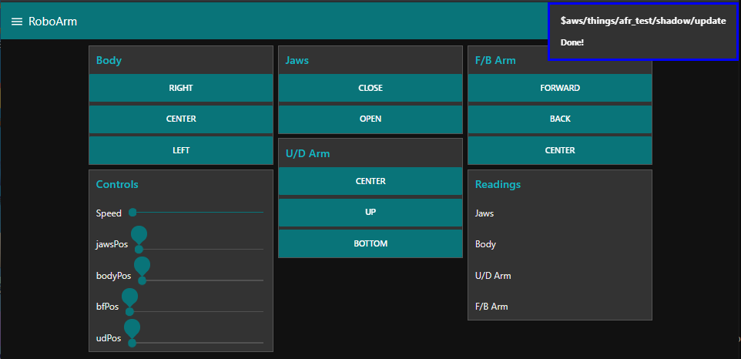

Slide 15
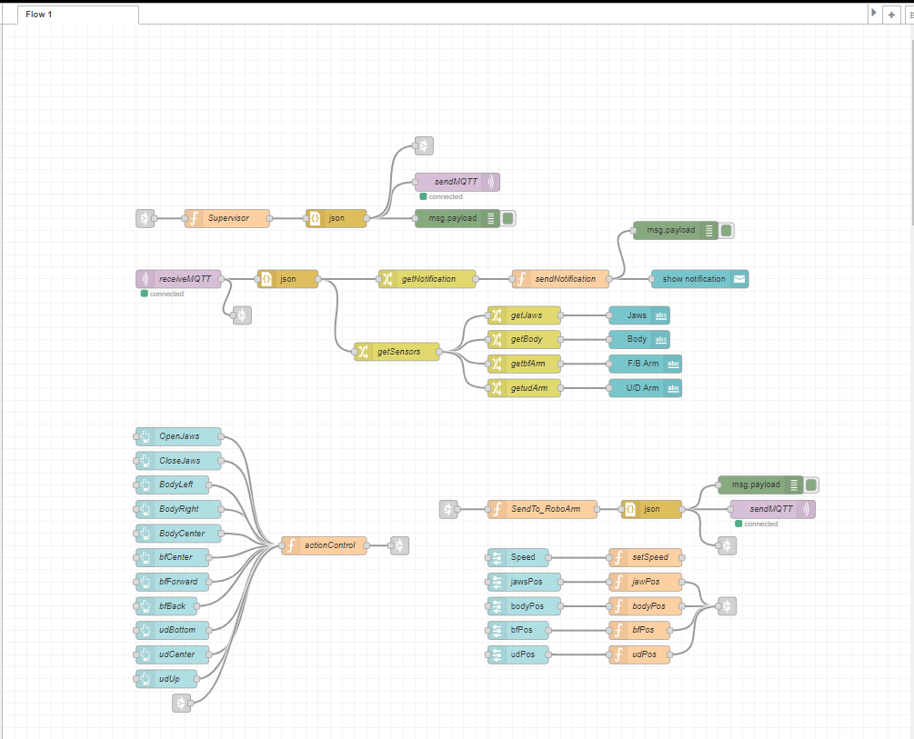
Node-Red
This is the structure of the flow used in this example: let’s analyze one section at the time.
The flow is mainly split in two parts:
Get the inputs from the dashboard and publish them on the topic
Get the feedback data sent by the board and display them on the dashboard
2
1

Slide 16
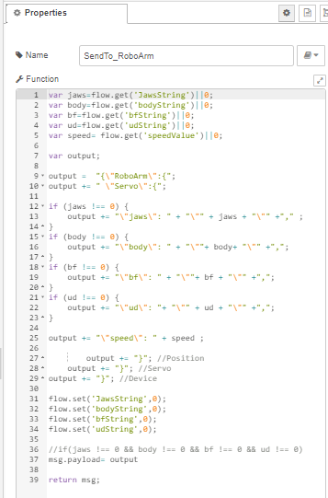
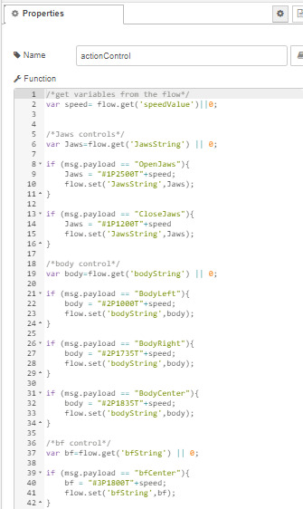
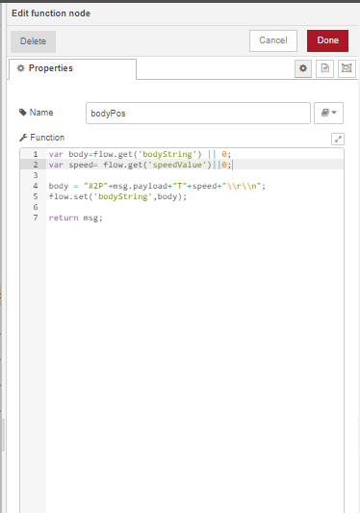
Dashboard Inputs
The nodes used in this section are the following:
Buttons to send a fixed position
Sliders to modify value and motor positions
Functions to get, set variables and creating JSON messages
JSON parser to convert string in JSON payloads
Link nodes to connect button inputs and sliders value to the SendTo_RoboArm function
Debug node
SendMQTT node to publish on the topic

Slide 17
Get and set Variables in Node-RED
Variables are a little different in node-RED:
There are no specific types and in order to store variables and read the last value set special functions need to be called.
To get the value of a variable:
context.get( ‘varName’ )
And to set the value of a variable:
context.set( ‘varName’ , value)
To find more information to manage variables in Node-RED see here.

Slide 18
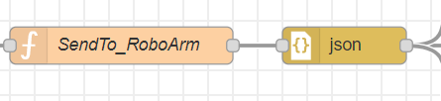
JSON Parser
Using the JSON Parser is possible to convert the msg object in a valid JSON Payload without writing any code.

Slide 19
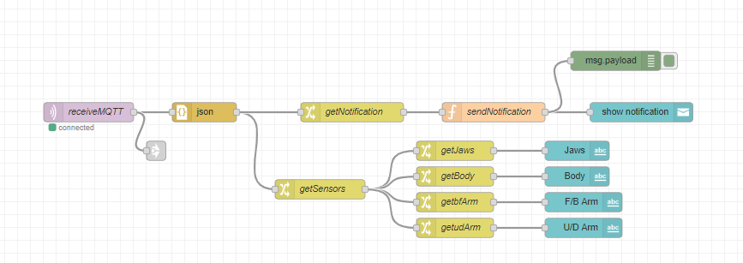
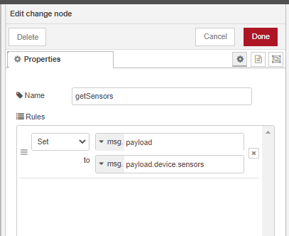
Get sensors values and notifications
When a message is received it’s converted in json format.
Getting the different tokens is really easy: they are now stored in the payload of the msg object, coming from the receiving block, and they are accessible by typing
msg.payload.token.subtoken
For doing this is better to use a change node so if the message is undefined (for example we send the position of only one motor an the message does not contain all the motors positions the payload will be undefined) nothing will be triggered.

Slide 20
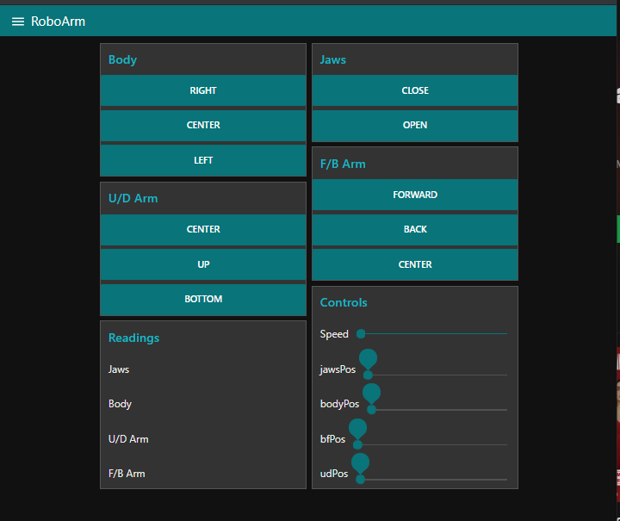
Dashboard
The Dashboard is the following one with this features:
On a button press a message with a fix position is published on the topic
Moving Position sliders, we send a message with the motor position equal to the slider value
Readings are the feedback values read from the board
When an action is performed by the board a notification will appear

Slide 21
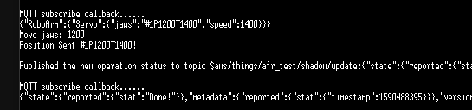
Callback Example
In this example we pushed the button on the dashboard to open the Jaws:
The board is capable of interpreting the message published on the topic, containing the position and the speed of the motors and after the action has been performed a notification of «Done» is published to the update topic resulting in a notification on the dashboard.
Motor Position
Status Notification

Slide 22
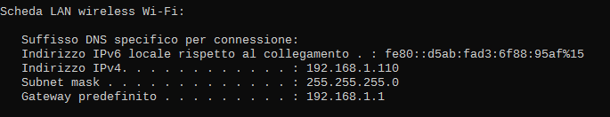
Access nodered from outside the network
When accessing nodered the address to reach it is
http://localhost:1880
Localhost is the equivalent to the IP address of the machine running Nodered.
In our case, the equivalent is
http://192.168.1.110:1880/
This address is reachable only by the local network. (To know your local ip address, use ipconfig command on the cmd)
So, how can i reach the computer running nodered from outside the local network ?
The answer is simple, just enable the remote access on your router and perform a port forwarding.
This process is different for each modem, so check the manufacturer guide.
The basic idea is to reach the modem’s ip address from the outside network, which will automatically redirect our request to the local ip address of the pc running Node-RED.
An example of port forwarding for a TP-LINK modem here.
Property of BEOND s.r.l. cannot be distributed or reproduced without authorization
22

Slide 23
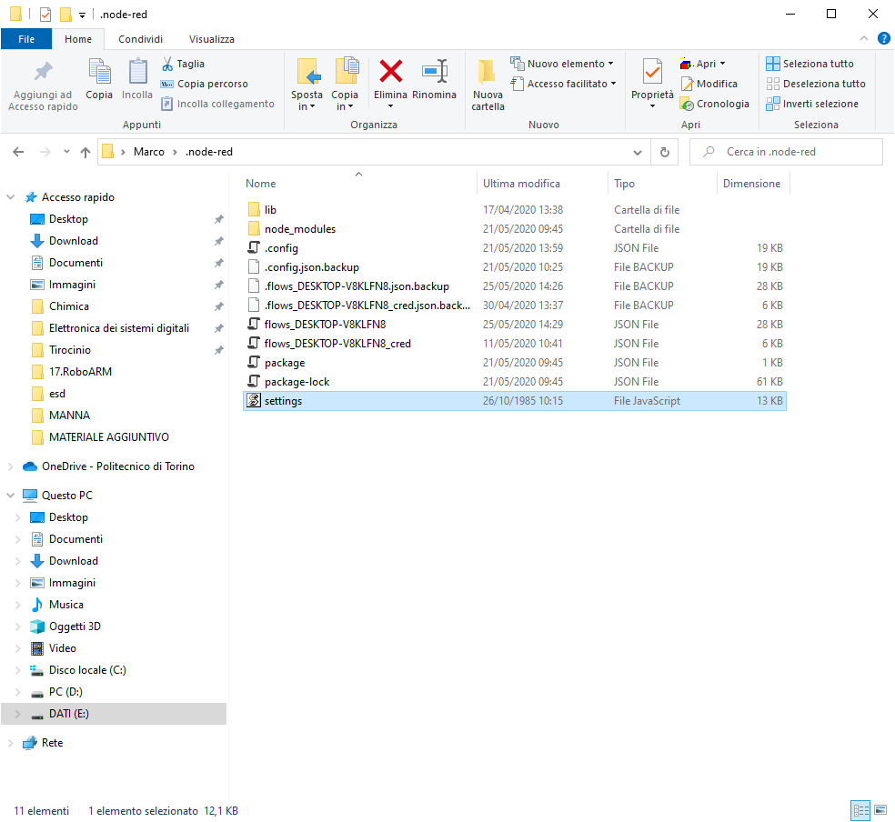
Securing Nodered
Now we can access nodered (and the dashboard) from anywhere in the world.
There is still a big problem, security.
It’s possible to protect nodered canvas and dashboard with some passwords.
Go to nodered folder
C:\Users\UserName\.node-red
And open the settings file (use notepad or any equivalent editor).

Slide 24
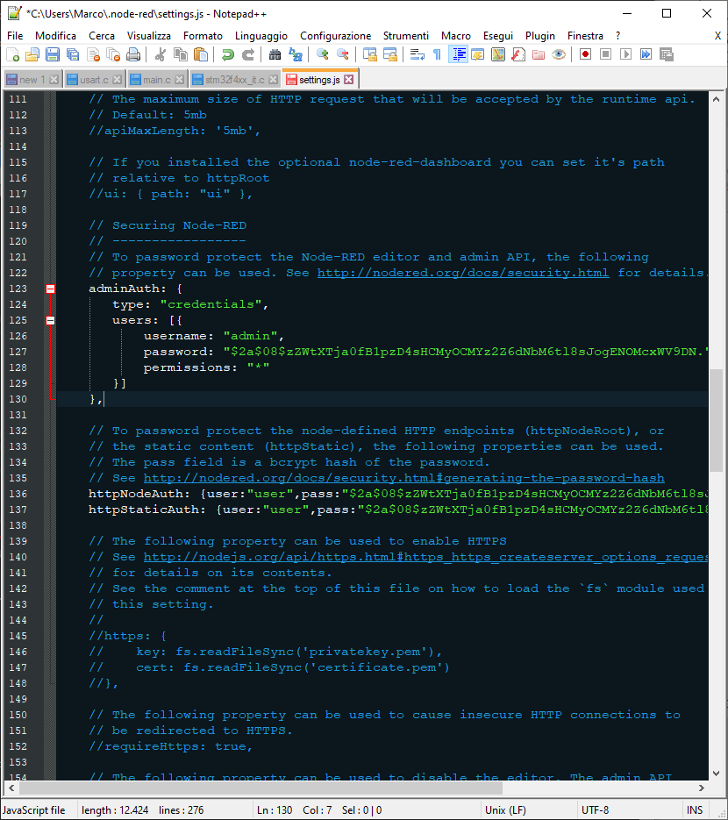
Securing Nodered
Find the Securing Node-RED section and uncomment the lines as in the picture.
The password is encripted and to set a new one, we need to create a new hash.
Open the terminal and install node-red-admin by typing the line
npm install –g node-red-admin
it will take a while.

Slide 25
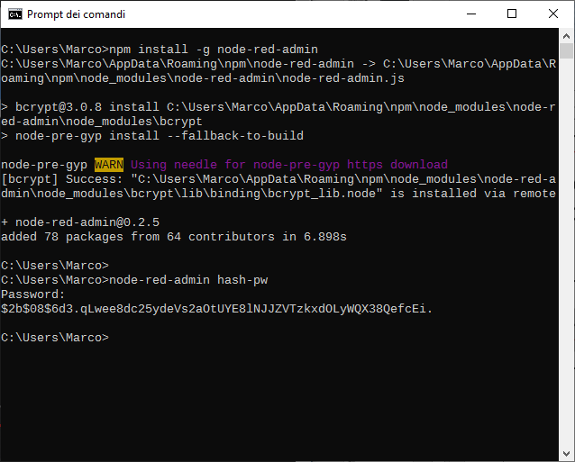
Create an hash password
In the same window type the line
node-red-admin hash-pw
Enter the password and press enter (the password will be transparent in the window).
Copy the generated hash in pass field of the settings file.
As you can see, there are multiple users:
AdminAuth: secures the canvas, it’s possible to add some users with only reading permissions (here)
httpAuth: secures the dashboard

