Slide 1
TI LaunchPad
00. Software Installation

Slide 2
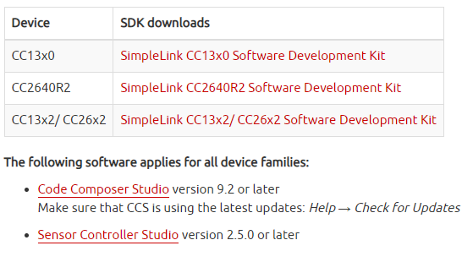
Prerequisites Software
In order to start with this platform you will need to download the correct Software Development Kit (SDK) for your LaunchPad. Software can be downloaded from HERE Download and install the 3 SDKs.
In order to download the software, a valid TI User Account is needed.

Slide 3
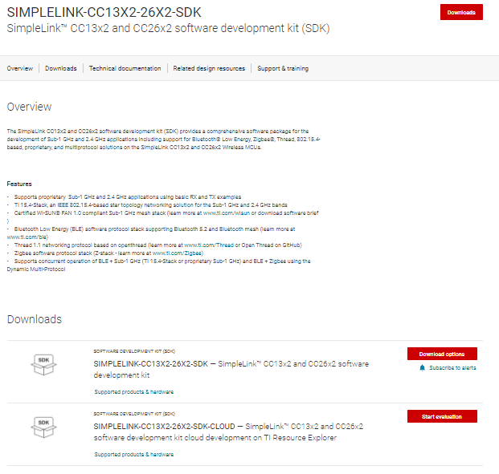
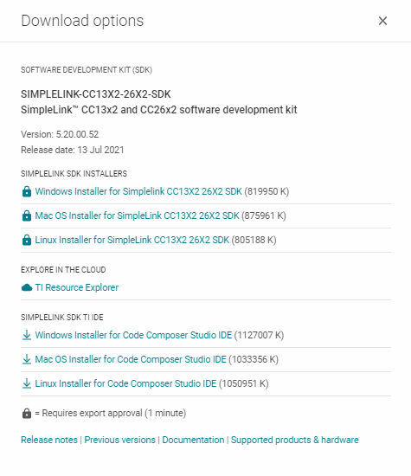
Prerequisites Software Download
1. →
3. →
2. →

Slide 4
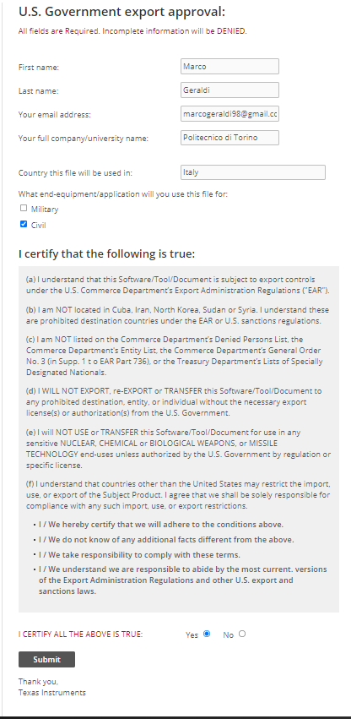
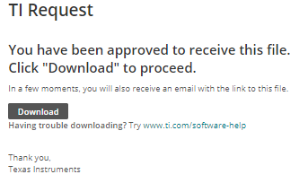
1. →
Prerequisites Software Download
2. →
U.S. Government export approval is needed to download software. Ceck for correctness of infos, in particular university name. Check that the application will be used for civil application and certify that you agree with conditions. Submit the application and you will be prompted to download the software.
Once all three SDK are downloaded, install them. Process is simple and illustrated in the next slide.
Repeat these steps per each SDK.
5. →
3. →
4. →

Slide 5
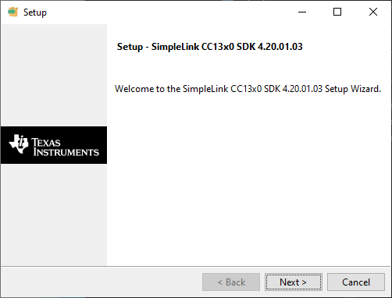
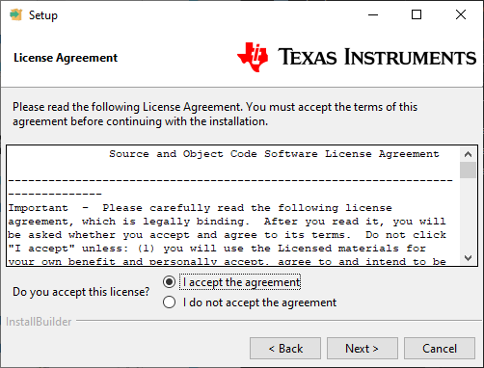
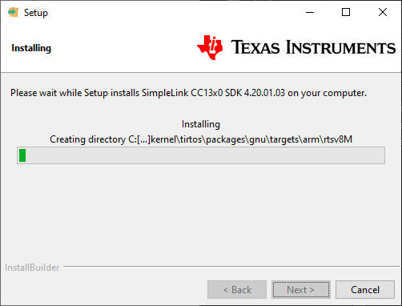
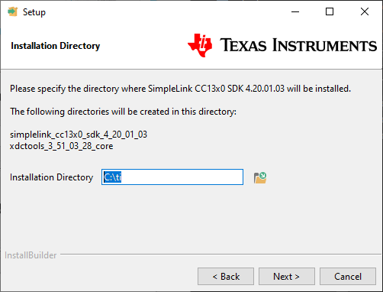
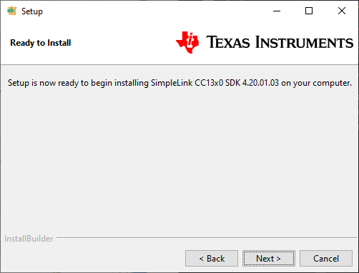
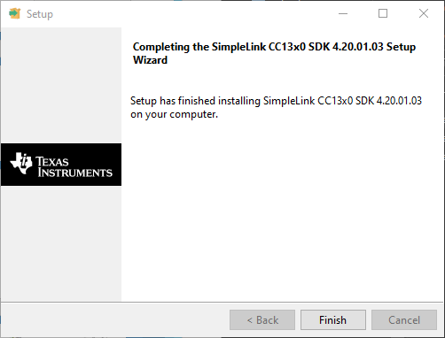
Prerequisites Software SDK Install

Slide 6
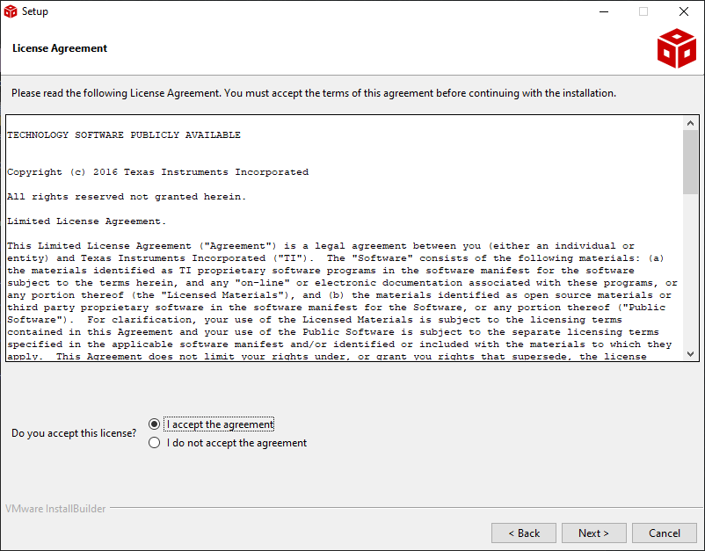
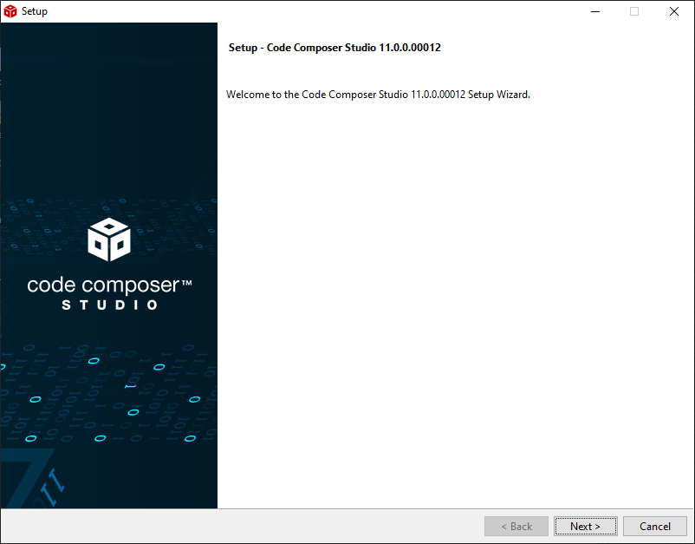
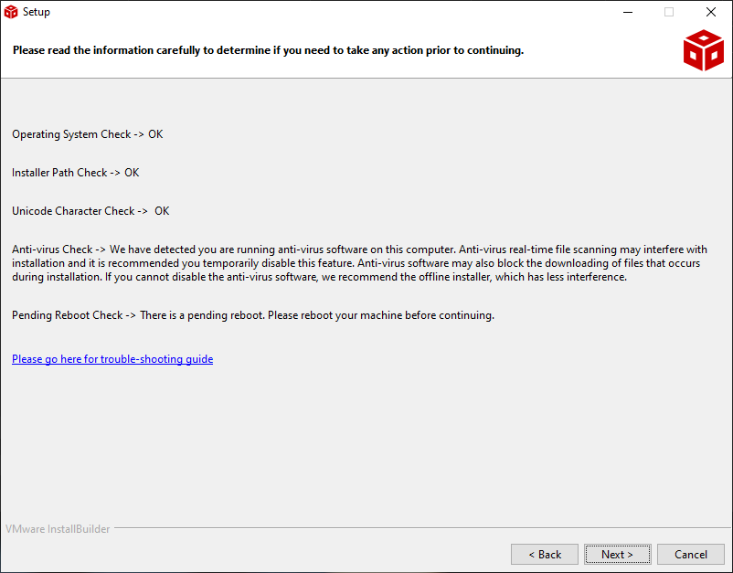
Prerequisites Software CCS Install
Download CCSTUDIO IDE and install it.
Accept the agreement and check that everything is ok for installation

Slide 7
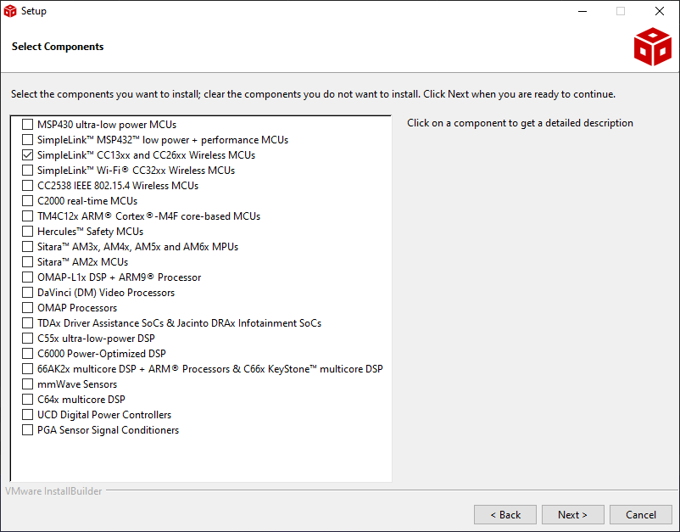
Prerequisites Software CCS Install
Select the components you need.
For LAUNCHXL-CC2640R2 board Select SimpleLink CC13xx and CC26xx Wireless MCU
Click Next
1. →
1. →

Slide 8
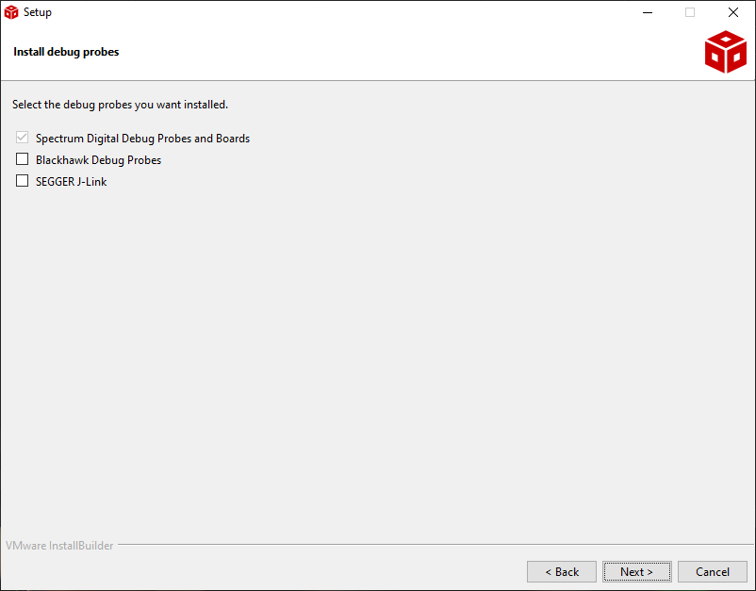
Prerequisites Software CCS Install
Select the components you need.
For LAUNCHXL-CC2640R2 board only the Default choice is needed.

Slide 9
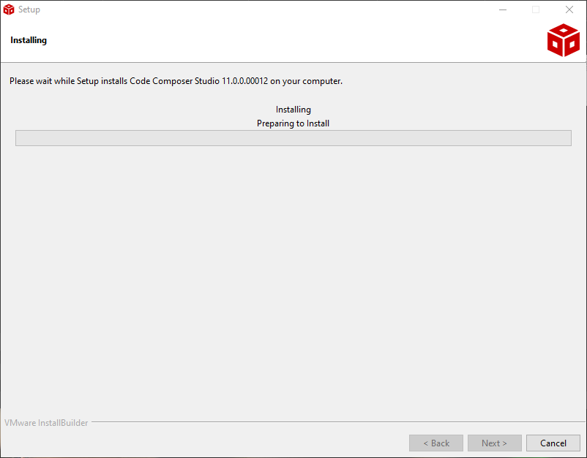
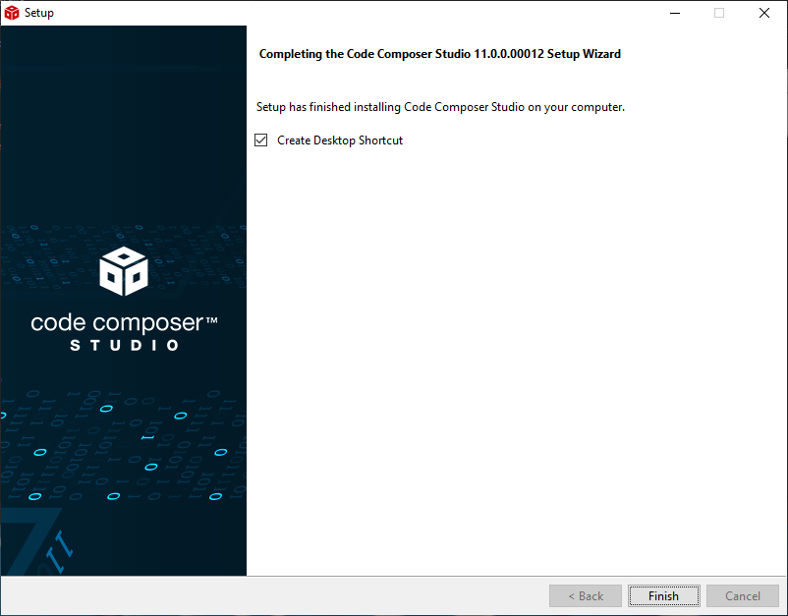

Slide 10
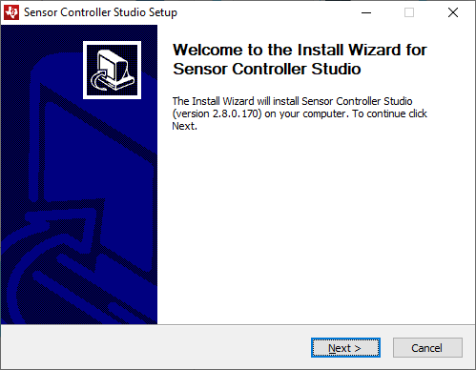
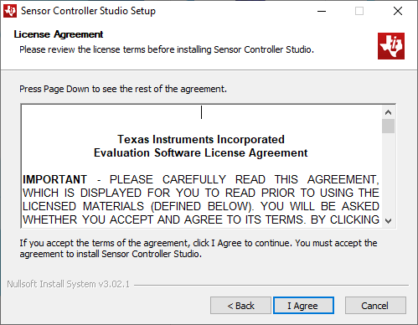
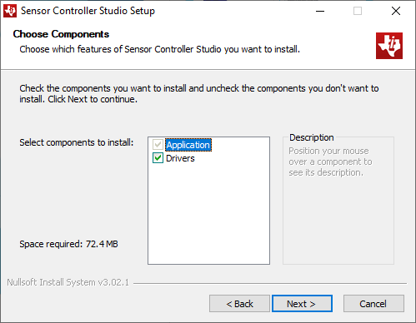
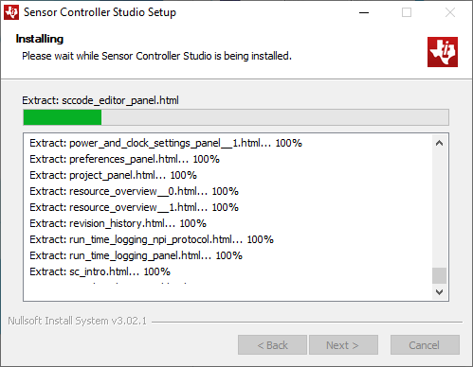
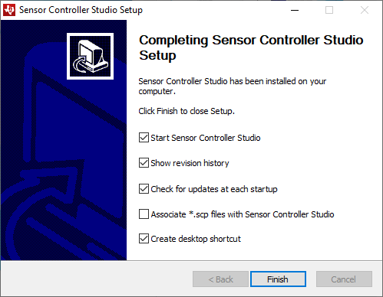
Prerequisites Software SCS Install

