Slide 1
TI LaunchPad
01. Getting Started

Slide 2
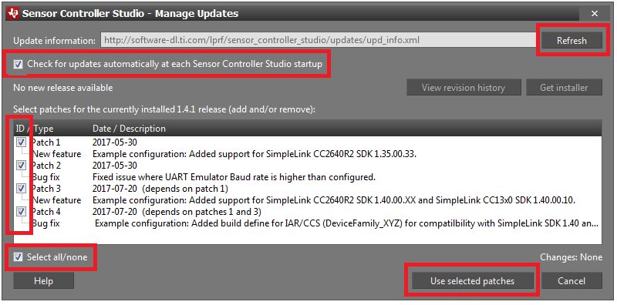
Set up Desktop Environment Software
Open SCS and click Updates → Check for Updates.
If any new patches are available, click Updates → Manage Updates... and apply all new patches.
Note that the picture below is only used as an example. You may have a newer version, and there may be no patches available.

Slide 3
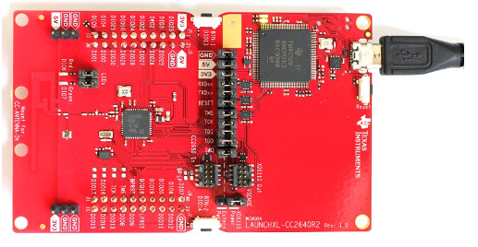
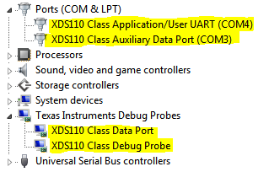
Connect LaunchPad Hardware
Simply connect the micro-USB cable from your computer to the LaunchPad as shown in the figure.
When the LaunchPad is connected, the Windows Device Manager (Start → Run → mmc devmgmt.msc → Ok) should show you the highlighted devices connected.

Slide 4
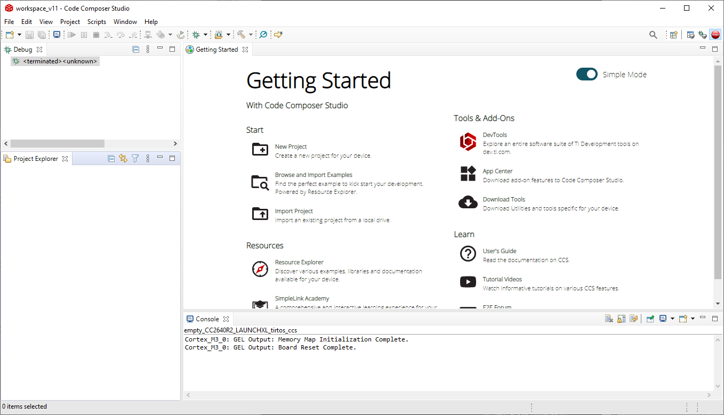
CCS IDE Import empty project
Open Code Composer Studio and Select Browse and import Examples
1. →

Slide 5
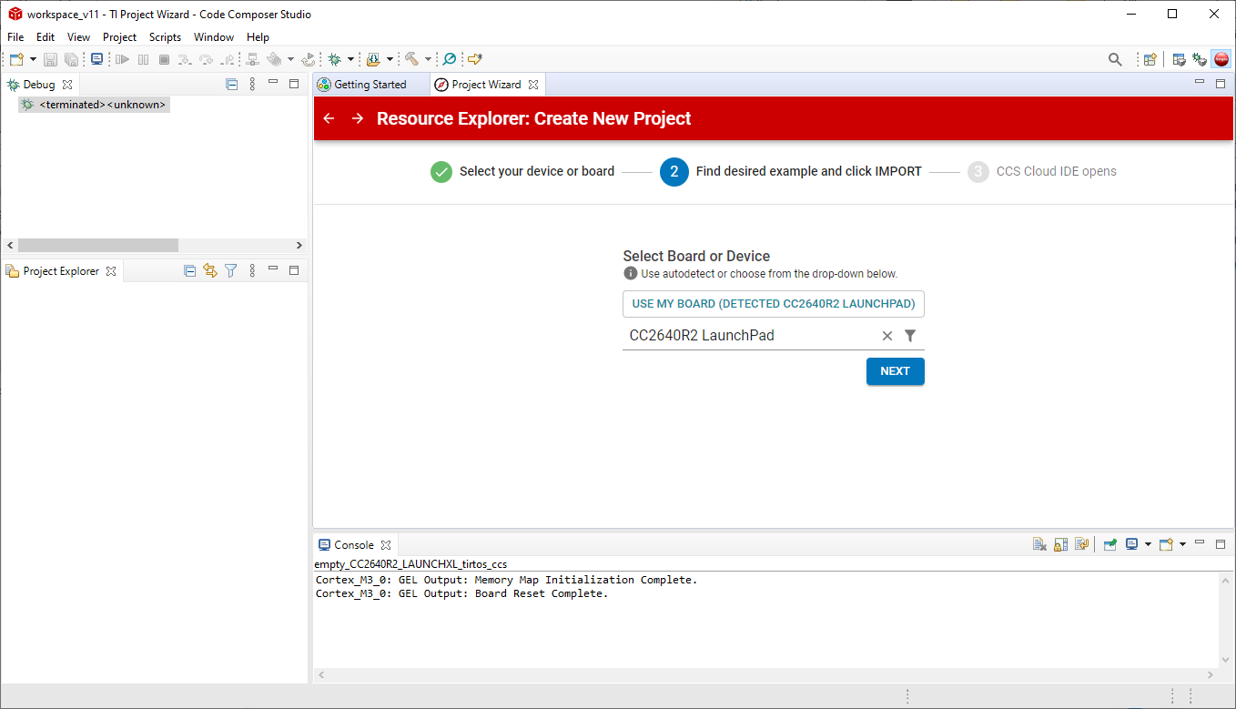
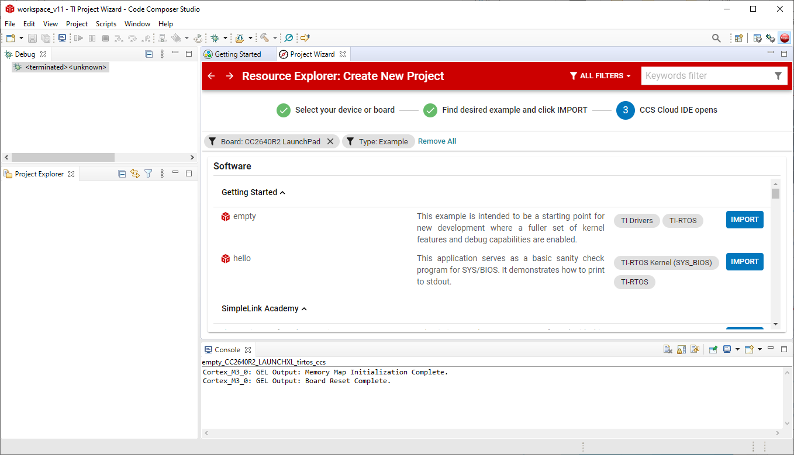
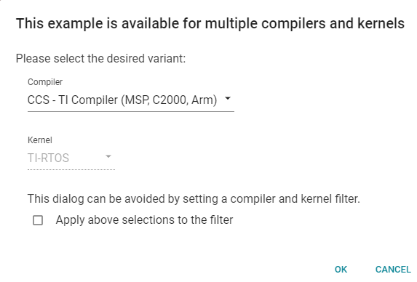
CCS IDE Import empty project
Resource Explorer will open:
If you have a board connected you can click on USE MY BOARD button and it will automatically fill the filters, then click NEXT
A list of examples will appear, for this example import the empty project
Then click OK
1. →
2. →
3. →
4. →

Slide 6
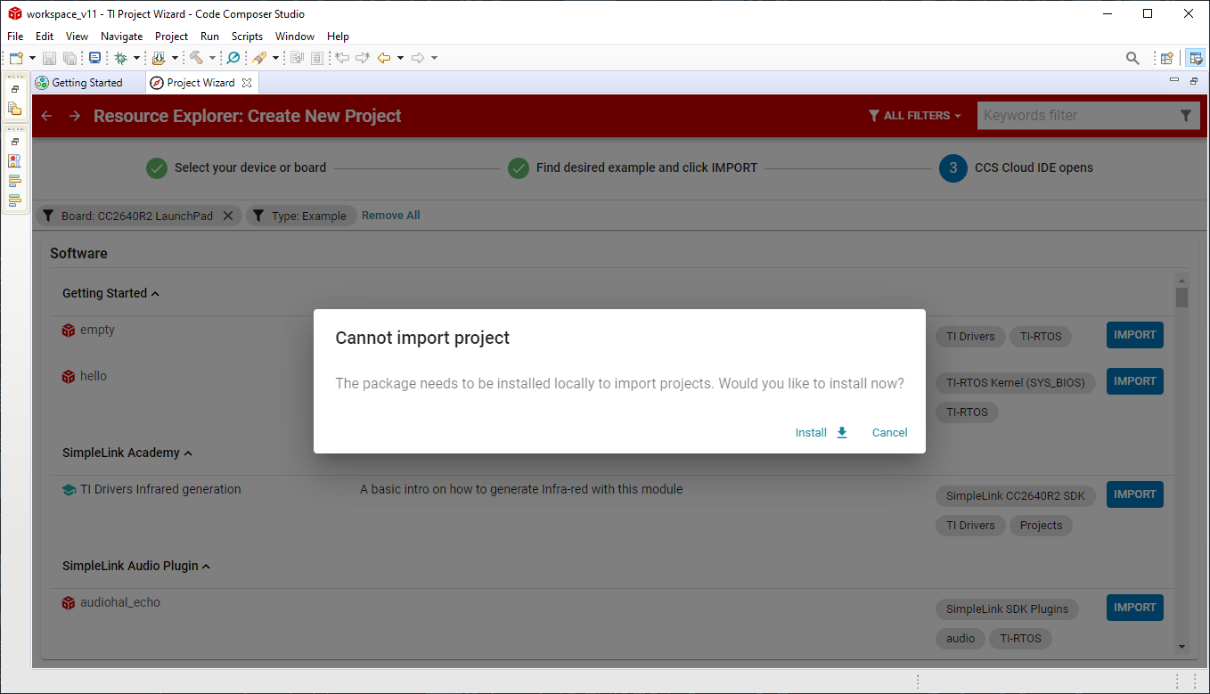
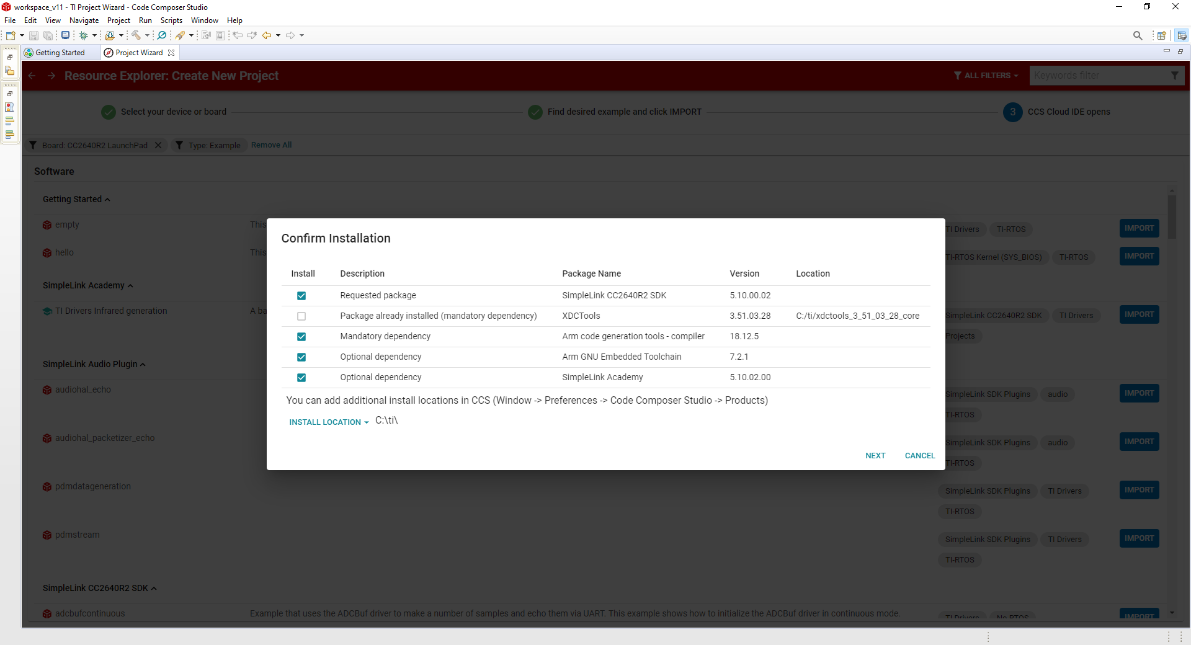
CCS IDE Possible Errors
At first import is possible that additional software is required to install.
Continue by installing it and try again.

Slide 7
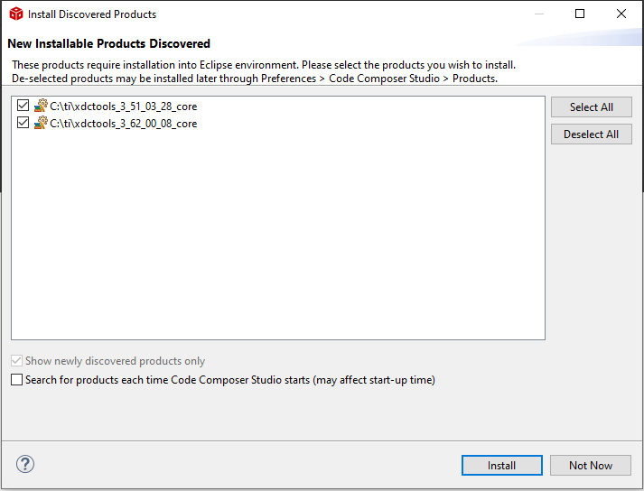

Slide 8
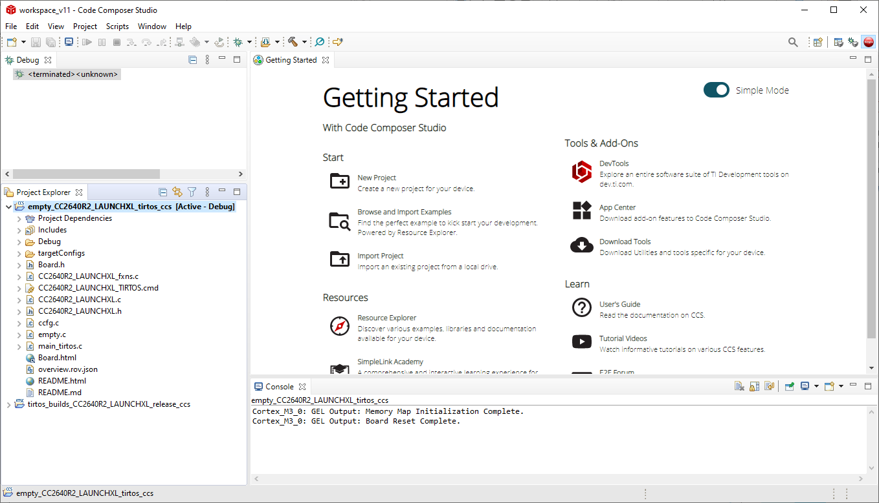
CCS IDE Import empty project
The empty project will appear in the project explorer, along with the tirtos one used in it (check Project Dependencies)
Then open empty.c file, where the main program is contained.
From here you can manage your projects, add, remove or move files.
1. →

Slide 9
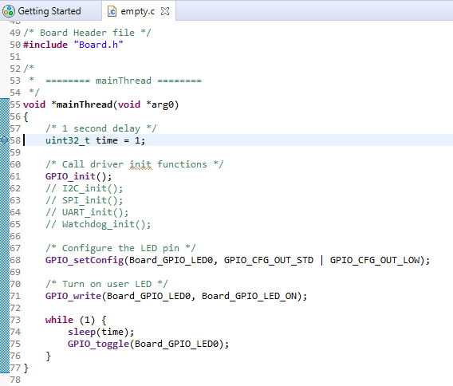
CCS IDE Import empty project
Empty project will import automatically everything needed for the board to start working.
Scroll down until line 58 end double click on the number to set a breakpoint: during debug the program will pause at the breakpoint.

Slide 10

CCS IDE build empty project
Before run the program on your board it’s a good idea to check for errors:
Compile the project by clicking on the Build icon .
The result will be shown in the console box.
If there are non errors, continue by downloading the project to your board.

Slide 11

CCS IDE Debug empty project
In order to test the program on the board there are two ways:
Flash: all the files will be download on the board and the program will start automatically
Debug: in this mode it’s possible to debug your application using breakpoints or moving step by step in the code using the arrows.
Now Click on the debug icon
Debug
Flash
Build

Slide 12
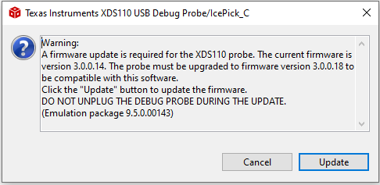
CCS IDE Possible Errors
While trying to upload firmware on the board is possible that a firmware update is required for the programmer (XDS110 Probe, top half of the launchpad board)
Update and try again.

Slide 13
CCS IDE Debug empty project
Play: will start the program until any breakpoint will catch
Pause: stop at the current instruction, usefull when program is not respondig correctly
Stop: terminate debugging
Step into: enter in the next function code section
Ste Over: continue to the next line without entering in the following function code section
Step Return: return to the higher level function code section
Pause
Step into
Step Return
Play
Stop
Step Over

Slide 14
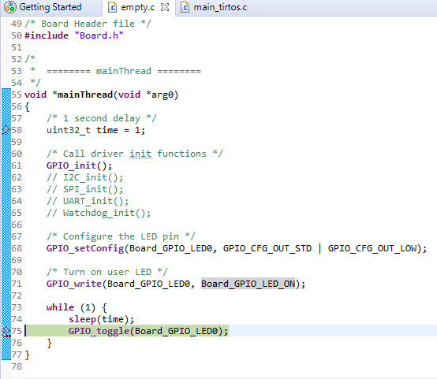
CCS IDE Debug empty project
Now try to work with the empty project:
Aim of the project is to blink the built-in LED
Put a breakpoint in line 58 and 75 end press play.
At each press the led will blink.
Double click again on the line number to remove breakpoint and click play
The program will run and the led blink automatically

