Slide 1
TI LaunchPad
02. GPIO Basics

Slide 2
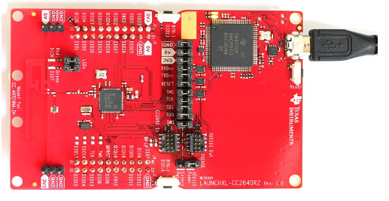
GPIO Introduction
A general-purpose input/output (GPIO) is an uncommitted digital signal pin on an integrated circuit or electronic circuit board which may be used as an input or output, or both, and is controllable by the user at runtime.
GPIOs have no predefined purpose and are unused by default.

Slide 3
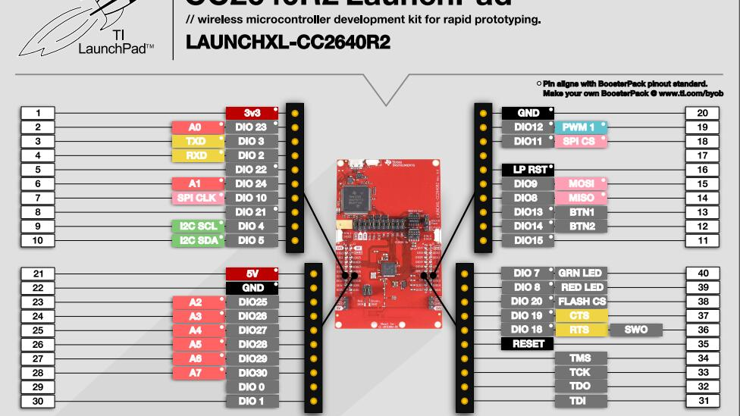

Slide 4
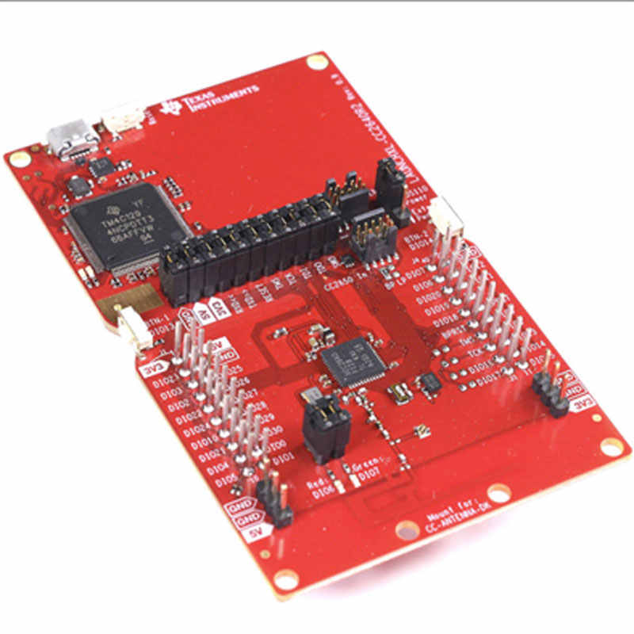
GPIO Basics Functions
In order to use a GPIO Pin the following steps are required:
Initialize the GPIO Peripheral with GPIO_init()
Configure the pin as Input or Output with GPIO_setConfig()
Write or Read the pin Status with GPIO_write() or GPIO_read()

Slide 5
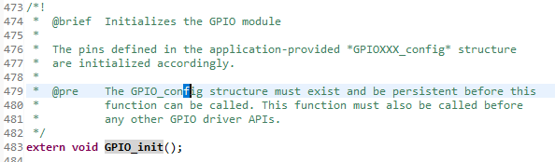
GPIO Initialization GPIO_init()
Gpio function are defined in the GPIO.h file
To open declaration double click on function name → Right click → open declaration
The GPIO Structure needs to be defined: starting from the empty project all the hard work is already done and structures are defined by default.
Call this function before use other GPIOs functions.

Slide 6
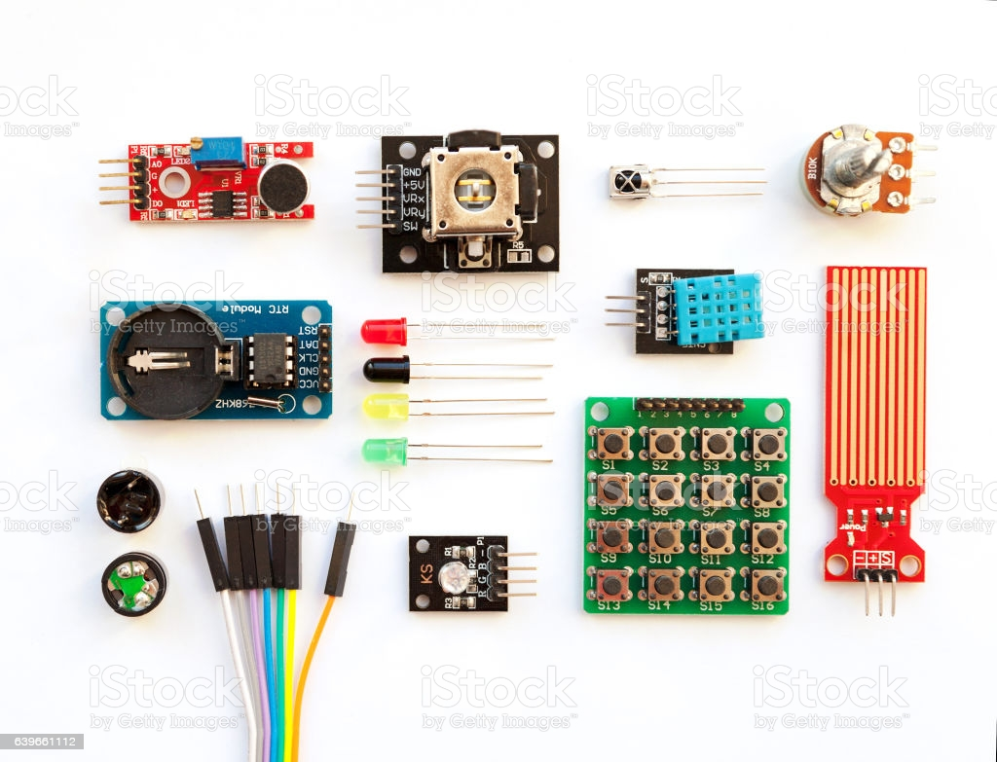
GPIO Setup GPIO_setConfig(uint_least8_t index,GPIO_PinConfig pinConfig)
Before using any pins, those must be configurated as inputs or outputs
@index: is the GPIO index, the full list of indexes is defined in the Board.h file
@pinConfig: are the device specific pin configuration settings, those can be accessed by starting typing GPIO_CFG_IN for inputs or GPIO_CFG_OUT for outputs (press CTRL+SPACEBAR for autocomplete)

Slide 7
GPIO input Pull-up resistors
Digital logic gates can be used for connection to external circuits or devices but care must be taken to ensure that their inputs or outputs function correctly and provide the expected switching condition.
If the inputs to a digital logic gate or circuit are not within the range by which it can be sensed as either a logic “0” or a logic “1” input, then the digital circuit may false trigger as the gate or circuit does not recognise the correct input value, as the HIGH may not be high enough or the LOW may not be low enough.
Then to prevent accidental switching of digital circuits, any unconnected inputs called “floating inputs” should be tied to a logic “1” or logic “0” as appropriate for the circuit. We can easily do this by using what are commonly called Pull-up Resistors and Pull-down Resistors to give the input pin a defined default state, even if the switch is open, closed or there is nothing is connected to it.
See here for more informations about pull up resistors.

Slide 8
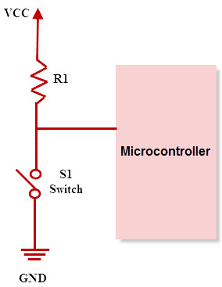
GPIO input Pull-up resistors
In a digital circuit, the pull-up configuration is useful, when the switch that we are going to read is connected to GND:
OPEN → VCC
CLOSED → GND
In this way the input read will be:
‘1’ → Open Switch
‘0’ → Closed switch

Slide 9
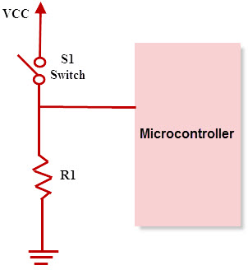
GPIO input Pull-down resistors
In a digital circuit, the pull-down configuration is useful, when the switch we are going to read is connected to VCC:
CLOSED → VCC
OPEN → GND
In this way the input read will be:
‘1’ → Switch Closed
'0' → Open switch

Slide 10
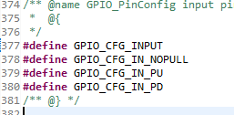
GPIO input Input Configurations
When configuring a GPIO pin as an input is necessary to know more about input configurations. In particular :
GPIO_CFG_INPUT: Pin is an input.
GPIO_CFG_IN_PU:Input pin with internal pull-up resistor
GPIO_CFG_IN_PD:Input pin with internal pull-down resistor
GPIO_CFG_IN_NOPULL: Input pin with no internal PU/PD resistor

Slide 11
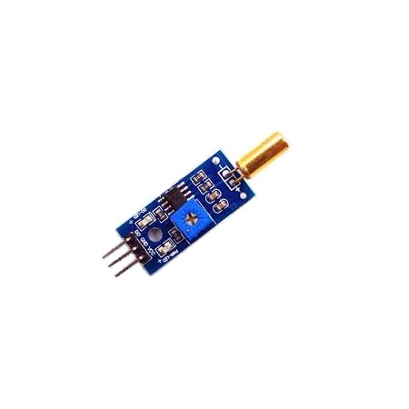

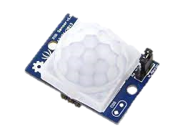
GPIO input GPIO_read(uint_least8_t index)
After configuring the pin as Input, in order to drive it is neccessary to exploit the GPIO read function
@index: as before the full list of indexes is defined in the Board.h file
The function returns 0 or 1, depending on the state of the pin.
Examples of inputs are tilt sensor, push buttons, PIR Sensors and etc.

Slide 12
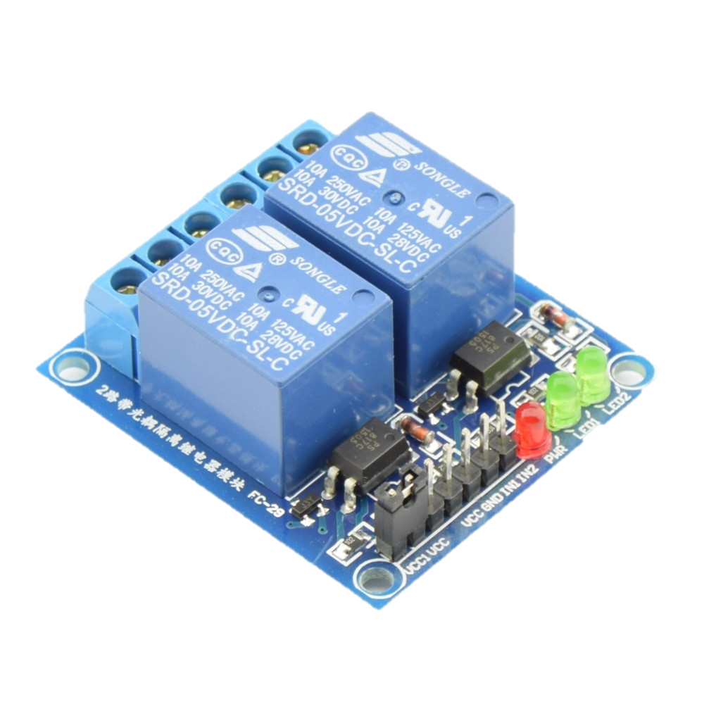
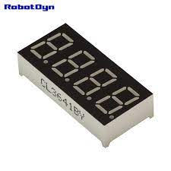
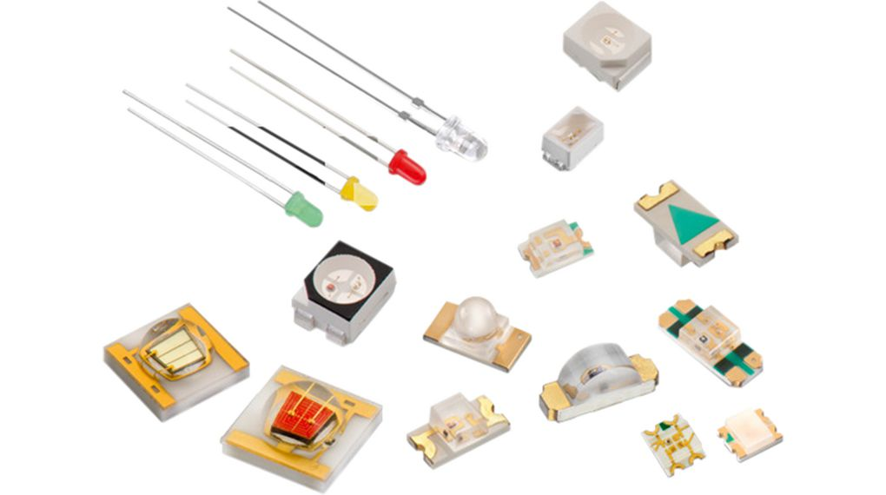
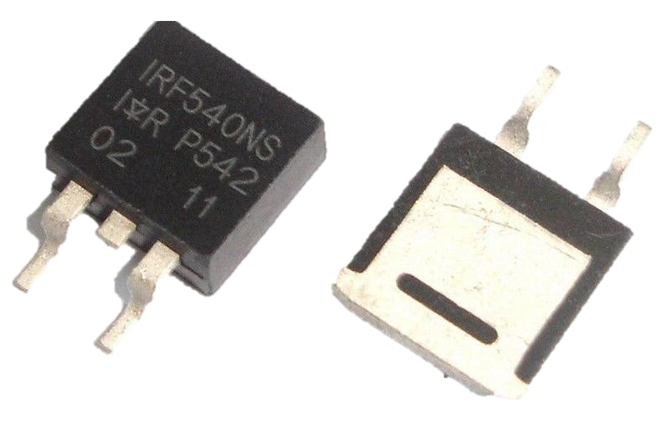
GPIO Output GPIO_write(uint_least8_t index, unsigned int value)
After configuring the pin as Output, in order to drive it is neccessary to exploit the GPIO write function
@index: as before the full list of indexes is defined in the Board.h file
@value: it can be 1 to drive the pin HIGH or 0 to drive the pin LOW. Is also possible to use the already defined macro GPIO_CFG_OUT_LOW and GPIO_CFG_OUT_HIGH.
Examples of outputs are LEDs, 7 segment Display, Relais, mosfets, ecc.

Slide 13
GPIO An example
void *mainThread(void *arg0)
{
/* Call driver init functions */
GPIO_init();
// I2C_init();
// SPI_init();
// UART_init();
// Watchdog_init();
/* Configure the LED and BTN pins */
GPIO_setConfig(Board_GPIO_LED0, GPIO_CFG_OUT_STD |
GPIO_CFG_OUT_LOW);
GPIO_setConfig(Board_GPIO_BTN1, GPIO_CFG_IN_PU);
/*loop*/
while (1) {
/* Read Board BTN-1 State*/
if ( GPIO_read(Board_GPIO_BTN1)){
/*Button is released -> LED0 OFF*/
GPIO_write(Board_GPIO_LED0, 0);
} else{
/*Button is pressed -> LED0 ON*/
GPIO_write(Board_GPIO_LED0, 1);
}
}
}
The following example shows how is possible to use the basic GPIO Functions
In particular the example will turn on the Red led on the LaunchPad board when the BTN-1 (the left one) is being pressed

