Slide 1
TI LaunchPad
03. Interrupts

Slide 2
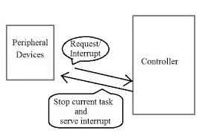
Interrupt What is an interrupt?
An interrupt is an asynchronous signal that allows you to manage situations in which particular attention is needed: there may be events such that it is necessary for the microcontroller to temporarily interrupt the normal execution of the program in order to execute a certain process.
Examples that generate an interrupt may be the pressing of a button, rather than an event at regular time intervals (timers) or a certain input being exceeded by a certain threshold.

Slide 3
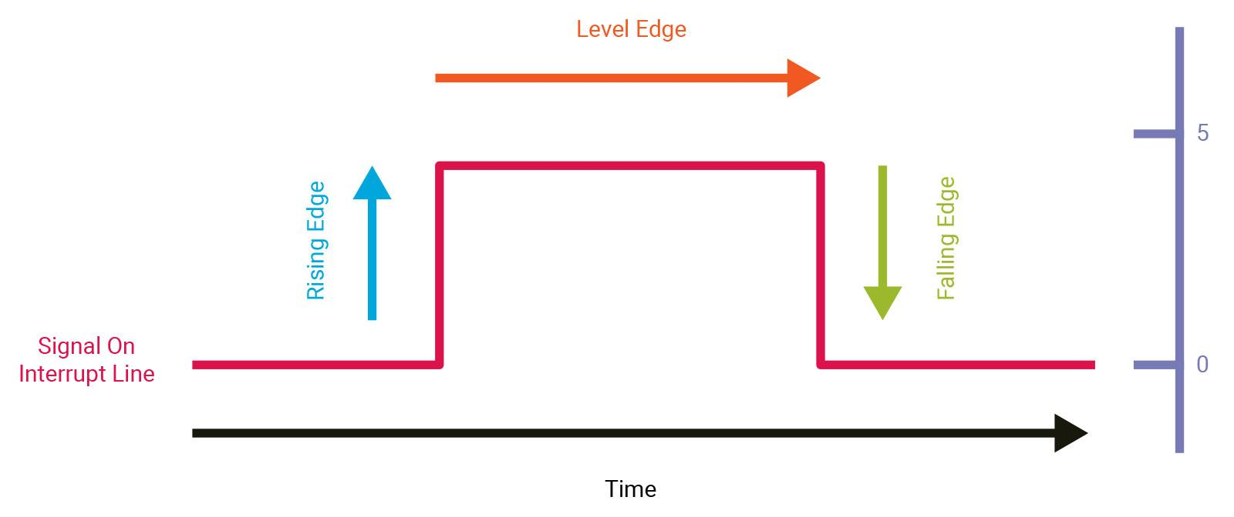
Interrupt Rising and falling edges
There are different option when considering the trigger of an interrupt.
In particular is possible to trigger an interrupt in presence of a:
Rising Edge: signal transition from logic low to ligic high.
Falling Edge: signal transition from logic high to logic low.

Slide 4
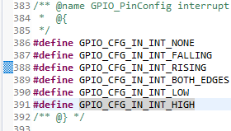
Interrupt Edge Detection Macros
With the Ti Driver is possible to set different interrupt edge detection:
GPIO_CFG_IN_INT_NONE: No Interrupt
GPIO_CFG_IN_INT_FALLING: Interrupt on falling edge
GPIO_CFG_IN_INT_RISING: Interrupt on rising edge
GPIO_CFG_IN_INT_BOTH_EDGES: Interrupt on both edges
GPIO_CFG_IN_INT_LOW: Interrupt on low level
GPIO_CFG_IN_INT_HIGH: Interrupt on high level
Those are defined in the GPIO.h file.

Slide 5
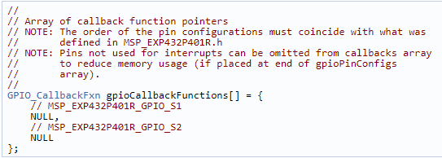
Interrupt Configure input pin as interrupt
An array of GPIO_CallbackFxn elements that is used to store callback function pointers for GPIO pins configured with interrupts. The indexes for these array elements correspond to the pins defined in the GPIO_pinConfig array.
These function pointers can be defined statically by referencing the callback function name in the array element, or dynamically, by setting the array element to NULL and using GPIO_setCallback() at runtime to plug the callback entry.

Slide 6
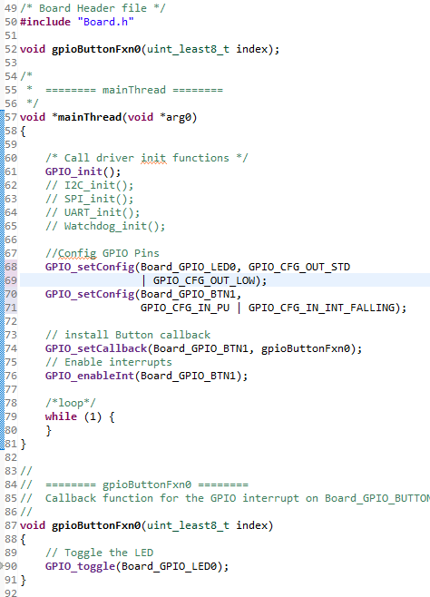
Interrupt Configure input pin as interrupt
As for a normal GPIO input, also for making a pin capable of firing interrupts is needed configure it with the GPIO_setConfig() function.
In this case is necessary to sum the input mask with the one for making it an interrupt, for example: GPIO_setConfig(Board_GPIO_BTN1, GPIO_CFG_IN_PU | GPIO_CFG_IN_INT_FALLING);
This instruction will set the BTN1 pin as input interrupt with falling edge detection.

Slide 7
Interrupt Configure input pin as interrupt
The callback function syntax should match the following: void(*GPIO_CallbackFxn)(uint_least8_t index)
To match index and callback function call GPIO_setCallback() and the enable the interrupt with GPIO_enableInt().
When the button will be released, the interrupt will fire and the gpioButtonFxn0() function will be called.

Slide 8
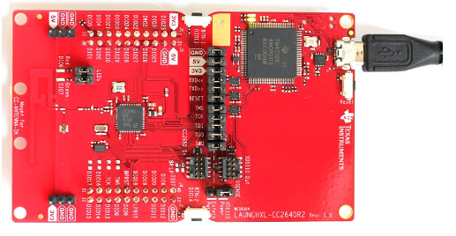
Interrupt Run the example
Load the program on the board by the debug icon, then press start
Now at each press of BTN1 the Red Led will toggle its state.

