Slide 1
TI LaunchPad
04. ADC Basics

Slide 2
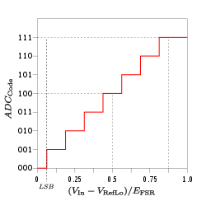
ADC What is an ADC?
In electronics, an analog-to-digital converter (ADC, A/D, or A-to-D) is a system that converts an analog signal, such as a sound picked up by a microphone or light entering a digital camera, into a digital signal.
An ADC may also provide an isolated measurement such as an electronic device that converts an analog input voltage or current to a digital number representing the magnitude of the voltage or current.
Typically the digital output is a two's complement binary number that is proportional to the input, but there are other possibilities.

Slide 3
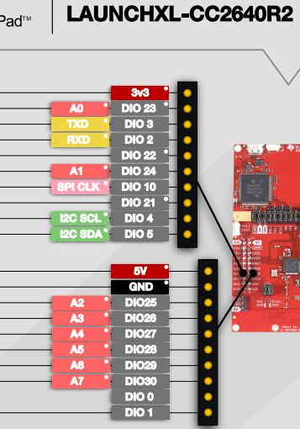
ADC Analog Pins on Launchpad Board
The LAUNCHXL-CC2640R2 Board has one 12-bit ADC with 8 analog channels.
The analog channels are available at digital pins 23 to 30.
In order to use the ADC function, the ADC driver MUST be imported. #include <ti/drivers/ADC.h>
Otherwise function would not be recognized

Slide 4
ADC TI RTOS Driver CSS Code
uint16_t result;
void *mainThread(void *arg0)
{
/* Call driver init functions */
GPIO_init();
ADC_init();
// I2C_init();
// SPI_init();
// UART_init();
// Watchdog_init();
/* initialize optional ADC parameters */
ADC_Params params;
ADC_Params_init(&params);
params.isProtected=true;
/* Open ADC channels for usage */
ADC_Handle adcHandle = ADC_open(1, &params);
/*loop*/
while (1) {
ADC_convert(adcHandle, &result);
}
}
ADC driver needs to be initalizated ( as for the GPIO one ) exploiting the ADC_init() function.
In order to start the ADC conversion some parameters need to be initialized. Use ADC_Params_init() function to initialize them
At this point is possible initalize the ADC peripheral with ADC_open() and finally store the analog conversion in the result variable with the function ADC_convert()

Slide 5
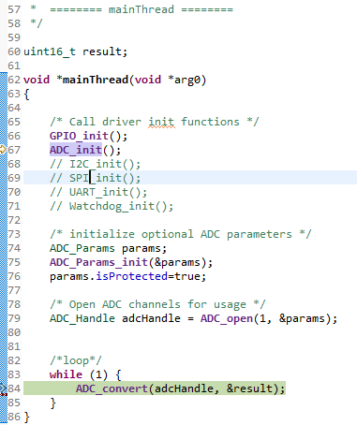
ADC TI RTOS Driver ADC_open(uint_least8_t index, ADC_Params *params)
ADC_open() function allows the initialization of the ADC peripheral.
@index is the Index in the @p ADC_Config[] array.
For Launchpad Board index is the analog channel number (the digit after the “A” of the digital pin function)
@params: Pointer to an initialized #ADC_Params structure. If NULL, the default #ADC_Params values are used.

Slide 6
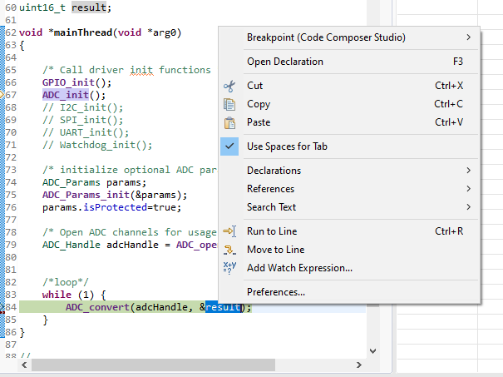

ADC TI RTOS Driver Debug
The aim of this project is to read the value of an analog sensor via the ADC.
Put a breakpoint on the AD_convert() function and start the debugging
Double click on the result variable → righ click → Add to watch Expression.
The result variable will be added to the watch expressions on the right.
At each conversion is possible to see how the result value changes.

