Slide 1
TI LaunchPad
05. UART Protocol

Slide 2
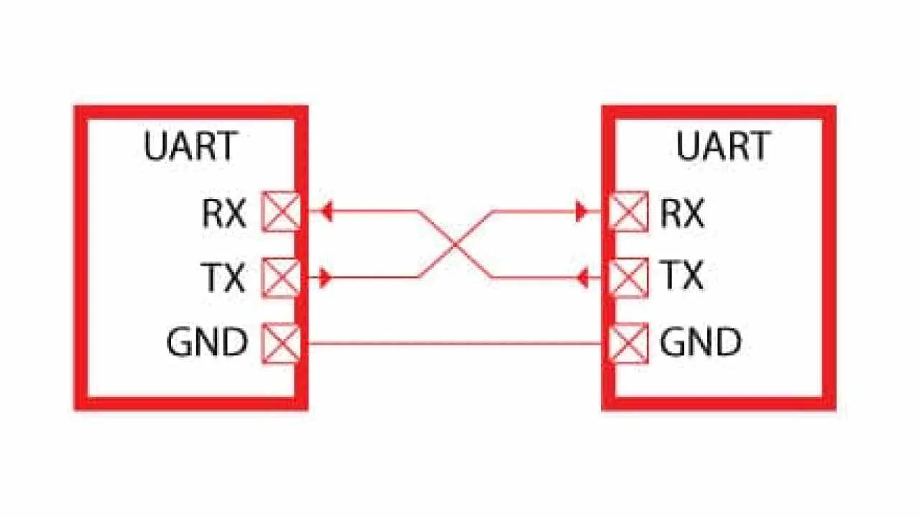
UART What is UART ?
“UART” stands for Universal Asynchronous receiver-transmitter. It is a peripheral that is present inside a microcontroller.
The function of UART is to convert the incoming and outgoing data into the serial binary stream.
Notice that in UART communication the TX pin of the transmitter is connected to the RX pin of the receiver and viceversa.
In UART communication the baud rate is the rate at which information is transferred in a communication channel

Slide 3
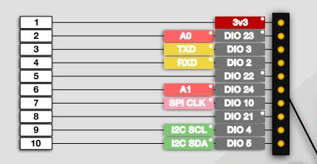
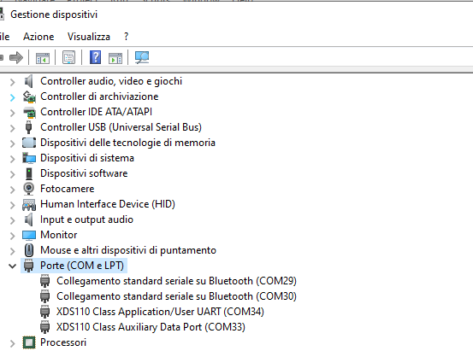
UART Hardware Overview
CC2460 microcontrollers are equipped with one UART peripheral available at pins DIO3 and DIO2.
The same UART peripheral is also connected to the XDS110 Debugger and accessible via USB
The serial port number can be found in «device manager» (Windows)

Slide 4
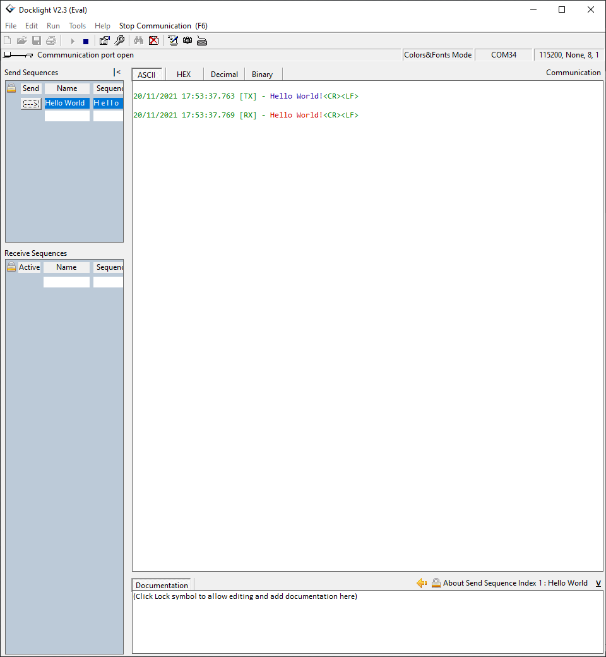
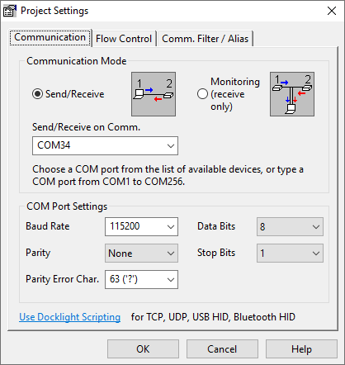
UART Connect to COM Port
In order to communicate with the COM port some kind of software is required.
The example in figure is «Docklight» available for free here
In Docklight to start a new connection double Click on the COMxx Port, then configure the project settings and open or close the communication by clicking on button

Slide 5
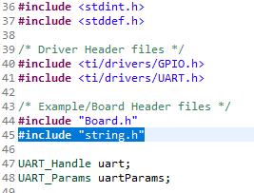
UART CSS configuration
Before start and configuring the Uart Driver Header file and the string.h library need to be included.
#include <ti/drivers/UART.h>
#include "string.h"
Uart handle and parameters needs also to be defined.

Slide 6
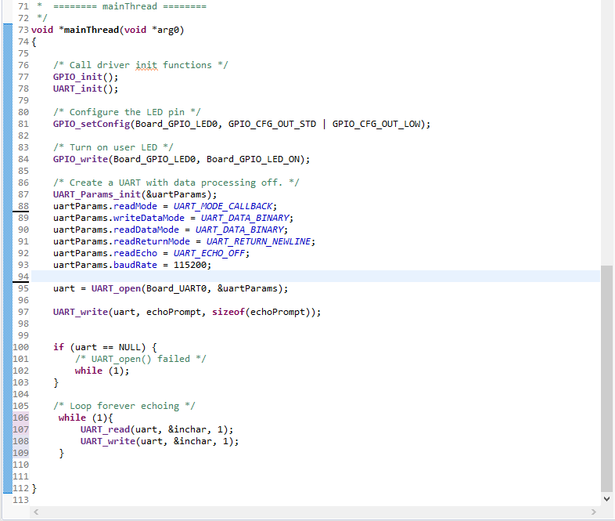
UART UART Driver initialization
As always initialization of UART driver is required with UART_init()

Slide 7
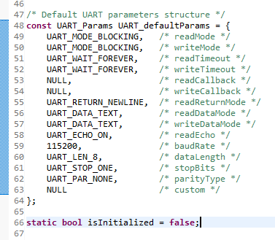
UART Parameters Definition
Parameters need to be initializated.
If some configuration is required is possible to modify uart parameter structure directly or by using UART library function. (More info in UART.h file)
The default parameter configuration can be found in the UART.C file.

Slide 8
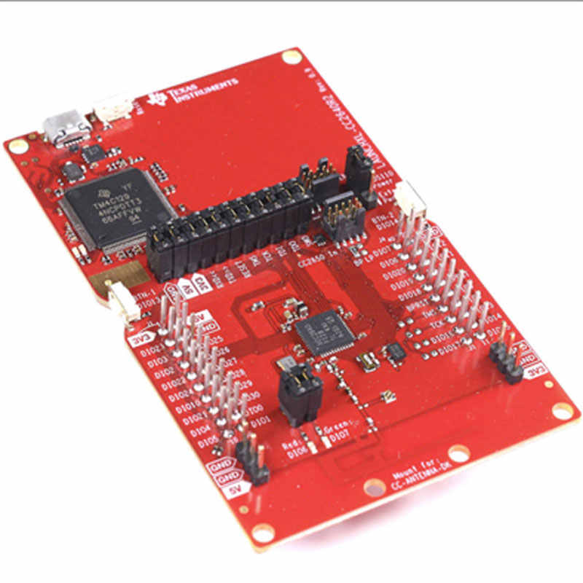
UART Start UART Peripheral
At this point is possible to open the UART communication exploiting UART_open() function.
In this case since there is only one UART peripheral the index is Board_UART0
Now is possible to send and receive UART data by means of UART_write() and UART_read() functions

Slide 9
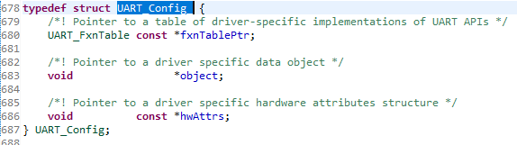
UART int_fast32_t UART_read(UART_Handle handle, void *buffer, size_t size);
@param handle: A #UART_Handle returned by UART_open()
@param buffer: A pointer to an empty buffer to which received data should be written
@param size: The number of bytes to be written into buffer
@return Returns the number of bytes that have been read from the UART, #UART_STATUS_ERROR on an error

Slide 10
UART int_fast32_t UART_write(UART_Handle handle, const void *buffer, size_t size);
@param handle: A #UART_Handle returned by UART_open()
@param buffer: A read-only pointer to buffer containing data to be written to the UART
@param size: The number of bytes to be written to UART
@return Returns the number of bytes that have been written to the UART. If an error occurs, #UART_STATUS_ERROR is returned. In #UART_MODE_CALLBACK mode, the return value is always 0.

Slide 11
UART Run the Example
At this point by running the example, the board will echo what has been sended trought the UART Bus.

Slide 12
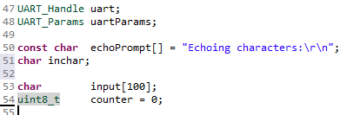
UART | Interrupt New Variables
UART Communication can also be managed via interrupt, in this case we will focus only in receiving data with interrupts.
Define two new variables.
Input: is an array where the UART data will be stored
Counter: needed to count the number of bytes received

Slide 13
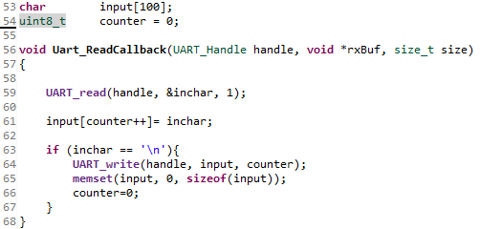
UART | Interrupt UART Callback
Create a new function that will be the callback for when the interrupt will be triggered.
In this case all characters received with UART are stored in the input array.
When a new line ‘\n’ arrives, the received buffer is echoed back and cleaned. Counter variable is reset to zero.

Slide 14
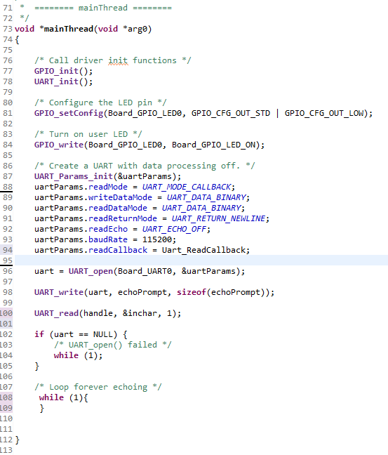
UART | Interrupt UART Callback
Add the UART Callback function to UART parameters
uartParams.readCallback = Uart_ReadCallback;
Leave the main loop empty, all the work is done via interrupt

