Slide 1
TI LaunchPad
06. PWM

Slide 2
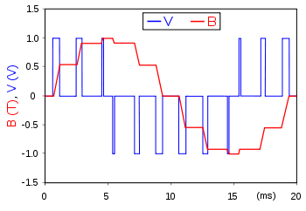
PWM Introduction
Pulse-width modulation (PWM), or pulse-duration modulation (PDM), is a method of reducing the average power delivered by an electrical signal, by effectively chopping it up into discrete parts.
The average value of voltage (and current) fed to the load is controlled by turning the switch between supply and load on and off at a fast rate.

Slide 3
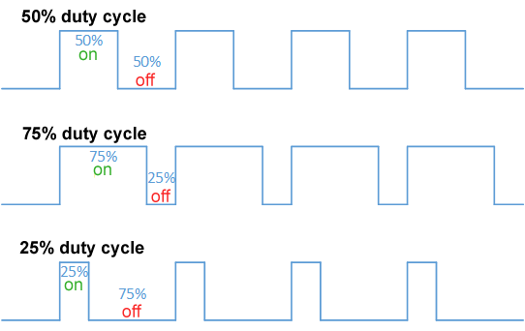
PWM Duty Cycle
The term duty cycle describes the proportion of 'on' time to the regular interval or 'period' of time; a low duty cycle corresponds to low power, because the power is off for most of the time.
Duty cycle is expressed in percent, 100% being fully on. When a digital signal is on half of the time and off the other half of the time, the digital signal has a duty cycle of 50% and resembles a "square" wave

Slide 4
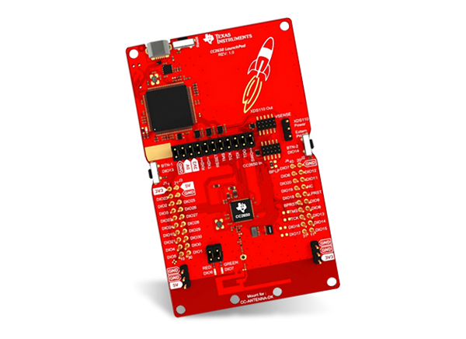
PWM Include Driver
In order to use the PWM functions the PWM driver needs to be included:
#include <ti/drivers/PWM.h>
Libraries in order to use sleep functions are required:
#include <unistd.h>
#include <stddef.h>

Slide 5
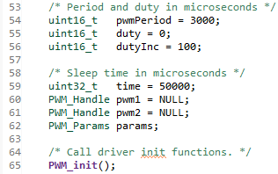
PWM Required Variables
Before starting the PWM peripheral some variables are defined.
In particular is possible to specify the frequency and the duty cycle of the PWM wave.
As for other peripherals, handle and parameters are required for PWM in order to work.
Use PWM_init() to initialize PWM driver

Slide 6
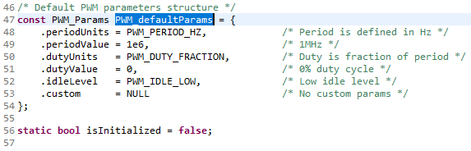
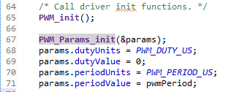
PWM Set Parameters
Call the PWM_Params_init(&params); to initalize PWM parameters to their default value (values can be found in PWM.C file)
After initialization, parameters are overwritten as in the picture.

Slide 7
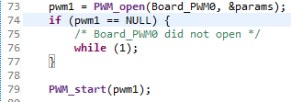
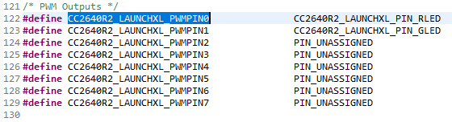
PWM PWM_Handle PWM_open(uint_least8_t index, PWM_Params *params);
PWM Handler need to be configured via the PWM_open() function.
@param[in] index : Logical instance number for the PWM indexed into the PWM_config table.
@param[in] params: Pointer to an parameter structure. If NULL default values are used
Board_PWM0 and Board_PWM1 pins are the red and green led pins. Other PWM pins can be assigned in the CC2640R2_LAUNCHXL.h file
Once everything is configured, peripheral can be started with PWM_start() function

Slide 8
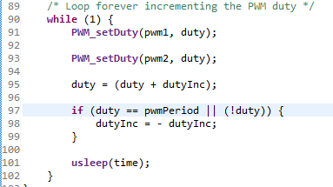
PWM Example
Using the function provided by Ti drivers is possible to overwrite PWM parameters.
By running the example provided is possible to notice how changing the duty-cycle the brightness of the LED changes.
Other functions can be found in the PWM.h file.

