Slide 1
TI LaunchPad
07. Timers

Slide 2
Timer Overview HW & SW Timers
A hardware timer is basically a digital counter that:
Counts regular events, which normally uses a clock source that has a relatively high and fixed frequency
Increment or decrement at a fixed frequency
Reset itself when reaching zero, or a predefined value
Generates an interrupt when reset
A software timer is a similar function block but implemented in software. Software timers usually:
Are based on a hardware timer
Increment or decrement when interrupted by hardware timers
Provides lower time precision compared with hardware timers
Can have multiple instances, more than the actual hardware timers

Slide 3
Timer Overview Timing System components
The programmable timer subsystem can be used in any situation where an accurate time interval or measurement is required.
The heart of the subsystem is a free running counter, which increments every integral number of clock cycles, depending on configuration.
Has three major functions:
output compare
input capture
pulse accumulator (when not explicitly present in block the function is made by Input Capture functions)

Slide 4
Timer Overview Components of a Standard Timer
Prescaler
Takes the clock source as its input
Divides the input frequency by a predefined value, e.g. 4, 8, 16…
Outputs the divided frequency to other components
Timer Register
Incremented or decremented at a fixed frequency
Driven by the output from the prescaler, often referred to as “ticks
Capture register
Loads the current value from the timer register upon the occurrence of certain events
Can also generate an interrupt upon events
Compare register
Is loaded with a value, which is periodically compared with the value in the timer register
If the two values are the same, an interrupt can be generated

Slide 5
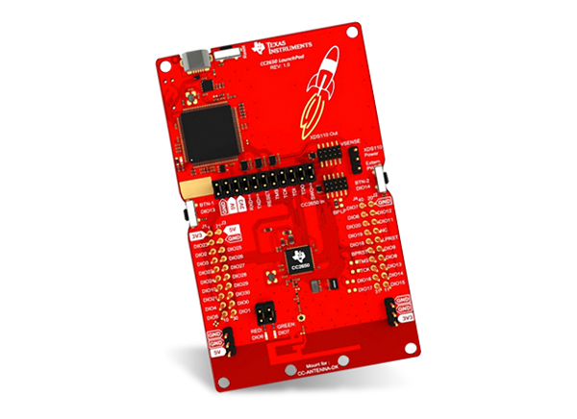
Timer Overview Why are Timer Functions Important?
It is very difficult and impossible to implement the following applications without a timer function:
Time delay creation and measurement
Period and pulse width measurement
Frequency measurement
Event counting
Arrival time comparison
Time-of-day tracking
Periodic interrupt generation
Waveform generation

Slide 6
Timer TI RTOS Driver Required Libraries
In order to get timers working with TI Launchpad boards it is necessary to include the following libraries :
#include <ti/drivers/timer/GPTimerCC26XX.h>
#include <xdc/runtime/Types.h>
#include <ti/sysbios/BIOS.h>

Slide 7
Timer TI RTOS Driver Overview and Configuration
This TI RTOS driver can be used to configure GPTimer modules to the modes supported by the GPTimer.
The board file or application must define the device specific configuration before using the driver.
The GPTimer can be used in two different configurations. In 32-bit mode the timer will act as a full-width timer and is controlled using the Timer A unit.
In split (16-bit) mode the timer is split into 2x 16-bit timers. In 16-bit mode a prescaler is available for each timer unit, effectively increasing the resolution in this mode to 24-bit.
All supported modes by driver in split configuration uses prescaler as timer extension.

Slide 8
Timer TI RTOS Driver Modes The GPTimer driver supports the following timer modes:
Oneshot mode counting upwards. When timer reaches load value, the timer is stopped automatically. Supported in both 16 and 32-bit configuration.
Periodic mode counting upwards. When timer reaches load value it wraps and starts counting from 0 again. Supported in both 16 and 32-bit configuration.
Input edge-count. Timer counts the number of events on its input capture port upwards from 0. Events can be rising-edge, falling-edge, or both. Supported only in 16-bit mode.
Input edge-time. Timer counts upwards from 0 and captures the time of an event on its input capture port. This can be used to count the time between events. Events can be rising-edge, falling-edge or both. Supported only in 16-bit mode.
PWM mode. Timer counts downwards from load value. CCP is set to 1 when reaching timeout (0) and toggles when reaching match value.

Slide 9
Timer TI RTOS Driver Accuracy and Limitations
Accuracy
The GPTimer clock is dependent on the MCU system clock. If very high-accuracy outputs are needed, the application should request
using the external HF crystal:
#include <ti/sysbios/family/arm/cc26xx/Power.h>
#include <ti/sysbios/family/arm/cc26xx/PowerCC2650.h>
Power_setDependency(XOSC_HF);
Limitations
DMA usage is not supported
Timer synchronization is not supported
Down counting modes (except for PWM) are not supported by driver

Slide 10
Timer TI RTOS Driver Timer Structure
typedef struct GPTimerCC26XX_Params
{
GPTimerCC26XX_Width width; /*!< Timer configuration (32/16-bit) */
GPTimerCC26XX_Mode mode; /*!< Timer mode */
GPTimerCC26XX_SetMatchTiming matchTiming; /*!< Set new match values on
next timeout or next cycle */
GPTimerCC26XX_Direction direction; /*!< Count up or down */
GPTimerCC26XX_DebugMode debugStallMode; /*!< Timer debug stall mode */
} GPTimerCC26XX_Params;
GPTimer parameters are used to with the GPTimerCC26XX_open() call.
Default values for these parameters are set using GPTimerCC26XX_Params_init().

Slide 11
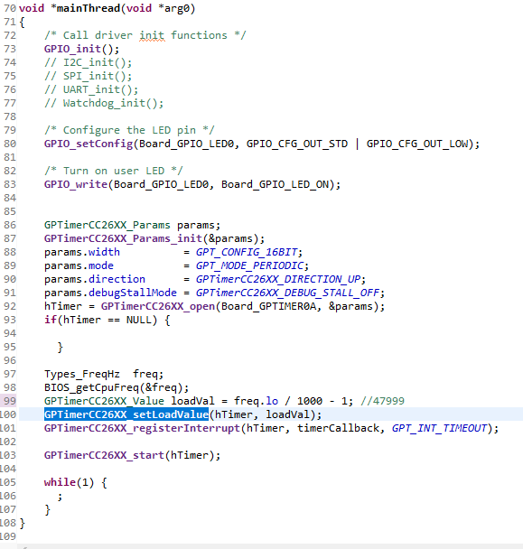
Timer TI RTOS Driver Timer Usage
In the mainThread define the timer parameters and set them as in the example
For this example the load value is computed in order to fire the interrupt each 1ms (MCU frequency is 48MHz)
timerCallback is the function that will be called when the interrupt is generated (function definition on the next slide)

Slide 12
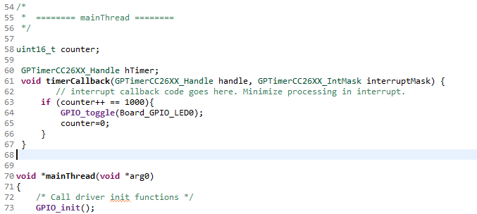
Timer TI RTOS Driver Timer interrupt function
/* Function prototype for interrupt callbacks */
typedef void (*GPTimerCC26XX_HwiFxn) (GPTimerCC26XX_Handle handle, GPTimerCC26XX_IntMask interruptMask);

Slide 13
Timer TI RTOS Driver Run the Example
By running this example, is possible to see how the interrupt function is called each 1ms, then a counter variable is used to toggle an LED each 1 second.

