Slide 1
TI LaunchPad
08. I2C Communication

Slide 2
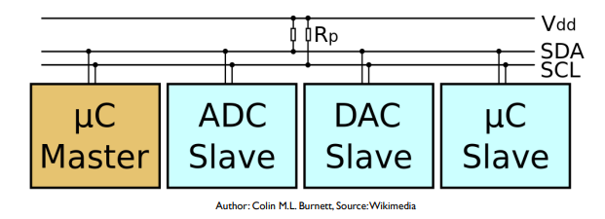
I2C Bus Overview
I2C (Inter-Integrated Circuit, eye-squared-C), alternatively known as I2C or IIC, is a synchronous, multi-controller/multi-target, packet switched, single-ended, serial communication bus invented in 1982 by Philips Semiconductors. It is widely used for attaching lower-speed peripheral ICs to processors and microcontrollers in short-distance, intra-board communication.

Slide 3
I2C Bus Design
I2C uses only two bidirectional open-collector or open-drain lines: serial data line (SDA) and serial clock line (SCL), pulled up with resistors. Typical voltages used are +5 V or +3.3 V, although systems with other voltages are permitted.
Common I2C bus speeds are the 100 kbit/s standard mode and the 400 kbit/s fast mode.
The number of nodes which can exist on a given I2C bus is limited by the address space and also by the total bus capacitance of 400 pF, which restricts practical communication distances to a few meters. The relatively high impedance and low noise immunity requires a common ground potential, which again restricts practical use to communication within the same PC board or small system of boards.

Slide 4
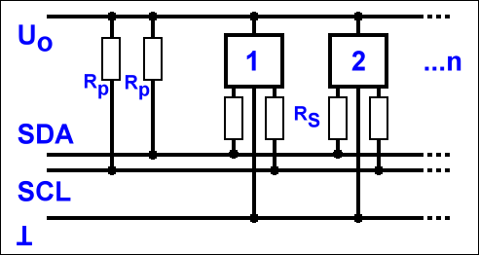
I2C Bus Phisical Layer
At the physical layer, both SCL and SDA lines are an open-drain (MOSFET) or open-collector (BJT) bus design, thus a pull-up resistor is needed for each line. A logic "0" is output by pulling the line to ground, and a logic "1" is output by letting the line float (output high impedance) so that the pull-up resistor pulls it high. A line is never actively driven high. This wiring allows multiple nodes to connect to the bus without short circuits from signal contention. High-speed systems (and some others) may use a current source instead of a resistor to pull-up only SCL or both SCL and SDA, to accommodate higher bus capacitance and enable faster rise times.

Slide 5
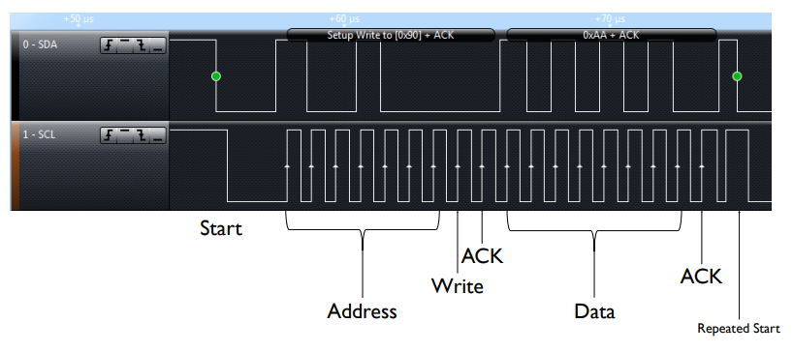
I2C Bus Master Writing Data to Slave

Slide 6
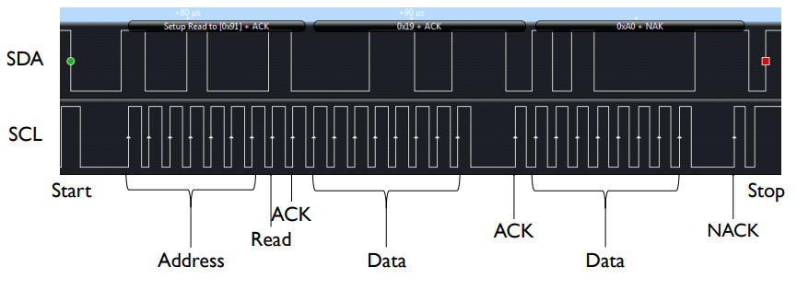
I2C Bus Master Reading Data from Slave

Slide 7
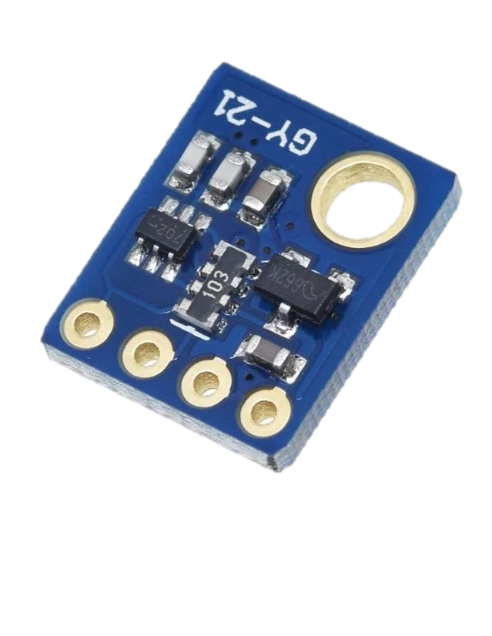
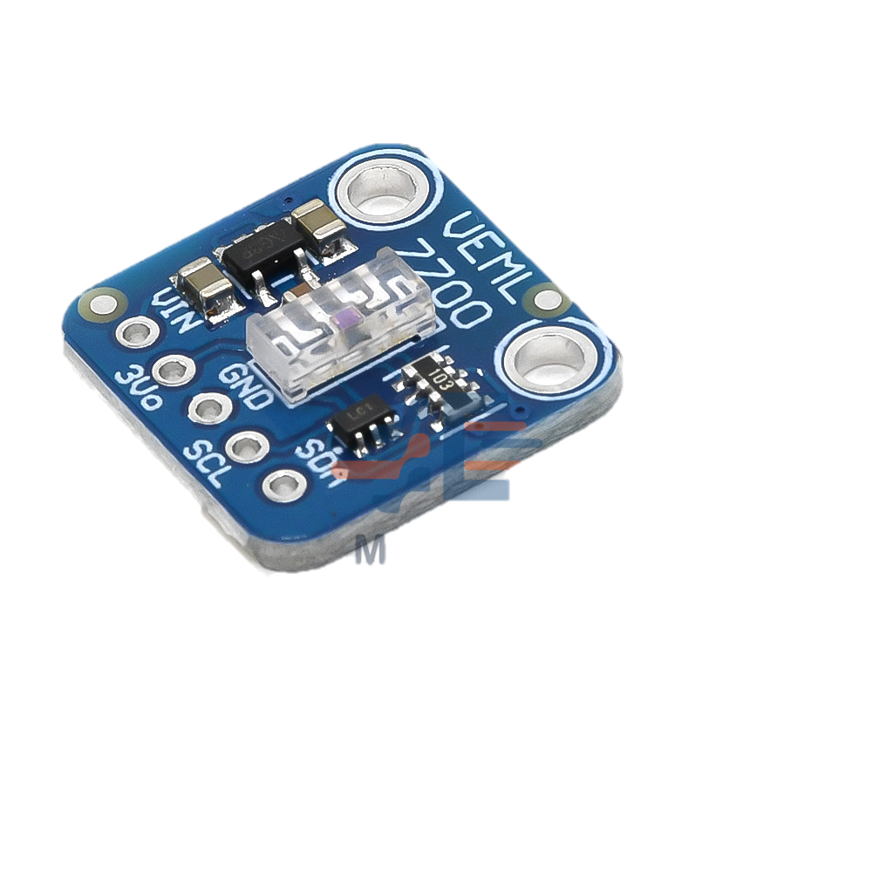
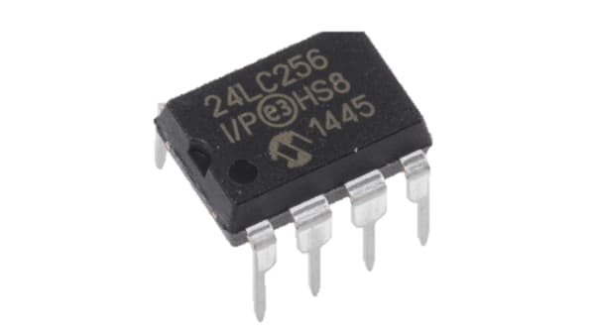
I2C Bus Addressing
Each device (IC) has seven-bit address
Different types of devices have different default addresses
Sometimes can select a secondary default address by tying a device pin to a different logic level
What if we treat the first byte of data as a register address?
Can specify registers within a given device: eight bits

Slide 8
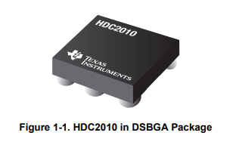
HDC2010 Sensor I2C Device Example
The HDC2010 is an integrated humidity and temperature sensor that provides high accuracy measurements with very low power consumption.
For this example, this device will be used to show how to communicate with I2C device using TI Launchpad Boards.

Slide 9
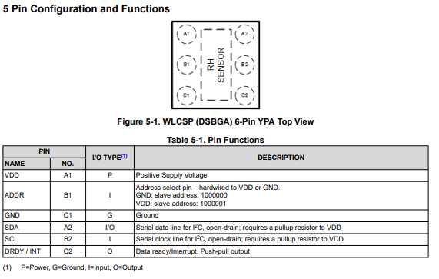

Slide 10
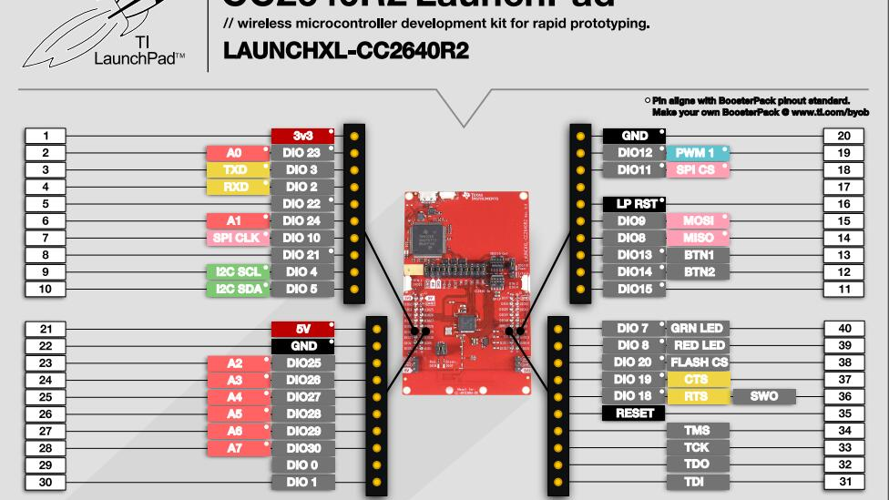

Slide 11
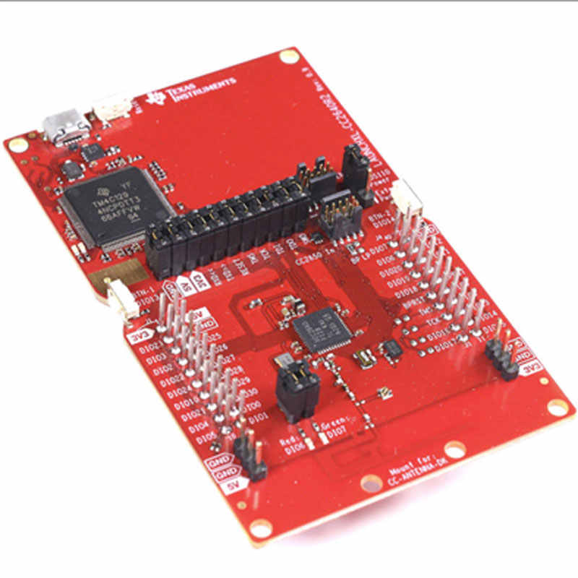
HDC2010 Sensor Wiring
In order to get the communication working is essential to connect properly the two devices
HDC2010 | CC2640R2
VDD | 3V3
GND | GND
SCL | DIO 4
SDA | DIO 5
Address for HDC2010 Sensor can be :
0x40 (ADDR pin connected to GND)
0x41 (ADDR pin connected to VDD)

Slide 12
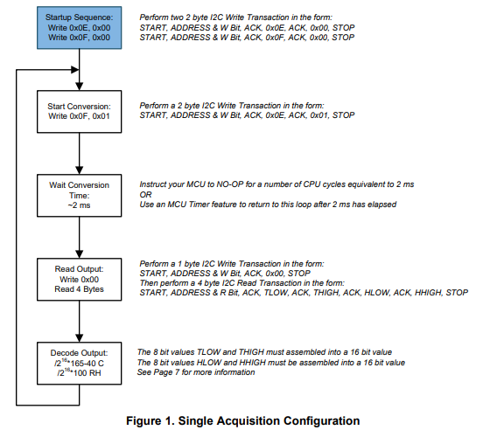
HDC2010 Sensor Acquisition Modes
The HDC20X0 has two modes of operation: sleep and measurement mode. After power up, the HDC20X0 enters sleep mode. In this mode, the HDC20X0 waits for I2C instruction to set programmable conversion times, trigger a measurement/conversion, or read/write valid data.
Different way of acquisition are available, in this example the Single Acquisition Configuration will be used.
Other information can be found here

Slide 13
I2C TI RTOS Driver Required Libraries
In order to get timers working with TI Launchpad boards it is necessary to include the following libraries :
#include <ti/drivers/I2C.h>
This specific example require also some math function that can be found in the math library
#include <math.h>

Slide 14
I2C TI RTOS Driver Overview
The I2C driver is designed to operate as an I2C master and will not function as an I2C slave.
Multi-master arbitration is not supported therefore, this driver assumes it is the only I2C master on the bus.
This I2C driver's API set provides the ability to transmit and receive data over an I2C bus between the I2C master and I2C slave(s).
The application is responsible for manipulating and interpreting the data.

Slide 15
I2C TI RTOS Driver Parameter Structure
typedef struct {
/*! #I2C_TransferMode for all I2C transfers. */
I2C_TransferMode transferMode;
/*!
* Pointer to a #I2C_CallbackFxn to be invoked after a
* I2C_transfer() completes when operating in #I2C_MODE_CALLBACK.
*/
I2C_CallbackFxn transferCallbackFxn;
/*!
* A #I2C_BitRate specifying the frequency at which the I2C peripheral
* will transmit data during a I2C_transfer().
*/
I2C_BitRate bitRate;
/*! Pointer to a device specific extension of the #I2C_Params */
void *custom;
} I2C_Params;

Slide 16
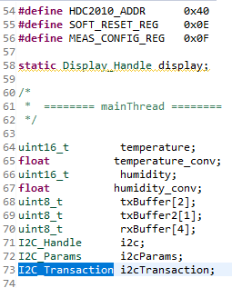
I2C TI RTOS Driver Required Variables
To make I2C peripheral working is essential to define some structures:
I2C_Handle i2c;
I2C_Params i2cParams;
I2C_Transaction i2cTransaction;
Then initialize I2C Driver with:
I2C_Params_init(&i2cParams); i2cParams.bitRate = I2C_400kHz; i2c = I2C_open(Board_I2C_TMP, &i2cParams);

Slide 17
I2C TI RTOS Driver I2C Parameters
typedef struct {
/*! #I2C_TransferMode for all I2C transfers. */
I2C_TransferMode transferMode;
/*!
* Pointer to a #I2C_CallbackFxn to be invoked after a
* I2C_transfer() completes when operating in #I2C_MODE_CALLBACK.
*/
I2C_CallbackFxn transferCallbackFxn;
/*!
* A #I2C_BitRate specifying the frequency at which the I2C peripheral
* will transmit data during a I2C_transfer().
*/
I2C_BitRate bitRate;
/*! Pointer to a device specific extension of the #I2C_Params */
void *custom;
} I2C_Params;

Slide 18
I2C TI RTOS Driver I2C Transaction
Communication between devices is managed with I2C Transactions:
slaveAddress: I2C slave address used for the transaction.
writeBuf: Pointer to a buffer of at least #I2C_Transaction.writeCount bytes
writeCount: Number of bytes to write to the I2C slave device. A value of 0 indicates no data will be written to the slave device and only a read will occur.
readBuf: Pointer to a buffer of at least #I2C_Transaction.readCount bytes.
readCount: Number of bytes to read from the I2C slave device. A value of 0 indicates no data will be read and only a write will occur.
When the parameters of the transaction have been set, is possible to write and read I2C data with I2C_transfer(i2c, &i2cTransaction);

Slide 19
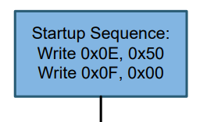
HDC2010 Example Startup Sequence
/*Startup Sequence*/
i2cTransaction.slaveAddress = HDC2010_ADDR;
i2cTransaction.writeBuf = txBuffer;
i2cTransaction.writeCount = 2;
i2cTransaction.readBuf = NULL;
i2cTransaction.readCount = 0;
txBuffer[0] = SOFT_RESET_REG;
txBuffer[1] = 0x00;
I2C_transfer(i2c, &i2cTransaction);
i2cTransaction.slaveAddress = HDC2010_ADDR;
i2cTransaction.writeBuf = txBuffer;
i2cTransaction.writeCount = 2;
i2cTransaction.readBuf = NULL;
i2cTransaction.readCount = 0;
txBuffer[0] = MEAS_CONFIG_REG;
txBuffer[1] = 0x00;
I2C_transfer(i2c, &i2cTransaction);
After power up, the HDC20X0 is in sleep mode waiting for I2C input commands. To configure the device to collect both the humidity and temperature data in single acquisition mode, select TRIGGER ON DEMAND in CONFIG register (0x0E), select the desired Temperature and Humidity resolutions and the Temperature + Humidity measurement configuration in MEASUR_CONFIG register (0x0F).

Slide 20
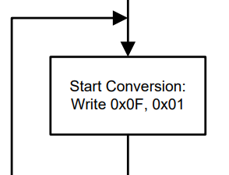
HDC2010 Example Start Conversion
To initiate a single measurement, the bit MEAS_TRIG is set to '1' in the MEASUR_CONFIG register. The device will exit from sleep mode and perform a single measurement. After the conversion, the device will update the respective measurement register and will return to sleep mode
/*Start Conversion*/
i2cTransaction.slaveAddress = HDC2010_ADDR;
i2cTransaction.writeBuf = txBuffer;
i2cTransaction.writeCount = 2;
i2cTransaction.readBuf = NULL;
i2cTransaction.readCount = 0;
txBuffer[0] = MEAS_CONFIG_REG;
txBuffer[1] = 0x01;
I2C_transfer(i2c, &i2cTransaction);

Slide 21
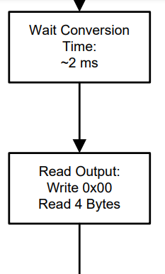
HDC2010 Example Read Output
/*Wait Conversion time 2ms*/
usleep(2000);
/*Read Output*/
i2cTransaction.slaveAddress = HDC2010_ADDR;
i2cTransaction.writeBuf = txBuffer2;
i2cTransaction.writeCount = 1;
i2cTransaction.readBuf = rxBuffer;
i2cTransaction.readCount = 4;
txBuffer2[0]=0x00;
I2C_transfer(i2c, &i2cTransaction);

Slide 22
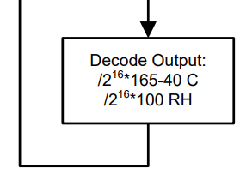
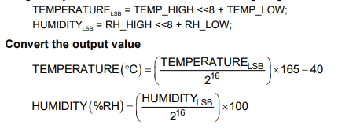
HDC2010 Example Decode Output
The measured temperature and humidity data are sent to the output register: TEMP_LOW, TEMP_HIGH, RH_LOW and RH_HIGH.
Temperature data are represented as 16-bit numbers, so the complete values are given by the concatenation of the low and high register:
/*Decode Output*/
temperature = (rxBuffer[1] << 8) | rxBuffer[0];
temperature_conv = ( temperature / pow(2, 16))*165 - 40;
humidity = (rxBuffer[3] << 8) | rxBuffer[2];
humidity_conv = ( humidity / pow(2, 16))*100;

Slide 23
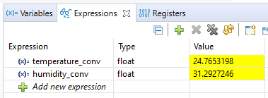
HDC2010 Example Run Example
Now is possible to run the example and if everything is correct, by adding the variables to the Watch Expressions and putting a breakpoint, is possible to run the code and see the correct readings of temperature and humidity.

