Slide 1
DATA MINING & MACHINE LEARNING
ASL Alphabet Recognition from MediaPipe Hand Landmarks
Data Mining & Machine Learning Project M.Sc. in Artificial Intelligence and Data Engineering — Academic Year 2025–2026
Elia Valeriano — ID: 585114 | Marco Guglielmi — ID: 720166
14/06/2026

Slide 2
OVERVIEW
Presentation Outline
01
Problem & Dataset
Task definition · features · EDA
02
Pipeline & Experiments
PART 1
Preprocessing · model selection · hyperparameter optimization
03
Evaluation & Results
Metrics · cross-validation · final model performance
04
Explainability
PART 2
Global & local techniques · consistency with domain knowledge
05
Critical Discussion
Error analysis · limitations · future directions

Slide 3
PART 1 — TECHNICAL
Problem, Pipeline & Results
Problem definition · feature engineering · model selection
hyperparameter optimization · evaluation · test-set results

Slide 4
PROBLEM
Problem Definition & Dataset
The Problem
Dataset at a Glance
Automatic recognition of American Sign Language (ASL) alphabet letters from static hand images, to support accessible communication between deaf users and non-signers.
Task type: supervised multi-class classification (26 classes, A–Z).
Practical relevance: enables real-time fingerspelling interfaces and assistive tools without deep learning complexity.
Key challenge: many ASL letters share nearly identical hand configurations — distinguishing them requires precise geometric descriptors, not raw pixels.
Task
26-class classification (A–Z)
Dataset
ASL Alphabet Dataset (Kaggle) — 154,924 samples, 95 features
Target
‘label’ — one of 26 ASL alphabet letters
Features
95 numerical: 63 landmarks + 12 distances + 10 angles + 10 vectors
Missing values
0 (invalid detections removed at extraction stage)
Class balance
Mostly 5k–7.7k per class — approximately balanced
Split
5-outer × 4-inner nested CV, group-stratified splits
Metric(s)
Macro F1-score (primary), Accuracy, Precision, Recall

Slide 5
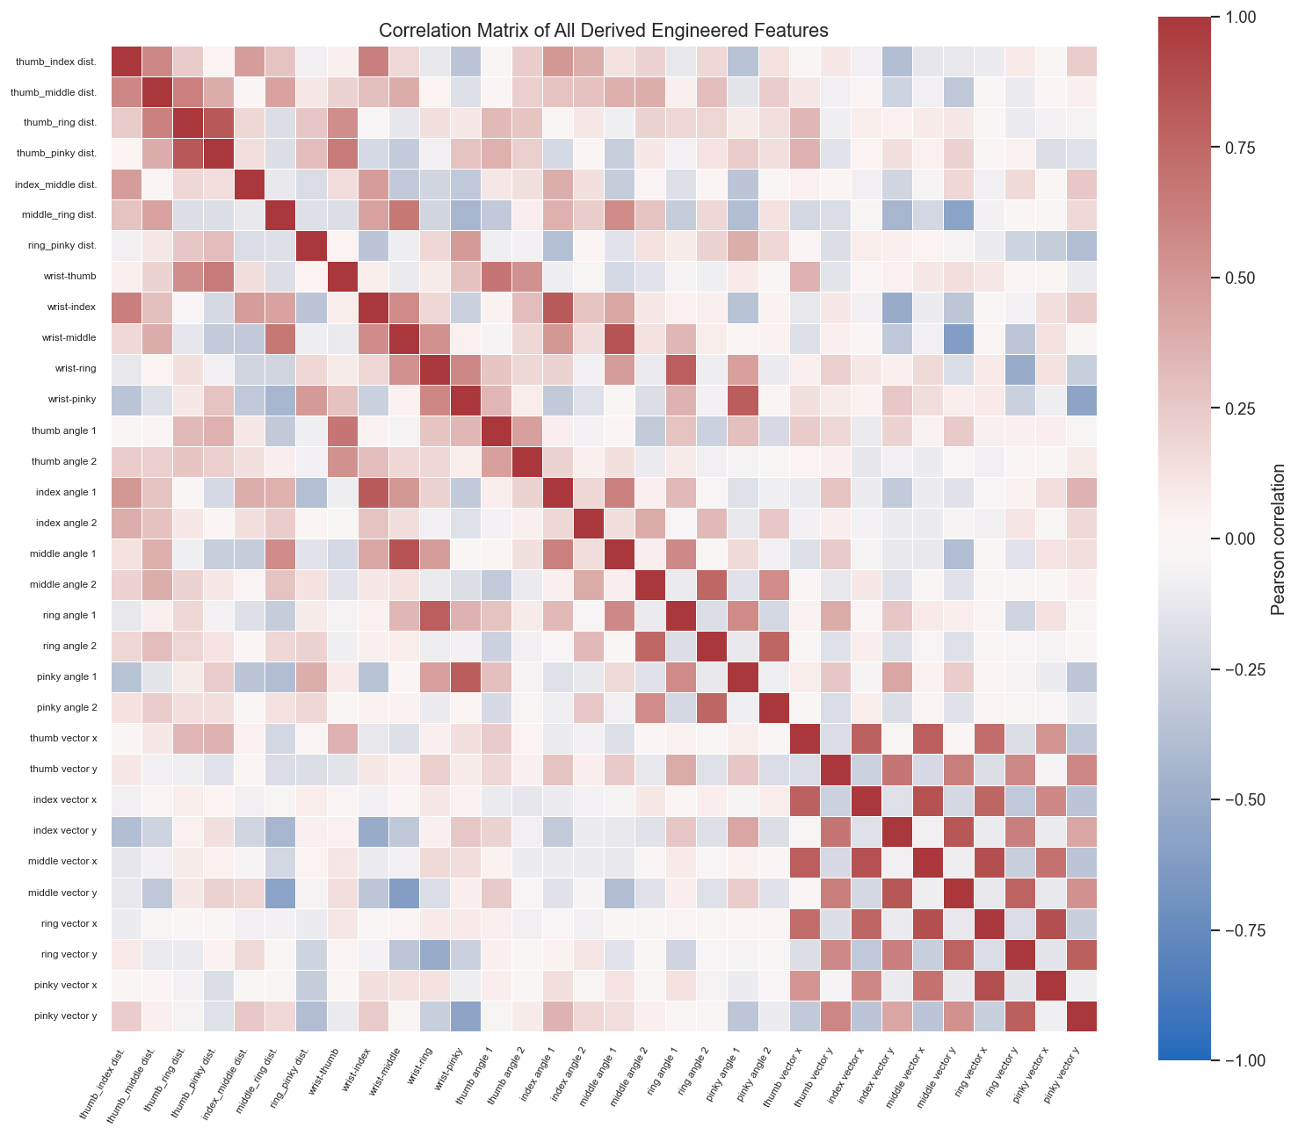
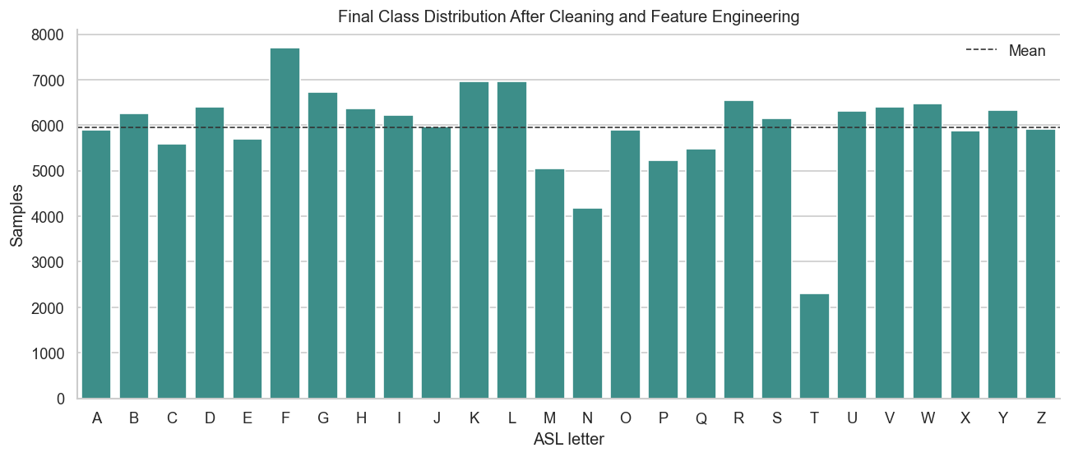
PROBLEM
Exploratory Data Analysis
Fig. 1 — Final class distribution after cleaning (154,924 samples, 26 classes)
Fig. 2 — Correlation matrix of all 95 engineered features
Key findings from EDA:
76.1% extraction success rate — 48,563 images discarded (no hand detected by MediaPipe). Classes mostly balanced (5k–7.7k samples) except T (2,308) after manual curation of a labeling inconsistency. Strong correlations among fingertip-distance features; wrist-to-fingertip and raw landmark coordinates are partially redundant.

Slide 6
PIPELINE
Feature Engineering & Selection
Engineering
Selection Method
Why These Features?
12 fingertip-to-fingertip and wrist-to-fingertip distances; 10 joint angles per finger; 10 wrist-to-fingertip directional vectors (x,y)
Landmarks normalized: wrist translated to origin, scaled by wrist–middle MCP distance
No categorical variables — all features are numerical after dropping metadata columns
No imputation needed — invalid samples removed at extraction (0 missing values)
No explicit selection — all features retained (embedded importance via tree models)
Post-hoc permutation importance confirms index_middle_tip_distance dominates
Validated indirectly: model performance stable across folds with full 95-feature set
95 features retained (63 landmarks + 32 engineered)
Fingertip distances capture hand openness; angles encode flexion; vectors preserve directional orientation — all directly meaningful for ASL gesture discrimination
Metadata (filepath, handedness, score) dropped before training; z-coordinates excluded from engineered features (MediaPipe depth is noisy)
See Fig. 8 (permutation importance) for post-hoc validation of feature relevance

Slide 7
PIPELINE
ML Pipeline: Avoiding Data Leakage & Bias
Raw
Data
Preprocessing
Feature
Selection
Model
Training
Validation
(held-out fold)
Final
Evaluation
▶
▶
▶
▶
▶
Data Leakage Prevention
Class Imbalance Handling
Metric Justification
All preprocessing fitted only on training folds
Sklearn Pipeline: preprocessing fitted only inside each training fold; scaling used for KNN and Approx RBF SVM, not for HistGradientBoosting
Groups built from feature hashes prevent near-duplicate samples from appearing in both train and test partitions
No SMOTE needed — dataset approximately balanced; class weights enabled for RF and SVM
Class weights applied only inside CV folds where used
Macro F1 chosen to give equal weight to all 26 letters
Primary metric: macro F1, because each class matters equally
Silent substitutions are more harmful than missed detections
Accuracy, macro precision, and macro recall reported for completeness

Slide 8
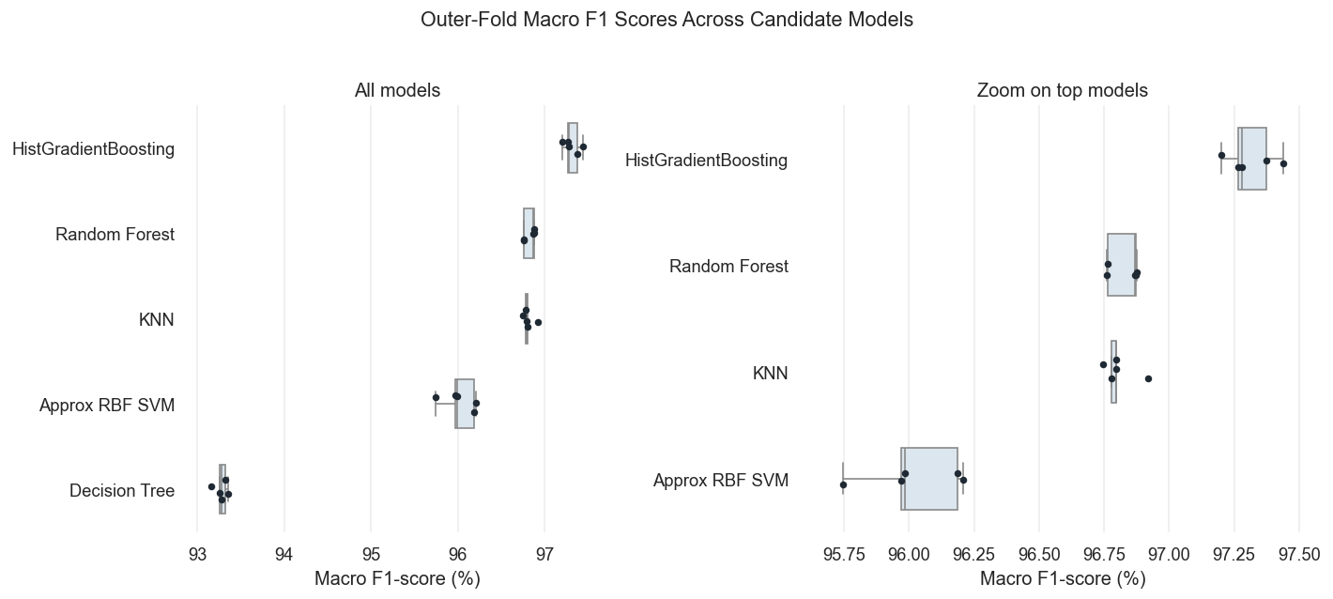
PIPELINE
Model Selection & Hyperparameter Optimization
Key Decisions
Candidate models
KNN, Decision Tree, Random Forest, HistGradientBoosting, Approx RBF SVM
CV strategy
5-outer × 4-inner nested CV with group-stratified splits (groups from feature hashes)
Selection criterion
Macro F1-score (equal weight to all 26 classes)
Chosen model
HistGradientBoosting — highest outer macro F1 (97.31%); Wilcoxon pairwise tests favored HGB against all competitors
Search strategy
Exhaustive Grid Search inside inner CV folds
Search space
learning_rate, max_iter, max_leaf_nodes, min_samples_leaf, l2_regularization, early_stopping
Best config
lr=0.05, max_iter=800, max_leaf_nodes=31, min_samples_leaf=40, l2=0.0 — identical across all 5 outer folds
Statistical test
Friedman: stat=19.36, p=0.00067; Wilcoxon HGB vs others: p=0.03125; Nemenyi rank 1.0

Slide 9
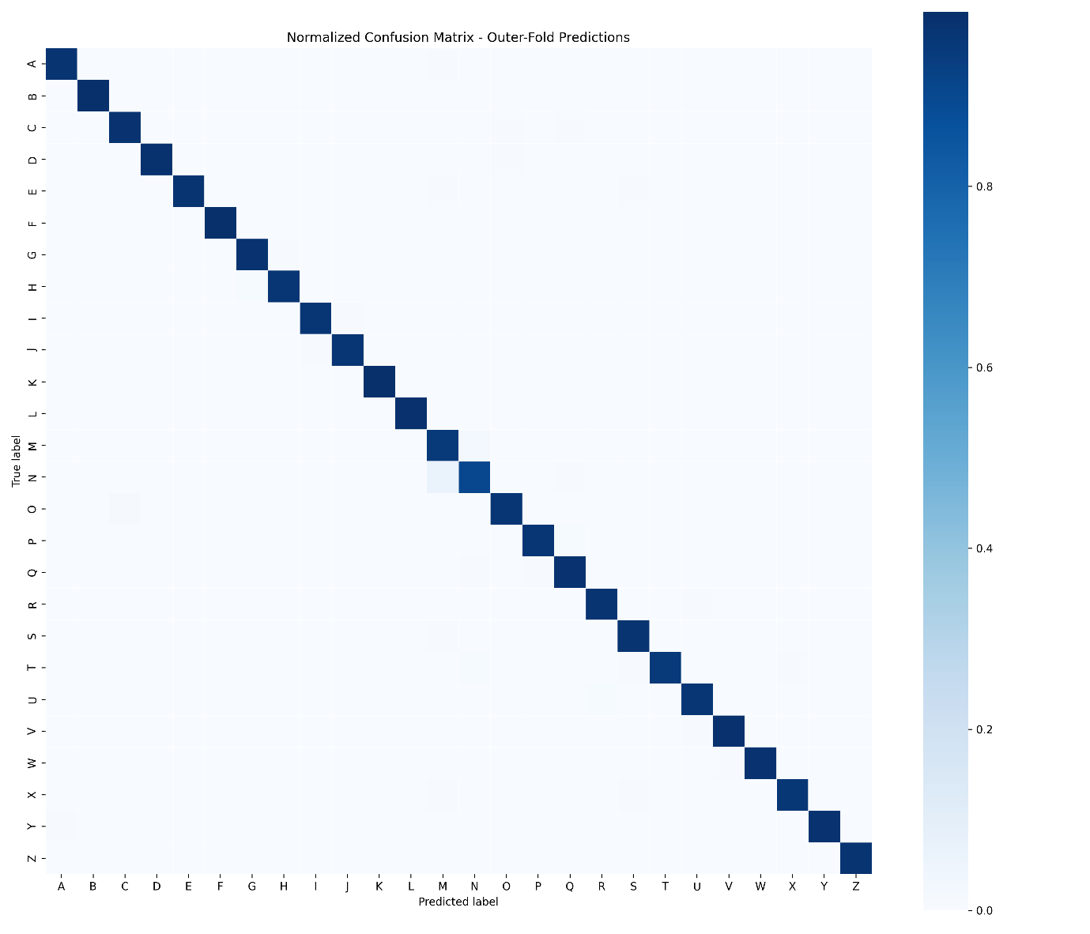
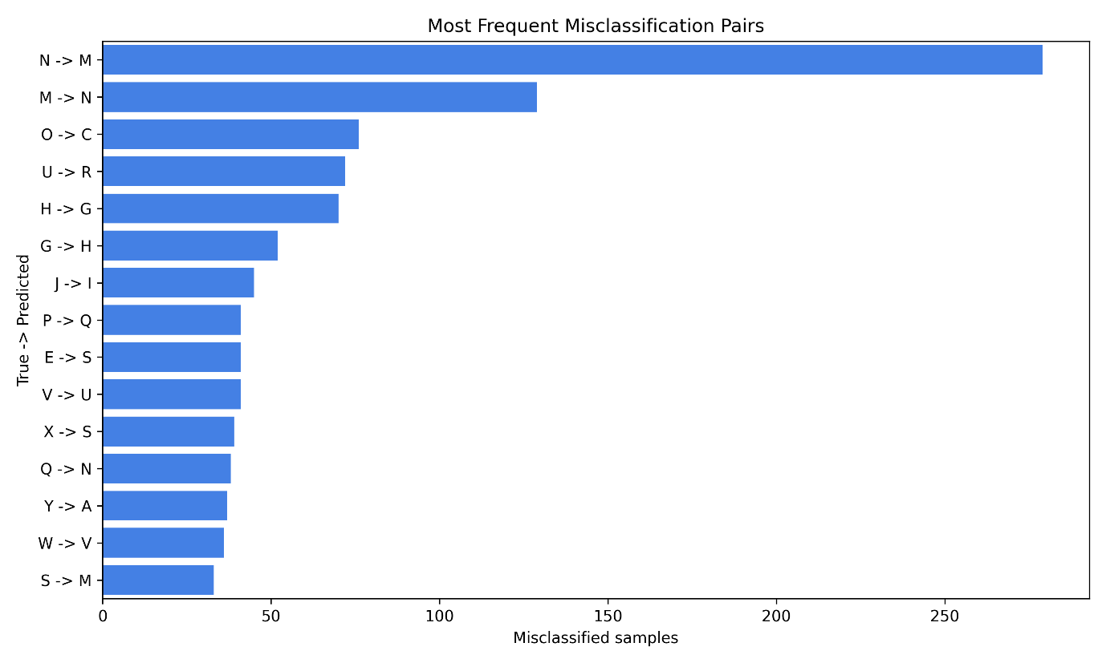
RESULTS
Outer-Fold Evaluation Results
Key Metrics (Outer Folds)
97.49%
97.31%
97.33%
96.83%
Accuracy
Macro F1
Macro Precision
Best Competitor (RF)

Slide 10
PART 2 — CRITICAL ANALYSIS
Explainability &
Critical Discussion
How does the model work? · What did it get wrong and why?
Limitations · future directions · domain impact

Slide 11
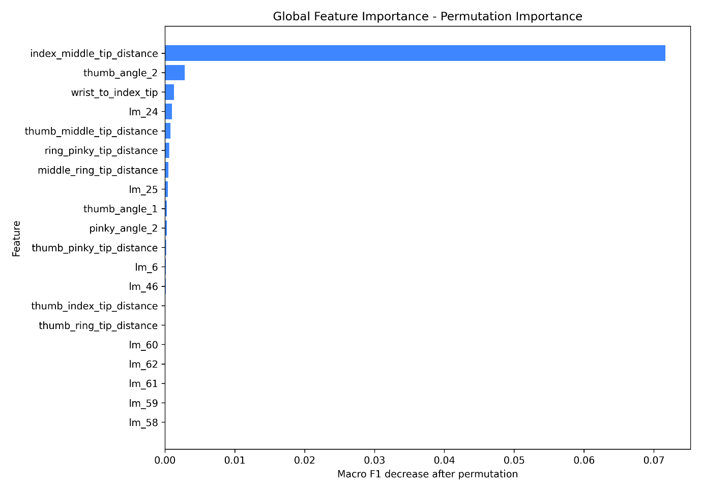
EXPLAINABILITY
Global Explainability: What Drives the Model Overall?
Interpretation
Permutation importance: shuffles each feature and measures macro F1 drop — model-agnostic, appropriate for HistGradientBoosting
index_middle_tip_distance dominates by an order of magnitude (ΔF1=0.071) — expected: it separates U/V, R/U and many other near-minimal pairs
Most other features show much smaller individual permutation effects — the model relies on one dominant geometric cue plus weaker supporting signals
Supports performance: 97.31% macro F1 achieved with interpretable geometry — a smaller feature subset could be investigated, but no feature-removal step was used in the final pipeline
Fig. 8 — Permutation importance: top 20 features ranked by macro F1 decrease

Slide 12
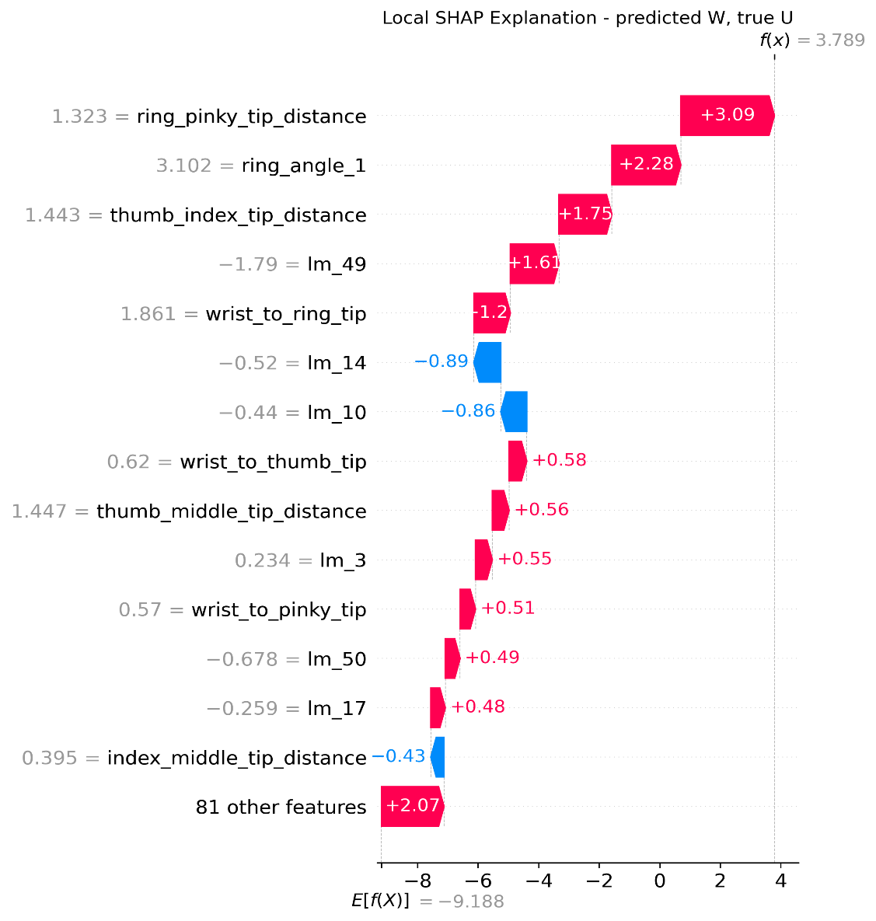
EXPLAINABILITY
Local Explainability: Why This Specific Prediction?
Case Analysis
Sample: true label U, predicted W — selected as highest-confidence misclassification from OOF predictions (f(x)=3.789 vs base E[f(X)]=−9.188)
Ring-finger features pushed toward W: ring_pinky_tip_distance (+3.09), ring_angle_1 (+2.28), thumb_index_tip_distance (+1.75)
Partially consistent: index_middle_tip_distance (globally #1) here contributes −0.43 — overridden by combined ring/pinky evidence
Consistent with ASL anatomy: U folds the ring finger, W spreads it — an inadvertently extended ring finger makes U look like W
This is a geometrically coherent failure — the model is not confused randomly, it responds to a genuinely ambiguous input near the U/W decision boundary
Fig. 9 — SHAP waterfall: highest-confidence misclassification (true U, predicted W)

Slide 13

CRITICAL DISCUSSION
Error Analysis: What Did the Model Get Wrong and Why?
Reverse-Engineering Errors
Errors cluster along geometric boundaries: N↔M (~400 total), O→C, U→R, G↔H — not random noise
M/N: ring_pinky_tip_distance takes ambiguous values; O/C: depth-encoded aperture lost in 2D features; G/H: lateral orientation collapses under camera angle variation
Confusion-matrix and top-pair analysis confirm that M/N and O/C remain difficult even after feature engineering — these pairs sit near genuine geometric boundaries
All major confusions have a clear geometric explanation rooted in ASL hand anatomy; no evidence of spurious correlations
Systematic: residual errors concentrated at 3 structural boundaries (finger-count, depth-aperture, lateral-orientation) — addressable with targeted features or depth sensors
Comparison with Prior Work
No direct published baseline uses the same dataset + landmark-only pipeline. CNN-based approaches on raw pixels report similar accuracy but lack interpretability and require far more compute. Our 97.31% macro F1 with 95 geometric features and a traditional ML model is competitive while remaining fully explainable and suitable for real-time inference.

Slide 14
CRITICAL DISCUSSION
Domain Impact, Limitations & Future Directions
Domain Impact
Limitations
Future Directions
Real-time webcam fingerspelling interface for deaf or hard-of-hearing users — already deployed as a demo application
Supports letter-by-letter communication between signers and non-signers; could integrate with text-to-speech or chat interfaces
Silent substitutions (FP) are more harmful than missed detections (FN) — a wrong letter corrupts the message without alerting the user
Human oversight needed — model should show confidence score; low-confidence predictions should prompt user to retry the sign
Dataset from a single source with controlled lighting — real-world performance may degrade under poor illumination or unusual hand sizes
No true 3D depth — MediaPipe z estimates too noisy to resolve depth-sensitive pairs (O/C); dynamic signs J and Z excluded entirely
Static single-frame assumption — full ASL communication requires motion, facial expression, and linguistic context
Evaluation on a single dataset — no deployment test with real users; MediaPipe detection failures (~24%) not accounted for in reported metrics
More diverse data: multiple signers, varied lighting, different camera angles to improve real-world robustness
Targeted features: ring-relative-to-middle distance for M/N; z-aware descriptors or RGB-D input for O/C; temporal sequences for J and Z
Post-processing language model: character-level n-gram prior to suppress structured substitution errors (M↔N, O→C) without changing the classifier
User study: deploy with real signers, collect failure cases, iterate on feature engineering based on observed error distribution

Slide 15
Thank You
Conclusions:
We built an end-to-end pipeline for ASL alphabet recognition (26 classes) from MediaPipe hand landmarks, achieving 97.49% accuracy and 97.31% macro F1 without any deep learning.
HistGradientBoosting selected via 5×4 nested CV with group-stratified splits; Friedman and Wilcoxon tests support its advantage, with Nemenyi strongest vs SVM and Decision Tree.
index_middle_tip_distance is the strongest global feature; all major errors are geometrically coherent — the model fails where the feature space structurally struggles to separate classes.
Main limitation: 2D engineered features struggle with depth-sensitive pairs (O/C), and M/N may need additional targeted ring-finger descriptors — both are concrete next steps.
Elia Valeriano (585114) · Marco Guglielmi (720166)

