Slide 1
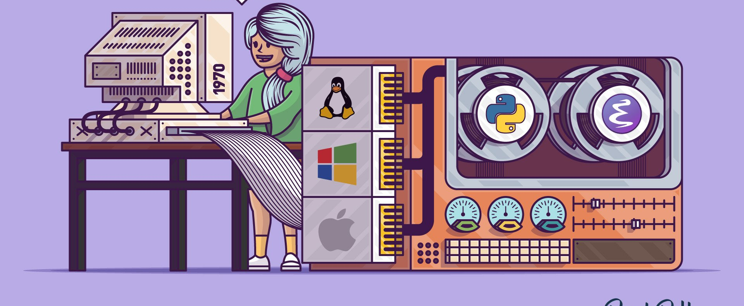
A Gentle Intro to Emacs
Marco Hassan, Zürich, 14/04/2021

Slide 2
What is Emacs – History
Emacs is a family of text editors that are characterized by their extensibility. (Wiki)
GNU Emacs – the most popular version of Emacs – describes it as "the extensible, customizable, self-documenting, real-time display editor".
The extension capability is possible through code written through a dialect of the Lisp programming language (functional programming language).
It is open by inception – check the GNU project Manifesto to understand why.

Slide 3

What is Emacs – The One Liner
Think it as the customizable Ring:
One emacs to rule them all, one emacs to find them, One emacs to bring them all and in the darkness bind them.
It can be a terminal, IDE, editor, browser (?), mail client (?), calendar, agenda, task manager and more.

Slide 4
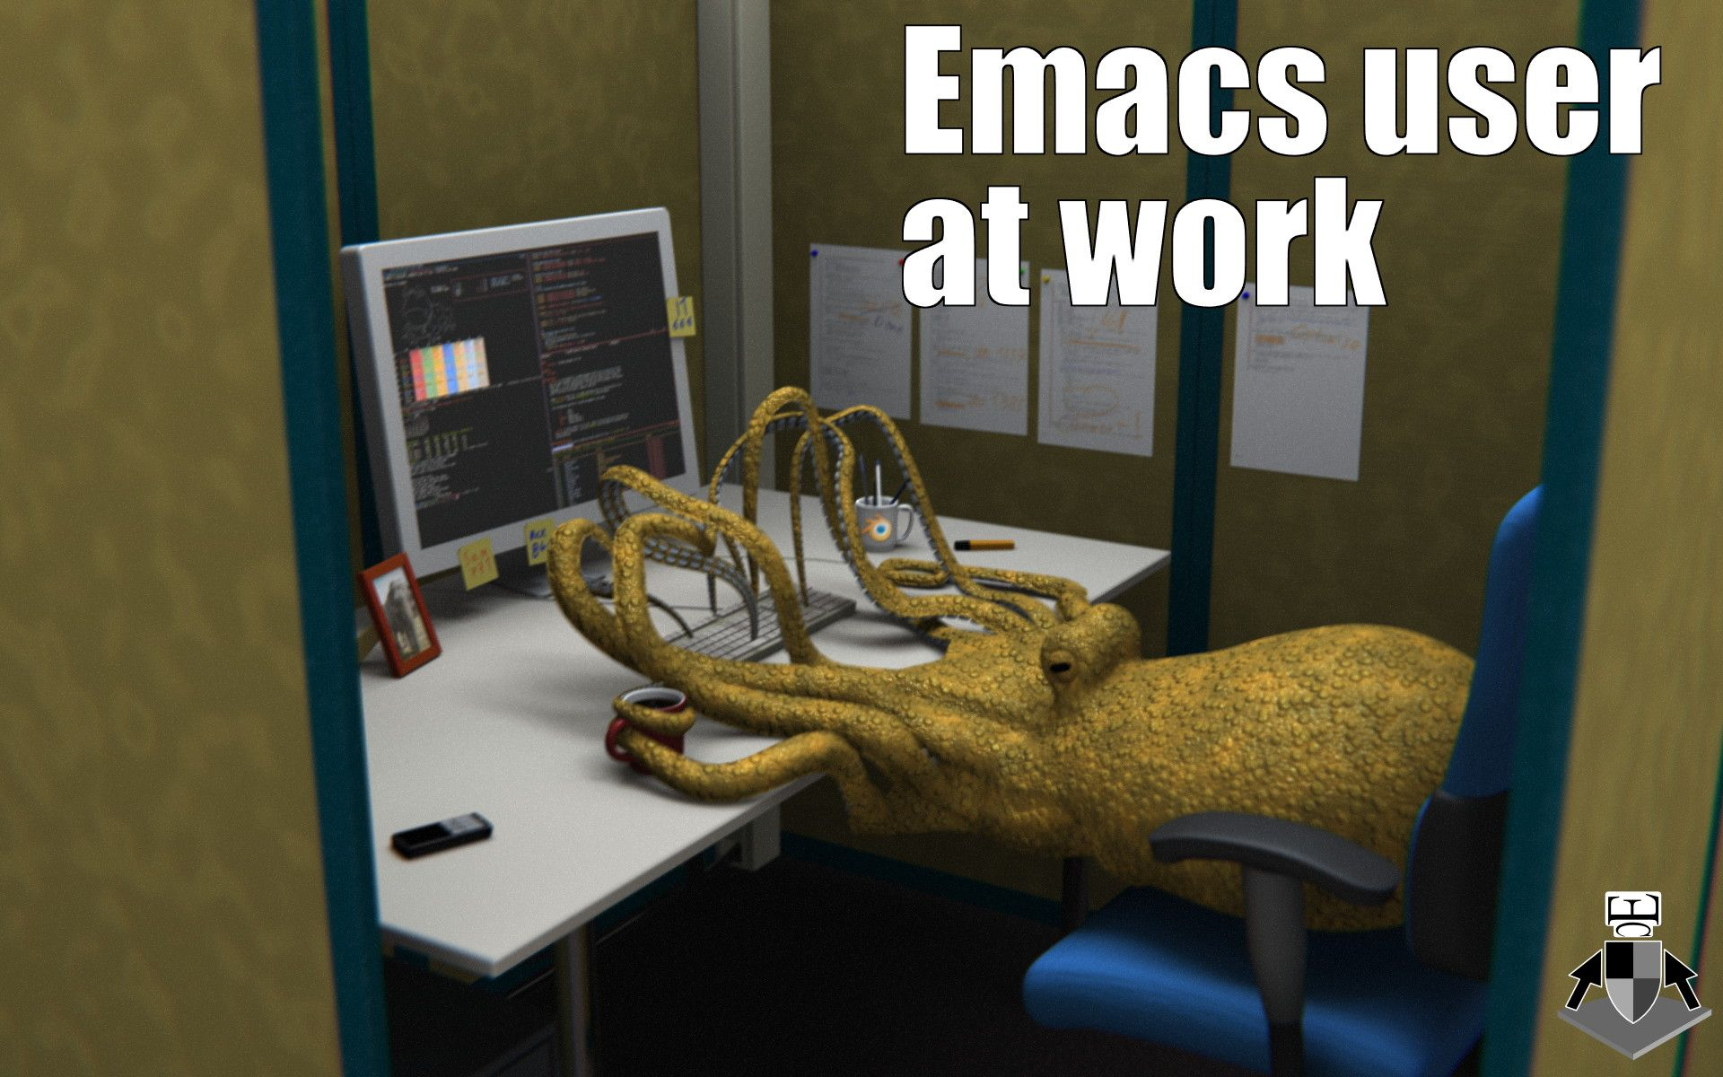
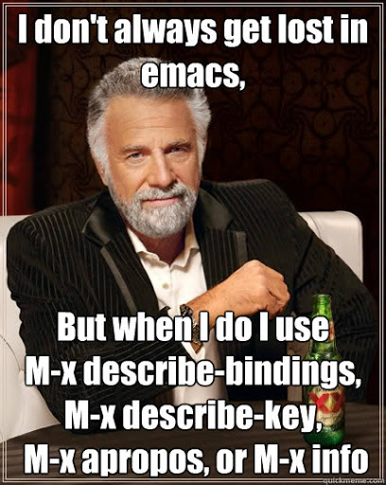
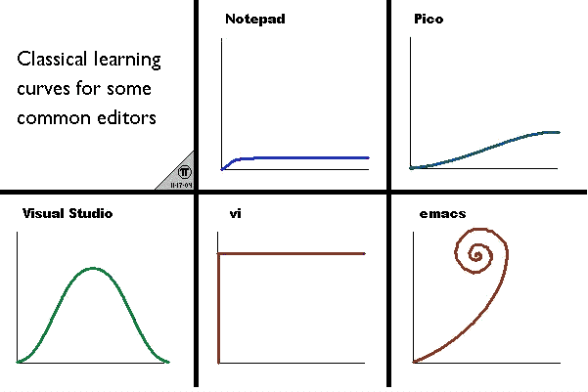

What is Emacs – The Meme Explaination

Slide 5
Emacs Installation
Check here the installation on the different OS: https://www.gnu.org/software/emacs/
Good to start: https://cestlaz.github.io/stories/emacs/
My configuration: https://github.com/MarcoHassan/emacs_config/tree/mac_install/Emacs%20Configuration
Plenty of Contribution around: just google and experiment

Slide 6
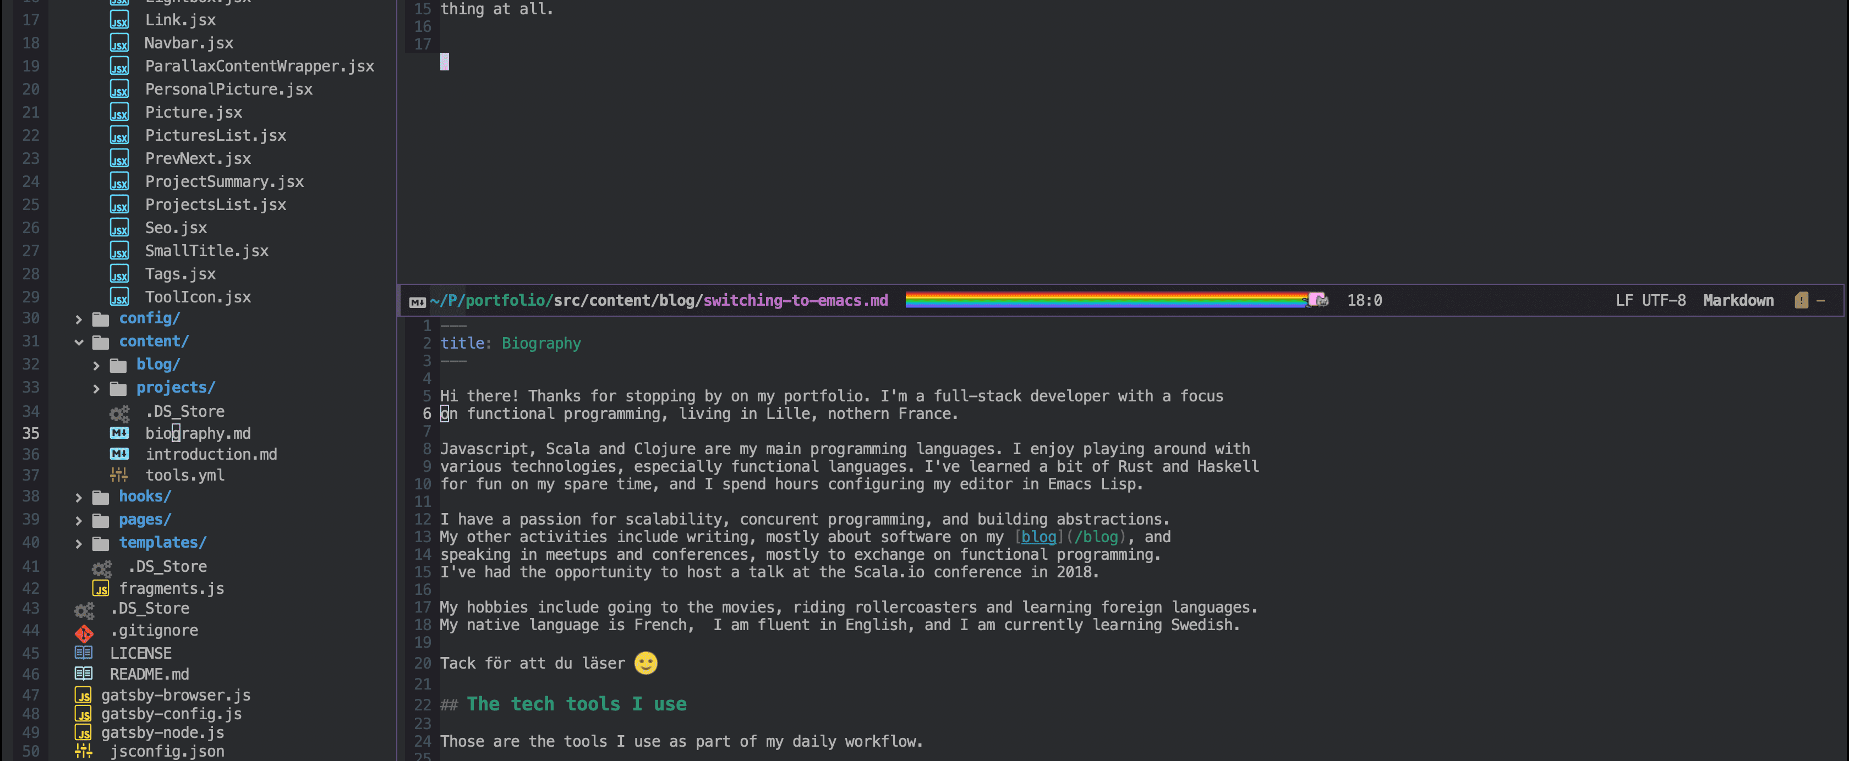

Emacs Hands On

