Slide 1
Retiming and scheduling implementation
Digital Systems Design Methodologies Project
Politecnico di Milano, 2017
Marco Ieni

Slide 2
Let’s apply retiming and get the scheduling of a simple code

Slide 3
Starting code
t0 = h0 * x0;
t1 = h1 * x1;
t7 = t0 + t1;
t2 = h2 * x2;
t3 = h3 * x3;
t8 = t2 + t3;
t4 = h4 * x4;
t5 = h5 * x5;
t10 = t7 + t8;
t9 = t4 + t5;
t6 = h6 * x6;
t11 = t9 + t6;
return t10 + t11;

Slide 4
SSA form
t0 = h0 * x0;
t1 = h1 * x1;
t7 = t0 + t1;
t2 = h2 * x2;
t3 = h3 * x3;
t8 = t2 + t3;
t4 = h4 * x4;
t5 = h5 * x5;
t10 = t7 + t8;
t9 = t4 + t5;
t6 = h6 * x6;
t11 = t9 + t6;
temp = t10 + t11;
return temp;
Operation | Delay units
t0 | 2
t1 | 2
t7 | 1
t2 | 2
t3 | 2
t8 | 1
t4 | 2
t5 | 2
t10 | 1
t9 | 1
t6 | 2
t11 | 1
temp | 1
ADDERs: (1 delay unit) for comparisons, sums and subtractions
MULTs: (2 delay units) for multiplications

Slide 5
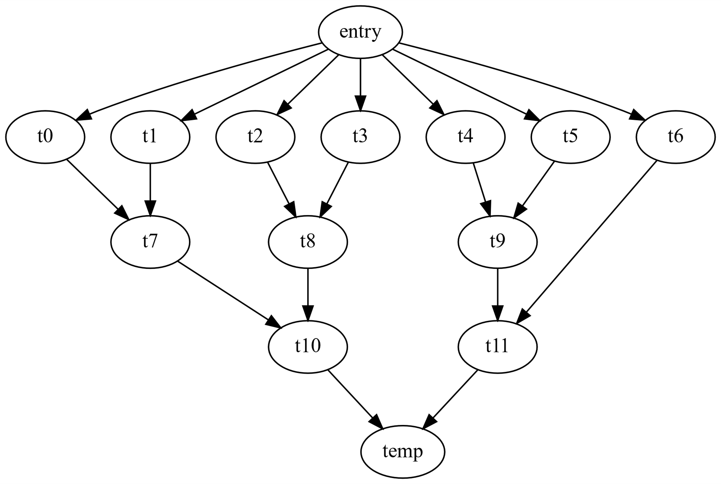
Graph
Operation | Delay units
entry | 0
t0 | 2
t1 | 2
t7 | 1
t2 | 2
t3 | 2
t8 | 1
t4 | 2
t5 | 2
t10 | 1
t9 | 1
t6 | 2
t11 | 1
temp | 1
t0 = h0 * x0;
t1 = h1 * x1;
t7 = t0 + t1;
t2 = h2 * x2;
t3 = h3 * x3;
t8 = t2 + t3;
t4 = h4 * x4;
t5 = h5 * x5;
t10 = t7 + t8;
t9 = t4 + t5;
t6 = h6 * x6;
t11 = t9 + t6;
temp = t10 + t11;
return temp;

Slide 6

Encoding
Operation | Delay units
0 | 0
1 | 2
2 | 2
3 | 1
4 | 2
5 | 2
6 | 1
7 | 2
8 | 2
9 | 1
10 | 1
11 | 2
12 | 1
13 | 1
1: t0 = h0 * x0;
2: t1 = h1 * x1;
3: t7 = t0 + t1;
4: t2 = h2 * x2;
5: t3 = h3 * x3;
6: t8 = t2 + t3;
7: t4 = h4 * x4;
8: t5 = h5 * x5;
9: t10 = t7 + t8;
10: t9 = t4 + t5;
11: t6 = h6 * x6;
12: t11 = t9 + t6;
13: temp = t10 + t11;
return temp;

Slide 7
Input file Format (1/2)
Operation | Delay units
0 | 0
1 | 2
2 | 2
3 | 1
4 | 2
5 | 2
6 | 1
7 | 2
8 | 2
9 | 1
10 | 1
11 | 2
12 | 1
13 | 1
For the first line take the delay units of the operations in order and separated by a space:
0 2 2 1 2 2 1 2 2 1 1 2 1 1

Slide 8
Input file Format (2/2)
In the next lines, write the vertices of each arc of the graph separated by a space
0 1
0 2
0 4
0 5
0 7
0 8
0 11
1 3
2 3
3 9
4 6
5 6
6 9
7 10
8 10
9 13
10 12
11 12
12 13

Slide 9
Let’s run the program
The minimum clock cycle duration to execute this circuit without introducing other flip flops is 5 (sum of the delays of the nodes of the critical path 0-1-3-9-13)
Let’s try to reduce the clock cycle duration to 4

Slide 10
Input parameters
Input:
required clock cycles = 4
control steps number = 1
input file = input/example1.txt
Command line args: input/example1.txt 1 4

Slide 11
Output file
0 2 2 1 2 2 1 2 2 1 1 2 1 1
0 1 0
0 2 0
0 4 0
0 5 0
0 7 0
0 8 0
0 11 1
1 3 1
2 3 1
3 9 0
4 6 1
5 6 1
6 9 0
7 10 1
8 10 1
9 13 0
10 12 0
11 12 0
12 13 0

Slide 12
Output Graph
0
0
0
0
0
0
0
1
1
1
1
FLIP FLOP INTRODUCED
IN THE OUTPUT FILE
1
1
SCHEDULING
1

Slide 13
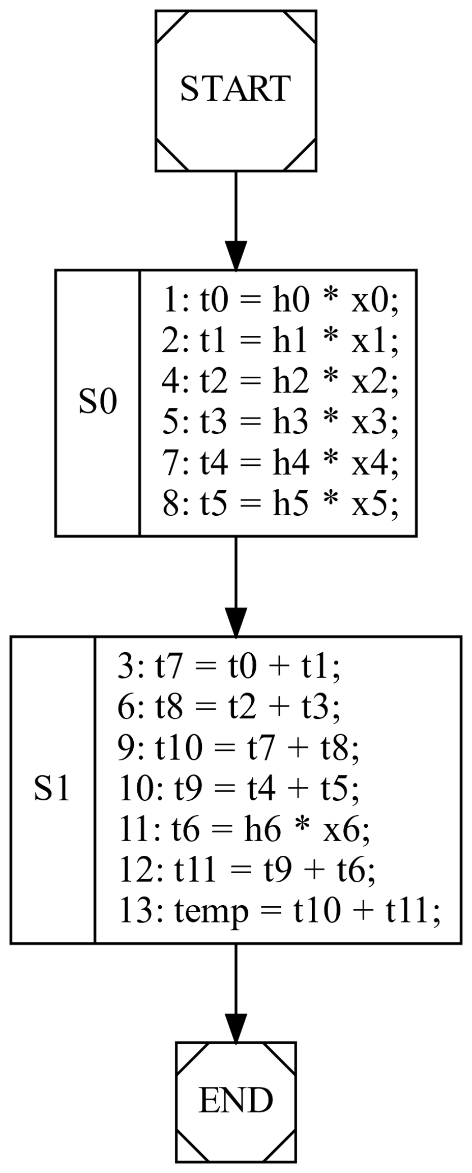
0
0
0
0
0
0
0
1
FSM
1
1
1
1
1
1

Slide 14
Let’s try a code with a loop

Slide 15
Starting code
res_1 = a * b;
do {
res_2 = PHI<res_1,res_3>;
t1 = a + b;
t2 = c + d;
t3 = t1 * t2;
t4 = t3 * t2;
t5 = a – b;
t6 = c – d;
t7 = t5 + t6;
t8 = a * b;
t9 = c * d;
t10 = t8 * t9;
t11 = t4 + t7;
res_3 = t10 + t11 + res_2;
cond = res_3 != 1;
} while (cond);
out1 = res_3 + 1;

Slide 16
SSA form
Operation | Delay units
res_1 | 2
res_2 | 0
t1 | 1
t2 | 1
t3 | 2
t4 | 2
t5 | 1
t6 | 1
t7 | 1
t8 | 2
t9 | 2
t10 | 2
t11 | 1
tmp | 1
res_3 | 1
cond | 1
out1 | 1
res_1 = a * b;
do {
res_2 = PHI<res_1,res_3>;
t1 = a + b;
t2 = c + d;
t3 = t1 * t2;
t4 = t3 * t2;
t5 = a – b;
t6 = c – d;
t7 = t5 + t6;
t8 = a * b;
t9 = c * d;
t10 = t8 * t9;
t11 = t4 + t7;
tmp = t10 + t11;
res_3 = tmp + res_2;
cond = res_3 != 1;
} while (cond);
out1 = res_3 + 1;
ADDERs: (1 delay unit) for comparisons, sums and subtractions
MULTs: (2 delay units) for multiplications

Slide 17
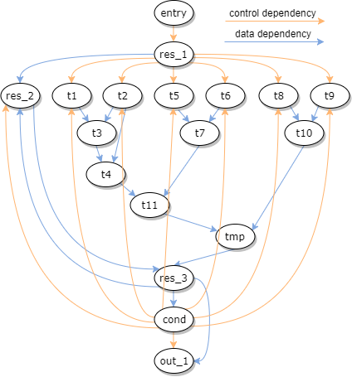
Graph
Operation | Delay units
entry | 0
res_1 | 2
res_2 | 0
t1 | 1
t2 | 1
t3 | 2
t4 | 2
t5 | 1
t6 | 1
t7 | 1
t8 | 2
t9 | 2
t10 | 2
t11 | 1
tmp | 1
res_3 | 1
cond | 1
out1 | 1
res_1 = a * b;
do{
res_2 = PHI<…>;
t1 = a + b;
t2 = c + d;
t3 = t1 * t2;
t4 = t3 * t2;
t5 = a – b;
t6 = c – d;
t7 = t5 + t6;
t8 = a * b;
t9 = c * d;
t10 = t8 * t9;
t11 = t4 + t7;
tmp = t10 + t11;
res_3 = tmp + res_2;
cond = res_3 != 1;
} while (cond);
out1 = res_3 + 1;

Slide 18
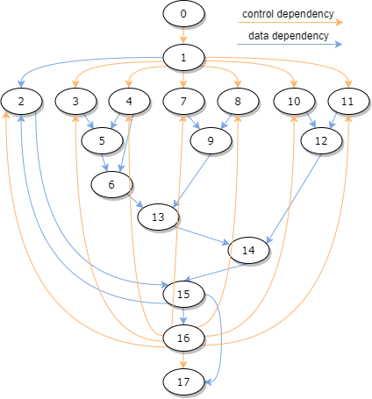
Encoding
Operation | Delay units
0 | 0
1 | 2
2 | 0
3 | 1
4 | 1
5 | 2
6 | 2
7 | 1
8 | 1
9 | 1
10 | 2
11 | 2
12 | 2
13 | 1
14 | 1
15 | 1
16 | 1
17 | 1
1: res_1 = a * b;
do{
2: res_2 = PHI<…>;
3: t1 = a + b;
4: t2 = c + d;
5: t3 = t1 * t2;
6: t4 = t3 * t2;
7: t5 = a – b;
8: t6 = c – d;
9: t7 = t5 + t6;
10: t8 = a * b;
11: t9 = c * d;
12: t10 = t8 * t9;
13: t11 = t4 + t7;
14: tmp = t10 + t11;
15: res_3 = tmp + res_2;
16: cond = res_3 != 1;
} while (cond);
17: out1 = res_3 + 1;

Slide 19
Problem: combinatorial cycles
The input graph contains cycles without any flip flop. It means that there are some cyclic combinatorial parts in the circuit.
Solution: introduce flip flops in the input graph.
For example we can introduce 1 flip flop from node 2 to 15 and another one from node 14 to 15).

Slide 20
New input graph
NEW FLIP FLOPS
INTRODUCED

Slide 21
Input file Format (1/2)
Operation | Delay units
0 | 0
1 | 2
2 | 0
3 | 1
4 | 1
5 | 2
6 | 2
7 | 1
8 | 1
9 | 1
10 | 2
11 | 2
12 | 2
13 | 1
14 | 1
15 | 1
16 | 1
17 | 1
For the first line take the delay units of the operations in order and separated by a space:
0 2 0 1 1 2 2 1 1 1 2 2 2 1 1 1 1 1

Slide 22
Input file Format (2/2)
In the next lines, write the vertices of each arc of the graph separated by a space, followed by the number of flip flops of the arc
0 1 0
1 2 0
1 3 0
1 4 0
1 7 0
1 8 0
1 10 0
1 11 0
2 15 1
3 5 0
4 5 0
4 6 0
5 6 0
6 13 0
7 9 0
8 9 0
9 13 0
10 12 0
11 12 0
12 14 0
13 14 0
14 15 1
15 2 0
15 16 0
15 17 0
16 2 0
16 3 0
16 4 0
16 7 0
16 8 0
16 10 0
16 11 0
16 17 0
This number can be whatever, because it will be replaced with the control steps number in input

Slide 23
Let’s run the program
The minimum clock cycle duration to execute this circuit without introducing other flip flops is 9 (sum of the delays of the nodes of the critical path 0-1-3-5-6-13-14)
Problem: if you try to reduce the clock cycle duration, you find negative cycles in the pC graph.
Solution: introduce flip flops in the input graph.
Adding 1 flip flop in all the outgoing arcs that goes backwards from node 16 is sufficient to get a clock duration of 8 delay units

Slide 24
New input file: while8.txt
0 2 0 1 1 2 2 1 1 1 2 2 2 1 1 1 1 1
0 1 0
1 2 0
1 3 0
1 4 0
1 7 0
1 8 0
1 10 0
1 11 0
2 15 1
3 5 0
4 5 0
4 6 0
5 6 0
6 13 0
7 9 0
8 9 0
9 13 0
10 12 0
11 12 0
12 14 0
13 14 0
14 15 1
15 2 0
15 16 0
15 17 0
16 2 1
16 3 1
16 4 1
16 7 1
16 8 1
16 10 1
16 11 1
16 17 0

Slide 25
Input parameters
Input:
required clock cycles = 8
control steps number = 1
input file = input/while8.txt
Command line args: input/while8.txt 1 8

Slide 26
Output file
0 2 0 1 1 2 2 1 1 1 2 2 2 1 1 1 1 1
0 1 0
1 2 1
1 3 1
1 4 1
1 7 1
1 8 1
1 10 1
1 11 1
2 15 1
3 5 0
4 5 0
4 6 0
5 6 0
6 13 0
7 9 0
8 9 0
9 13 0
10 12 0
11 12 0
12 14 0
13 14 0
14 15 1
15 2 0
15 16 0
15 17 0
16 2 1
16 3 1
16 4 1
16 7 1
16 8 1
16 10 1
16 11 1
16 17 0

Slide 27
Output Graph
0
0
1
1
1
1
1
1
1
FLIP FLOP INTRODUCED
IN THE INPUT FILE
1
1
1
1
FLIP FLOP INTRODUCED
IN THE OUTPUT FILE
1
1
SCHEDULING
2
2
2

Slide 28
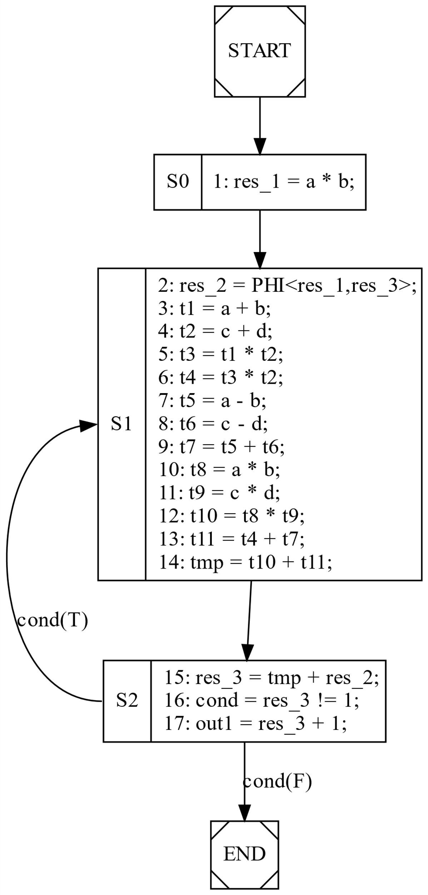
0
0
1
1
1
1
1
1
1
1
1
1
FSM
1
1
1
2
2
2

