Slide 1
Dynamic Autonomous Sensor Hub (DASH)
A mesh network for sensing applications
Lorenzo Orsingher, Marco Keppel

Slide 2
Why DASH?
Monitoring of big, open spaces with no centralized wireless connection
Faster data transfer than LoRa, and without limits on transmission time.
Network will re-adjust in the event of a lost node
Sensors configured on each slave device via a JSON file stored in its flash memory: easy to change configuration quickly and via a human readable language.
Adding a new device is as easy as flashing the firmware and uploading a suitable JSON

Slide 3
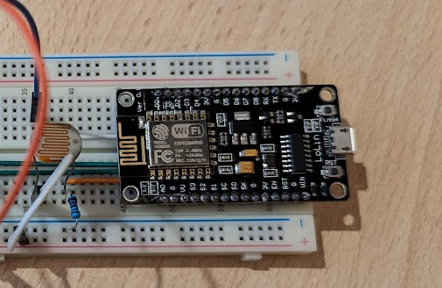
Hardware
Based on ESP8266 (ESP32 should technically be compatible as well)
Many sensors are (and can be) supported, such as switches (not only human-operated), temperature, light, humidity, …
Networking capabilities of the ESP platform are the main component of this project

Slide 4
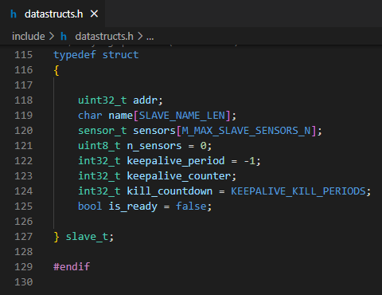
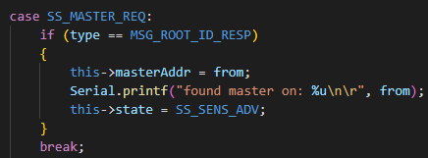
Software
ESP8266:
(The implementation of the mesh is handled by another library (painlessMesh), as well as the JSON parsing/serialization (ArduinoJson), as they were not the main focus of this project and require lots of time to implement from scratch)
Written in C++ using the Arduino framework
System based on JSON messages, shared on the mesh network
Slave devices will first find the master, send it their configuration (e.g. sensors attached), and then update the master with sensors values periodically (period is configurable per-sensor)
If a slave disconnects, the master will detect it and remove it from the list (keepalive mechanism)
Data is memorized via structs
Static allocation only, to avoid heap fragmentation
States in slaves are managed via state machine
Highly configurable via a vast number of C macros
Host machine
Program implemented in Python
TUI made using the “Rich” library
Communicates with the master ESP via serial

Slide 5
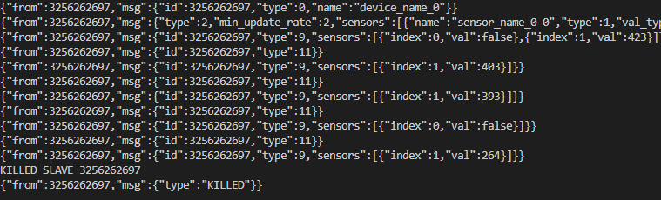
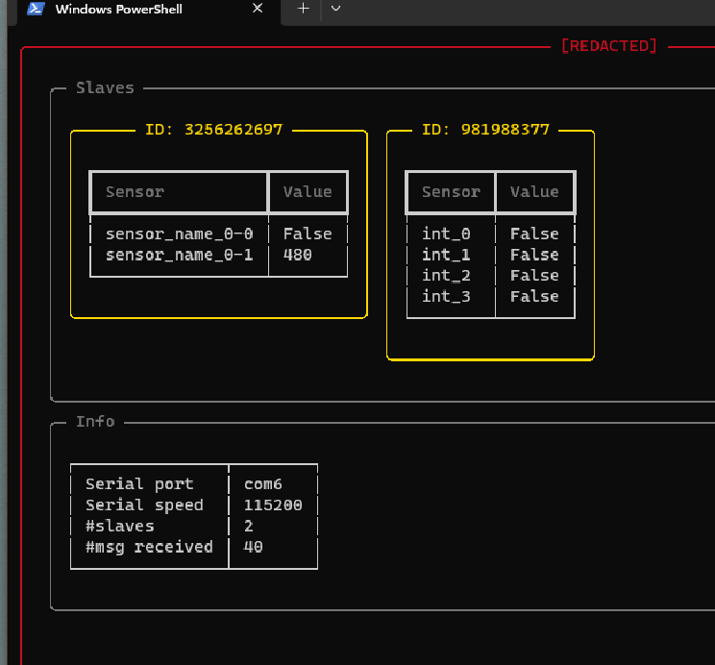
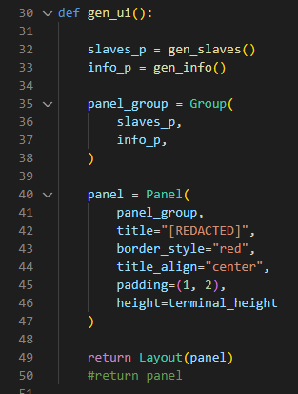
DASH in action

Slide 6
Limitations
Using JSON is convenient but costs (a lot of) memory (especially RAM)
limits the maximum number of sensors per slave
limits the length, complexity and “expressiveness” of messages sent on the mesh
it’s a lot nicer to debug compared to other kinds of representations
Computer applications cannot interface with the data coming from the network
it is limited to being displayed in the terminal via [REDACTED]
Limited sensors selection
no I2C support as of today
sensors (especially analog) are just a raw ADC value, cannot be “transformed” (e.g. from ADC value to temperature)
Only supports sensors, no “outputs”
JSON must be uploaded from a serial port

Slide 7
How DASH could be improved
I2C support
Sensors “post processing” support (e.g. converting raw ADC value to temperature in °C)
[REDACTED] will be able to interface with other applications that can use this data
Support for “output” devices, controllable via [REDACTED] and (possibly) applications connected to it
Support for serial CLI-based commands to edit the device configuration (without uploading the JSON)

