Slide 1
Becoming Fluent in Data (2022)
Welcome
Today: Workflow

Slide 2


Most Essential Software At The Moment
The course uses different software components for learning.
Join: MS Teams
Assignments
Announcements
Discussion
Statistical Software
Integrated Development Environment
- Software to do data
Join: DataCamp
Assignments
Learn & Practice

Slide 3

Make sure
You understand this workflow
Get lectures and exercises from GitHub:
Professional approach: Connect to GitHub Repo and Pull (see Setup Guide)
Also fine at the moment: Click homepage and download manually.
https://github.com/MarcoKuehne/seminars_in_applied_economics

Slide 4
Make sure
You understand this workflow
Get and solve exercises:
Get R Markdown (e.g. R02) from GitHub
https://github.com/MarcoKuehne/seminars_in_applied_economics/tree/main/Exercises
Create a New Script/Project/File in RStudio
Use Starter Code from RXX Markdown to New Script

Slide 5

Make sure
You understand this workflow
Get and solve exercises:
Get R Markdown (e.g. R02) from GitHub
https://github.com/MarcoKuehne/seminars_in_applied_economics/tree/main/Exercises
Create a New Script/Project/File in RStudio
Use Starter Code from RXX Markdown to New Script
Coffee

Slide 6

Make sure
You understand this workflow
Get and solve exercises:
Get R Markdown (e.g. R02) from GitHub
https://github.com/MarcoKuehne/seminars_in_applied_economics/tree/main/Exercises
Create a New Script/Project/File in RStudio
Use Starter Code from RXX Markdown to New Script
Coffee
Frustration

Slide 7

Make sure
You understand this workflow
Get and solve exercises:
Get R Markdown (e.g. R02) from GitHub
https://github.com/MarcoKuehne/seminars_in_applied_economics/tree/main/Exercises
Create a New Script/Project/File in RStudio
Use Starter Code from RXX Markdown to New Script
Coffee
Frustration
Solution

Slide 8
Make sure
You understand this workflow
Get and solve exercises:
Get R Markdown (e.g. R02) from GitHub
https://github.com/MarcoKuehne/seminars_in_applied_economics/tree/main/Exercises
Create a New Script/Project/File in RStudio
Use Starter Code from RXX Markdown to New Script
Coffee
Frustration
Solution
Upload on Microsoft Teams

Slide 9
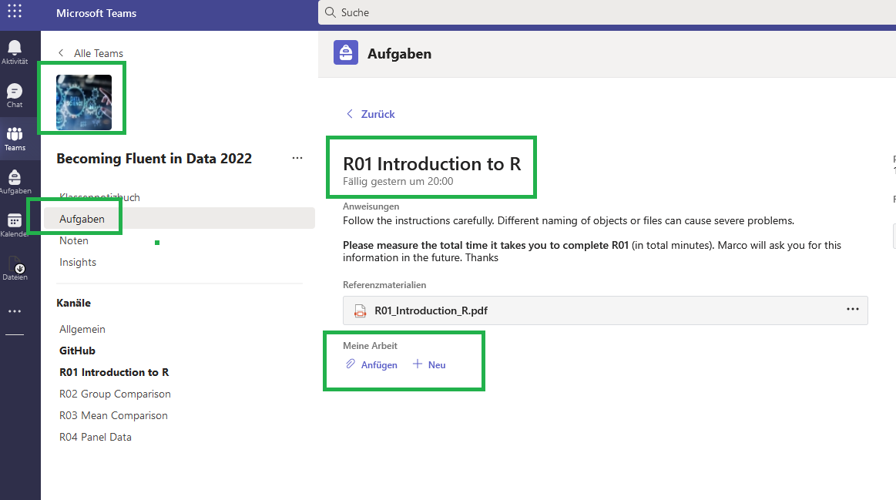
Make sure
You understand this workflow
Upload on Microsoft Teams

Slide 10
Almost setup…don’t worry if you need help live.

