Slide 1
Wrap up interim results on:
setting up and train (Deep)ESN models
decomposing timeseries
ESN_wrapUP_decomosition_and_DeepESN.ipynb
ESN_exp01 .. 05.ipynb

Slide 2
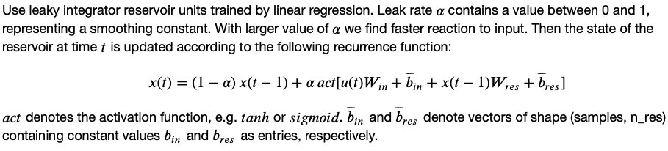
Base ESN – methodology and reservoir transition
(Hyper)parameters:
n_res: number of res. units
sparsity of reservoir connections
spectral radius: max EV of W_{res}
leak rate ⍺ in reservoir transition
activation for reservoir transition
Reservoir states X
(samples, timesteps, n_res)
W_{res}
Dimensions:
W_{in} (input features, n_res)
W_{res} (n_res, n_res)
W_{out} (n_res, output features)
Biases:
b_{in} , b_{res} , b_{out}
W_{in}
W_{out}
Output Y
(samples, output features)
Input U
(samples, timesteps, input features)

Slide 3
Base ESN – methodology and reservoir transition
(Hyper)parameters:
n_res: number of res. units
sparsity of reservoir connections
spectral radius: max EV of W_{res}
leak rate ⍺ in reservoir transition
activation for reservoir transition
Reservoir states X
(samples, timesteps, n_res)
W_{res}
Dimensions:
W_{in} (input features, n_res)
W_{res} (n_res, n_res)
W_{out} (n_res, output features)
Biases:
b_{in} , b_{res} , b_{out}
W_{in}
W_{out}
Output Y
(samples, output features)
Input U
(samples, timesteps, input features)
current timestep‘s input
keep fraction of previous timestep‘s reservoir state
recurrence inside reservoir

Slide 4
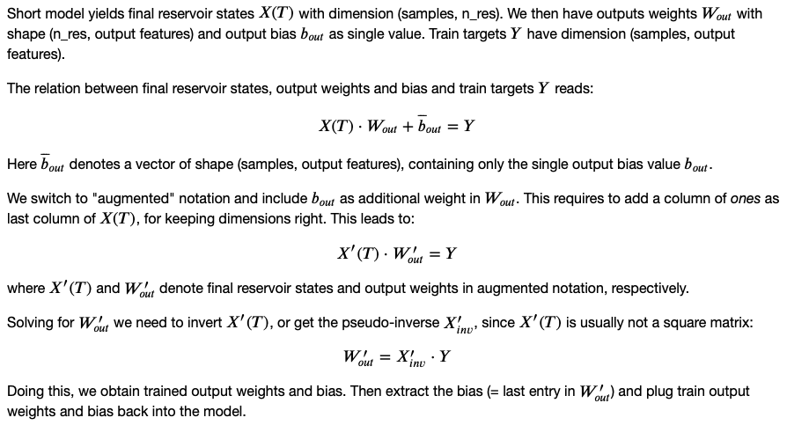
Base ESN – training output weights and bias
Final Reservoir states X(T)
(samples, n_res)
Input U
W_{res}
W_{in}
class / functions:
ESN layer: extends tf.layer
setESN: set up model with scaled W_{res}
trainESN: train W_{out} and b_{out}
predESN: evaluate model performance

Slide 5
From base ESN to Deep ESN
(Hyper)parameters:
n_layers (N): number of reservoirs
n_res: number of res. units
sparsity of reservoir connections
spectral radius: max EV of W_{res}
leak rate ⍺^{l} in reservoir transition
activation for reservoir transition
Reservoir states X¹
Reservoir states X²
Reservoir states X^{N}
W¹_{res}
W²_{res}
W^{N}_{res}
X¹
X^{N-1}
W_{out}
Dimensions:
W¹_{in} (input features, n_res)
W^{l}_{in} (n_res, n_res)
W^{l}_{res} (n_res, n_res)
W_{out} (n_res, output features)
Biases:
b^{l}_{in} , b^{l}_{res} , b_{out}
Inputs i^{l}:
i¹ = U
i^{l} = X^{l-1}
W¹_{in}
W²_{in}
W^{N}_{in}
Input U
Output Y
X¹(T)
Final res. states X¹(T)
X²(T)
Final res. states X²(T)
X^{N}(T)
X^{N}(T)
Concatenate
Reservoir state transition:

Slide 6
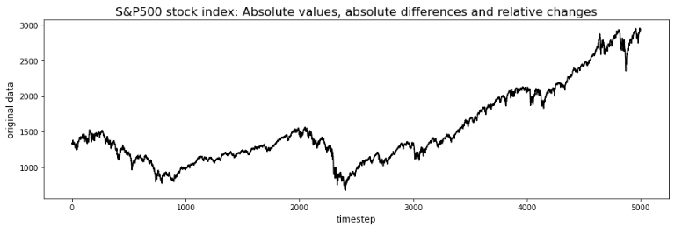
stationary vs. non-stationary
1st step: de-trend timeseries of absolute values
Usually find some long-term exponential trend
Plus series of „bear“ vs. „bull“ markets

Slide 7
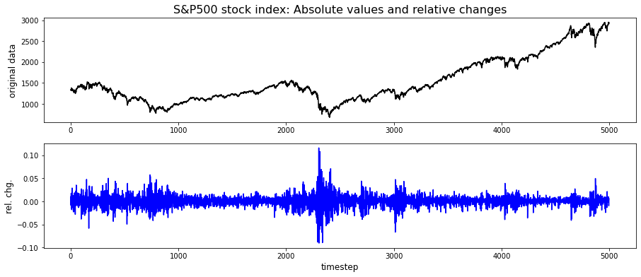
stationary vs. non-stationary
high-volatility regime

Slide 8
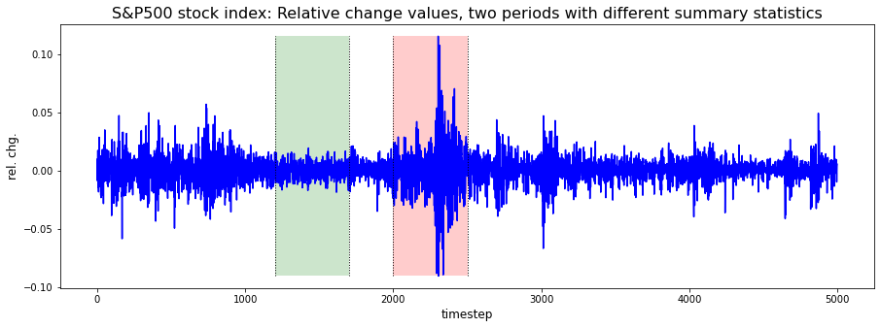
stationary vs. non-stationary
mean: 0.0 0.0
std dev: 0.006 0.022

Slide 9
stationary vs. non-stationary
Discussion on stock price prediction / challenges
Stock market has no (known) seasonality pattern, short term trends don‘t alternate in regular cycle.
Without reliable information of current short term trend, multistep prediction will fail!
Need model to predict „regime shifts“ as events (or classifacation: We are currently in bull or bear market).
Series of relative changes still comes with non-stationary summary statistics. Mean zero, but varying variance over time: high / low volatility regimes.
Stock price movements cannot be predicted from their own history alone (→ random walk).
Require additional information in terms of additional external input features.

Slide 10
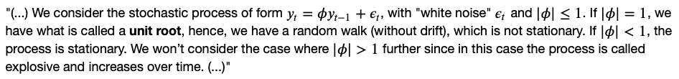
Augmented Dickey-Fuller Test (ADFT)
Statistical test, called „unit root“ test.
Determines, how strongly a timeseries is defined by a trend.
Uses an autoregressive model, optimizes information criterion across multiple different lag values.
Null Hypothesis (H0): Timeseries has unit root, meaning it is non-stationary, has time dependent structure.
Choose confidence level, e.g. 5%.
p-value < 0.05 → reject H0

Slide 11
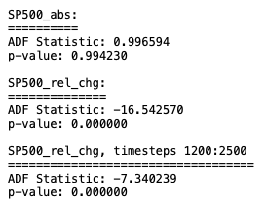
Augmented Dickey-Fuller Test (ADFT)
→ ADFT indicates SP500_rel_chg to be stationary, at least in terms of having „no trend“.
However, still non-stationary, since variance varies over time!

Slide 12
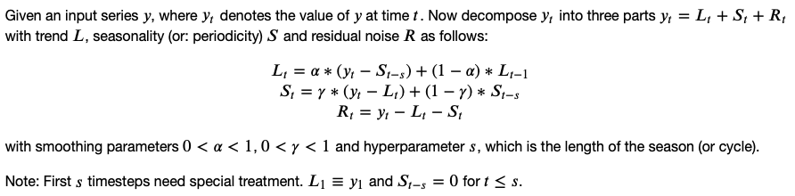
Additive decomposition of timeseries

Slide 13
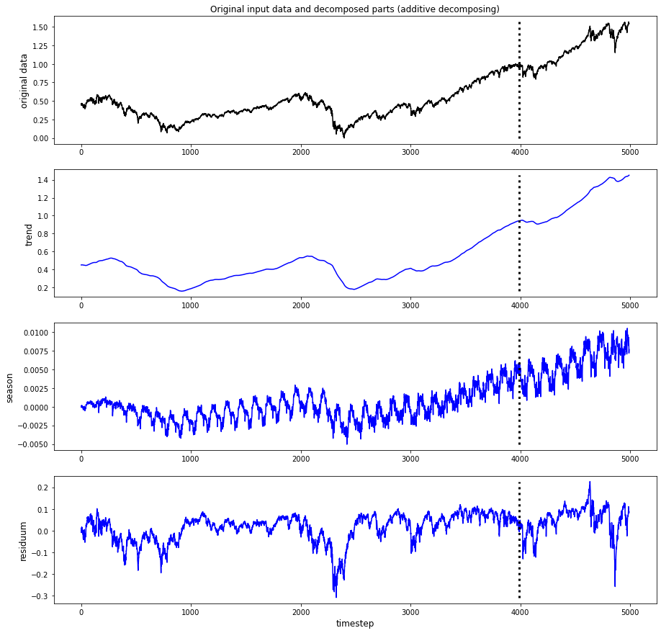
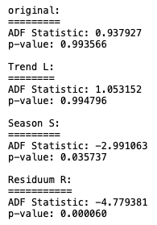
Additive decomposition: SP500
(scaled absolute values)
→ Artefact!
Got smoothing parameters (alpha, gamma) and cycle length (s) from gridsearch optimization, searching lowest p-values for S and R:
alpha = gamma = 0.01, s = 126

Slide 14
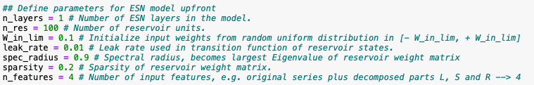
Additive decomposition: SP500
(scaled absolute values)
Find original series and trend L with p-value = 1.
Find season S and residuum R with p-value = 0
Have a good chance to model S and R. But still impossible to predict whole series, as long as we cannot model trend L.
Try: Input original SP500 series plus L, S, R into baseESN (next slide!)

Slide 15
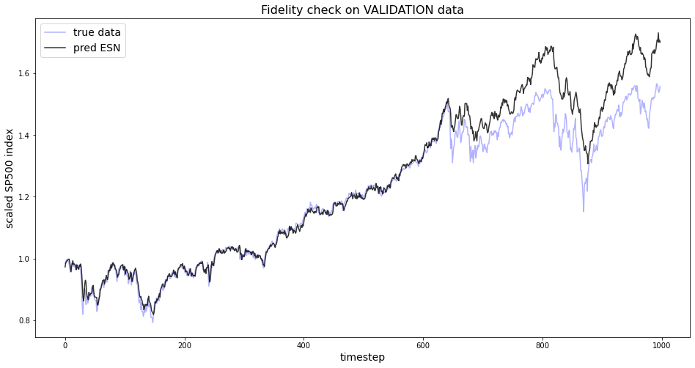
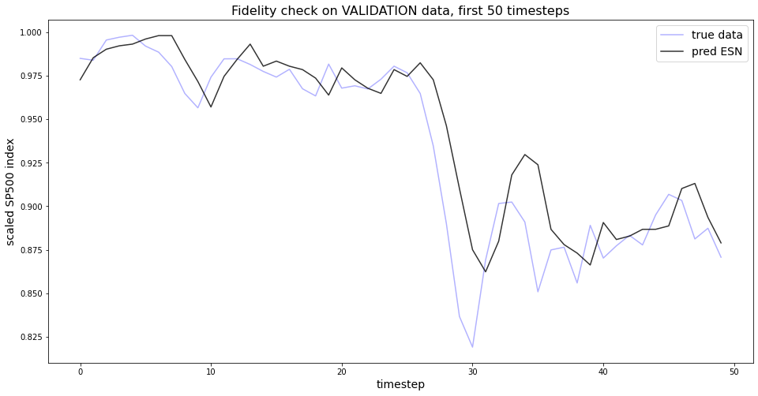
input_length = 10
target_length = 1
find lag (= target_length) between prediction and true values

Slide 16
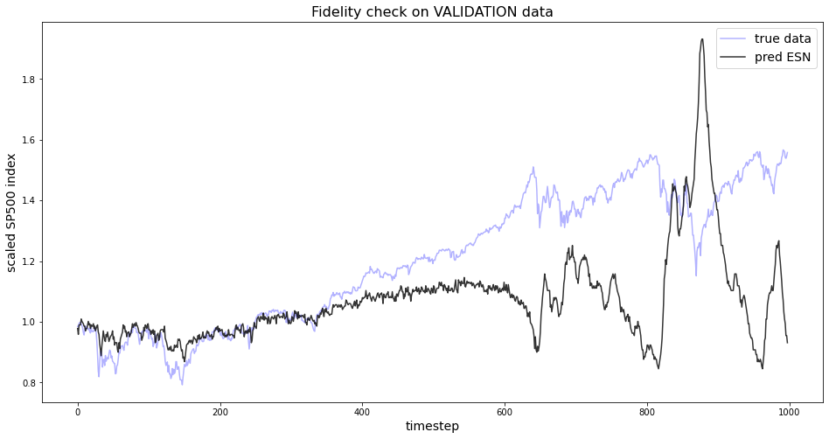
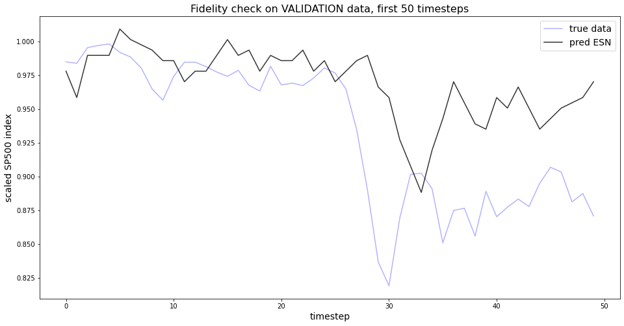
unstable prediction, when it get‘s rough, plus inversion!
input_length = 10
target_length = 3
find lag (= target_length) between prediction and true values

Slide 17
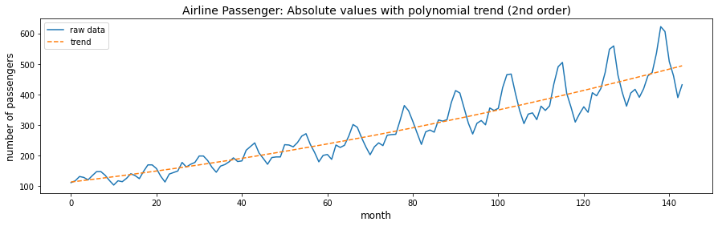
Another example: Airline passengers

Slide 18
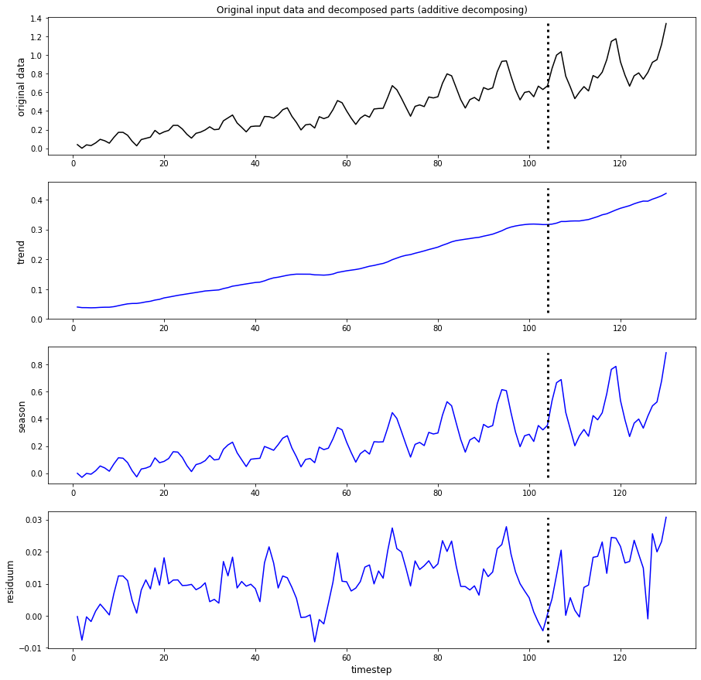
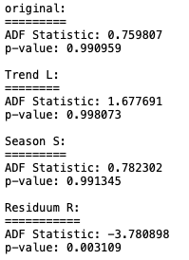
Additive decomposition fails!
orig, L and S with p-value = 1
Got smoothing parameters (alpha, gamma) and cycle length (s) empirically:
alpha = 0.05, gamma = 0.8,
s = 12 (known in this case!)

Slide 19
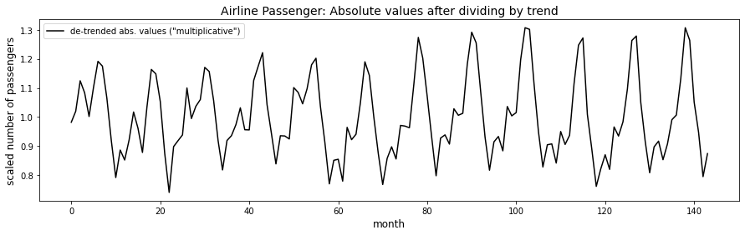
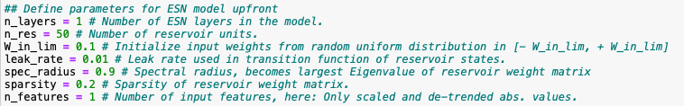
Multiplicative decomposition: Airline passengers
Try: Input scaled to [0,1] de-trended absolute values into baseESN (next slide!)

Slide 20
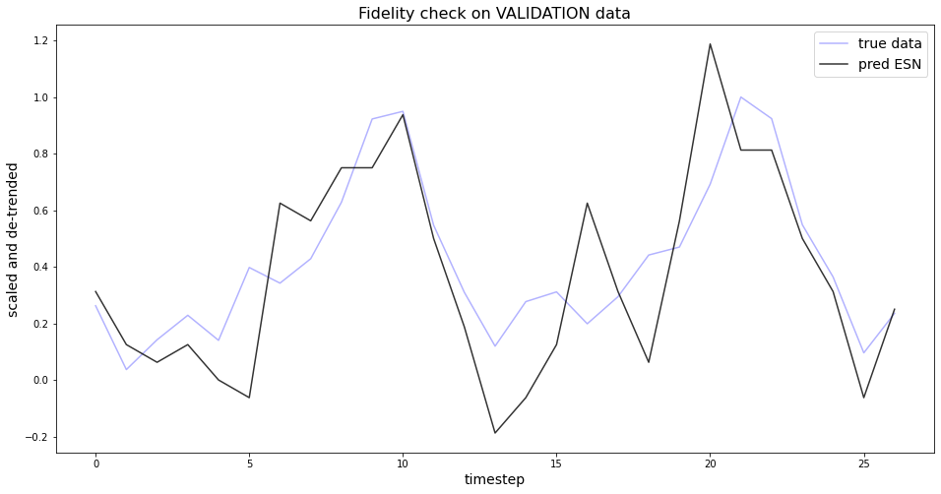
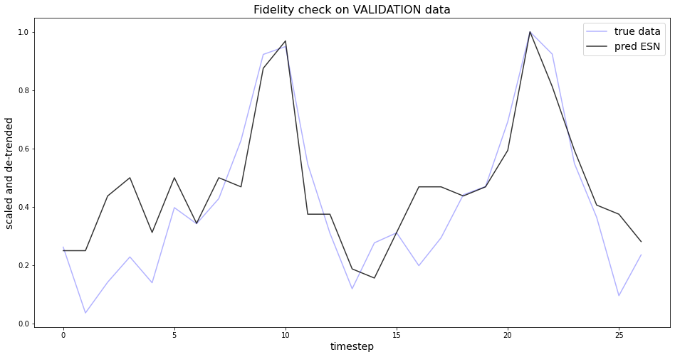
input_length = 10
target_length = 1
→ no lag
input_length = 10
target_length = 3
→ no lag

Slide 21
Discussion on Airline Passengers:
Raw data needs to be de-trended in an appropriate way.
Can then successfully be modelled.
No need for additional (external) information.

Slide 22
Next steps:
tackle real-world problem (ENSO)
pimp functions (trainESN, predESN, gridsearch)

