Slide 1
ESN_exp01.ipynb covers the first systematic view an basic ESNs.
Set up everything manually. But use functional form for preparing inputs, training ESN and prediction.
Here we choose an input length and then use this input length for all input samples in the same training run.
Later tune and play with hyperparameters, input length, number of reservoir units, activation function, scaling of input values, spectral radius.
Agenda
Introduction of base ESN: Setup, initialization of weight matrices, training
Gridsearch on parameters: Number of reservoir units (n_res) vs. Input length
Analyse convergence / divergence of reservoir states for various (hyper-)parameters

Slide 2
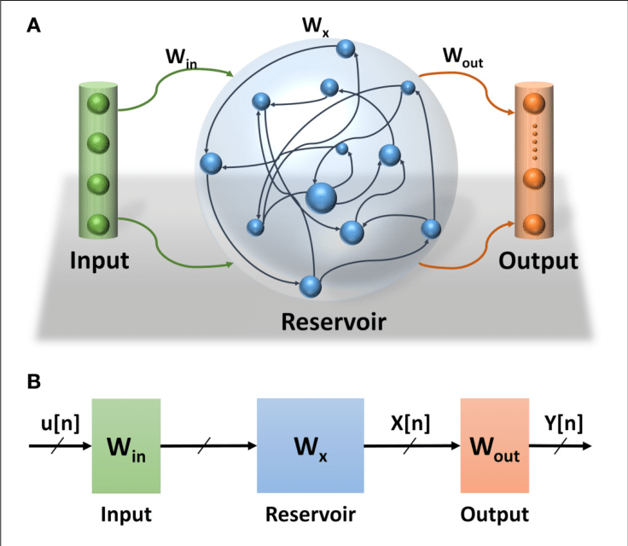
Base ESN setup
One input unit, one output unit
fully connected to n_res reservoir units
Input weights W_in: (n_res x 1)
Output weights W_out: (1 x n_res)
Reservoir weights W_res: (n_res x n_res) → sparse!

Slide 3
Base ESN initialization
W_in: Initialize randomly from uniform distribution, usually set range to [-1,1]
W_res: Choose „spectral radius“, default 1.2, defines largest Eigenvalue of W_res and determines convergence behavior of reservoir states
Start with sparse matrix W_temp (sparsity default: 0.2), initialized randomly from uniform dist. in range [-1,1]
Get largest Eigenvalue max_ev of start matrix W_temp.
Set W_res = spectral_rad * W_temp / max_ev

Slide 4
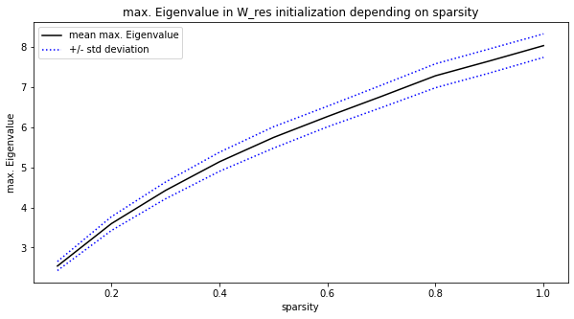
Base ESN initialization
→ max. Eigenvalue used for initialization process of W_res is found in narrow range

Slide 5
Base ESN training
Feed input samples (length T) to network.
Reservoir states x(t) are calculated from current timestep‘s input u(t) and previous reservoir state x(t-1) as follows:
x(t) = activation[W_in * u(t) + W_res * x(t-1)], where ‘activation‘ denotes some function (‚tanh‘, ‚sigmoid‘,…).
Keep final reservoir states for all n_res units for all n_samples training samples in state matrix X: (n_res x n_samples)
Knowing W_out, the output Y is calculated from: Y = W_out * X.
But for training we reverse the relation, since we know training targets Y, but don‘t have W_out, yet: W_out = Y * X⁻¹
X is usually not a square matrix. Getting the „pseudo-inverse“ of X encounters singular value decomposition (SVD).

Slide 6
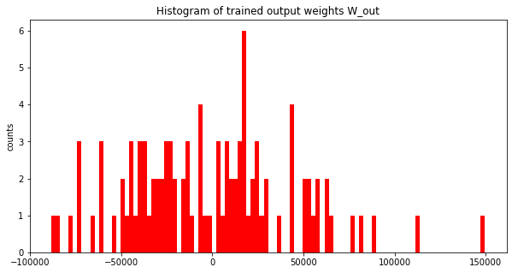
Base ESN training
Question:
How are the output weights distributed?
Do only few weights determine the prediction?
Or are most weights involved, having the prediction as linear combination of many final reservoir states?
Work with standard setting:
working with scaled relativ change values as input
use 'sigmoid' activation
stick to input length 10d, 100 reservoir units, spectral radius 1.2, sparsity 0.2.
→ That really broad range of output weights needs to be further investigated! Expected something in the range [-1,1].

Slide 7
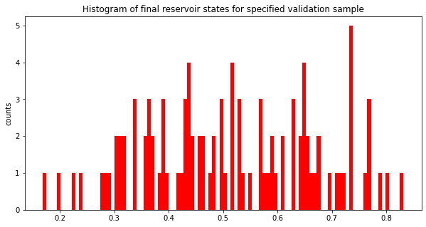
Base ESN training
Show here:
How are the n_res final reservoir states x(T) distributed for a single validation sample?

Slide 8
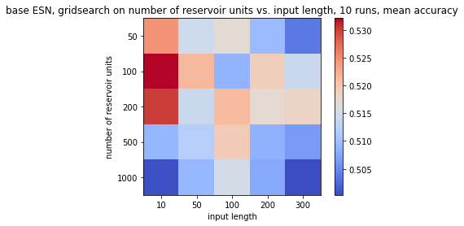
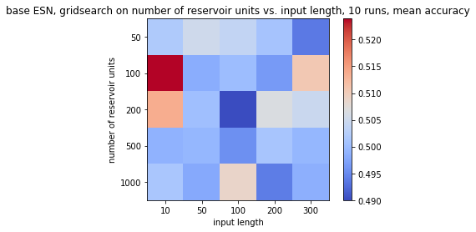
Base Parameters
for gridsearch:
sparsity=0.2
w_in_lim=1.0
spectral_radius = 1.2
target_length=1
time_lag=0
activation='tanh'
Work with scaled relative change values as inputs.
(min/max scaling to [0,1])
Work with un-scaled relative change values as inputs.
→ Find 100 reservoir units with input length 10 steps as optimum, independent of scaling.

Slide 9
Next: analyse „Eche State Property“
Add formal definition plus sketch!

Slide 10
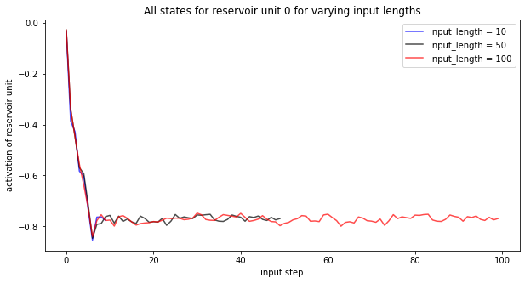
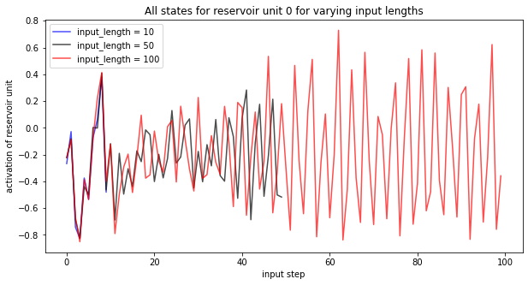
Play with (hyper-)parameters
n_res=100
sparsity=0.2
w_in_lim=1.0
target_length=1
time_lag=0
input_length_grid = [10, 50, 100]
spectral_radius = 1.2 (default)
scaled_YN=True
activation='tanh'
Not stable / reproducible
Or it could mean, that some reservoir units converge while others don‘t. Here we always show the same reservoir unit, but ist behavior changes with different initializations.

Slide 11
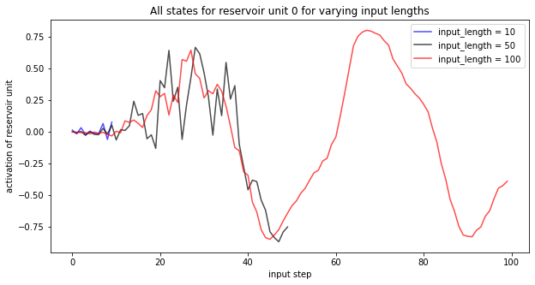
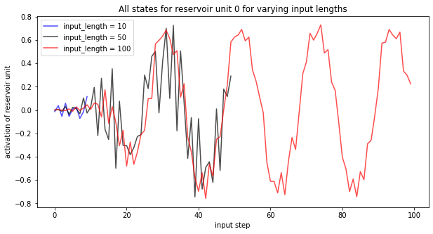
Play with (hyper-)parameters
n_res=100
sparsity=0.2
w_in_lim=1.0
target_length=1
time_lag=0
input_length_grid = [10, 50, 100]
spectral_radius = 1.2 (default)
scaled_YN=False
activation='tanh'
Not stable / but reproducible
So working with un-scaled relative changes leads to some major oscillation patterns

Slide 12
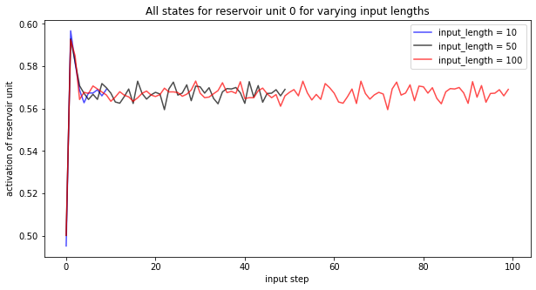
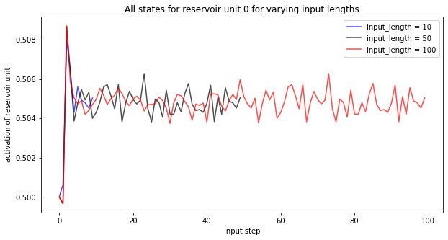
Play with (hyper-)parameters
n_res=100
sparsity=0.2
w_in_lim=1.0
target_length=1
time_lag=0
input_length_grid = [10, 50, 100]
spectral_radius = 1.2 (default)
scaled_YN=False
activation= 'sigmoid'
Stable / reproducible
The combination of un-scaled inputs with sigmoid reservoir transition function reproducibly leads to converging states – after only a few steps

Slide 13
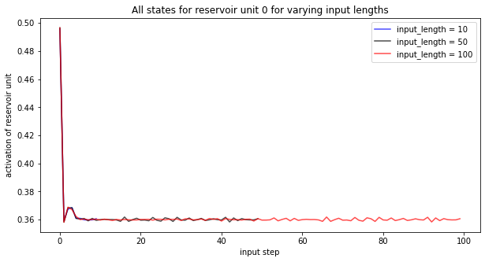
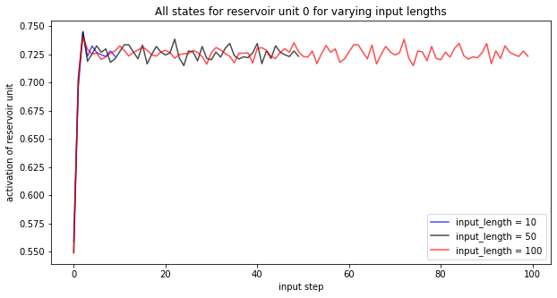
Play with (hyper-)parameters
n_res=100
sparsity=0.2
w_in_lim=1.0
target_length=1
time_lag=0
input_length_grid = [10, 50, 100]
spectral_radius = 1.2 (default)
scaled_YN=True
activation= 'sigmoid'
Best stability: Scaled + sigmoid
Find fast converging reservoir states in a quite narrow range after only a few steps.

Slide 14
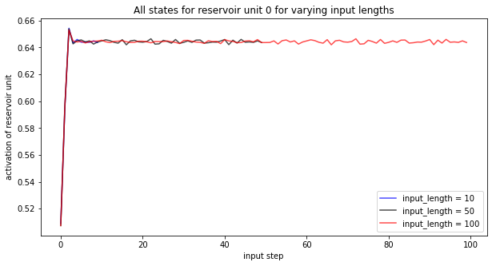
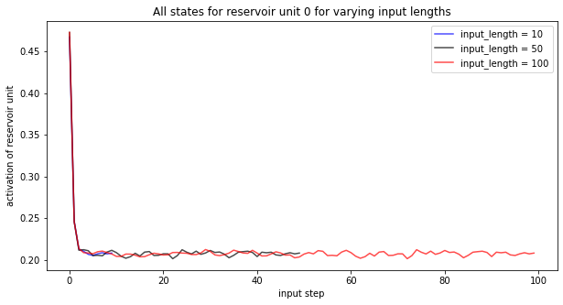
Play with (hyper-)parameters
n_res=100
sparsity=0.2
w_in_lim=1.0
target_length=1
time_lag=0
input_length_grid = [10, 50, 100]
spectral_radius = 1.0
scaled_YN=True
activation= 'sigmoid'
Lowering spectral radius from 1.2 to 1.0 leads to even better convergence behavior, with even smaller range.

Slide 15
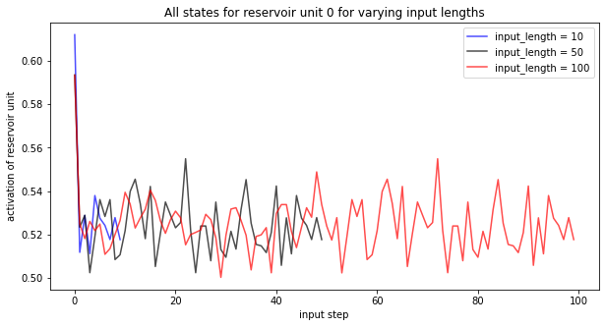
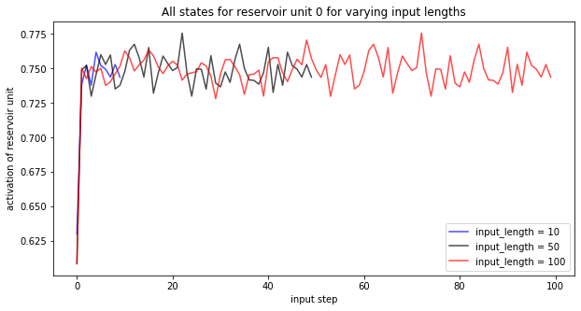
Play with (hyper-)parameters
n_res=100
sparsity=0.2
w_in_lim=1.0
target_length=1
time_lag=0
input_length_grid = [10, 50, 100]
spectral_radius = 0.5
scaled_YN=True
activation= 'sigmoid'
Further lowering spectral radius from 1.0 to 0.5 leads to more noise.

Slide 16
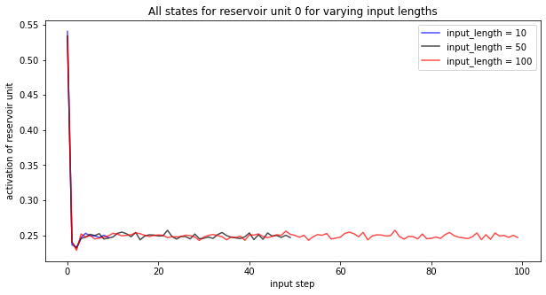
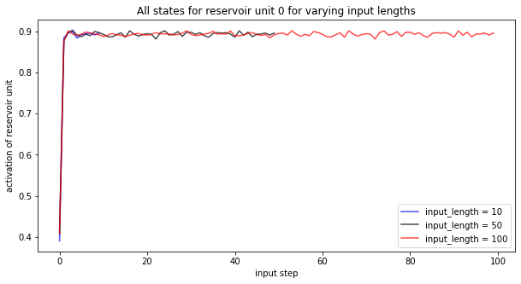
Play with (hyper-)parameters
n_res=100
sparsity=0.2
w_in_lim=1.0
target_length=1
time_lag=0
input_length_grid = [10, 50, 100]
spectral_radius = 2.0
scaled_YN=True
activation= 'sigmoid'
Going into the opposite direction and try larger spectral radius: Reservoir states show very good and stable convergence to narrow range.

Slide 17
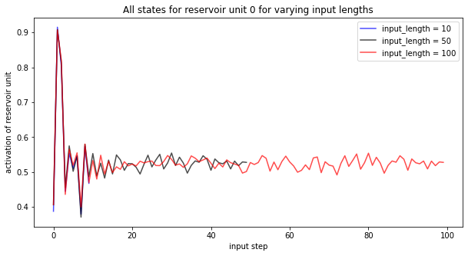
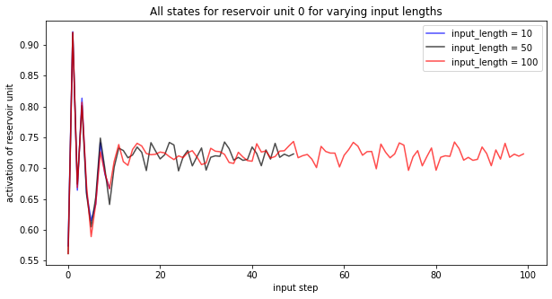
Play with (hyper-)parameters
n_res=100
sparsity=0.2
w_in_lim=1.0
target_length=1
time_lag=0
input_length_grid = [10, 50, 100]
spectral_radius = 5.0
scaled_YN=True
activation= 'sigmoid'
Even larger spectral radius still leads to converging states, however, initial timesteps show damped oscillation.

Slide 18
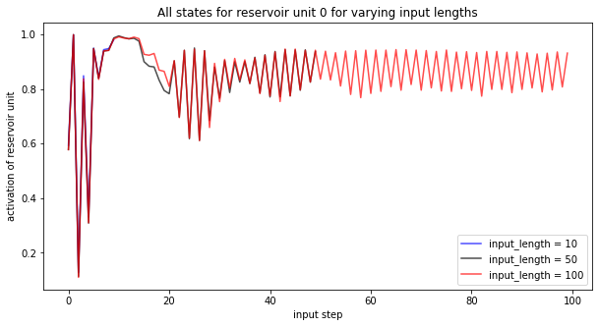
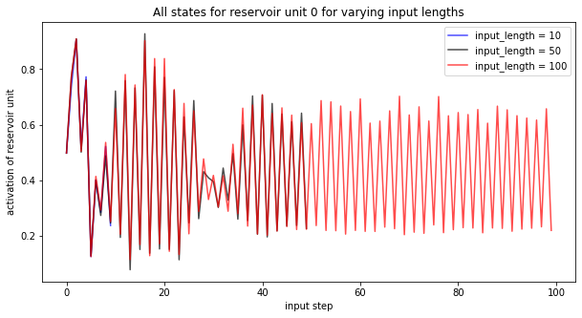
Play with (hyper-)parameters
n_res=100
sparsity=0.2
w_in_lim=1.0
target_length=1
time_lag=0
input_length_grid = [10, 50, 100]
spectral_radius = 10.0
scaled_YN=True
activation= 'sigmoid'
Choosing spectral radius too high destroys convergence, as expected.

Slide 19
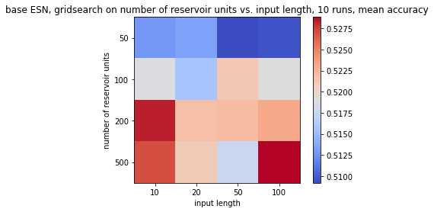
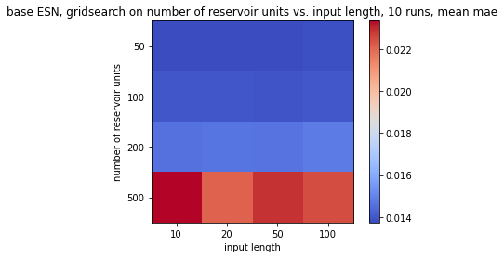
Repeat gridsearch with optimized
scaling, activation and
spectral radius
sparsity=0.2
w_in_lim=1.0
spectral_radius = 1.2
target_length=1
time_lag=0
activation=sigmoid‘
scaled inputs
→ Find 200 reservoir units with input length 10 steps as optimum, in terms of accuracy, taking mae into account.

Slide 20
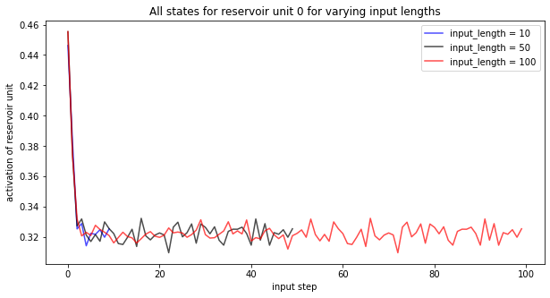
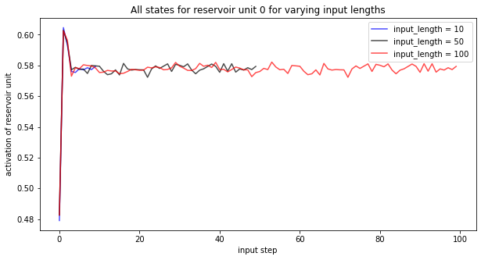
Set „more-or-less“ optimum parameters
and play with SPARSITY:
input_length = 10
n_res=200
w_in_lim=1.0
target_length=1
time_lag=0
spectral_radius = 1.2
scaled_YN=True
activation= 'sigmoid'
Sparsity 0.5 shows best accuracy and mae, but still lousy (acc = 53%). Convergence is not affected significantly.

