Slide 1
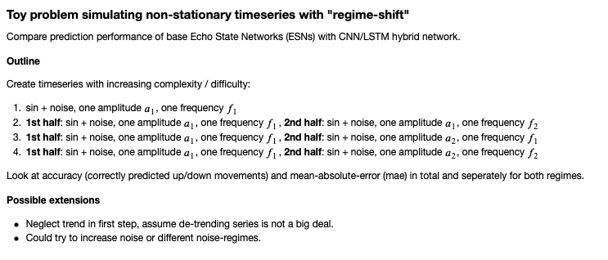
ESN_exp02.ipynb

Slide 2
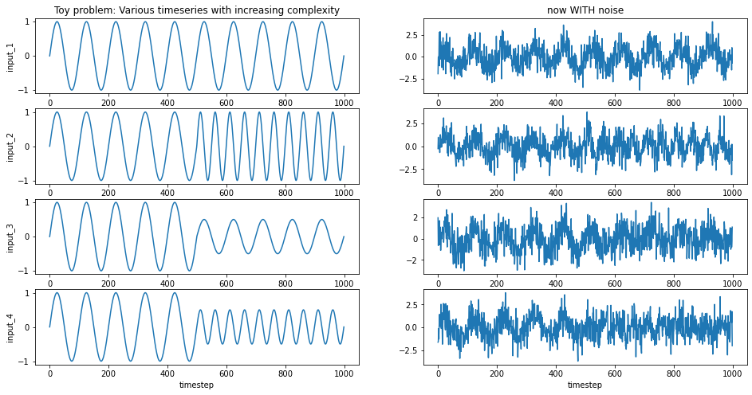

Slide 3
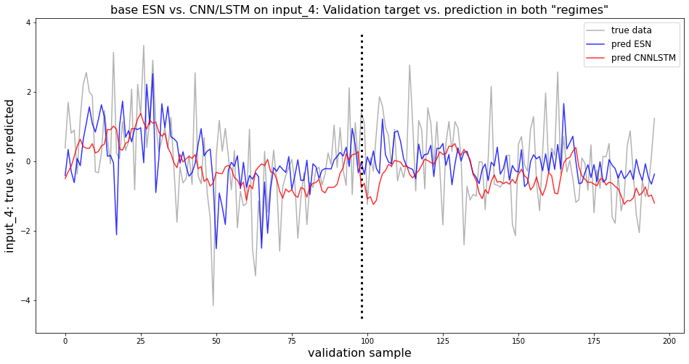
single run experiment for ESN and CNN/LSTM for noise parameter 1.0 on input_4: Two regimes of sin function with different amplitudes AND frequencies.
Note: Took validation samples from BEGINNING and END of toy series.
→ ESN prediction reaches a broader range to better meet the noise amplitude, whereas CNN/LSTM prediction appears in a rather narrow range.

Slide 4
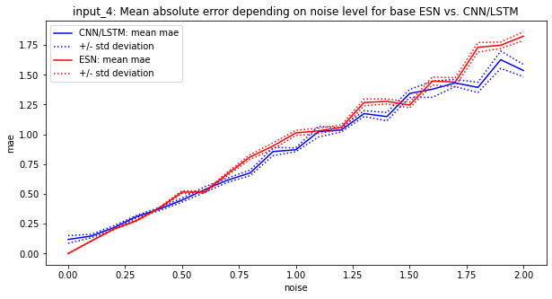
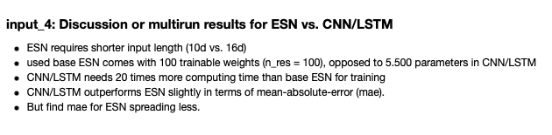
multirun experiment for ESN (20 runs) and CNN/LSTM (10 runs) for noise parameter 0.0 .. 2.0 on input_4: Two regimes of sin function with different amplitudes AND frequencies.

