Slide 1
ESN_exp01.ipynb covers the first systematic view an basic ESNs.
Set up everything manually. But use functional form for preparing inputs, training ESN and prediction.
Here we choose an input length and then use this input length for all input samples in the same training run.
Later tune and play with hyperparameters, input length, number of reservoir units, activation function, scaling of input values, spectral radius.

Slide 2
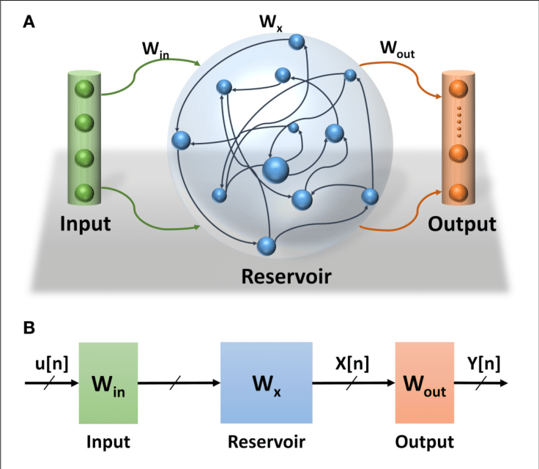
Base ESN setup
One input unit
One output unit
n_res reservoir units
Input weights W_in: (n_res x 1)
Output weights W_out: (1 x n_res)
Reservoir weights W_res: (n_res x n_res)

Slide 3
Base ESN initialization
W_in: Initialize randomly from uniform distribution, usually set range to [-1,1]
W_res: Choose „spectral radius“, default 1.2, determines convergence behavior of reservoir states
Start with sparse matrix W_temp (sparsity default: 0.2), initialized randomly from uniform dist. in range [-1,1]
Get largest Eigenvalue max_ev of start matrix W_temp.
Set W_res = spectral_rad * W_temp / max_ev

Slide 4
Base ESN training
Feed input samples (length T) to network.
Reservoir states x(t) are calculated from current timestep‘s input u(t) and previous reservoir state x(t-1) as follows:
x(t) = activation[W_in * u(t) + W_res * x(t-1)], where ‘activation‘ denotes some function (‚tanh‘, ‚sigmoid‘,…).
Keep final reservoir states for all n_res units for all n_samples training samples in state matrix X: (n_res x n_samples)
Knowing W_out, the output Y is calculated from: Y = W_out * X.
But for training we reverse the relation, since we know training targets Y, but don‘t have W_out, yet: W_out = Y * X⁻¹
X is usually not a square matrix. Getting the „pseudo-inverse“ of X encounters singular value decomposition (SVD).

Slide 5
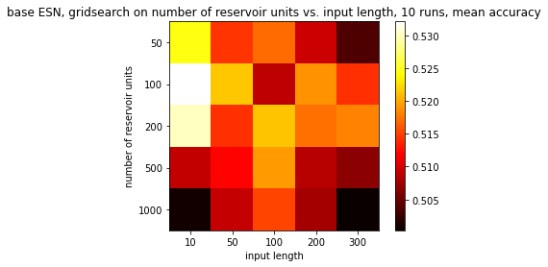
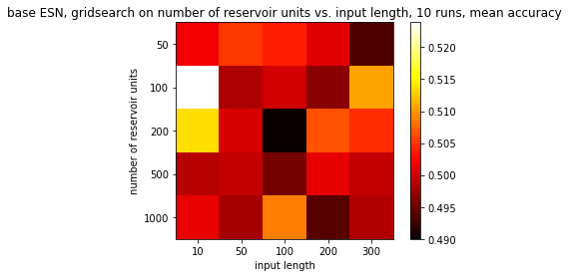
Base Parameters
for gridsearch:
sparsity=0.2
w_in_lim=1.0
spectral_radius = 1.2
target_length=1
time_lag=0
activation='tanh'
Work with scaled relative change values as inputs.
(min/max scaling to [0,1])
Work with un-scaled relative change values as inputs.
→ Find 100 reservoir units with input length 10 steps as optimum, independent of scaling.

Slide 6
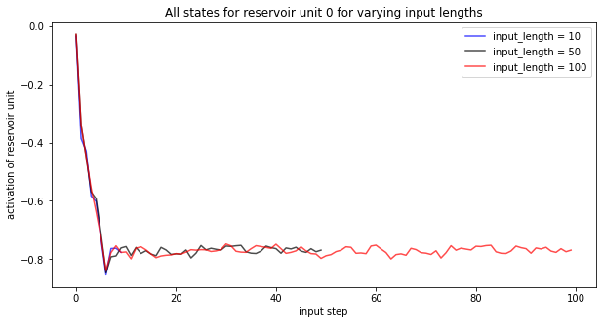
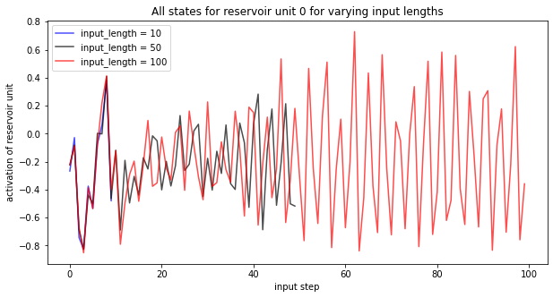
Play with (hyper-)parameters
n_res=100
sparsity=0.2
w_in_lim=1.0
target_length=1
time_lag=0
input_length_grid = [10, 50, 100]
spectral_radius = 1.2 (default)
scaled_YN=True
activation='tanh'
Not stable / reproducible
Or it could mean, that some reservoir units converge while others don‘t. Here we always show the same reservoir unit, but ist behavior changes with different initializations.

Slide 7
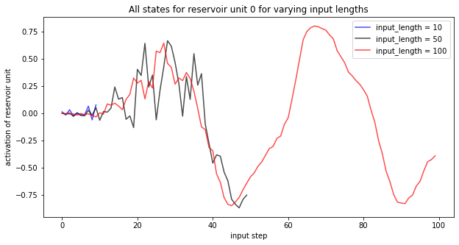
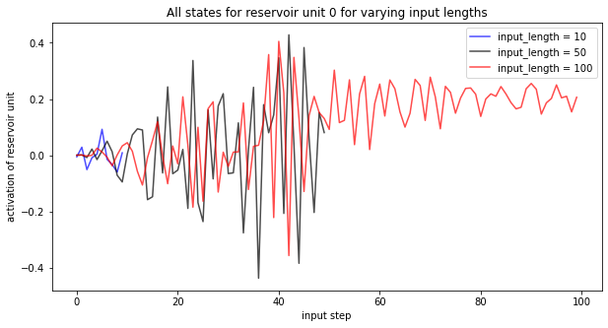
Play with (hyper-)parameters
n_res=100
sparsity=0.2
w_in_lim=1.0
target_length=1
time_lag=0
input_length_grid = [10, 50, 100]
spectral_radius = 1.2 (default)
scaled_YN=False
activation='tanh'
Not stable / reproducible
So working with scaled relative changes doesn‘t change characteristic behavior.

Slide 8
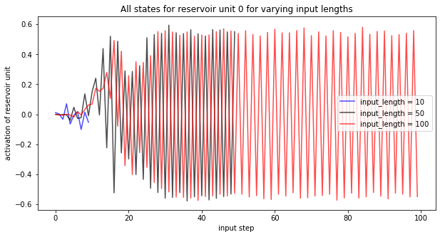
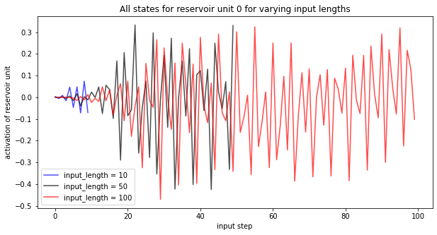
Play with (hyper-)parameters
n_res=100
sparsity=0.2
w_in_lim=1.0
target_length=1
time_lag=0
input_length_grid = [10, 50, 100]
spectral_radius = 1.2 (default)
scaled_YN=False
activation= 'sigmoid'
Not stable / reproducible
The combination of un-scaled inputs with sigmoid reservoir transition function seems to disturb convergence. Only find heavily fluctuating states.

Slide 9
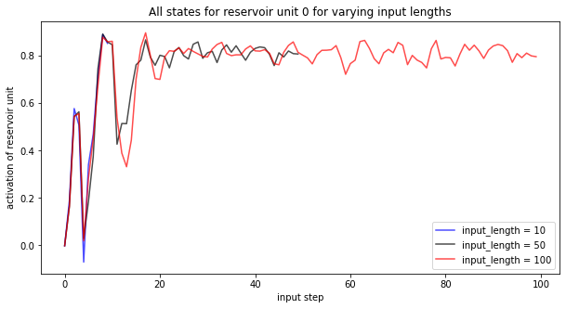
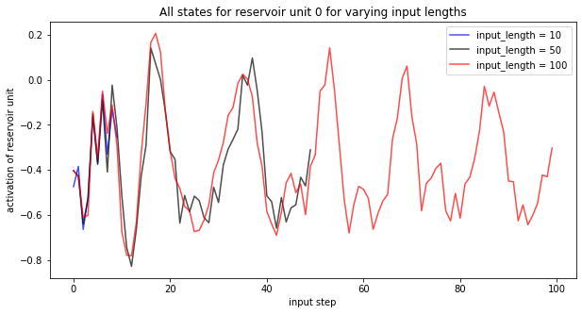
Play with (hyper-)parameters
n_res=100
sparsity=0.2
w_in_lim=1.0
target_length=1
time_lag=0
input_length_grid = [10, 50, 100]
spectral_radius = 1.2 (default)
scaled_YN=True
activation= 'sigmoid'
Best stability: Scaled + sigmoid
Find either fast converging reservoir states or at least the tendency to lower amplitudes with increasing input length.

Slide 10
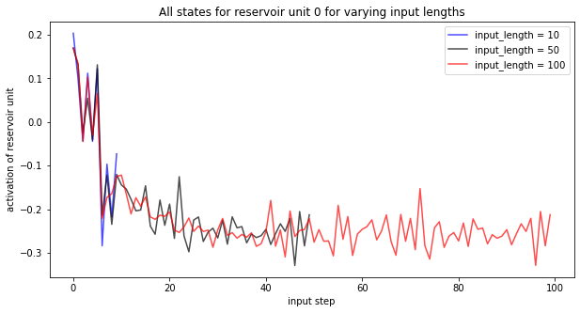
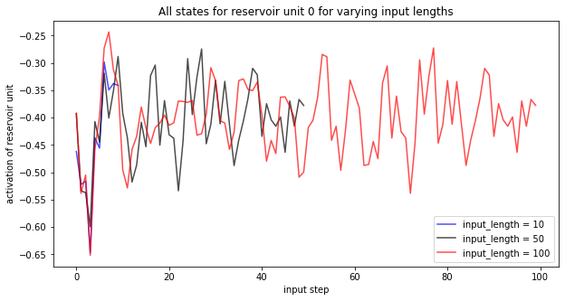
Play with (hyper-)parameters
n_res=100
sparsity=0.2
w_in_lim=1.0
target_length=1
time_lag=0
input_length_grid = [10, 50, 100]
spectral_radius = 1.0
scaled_YN=True
activation= 'sigmoid'
Still fluctuating
Now lowering spectral_radius: Reservoir states can still show heavy fluctuation.

Slide 11
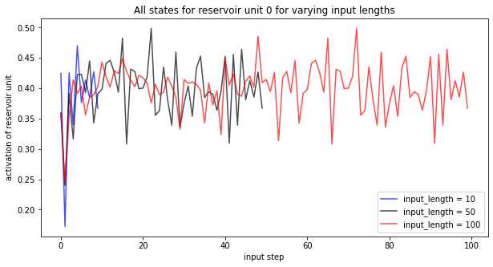
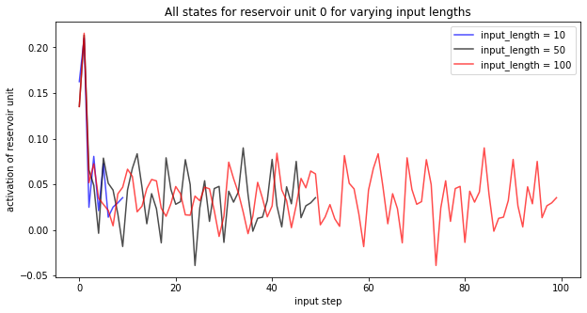
Play with (hyper-)parameters
n_res=100
sparsity=0.2
w_in_lim=1.0
target_length=1
time_lag=0
input_length_grid = [10, 50, 100]
spectral_radius = 0.5
scaled_YN=True
activation= 'sigmoid'
Fluctuating, but narrow range
Further lowering spectral_radius narrows the fluctuation range.

Slide 12
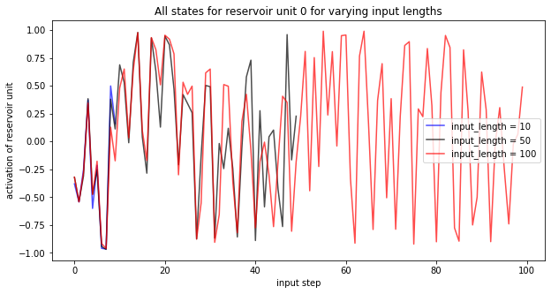
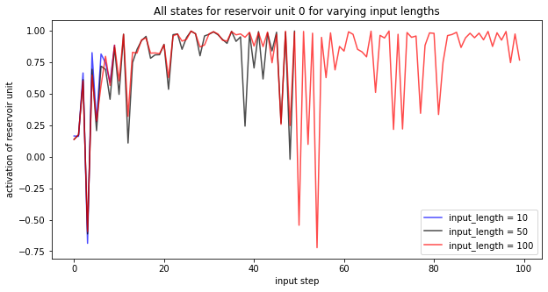
Play with (hyper-)parameters
n_res=100
sparsity=0.2
w_in_lim=1.0
target_length=1
time_lag=0
input_length_grid = [10, 50, 100]
spectral_radius = 2.0
scaled_YN=True
activation= 'sigmoid'
The opposite holds true for larger spectral radius: Now reservoir states heavily fluctuate without any convergence tendency.

