Slide 1
Summarize results on:
setting up and train (Deep)ESN models
application: ENSO index
outlook: Agglomerative Relevance
ESN_exp06_ENSO.ipynb
ESN_exp07_AggRel.ipynb

Slide 2
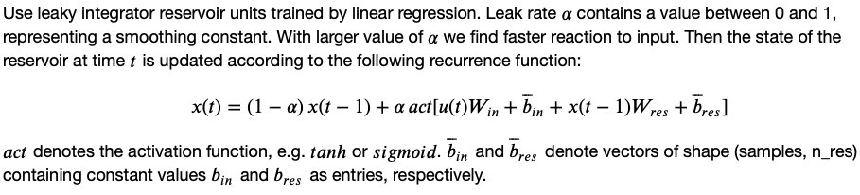
Base ESN – methodology and reservoir transition
(Hyper)parameters:
n_res: number of res. units
sparsity of reservoir connections
spectral radius: max EV of W_{res}
leak rate ⍺ in reservoir transition
activation for reservoir transition
Reservoir states X
(samples, timesteps, n_res)
W_{res}
Dimensions:
W_{in} (input features, n_res)
W_{res} (n_res, n_res)
W_{out} (n_res, output features)
Biases:
b_{in} , b_{res} , b_{out}
W_{in}
W_{out}
Output Y
(samples, output features)
Input U
(samples, timesteps, input features)

Slide 3
Base ESN – methodology and reservoir transition
(Hyper)parameters:
n_res: number of res. units
sparsity of reservoir connections
spectral radius: max EV of W_{res}
leak rate ⍺ in reservoir transition
activation for reservoir transition
Reservoir states X
(samples, timesteps, n_res)
W_{res}
Dimensions:
W_{in} (input features, n_res)
W_{res} (n_res, n_res)
W_{out} (n_res, output features)
Biases:
b_{in} , b_{res} , b_{out}
W_{in}
W_{out}
Output Y
(samples, output features)
Input U
(samples, timesteps, input features)
current timestep‘s input
keep fraction of previous timestep‘s reservoir state
recurrence inside reservoir

Slide 4
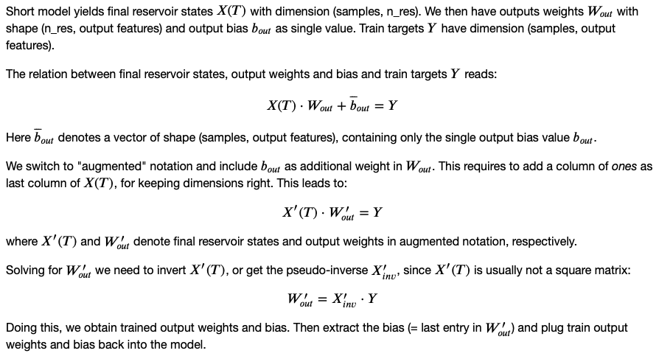
Base ESN – training output weights and bias
Final Reservoir states X(T)
(samples, n_res)
Input U
W_{res}
W_{in}
class / functions:
ESN layer: extends tf.layer
setESN: set up model with scaled W_{res}
trainESN: train W_{out} and b_{out}
predESN: evaluate model performance

Slide 5
From base ESN to Deep ESN
(Hyper)parameters:
n_layers (N): number of reservoirs
n_res: number of res. units
sparsity of reservoir connections
spectral radius: max EV of W_{res}
leak rate ⍺^{l} in reservoir transition
activation for reservoir transition
Reservoir states X¹
Reservoir states X²
Reservoir states X^{N}
W¹_{res}
W²_{res}
W^{N}_{res}
X¹
X^{N-1}
W_{out}
Dimensions:
W¹_{in} (input features, n_res)
W^{l}_{in} (n_res, n_res)
W^{l}_{res} (n_res, n_res)
W_{out} (n_res, output features)
Biases:
b^{l}_{in} , b^{l}_{res} , b_{out}
Inputs i^{l}:
i¹ = U
i^{l} = X^{l-1}
W¹_{in}
W²_{in}
W^{N}_{in}
Input U
Output Y
X¹(T)
Final res. states X¹(T)
X²(T)
Final res. states X²(T)
X^{N}(T)
X^{N}(T)
Concatenate
Reservoir state transition:

Slide 6
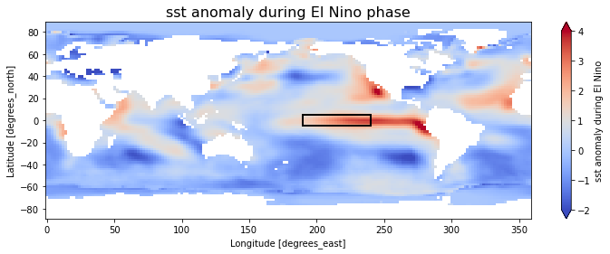
El Niño Southern Oscillation (ENSO)
Use Nino3.4 box (5°N–5°S, 120–170°W) in the tropical Pacific to diagnose ENSO from sea-surface temperature (SST) anomalies.
SST data: https://downloads.psl.noaa.gov/Datasets/noaa.ersst.v5/sst.mnmean.nc
Provides monthly mean SST from 1854 to now in 2° by 2° lat/lon grid
Start from 1880
Calaculate ENSO index:
Compute area averaged total SST from Niño 3.4 region
Compute monthly climatology (e.g., 1950-1979) for area averaged total SST from Niño 3.4 region, and subtract climatology from area averaged total SST time series to obtain anomalies
Smooth and normalize

Slide 7
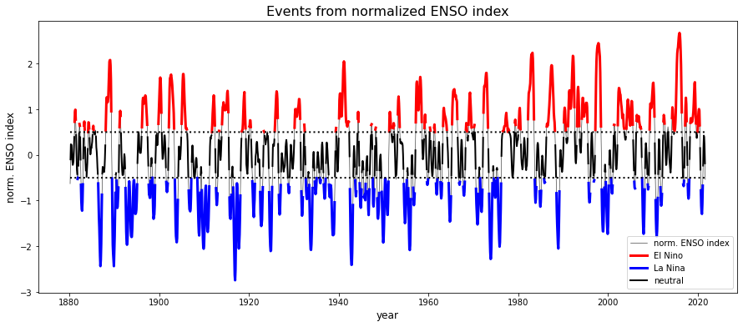
El Niño Southern Oscillation (ENSO)

Slide 8
El Niño Southern Oscillation (ENSO)
Work with un-scaled ENSO index and stick to ‚sigmoid‘ activation.
Still have many (hyper-)parameters to be optimized:
input_length: Number of timesteps per input sample.
n_res: Number of reservoir units.
W_in_lim: Initialize input weights from random distribution in [-W_in_lim, +W_in_lim]
leak_rate: Leak rate used in transition function of reservoir states.
spec_radius: Spectral radius, becomes largest Eigenvalue of reservoir weight matrix
sparsity: Sparsity of reservoir weight matrix.
Instead of gridsearch, use some form of gradient descent to find optimal parameters for specified target_length.
Simple comparision: gridsearch on 6 parameters with e.g. 10 disctings steps for each parameter means to try on 10⁶ = 1.000.000 possible parameter settings.
For gradient descent with e.g. 20 iterations on 6 parameters (up/down for each parameter individually) plus adjusted setting (all parameters adjusted simultaneously) requires 20 x (6 x 2 + 1) = 260 possibilities.

Slide 9
Gradient Descent Optimization for base ESN on ENSO index
Outline of algorithm:
Set range for each parameter (parameter_min / _max): Optimization is only performed within chosen range.
Set initial parameter values within specified range (parameter_base).
Set step size for each parameter used over the whole optimization process (parameter_step).
Set n_iterations, as maximal number of optimization iterations.
Set n_runs, defining how many runs we average over in each iteration, to achieve stable metrics and gradients.
Start iterating:
Get mse for base parameter setting on train data.
Modify each parameter individually (up and down), get mse for modification.
Estimate gradients for each parameter, when modifying parameter up / down.
Modify parameter setting according to gradients for all parameters (if possible).
Early stop iteration process when all parameters are left unchanged.

Slide 10
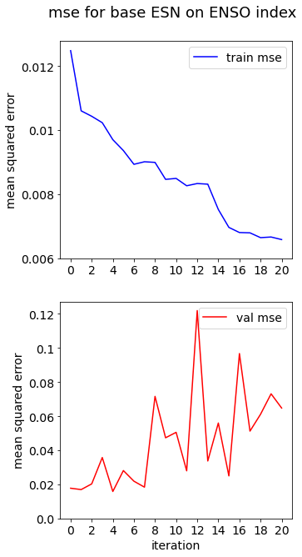
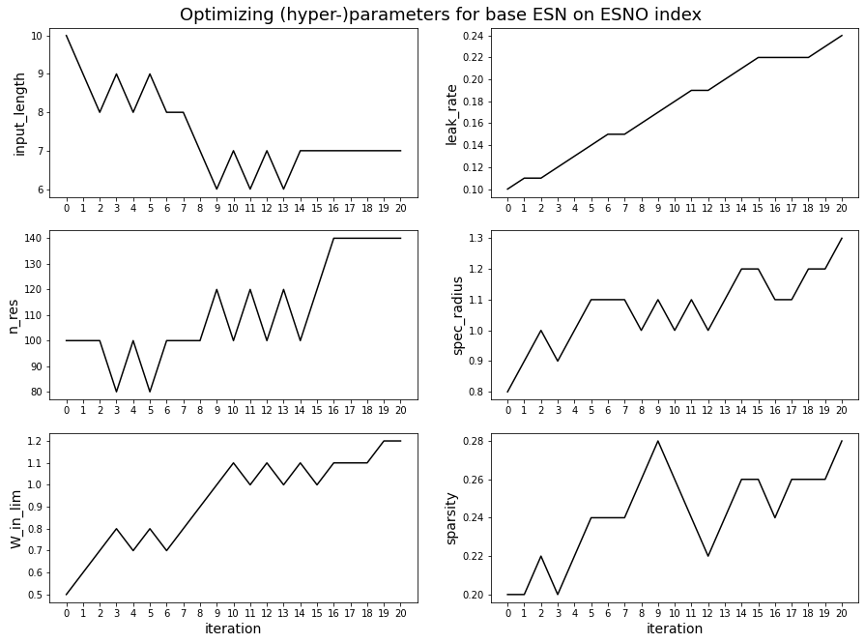
Gradient Descent Optimization for base ESN on ENSO index (target_length = 1, un-scaled, ‚sigmoid‘ activation)

Slide 11
Gradient Descent Optimization for base ESN on ENSO index (target_length = 1, un-scaled, ‚sigmoid‘ activation)
Need early-stopping to avoid overfitting!

Slide 12
Gradient Descent Optimization for base ESN on ENSO index
optimized (hyper-)parameters
target_length → | 1 | 2 | 3 | 6 | 12
input_length | 10 | 11 | 11 | 21 | 16
n_res | 100 | 180 | 160 | 240 | 160
W_in_lim | 0.9 | 1.1 | 1.0 | 1.2 | 0.9
leak_rate | 0.15 | 0.16 | 0.13 | 0.14 | 0.10
spec_radius | 1.1 | 1.6 | 1.1 | 1.3 | 1.0
sparsity | 0.2 | 0.2 | 0.2 | 0.25 | 0.15
stop iteration | 9 | 11 | 9 | 11 | 4

Slide 13
Gradient Descent Optimization for base ESN on ENSO index
optimized (hyper-)parameters
target_length → | 1 | 2 | 3 | 6 | 12
input_length | 10 | 11 | 11 | 21 | 16
n_res | 100 | 180 | 160 | 240 | 160
W_in_lim | 0.9 | 1.1 | 1.0 | 1.2 | 0.9
leak_rate | 0.15 | 0.16 | 0.13 | 0.14 | 0.10
spec_radius | 1.1 | 1.6 | 1.1 | 1.3 | 1.0
sparsity | 0.2 | 0.2 | 0.2 | 0.25 | 0.15
stop iteration | 9 | 11 | 9 | 11 | 4
For target 1..3 months, input one year is sufficient.

Slide 14
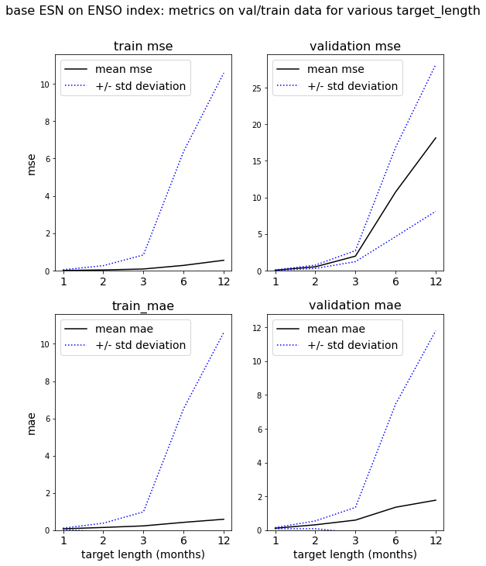
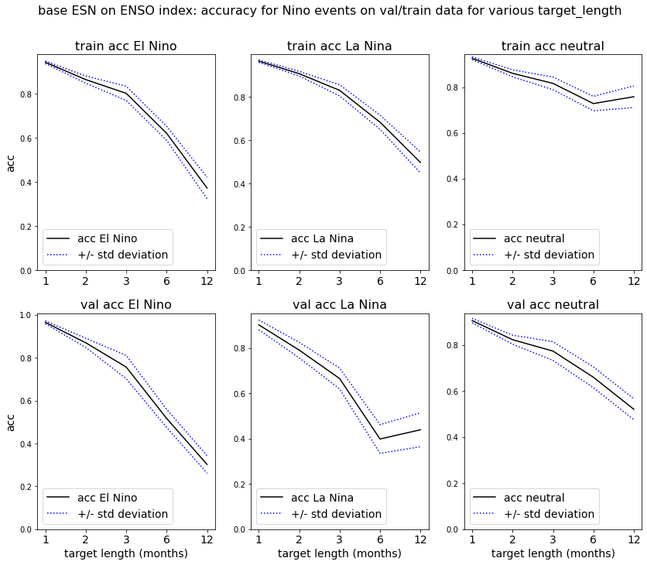
Evaluation metrics and accuracy for base ESN on ENSO index
optimized (hyper-)parameters*⁾
*⁾ slightly modified

Slide 15
Evaluation metrics and accuracy for base ESN on ENSO index
optimized (hyper-)parameters*⁾
*⁾ slightly modified
Careful: x-axis is compressed here!

Slide 16
Evaluation metrics and accuracy for base ESN on ENSO index
optimized (hyper-)parameters*⁾
*⁾ slightly modified
→ Works fine for short target length up to 3 months!

Slide 17
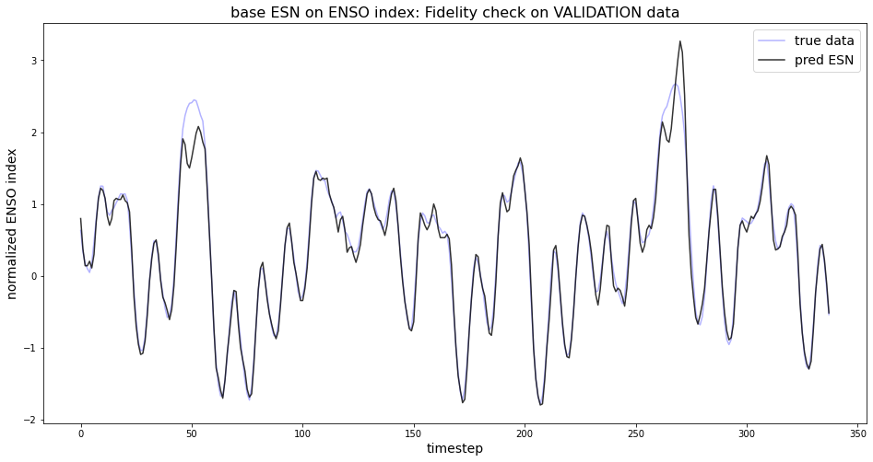
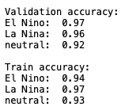
Fidelity check for base ESN on ENSO index
target_length = 1 month

Slide 18
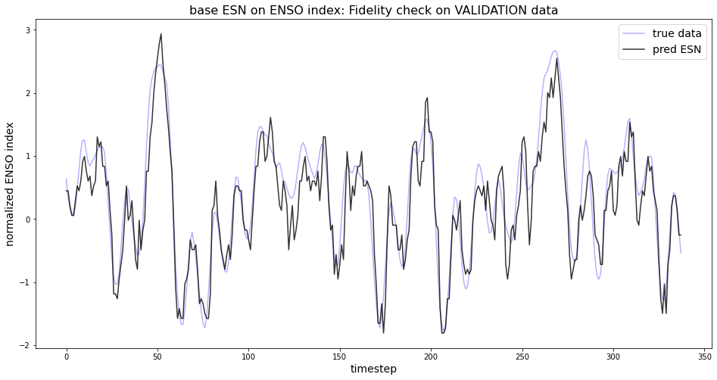
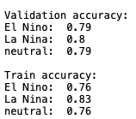
Fidelity check for base ESN on ENSO index*⁾
target_length = 3 months
*⁾ scaled inputs for stability reasons

Slide 19
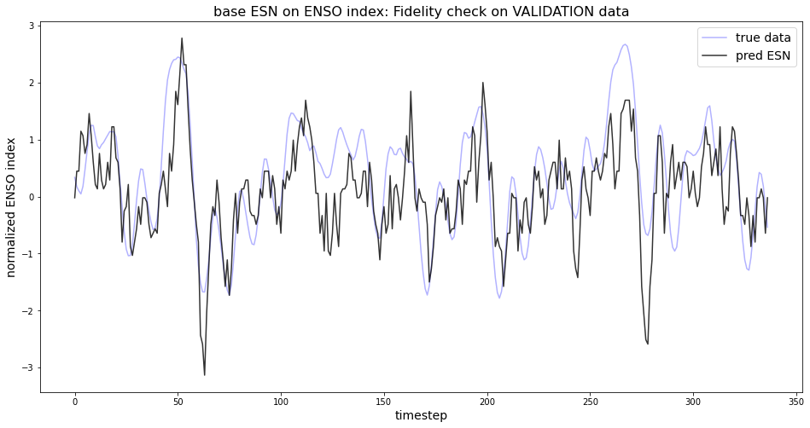
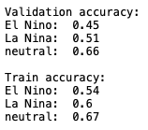
Fidelity check for base ESN on ENSO index*⁾
target_length = 6 months
*⁾ scaled inputs for stability reasons

Slide 20
Discussion on Gradient Descent Optimization
Very fast optimization (compared to gridsearch over ALL possible parameter combinations).
Observe that we get back some problems from training ANNs, when we apply gradient descent optimization:
overfitting: train_mse decreases while val_mse starts to rise or even explodes. Force early stopping!
Can be stuck in local minimum of parameter space.
Challenge: How to find „suitable“ initial parameters? (see paper [Öztürk et al., 2020], they use fisher maximation)
Some optional next steps to keep in mind:
Check: Do multiple runs leed to comparable/similar optimal parameters? (--> Reproducibility desired!)
One could try to extend the optimization algorithm to DeepESN models: Further parameter n_layers.
Could think of adding some form of momentum, like in ADAM optimizer.

Slide 21
Summary and Outlook
Predicting ENSO index from its own history alone is limited to very short target lengths.
Need additional input features for long-term predictions.
Or try idea – inspired by LRP paper („Physically Interpretable Neural Networks for the Geosciences: Applications to Earth System Variability“)
Take increasing number of gridpoints from SST field as input. Focus on extended Nino region, to limit number of gridpoints.
Start with gridpoint that (alone) leeds to highest acccuracy on predicting El Nino / La Nina events.
Add further gridpoint and keep the first (vs. look for the two gridpoints) providing highest accuracy („agglomerative relevance“).
Look at variance in time for gridpoints of SST anomaly. Expect highest variance in Nino region. Question: Are these gridpoints with highest variance also most relevant for predicting ENSO index?

Slide 22
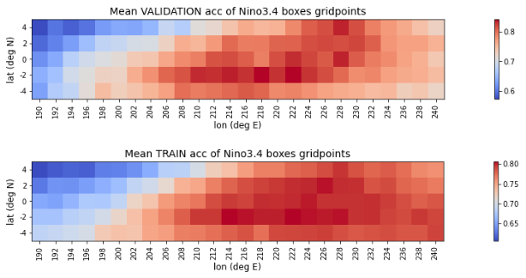
First attempt: Agglomerative Relevance
Looked for single sst timeseries that best predicts sst anomaly (= Nino events)
Only considered gridpoints from Nino3.4 box.
target_length = 1

Slide 23
Sources
[Kim & King, 2020] „Time series prediction using deep echo state networks“
[Toms et al., 2019] „Physically Interpretable Neural Networks for the Geosciences: Applications to Earth System Variability“
[Hassanibesheli et al., 2021] „Echo-State Networks for Predicting ENSO Beyond One Year“
[Öztürk et al., 2020] „Optimizing echo state network through a novel fisher maximization based stochastic gradient descent“

