Slide 1
Summarize results on:
Classification of sst anomaly fields (ENSO)
Layer-wise relevance propagation (LRP)
ESN_exp08_LRP.ipynb .. ESN_exp08_LRP_part5.ipynb
ESN_exp09_Classification_LRP.ipynb

Slide 2
Base ESN – methodology and reservoir transition
(Hyper)parameters:
n_res: number of res. units
sparsity of reservoir connections
spectral radius: max EV of W_{res}
leak rate ⍺ in reservoir transition
activation for reservoir transition
Reservoir states X
(samples, timesteps, n_res)
W_{res}
Dimensions:
W_{in} (input features, n_res)
W_{res} (n_res, n_res)
W_{out} (n_res, output features)
Biases:
b_{in} , b_{res} , b_{out}
W_{in}
W_{out}
Output Y
(samples, output features)
Input U
(samples, timesteps, input features)
current timestep‘s input
keep fraction of previous timestep‘s reservoir state
recurrence inside reservoir

Slide 3
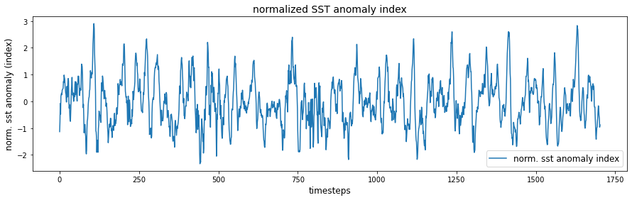
El Niño Southern Oscillation (ENSO)
Use Nino3.4 box (5°N–5°S, 120–170°W) in the tropical Pacific to diagnose ENSO from sea-surface temperature (SST) anomalies.
SST data: https://downloads.psl.noaa.gov/Datasets/noaa.ersst.v5/sst.mnmean.nc
Provides monthly mean SST from 1854 to now in 2° by 2° lat/lon grid
Start from 1880
Calaculate ENSO index:
Compute area averaged total SST from Niño 3.4 region
Compute monthly climatology (e.g., 1980-2009) for area averaged total SST from Niño 3.4 region, and subtract climatology from area averaged total SST time series to obtain anomalies
Normalize no rolling mean!

Slide 4
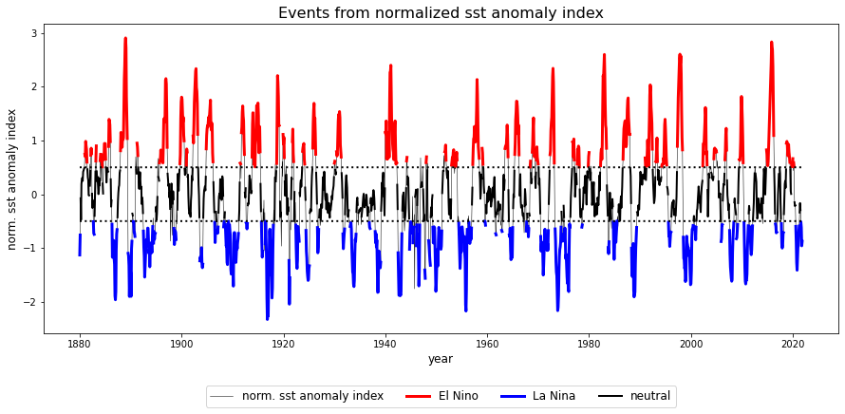
El Niño Southern Oscillation (ENSO)

Slide 5
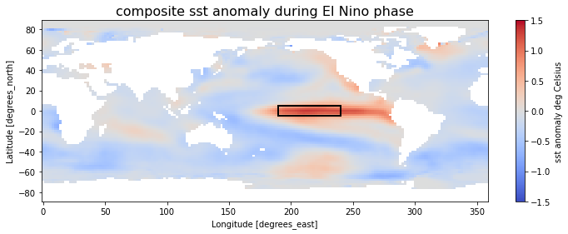
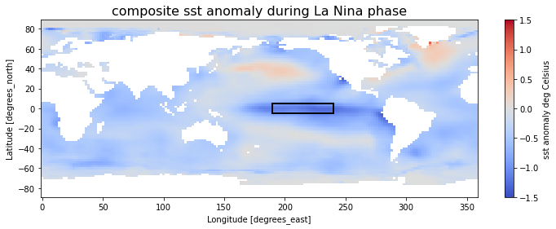
El Niño Southern Oscillation (ENSO)

Slide 6
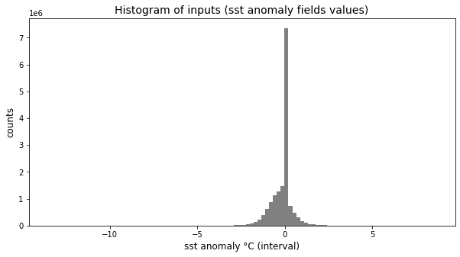
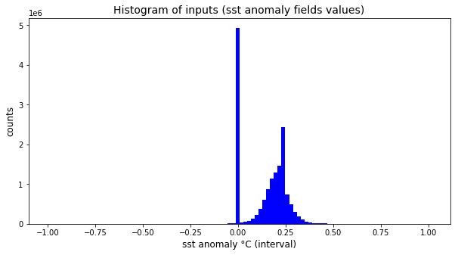
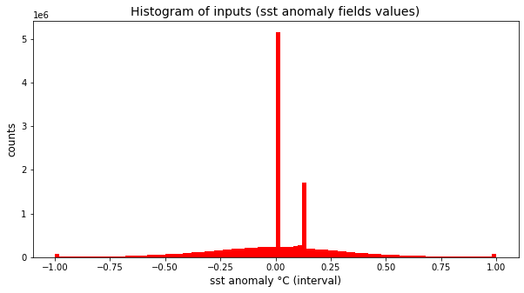
El Niño Southern Oscillation (ENSO)
raw values
NaN to zero
scaled to [-1,1]
NaN to zero
capped (0.005% quantile)
scaled to [-1,1]
NaN to zero
→ All models can handle un-capped input data. But for getting „nice“ relevance maps, prefere working on capped inputs, at least for ESN models (see later results…)

Slide 7
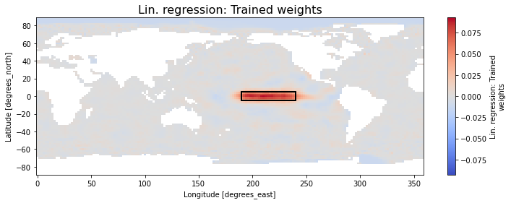
1. Linear Regression: Classification and „LRP“
Best performance is found for the following setup:
Feed whole world's sst anomaly fields as input, flattened (vectorized)
without capping
scaled to [-1,1]
unscaled continuous normalized sst anomaly index as target.
train accuracy 100%
validation accuracy of 97% / 100% for El Nino / La Nina samples
(Fidelity is close to perfect!)

Slide 8
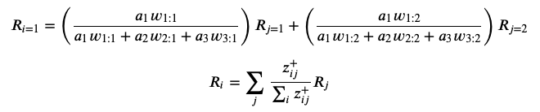
Layer-wise relevance propagation in a nutshell
R_{i=1}
layer i
i = 1
a₁
layer j
w_{1:1}
j = 1
R_{j=1}
a₂
i = 2
w_{1:2}
j = 2
R_{j=2}
a₃
i = 3

Slide 9
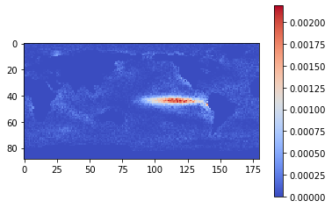
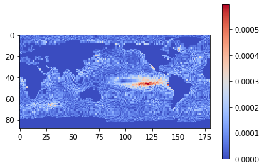
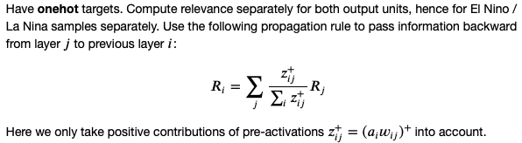
2. Multilayer Perceptron (MLP): Classification and LRP
mean relevance map: EL NINO
Best performance is found for the following setup:
Feed whole world's sst anomaly fields as input, flattened (vectorized)
without capping
scaled to [-1,1]
one-hot targets (needed for LRP).
train accuracy 100%
validation accuracy of 96% / 100% for El Nino / La Nina samples
(Note: Find 100% validation accuracy on capped inputs)
mean relevance map: LA NINA

Slide 10

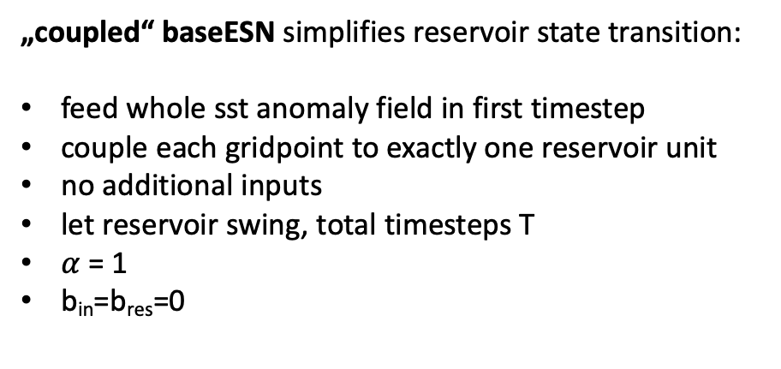
Layer-wise relevance propagation for „coupled“ baseESN
current timestep‘s input
keep fraction of previous timestep‘s reservoir state
recurrence inside reservoir
„coupled“ baseESN simplifies reservoir state transition:
feed whole sst anomaly field in first timestep
couple each gridpoint to exactly one reservoir unit
no additional inputs
let reservoir swing, total timesteps T
$α$ = 1
b_{in}=b_{res}=0

Slide 11




„coupled“ baseESN: Unfold recurrence
input
u(1)
act(1)
act(T-1)
act(T)
output (one-hot)
$α$=1
$α$=1
$α$=1
W_{out} b_{out}
W_{res}
W_{res}
(…)
x(1)
x(T-2)
x(T-1)

Slide 12
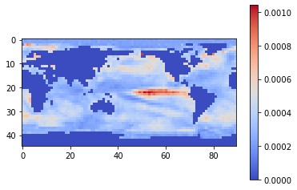
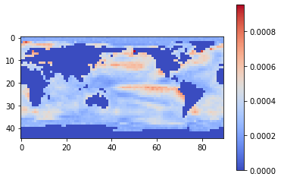
„coupled“ baseESN
mean relevance map: EL NINO
Best performance is found for the following setup:
Feed whole world's sst anomaly fields as input
reduced in size by factor of 4, flattened (vectorized)
capped with quantile limits 0.005% and 0.995%
scaled to [-1,1]
one-hot targets
tanh activation
n_{res} = lat x lon gridpoints
spectral radius = 0.8
sparsity = 0.3
total timesteps T = 3
train accuracy 100%
validation accuracy of 98% / 98% for El Nino / La Nina
mean relevance map: LA NINA

Slide 13




baseESN: Feed inputs column-wise or row-wise
input
u(1)
act(1)
input
u(T-1)
act(T-1)
input
u(T)
act(T)
W_{in} b_{in}
W_{in} b_{in}
W_{in} b_{in}
$$α$$
W_{out} b_{out}
output (one-hot)
W_{res}b_{res}
$$α$$
W_{res}b_{res}
W_{out} b_{out}
$$(1−α)$$
(…)
$$(1−α)$$
x(1)
x(T-2)
x(T-1)

Slide 14
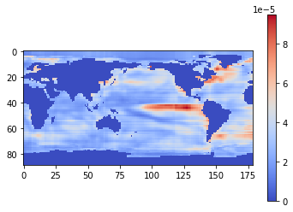
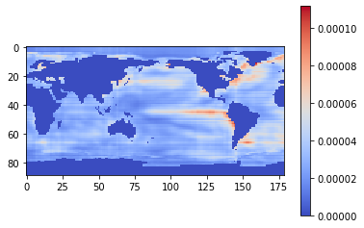
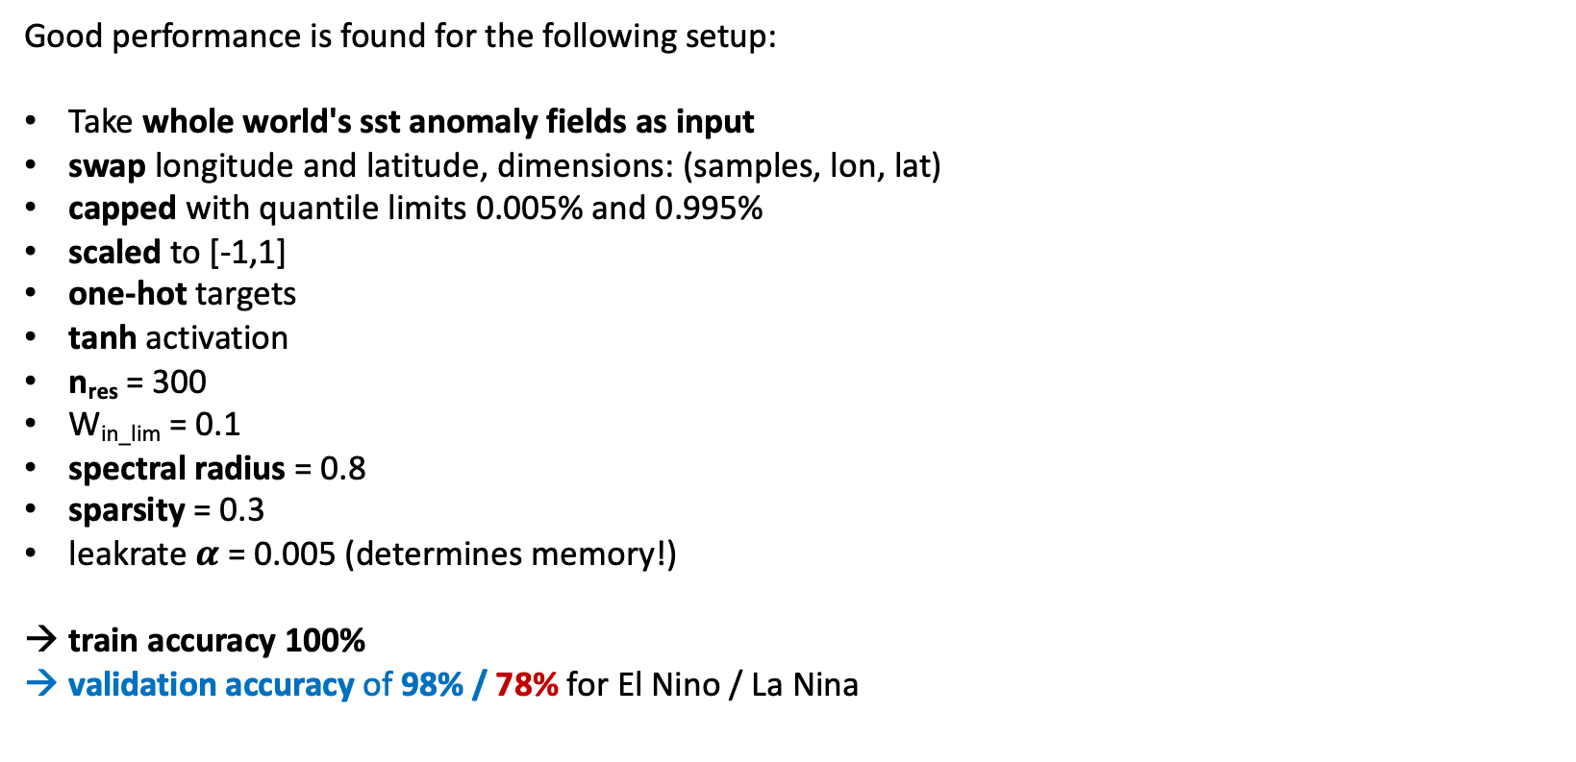
baseESN: Feed inputs column by column
mean relevance map: EL NINO
Good performance is found for the following setup:
Take whole world's sst anomaly fields as input
swap longitude and latitude, dimensions: (samples, lon, lat)
capped with quantile limits 0.005% and 0.995%
scaled to [-1,1]
one-hot targets
tanh activation
n_{res} = 300
W_{in_lim} = 0.1
spectral radius = 0.8
sparsity = 0.3
leakrate $α$ = 0.005 (determines memory!)
train accuracy 100%
validation accuracy of 98% / 78% for El Nino / La Nina
timesteps features
mean relevance map: LA NINA

Slide 15
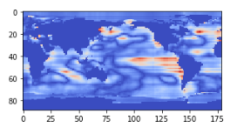
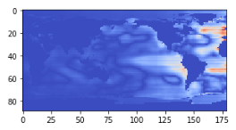
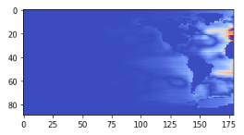



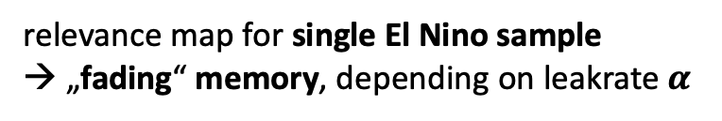
baseESN: Feed inputs column by column
relevance map for single El Nino sample
→ „fading“ memory, depending on leakrate $α$
$α$ = 0.005
$α$ = 0.05
$α$ = 0.1

Slide 16
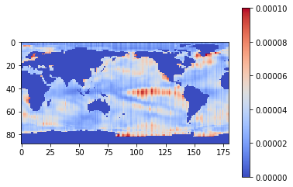
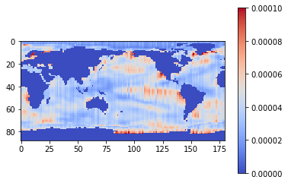
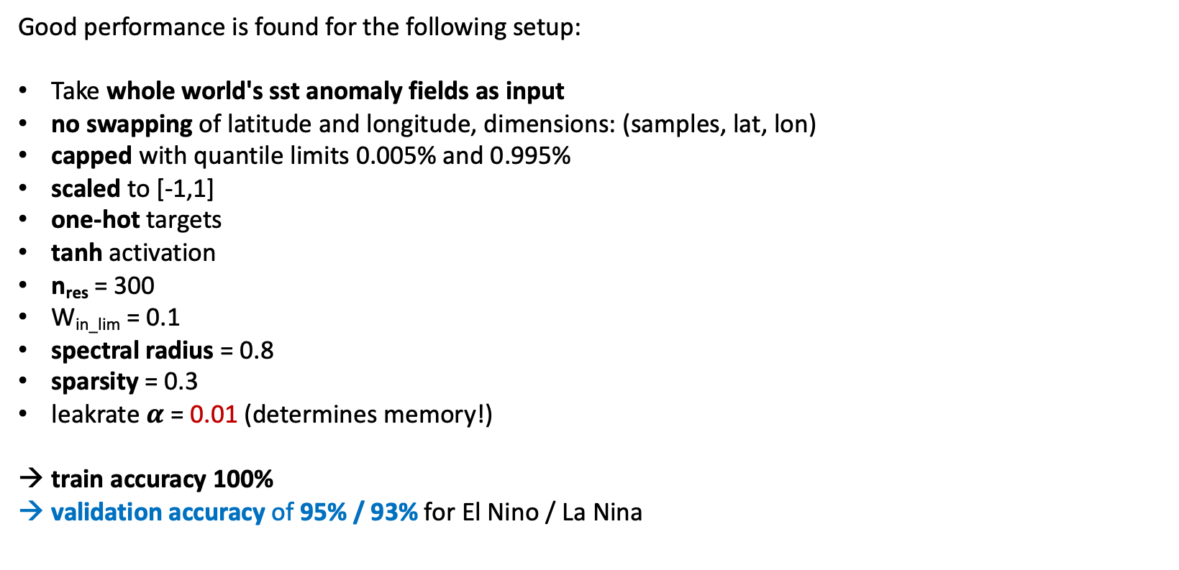
baseESN: Feed inputs row by row
mean relevance map: EL NINO
Good performance is found for the following setup:
Take whole world's sst anomaly fields as input
no swapping of latitude and longitude, dimensions: (samples, lat, lon)
capped with quantile limits 0.005% and 0.995%
scaled to [-1,1]
one-hot targets
tanh activation
n_{res} = 300
W_{in_lim} = 0.1
spectral radius = 0.8
sparsity = 0.3
leakrate $α$ = 0.01 (determines memory!)
train accuracy 100%
validation accuracy of 95% / 93% for El Nino / La Nina
timesteps features
mean relevance map: LA NINA

Slide 17
Discussion
ESN models also work on un-capped inputs, in some case with even better performance.
But then don‘t find nice relevance maps highlighting Nino region.
Feeding inputs row by row outperforms column by column approach in terms of accuracy.
But observe stronger artefacts in terms of stripes for row by row method.
Try to improve validation accuracy for column by column approach on La Nina samples!
Coupled ESN requires very large reservoirs (lat x lon gridpoints = n_{res}). That leads to runtime explosion, since we need largest eigenvalue of reservoir weights. Reduced input size by factor of 4 to overcome this problem. Look for fast algorithms to at least estimate largest eigenvalue.
Comparing number of trainable parameters, ESN models clearly win:
Linear Regression has 16.020 weights.
MLP (2 hidden layers with 8 units each) has some 128.000 parameters.
couples ESN has 4.005 x 2 output weights to train but note: With one-targets and output weights trained in closed-form manner, find inverse weights.
base ESN with column by column and row by row approach only work with n_{res}=300 output weights to be trained.

Slide 18
Sources
[Kim & King, 2020] „Time series prediction using deep echo state networks“
[Toms et al., 2020] „Physically Interpretable Neural Networks for the Geosciences: Applications to Earth System Variability“
[Woodward et al., 2011] "A Reservoir Computing approach to Image Classification using Coupled Echo State and Back-Propagation Neural Networks"

