Slide 1
Wrap up interim results on:
setting up and train (Deep)ESN models
decomposing timeseries
ESN_wrapUP_decomosition_and_DeepESN.ipynb
ESN_exp01 .. 05.ipynb

Slide 2
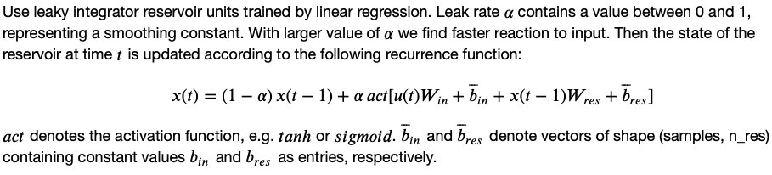
Base ESN – methodology and reservoir transition
(Hyper)parameters:
n_res: number of res. units
sparsity of reservoir connections
spectral radius: max EV of W_{res}
leak rate ⍺ in reservoir transition
activation for reservoir transition
Reservoir states X
(samples, timesteps, n_res)
W_{res}
Dimensions:
W_{in} (input features, n_res)
W_{res} (n_res, n_res)
W_{out} (n_res, output features)
Biases:
b_{in} , b_{res} , b_{out}
W_{in}
W_{out}
Output Y
(samples, output features)
Input U
(samples, timesteps, input features)

Slide 3
Base ESN – methodology and reservoir transition
(Hyper)parameters:
n_res: number of res. units
sparsity of reservoir connections
spectral radius: max EV of W_{res}
leak rate ⍺ in reservoir transition
activation for reservoir transition
Reservoir states X
(samples, timesteps, n_res)
W_{res}
Dimensions:
W_{in} (input features, n_res)
W_{res} (n_res, n_res)
W_{out} (n_res, output features)
Biases:
b_{in} , b_{res} , b_{out}
W_{in}
W_{out}
Output Y
(samples, output features)
Input U
(samples, timesteps, input features)
current timestep‘s input
keep fraction of previous timestep‘s reservoir state
recurrence inside reservoir

Slide 4
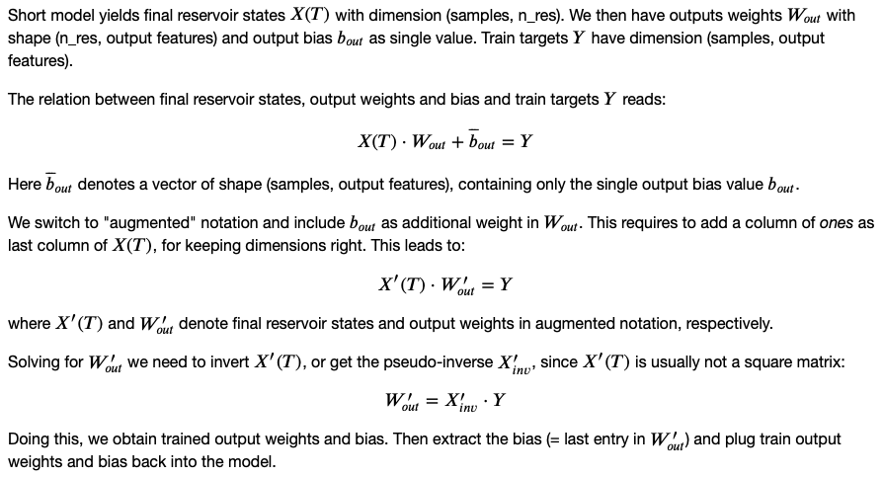
Base ESN – training output weights and bias
Final Reservoir states X(T)
(samples, n_res)
Input U
W_{res}
W_{in}
class / functions:
ESN layer: extends tf.layer
setESN: set up model with scaled W_{res}
trainESN: train W_{out} and b_{out}
predESN: evaluate model performance

Slide 5
From base ESN to Deep ESN
(Hyper)parameters:
n_layers (N): number of reservoirs
n_res: number of res. units
sparsity of reservoir connections
spectral radius: max EV of W_{res}
leak rate ⍺^{l} in reservoir transition
activation for reservoir transition
Reservoir states X¹
Reservoir states X²
Reservoir states X^{N}
W¹_{res}
W²_{res}
W^{N}_{res}
X¹
X^{N-1}
W_{out}
Dimensions:
W¹_{in} (input features, n_res)
W^{l}_{in} (n_res, n_res)
W^{l}_{res} (n_res, n_res)
W_{out} (n_res, output features)
Biases:
b^{l}_{in} , b^{l}_{res} , b_{out}
Inputs i^{l}:
i¹ = U
i^{l} = X^{l-1}
W¹_{in}
W²_{in}
W^{N}_{in}
Input U
Output Y
X¹(T)
Final res. states X¹(T)
X²(T)
Final res. states X²(T)
X^{N}(T)
X^{N}(T)
Concatenate
Reservoir state transition:

Slide 6
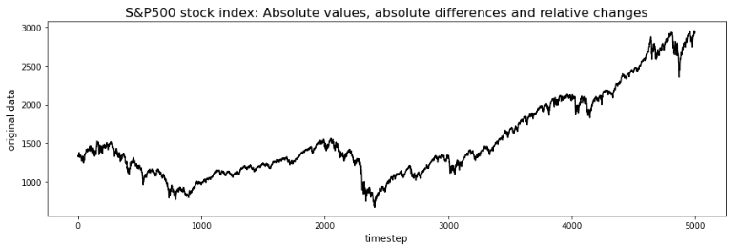
stationary vs. non-stationary
1st step: de-trend timeseries of absolute values
Usually find some long-term exponential trend
Plus series of „bear“ vs. „bull“ markets

Slide 7
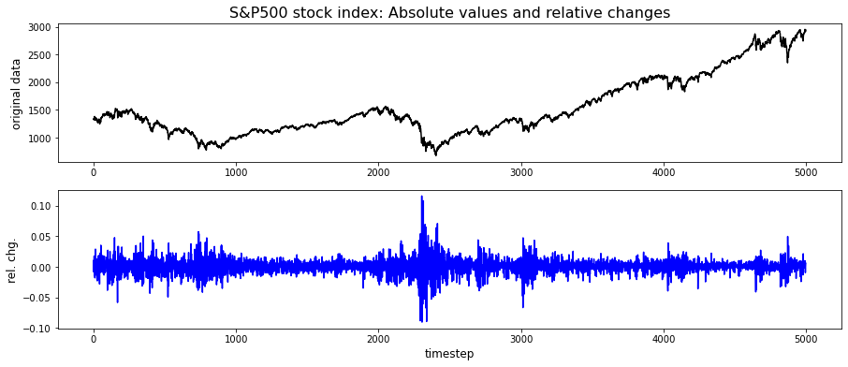
stationary vs. non-stationary
high-volatility regime

Slide 8
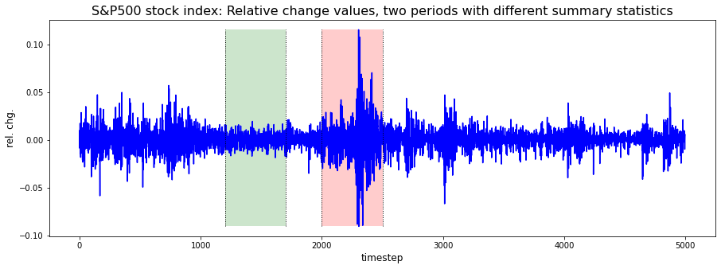
stationary vs. non-stationary
mean: 0.0 0.0
std dev: 0.006 0.022

Slide 9
stationary vs. non-stationary
Discussion on stock price prediction / challenges
Stock market has no (known) seasonality pattern, short term trends don‘t alternate in regular cycle.
Without reliable information of current short term trend, multistep prediction will fail!
Need model to predict „regime shifts“ as events (or classifacation: We are currently in bull or bear market).
Series of relative changes still comes with non-stationary summary statistics. Mean zero, but varying variance over time: high / low volatility regimes.
Stock price movements cannot be predicted from their own history alone (→ random walk).
Require additional information in terms of additional external input features.

