Slide 1



“Using Echo State Networks for detecting ENSO“
Marco Landt-Hayen Prof. Dr. Peer Kröger (CAU Kiel)
June 2nd, 2022 Prof. Dr. Martin Claus (GEOMAR)
Dr. Willi Rath (GEOMAR)

Slide 2
Let‘s start with a quiz!

Slide 3
Let‘s start with a quiz!
1. Who of you has ever trained some artificial neural network?

Slide 4
Let‘s start with a quiz!
2. Who of you knows what is meant by (Stochastic) Gradient Descent?

Slide 5
Let‘s start with a quiz!
3. Who of you has at least a rough idea, what „explainable AI“ refers to?

Slide 6
Agenda
Classification of sst anomaly fields: ENSO “detector“
Multilayer perceptron
Echo State Network: feed inputs column by column
Layer-wise relevance propagation for both models

Slide 7
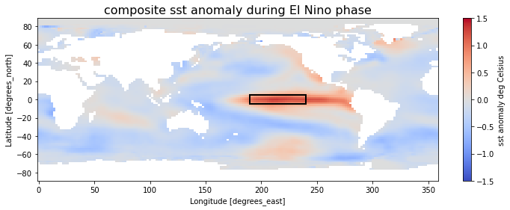
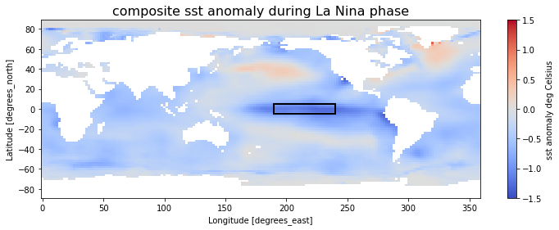
El Niño Southern Oscillation (ENSO)

Slide 8
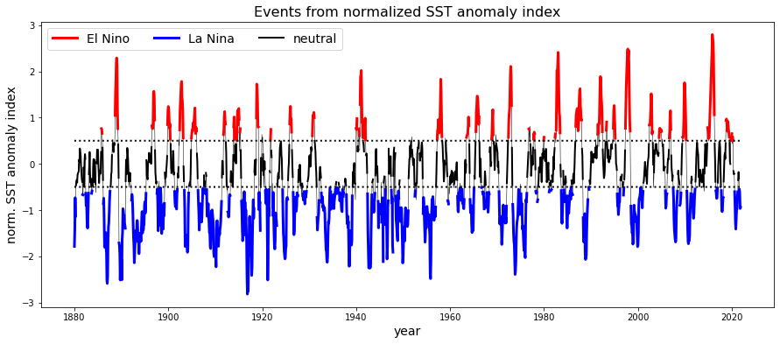
El Niño Southern Oscillation (ENSO)

Slide 9
Baseline: Multilayer Perceptron
Use 2D image data as input
input layer
X dimension
2 hidden layers
Y dimension
output
target

Slide 10
Baseline: Multilayer Perceptron
Use 2D image data as input
87,993 trainable parameters!
input layer
X dimension
2 hidden layers
Y dimension
output
target

Slide 11
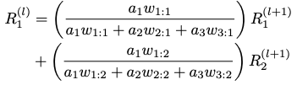
Layer-wise relevance propagation in a nutshell
layer (l)
R₁^{(l)}
i = 1
a₁
layer (l+1)
w_{1:1}
j = 1
R₁^{(l+1)}
a₂
i = 2
w_{1:2}
j = 2
R₂^{(l+1)}
a₃
i = 3

Slide 12
Layer-wise relevance propagation in a nutshell
layer (l)
R₁^{(l)}
i = 1
a₁
layer (l+1)
w_{1:1}
j = 1
R₁^{(l+1)}
a₂
i = 2
w_{1:2}
j = 2
R₂^{(l+1)}
a₃
i = 3

Slide 13
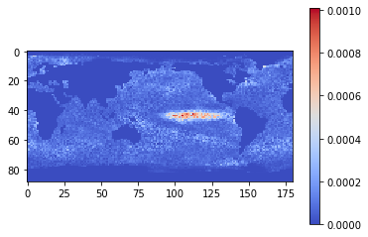
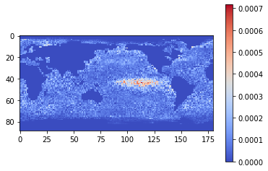
2. Multilayer Perceptron (MLP): Classification and LRP
mean relevance map: EL NINO
Best performance is found for the following setup:
Feed whole world's sst anomaly fields as input
Only consider „valid“ gridpoints (remove NaN values)
flattened (vectorized)
capped with “absolute“ limits [-5°C, 5°C]
scaled to [-1,1]
sst anomaly index as single target
train accuracy 100%
validation accuracy 100% for El Nino / La Nina samples
mean relevance map: LA NINA

Slide 14
baseESN: Feed inputs column-wise or row-wise

Slide 15
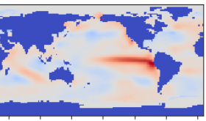
Base ESN – methodology and reservoir transition
T timesteps
T timesteps, here: Longitude in 180 steps
D input features
D input features, here: Latitude in 89 steps
u(3)
u(1)
u(2)
u(4)
t=1
t=5
t=2
t=4
t=3

Slide 16
Base ESN – methodology and reservoir transition
T timesteps
Reservoir states X
(samples, timesteps, n_res)
D input features
W_{res}
W_{in}
u(3)
u(1)
u(2)
u(4)
Input U
here 5 input features with T=10 timesteps

Slide 17
Base ESN – methodology and reservoir transition
T timesteps
Reservoir states X
(samples, timesteps, n_res)
D input features
W_{res}
W_{in}
u(3)
u(1)
u(2)
u(4)
Input U
here 5 input features with T=10 timesteps
current timestep‘s input
keep fraction of previous timestep‘s reservoir state
recurrence inside reservoir

Slide 18

Base ESN – methodology and reservoir transition
T timesteps
Reservoir states X
(samples, timesteps, n_res)
D input features
W_{res}
W_{in}
W_{out}
Output Y
(here a single output feature)
u(3)
u(1)
u(2)
u(4)
Input U
here 5 input features with T=10 timesteps

Slide 19
Base ESN – methodology and reservoir transition
T timesteps
Only 301 trainable parameters!
Reservoir states X
(samples, timesteps, n_res)
D input features
W_{res}
W_{in}
W_{out}
Output Y
(here a single output feature)
u(3)
u(1)
u(2)
u(4)
Input U
here 5 input features with T=10 timesteps

Slide 20
Base ESN – methodology and reservoir transition
(Hyper)parameters:
n_res: number of res. units
sparsity of reservoir connections
spectral radius: max EV of W_{res}
leak rate ⍺ in reservoir transition
activation for reservoir transition
T timesteps
Reservoir states X
(samples, timesteps, n_res)
D input features
Dimensions:
W_{in} (input features, n_res)
W_{res} (n_res, n_res)
W_{out} (n_res, output features)
Biases:
b_{in} , b_{res} , b_{out}
W_{res}
W_{in}
W_{out}
Output Y
(here a single output feature)
u(3)
u(1)
u(2)
u(4)
Input U
here 5 input features with T=10 timesteps

Slide 21





baseESN: Feed inputs column-wise (or row-wise)
input
u(1)
input
u(2)
input
u(T-1)
input
u(T)
act(1)
act(2)
act(T-1)
act(T)
W_{in} b_{in}
W_{in} b_{in}
W_{in} b_{in}
W_{in} b_{in}
(…)
$$α$$
$$α$$
$$α$$
W_{res}b_{res}
W_{res}b_{res}
W_{res}b_{res}
output y(T)
W_{out} b_{out}
(…)
$$(1−α)$$
$$(1−α)$$
x(1)
x(T-2)
x(T-1)
x(T)

Slide 22
baseESN: Feed inputs column-wise (or row-wise)
input
u(1)
input
u(2)
input
u(T-1)
input
u(T)
act(1)
act(2)
act(T-1)
act(T)
W_{in} b_{in}
W_{in} b_{in}
W_{in} b_{in}
W_{in} b_{in}
(…)
$$α$$
$$α$$
$$α$$
W_{res}b_{res}
W_{res}b_{res}
W_{res}b_{res}
output y(T)
W_{out} b_{out}
(…)
$$(1−α)$$
$$(1−α)$$
x(1)
x(T-2)
x(T-1)
x(T)

Slide 23
baseESN: Feed inputs column-wise (or row-wise)
input
u(1)
input
u(2)
input
u(T-1)
input
u(T)
act(1)
act(2)
act(T-1)
act(T)
W_{in} b_{in}
W_{in} b_{in}
W_{in} b_{in}
W_{in} b_{in}
(…)
$$α$$
$$α$$
$$α$$
W_{res}b_{res}
W_{res}b_{res}
W_{res}b_{res}
output y(T)
W_{out} b_{out}
(…)
$$(1−α)$$
$$(1−α)$$
x(1)
x(T-2)
x(T-1)
x(T)

Slide 24
baseESN: Feed inputs column-wise (or row-wise)
input
u(1)
input
u(2)
input
u(T-1)
input
u(T)
act(1)
act(2)
act(T-1)
act(T)
W_{in} b_{in}
W_{in} b_{in}
W_{in} b_{in}
W_{in} b_{in}
(…)
$$α$$
$$α$$
$$α$$
W_{res}b_{res}
W_{res}b_{res}
W_{res}b_{res}
output y(T)
W_{out} b_{out}
(…)
$$(1−α)$$
$$(1−α)$$
x(1)
x(T-2)
x(T-1)
x(T)

Slide 25
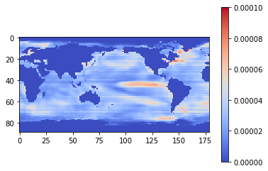
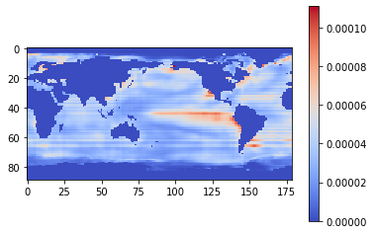
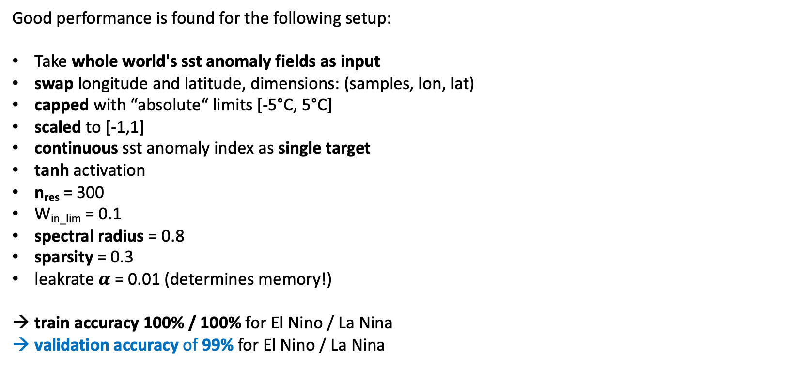
baseESN: Feed inputs column by column
mean relevance map: EL NINO
Good performance is found for the following setup:
Take whole world's sst anomaly fields as input
swap longitude and latitude, dimensions: (samples, lon, lat)
capped with “absolute“ limits [-5°C, 5°C]
scaled to [-1,1]
continuous sst anomaly index as single target
tanh activation
n_{res} = 300
W_{in_lim} = 0.1
spectral radius = 0.8
sparsity = 0.3
leakrate $α$ = 0.01 (determines memory!)
train accuracy 100% / 100% for El Nino / La Nina
validation accuracy of 99% for El Nino / La Nina
timesteps features
mean relevance map: LA NINA

Slide 26
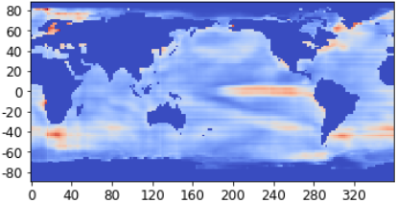
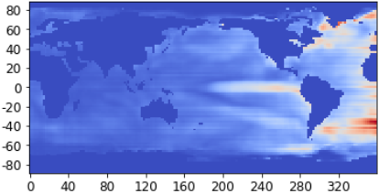
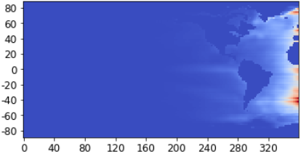
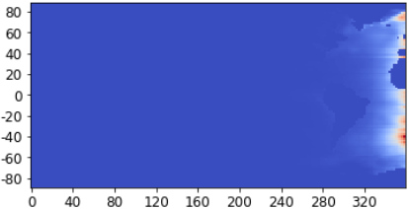
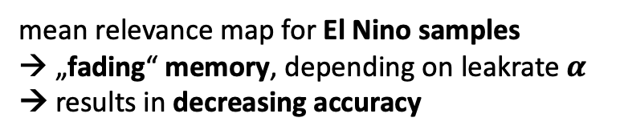
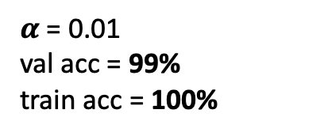
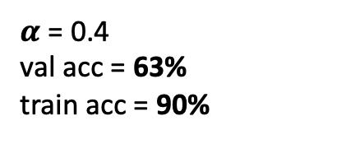
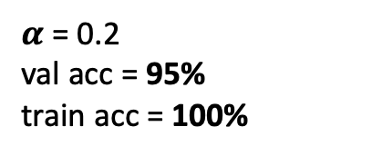
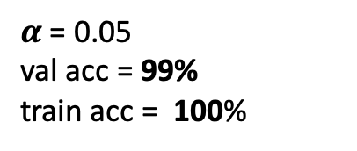
baseESN: Feed inputs column by column
mean relevance map for El Nino samples
→ „fading“ memory, depending on leakrate $α$
→ results in decreasing accuracy
$α$ = 0.01
val acc = 99%
train acc = 100%
$α$ = 0.05
val acc = 99%
train acc = 100%
$α$ = 0.2
val acc = 95%
train acc = 100%
$α$ = 0.4
val acc = 63%
train acc = 90%

Slide 27
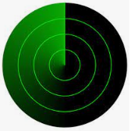
baseESN: Feed inputs column by column
mean relevance map for El Nino samples
→ „fading“ memory, depending on leakrate $α$
→ results in decreasing accuracy
$α$ = 0.01
val acc = 99%
train acc = 100%
$α$ = 0.05
val acc = 99%
train acc = 100%
$α$ = 0.2
val acc = 95%
train acc = 100%
$α$ = 0.4
val acc = 63%
train acc = 90%
„radar sweep“

Slide 28
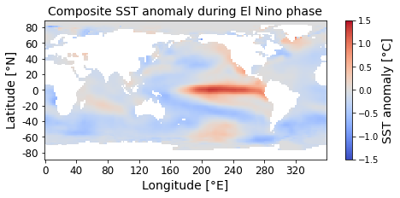
FollowUp experiment: Permutation
ENSO has some strong zonal structure. Question is, what happens if we apply some (reversible!) transformation on sst field?
Still have the same information, but does that “destroy“ ESN model performance?

Slide 29
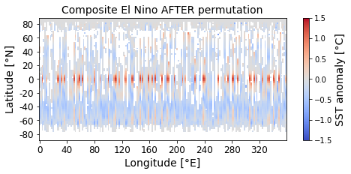
FollowUp experiment: Permutation
ENSO has some strong zonal structure. Question is, what happens if we apply some (reversible!) transformation on sst field?
Still have the same information, but does that “destroy“ ESN model performance?
apply (same) random permutation on input sample for each row, to disturb zonal structure

Slide 30
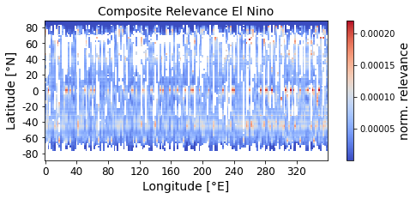
FollowUp experiment: Permutation
ENSO has some strong zonal structure. Question is, what happens if we apply some (reversible!) transformation on sst field?
Still have the same information, but does that “destroy“ ESN model performance?

Slide 31
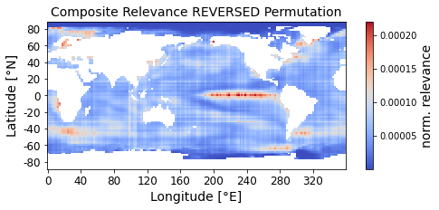
FollowUp experiment: Permutation
ENSO has some strong zonal structure. Question is, what happens if we apply some (reversible!) transformation on sst field?
Still have the same information, but does that “destroy“ ESN model performance?
reverse permutation to restore relevance map

Slide 32
Conclusion and further work
Echo State Networks can be successfully used for image classification.
That opens the door for applying xAI techniques from computer vision.
ESNs come with significantly less trainable parameters compared to other ANN architectures.
That qualifies them to be used on climate related problems.
ESNs are robust to permutation of inputs and yield reproducible and stable results.
ESNs can easily be used on multiple time series (like climate indices) in combination with LRP

Slide 33
Sources
[Kim & King, 2020] „Time series prediction using deep echo state networks“
[Toms et al., 2020] „Physically Interpretable Neural Networks for the Geosciences: Applications to Earth System Variability“
[Schaetti et al., 2017] „Echo State Networks-based Reservoir Computing for MNIST Handwritten Digits Recognition“
[Woodward et al., 2011] "A Reservoir Computing approach to Image Classification using Coupled Echo State and Back-Propagation Neural Networks“
Free online book „Mining massive data sets“ (http://www.mmds.org), shows two approaches to get largest eigenvalue and related eigenvector in ch. 11: „Power iteration“ and „CUR decomposition“

Slide 34
BackUp

Slide 35
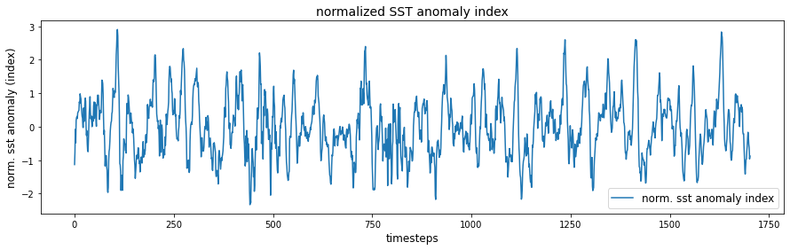
El Niño Southern Oscillation (ENSO)
Use Nino3.4 box (5°N–5°S, 120–170°W) in the tropical Pacific to diagnose ENSO from sea-surface temperature (SST) anomalies.
SST data: https://downloads.psl.noaa.gov/Datasets/noaa.ersst.v5/sst.mnmean.nc
Provides monthly mean SST from 1854 to now in 2° by 2° lat/lon grid
Start from 1880
Calaculate ENSO index:
Compute area averaged total SST from Niño 3.4 region
Compute monthly climatology (e.g., 1980-2009) for area averaged total SST from Niño 3.4 region, and subtract climatology from area averaged total SST time series to obtain anomalies
Normalize, no rolling mean!

Slide 36
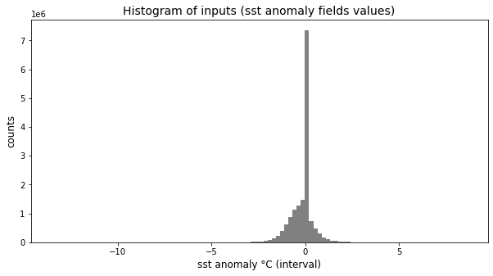
Data pre-processing: Scale inputs
raw input values
NaN to zero

Slide 37
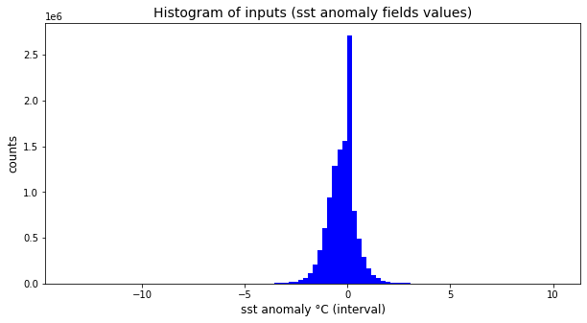
Data pre-processing: Scale inputs
raw input values
NaN to zero
remove NaN
→ Even with removed (former) NaN values find peek from sst anomalies over Arctic region, seasonally covered with ice.

Slide 38
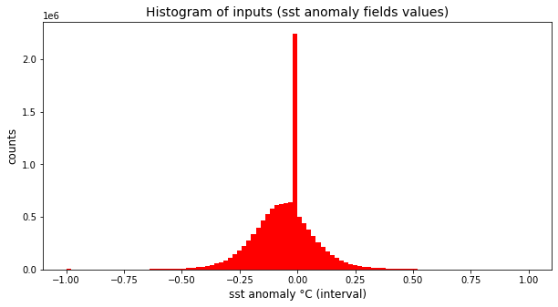
Data pre-processing: Scale inputs
raw input values
NaN to zero
remove NaN
→ Even with removed (former) NaN values find peek from sst anomalies over Arctic region, seasonally covered with ice.
→ All models can handle un-capped input data. But for getting „nice“ relevance maps, prefere working on capped inputs, essential for ESN models (see later results…)
capped values outside [-5,5]
scaled to [-1,1]

Slide 39
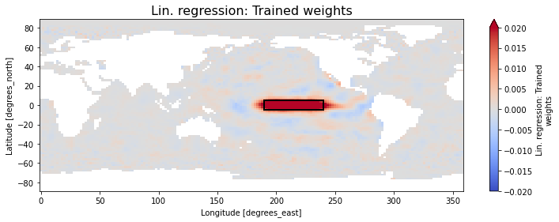
1. Linear Regression: Classification and „LRP“
Best performance is found for the following setup:
Feed whole world's sst anomaly fields as input
Only consider „valid“ gridpoints (remove NaN values), flattened (vectorized)
capped with “absolute“ limits [-5°C, 5°C]
scaled to [-1,1]
unscaled continuous normalized sst anomaly index as target.
train accuracy 100%
validation accuracy of 100% / 100% for El Nino / La Nina samples
(Fidelity is close to perfect!)

Slide 40

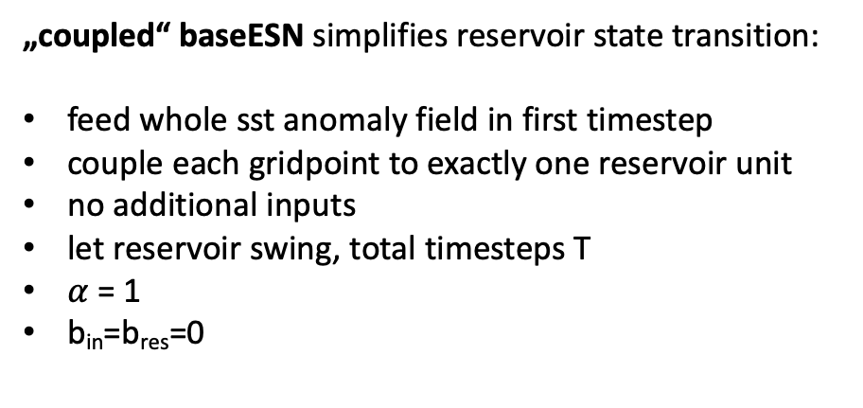
Layer-wise relevance propagation for „coupled“ baseESN
current timestep‘s input
keep fraction of previous timestep‘s reservoir state
recurrence inside reservoir
„coupled“ baseESN simplifies reservoir state transition:
feed whole sst anomaly field in first timestep
couple each gridpoint to exactly one reservoir unit
no additional inputs
let reservoir swing, total timesteps T
$α$ = 1
b_{in}=b_{res}=0

Slide 41




„coupled“ baseESN: Unfold recurrence
input
u(1)
act(1)
act(T-1)
act(T)
output (one-hot)
$α$=1
$$α$$
$α$=1
W_{out} b_{out}
W_{res}
W_{res}
(…)
x(1)
x(T-2)
x(T-1)

Slide 42

„coupled“ baseESN: Unfold recurrence
input
u(1)
act(1)
act(T-1)
act(T)
output (one-hot)
$α$=1
$α$=1
$α$=1
W_{out} b_{out}
W_{res}
W_{res}
(…)
x(1)
x(T-2)
x(T-1)

Slide 43
„coupled“ baseESN: Unfold recurrence
input
u(1)
act(1)
act(T-1)
act(T)
output (one-hot)
$α$=1
$α$=1
$α$=1
W_{out} b_{out}
W_{res}
W_{res}
(…)
x(1)
x(T-2)
x(T-1)

Slide 44
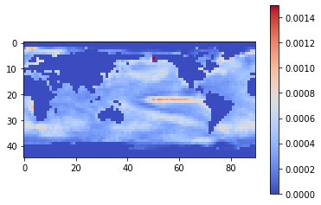
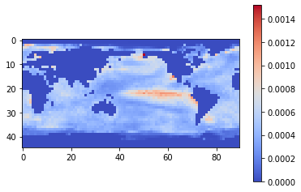
„coupled“ baseESN
mean relevance map: EL NINO
Best performance is found for the following setup:
Feed whole world's sst anomaly fields as input
Only consider „valid“ gridpoints (remove NaN values)
reduced in size by factor of 4, flattened (vectorized)
capped with “absolute“ limits [-5°C, 5°C]
scaled to [-1,1]
continuous sst anomaly index as single target
tanh activation
n_{res} = lat x lon gridpoints
spectral radius = 0.8
sparsity = 0.3
total timesteps T = 4
train accuracy 100%
validation accuracy of 97% / 100% for El Nino / La Nina
mean relevance map: LA NINA

