Slide 1
PI meeting MarDATA-01
4. Feb 2022

Slide 2
Extract of example „ESN_vs_CNNLSTM_amazon“
Work with Amazon daily stock prices. Apply two Models:
Hybrid CNN/LSTM:
2 CNN layers (10/20 filters, size 7/4)
2 LSTM layers (20/10 units)
1 fc output unit
5.500 trainable parameters
ESN
Basic form: Input / Reservoir (500 units) / Output
Only 500 trainable weights

Slide 3
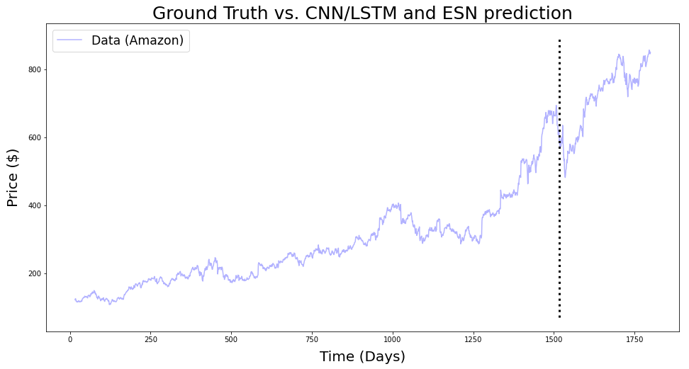
Shown here: Absolute stock prices.
Models work with scaled relative changes.
Input length differs: CNN/LSTM 16d, ESN 1500d.

Slide 4
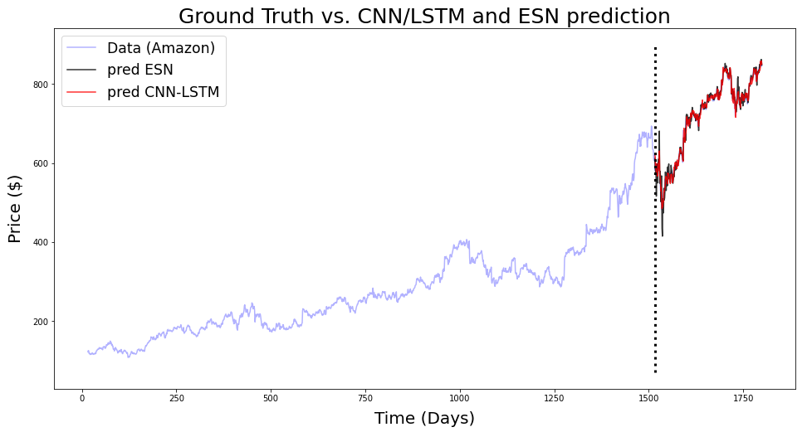
High fidelity can be deceiving.
Only due to 1-step prediction with „teacher-forcing“.

Slide 5
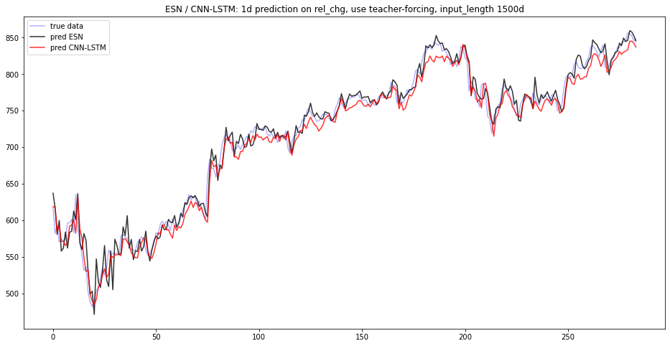
Zoom in:
Both models perform equally well in 1-step prediction with „teacher-forcing“.

Slide 6
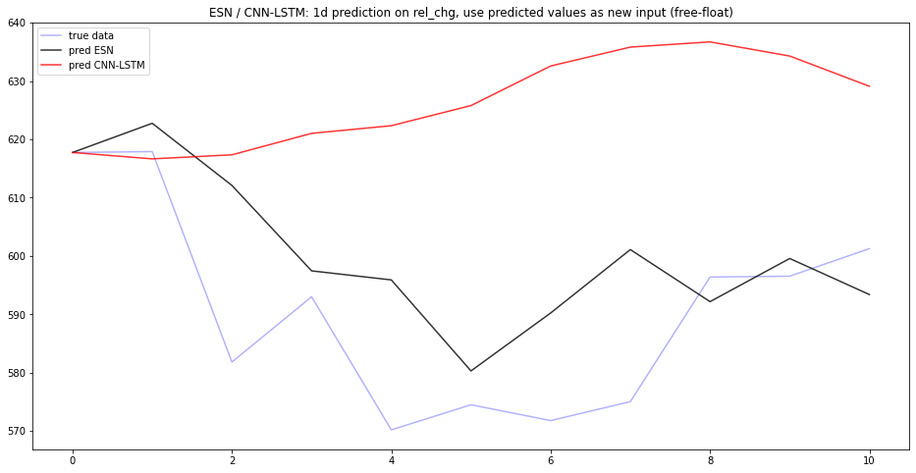
Switch to „free-float“ modus:
Now ESN shows higher fidelity here.

Slide 7
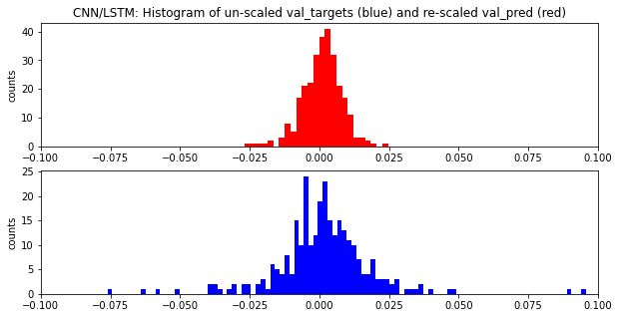
Problems with CNN/LSTM: Fails to predict extreme values
rel. changes

Slide 8
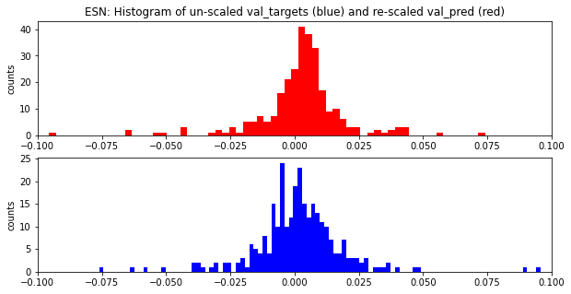
ESN seems to be more robust to „regime-shifts“: high-volatility phases.

Slide 9
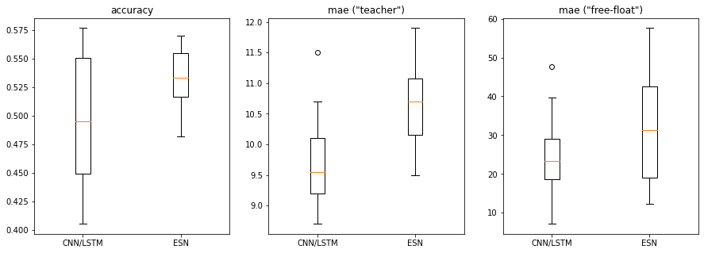
Evaluate some performance metrics for multiple runs, here 20 runs:
Higher stability in terms of accuracy for ESN, although CNN/LSTM can (randomly) reach higher accuracy, but not reproducible!
CNN/LSTM slightly outperforms ESN in terms of mean-absolute error. But keep in mind that we compare „high-end“ CNN/LSTM with „basic-basic-basic“ ESN. The latter has probably more room for optimization!

Slide 10
Sources
A Review of Designs and Applications of Echo State Networks (https://arxiv.org/abs/2012.02974)
Notebook „ESN_vs_CNNLSTM_amazon.ipynb“ on https://github.com/MarcoLandtHayen/EchoStateNetworks

