Slide 1
Wrap up interim results on:
setting up and train (Deep)ESN models
decomposing timeseries
ESN_wrapUP_decomosition_and_DeepESN.ipynb

Slide 2
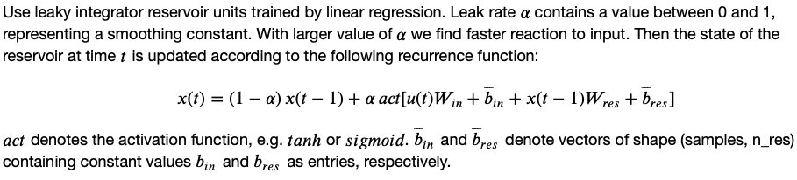
Base ESN – methodology and reservoir transition
(Hyper)parameters:
n_res: number of res. units
sparsity of reservoir connections
spectral radius: max EV of W_{res}
leak rate ⍺ in reservoir transition
activation for reservoir transition
Reservoir states X
(samples, timesteps, n_res)
W_{res}
Dimensions:
W_{in} (input features, n_res)
W_{res} (n_res, n_res)
W_{out} (n_res, output features)
Biases:
b_{in} , b_{res} , b_{out}
W_{in}
W_{out}
Output Y
(samples, output features)
Input U
(samples, timesteps, input features)

Slide 3
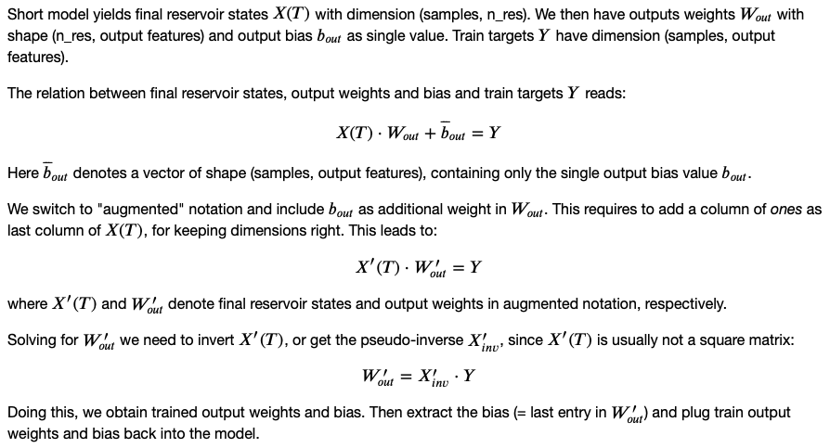
Base ESN – training output weights and bias
Final Reservoir states X(T)
(samples, n_res)
Input U
W_{res}
W_{in}
class / functions:
ESN layer: extends tf.layer
setESN: set up model with scaled W_{res}
trainESN: train W_{out} and b_{out}
predESN: evaluate model performance

Slide 4
From base ESN to Deep ESN
(Hyper)parameters:
n_layers (N): number of reservoirs
n_res: number of res. units
sparsity of reservoir connections
spectral radius: max EV of W_{res}
leak rate ⍺^{l} in reservoir transition
activation for reservoir transition
Reservoir states X¹
Reservoir states X²
Reservoir states X^{N}
W¹_{res}
W²_{res}
W^{N}_{res}
X¹
X^{N-1}
W_{out}
Dimensions:
W¹_{in} (input features, n_res)
W^{l}_{in} (n_res, n_res)
W^{l}_{res} (n_res, n_res)
W_{out} (n_res, output features)
Biases:
b^{l}_{in} , b^{l}_{res} , b_{out}
Inputs i^{l}:
i¹ = U
i^{l} = X^{l-1}
W¹_{in}
W²_{in}
W^{N}_{in}
Input U
Output Y
X¹(T)
Final res. states X¹(T)
X²(T)
Final res. states X²(T)
X^{N}(T)
X^{N}(T)
Concatenate
Reservoir state transition:

